Slide 1
Power BI Desktop
country name
countryID
Australia 14
Brazil 30
Canada 37
India 1
Indonesia 94
New Zealand 148
Philippines 162
Qatar 166
Singapore 184
South Africa 189
Sri Lanka 191
Turkey 208
United Arab Emirates 214
United Kingdom 215
United States of America 216

Slide 2
Year
Quarter Month Day month/year Day Name
Month Financial month financial quarter

Power BI Desktop
2010 Qtr 2 | April | 2 4/2010 | Friday | 4 FM1 | Q1
2010 Qtr 2 | April | 9 4/2010 | Friday | 4 FM1 | Q1
2010 Qtr 2 | April | 16 4/2010 | Friday | 4 FM1 | Q1
2010 Qtr 2 | April | 23 4/2010 | Friday | 4 FM1 | Q1
2010 Qtr 2 | April | 5 4/2010 | Monday | 4 FM1 | Q1
2010 Qtr 2 | April | 12 4/2010 | Monday | 4 FM1 | Q1
2010 Qtr 2 | April | 19 4/2010 | Monday | 4 FM1 | Q1
2010 Qtr 2 | April | 26 4/2010 | Monday | 4 FM1 | Q1
2010 Qtr 2 | April | 3 4/2010 | Saturday | 4 FM1 | Q1
2010 Qtr 2 | April | 10 4/2010 | Saturday | 4 FM1 | Q1
2010 Qtr 2 | April | 17 4/2010 | Saturday | 4 FM1 | Q1
2010 Qtr 2 | April | 24 4/2010 | Saturday | 4 FM1 | Q1
2010 Qtr 2 | April | 4 4/2010 | Sunday | 4 FM1 | Q1
2010 Qtr 2 | April | 11 4/2010 | Sunday | 4 FM1 | Q1
2010 Qtr 2 | April | 18 4/2010 | Sunday | 4 FM1 | Q1
2010 Qtr 2 | April | 25 4/2010 | Sunday | 4 FM1 | Q1
2010 Qtr 2 | April | 1 4/2010 | Thursday | 4 FM1 | Q1
2010 Qtr 2 | April | 8 4/2010 | Thursday | 4 FM1 | Q1
2010 Qtr 2 | April | 15 4/2010 | Thursday | 4 FM1 | Q1
2010 Qtr 2 | April | 22 4/2010 | Thursday | 4 FM1 | Q1
2010 Qtr 2 | April | 6 4/2010 | Tuesday | 4 FM1 | Q1
2010 Qtr 2 | April | 13 4/2010 | Tuesday | 4 FM1 | Q1
2010 Qtr 2 | April | 20 4/2010 | Tuesday | 4 FM1 | Q1

Slide 3
Power BI Desktop
8652
434
24
60
4
21
40 22
New Philippines Zealand
20
20
60
20
34
60
80
Australia
Brazil
Canada
India
Indonesia
Qatar
Singapore
South Africa
Sri Lanka
Turkey
United Arab Emirates
United Kingdom
United States of America

Slide 4
Power BI Desktop
4.6K
2.2K
1.4K
1.1K
1-2
2-3
3-4
4-5

Slide 5

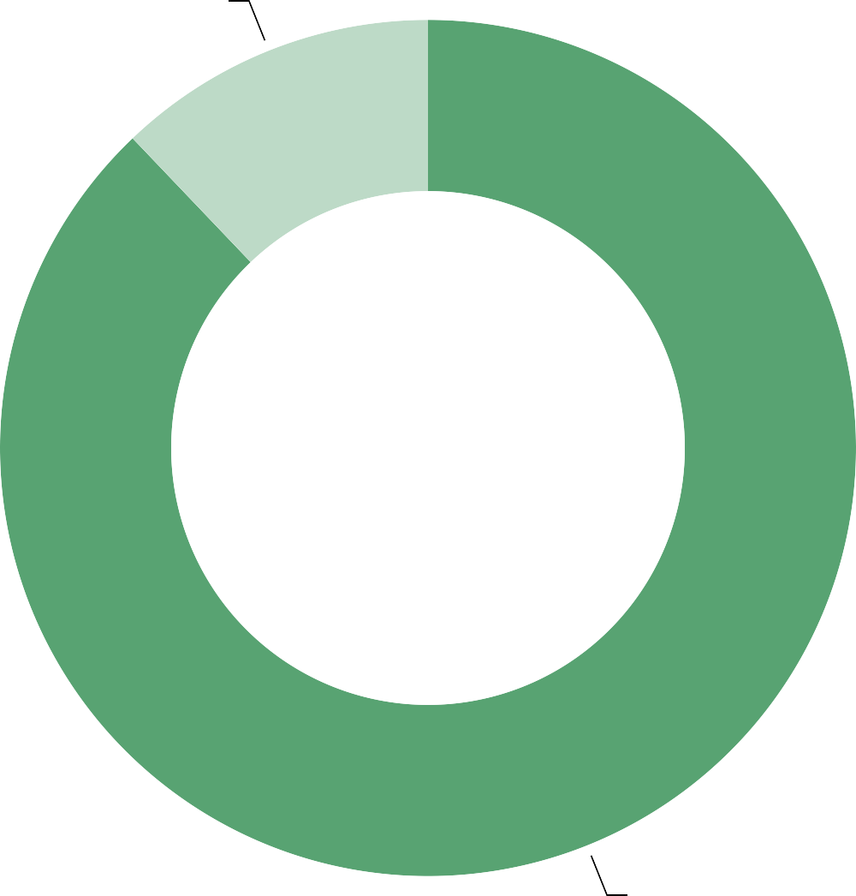
Power BI Desktop
1.16K
8.39K
No
Yes

Slide 6

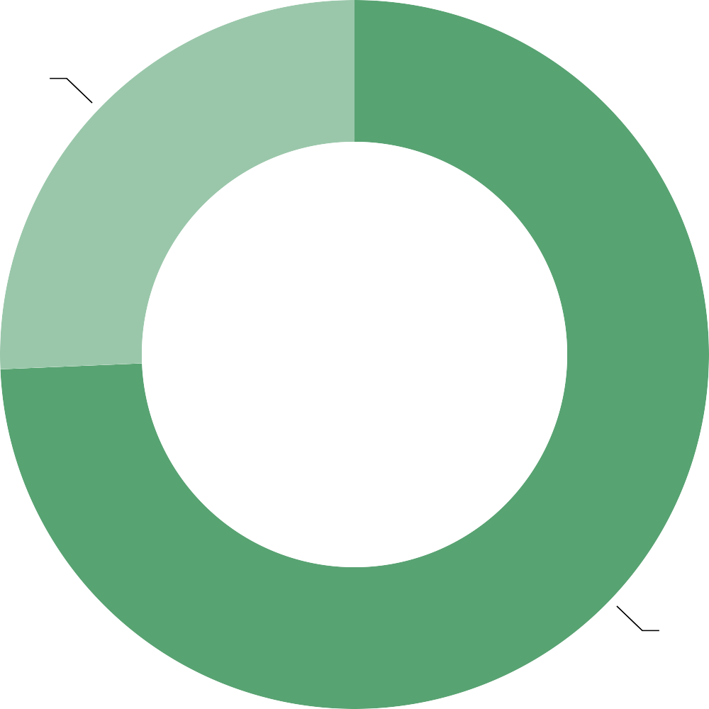
Power BI Desktop
2.45K
7.1K
No
Yes

Slide 7
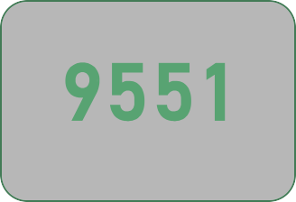






Power BI Desktop
Select Year
All V
Restaurants
Cuisines
Countries
Cities
Votes
Rating
Countries
V
☐
☐
☐
☐
☐
☐
☐
☐
☐
☐
☐
☐
☐
☐
☐
Australia
Brazil
Canada
India
Indonesia
New Zealand
Philippines
New Delhi Gurgaon
Noida Faridabad
5473
 | 1118 1080
Count of Cuisines
Average of Rating
3
251
Ahmedabad 21
Chennai 20
Jaipur 20
Mumbai 20
Pretoria 20
Pune 20
3.36
3
2.80
2.94
3
2.81
2.61
3
3
Cafe Coffee Day
Domino's Pizza
Subway
Green Chick Chop
McDonald's
Qatar
Singapore
South Africa
Sri Lanka
Turkey
United Arab Emirates
United Kingdom
United States of Am…
1.16K
North Indian
Chinese Fast Food Mughlai
Italian Bakery
Continental
Cafe
3960
2.45K
2735
1986
764
745
736
703
995
7.1K
8.39K
No Yes
No Yes

