Slide 1
Does the Emoji Matter?
A Controlled Comparison of Emoji Removal and Emoji Verbalisation in Multi-Label Emotion Classification of Tweets
Krishkumar Jatinbhai Sorathiya
Student Number 35042390
c5042390@hallam.shu.ac.uk
MSc Data Science and Artificial Intelligence
School of Computing and Digital Technologies
College of Business, Technology and Engineering
Sheffield Hallam University
September 2026
This Research Project is NOT confidential and may be made available for consultation.
KJS | Krishkumar Jatinbhai Sorathiya | 35042390
1
c5042390@hallam.shu.ac.uk
Notes:
Cover slide. Title, candidate details, course, and the confidentiality statement required by the handbook.

Slide 2
Acknowledgements
I thank my supervisor for guidance throughout this project. The most useful advice was to narrow a broad interest in emotion recognition down to one testable question about emoji. That is why this project is a controlled experiment rather than a general model-building exercise.
I thank the organisers of the SemEval-2018 Affect in Tweets shared task for releasing the annotated corpus used here.
I thank the maintainers of the open-source libraries this work depends on: TensorFlow, Keras, scikit-learn, NLTK, emoji, demoji and Streamlit.
GPU training was carried out on a personal compute account. No industry partner or host organisation was involved, and no third-party data was accessed.
KJS | Krishkumar Jatinbhai Sorathiya | 35042390
2
c5042390@hallam.shu.ac.uk
Notes:
Acknowledgements on a separate slide, as required by the handbook.

Slide 3
Presentation Agenda I
Section | Slide
1. Introduction | Slide 5
2. Literature Review | Slide 10
3. Research Methodology | Slide 14
4. Ethics | Slide 17
5. Implementation | Slide 22
KJS | Krishkumar Jatinbhai Sorathiya | 35042390
3
c5042390@hallam.shu.ac.uk

Slide 4
Presentation Agenda II
Section | Slide
6. Results | Slide 30
7. Evaluation | Slide 37
8. Conclusion | Slide 42
9. References | Slide 46
10. AI Declaration | Slide 53
Appendix | Slide 57
KJS | Krishkumar Jatinbhai Sorathiya | 35042390
4
c5042390@hallam.shu.ac.uk

Slide 5
1
Introduction
KJS | Krishkumar Jatinbhai Sorathiya | 35042390
5
c5042390@hallam.shu.ac.uk

Slide 6
Background and the Problem
Situation
Emotion recognition assigns feelings such as anger, joy or fear to text. On social media, much of that feeling is carried by emoji (Carroll, 2025).
Complication
Before a model sees a tweet, the pipeline must delete the emoji or turn them into words. Both appear in the literature, and the choice is largely untested.
Why It Is Untested
Studies that report a gain from emoji change several things at once, so the reported improvement is a combined effect (Z. Zhang et al., 2024).
Resolution
One preprocessing pipeline that splits at exactly one step, so the only difference between the two corpora is whether emoji survive as text.
KJS | Krishkumar Jatinbhai Sorathiya | 35042390
6
c5042390@hallam.shu.ac.uk
Notes:
Situation, Complication, Resolution. The key point is that existing studies confound the emoji decision with other changes.

Slide 7
Research Question and Objectives
Research Question
To what extent does the treatment of emoji during preprocessing, that is removal compared with conversion into text descriptions, affect deep learning performance on multi-label emotion classification of tweets, and does that effect depend on the model architecture and on the specific emotion?
O1 Review recent literature and identify the gap
O2 Build one preprocessing pipeline that splits at a single step
O3 Implement two architectures trainable identically on either track
O4 Tune each condition, handling severe label imbalance
O5 Evaluate all four conditions and compute the difference between tracks
O6 Deliver a working application and verify it by system testing
KJS | Krishkumar Jatinbhai Sorathiya | 35042390
7
c5042390@hallam.shu.ac.uk
Notes:
The two original research questions are combined into one. Six objectives follow from it.

Slide 8
The Corpus and Course Alignment
Corpus Under Test
SemEval-2018 Task 1, Task E-c, English subtask
6,838 training, 886 development, 3,259 test tweets
Eleven emotion labels, several per tweet
Emoji in 11.3% of training and 24.8% of development rows
Course Alignment: Applied Route
The handbook classifies MSc Data Science and Artificial Intelligence as an Applied project, requiring a machine learning pipeline covering data preparation, modelling and evaluation, delivered in a quantitative or mixed-methods design.
This project delivers exactly that in Python, using TensorFlow and Keras, scikit-learn and NLTK, plus a Streamlit prototype.
KJS | Krishkumar Jatinbhai Sorathiya | 35042390
8
c5042390@hallam.shu.ac.uk
Notes:
The handbook lists MSc Data Science and Artificial Intelligence under the Applied route, with a data analytics or machine learning pipeline as the expected deliverable.

Slide 9
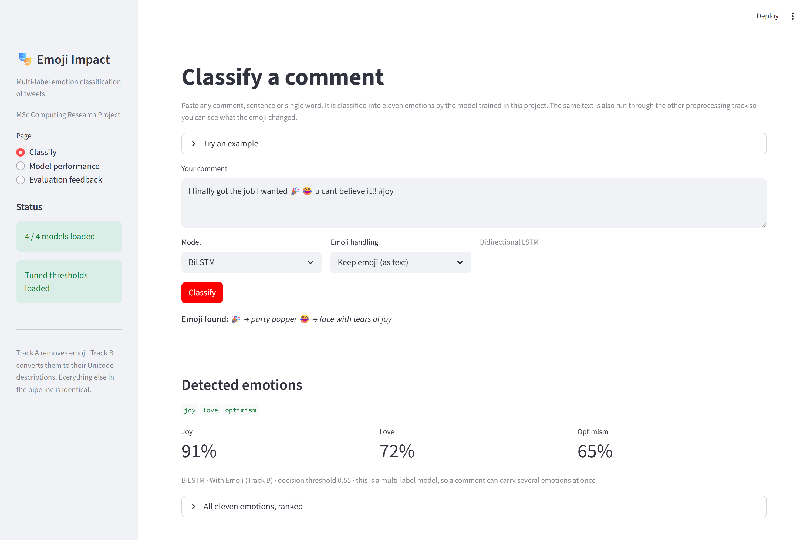
The Deliverable in Use
What the User Sees
One text box for any comment
Eleven emotions with confidences
Which labels the emoji changed
The pipeline, stage by stage
Deployment
One command, no manual setup
Runs on CPU; a GPU only shortens training
Figure 1: The delivered Streamlit application classifying a comment with the BiLSTM trained in this project.
KJS | Krishkumar Jatinbhai Sorathiya | 35042390
9
c5042390@hallam.shu.ac.uk
Notes:
The prototype required by the Applied route. It loads the same models and thresholds that produced the reported results.

Slide 10
2
Literature Review
KJS | Krishkumar Jatinbhai Sorathiya | 35042390
10
c5042390@hallam.shu.ac.uk

Slide 11
Themes in the Literature
Theme 1
Emotion Recognition as a Multi-Label Task
Labels overlap, so per-label thresholds and Micro-F1 with Macro-F1 are needed rather than accuracy.
Jim et al., 2024; Muhammad et al., 2025
Theme 2
Model Architectures
Recurrent networks remain in use in hybrids. Transformers give consistent gains, but the advantage is credited largely to pre-training.
Rezapour, 2024; B. Khan et al., 2026
Theme 3
Emoji as a Carrier of Feeling
Emoji carry usable signal, yet their meaning shifts between communities and between writers.
Huang et al., 2024; Zhou et al., 2024
KJS | Krishkumar Jatinbhai Sorathiya | 35042390
11
c5042390@hallam.shu.ac.uk
Notes:
Three themes, one per part of the experiment: the task type, the architectures, and emoji themselves.

Slide 12
Critical Analysis and Screening
Critical Analysis
Studies reporting emoji benefits are convincing about their own systems, but none is designed to isolate the preprocessing decision.
In each case a new representation is introduced alongside the emoji information and compared against an emoji-free baseline, so the reported improvement is a combined effect.
None tells a practitioner what happens if only the preprocessing line changes.
Search and Screening
180 records returned
70 after de-duplication
40 after abstract screening
25 read in full and retained
Sources: SHU Library Search, Google Scholar, ACL Anthology, arXiv, ScienceDirect, SpringerLink. Every reference was verified against the Crossref API.
KJS | Krishkumar Jatinbhai Sorathiya | 35042390
12
c5042390@hallam.shu.ac.uk
Notes:
The screening funnel and the single critical point: no reviewed study isolates the preprocessing step.

Slide 13
Gaps in the Literature
Gap 1
The emoji decision is confounded with other changes, so its own contribution cannot be measured.
Gap 2
Emoji effects are reported as a single average and never broken down per emotion.
Gap 3
The interaction between emoji handling and architecture has not been tested by varying both factors in one design.
Gap 4
Emoji density is rarely stated, so a reader cannot judge whether a reported gain is large relative to the opportunity.
KJS | Krishkumar Jatinbhai Sorathiya | 35042390
13
c5042390@hallam.shu.ac.uk
Notes:
Four gaps. Each one is closed by a specific feature of the design, revisited in the conclusion.

Slide 14
3
Research Methodology
KJS | Krishkumar Jatinbhai Sorathiya | 35042390
14
c5042390@hallam.shu.ac.uk

Slide 15
The Research Onion
Table 1: The six layers of the research onion and the choice made at each.
Layer | Choice Made | Why It Fits This Project
Philosophy | Positivism | The difference being measured is numeric
Approach | Deductive | Theory predicts the effect; it is tested, not generated
Strategy | Experiment | Two tracks by two architectures, all else constant
Methodological Choice | Mono-Method Quantitative | One data type, one analysis: F1, accuracy, ROC-AUC
Time Horizon | Cross-Sectional | A fixed corpus, analysed once
Techniques | Secondary Data Analysis | A published benchmark reused, processed in code
The layers are consistent with each other: a positivist, deductive, experimental design measured quantitatively on secondary data.
KJS | Krishkumar Jatinbhai Sorathiya | 35042390
15
c5042390@hallam.shu.ac.uk
Notes:
Table 1. Six layers of the research onion and the choice made at each.

Slide 16
Alternatives Considered
Table 2: Alternatives considered and rejected, with the choice made in each case.
Alternative | Why It Was Rejected | Chosen Instead
Interpretivism with qualitative reading | Cannot produce a measurable effect size | Positivist quantitative measurement
Survey of practitioners | Reports what people believe, not what happens to the model | Controlled experiment on the model
Case study of one production system | Would not separate the emoji step from everything else | Two-by-two factorial design
Collecting fresh tweets from an API | Slower, raises licensing issues, loses comparability | Public benchmark corpus
Fine-tuning a pre-trained encoder | It has already seen emoji and their descriptions | Both architectures trained from scratch
The research question asks for the size of an effect and whether it is conditional. Only a controlled design with two factors answers both.
KJS | Krishkumar Jatinbhai Sorathiya | 35042390
16
c5042390@hallam.shu.ac.uk
Notes:
Table 2. Alternatives considered and rejected, with the choice made in each case.

Slide 17
4
Ethics
KJS | Krishkumar Jatinbhai Sorathiya | 35042390
17
c5042390@hallam.shu.ac.uk

Slide 18
Ethics Approval and Governance
Approval
Approved via Blackboard under category UREC1 before any data was collected.
Both screening questions were answered No: no human participants, and the secondary data is neither sensitive nor identifying, so no UREC2 or UREC3 was required.
The signed form is Appendix B of the report.
Data and GDPR
Secondary data only. No participants recruited, contacted or observed.
Held on the University-allocated networked drive, with no removable media.
No personal data is processed. The corpus is already de-identified.
Mentions and URLs are removed at the first preprocessing step, so no identifier reaches a model or a result file.
No tweet is reproduced verbatim anywhere in the project.
KJS | Krishkumar Jatinbhai Sorathiya | 35042390
18
c5042390@hallam.shu.ac.uk
Notes:
UREC1, no participants, no personal data. De-identification is built into preprocessing rather than bolted on.

Slide 19
Risk Register
Table 3: Risk register, eight identified risks with likelihood, impact and mitigation.
ID | Risk | Likelihood | Impact | Mitigation
R1 | Imbalance stops rare emotions being learned | High | High | Weighted loss plus threshold tuning
R2 | Overfitting on a small corpus | High | Medium | Dropout, early stopping, best weights
R3 | Emoji density too low to show an effect | Medium | High | Density measured first, used to bound claims
R4 | Something other than emoji differs | Low | High | Single pipeline forked at one operation
R5 | Results not reproducible | Medium | High | Seed fixed, all artefacts written to disk
R6 | Source dataset unavailable | Medium | High | Download script plus documented mirrors
R7 | Library drift breaks saved models | Medium | Medium | Versions pinned in requirements.txt
R8 | Compute or internet limits on the platform | Medium | Medium | Offline wheel install, GPU account arranged early
KJS | Krishkumar Jatinbhai Sorathiya | 35042390
19
c5042390@hallam.shu.ac.uk
Notes:
Table 3. The register. The matrix on the next slide plots the same seven risks.

Slide 20
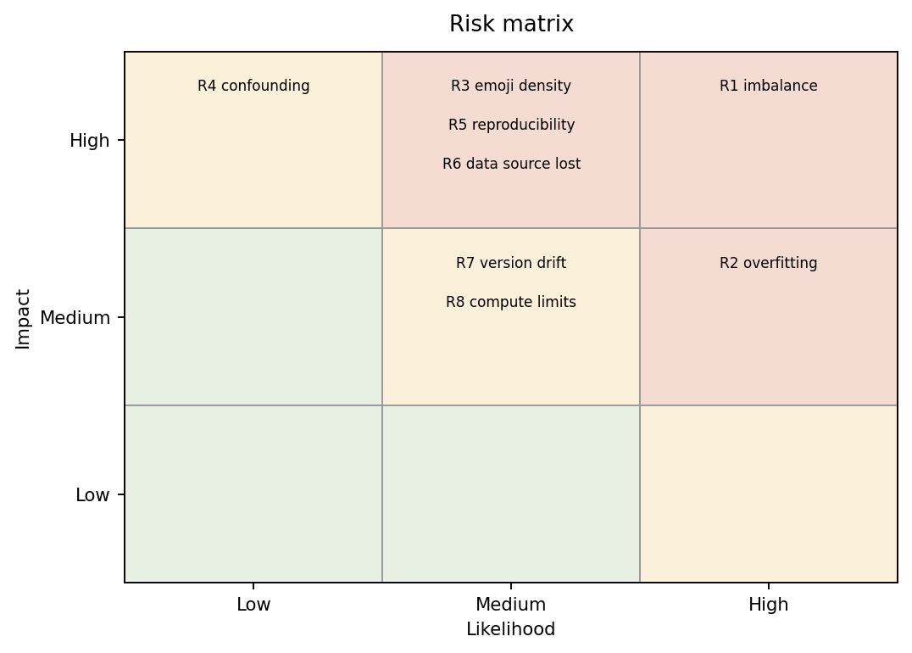
Risk Matrix
Reading the Matrix
Top right is the priority corner. R1, imbalance, sits there and drove two design decisions: the weighted loss and the tuned threshold.
R3, R5 and R6 are high impact but only medium likelihood, so each was handled by a control put in place before it could occur.
R4, confounding, would invalidate the whole study. It is low likelihood only because the single-fork design makes it hard to occur.
Figure 2: Risk matrix, likelihood against impact.
KJS | Krishkumar Jatinbhai Sorathiya | 35042390
20
c5042390@hallam.shu.ac.uk
Notes:
Figure 2. The matrix places each register entry by likelihood and impact.

Slide 21
Risks Encountered and How They Were Mitigated
What happened: The Kaggle dataset path stopped resolving, so the corpus could not be fetched.
Mitigation: Wrote download_data.py to pull the official release, with two documented mirrors. Row counts verified against the original notebook.
R6
What happened: Kaggle grants notebook internet only to phone-verified accounts, so demoji could not be installed.
Mitigation: Shipped the emoji and demoji wheels as an attached dataset and installed them offline.
R8
What happened: Saved models failed to load on an older Keras, which rejected a field the newer version writes.
Mitigation: Pinned keras to the 3.13 line in requirements.txt and recorded the exact error in the README.
R7
All three were resolved without changing the experimental design or the reported results.
KJS | Krishkumar Jatinbhai Sorathiya | 35042390
21
c5042390@hallam.shu.ac.uk
Notes:
Three of the seven registered risks actually materialised. Each mitigation is a concrete artefact in the repository.

Slide 22
5
Implementation
KJS | Krishkumar Jatinbhai Sorathiya | 35042390
22
c5042390@hallam.shu.ac.uk

Slide 23
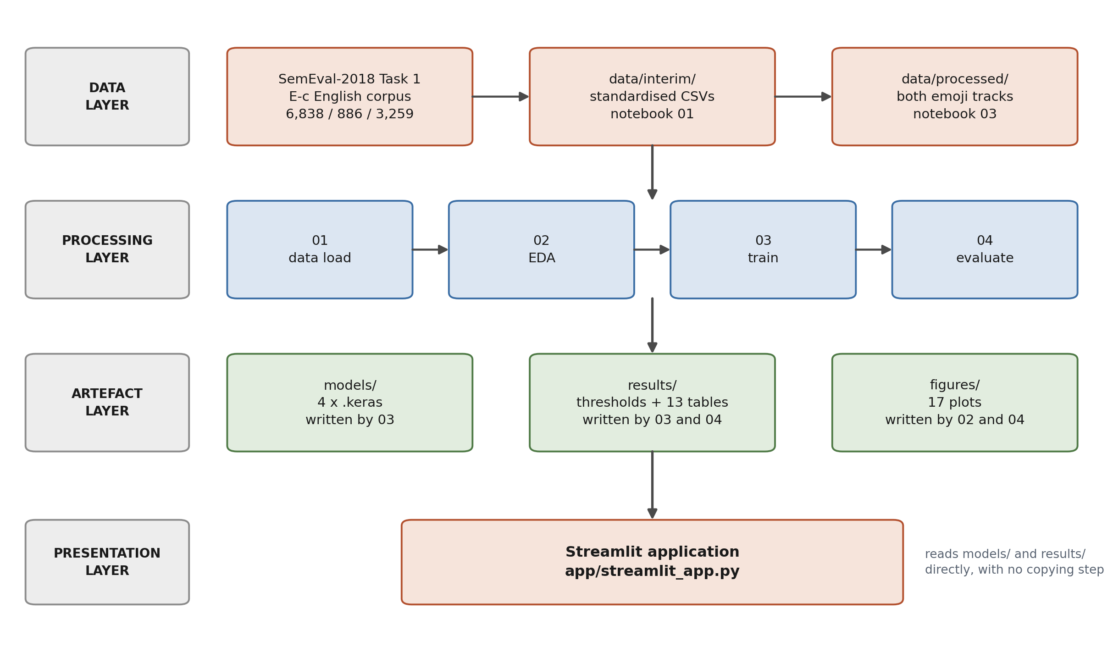
System Architecture I: Four Layers
How to Read It
Data flows down through four layers. Each arrow is a real dependency.
Data: the corpus and its two derived copies.
Processing: four notebooks, run in order.
Artefacts: models, tables and figures.
Presentation: the Streamlit app.
The app reads the artefacts directly, so there is no copying step to get wrong.
Figure 3: High-level architecture. Every arrow shows one direction of flow, top to bottom.
KJS | Krishkumar Jatinbhai Sorathiya | 35042390
23
c5042390@hallam.shu.ac.uk
Notes:
Figure 3. Four layers. Development lifecycle was staged and incremental, one notebook per stage, each verified before the next was written.

Slide 24
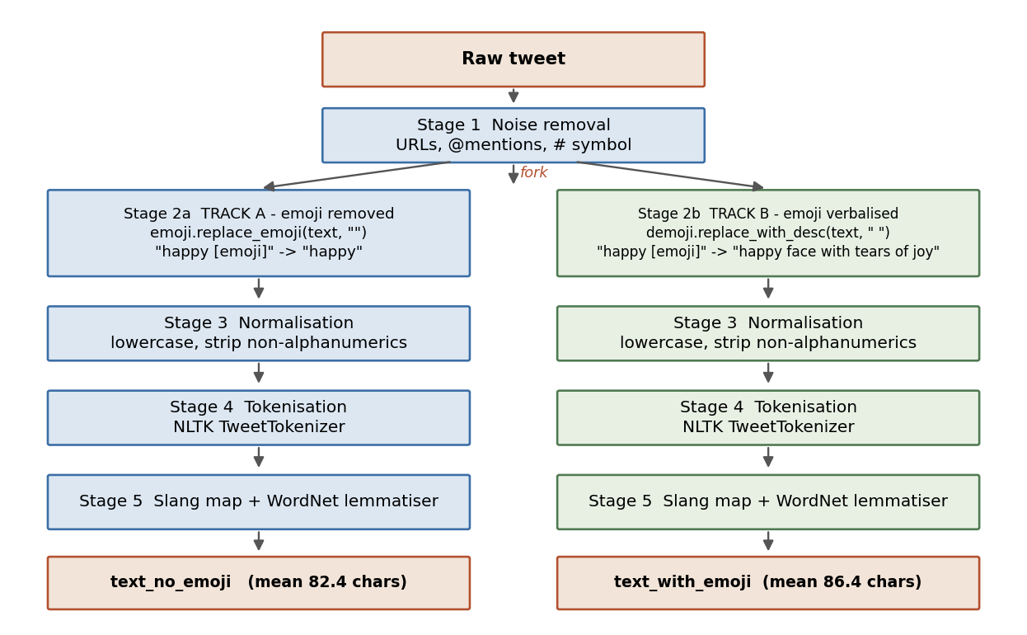
System Architecture II: The Preprocessing Pipeline
Reading the Flowchart
A raw tweet enters at the top and runs through Stage 1, which strips URLs, mentions and the hash symbol.
At Stage 2 the flow splits. The left branch deletes every emoji, the right replaces each with its description.
Stages 3, 4 and 5 are the same code on both branches, so the two outputs differ only by the emoji step.
Track B is 4 characters longer on average.
Figure 4: The preprocessing pipeline, forked at Stage 2.
KJS | Krishkumar Jatinbhai Sorathiya | 35042390
24
c5042390@hallam.shu.ac.uk
Notes:
Figure 4. The fork is a single function call. Everything above and below it is shared code.

Slide 25
Source Code: The Single Fork
def handle_emoji_no(text):
"""Track A: delete every emoji."""
return emoji.replace_emoji(
str(text), replace="")
def handle_emoji_yes(text):
"""Track B: replace with description."""
return demoji.replace_with_desc(
str(text), sep=" ")
Worked Example
In: so happy today [tears of joy] u cant believe it
A: so happy today you cannot believe it
B: so happy today face with tear of joy you cannot believe it
Code 1: The two functions that constitute the entire manipulation.
Stage 2 is the only operation that differs between the two tracks. Stages 1, 3, 4 and 5 are shared code, and 12.1% of training rows actually differ as a result.
KJS | Krishkumar Jatinbhai Sorathiya | 35042390
25
c5042390@hallam.shu.ac.uk
Notes:
The entire experimental manipulation is these two function bodies.

Slide 26
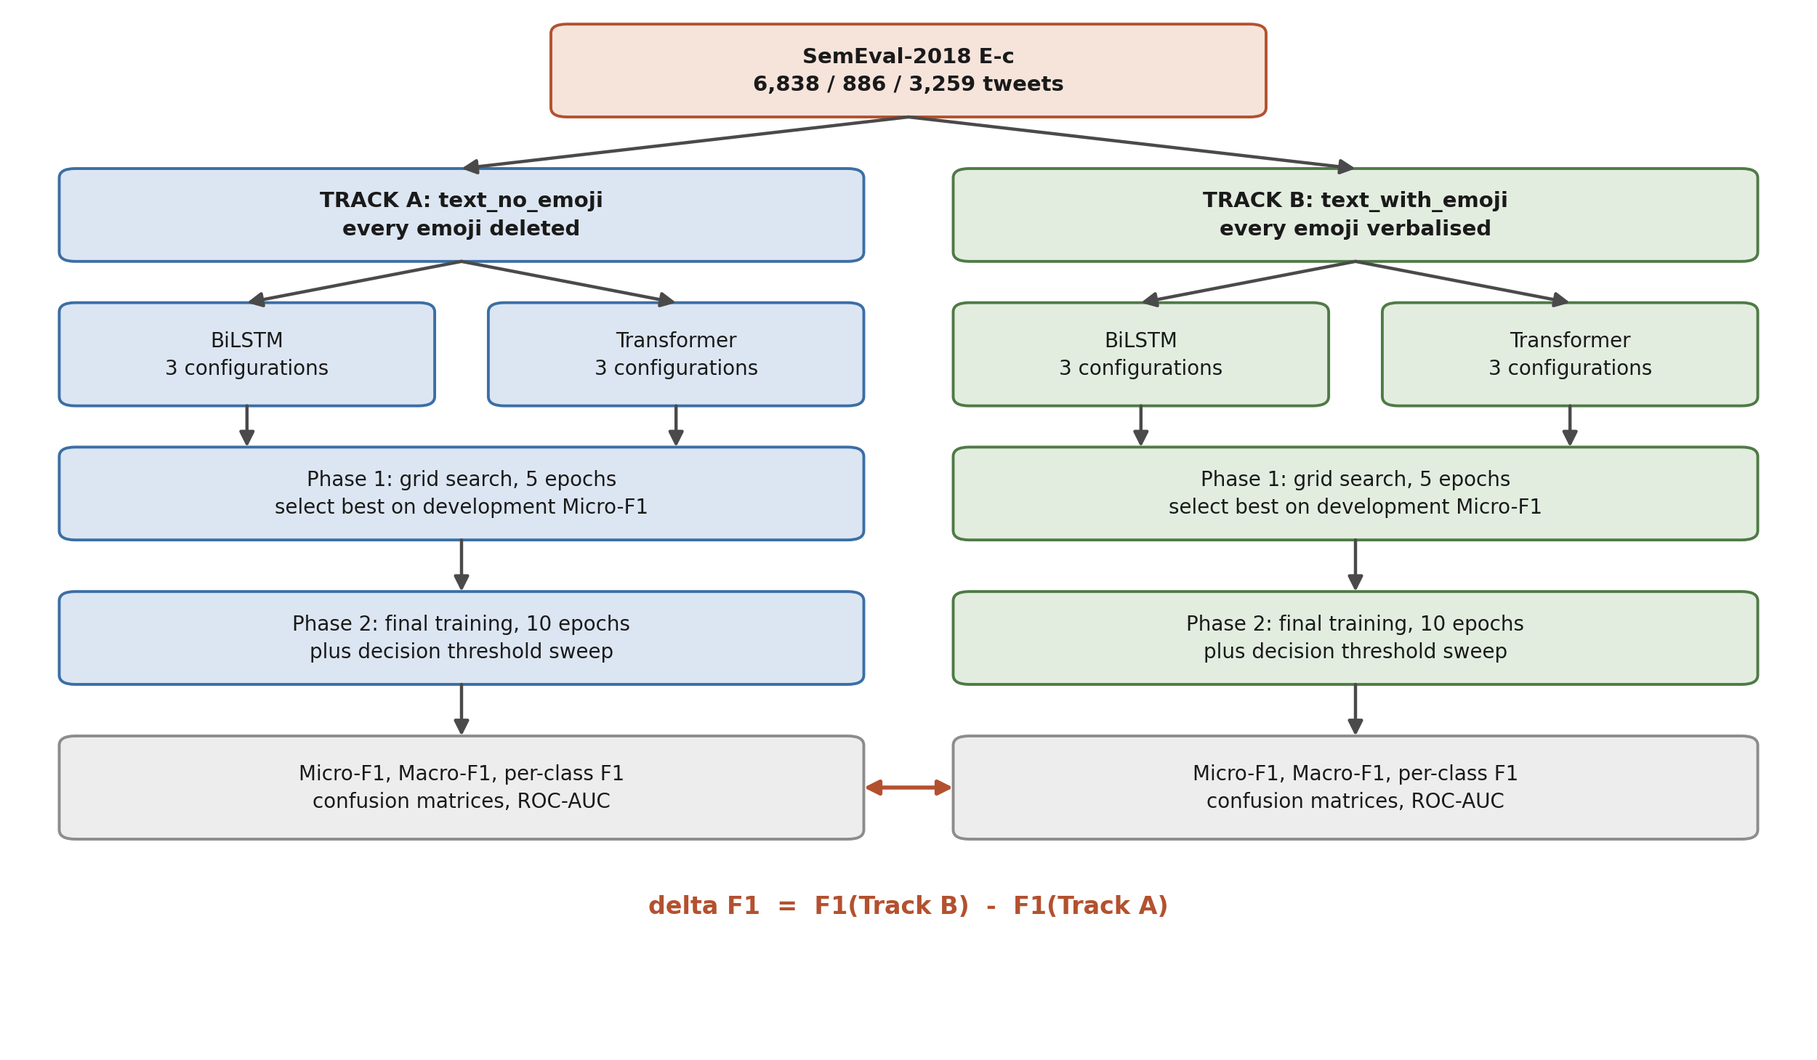
System Architecture III: Experimental Design
Reading the Flowchart
One corpus splits into the two tracks. Each track trains both architectures, so the diagram is symmetrical by construction.
Each branch runs the same two phases: a grid search over three configurations, then final training with a threshold sweep.
The two grey boxes hold identical metrics. The arrow between them is the measurement this project exists to make.
Held constant: corpus, splits, tokeniser, vocabulary, grid, loss, sweep and seed 42.
Figure 5: Two tracks crossed with two architectures, giving four conditions.
KJS | Krishkumar Jatinbhai Sorathiya | 35042390
26
c5042390@hallam.shu.ac.uk
Notes:
Figure 5. Only the Stage 2 emoji operation changes, so any difference in score belongs to that step.

Slide 27
Testing and Validation
Table 4: Selected system test cases.
Four Levels of Testing
Unit: functions checked against known outputs, and the pipeline against a stored fixture, so training and serving cannot drift apart.
Integration: raw text to thresholded prediction, exercised end to end with stand-in models.
System: all four notebooks run in order on the real corpus; row counts and artefact writes matched.
Acceptance: the application driven through every page against four acceptance criteria. All four held.
ID | Test | Result
TC2 | Pipeline matches the training definition | Pass
TC3 | Tracks differ only where emoji occur | Pass
TC9 | Classify emoji-only input | Pass
TC11 | Starts with no manual setup | Pass
Outcome
Twelve system test cases, all passed. Two defects were found in integration testing and both were fixed and retested.
KJS | Krishkumar Jatinbhai Sorathiya | 35042390
27
c5042390@hallam.shu.ac.uk
Notes:
Table 4. Four of the twelve system test cases. The fixture test is the one that guarantees the served model sees the same text the trained model saw.

Slide 28
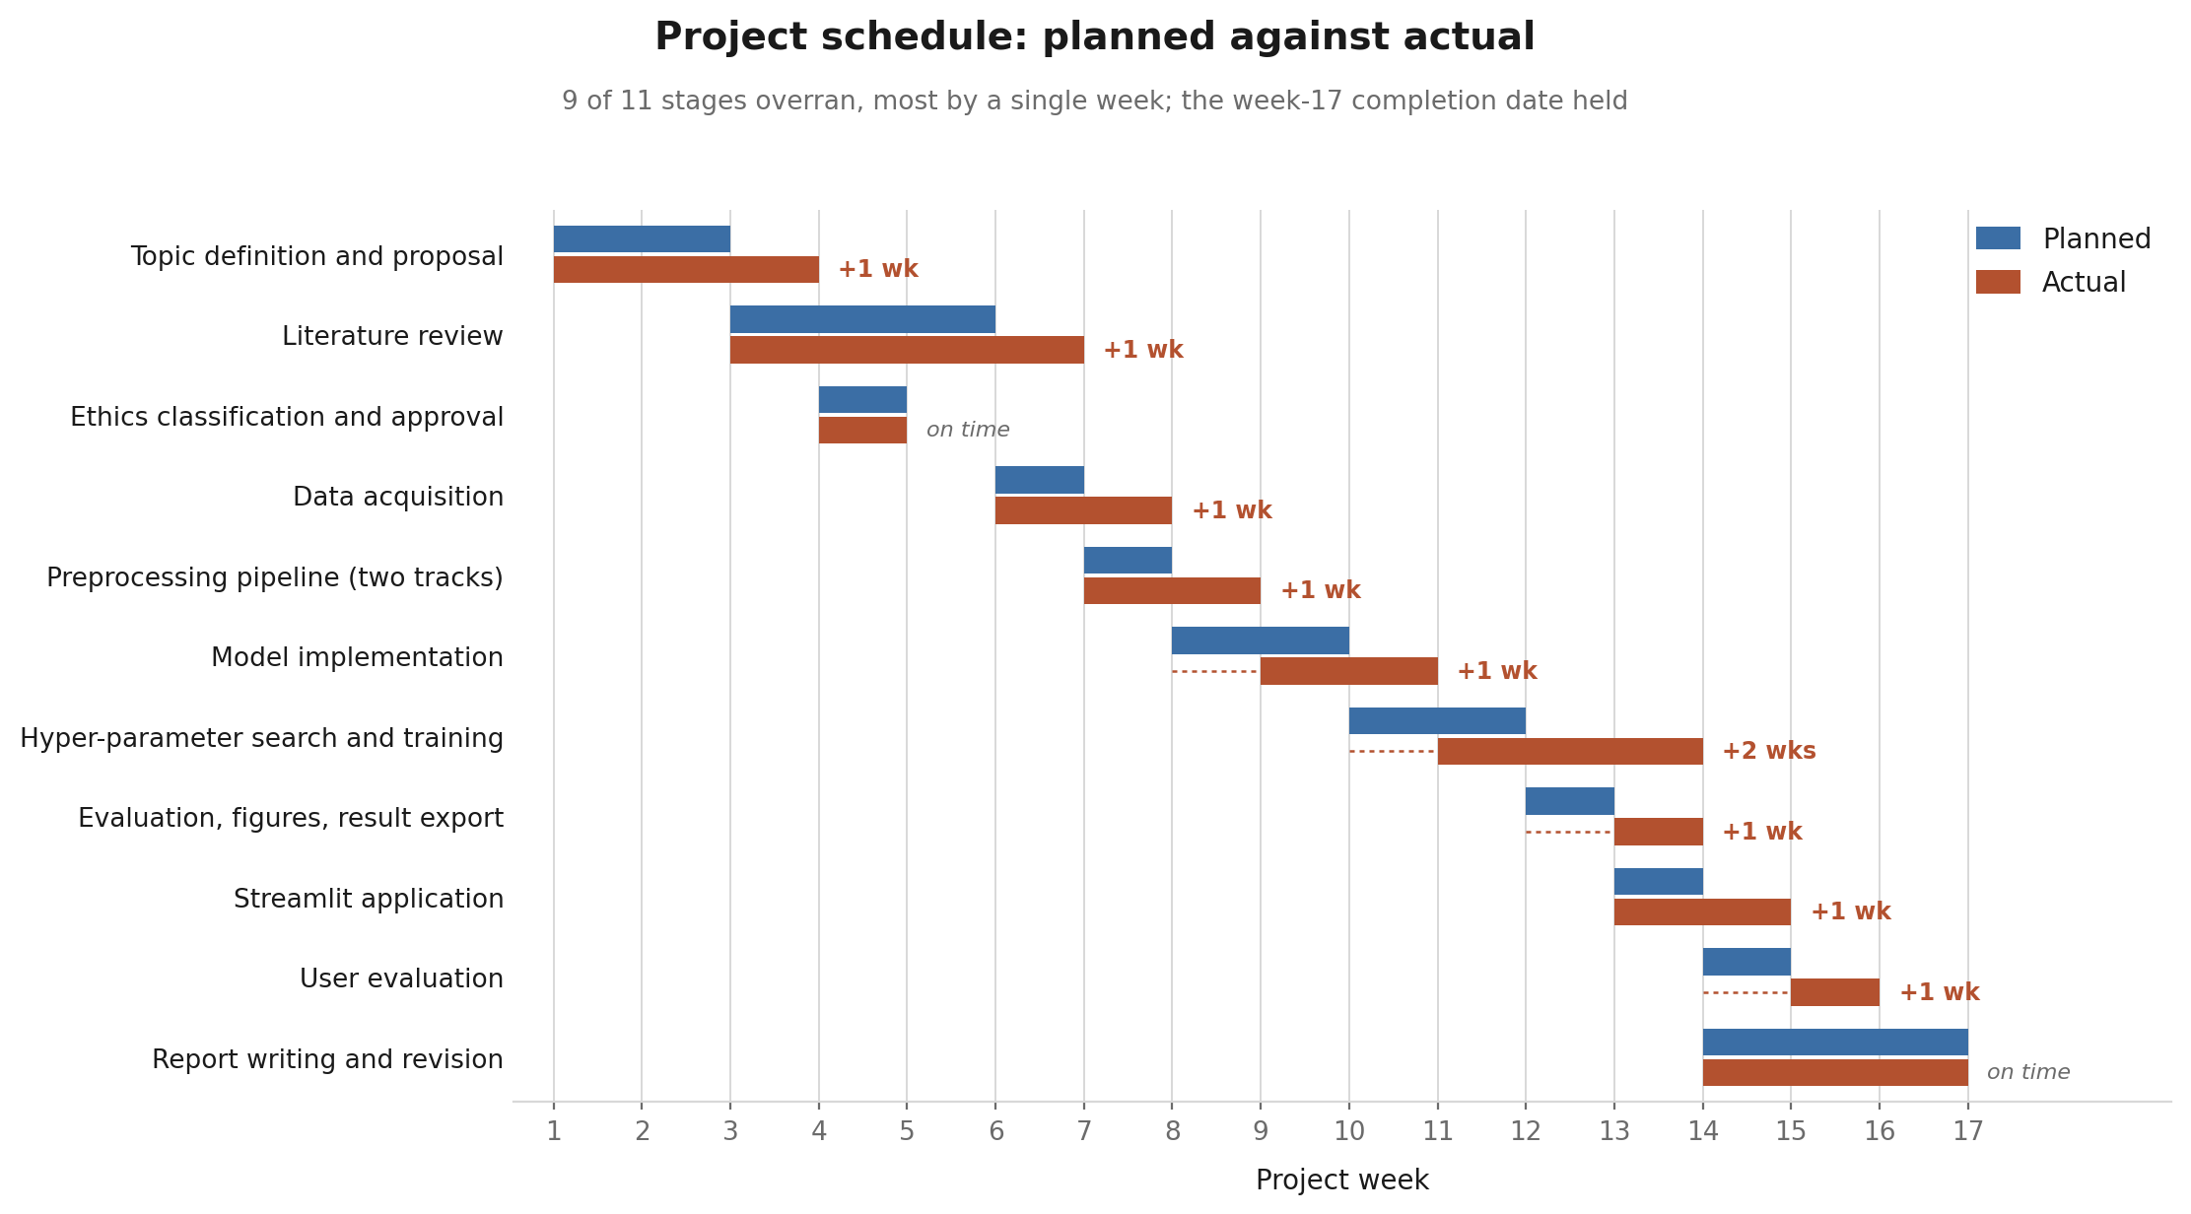
Schedule: Planned Against Actual
What Slipped
9 of 11 stages overran, most by one week.
Hyper-parameter training slipped most, by two weeks, because GPU runs ran long.
Ethics approval and report writing ran to plan.
Week 17 held, because slack in the writing window absorbed the earlier slip.
Figure 6: Planned schedule against actual execution, by project week.
KJS | Krishkumar Jatinbhai Sorathiya | 35042390
28
c5042390@hallam.shu.ac.uk
Notes:
Figure 6. Appendix G of the report. Blue is planned, rust is actual, and the dashed line marks a late start.

Slide 29
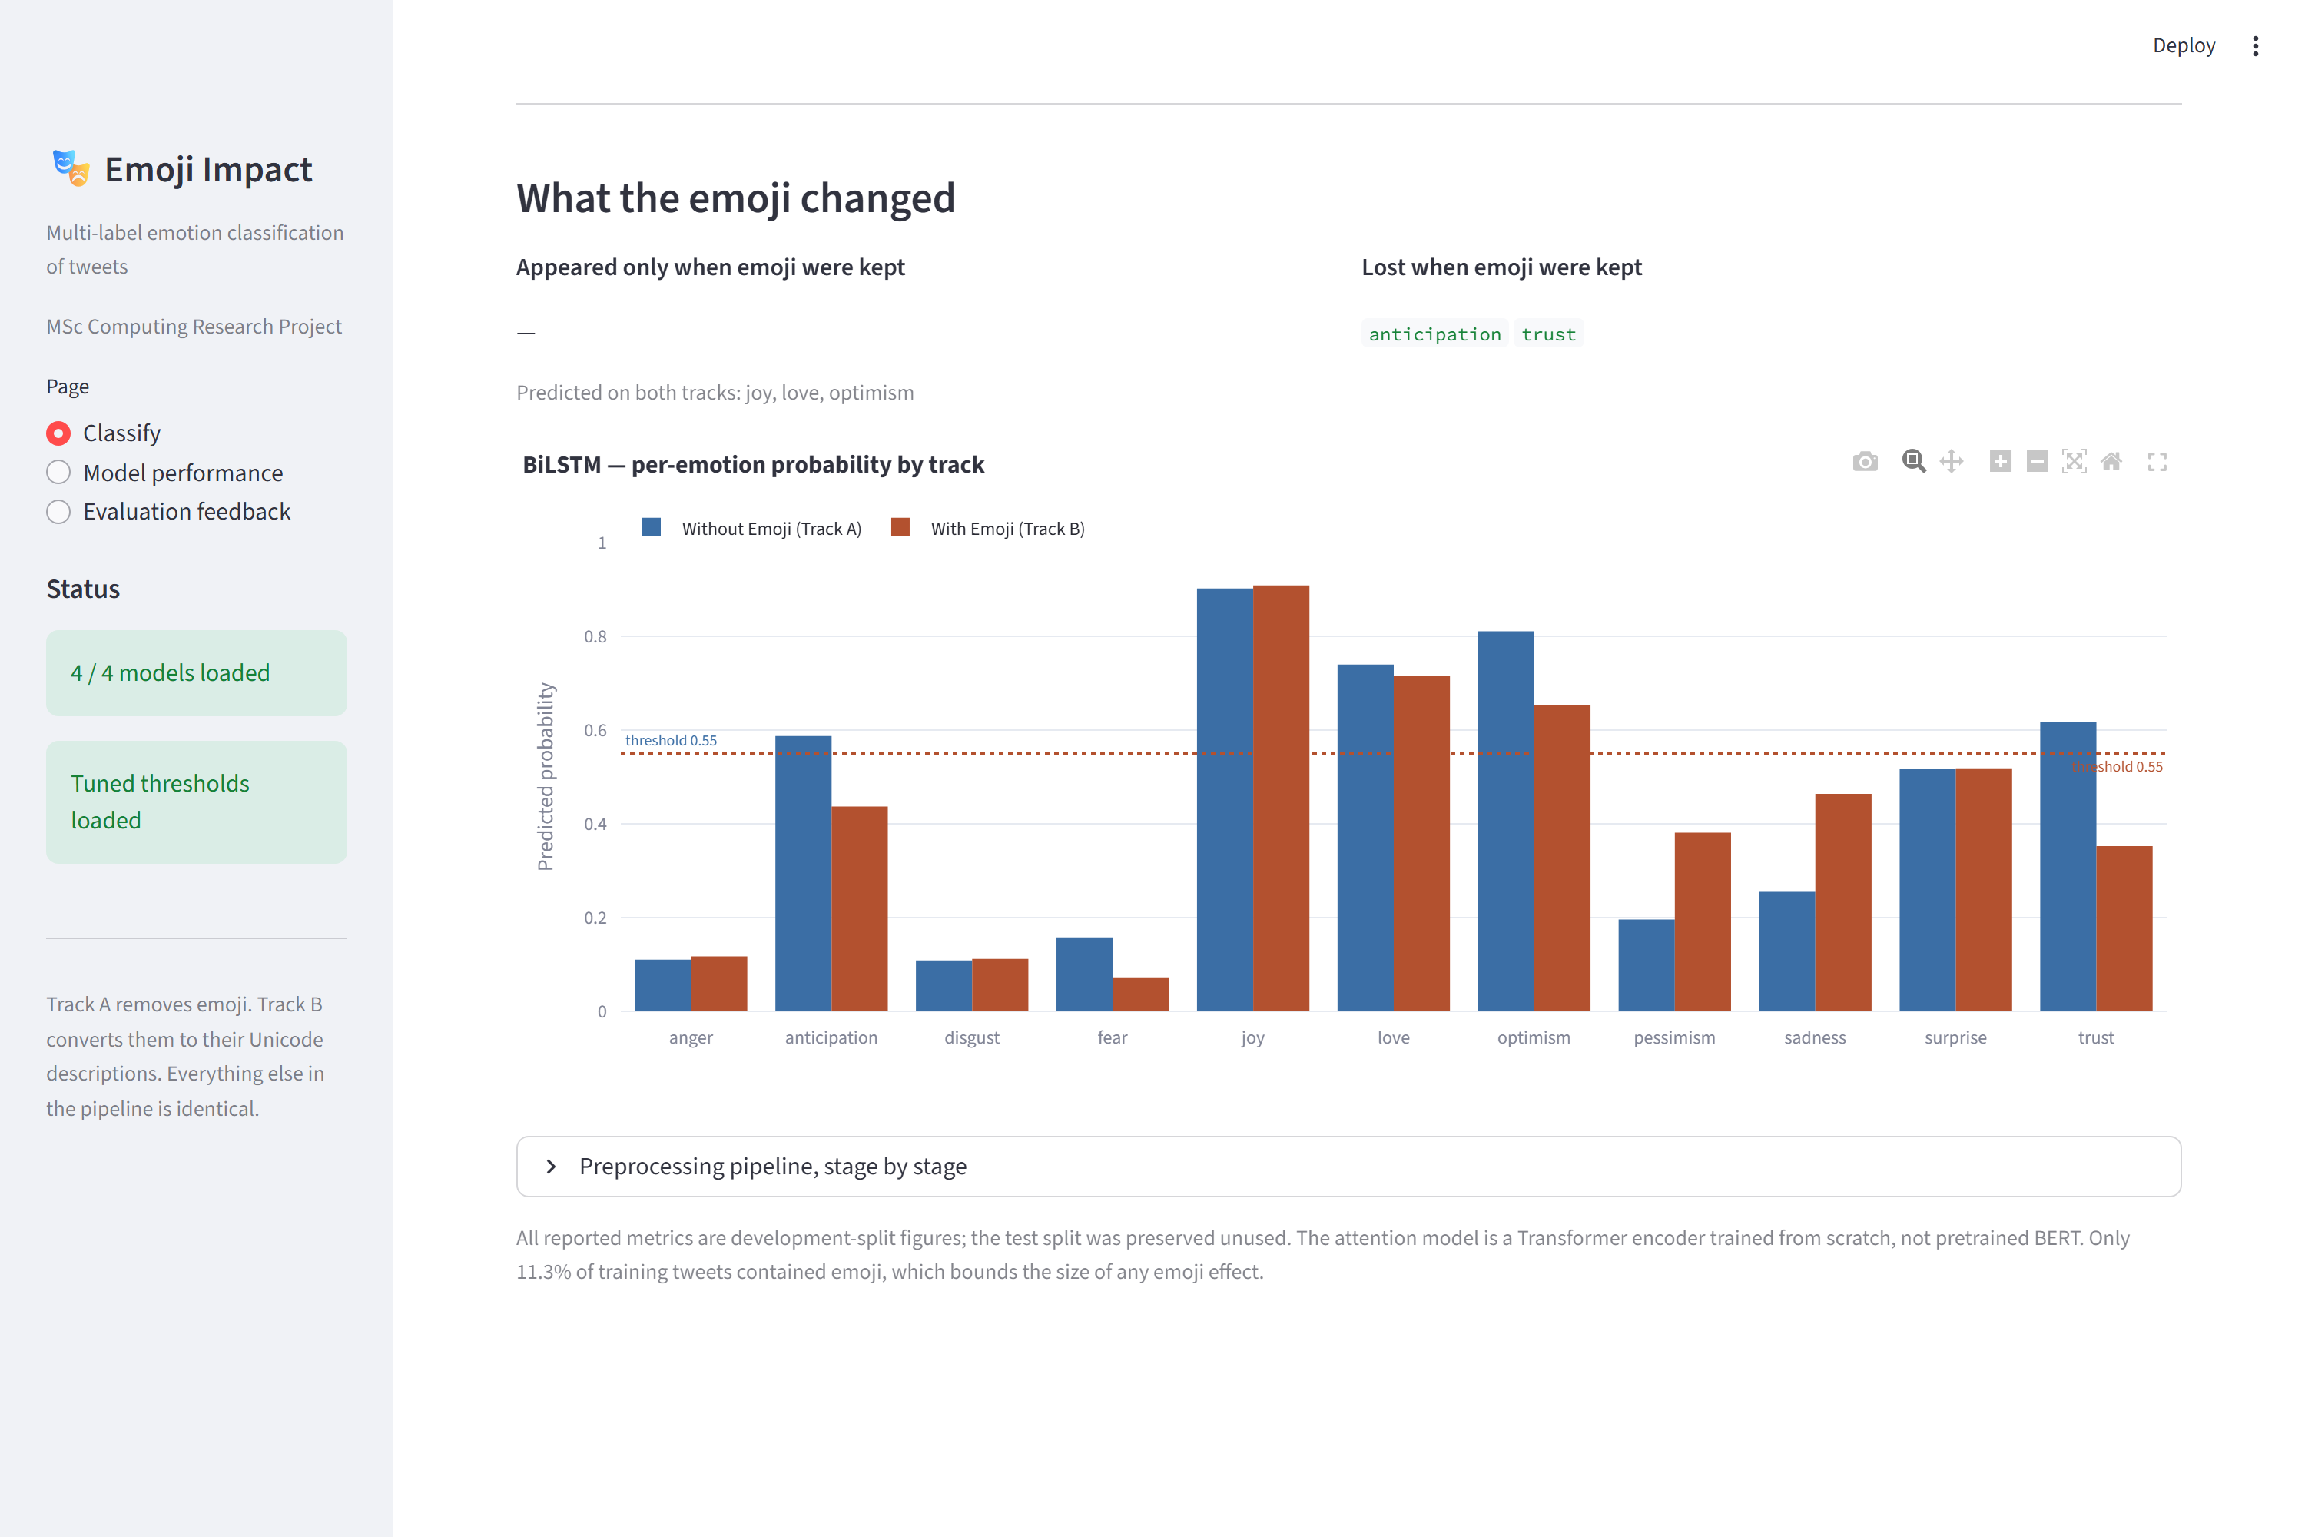
Prototype: Comparing the Two Tracks
How It Closes the Loop
It loads the same models and thresholds that produced the reported results, so what the user sees is what was evaluated.
It shows which labels appeared only when emoji were kept, and which were lost.
The probability chart puts both tracks against the tuned threshold.
The pipeline view makes the single fork visible for any text supplied.
Figure 7: The application showing both preprocessing tracks side by side.
KJS | Krishkumar Jatinbhai Sorathiya | 35042390
29
c5042390@hallam.shu.ac.uk
Notes:
Figure 7. This turns the experiment from a table of numbers into something a practitioner can try on their own text.

Slide 30
6
Results
KJS | Krishkumar Jatinbhai Sorathiya | 35042390
30
c5042390@hallam.shu.ac.uk

Slide 31
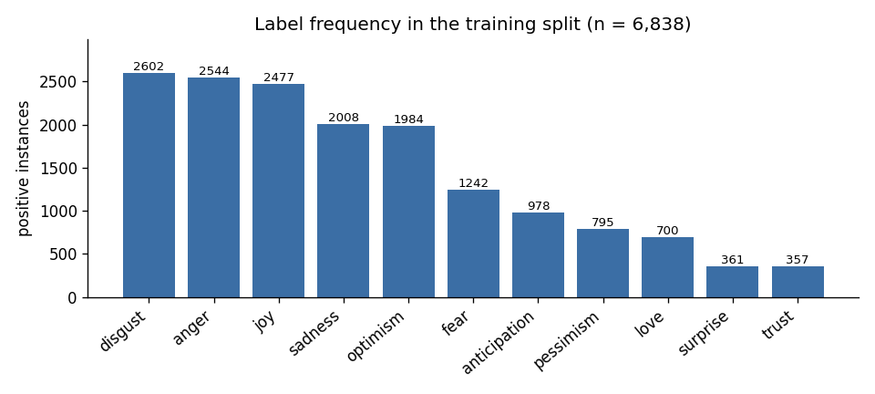
Corpus Profile and Emoji Density
Emoji Density Bounds the Claim
11.3%
of training tweets contain emoji
24.8%
of development tweets contain emoji
Any effect comes from a minority of rows. The split it is measured on is less diluted than the training split.
Figure 8: Label distribution across the eleven emotions, training split.
Imbalance is severe, 7.3 to 1 between the most and least frequent label. That is why a weighted loss and a tuned threshold were used.
KJS | Krishkumar Jatinbhai Sorathiya | 35042390
31
c5042390@hallam.shu.ac.uk
Notes:
Figure 8. Emoji density is the ceiling on the whole study, and it is the most important caveat on the headline numbers.

Slide 32
Performance of the Four Conditions
Table 5: Development split results for the four conditions, in percent.
Model | Track | Micro-F1 | Macro-F1 | Label Accuracy
BiLSTM | Without Emoji | 53.63 | 47.86 | 74.02
BiLSTM | With Emoji | 55.65 | 48.86 | 75.85
Transformer | Without Emoji | 47.29 | 44.36 | 70.19
Transformer | With Emoji | 51.00 | 47.30 | 72.63
Keeping emoji as text improved both models on every headline metric.
The BiLSTM beat the Transformer, which is expected: both were trained from scratch on 6,838 tweets, so the Transformer has no pre-training advantage.
The threshold was tuned per condition by sweeping 0.10 to 0.55 and taking the best Micro-F1.
KJS | Krishkumar Jatinbhai Sorathiya | 35042390
32
c5042390@hallam.shu.ac.uk
Notes:
Table 5. All figures are development split. The test split was preserved unused.

Slide 33
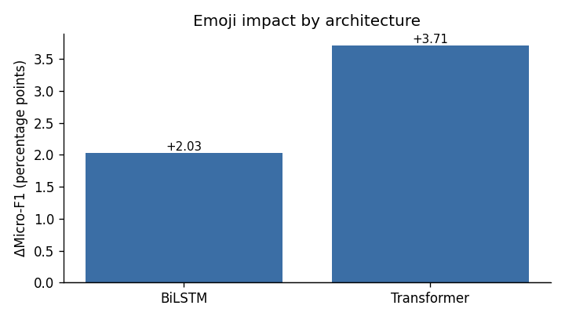
The Emoji Effect by Architecture
+2.03
Micro-F1 points, BiLSTM
+3.71
Micro-F1 points, Transformer
Macro-F1 moves the same way for both, by 0.99 and 2.94 points.
Figure 9: Aggregate emoji effect by architecture, in Micro-F1 points.
For context, the twelve tuning configurations span 7.4 Micro-F1 points. The emoji effect is a meaningful share of that range, but it is smaller than it, so the aggregate result is indicative rather than confirmed.
KJS | Krishkumar Jatinbhai Sorathiya | 35042390
33
c5042390@hallam.shu.ac.uk
Notes:
Figure 9. Both architectures move in the same direction, so the coarse claim holds for both.

Slide 34
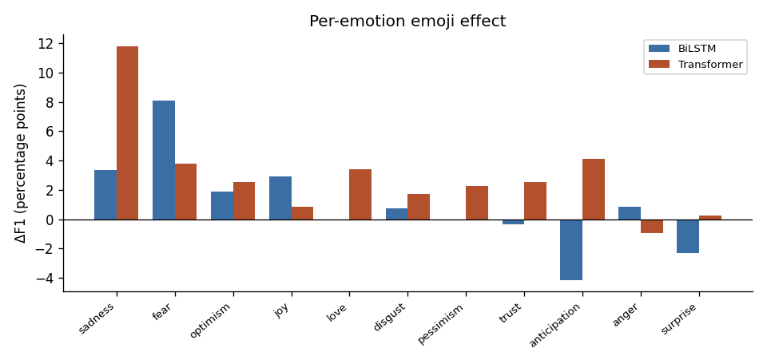
The Effect Varies Sharply by Emotion
15.9
points of spread across the eleven emotions
From +11.80 for sadness under the Transformer to -4.13 for anticipation under the BiLSTM.
The emotions that gain most are the ones the exploratory analysis showed to be over-represented among emoji-bearing tweets: sadness, fear, joy and love.
Figure 10: Per-emotion emoji effect for both architectures.
The aggregate number is the near cancellation of much larger opposing movements.
KJS | Krishkumar Jatinbhai Sorathiya | 35042390
34
c5042390@hallam.shu.ac.uk
Notes:
Figure 10. This is the strongest finding in the project, because the per-emotion effects are large relative to the noise floor.

Slide 35
Robustness Checks
Threshold-Free. ROC-AUC rose for both models, so the gain does not depend on the chosen cut-off. Mean AUC moved from 0.786 to 0.788 for the BiLSTM and from 0.754 to 0.777 for the Transformer.
Error Structure. The improvement comes from recovering true positives on emoji-bearing rows, not from predicting fewer labels overall.
Precision and Recall. Recall exceeds precision by 21 to 23 points in every condition, which is the expected effect of the weighted loss. The pattern holds on both tracks, so the emoji step did not introduce it.
Reproducibility. The random seed is fixed and every artefact is written to disk, so re-running the notebooks reproduces every number in this deck.
KJS | Krishkumar Jatinbhai Sorathiya | 35042390
35
c5042390@hallam.shu.ac.uk
Notes:
Four independent checks. The AUC check matters most, because every other metric depends on the tuned threshold.

Slide 36
Answering the Research Question
Does emoji handling affect performance, and by how much?
Yes. Converting emoji into text raised Micro-F1 by 2.03 points for the BiLSTM and 3.71 points for the Transformer. Macro-F1 moved the same way for both, and threshold-free ROC-AUC rose for both. On this corpus the effect is real, and it favours keeping emoji as text rather than deleting them.
Is the effect the same across architectures and emotions?
No, on both counts. The effect is roughly 80 per cent larger for the Transformer than for the BiLSTM. It varies far more by emotion, from +11.80 points for sadness to -4.13 for anticipation. Emotions with clear emoji conventions gain most; emotions with no such convention gain little or lose. Because the pipeline forks at exactly one operation, these differences belong to the emoji step and to nothing else.
KJS | Krishkumar Jatinbhai Sorathiya | 35042390
36
c5042390@hallam.shu.ac.uk
Notes:
The single research question has two halves, answered here in turn.

Slide 37
7
Evaluation
KJS | Krishkumar Jatinbhai Sorathiya | 35042390
37
c5042390@hallam.shu.ac.uk

Slide 38
Evaluation Approach: Applied Route
Why There Is No User Cohort
This is an Applied route project, so the handbook expects the deliverable to be validated by potential beneficiaries or by an expert.
The project uses secondary data only and recruits no participants, settled at the ethics stage under UREC1. There is therefore no participant cohort, no demographics and no consent process to report.
Validation is by expert review instead, which the marking criteria accept as an alternative.
How the Deliverable Was Validated
Expert review: supervisor critique at each project milestone.
Technical validation: the artefact measured against the Track A baseline across four metrics.
Acceptance testing: the application driven through every page against four acceptance criteria.
Self-evaluation: progress assessed against the six objectives at each stage.
KJS | Krishkumar Jatinbhai Sorathiya | 35042390
38
c5042390@hallam.shu.ac.uk
Notes:
The handbook places MSc Data Science and AI on the Applied route. Applied evaluation normally means user acceptance testing, but the marking criteria also accept evaluation by an expert, which is what applies here given UREC1.

Slide 39
Triangulation Against the Baseline
Table 6: Triangulation across technical, strategic and operational vectors.
Vector | Baseline: Track A, Emoji Removed | Artefact: Track B, Emoji Verbalised
Technical: BiLSTM Micro-F1 | 53.63% | 55.65% (+2.03)
Technical: Transformer Micro-F1 | 47.29% | 51.00% (+3.71)
Technical: BiLSTM label accuracy | 74.02% | 75.85% (+1.83)
Technical: BiLSTM subset accuracy | 5.53% | 9.48% (+3.95)
Strategic: basis for the choice | An untested convention | A measured effect
Operational: visibility | No way to see the contribution | Side by side in the application
Every vector moves in the same direction, which is what gives confidence that the improvement is the emoji step rather than noise in one metric.
KJS | Krishkumar Jatinbhai Sorathiya | 35042390
39
c5042390@hallam.shu.ac.uk
Notes:
Table 6. All figures are development split results, so they are indicative rather than confirmed generalisation estimates.

Slide 40
Feedback and How It Was Applied
Narrow the scope. A general modelling exercise became a controlled experiment with a single fork. This is the change that made the project answerable.
Supervisor
Review of early results. Reporting moved from the average alone to per-emotion figures, which exposed the 15.9 point spread the average hides.
Supervisor
Two defects in integration. An unsupported text input type and an undefined output when emoji-only input left Track A empty. Both were fixed, retested and guarded.
Testing
Each of these changed the final artefact rather than only the write-up.
KJS | Krishkumar Jatinbhai Sorathiya | 35042390
40
c5042390@hallam.shu.ac.uk
Notes:
Critical analysis of the feedback: the scope advice was the single most valuable input to the project.

Slide 41
Strengths, Weaknesses and Limitations
Strengths
Weaknesses
Limitations
The single fork removes the confound the literature could not remove
Identical protocol and budget across all four conditions
Fixed seed, with every artefact written to disk
Per-emotion reporting, which the reviewed studies omit
Test split preserved unused
Both architectures trained from scratch, so absolute scores are modest
One Transformer comparison also involves a configuration change
Three configurations per condition, not an exhaustive search
Emoji-only input is a genuine edge case
Development split figures, so absolute values are optimistic
Each condition trained once, so no variance estimate exists
One English corpus and one eleven-label inventory
Only 11.3% of training tweets carry emoji, which bounds any effect
KJS | Krishkumar Jatinbhai Sorathiya | 35042390
41
c5042390@hallam.shu.ac.uk
Notes:
The limitations concern how far the number generalises, not whether the comparison was fair.

Slide 42
8
Conclusion
KJS | Krishkumar Jatinbhai Sorathiya | 35042390
42
c5042390@hallam.shu.ac.uk

Slide 43
Gaps Closed and Objectives Met
Table 7: Objective completion mapping. All six met.
Literature Gaps Closed
Gap 1. The single fork isolates the emoji step, so the difference belongs to it alone.
Gap 2. Per-emotion F1 is reported for all eleven labels, exposing a 15.9 point range.
Gap 3. Both factors varied in one design, showing the effect is 80% larger for the Transformer.
Gap 4. Emoji density measured before modelling: 11.3% of training and 24.8% of development rows.
Objective | Outcome
O1 Identify the gap | Four gaps traced to design | Met
O2 Single-fork pipeline | Fixture test proves no drift | Met
O3 Two architectures | Identical protocol on both | Met
O4 Tune with imbalance | Weighted loss plus sweep | Met
O5 Evaluate and compare | Four conditions scored | Met
O6 Deliver an application | Twelve test cases passed | Met
KJS | Krishkumar Jatinbhai Sorathiya | 35042390
43
c5042390@hallam.shu.ac.uk
Notes:
Table 7. Every gap identified in the literature review is closed by a specific design feature.

Slide 44
Contribution and Lessons Learned
Method
A reusable way to test one preprocessing choice in isolation, which the reviewed literature does not provide.
Finding
Evidence that the emoji effect is conditional on the emotion, rather than a single average number.
Artefact
An application that lets anyone see, for their own text, exactly which labels the emoji changed.
Lessons Learned. A narrow, testable question produced stronger work than a broad one. Fixing the random seed earlier would have saved effort, since the first unseeded runs could not be reproduced, and checking library versions before changing environment would have avoided a model-loading failure.
KJS | Krishkumar Jatinbhai Sorathiya | 35042390
44
c5042390@hallam.shu.ac.uk
Notes:
Three contributions: method, finding and artefact.

Slide 45
Recommendations and Future Work
Table 8: Five extensions, ordered by cost. The first needs no retraining.
Recommendations for Practice
Test emoji handling on your own task and label set rather than applying a default.
Check results per label, because gains on frequent emotions can hide losses on rarer ones.
Report emoji density, so a reader can judge the size of any reported effect.
Future Work | Why It Matters
1 Score the preserved test split | Converts indicative results into confirmed ones
2 Repeat across several seeds | Provides the variance estimate this study lacks
3 Fix the Transformer configuration | Removes the one remaining confound
4 Evaluate only emoji-bearing tweets | Gives a sharper estimate of the true effect
5 Repeat with a pre-trained encoder | Tests whether the pattern survives pre-training
KJS | Krishkumar Jatinbhai Sorathiya | 35042390
45
c5042390@hallam.shu.ac.uk
Notes:
Table 8. Scoring the held-out test split is the single highest-value extension and requires no retraining.

Slide 46
9
References
KJS | Krishkumar Jatinbhai Sorathiya | 35042390
46
c5042390@hallam.shu.ac.uk

Slide 47
References, APA 7th Edition (I of V)
Afriyie, Y., & Weyori, B. A. (2026). Sentiment analysis based on deep learning approaches for text classification. Journal of Electrical Systems and Information Technology, 13(1), 14. https://doi.org/10.1186/s43067-026-00322-4
Bendl, A. M., Cunningham, R. M., Hill, L., & Jarcho, J. M. (2025). Social anxiety and emoji use: Gender differences and the role of loneliness in digital communication among college students. Frontiers in Psychology, 16, 1626509. https://doi.org/10.3389/fpsyg.2025.1626509
Carroll, J. (2025). The role of prosocial behaviour, personality and general mental health in predicting emoji use and preference. Psychological Reports, 128(6), 4210-4226. https://doi.org/10.1177/00332941231220304
Chandra Sekhar, J. N., Kiran Mayee, M., Nadagoudar, R., Chinna Alluraiah, N., Dhanamjayulu, C., Chinthaginjala, R., Ramesh, K., Prakash, M., Mohanty, S., & Khan, B. (2024). Classification and comparative evaluation of text and emoji-based tweets with deep neural network models. Journal of Electrical and Computer Engineering, 2024, 9652424. https://doi.org/10.1155/2024/9652424
Ghosh, S., Gupta, S., Bhattacharyya, S., Das, A. K., Nandi, A., Sarkar, A., Samanta, P. S., & Polprasert, C. (2025). Multi-label imbalanced text handling using ensemble methodology with application to biomedical data classification. Iran Journal of Computer Science, 8(4), 2949-2963. https://doi.org/10.1007/s42044-025-00332-x
KJS | Krishkumar Jatinbhai Sorathiya | 35042390
47
c5042390@hallam.shu.ac.uk

Slide 48
References, APA 7th Edition (II of V)
Hameed, S., Nauman, M., Akhtar, N., Fayyaz, M. A. B., & Nawaz, R. (2025). Explainable AI-driven depression detection from social media using natural language processing and black box machine learning models. Frontiers in Artificial Intelligence, 8, 1627078. https://doi.org/10.3389/frai.2025.1627078
Hanif, I. A., Yulianrifat, E. P., Ongris, J. G., Tjitrahardja, E., Azmi, M. F., Naufal, R. B., & Wicaksono, A. F. (2025). University of Indonesia at SemEval-2025 Task 11: Evaluating state-of-the-art encoders for multi-label emotion detection. arXiv. https://arxiv.org/abs/2505.16460
Harrington, C. (2025). Making ethical judgement calls about qualitative social media research on sensitive issues. International Journal of Social Research Methodology, 28(4), 397-409. https://doi.org/10.1080/13645579.2024.2393796
Huang, J., Li, X., Li, Q., Du, Y., Fan, Y., Chen, X., Huang, D., & Wang, S. (2024). Incorporating emoji sentiment information into a pre-trained language model for Chinese and English sentiment analysis. Intelligent Data Analysis, 28(6), 1601-1625. https://doi.org/10.3233/IDA-230864
Jim, J. R., Talukder, M. A. R., Malakar, P., Kabir, M. M., Nur, K., & Mridha, M. F. (2024). Recent advancements and challenges of NLP-based sentiment analysis: A state-of-the-art review. Natural Language Processing Journal, 6, 100059. https://doi.org/10.1016/j.nlp.2024.100059
KJS | Krishkumar Jatinbhai Sorathiya | 35042390
48
c5042390@hallam.shu.ac.uk

Slide 49
References, APA 7th Edition (III of V)
Khan, A., Majumdar, D., & Mondal, B. (2025). Sentiment analysis of emoji fused reviews using machine learning and BERT. Scientific Reports, 15, 7538. https://doi.org/10.1038/s41598-025-92286-0
Khan, B., Usman, M., & Binsawad, M. (2026). A novel hybrid model for emotion detection in text through sequential and transformer-based approaches: LSTM enhanced RoBERTa (LER). Scientific Reports, 16, 2224. https://doi.org/10.1038/s41598-025-31984-1
Lou, Y., Zhou, J., Zhou, J., Ji, D., & Zhang, Q. (2024). Emoji multimodal microblog sentiment analysis based on mutual attention mechanism. Scientific Reports, 14, 29314. https://doi.org/10.1038/s41598-024-80167-x
Mohammad, S., Bravo-Marquez, F., Salameh, M., & Kiritchenko, S. (2018). SemEval-2018 Task 1: Affect in tweets. In Proceedings of the 12th International Workshop on Semantic Evaluation (pp. 1-17). Association for Computational Linguistics. Cited as the source of the dataset analysed in this project. https://aclanthology.org/S18-1001/
Muhammad, S. H., Ousidhoum, N., Abdulmumin, I., Yimam, S. M., Wahle, J. P., Ruas, T., Beloucif, M., De Kock, C., Belay, T. D., Ahmad, I. S., Surange, N., Teodorescu, A., Adelani, D. I., Aji, A. F., Ali, F., Araujo, V., Ayele, A. A., Ignat, O., Panchenko, A., ... Mohammad, S. M. (2025). SemEval-2025 Task 11: Bridging the gap in text-based emotion detection. arXiv. https://arxiv.org/abs/2503.07269
KJS | Krishkumar Jatinbhai Sorathiya | 35042390
49
c5042390@hallam.shu.ac.uk

Slide 50
References, APA 7th Edition (IV of V)
Nwaiwu, S. (2025). Parameter-efficient fine-tuning for low-resource text classification: A comparative study of LoRA, IA3, and ReFT. Frontiers in Big Data, 8, 1677331. https://doi.org/10.3389/fdata.2025.1677331
Rezapour, M. (2024). Emotion detection with transformers: A comparative study. arXiv. https://arxiv.org/abs/2403.15454
Shamatrin, D. (2025). Adaptive thresholding for multi-label classification via global-local signal fusion. arXiv. https://arxiv.org/abs/2505.03118
Shukla, D., & Dwivedi, S. K. (2024). The study of the effect of preprocessing techniques for emotion detection on Amazon product review dataset. Social Network Analysis and Mining, 14, 191. https://doi.org/10.1007/s13278-024-01352-4
Singh, G. V., Ghosh, S., Firdaus, M., Ekbal, A., & Bhattacharyya, P. (2024). Predicting multi-label emojis, emotions, and sentiments in code-mixed texts using an emojifying sentiments framework. Scientific Reports, 14, 12204. https://doi.org/10.1038/s41598-024-58944-5
KJS | Krishkumar Jatinbhai Sorathiya | 35042390
50
c5042390@hallam.shu.ac.uk

Slide 51
References, APA 7th Edition (V of V)
Xue, J., Nguyen, P. M., Nguyen, M. L., & Liu, X. (2025). JNLP at SemEval-2025 Task 11: Cross-lingual multi-label emotion detection using generative models. arXiv. https://arxiv.org/abs/2505.13244
Zhang, S., Yang, Y., Chen, C., Zhang, X., Leng, Q., & Zhao, X. (2024). Deep learning-based multimodal emotion recognition from audio, visual, and text modalities: A systematic review of recent advancements and future prospects. Expert Systems with Applications, 237, 121692. https://doi.org/10.1016/j.eswa.2023.121692
Zhang, Y., Fu, J., Lai, J., Deng, S., Guo, Z., Zhong, C., Tang, J., Cao, W., & Wu, Y. (2024). Reporting of ethical considerations in qualitative research utilizing social media data on public health care: Scoping review. Journal of Medical Internet Research, 26, e51496. https://doi.org/10.2196/51496
Zhang, Z., Tan, D., Wang, J., Chen, Y., & Xu, J. (2024). Unleashing the power of emojis in texts via self-supervised graph pre-training. In Proceedings of the 2024 Conference on Empirical Methods in Natural Language Processing (pp. 17851-17863). Association for Computational Linguistics. https://doi.org/10.18653/v1/2024.emnlp-main.989
Zhou, G., De Souza, S., Markham, E., Kwakpovwe, O., & Zhao, S. (2024). Semantics and sentiment: Cross-lingual variations in emoji use. In Proceedings of the 2024 Conference on Empirical Methods in Natural Language Processing (pp. 18698-18712). Association for Computational Linguistics. https://doi.org/10.18653/v1/2024.emnlp-main.1041
KJS | Krishkumar Jatinbhai Sorathiya | 35042390
51
c5042390@hallam.shu.ac.uk

Slide 52
A Note on the Reference List
All 25 sources were published in 2023 or later.
The one exception is the SemEval-2018 paper, cited because it is the origin of the dataset analysed here.
Every DOI and URL was verified against Crossref, arXiv or the ACL Anthology.
Every entry carries a live link. Click any underlined URL to open the source.
Referencing follows APA 7th Edition, per the SHU library guidance at https://libguides.shu.ac.uk/referencing
KJS | Krishkumar Jatinbhai Sorathiya | 35042390
52
c5042390@hallam.shu.ac.uk
Notes:
Reference integrity: every entry was checked against the publisher record rather than accepted from a search result.

Slide 53
10
AI Declaration
KJS | Krishkumar Jatinbhai Sorathiya | 35042390
53
c5042390@hallam.shu.ac.uk

Slide 54
AI Use Transparency Statement
AITS Level 2, AI for Shaping. This assessment aligns with the Level 2 configuration permitted under University academic conduct policy.
Tools Used
A general-purpose AI writing and coding assistant, used strictly for outline structure, clarity of drafted prose, reference-format checking, literature suggestions that were then verified independently, and code review.
No AI tool generated results, and no AI output is presented as an experimental finding.
Human Critical Contribution
The research question, experimental design, preprocessing pipeline, model implementations, tuning grids, evaluation protocol and all interpretation are my own work.
Every number in this presentation was produced by executing my own code.
KJS | Krishkumar Jatinbhai Sorathiya | 35042390
54
c5042390@hallam.shu.ac.uk
Notes:
AITS Level 2 declaration. The full statement is Appendix A of the report.

Slide 55
AI Use: Purpose and Oversight
Table 9: Purpose of AI use against the human oversight applied in each case.
Purpose of AI Use | Human Oversight Applied
Organising the report against the required structure | Author decided all content and ordering
Improving clarity of drafted prose | Author wrote the substance and rejected overstated wording
Checking reference formatting | Author verified every entry against publisher records
Suggesting candidate literature | Author checked each suggestion; some rejected as irrelevant
Reviewing code for defects | Author diagnosed, fixed and retested every change
Reflection. Assistance was most useful for structure and for catching defects early, and least useful for judgement. Keeping verification manual was essential to the integrity of the work.
KJS | Krishkumar Jatinbhai Sorathiya | 35042390
55
c5042390@hallam.shu.ac.uk
Notes:
Table 9. Every row pairs an AI use with the oversight that was applied to it.

Slide 56
Thank You
Questions and Academic Discussion Welcome
Krishkumar Jatinbhai Sorathiya
Student Number 35042390
c5042390@hallam.shu.ac.uk
MSc Data Science and Artificial Intelligence, Sheffield Hallam University
KJS | Krishkumar Jatinbhai Sorathiya | 35042390
56
c5042390@hallam.shu.ac.uk
Notes:
Appendix slides follow, for use during questions.

Slide 57
Appendix
Supporting detail, held back for questions
KJS | Krishkumar Jatinbhai Sorathiya | 35042390
57
c5042390@hallam.shu.ac.uk

Slide 58
Appendix A: Aims, Benefits and Beneficiaries
Aim
To measure, under controlled conditions, how emoji handling affects multi-label emotion classification, and whether the effect is the same across model types and emotions.
Benefits and Beneficiaries
Practitioners gain evidence about a decision they must make anyway.
Researchers gain a reusable method for isolating one preprocessing step.
Organisations monitoring feedback gain a cleaner emotion signal.
KJS | Krishkumar Jatinbhai Sorathiya | 35042390
58
c5042390@hallam.shu.ac.uk

Slide 59
Appendix B: Held Constant Across All Four Conditions
The same corpus and the same fixed splits.
The same tokeniser, lemmatiser and 20,000 word vocabulary cap.
The same three-configuration tuning grid per condition.
The same positive-weighted loss for class imbalance.
The same threshold sweep, 0.10 to 0.55, maximising Micro-F1.
The same random seed, fixed at 42.
Only the Stage 2 emoji operation changes, so any difference in score belongs to that step.
KJS | Krishkumar Jatinbhai Sorathiya | 35042390
59
c5042390@hallam.shu.ac.uk

Slide 60
Appendix C: Strengths and Weaknesses of Existing Research
Strengths of Existing Research | Weaknesses of Existing Research
Large, well-annotated shared task corpora allow direct comparison | Emoji effects are reported as a single average, hiding per-label variation
Strong evidence that emoji carry usable affective signal | Emoji handling is confounded with architectural changes
Growing attention to explainability in sensitive settings | Emoji density of the corpus is rarely reported, so effect size cannot be judged
Established metric conventions for multi-label problems | Small gains are often reported without repeated runs or variance estimates
KJS | Krishkumar Jatinbhai Sorathiya | 35042390
60
c5042390@hallam.shu.ac.uk

Slide 61
Appendix D: Hyper-parameter Search Log
Table 10: Development Micro-F1 for every configuration, in percent.
Model | Track | cfg1 | cfg2 | cfg3 | Selected
BiLSTM | Without Emoji | 52.31 | 54.49 | 54.66 | cfg3
BiLSTM | With Emoji | 51.42 | 53.97 | 54.17 | cfg3
Transformer | Without Emoji | 54.81 | 49.38 | 47.43 | cfg1
Transformer | With Emoji | 47.85 | 47.59 | 50.25 | cfg3
The spread across configurations is 7.38 points, from 47.43 to 54.81.
That is larger than the biggest emoji effect measured, 3.71 points, which is why the aggregate result is reported as indicative rather than confirmed.
The Transformer picked different winning configurations on the two tracks, which is the one remaining confound in its comparison.
KJS | Krishkumar Jatinbhai Sorathiya | 35042390
61
c5042390@hallam.shu.ac.uk

Slide 62
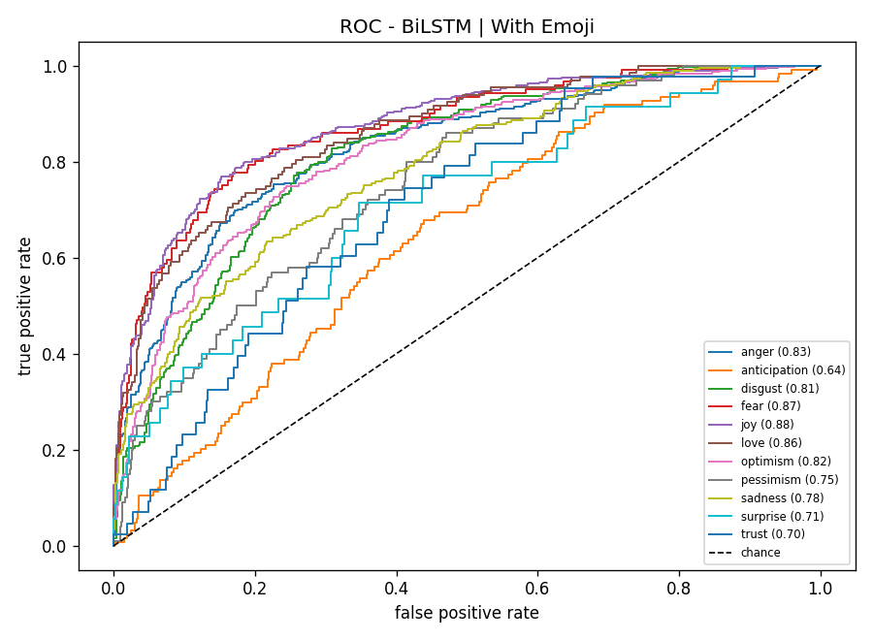
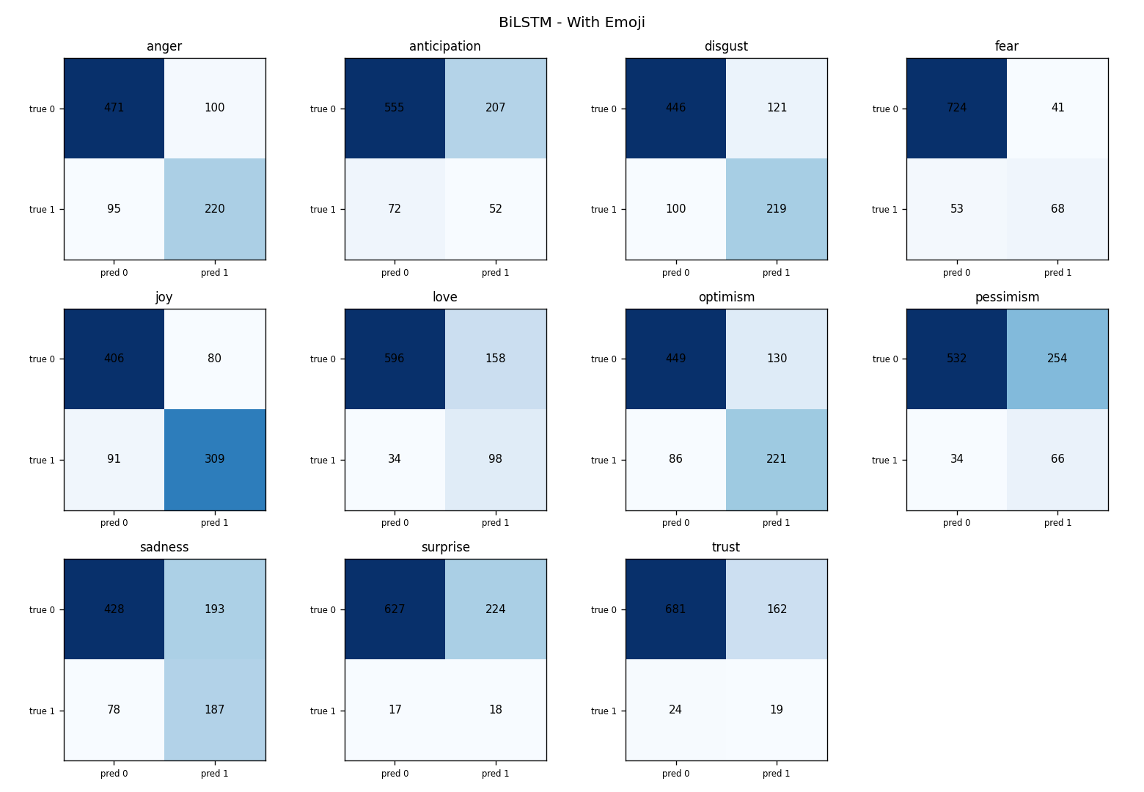
Appendix E: Robustness Evidence
Figure 11: ROC curves per emotion, BiLSTM with emoji.
Figure 12: Confusion matrices per emotion, same condition.
KJS | Krishkumar Jatinbhai Sorathiya | 35042390
62
c5042390@hallam.shu.ac.uk

