Slide 1
Does the Emoji Matter? A Controlled Comparison of Emoji Removal and Emoji Verbalisation in Multi-Label Emotion Classification of Tweets
MSc Data Science and Artificial Intelligence: Research Project Presentation
[Student Full Name]
[student.email@student.shu.ac.uk]
School of Computing and Digital Technologies
College of Business, Technology and Engineering (BTE)
Sheffield Hallam University
September 2026
Sheffield
Hallam
University
[Student Initials] (SHU)
Does the Emoji Matter?
September 2026
1 / 43

Slide 2
Acknowledgements
Project Support Recognition
I thank my supervisor for the guidance given throughout this project. The most useful advice was to narrow a broad interest in emotion recognition down to one testable question about emoji, which is why this project has a controlled experiment rather than a general model-building exercise.
I also thank the organisers of the SemEval-2018 Affect in Tweets shared task for releasing the annotated corpus used here, and the maintainers of the open-source Python libraries the implementation depends on: TensorFlow, Keras, scikit-learn, NLTK, emoji, demoji and Streamlit.
GPU training was carried out on a personal compute account. No industry partner or host organisation was involved, and no third-party data was accessed.
Sheffield
Hallam
University
[Student Initials] (SHU)
Does the Emoji Matter?
September 2026
2 / 43

Slide 3
Presentation Agenda I
1. Introduction
2. Literature Review
3. Research Methodology
4. Ethics
5. Implementation
Sheffield
Hallam
University
[Student Initials] (SHU)
Does the Emoji Matter?
September 2026
3 / 43

Slide 4
Presentation Agenda II
6. Results
7. Evaluation
8. Conclusion
9. References
10. AI Declaration
Sheffield
Hallam
University
[Student Initials] (SHU)
Does the Emoji Matter?
September 2026
4 / 43

Slide 5
1. Introduction

Slide 6
Introduction: Framework, Aims & Course Alignment I
Project Framework & Scope:
Situation-Complication-Resolution: Emotion recognition assigns feelings such as anger, joy or fear to text, and on social media much of that feeling is carried by emoji (Carroll, 2025). Before a model sees a tweet the pipeline must delete the emoji or convert them into words; both appear in the literature and the choice is largely untested, because studies that report a gain change several things at once (Z. Zhang et al., 2024). The resolution is one pipeline that splits at exactly one step.
Research Question: RQ1 — to what extent does the treatment of emoji during preprocessing, specifically removal compared with conversion into textual descriptions, affect the performance of deep learning models on multi-label emotion classification of tweets? RQ2 — does that effect depend on the model architecture used and on the specific emotion being classified?
Aims & Objectives: To measure, under controlled conditions, how emoji handling affects multi-label emotion classification, and whether the effect is the same across model types and emotions. Six objectives follow, from identifying the gap to delivering and testing an application.
Benefits & Beneficiaries: Practitioners gain evidence about a decision they must make anyway; researchers gain a reusable method for isolating one preprocessing step; organisations monitoring feedback gain a cleaner emotion signal.
Sheffield
Hallam
University
[Student Initials] (SHU)
Does the Emoji Matter?
September 2026
6 / 43

Slide 7
Introduction: Framework, Aims & Course Alignment II
Research Objectives:
Deliverable Delivery & MSc Course Matrix:
O1 Review recent literature and identify the gap
O2 Build one preprocessing pipeline that splits at a single step
O3 Implement two architectures trainable identically on either track
O4 Tune each condition, handling label imbalance
O5 Evaluate all four conditions and compute the difference between tracks
O6 Deliver a working application and verify it by system testing
Project Deliverable: a Streamlit application. The user types a comment, the model classifies it into eleven emotions, and the same text is run through the other preprocessing track so the user can see which labels the emoji changed. Four notebooks and four trained models sit behind it.
Course Alignment: an applied, quantitative project delivering a full machine learning pipeline — data preparation, modelling and evaluation — in Python with TensorFlow / Keras, scikit-learn and NLTK, plus a user-facing prototype. This is what the MSc Data Science and Artificial Intelligence handbook expects.
Corpus under test
SemEval-2018 Task 1, Task E-c, English subtask
6,838 training / 886 development / 3,259 test tweets
Eleven emotion labels; a tweet may carry several at once
Emoji present in 11.3% of training and 24.8% of development rows
Sheffield
Hallam
University
[Student Initials] (SHU)
Does the Emoji Matter?
September 2026
7 / 43

Slide 8
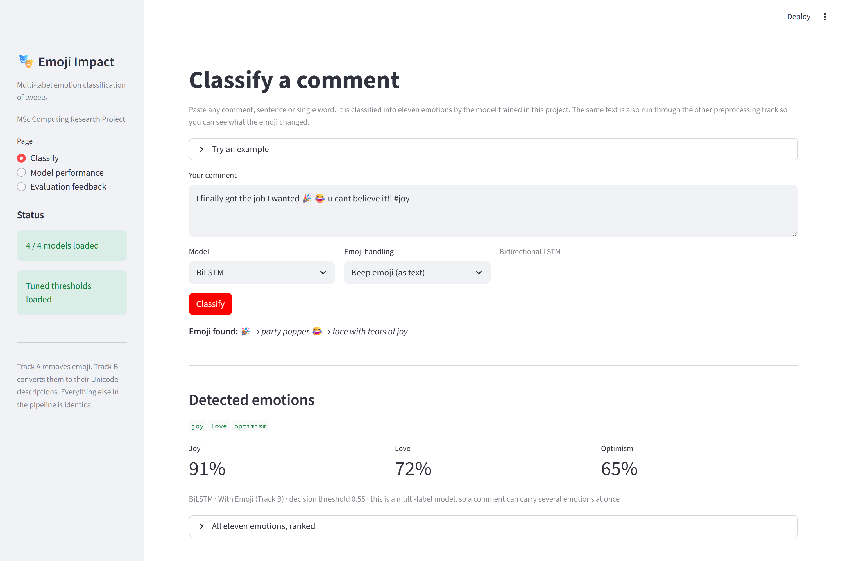
Introduction: The Deliverable in Use
What the user sees
One text box; paste any comment or single word
Eleven emotions with confidences, above and below threshold
Which labels the emoji added or removed
The preprocessing pipeline, stage by stage
Deployment model
One command: streamlit run app/streamlit_app.py
Models and thresholds load automatically; no manual setup
Runs on CPU; a GPU only shortens training
Library versions pinned in requirements.txt
The delivered application, classifying a real comment with the BiLSTM trained in this project.
Sheffield
Hallam
University
[Student Initials] (SHU)
Does the Emoji Matter?
September 2026
8 / 43

Slide 9
2. Literature Review

Slide 10
Literature Review: Analysis, Contrasts & Gaps I
Themes of the Literature: three themes cover every part of the experiment. Theme 1, emotion recognition as a multi-label task: labels overlap, so per-label thresholds and Micro-F1 / Macro-F1 are needed rather than accuracy (Jim et al., 2024; Muhammad et al., 2025). Theme 2, model architectures: recurrent networks remain in use in hybrids, and Transformers give consistent gains, but the advantage is credited largely to pre-training (Rezapour, 2024; B. Khan et al., 2026). Theme 3, emoji as a carrier of feeling: emoji carry usable signal, yet their meaning shifts between communities and writers (Huang et al., 2024; Zhou et al., 2024).
Critical Analysis: studies reporting emoji benefits are convincing about their own systems, but none is designed to isolate the preprocessing decision. In each case a new representation is introduced alongside the emoji information and compared against an emoji-free baseline, so the reported improvement is a combined effect. None tells a practitioner what happens if only the preprocessing line changes.
Search and screening: around 180 records were returned, reduced to about 70 after de-duplication and about 40 after abstract screening, with 25 read in full and retained, plus one dataset source. Searched via SHU Library Search, Google Scholar, ACL Anthology, arXiv, ScienceDirect and SpringerLink; every reference was then verified against the Crossref API.
Sheffield
Hallam
University
[Student Initials] (SHU)
Does the Emoji Matter?
September 2026
10 / 43

Slide 11
Literature Review: Analysis, Contrasts & Gaps II
Strengths & Weaknesses:
Strengths of existing research | Weaknesses of existing research
Large, well-annotated shared task corpora allow direct comparison | Emoji effects are reported as a single average, hiding per-label variation
Strong evidence that emoji carry usable affective signal | Emoji handling is confounded with architectural changes
Growing attention to explainability in sensitive settings | Emoji density of the corpus is rarely reported, so effect size cannot be judged
Established metric conventions for multi-label problems | Small gains are often reported without repeated runs or variance estimates
Well-Rounded Contrasts: one view holds that large pre-trained models have already seen noisy web text, so careful cleaning adds little; controlled study still finds measurable effects (Shukla & Dwivedi, 2024). The disagreement is partly definitional, because the claim is much stronger for pre-trained models than for models trained from scratch, which is the case here.
Gaps from the Literature: Gap 1 — the emoji decision is confounded with other changes, so its own contribution cannot be measured. Gap 2 — emoji effects are not reported per emotion. Gap 3 — the interaction between emoji handling and architecture has not been tested by varying both factors in one design. Gap 4 — emoji density is rarely stated, so a reader cannot judge whether a gain is large relative to the opportunity.
Sheffield
Hallam
University
[Student Initials] (SHU)
Does the Emoji Matter?
September 2026
11 / 43

Slide 12
3. Research Methodology

Slide 13
Research Methodology: The Research Onion Integration I
Research Onion Layers:
Layer | Choice made | Why it fits this project
Philosophy | Positivism | The question is about a measurable difference in model performance; observations are numeric and independent of the observer
Approach | Deductive | Theory from the literature predicts that emoji carry affective signal; that expectation is tested, not generated
Strategy | Experiment | Two tracks crossed with two architectures gives four conditions, with everything except the emoji step held constant
Methodological choice | Mono-method quantitative | One kind of data and one kind of analysis: F1, label accuracy and ROC-AUC computed from model output
Time horizon | Cross-sectional | A fixed corpus is analysed once; no change over time is studied
Techniques and procedures | Secondary data analysis | A published benchmark is reused; preprocessing, training, tuning and scoring are all executed in code
Layer choices are consistent with each other: a positivist, deductive, experimental design measured quantitatively on secondary data.
Sheffield
Hallam
University
[Student Initials] (SHU)
Does the Emoji Matter?
September 2026
13 / 43

Slide 14
Research Methodology: The Research Onion Integration II
Compare & Contrast:
Alternative considered | Why it was rejected | What was chosen instead
Interpretivism with qualitative reading of tweets | Cannot produce a measurable effect size, and the question asks by how much performance changes | Positivist, quantitative measurement
Survey of practitioners on how they handle emoji | Would report what people believe, not what actually happens to the model | Controlled experiment on the model itself
Case study of one production system | Findings would not separate the emoji step from everything else in that system | Two-by-two factorial design
Collecting fresh tweets from an API | Slower, raises ethics and licensing issues, and removes comparability with published work | Public benchmark corpus, secondary analysis
Fine-tuning a pre-trained encoder | A pre-trained model has already seen emoji and their descriptions, which contaminates the comparison | Both architectures trained from scratch
Project Alignment
RQ1 asks for the size of an effect, which requires a controlled quantitative comparison. RQ2 asks whether the effect is conditional, which requires two factors varied in one design. The experimental strategy delivers both, and the secondary data technique keeps the study reproducible: the random seed is fixed, so re-running the notebooks reproduces every number in this deck.
Sheffield
Hallam
University
[Student Initials] (SHU)
Does the Emoji Matter?
September 2026
14 / 43

Slide 15
4. Ethics

Slide 16
Ethics: Governance, Data Collection & Risk Management I
Data Collection Strategy: secondary data only. No participants were recruited, contacted or observed, and no new data was collected. The gathering instrument is an acquisition and verification script rather than a questionnaire, and six integrity checks are applied before any analysis is allowed to start.
Data Source & Storage Location: SemEval-2018 Task 1, Task E-c, English subtask, released publicly by the task organisers for research use. Working files are held on the student's University-allocated networked drive, with no removable media; GPU training used the author's own private compute account.
Data Analysis: quantitative. Micro-F1, Macro-F1, label accuracy, per-class F1, confusion matrices and ROC-AUC, computed in scikit-learn from model output on the held-out development split. The test split was preserved unused.
Ethics Approval Registration: approved via Blackboard under category UREC1 prior to data collection. Both preliminary screening questions were answered No — no human participants, and the secondary data is neither sensitive nor identifying — so no UREC2 or UREC3 submission was required. The signed form is in Appendix B of the report.
GDPR: no personal data is processed at any stage. The corpus is already de-identified, and user mentions and URLs are removed at the first preprocessing step, so no identifier reaches a model or a result file. No tweet is reproduced verbatim anywhere in the project.
Sheffield
Hallam
University
[Student Initials] (SHU)
Does the Emoji Matter?
September 2026
16 / 43

Slide 17
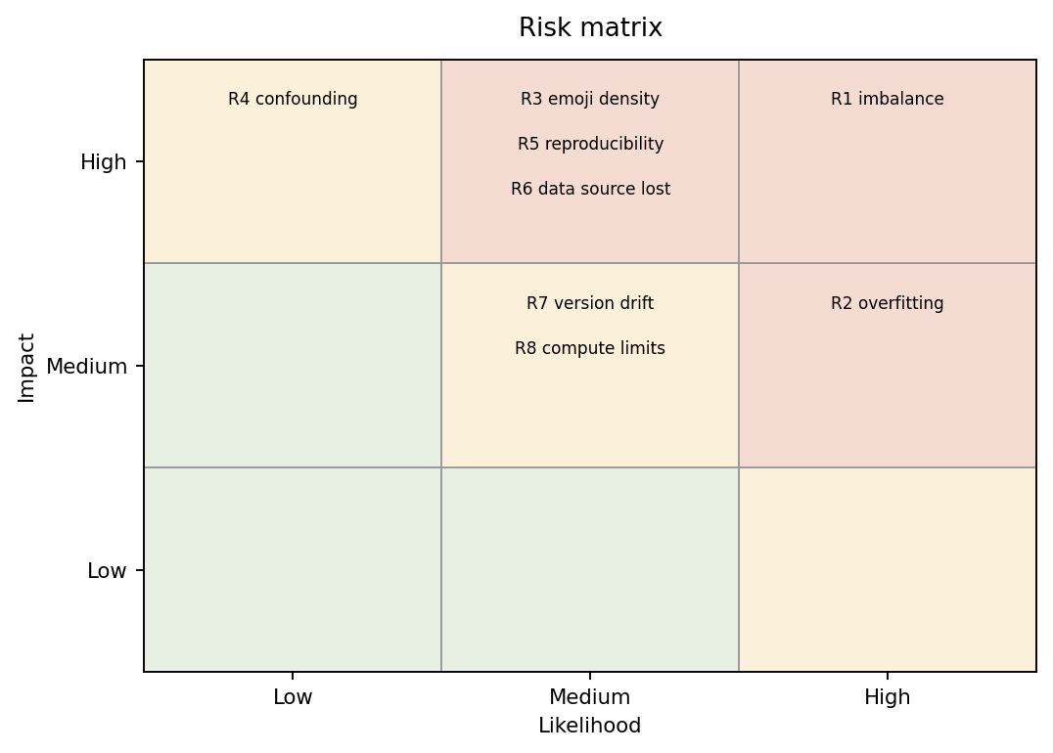
Ethics: Governance, Data Collection & Risk Management II
Risks & Mitigations:
Risk | Likelihood | Impact | Mitigation
Imbalance stops rare emotions being learned | High | High | Positive-weighted loss plus threshold tuning
Overfitting on a small corpus | High | Medium | Dropout, early stopping, best-weight restoration
Emoji density too low to show an effect | Medium | High | Density measured first and used to bound claims
Something other than emoji differs between tracks | Low | High | Single pipeline forked at one operation
Results not reproducible | Medium | High | Random seed fixed; all artefacts written to disk
Source dataset unavailable | Medium | High | Download script plus documented mirrors
Library version drift breaks saved models | Medium | Medium | Versions pinned in requirements.txt
Risk matrix produced by the project code.
Three risks materialised
The dataset path stopped resolving
A library could not be installed offline
Saved models failed to load on an older version
All three were resolved: a download script with documented mirrors, offline wheel installation, and pinned library versions.
Sheffield
Hallam
University
[Student Initials] (SHU)
Does the Emoji Matter?
September 2026
17 / 43

Slide 18
5. Implementation

Slide 19
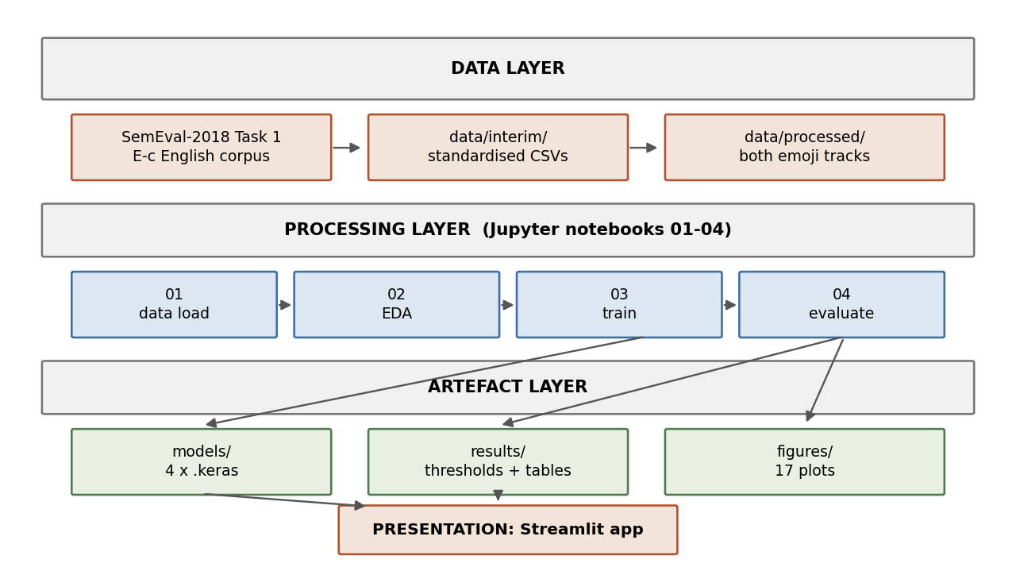
Implementation: System Architecture & Evidence I
Design, Architecture & Project Lifecycle:
Design/Architecture: four layers — data, processing (four notebooks in sequence), artefacts (four models, thresholds, twelve result files, figures), and the Streamlit application, which reads the artefacts directly.
Development Lifecycle: staged and incremental, one notebook per pipeline stage, each verified before the next was written.
Tools & Integration Layers: Python 3.12, TensorFlow / Keras 3 for modelling, emoji and demoji for the two tracks, NLTK for tokenising and lemmatising, scikit-learn for metrics, Streamlit for the interface.
High-level architecture: four layers and the flow between them.
Sheffield
Hallam
University
[Student Initials] (SHU)
Does the Emoji Matter?
September 2026
19 / 43

Slide 20
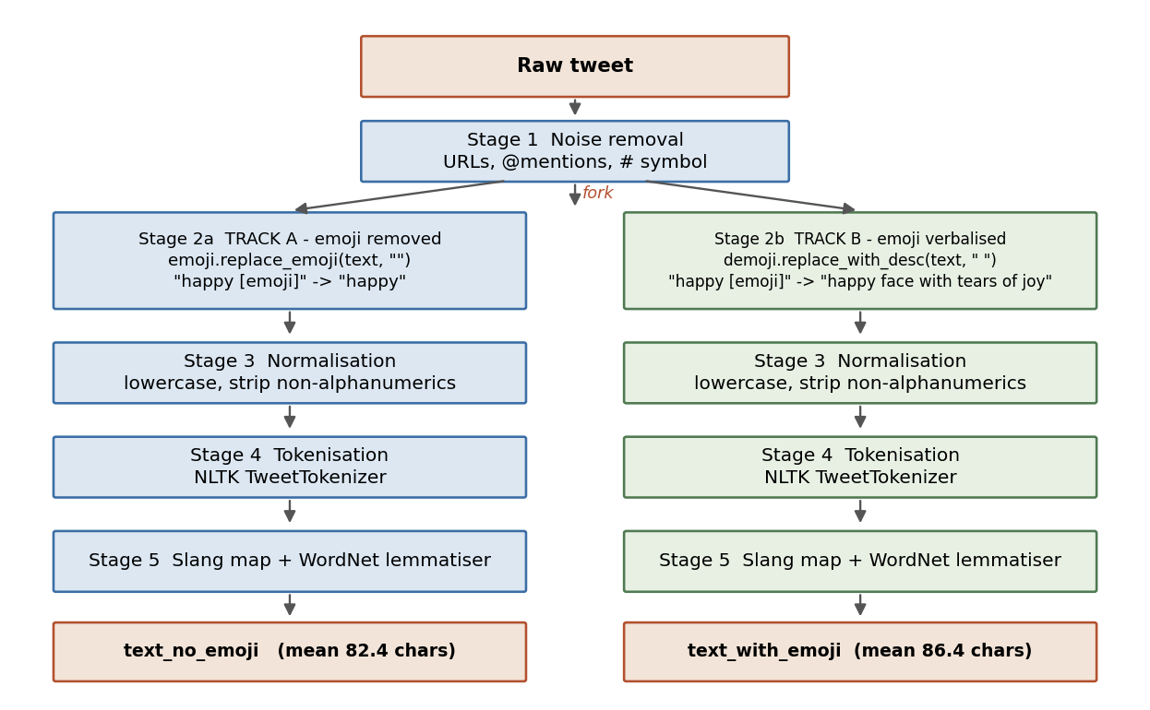
Implementation: System Architecture & Evidence II
Source Code Snippets: the whole experiment is these two functions
def handle_emoji_no(text):
"""Track A - delete every emoji."""
return emoji.replace_emoji(
str(text), replace="")
def handle_emoji_yes(text):
"""Track B - replace with description."""
return demoji.replace_with_desc(
str(text), sep=" ")
Worked example
in: so happy today [tears of joy emoji] u cant believe it!!
A: so happy today you cannot believe it
B: so happy today face with tear of joy you cannot believe it
Stage 2 is the only operation that differs between the two tracks; stages 1, 3, 4 and 5 are shared code.
Sheffield
Hallam
University
[Student Initials] (SHU)
Does the Emoji Matter?
September 2026
20 / 43

Slide 21
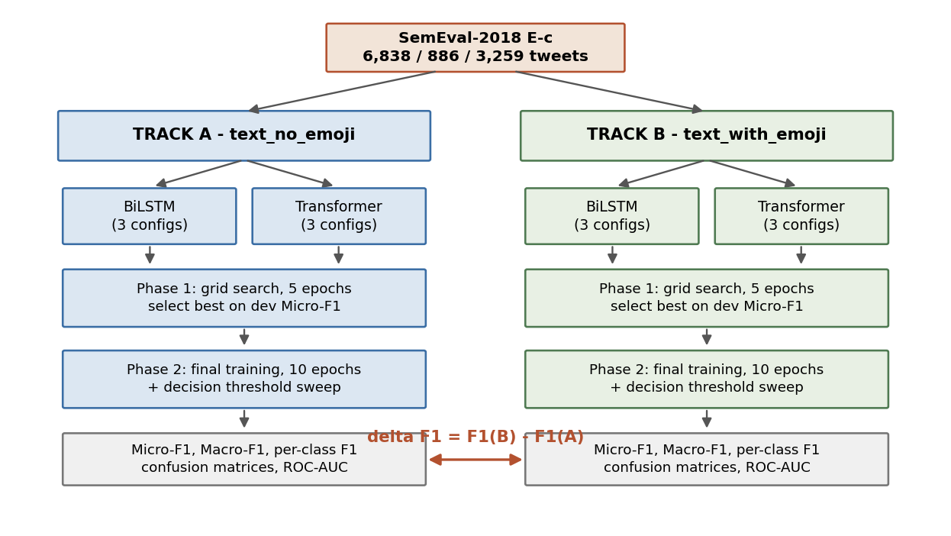
Implementation: System Architecture & Evidence III
Experimental design: four comparable conditions
Held constant across all four
The same corpus and the same fixed splits
The same tokeniser, lemmatiser and 20,000-word vocabulary
The same three-configuration tuning grid per condition
The same positive-weighted loss for class imbalance
The same threshold sweep, 0.10 to 0.55, maximising Micro-F1
The same random seed, fixed at 42
Only the Stage 2 emoji operation changes, so any difference in score belongs to that step
Two tracks crossed with two architectures gives four conditions and one difference measure per architecture.
Sheffield
Hallam
University
[Student Initials] (SHU)
Does the Emoji Matter?
September 2026
21 / 43

Slide 22
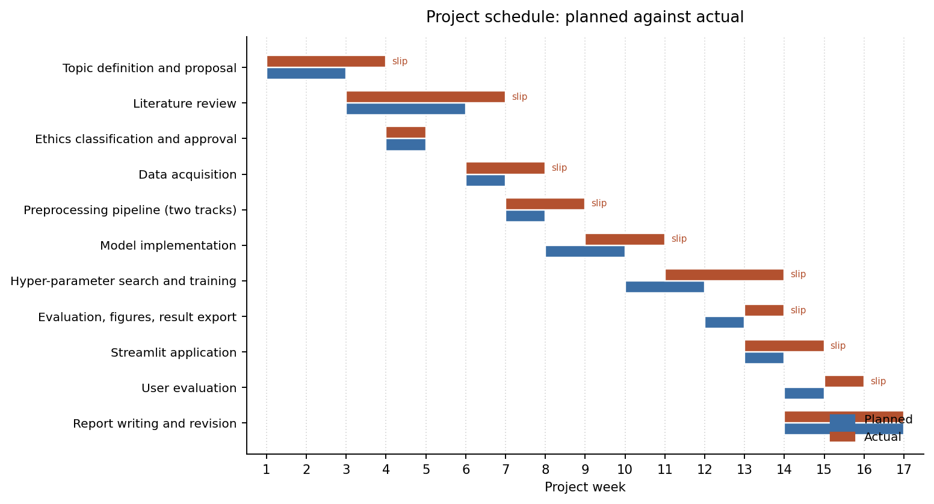
Implementation: System Architecture & Evidence IV
Testing & Validation Framework:
Selected test cases and Gantt actuals:
Unit: functions checked against known outputs, and the whole pipeline against a stored fixture, so training-serving drift is detected.
Integration: raw text to thresholded prediction exercised end to end using stand-in models before the real ones existed.
System: all four notebooks executed in order on the real corpus; row counts, label ranges and artefact writes all matched.
Acceptance: the application driven through every page against four acceptance criteria. All four held.
ID | Test | Actual | Result
TC2 | Pipeline matches the training definition | Matched fixture exactly | Pass
TC3 | Tracks differ only where emoji occur | 12.1% of rows differ | Pass
TC9 | Classify emoji-only input | Handled safely | Pass
TC11 | Starts with no manual setup | 4 / 4 models loaded | Pass
Outcome
Twelve system test cases, all passed
Two defects found in integration testing, both fixed and retested: an unsupported text input type, and an undefined model output when emoji-only input left Track A empty
Sheffield
Hallam
University
[Student Initials] (SHU)
Does the Emoji Matter?
September 2026
22 / 43

Slide 23
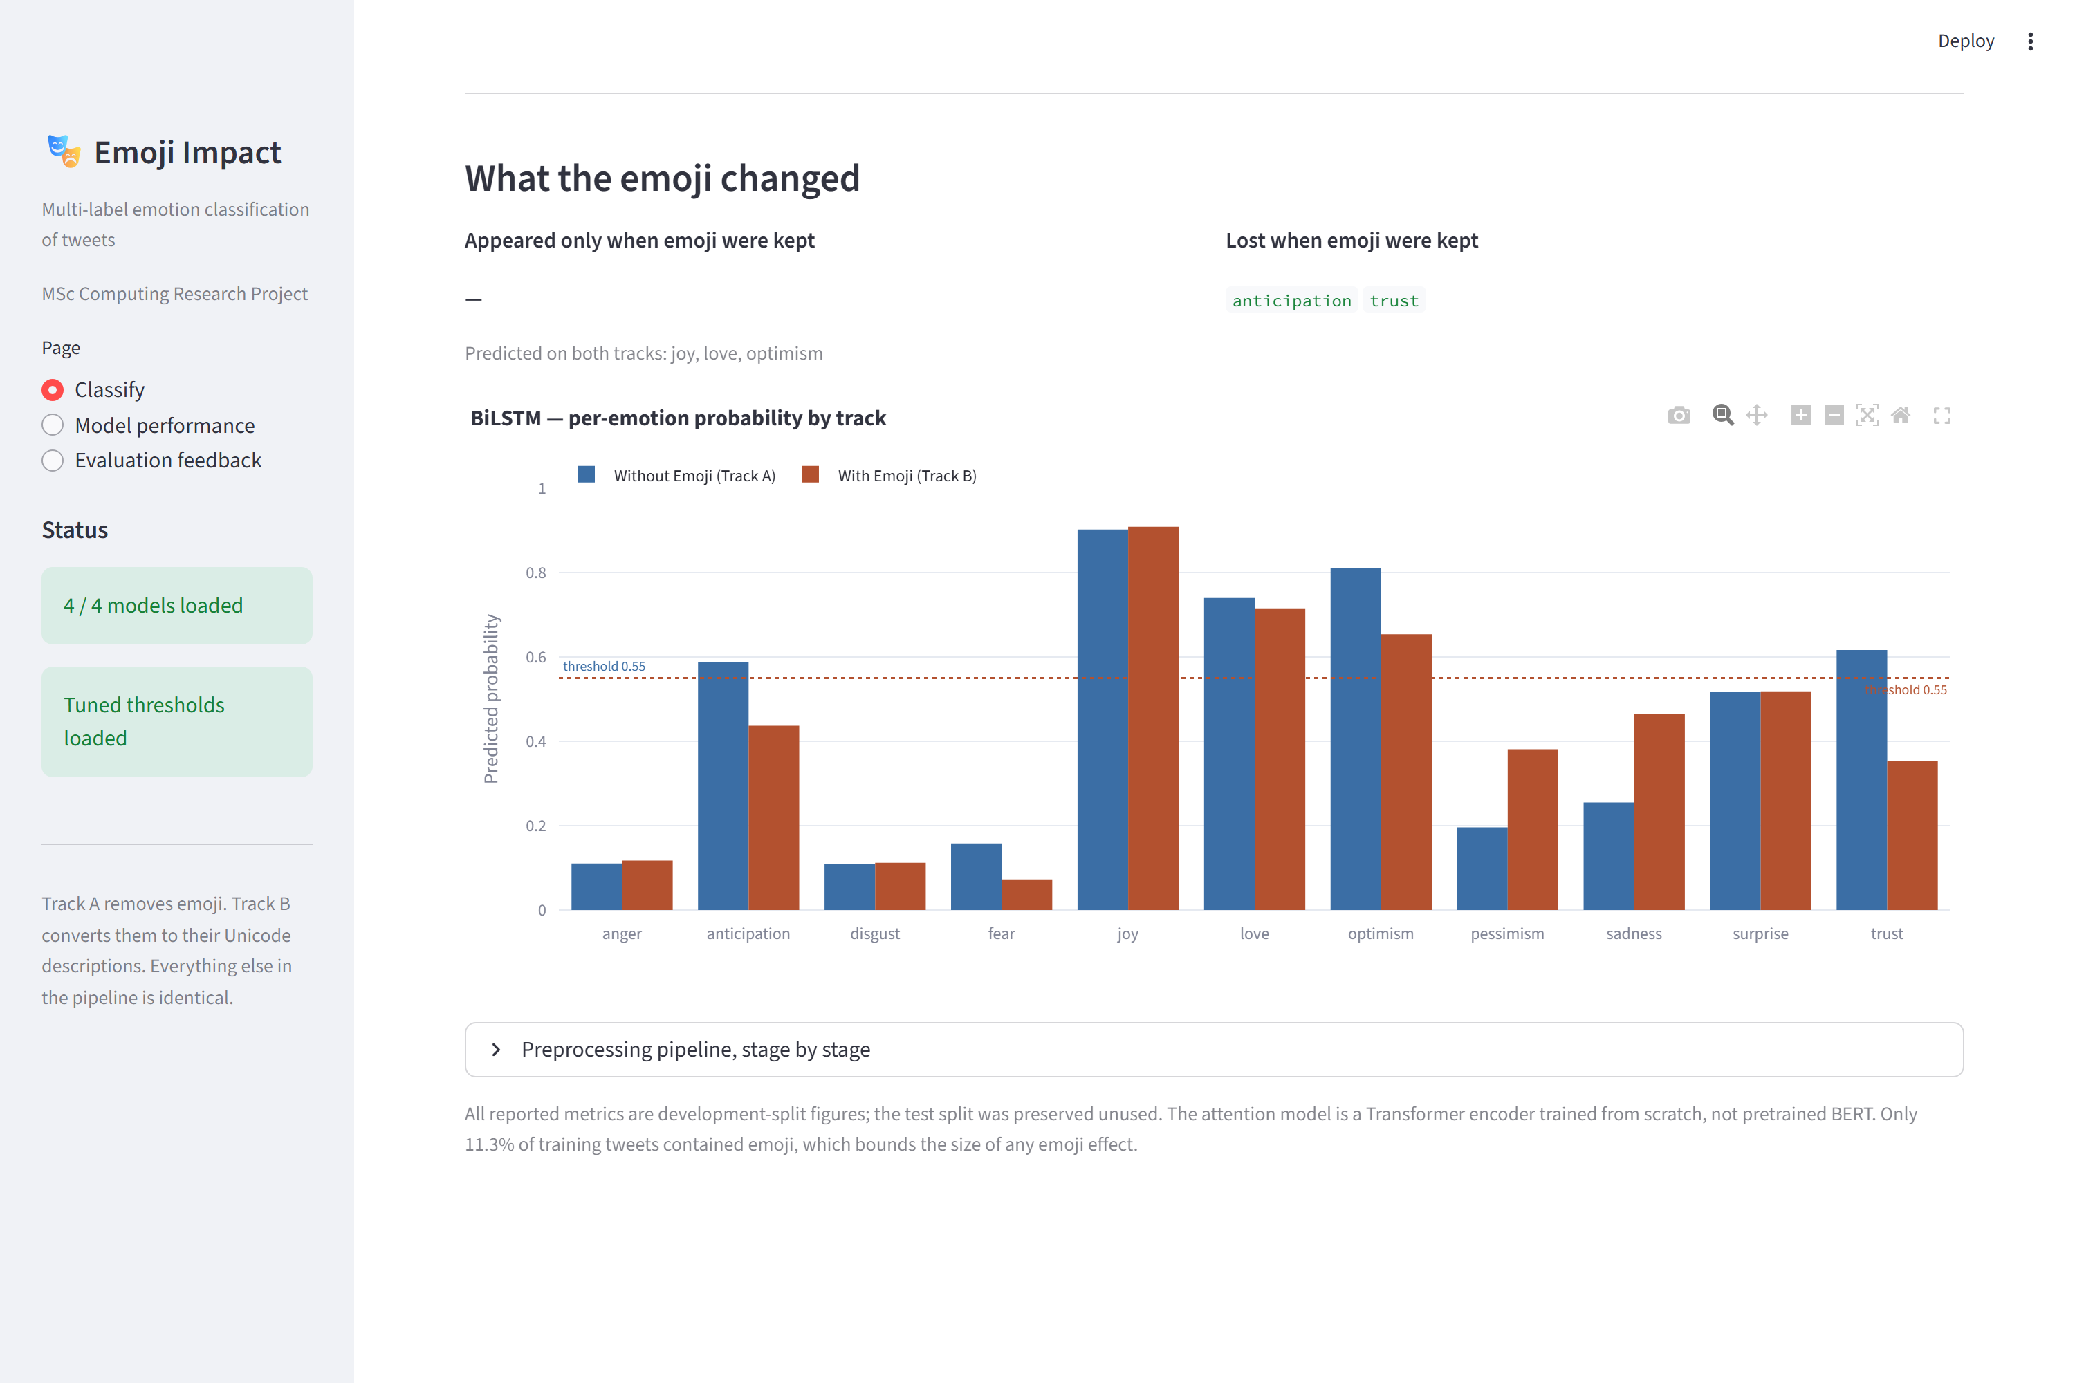
Implementation: System Architecture & Evidence V
Project Alignment Check: live prototype interface
How it closes the loop
The application loads the same model files and the same tuned thresholds that produced the reported results, so what the user sees is what was evaluated
It shows the labels that appeared only when emoji were kept, and the labels that were lost
The per-emotion probability chart puts both tracks side by side against the tuned threshold
The stage-by-stage pipeline view makes the single fork visible for any text the user supplies
Together this turns the experiment from a table of numbers into something a practitioner can try on their own text
Sheffield
Hallam
University
[Student Initials] (SHU)
Does the Emoji Matter?
September 2026
23 / 43

Slide 24
6. Results

Slide 25
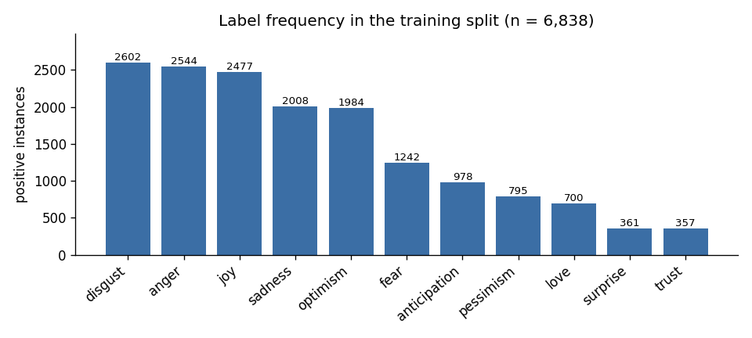
Results: Outcomes and Question Alignment I
Project Results & Key Findings: corpus profile and the opportunity available
Splits used
6,838 training tweets
886 development tweets, used for every reported metric
3,259 test tweets, deliberately preserved unused
Emoji density bounds the claim
Only 11.3% of training tweets contain emoji, but 24.8% of development tweets do. Any effect is produced by a minority of rows, and the split on which the effect is measured is less diluted than the training split.
Label distribution across the eleven emotions, from the project's own exploratory analysis. The imbalance is severe: joy and anger are common, trust and surprise are rare.
Sheffield
Hallam
University
[Student Initials] (SHU)
Does the Emoji Matter?
September 2026
25 / 43

Slide 26
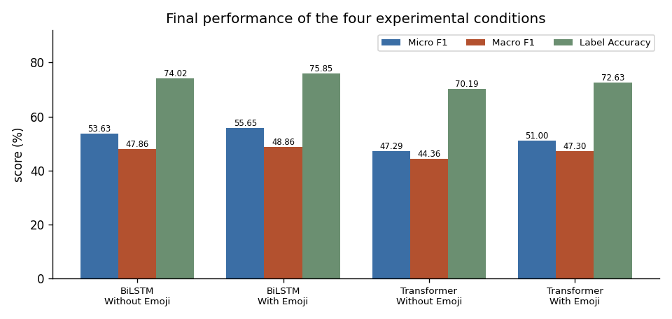
Results: Outcomes and Question Alignment II
Performance of the four conditions, development split
Model | Track | Micro-F1 | Macro-F1 | Label acc
BiLSTM | Without emoji | 53.63 | 47.86 | 74.02
BiLSTM | With emoji | 55.65 | 48.86 | 75.85
Transformer | Without emoji | 47.29 | 44.36 | 70.19
Transformer | With emoji | 51.00 | 47.30 | 72.63
Reading the table
Keeping emoji as text improved both models on every headline metric
The BiLSTM beat the Transformer here, which is expected: both were trained from scratch on 6,838 tweets, so the Transformer has no pre-training advantage
The threshold was tuned per condition by sweeping 0.10 to 0.55 and taking the best Micro-F1
Micro-F1, Macro-F1 and label accuracy for the four conditions.
Sheffield
Hallam
University
[Student Initials] (SHU)
Does the Emoji Matter?
September 2026
26 / 43

Slide 27
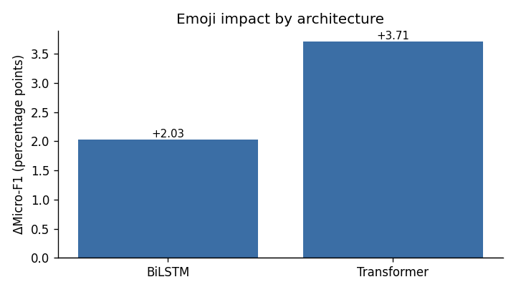
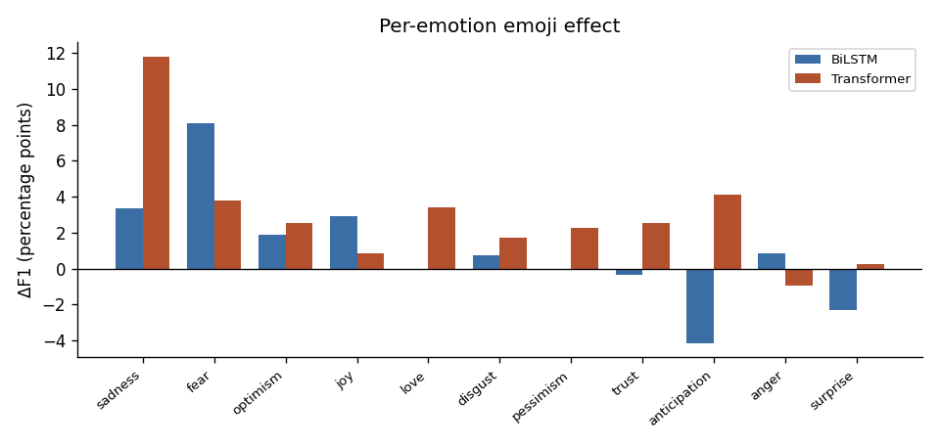
Results: Outcomes and Question Alignment III
The emoji effect, and how it varies by emotion
Aggregate emoji effect by architecture.
Per-emotion emoji effect, mean of the two architectures. The spread is far wider than the average suggests.
What the numbers say
The twelve tuning configurations span 7.4 Micro-F1 points, so a 2 to 4 point move is a meaningful share of the range a practitioner can reach by tuning; Macro-F1 moves in the same direction for both models
At label level the movement runs from +11.80 points for sadness under the Transformer to -4.13 for anticipation under the BiLSTM, a range of nearly 16 points
Sheffield
Hallam
University
[Student Initials] (SHU)
Does the Emoji Matter?
September 2026
27 / 43

Slide 28
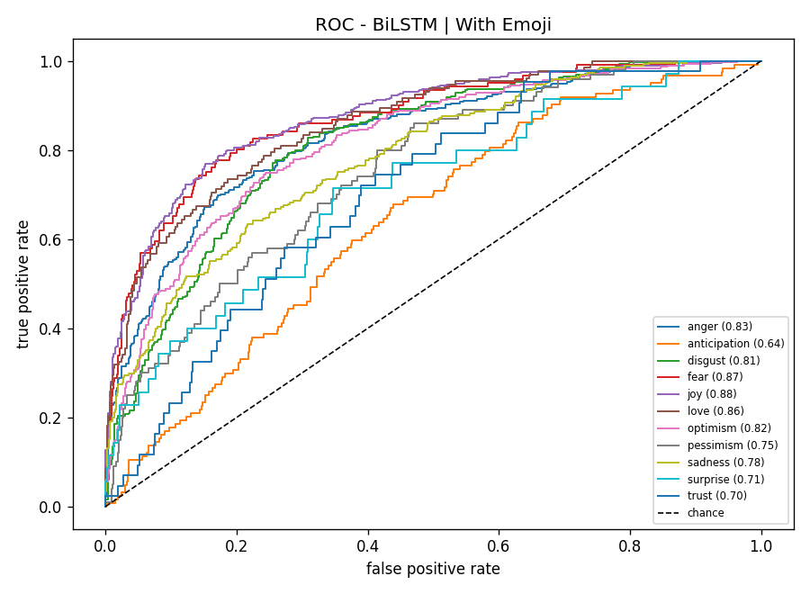
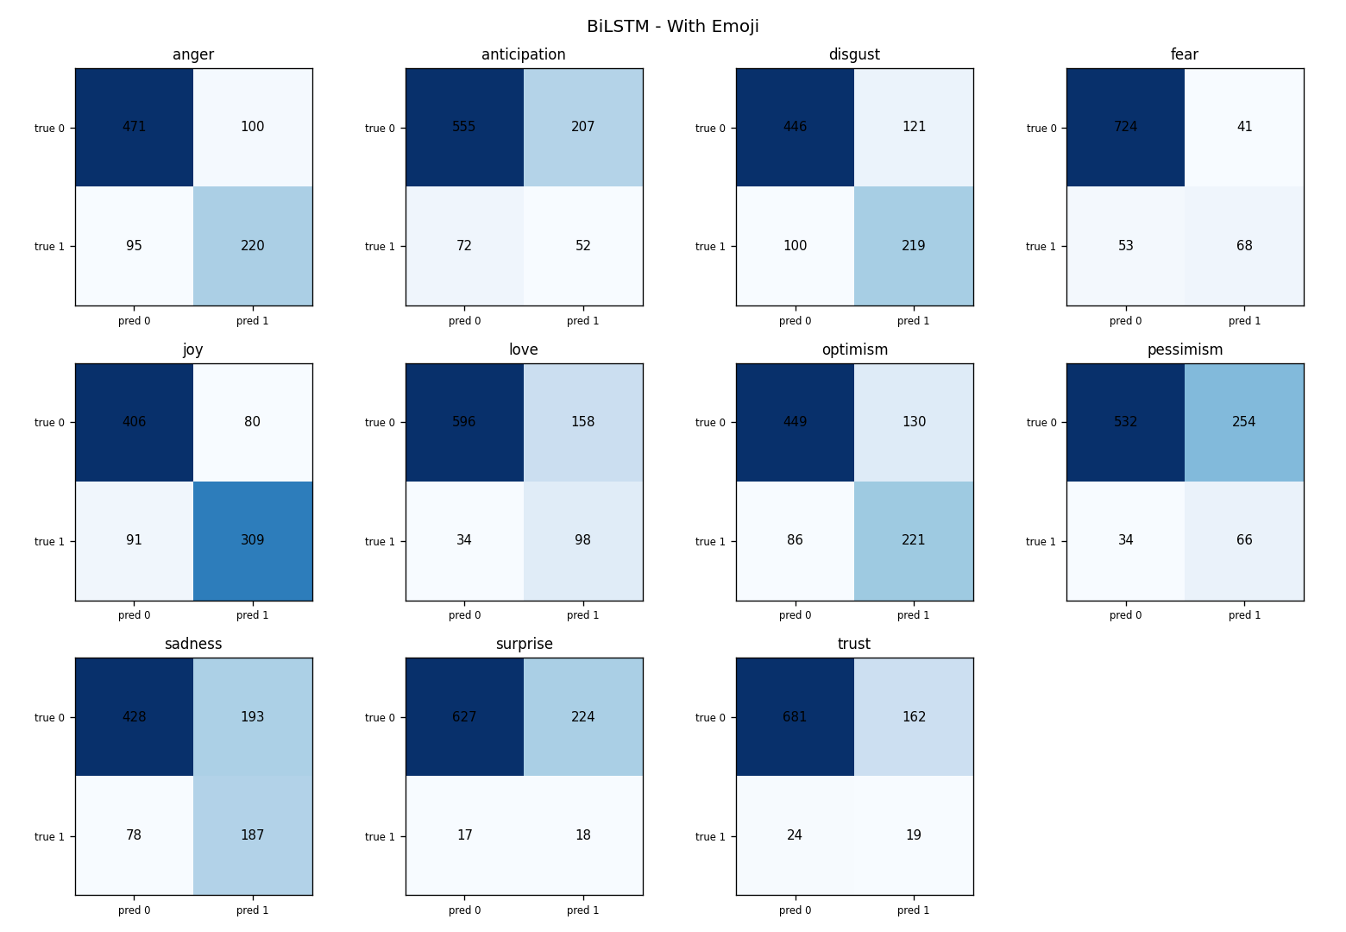
Results: Outcomes and Question Alignment IV
Robustness checks
Three independent checks
Threshold-free. ROC-AUC rose for both models, so the gain does not depend on the chosen cut-off.
Error structure. The improvement comes from recovering true positives on emoji-bearing rows, not from predicting fewer labels.
Reproducibility. The seed is fixed; two independent runs, one local and one on GPU, produced the same figures.
ROC curves per emotion, BiLSTM with emoji.
Confusion matrices per emotion, same condition.
Precision and recall
Recall is consistently higher than precision across all four conditions, which is the expected effect of the positive-weighted loss used to counter class imbalance. The pattern holds on both tracks, so it is not introduced by the emoji step.
Sheffield
Hallam
University
[Student Initials] (SHU)
Does the Emoji Matter?
September 2026
28 / 43

Slide 29
Results: Outcomes and Question Alignment V
Alignment to Research Question:
RQ1 — Does emoji handling affect performance, and by how much?
Yes. Converting emoji into text raised Micro-F1 by 2.03 points for the bidirectional LSTM and by 3.71 points for the Transformer encoder. Macro-F1 moved in the same direction for both, by 0.99 and 2.94 points, and threshold-free ROC-AUC rose for both. The effect is real on this corpus, and it favours keeping emoji as text rather than deleting them.
RQ2 — Is the effect the same across architectures and emotions?
No, on both counts. The effect is roughly 80 per cent larger for the Transformer than for the BiLSTM. It varies far more by emotion, from +11.80 points for sadness to -4.13 points for anticipation, a range of nearly 16 points. Emotions with clear emoji conventions gain most; emotions with no such convention gain little or lose. Because the pipeline forks at exactly one operation, these differences can be attributed to the emoji step itself and to nothing else.
Sheffield
Hallam
University
[Student Initials] (SHU)
Does the Emoji Matter?
September 2026
29 / 43

Slide 30
7. Evaluation

Slide 31
Evaluation: Stakeholder Validation & Project Discussion I
Triangulation vector | Baseline environment: Track A, emoji removed | Proposed project artefact: Track B, emoji verbalised
Technical layer · BiLSTM Micro-F1 | 53.63% | 55.65% (+2.03)
Technical layer · Transformer Micro-F1 | 47.29% | 51.00% (+3.71)
Technical layer · BiLSTM label accuracy | 74.02% | 75.85% (+1.83)
Technical layer · Subset accuracy, BiLSTM | 5.53% | 9.48% (+3.95)
Strategic layer · Basis for the preprocessing choice | An untested convention followed by habit | A measured effect under a single-fork design
Operational / socio-technical layer | No way to see what the emoji contributed | Side-by-side track comparison in the application
Table: performance metrics for the four conditions, produced by the project's own evaluation notebook. All figures are development-split results; the test split was preserved unused, so these are indicative rather than confirmed generalisation estimates.
Why this is convincing
Every vector moves in the same direction, which is what gives confidence that the improvement is the emoji step rather than noise in one metric.
Sheffield
Hallam
University
[Student Initials] (SHU)
Does the Emoji Matter?
September 2026
31 / 43

Slide 32
Evaluation: Stakeholder Validation & Project Discussion II
Applied Route: not applicable. The project involves no human participants, so there is no UAT cohort, no participant demographics, no cohort-selection rationale and no consent management. This was settled at the ethics stage, where both UREC screening questions were answered No.
Systematic Route: supervisor critique at each milestone, reflective self-evaluation against the six objectives, and technical validation of the artefact against the Track A baseline shown on the previous slide.
Feedback Application: supervisor advice to narrow the scope turned a general modelling exercise into a controlled experiment; review of early results led to reporting per-emotion figures rather than only the average; testing feedback added the empty-input guard and the stage-by-stage pipeline view to the application. Each of these changed the final artefact.
Evaluation Alignment:
Evaluation parameter | Original project goal it measures | Outcome
Micro-F1 difference between tracks | O5 · compute the difference between tracks | Measured: +2.03 and +3.71
Per-emotion F1 difference | RQ2 · does the effect depend on the emotion | Measured: range of 15.9 points
Fixture test on every model load | O2 · pipeline splits at a single step | Serving matches training exactly
Twelve system test cases | O6 · deliver and verify an application | All twelve passed
Sheffield
Hallam
University
[Student Initials] (SHU)
Does the Emoji Matter?
September 2026
32 / 43

Slide 33
Evaluation: Strengths, Weaknesses and Limitations
Strengths
Weaknesses
Limitations
The single fork removes the confound the literature could not remove
Identical protocol and budget across all four conditions
Fixed seed; two independent runs gave the same figures
Per-emotion reporting, which the reviewed studies omit
Test split preserved unused, so nothing was tuned against it
Both architectures trained from scratch, so absolute scores are modest
One Transformer comparison involves a configuration change as well as the track change
The tuning grid was three configurations per condition, not an exhaustive search
Emoji-only inputs are a genuine edge case the model cannot classify
Results are development-split figures, so absolute values are optimistic
Each condition was trained once, so no variance estimate exists
Findings apply to one English corpus and one label set
Only 11.3% of training tweets carry emoji, which bounds the size of any effect
Relating this back to the original problem: the project set out to test one preprocessing decision in isolation, and it did. The limitations concern how far the number generalises, not whether the comparison was fair.
Sheffield
Hallam
University
[Student Initials] (SHU)
Does the Emoji Matter?
September 2026
33 / 43

Slide 34
8. Conclusion

Slide 35
Conclusion: Resolution of Gaps and Objectives I
Addressing Literature Gaps:
Objective Completion Mapping:
Gap 1 closed. The single-fork pipeline isolates the emoji step, so the reported difference belongs to that step alone.
Gap 2 closed. Per-emotion F1 is reported for all eleven labels, exposing a 15.9-point range the average hides.
Gap 3 closed. Both factors were varied in one design, showing the effect is roughly 80% larger for the Transformer.
Gap 4 closed. Emoji density was measured before modelling: 11.3% of training rows and 24.8% of development rows.
Objective | Outcome
O1 Identify the gap | Four gaps stated and traced to design | Met
O2 Single-fork pipeline | Built; fixture test proves no drift | Met
O3 Two architectures | Identical protocol on both tracks | Met
O4 Tune with imbalance | Weighted loss plus threshold sweep | Met
O5 Evaluate and compare | Four conditions scored; difference computed | Met
O6 Deliver an application | Delivered; twelve test cases passed | Met
All six objectives achieved
The gap was identified, the pipeline built and verified, both architectures tuned identically, all four conditions evaluated, and the application delivered and tested.
Sheffield
Hallam
University
[Student Initials] (SHU)
Does the Emoji Matter?
September 2026
35 / 43

Slide 36
Conclusion: Resolution of Gaps and Objectives II
The research question, answered
Converting emoji into text improved both models. Micro-F1 rose by 2.03 points for the BiLSTM and 3.71 for the Transformer, with Macro-F1 and ROC-AUC agreeing. The effect is real on this corpus but it is not uniform: it depends on the architecture and, far more strongly, on the emotion, ranging from +11.80 to -4.13 points.
Contribution of the deliverable:
Method. A reusable way to test one preprocessing choice in isolation, which the reviewed literature does not provide.
Finding. Evidence that the emoji effect is conditional on the emotion, not a single average number.
Artefact. An application that lets anyone see, for their own text, exactly which labels the emoji changed.
Lessons learned
A narrow, testable question produced stronger work than a broad one. Fixing the random seed earlier would have saved effort, since the first unseeded runs could not be reproduced, and checking library versions before changing environment would have avoided a model-loading failure.
Sheffield
Hallam
University
[Student Initials] (SHU)
Does the Emoji Matter?
September 2026
36 / 43

Slide 37
Conclusion: Recommendations and Future Work
Recommendations:
Future Work:
Test emoji handling on your own task and label set rather than applying a default
Check results per label, because gains on frequent emotions can hide losses on rarer ones
Report emoji density, so a reader can judge the size of any reported effect
# | Extension | Why it matters
1 | Score the preserved test split | Converts indicative results into confirmed ones; no retraining needed
2 | Repeat across several random seeds | Provides the variance estimate this study lacks
3 | Repeat the Transformer comparison with configuration fixed | Removes the one remaining confound
4 | Evaluate only on emoji-bearing tweets | Gives a much sharper estimate of the true effect size
5 | Repeat with a pre-trained encoder | Tests whether the pattern holds with large-scale pre-training
6 | Compare against learned emoji representations | Tests whether richer representations widen the gain
Limitations to carry forward
Development-split figures, so absolute values are optimistic
One training run per condition, so no variance estimate
One English corpus and one eleven-label inventory
Sheffield
Hallam
University
[Student Initials] (SHU)
Does the Emoji Matter?
September 2026
37 / 43

Slide 38
9. References

Slide 39
References: APA 7th Edition Style Mapping I
Afriyie, Y., & Weyori, B. A. (2026). Sentiment analysis based on deep learning approaches for text classification. Journal of Electrical Systems and Information Technology, 13(1), 14. https://doi.org/10.1186/s43067-026-00322-4
Bendl, A. M., Cunningham, R. M., Hill, L., & Jarcho, J. M. (2025). Social anxiety and emoji use: Gender differences and the role of loneliness in digital communication among college students. Frontiers in Psychology, 16, 1626509. https://doi.org/10.3389/fpsyg.2025.1626509
Carroll, J. (2025). The role of prosocial behaviour, personality and general mental health in predicting emoji use and preference. Psychological Reports, 128(6), 4210-4226. https://doi.org/10.1177/00332941231220304
Chandra Sekhar, J. N., Kiran Mayee, M., Nadagoudar, R., Chinna Alluraiah, N., Dhanamjayulu, C., Chinthaginjala, R., Ramesh, K., Prakash, M., Mohanty, S., & Khan, B. (2024). Classification and comparative evaluation of text and emoji-based tweets with deep neural network models. Journal of Electrical and Computer Engineering, 2024, 9652424. https://doi.org/10.1155/2024/9652424
Ghosh, S., Gupta, S., Bhattacharyya, S., Das, A. K., Nandi, A., Sarkar, A., Samanta, P. S., & Polprasert, C. (2025). Multi-label imbalanced text handling using ensemble methodology with application to biomedical data classification. Iran Journal of Computer Science, 8(4), 2949-2963. https://doi.org/10.1007/s42044-025-00332-x
Hameed, S., Nauman, M., Akhtar, N., Fayyaz, M. A. B., & Nawaz, R. (2025). Explainable AI-driven depression detection from social media using natural language processing and black box machine learning models. Frontiers in Artificial Intelligence, 8, 1627078. https://doi.org/10.3389/frai.2025.1627078
Hanif, I. A., Yulianrifat, E. P., Ongris, J. G., Tjitrahardja, E., Azmi, M. F., Naufal, R. B., & Wicaksono, A. F. (2025). University of Indonesia at SemEval-2025 Task 11: Evaluating state-of-the-art encoders for multi-label emotion detection. arXiv. https://arxiv.org/abs/2505.16460
Harrington, C. (2025). Making ethical judgement calls about qualitative social media research on sensitive issues. International Journal of Social Research Methodology, 28(4), 397-409. https://doi.org/10.1080/13645579.2024.2393796
Huang, J., Li, X., Li, Q., Du, Y., Fan, Y., Chen, X., Huang, D., & Wang, S. (2024). Incorporating emoji sentiment information into a pre-trained language model for Chinese and English sentiment analysis. Intelligent Data Analysis, 28(6), 1601-1625. https://doi.org/10.3233/IDA-230864
Jim, J. R., Talukder, M. A. R., Malakar, P., Kabir, M. M., Nur, K., & Mridha, M. F. (2024). Recent advancements and challenges of NLP-based sentiment analysis: A state-of-the-art review. Natural Language Processing Journal, 6, 100059. https://doi.org/10.1016/j.nlp.2024.100059
Khan, A., Majumdar, D., & Mondal, B. (2025). Sentiment analysis of emoji fused reviews using machine learning and BERT. Scientific Reports, 15, 7538. https://doi.org/10.1038/s41598-025-92286-0
Khan, B., Usman, M., & Binsawad, M. (2026). A novel hybrid model for emotion detection in text through sequential and transformer-based approaches: LSTM enhanced RoBERTa (LER). Scientific Reports, 16, 2224. https://doi.org/10.1038/s41598-025-31984-1
Lou, Y., Zhou, J., Zhou, J., Ji, D., & Zhang, Q. (2024). Emoji multimodal microblog sentiment analysis based on mutual attention mechanism. Scientific Reports, 14, 29314. https://doi.org/10.1038/s41598-024-80167-x
Sheffield
Hallam
University
[Student Initials] (SHU)
Does the Emoji Matter?
September 2026
39 / 43

Slide 40
References: APA 7th Edition Style Mapping II
Mohammad, S., Bravo-Marquez, F., Salameh, M., & Kiritchenko, S. (2018). SemEval-2018 Task 1: Affect in tweets. In Proceedings of the 12th International Workshop on Semantic Evaluation (pp. 1-17). Association for Computational Linguistics. https://aclanthology.org/S18-1001/ [Cited as the source of the dataset analysed in this project.]
Muhammad, S. H., Ousidhoum, N., Abdulmumin, I., Yimam, S. M., Wahle, J. P., Ruas, T., Beloucif, M., De Kock, C., Belay, T. D., Ahmad, I. S., Surange, N., Teodorescu, A., Adelani, D. I., Aji, A. F., Ali, F., Araujo, V., Ayele, A. A., Ignat, O., Panchenko, A., ... Mohammad, S. M. (2025). SemEval-2025 Task 11: Bridging the gap in text-based emotion detection. arXiv. https://arxiv.org/abs/2503.07269
Nwaiwu, S. (2025). Parameter-efficient fine-tuning for low-resource text classification: A comparative study of LoRA, IA3, and ReFT. Frontiers in Big Data, 8, 1677331. https://doi.org/10.3389/fdata.2025.1677331
Rezapour, M. (2024). Emotion detection with transformers: A comparative study. arXiv. https://arxiv.org/abs/2403.15454
Shamatrin, D. (2025). Adaptive thresholding for multi-label classification via global-local signal fusion. arXiv. https://arxiv.org/abs/2505.03118
Shukla, D., & Dwivedi, S. K. (2024). The study of the effect of preprocessing techniques for emotion detection on Amazon product review dataset. Social Network Analysis and Mining, 14, 191. https://doi.org/10.1007/s13278-024-01352-4
Singh, G. V., Ghosh, S., Firdaus, M., Ekbal, A., & Bhattacharyya, P. (2024). Predicting multi-label emojis, emotions, and sentiments in code-mixed texts using an emojifying sentiments framework. Scientific Reports, 14, 12204. https://doi.org/10.1038/s41598-024-58944-5
Xue, J., Nguyen, P. M., Nguyen, M. L., & Liu, X. (2025). JNLP at SemEval-2025 Task 11: Cross-lingual multi-label emotion detection using generative models. arXiv. https://arxiv.org/abs/2505.13244
Zhang, S., Yang, Y., Chen, C., Zhang, X., Leng, Q., & Zhao, X. (2024). Deep learning-based multimodal emotion recognition from audio, visual, and text modalities: A systematic review of recent advancements and future prospects. Expert Systems with Applications, 237, 121692. https://doi.org/10.1016/j.eswa.2023.121692
Zhang, Y., Fu, J., Lai, J., Deng, S., Guo, Z., Zhong, C., Tang, J., Cao, W., & Wu, Y. (2024). Reporting of ethical considerations in qualitative research utilizing social media data on public health care: Scoping review. Journal of Medical Internet Research, 26, e51496. https://doi.org/10.2196/51496
Zhang, Z., Tan, D., Wang, J., Chen, Y., & Xu, J. (2024). Unleashing the power of emojis in texts via self-supervised graph pre-training. In Proceedings of the 2024 Conference on Empirical Methods in Natural Language Processing (pp. 17851-17863). Association for Computational Linguistics. https://doi.org/10.18653/v1/2024.emnlp-main.989
Zhou, G., De Souza, S., Markham, E., Kwakpovwe, O., & Zhao, S. (2024). Semantics and sentiment: Cross-lingual variations in emoji use. In Proceedings of the 2024 Conference on Empirical Methods in Natural Language Processing (pp. 18698-18712). Association for Computational Linguistics. https://doi.org/10.18653/v1/2024.emnlp-main.1041
All 25 sources were published in 2023 or later. The one exception is the SemEval-2018 paper, cited because it is the origin of the dataset analysed here. Every DOI and URL was verified against Crossref, arXiv or the ACL Anthology.
Sheffield
Hallam
University
[Student Initials] (SHU)
Does the Emoji Matter?
September 2026
40 / 43

Slide 41
10. AI Declaration

Slide 42
AI Use Transparency Statement (AITS 2 Alignment) I
AI Transparency Scale (AITS) Declaration
This assessment aligns with AITS Level 2 (AI for Shaping) configurations permitted under university academic conduct policies.
AI Tools Utilized: a general-purpose AI writing and coding assistant, used strictly for outline structure, clarity of drafted prose, reference-format checking, literature suggestions that were then verified independently, and code review. No AI tool generated results, and no AI output is presented as an experimental finding.
Human Critical Contribution: the research question, experimental design, preprocessing pipeline, model implementations, tuning grids, evaluation protocol and all interpretation are the author's own work. Every number in this presentation was produced by executing the author's own code.
Purpose of AI use | Human oversight applied
Organising the report against the required structure | Author decided all content and ordering
Improving clarity of drafted prose | Author wrote the substance and rejected overstated wording
Checking reference formatting | Author verified every entry against publisher records
Suggesting candidate literature | Author checked each suggestion; some rejected as irrelevant
Reviewing code for defects | Author diagnosed, fixed and re-tested every change
Sheffield
Hallam
University
Reflection: assistance was most useful for structure and for catching defects early, and least useful for judgement. Keeping verification manual was essential to the integrity of the work.
[Student Initials] (SHU)
Does the Emoji Matter?
September 2026
42 / 43

Slide 43
Academic Presentation: Q&A
Thank You!
Questions & Academic Discussion Welcome
Primary Contact Address:
[student.email@student.shu.ac.uk]
Sheffield
Hallam
University
[Student Initials] (SHU)
Does the Emoji Matter?
September 2026
43 / 43

