Slide 1
Name : Krishnan K
NM id : au730321104023
Reg.No : 730321104023
Year : III
Degree : B.E / CSE
College Name : Builders Engineering College
3/21/2024 Annual Review

Slide 2
HAND GESTURES RECOGNITION WITH OPENCV AND CNN
3/21/2024 Annual Review

Slide 3


AGENDA
Introduction
Data Collection and Preprocessing
Model Architecture
Training and Testing
Results and Future Work
3/21/2024 Annual Review

Slide 4

PROBLEM STATEMENT
The problem statement for hand gesture recognition with OpenCV and CNN involves developing a system that can accurately detect and classify hand gestures in real-time. This system should be able to recognize a variety of hand gestures, such as gestures representing numbers, letters, or specific commands. The goal is to create a robust and efficient model that can be integrated into various applications, such as sign language translation, virtual reality interactions, or gesture-based controls. The system should be able to handle varying lighting conditions, hand orientations, and backgrounds, ensuring reliable performance in different environments. The ultimate objective is to improve human-computer interaction by enabling intuitive and natural gestures to control devices or interact with digital content.
3/21/2024 Annual Review

Slide 5

PROJECT OVERVIEW
Objective: Develop a real-time hand gesture recognition system using OpenCV and Convolutional Neural Networks (CNN) to interpret and classify gestures for human-computer interaction.
Methodology: Utilize OpenCV for hand detection and tracking, preprocess hand images for CNN input, and train a CNN model to recognize gestures based on extracted features.
Implementation: Implement the system to detect and classify a predefined set of hand gestures, such as numbers, letters, or specific commands, with a focus on accuracy and efficiency.
Evaluation: Evaluate the performance of the system through metrics like accuracy, speed, and robustness against variations in lighting, hand orientation, and background.
Applications: Explore potential applications of the system, such as sign language translation, virtual reality interactions, or gesture-based controls in devices, to demonstrate its practical utility and impact.
3/21/2024 Annual Review

Slide 6

WHO ARE THE END USERS?
Healthcare Professionals: End users in healthcare can benefit from hands-free operation of medical equipment and access to patient records through gesture recognition, improving efficiency and hygiene.
Industrial Workers: Workers in manufacturing can use gesture recognition to control machinery or perform tasks without physical contact, enhancing safety and productivity.
Gaming Enthusiasts: Gamers can enjoy immersive experiences with gesture-based controls for interacting with virtual environments and controlling gameplay.
Smart Home Owners: Homeowners can use hand gestures to control smart home devices, such as lights and thermostats, adding convenience and automation to their homes.
Educators and Students: In educational settings, gesture recognition can enhance interactive learning experiences, allowing educators to engage students in new and innovative ways.
3/21/2024 Annual Review

Slide 7

YOUR SOLUTION AND ITS VALUE PROPOSITION
Our solution utilizes OpenCV and CNN to accurately recognize and interpret hand gestures, enabling intuitive human-computer interaction. The value proposition lies in its ability to enhance accessibility, productivity, and user experience across various industries and applications, from healthcare and gaming to smart homes and education.
3/21/2024 Annual Review

Slide 8

THE WOW IN YOUR SOLUTION
1. Real-time Recognition: Our solution offers real-time hand gesture recognition, providing instantaneous feedback and enabling seamless interactions.
2. High Accuracy: By leveraging CNNs, our solution achieves high accuracy in recognizing a wide range of hand gestures, ensuring reliable performance in diverse environments.
3. Robustness: Our solution is robust against variations in lighting conditions, hand orientations, and backgrounds, ensuring consistent performance in real-world scenarios.
3/21/2024 Annual Review

Slide 9
MODELLING
Data Collection
Data Preprocessing
Model Architecture
Training
Testing
Deployment
Optimization
3/21/2024 Annual Review

Slide 10
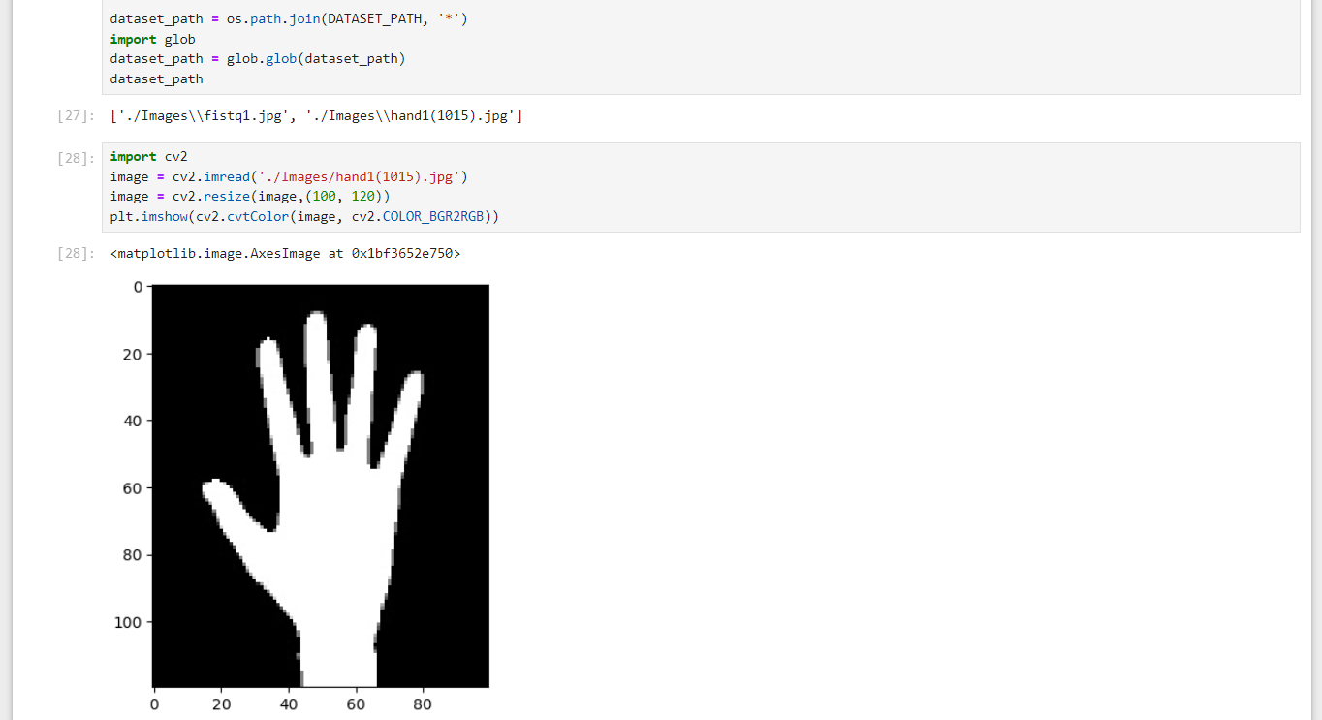
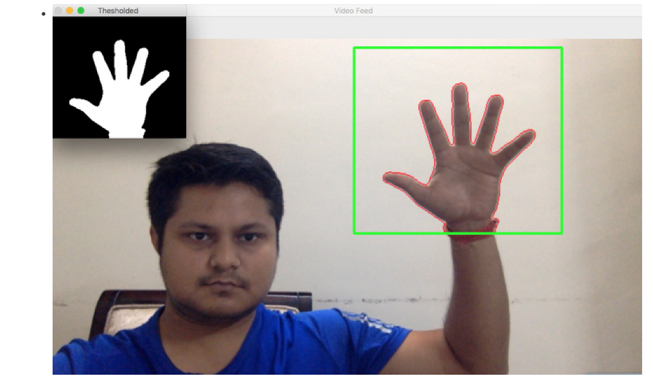
RESULTS
Demo Link
3/21/2024 Annual Review

