Slide 1
Outline:
Introduction
Classification
Nomenclature
Structure
Preparation of alcohols and phenols
Physical properties of alcohols and phenols
Chemical properties of alcohols and phenols
Commercially important alcohols methanol and ethanol
Preparation, physical and chemical properties of Ethers

Slide 2
Part-I
Introduction
Classification
Nomenclature of Alcohols, Phenols & Ethers
Structure of Alcohols, Phenols and Ethers
Preparation of Alcohols and phenols
Physical properties of Alcohols and Phenols.
Summary

Slide 3
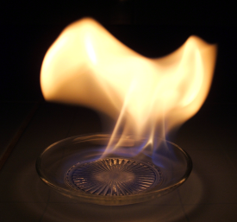
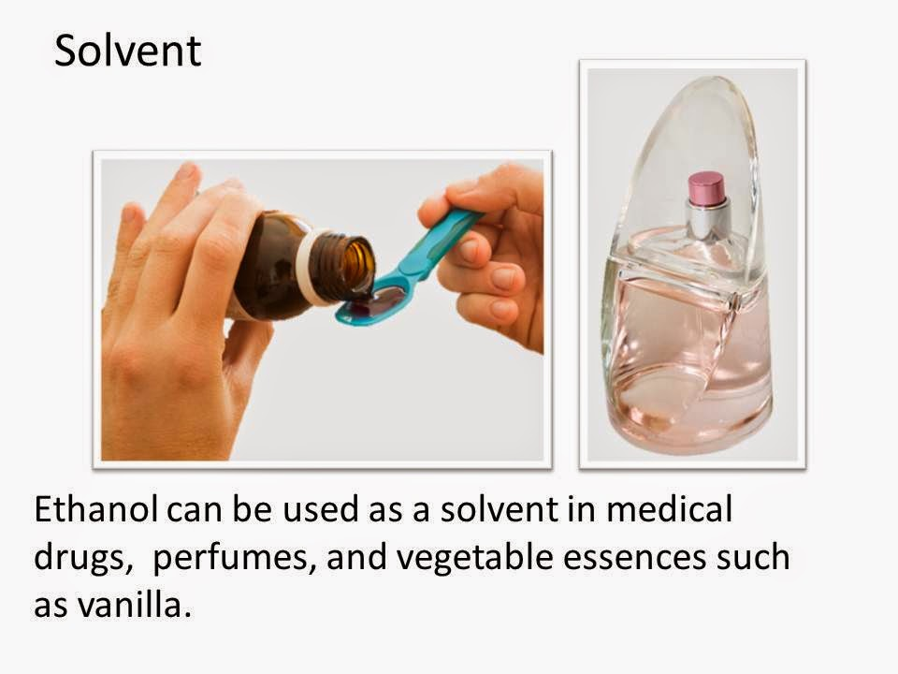
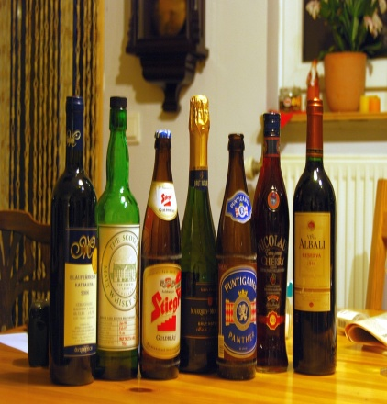
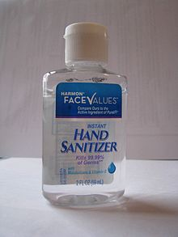
Importance of Alcohols
Solvent
Fuel
Uses of Alcohols
In Drugs
In Alcoholic drinks
Antiseptic
In Perfumes

Slide 4
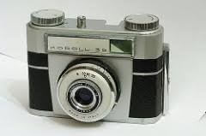
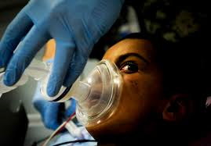
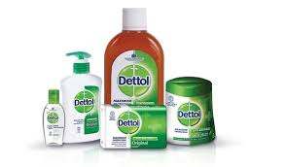
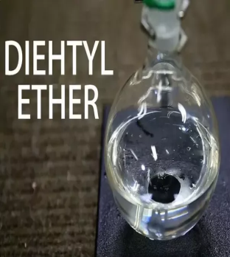
Importance of Phenols and Ethers
Uses of Phenols
Uses of Ethers
Anaesthetic
In Bakelite
As Antiseptic
Solvent

Slide 5
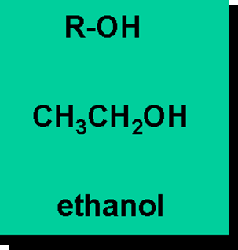
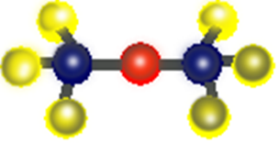

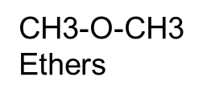
Alcohols, Phenols & Ethers
Alcohol- Hydroxyl group attached to alkyl or aryl group.
Phenols – OH is attached to aromatic ring (aryl group)
Ethers – an alkoxy or aryl.oxy attached to an alkyl or aryl group
Phenol

Slide 6
Classification of Alcohols and Phenols
Based on Number of hydroxyl groups
Monohydric
Dihydric
Based on the hybridisation of C−atom of C−OH bond of monohydric compounds
Compounds containing sp³ hybridised C−OH bond
Compounds containing sp²hybridised C−OH bond
Polyhydric

Slide 7
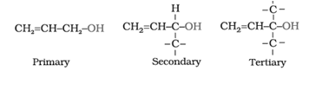
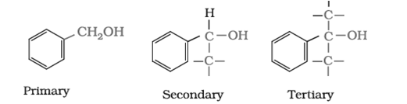

Classification of Alcohols
Compounds containing sp³ C−OH bond
Alkyl alcohols (R−OH)primary, secondary, and tertiary
Allylic alcohols
Benzylic alcohols

Slide 8
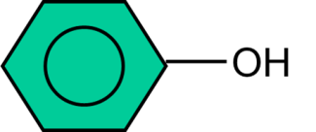
Compounds containingC_{sp2} –OH bond.
-OH group bonded to a carbon – carbon double bond
Eg. CH₂ = CH – OH (Vinylic alcohol)
Phenol

Slide 9
Classification of Ethers
Ethers
Simple or Symmetrical
C₂H₅OC₂H₅
Mixed or Unsymmetrical
C₂H₅OC₆H₅

Slide 10
NOMENCLATURE

Slide 11


IUPAC Nomenclature of Alcohols
Prefix+ Word root +Primary suffix +Secondary suffix
Prefix – name of substituent with its location
Word root – name of carbon atoms in parent chain
Primary suffix – name of single double/triple bond in parent chain
Secondary suffix – IUPAC name of functional group
CH₃
1
Side chain
2
Functional group (Alcohol)
CH3 – C - OH
3
3
Word root -Parent chain with3 C atoms
2-Methyl
Prop +
an +
2-ol
= 2-Methylpropan-2-ol

Slide 12
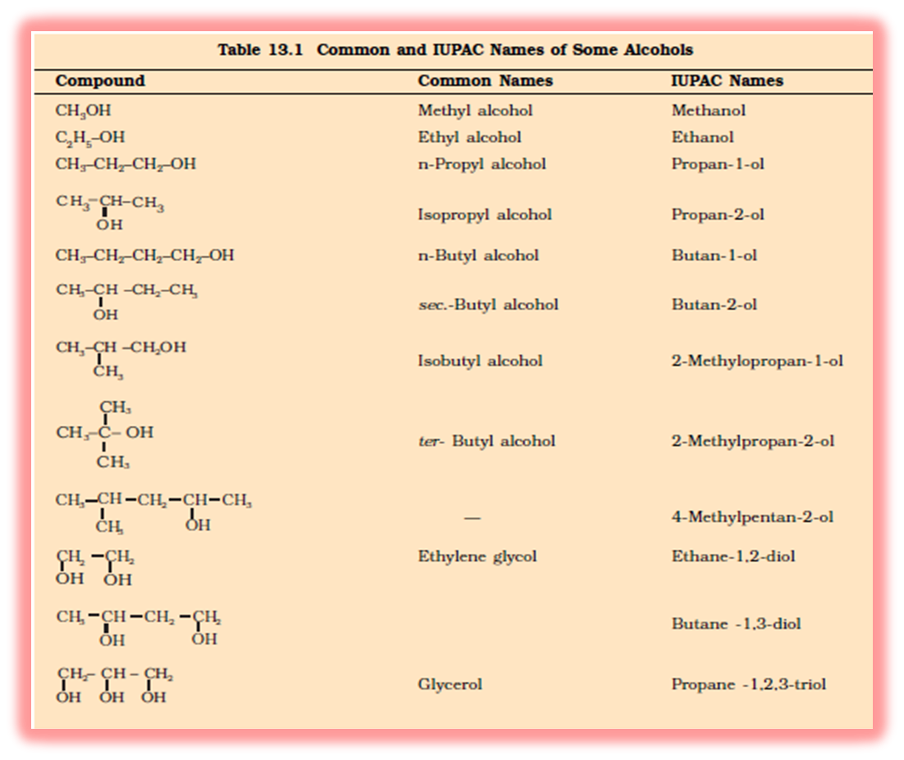
Common and IUPAC Names of Alcohols

Slide 13
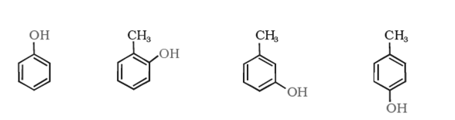
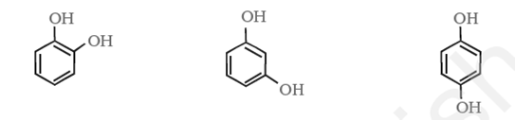
Nomenclature of Phenols
Phenol 2-Methyl 3-Methyl 4-Methyl
phenol phenol phenol
Dihydroxy derivatives of benzene are known as 1, 2-, 1, 3- and 1, 4-benzenediol.
IUPAC Benzene Benzene Benzene
name -1,2-diol -1,3-diol - 1,4-diol

Slide 14
Nomenclature of Ethers
IUPAC Name – Alkoxy alkane
Name of smaller alkyl
Name of bigger alkyl
CH₃CH₂ - O
- CH₂CH₂CH₃
1- Ethoxy
propane

Slide 15
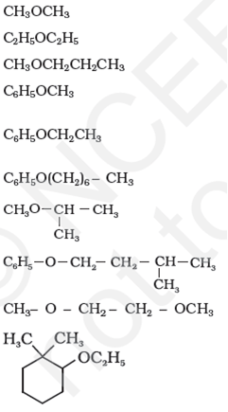
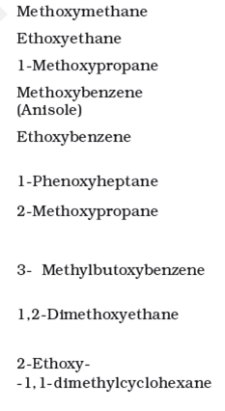
IUPAC Names of some Ethers

Slide 16



Learning Check:
Name the following compounds according to IUPAC system.
1.
2.
3.

Slide 17
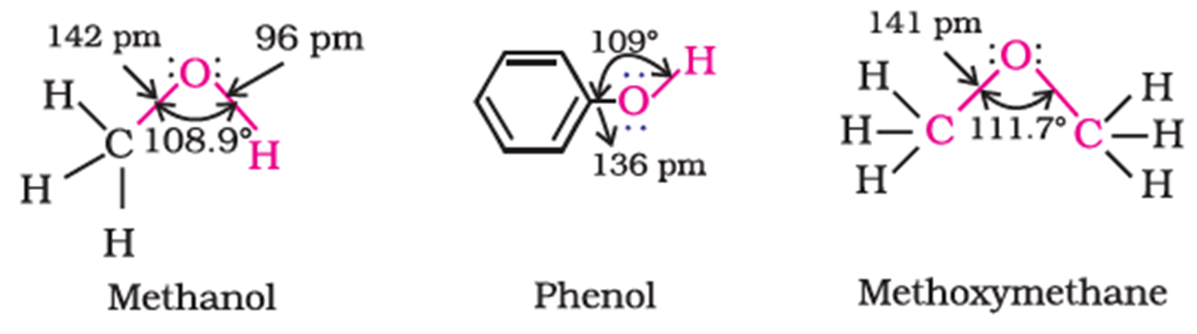
Structure of Alcohols ,Phenols and Ethers
Ether has larger bond angle due to repulsion between bulkier groups
Phenol has smaller bond length due to partial double bond character.

Slide 18
Preparation of Alcohols
From Alkenes
From Carbonyl Compounds

Slide 19
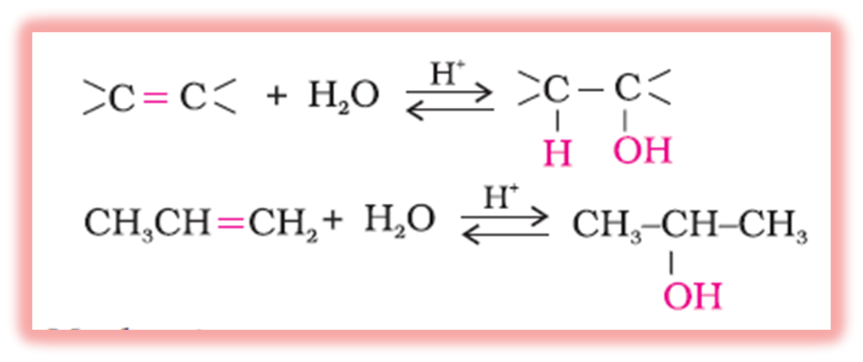
Preparation of Alcohol
1.From alkenes:
(i) By acid catalyzed hydration:

Slide 20
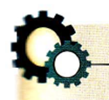



Mechanism
The mechanism of the reaction involves the following three steps:
Step 1: Protonation of alkene to form carbocation by electrophilic
attack of H₃O⁺.
H₂O + H⁺ → H₃O⁺
Step 2: Nucleophilic attack of water on carbocation.
Step 3: Deprotonation to form an alcohol.

Slide 21
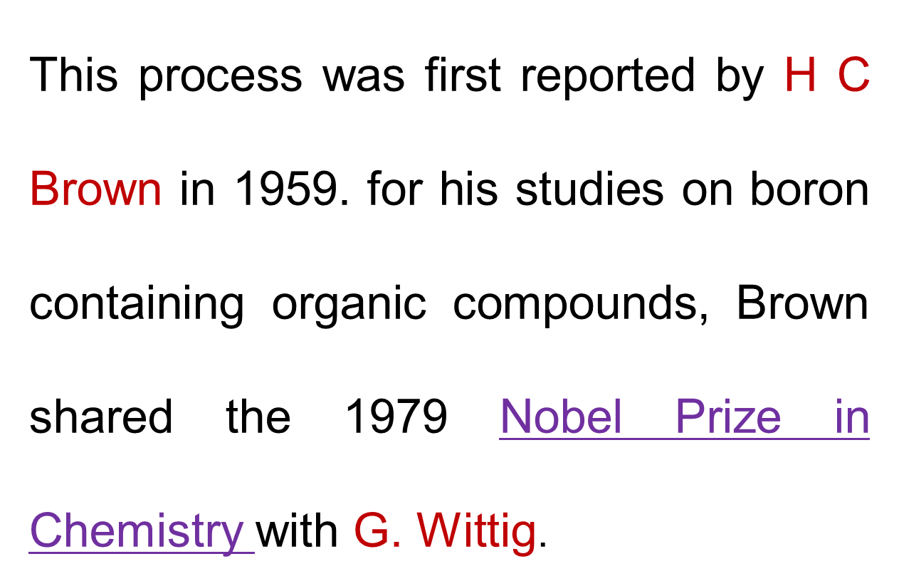
(ii) By hydroboration - oxidation

Slide 22
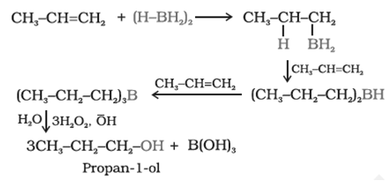
excellent yield of alcohol.
follows Markonikov’ rule to form Propan–1–ol which is different from hydration of alkene.

Slide 23
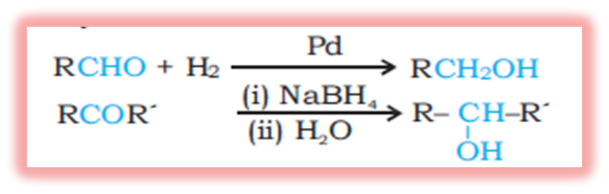
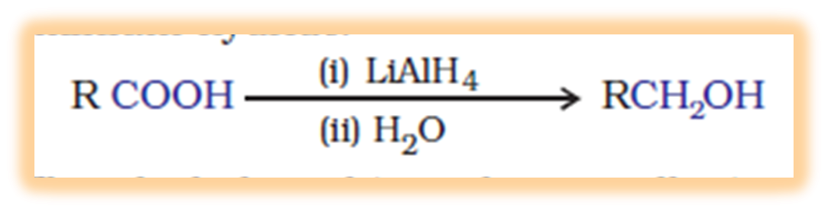
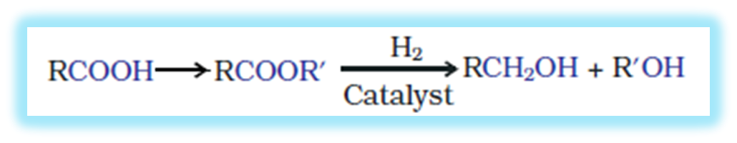
2.From Carbonyl Compounds
(i) By reduction of aldehydes and ketones
(ii) By reduction of carboxylic acids and esters:

Slide 25



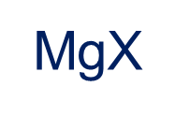


3.From Grignard reagents
Grignard reagents act as nucleophiles toward the carbonyl group to form alcohol in two steps
δ+
δ–
R
C
Diethyl
Ether
R
C
MgX
O
O
o
+
–
H₃O⁺
C
H

Slide 26
Reaction of Grignard reagent with Aldehydes and Ketones
H
OH
H₂O
RCH₂OH
Primary (1⁰)
Alcohol
+
RCH₂O MgX
Mg(OH)X
HCHO
Formaldehyde
OH
H₂O
H
+
Mg(OH)X
RCHO MgX
RCH(R))OH
Secondary (2⁰)
Alcohol
RMgX
Grignard reagent
RCHO
Aldehyde
R
RCOR
Ketone
R
OH
H
R₃COH
Tertiary (3⁰)
Alcohol
RCO MgX
Mg(OH)X
+
R

Slide 27
Preparation of Phenols
Phenol known as Carbolic Acid
Lets prepare Phenol from:
Haloarenes.
Benzene sulphonic acid (alkaline hydrolysis).
Hydrolysis of benzene diazonium salt.
Cumene.

Slide 28
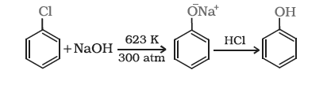
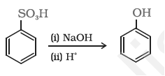
Preparation of Phenols
i) From Haloarenes:
ii) From Benzene sulphonic acid

Slide 29
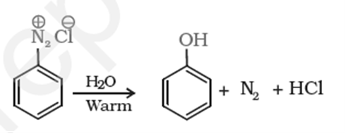
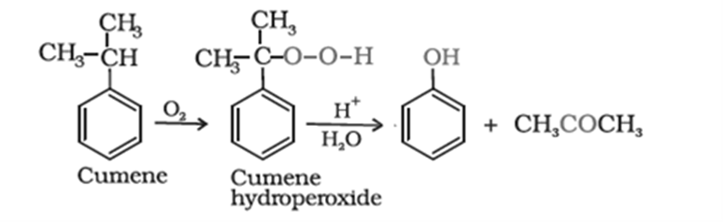
Preparation of Phenols
iii) From diazonium salt
iv) Industrial preparation
Most of the worldwide production of phenol is from cumene

Slide 30
Check your understanding:
1. The carbon – oxygen bond length (136 pm) in phenol is slightly less than that in methanol. Give reason.
2. How will you convert propene to propan-1-ol ?
3. How will you prepare phenol industrially?

Slide 31
Physical Properties of Alcohols &Phenols
Recall………
General observation:
# As molar mass increases, tendency towards solids increases.
# If molecule is polar, it will have more Melting Point and Boiling Point.
# As branching increases, Melting Point and Boiling Point decreases.
# As carbon number increases in chain, solubility decreases in water.

Slide 32
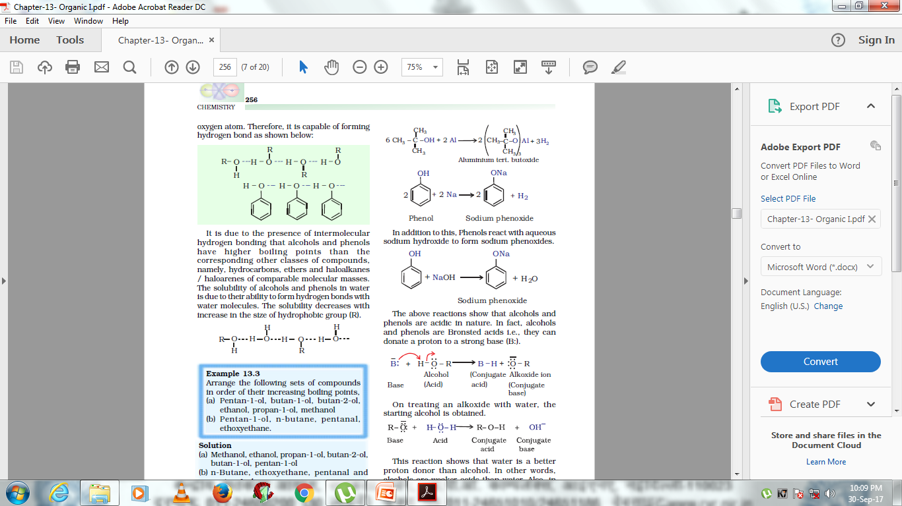
Physical Properties of Alcohols and Phenols
Melting Points and Boiling Points of alcohols and Phenols are higher in comparison to other classes of compounds like hydrocarbons, ethers, haloalkanes of comparable molecular mass due to the presence of Intermolecular hydrogen bonding.

Slide 33
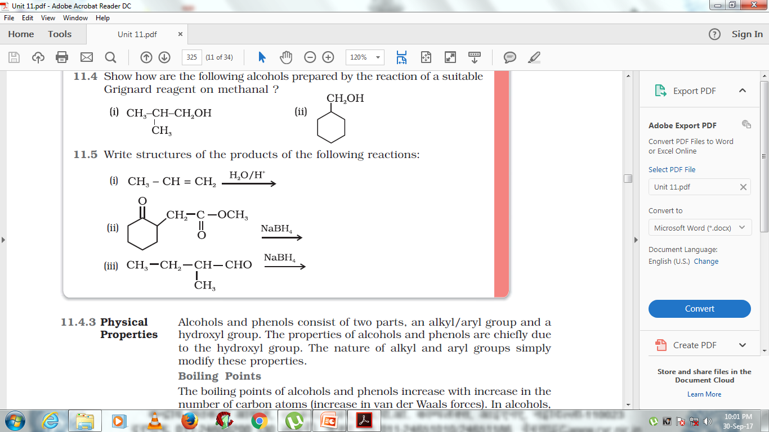
Test your Knowledge
1.Write product for following conversions:
2.Arrange the following compounds in the increasing order of boiling points and justify your answer.
i) Butan-1-ol,2-methylpropan-1-ol,2-methylpropan-2-ol

Slide 34
Let’s Recall
Formula of Alcohol – ROH,Phenol–ArOH & Ether R-O-R
Classification of alcohols , phenols and ethers.
IUPAC Nomenclature of alcohols, Phenols and Ethers
These have Bent shape.
Methods of preparation of alcohols and phenols
Mechanism of hydration of alkenes to form alcohol
Reaction of aldehydes and ketones with Grignard reagent to form alcohol.
Alcohols and Ethers are more soluble in water and have high boiling point due to the presence of more electronegative oxygen atom forming intermolecular Hydrogen bonding

