Slide 1
OUTLINE
Introduction
Structure of amine
Classification of amine
Nomenclature of amine
Method of Preparation of amines
Physical Properties of amines
Chemical properties of amines

Slide 2
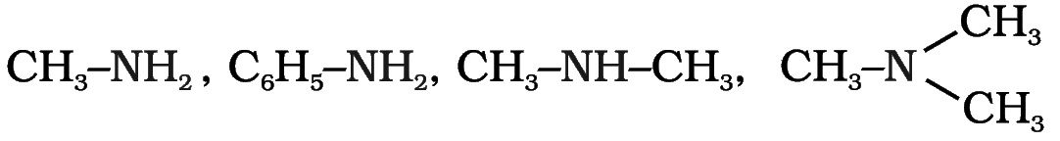
Amines
Amines are the derivatives of ammonia, obtained by replacement of one, two or all the three hydrogen atoms of ammonia by alkyl and/or aryl groups.

Slide 3
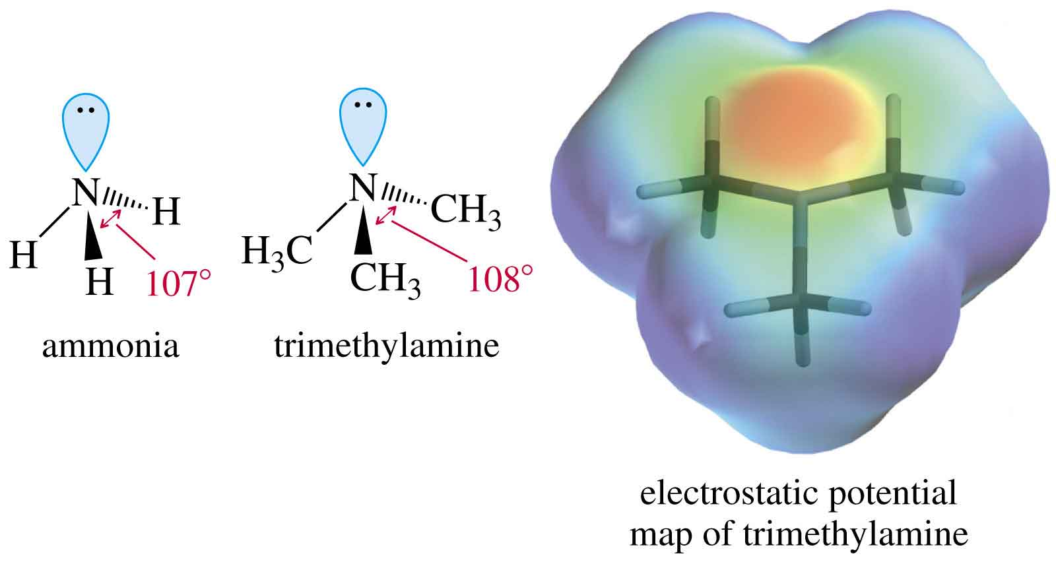
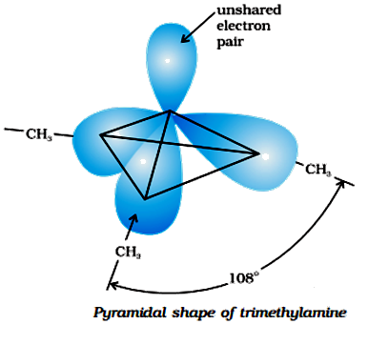
Structure of Amines
Nitrogen atom in amine is trivalent and carries an unshared pair of electrons.
Nitrogen orbitals in amines are sp³hybridised.

Slide 4
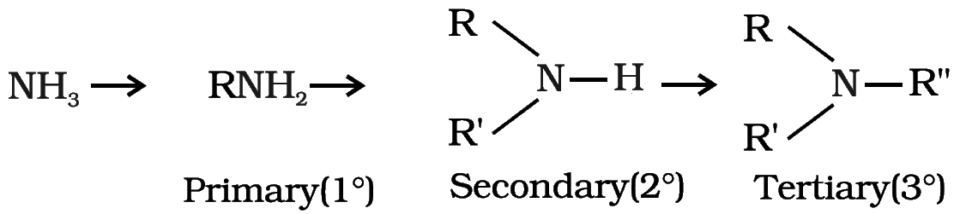
Classification of amines
Amines
Primary 1°,
Tertiary 3°
Secondary 2°

Slide 5
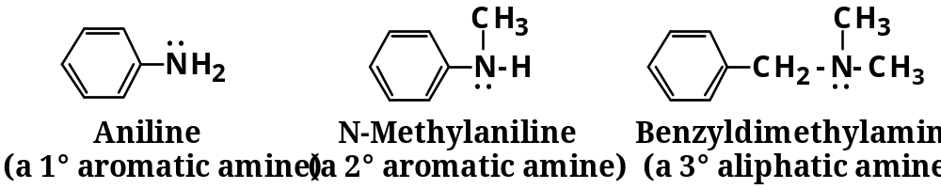
Classification of amines……..
  Aliphatic amine: An amine in which nitrogen is bonded only to alkyl groups.
  CH₃NH₂ C₂H₅NH₂
  Aromatic amine: An amine in which nitrogen is bonded to one or more aryl groups.

Slide 6
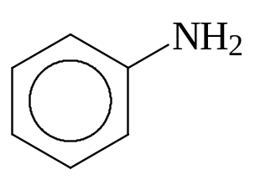
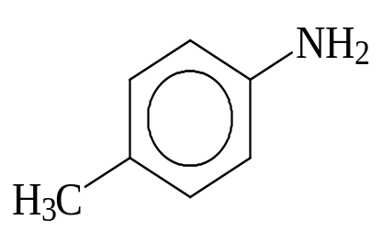
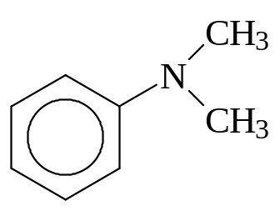
Aromatic Amines
Amino group is bonded to a benzene ring. Parent compound is called aniline.
aniline
4-methylaniline
N,N-dimethylaniline

Slide 7
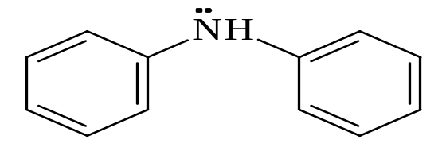
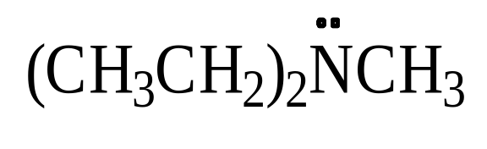
Nomenclature of amines
Common names
Name the alkyl or aryl groups bonded to nitrogen, then add suffix -amine.
CH₃NH₂ C ₂ H₅NH₂
Methylamine Ethylamine
Diphenylamine
Diethylmetylamine

Slide 8
Nomenclature
In IUPAC system, amines are named as alkanamines
Aliphatic amines: replace the suffix -e of the parent alkane by -amine.
CH₃NH₂ C ₂ H₅NH₂
Methnamine Ethanamine

Slide 9
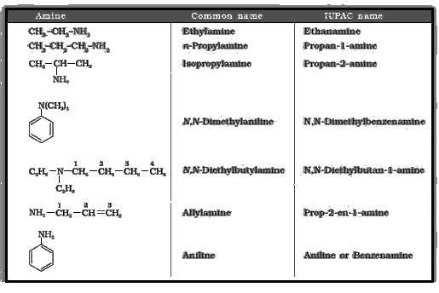
Common &IUPAC name of some alkylamines and arylamines

Slide 10
Methods of Preparation of Amines
By reduction of nitro compound
By ammonolysis of alkyl halides
By reduction of nitriles
By reduction of amides
By gabriel Phthalimide synthesis
By hoffmann brommide degradation reaction

Slide 11
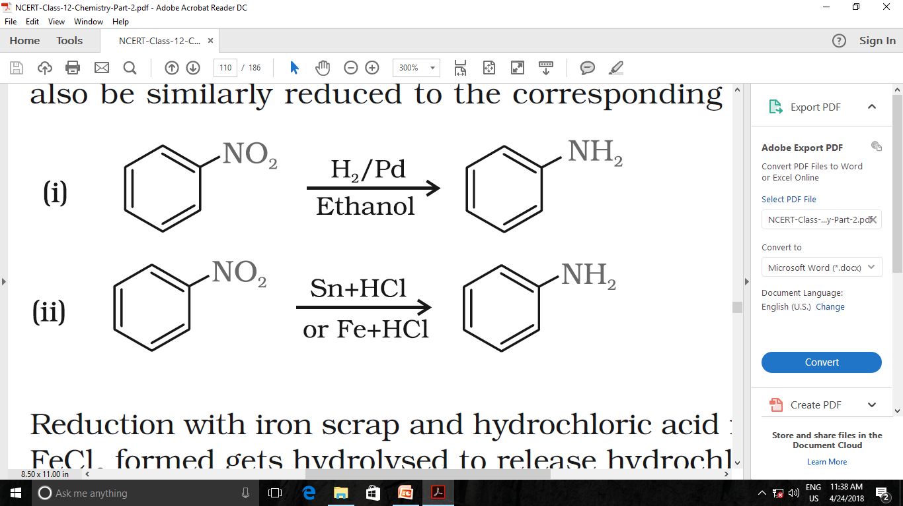
Methods of Preparation of Amines…..
By reduction of nitro compound

Slide 12
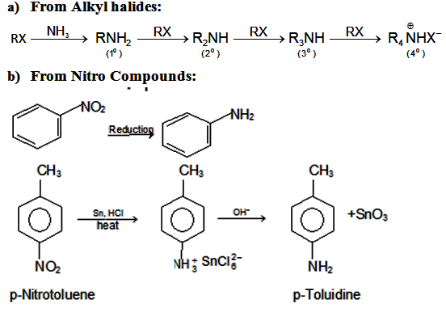
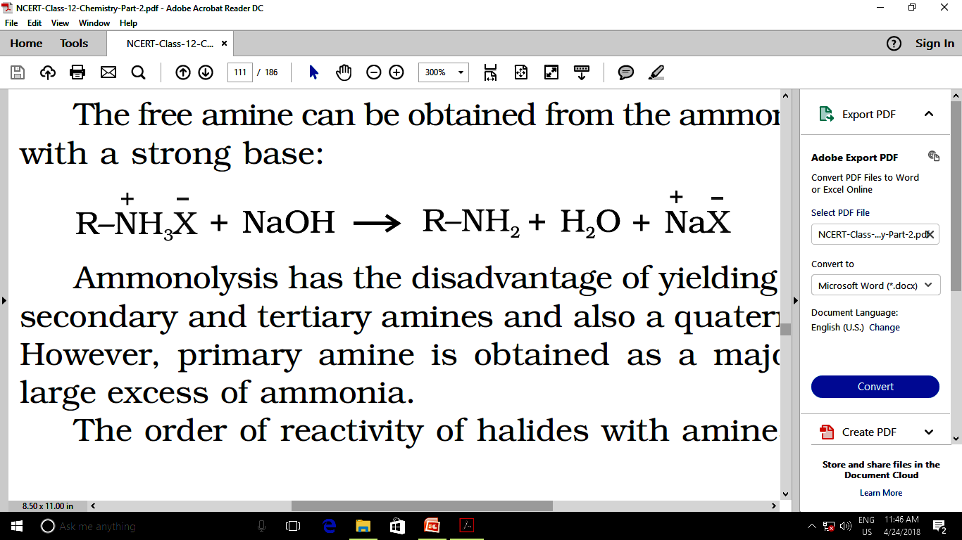
By ammonolysis of alkyl halides
Methods of Preparation of Amines…..
Ammonium salt

Slide 13

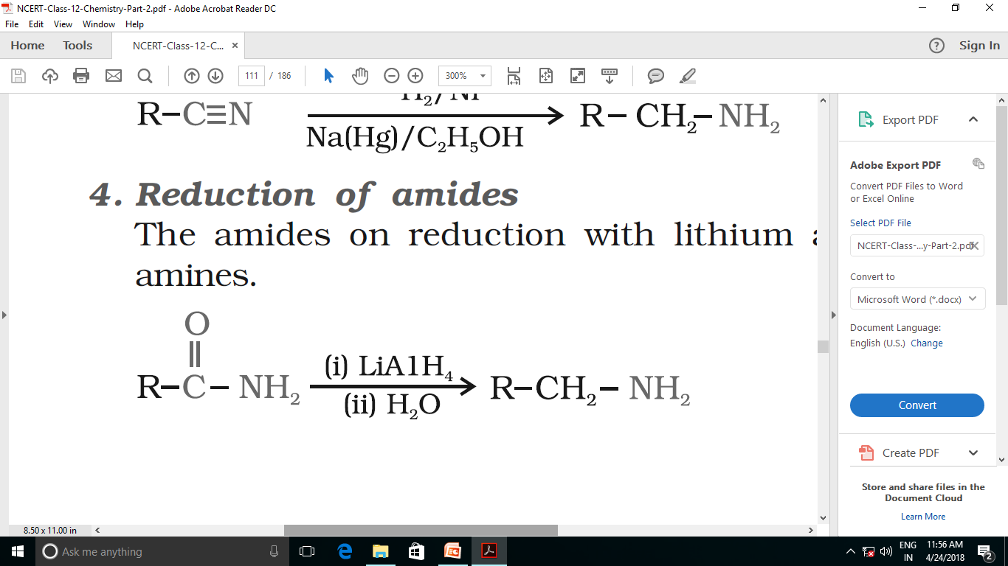
Methods of Preparation of Amines…..
By reduction of nitriles
By reduction of amides

Slide 14
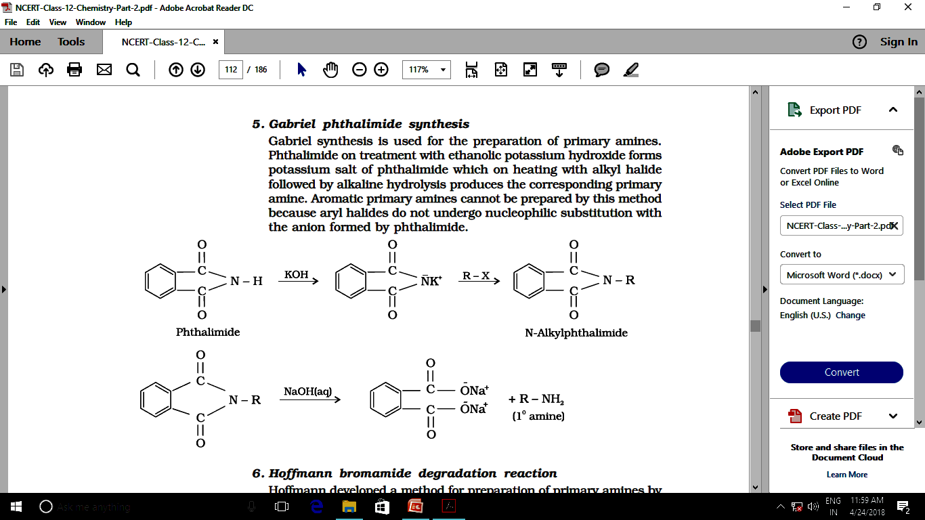
By gabriel phthalimide synthesis
Methods of Preparation of Amines…..
It only produces 1° amines. This method is not suitable for 1° arylamine because aryl halide does not give nucleophilic substitution reaction.

Slide 15
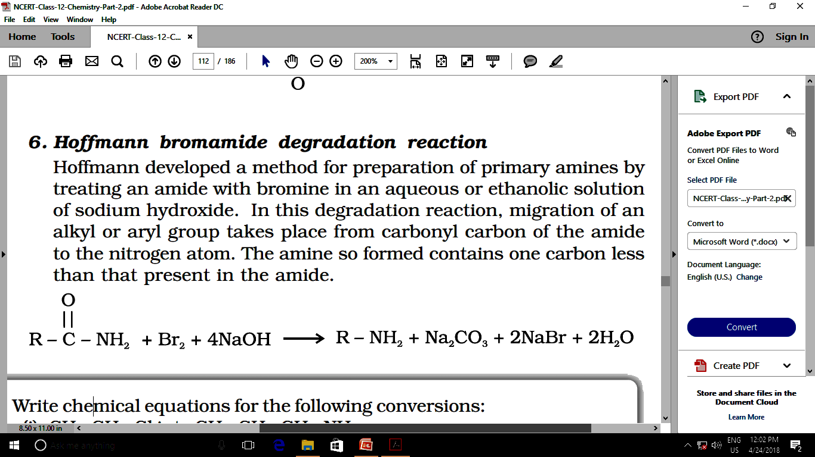
Hoffmann bromamide degradation reaction
Methods of Preparation of Amines…..
In Hofmann degradation reaction, the amine formed has one carbon less than the parent amide.

Slide 16
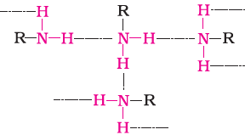
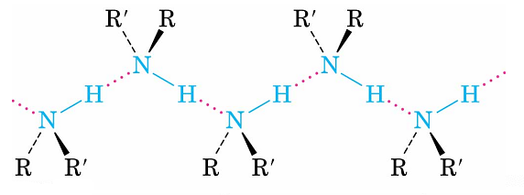
Physical Properties of Amines
  The lower aliphatic amines are gases with fishy smell
  Amines with fewer than five carbons are water-soluble
  Primary and secondary amines form hydrogen bonds,but not tertiary amines
  Therefore order of boiling points of isomeric amines is as follows: primary > secondary > tertiary

Slide 17
Chemical Reactions of Amines
Basicity of amines
Lone pair of electrons on nitrogen can accept a proton from an acid.
Alkyl amines are usually stronger bases than ammonia.
Increasing the number of alkyl groups decreases solvation of ion, but increases the availability of lone pair on nitrogen atom.

Slide 18
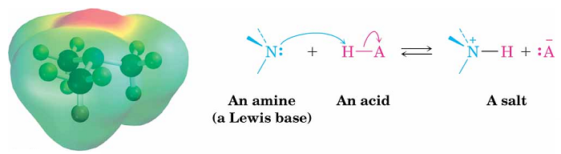
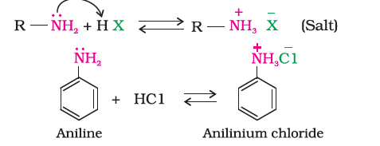
Basicity of Amines…….
Amines basic in nature react with acids to form salts.
.
.

Slide 19
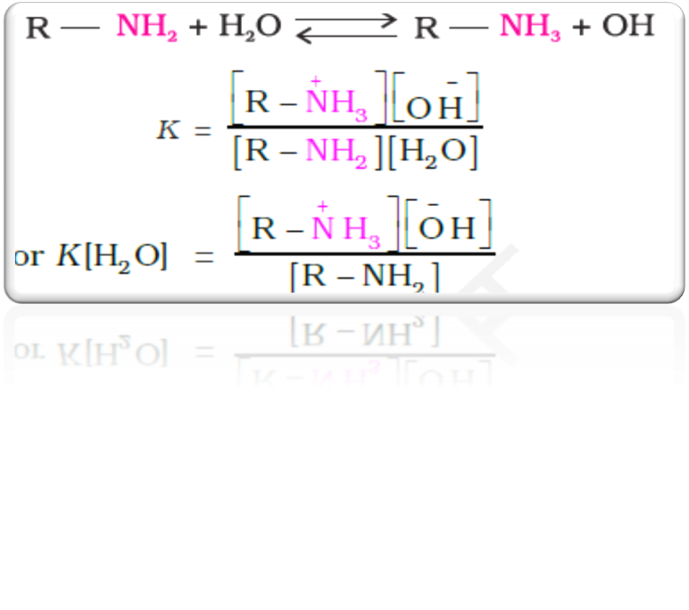
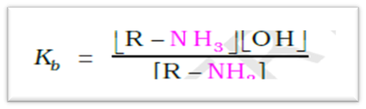
Basicity of Amines………
Basic character of amines can be better understood in terms of their Kb and pKb values
Larger the value of Kb or smaller the value of pKb, stronger is the base.

Slide 20
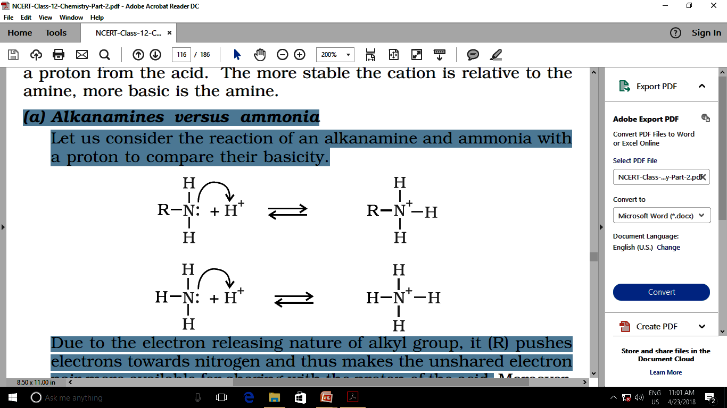
Basicity of Amines………
(a) Alkanamines verses ammonia
Due to the electron releasing nature of alkyl group, it (R) pushes electrons towards nitrogen and thus makes the unshared electron pair more available for sharing with the proton of the acid.

Slide 21
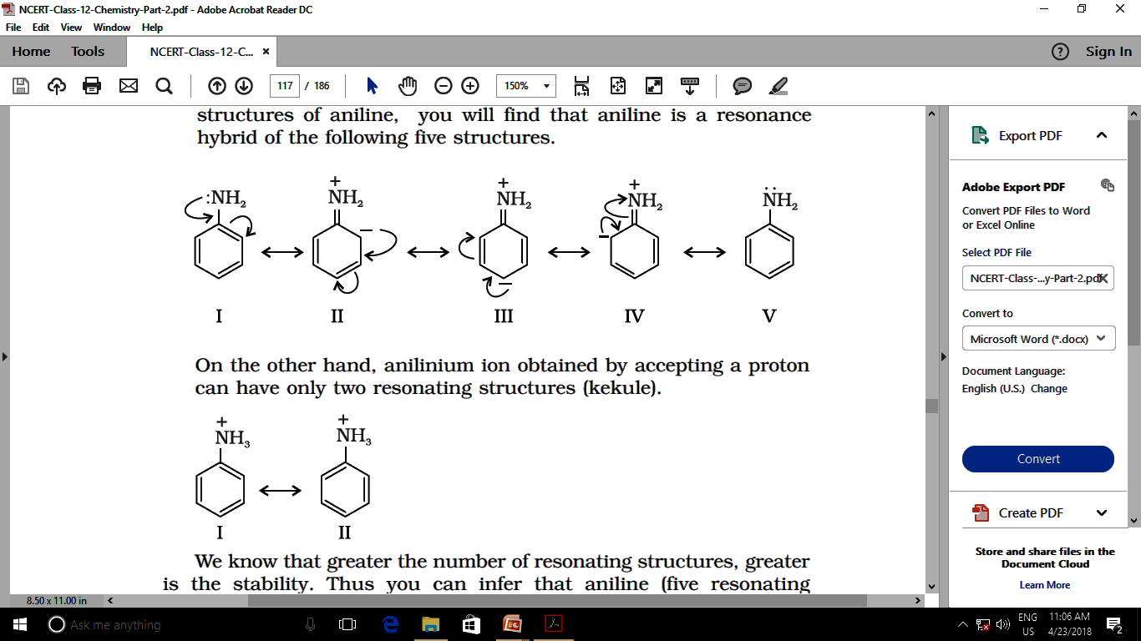
b) Arylamines verses ammonia
Basicity of Amines………
Arylamines such as aniline is weaker bases than ammonia. It is because in aniline or other arylamines due to resonance the lone pair of electrons are less available for protonation
On the other hand, anilinium ion obtained by accepting a proton can have only two resonating structures
Greater the number of resonating structures, greater is the stability hence it is less basic than ammonia

Slide 22
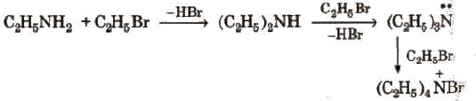
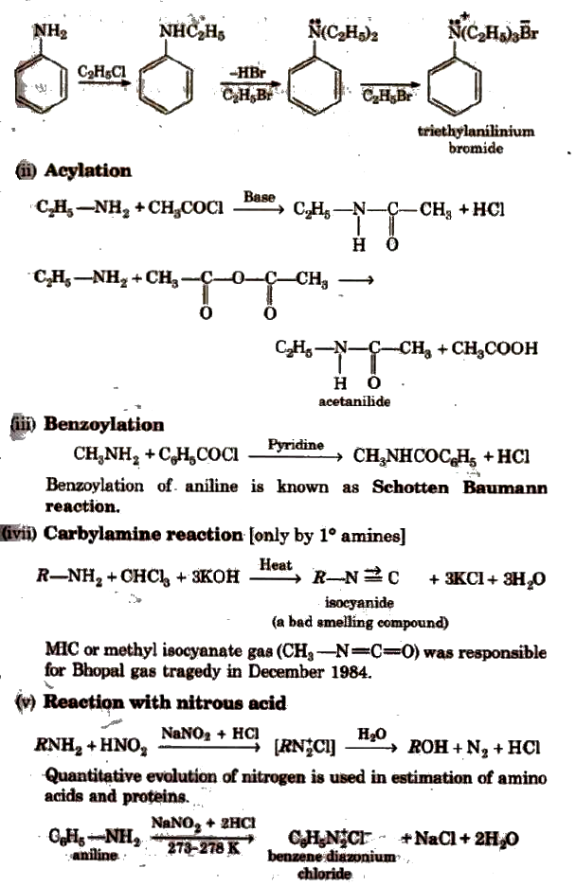
(ii) Alkylation
All the three types of amines react with alkyl halides to form quaternary ammonium salt as the final product provided alkyl halide is present in excess.
Aromatic amines also undergo alkylation as given below.

Slide 23
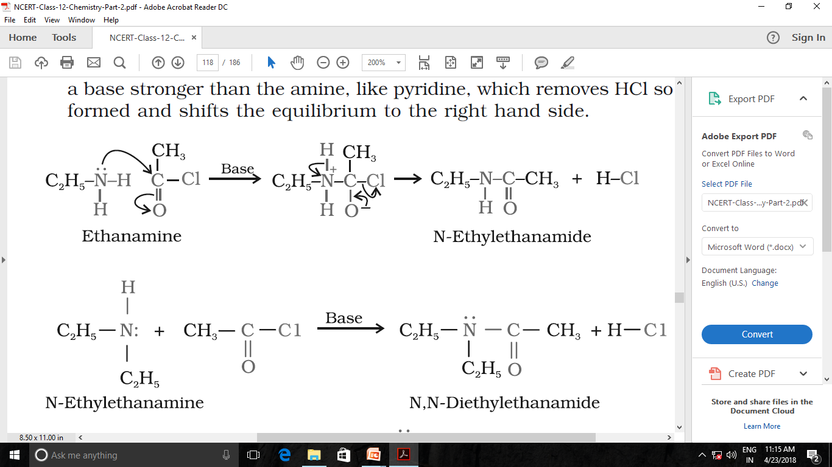
(iii)Acylation
Aliphatic and aromatic primary and secondary amines reacts with acid chlorides, anhydrides and esters by nucleophilic substitution reaction.

Slide 24
This reaction is given only by primary aliphatic or primary aromatic amines
(iv) Carbylamine Reaction
C₂H₅NH₂ + CHCl₃ + 3KOH → C₂H₅NC + 3KCl + 3H₂O
C₆H₅ NH₂ + CHCl₃ + 3KOH → C₆H₅NC + 3KCl + 3H₂O

Slide 25
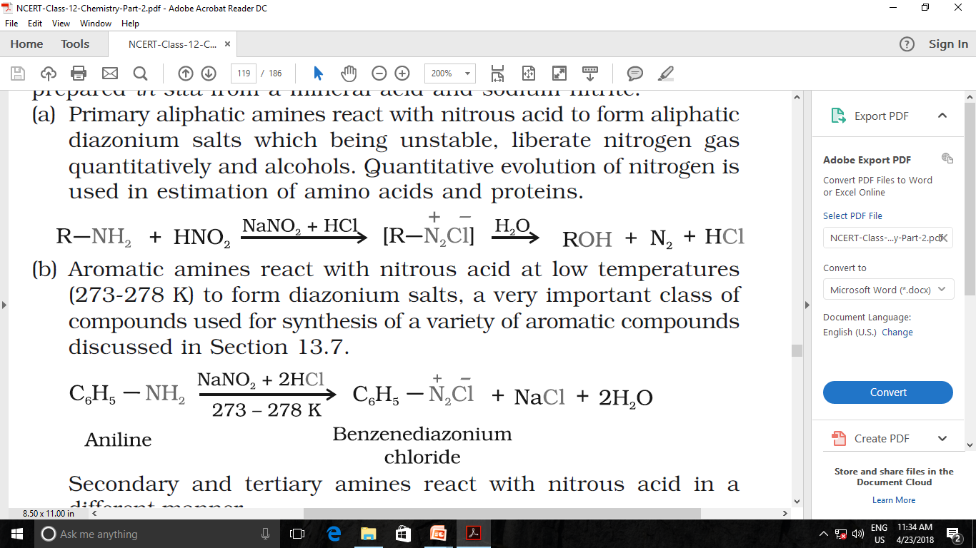
Reaction with nitrous acid
Secondary and tertiary amines react with nitrous acid in different manner. Methyl amine give dimethyl ether with HNO₂.

Slide 26
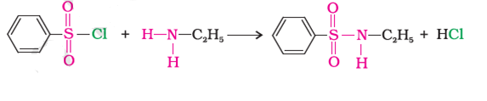
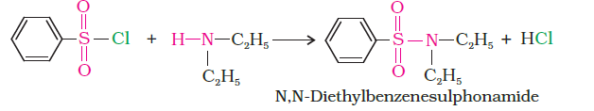
(vi)Reaction with benzensulphonyl chloride [Hinsberg reagent]
The reaction of benzenesulphonyl chloride with primary amine yield N-ethyl benzenesulphonyl amide.
Tertiary amines does not react with benzenesulphonyl chloride.

Slide 27
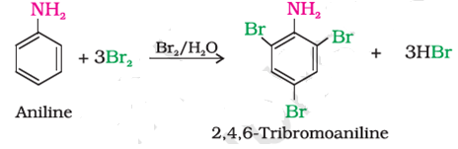
(vii)Electrophilic substitution reactions
Aniline is ortho and para directing towards electrophilic substitution reactions
Bromination:
Amines react with bromine water and form yellow precipitate of 2,4,6 -tri bromoaniline

Slide 28
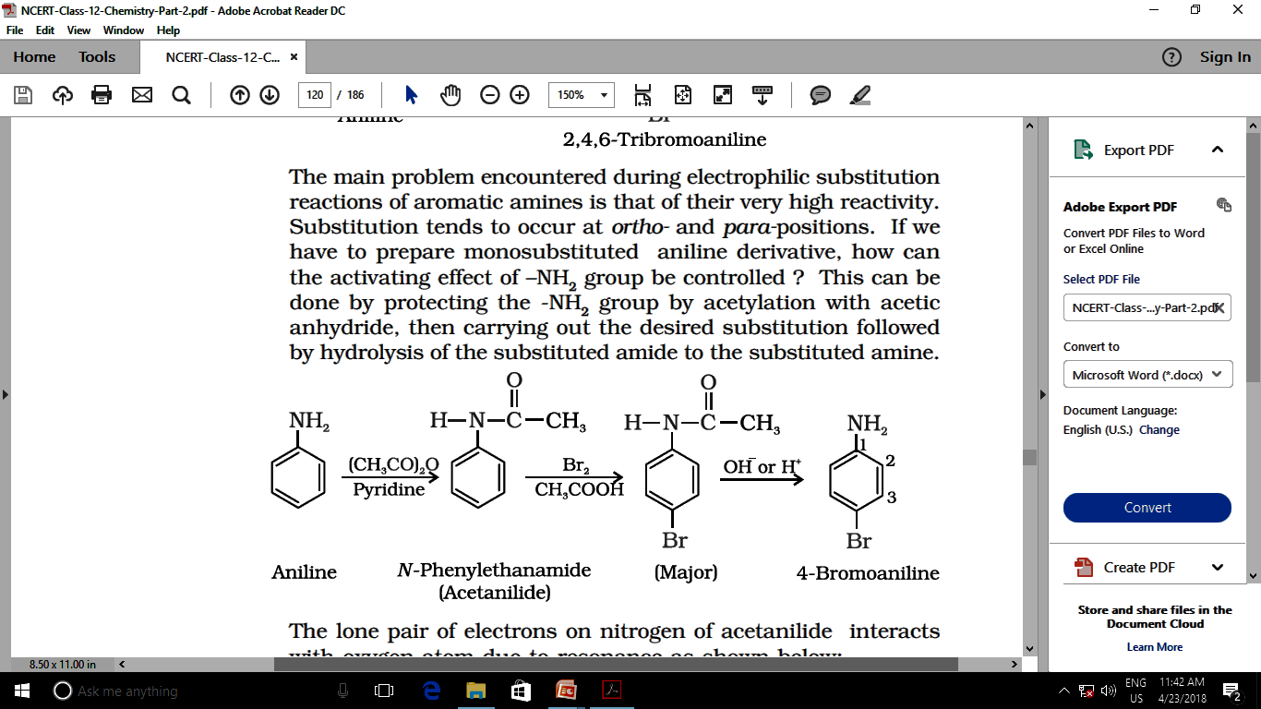
Bromination……

Slide 29
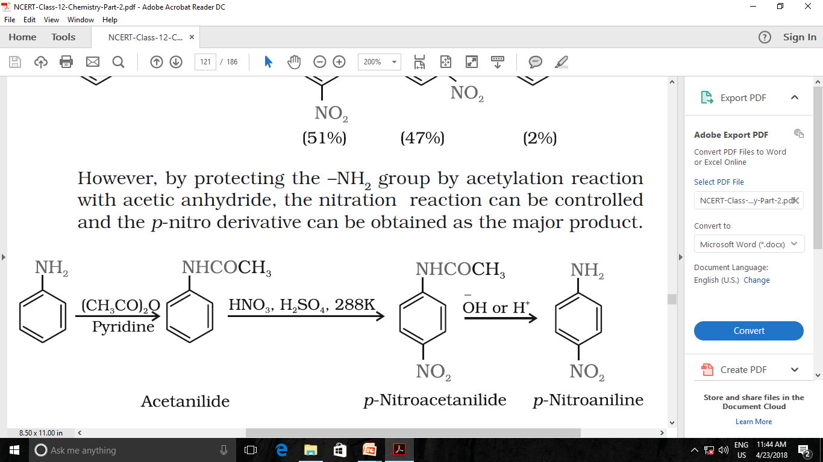
Nitration :
Nitration of aniline is not possible as it is susceptible to oxidation, thus amino group is first protected by acetylation.

Slide 30
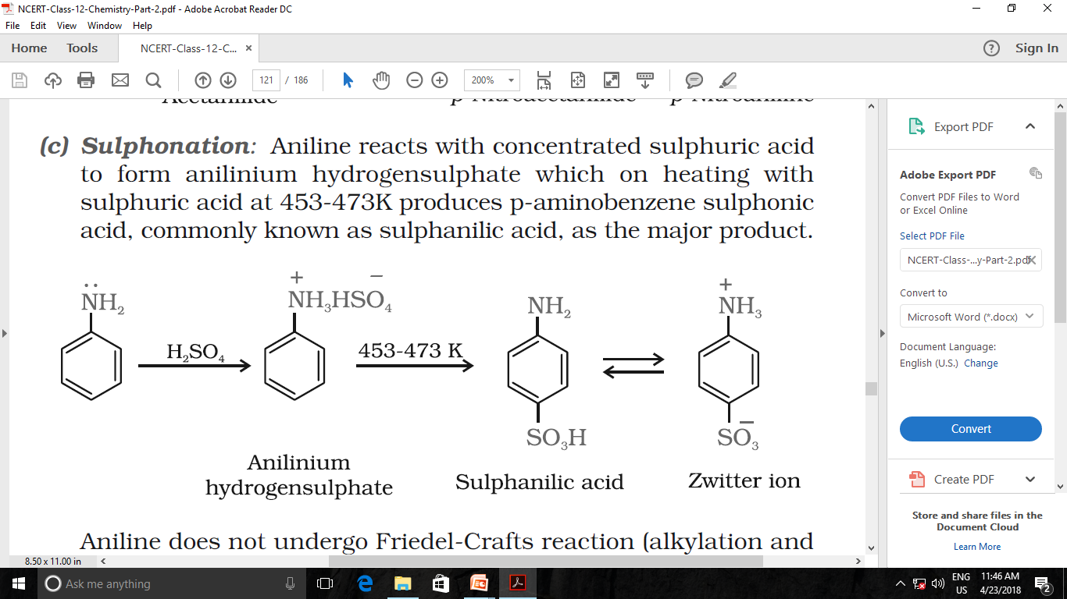
Sulphonation :
On sulphonation, aniline gives sulphanilic acid

Slide 31
Summary
Structure
Classification
Nomenclature
Methods of preparation of amines
Physical and chemical properties of amines.
R O PUNE

Slide 32
HOME WORK
1.Writes short notes on the following
(i) Carbylamine reaction
(ii) Hoffman bromamide reaction
(iii) Gabriel phthalimide synthesis.
2. Aniline is less basic than ammonia.Why?
3. How will you convert aniline in to p-bromo aniline

Slide 33
Thanks

