Slide 1
SOLUTIONS
Solution is a homogeneous mixture of two or more substances.
In binary solution the part which is present in larger amount is called solvent and the part which is present in lesser amount is called solute.

Slide 2
TYPES OF SOLUTION
SOLID SOLUTION ( Solid is the solvent) 1.gas in solid
2. liquid in solid
3. gas in solid
LIQUID SOLUTION ( Liquid is the solvent)1. gas in liquid
2 . liquid in liquid
3. solid in liquid
GASEOUS SOLUTION(Gas is the solvent)1. gas in gas
2. liquid in gas
3. Solid in gas

Slide 3
TYPES OF SOLUTIONS
Gaseous solutions Liquid solutions Solid solutions
Gas in Gas Gas in Liquid Gas in solid
Liquid in Gas liquid in liquid Liquid in solid
Solid in Gas Solid in Liquid Solid in solid

Slide 4
Examples
Gaseous solutions
Gas in Gas- Air ( oxygen in nitrogen)
Liquid in Gas ( Chloroform in nitrogen)
Solid in gas ( Camphor in nitrogen)
Liquid Solutions
Gas in liquid (Oxygen in water )
Liquid in liquid ( ethanol in water )
Solid in liquid (glucose in water )
Solid solutions
Gas in solid ( Hydrogen in Palladium)
liquid in solid ( Mercuy in sodium)
solid in solid ( copper in gold)

Slide 5
WAYS OF EXPRESSING CONCENTRATIONS
( TEMPERATURE DEPENDANT) (TEMPERATURE INDEPENDENT)
VOLUME PERCENTAGE MASS PERCENTAGE
MASS BY VOLUME PERCENTAGE MOLE FRACTION
MOLARITY MOLALITY
NORMALITY ppm ( parts per million)

Slide 6
MASS PERCENTAGE (W/W)
Mass % = Mass of the component in the solution
----------------------------------------------------- X 100
Total mass of the solution
Mass percentage is the weight of the solute present per 100 units of the solution.
Eg: 10% glucose in water means 10 g of glucose in 90 g of water

Slide 7
VOLUME PERCENTAGE (v/v)
volume of the component
Volume % = -------------------------------------- X 100
Total volume of solution
Eg : 10% ethanol solution in water means
ie 10 mL of ethanol is dissolved in 90 mL of water

Slide 8
MASS BY VOLUME PERCENTAGE (w/v)
Mass of the solute
Mass /volume % = ----------------------------- X 100
total volume of the solution
Eg : 23% w/v glucose solution means 23 g of glucose dissolved in 100 mL of water.
This unit is used in medicine and pharmacy
Parts per million(ppm)
Number of parts of the component
ppm = ------------------------------------------------------------------------------ X 10⁶
Total number of parts of all components in the solution

Slide 9
Mole fraction ( χ)
Number of moles of the component
Molefraction of a component = ---------------------------------------------------
total number of moles of all the components
_{ȠA}
molefraction of A , XA =--------------------------
ȠA +ȠB
ȠB
molefraction of B, XB = -------------------------
ȠA + ȠB
XA + XB = 1

Slide 10
MOLARITY(M)
It is defined as the number of moles of a solute dissolved in one litre of the solution
number of moles of solute
M = -------------------------------------------------------
Total volume of the solution in litre
Mass of the solute x 1000
= ------------------------------------
Molar mass the solute x Volume of the solution in mL

Slide 11
MOLALITY (m) :
It is defined as the number of moles of solute present in 1 Kg of the solvent
Moles of solute
Molality =--------------------------------
Mass of solvent in Kg
Mass of the solute x 1000
= ---------------------------------------------------
Molar mass of solute X Mass of solvent in g

Slide 12
SOLUBILITY
solubility of a substance is its maximum amount that can be dissolved in a specific amount of solvent at a specified temperature.
It depends on * nature of solute and solvent
* temperature
* Pressure
Polar solutes dissolve in polar solvents and nonpolar solutes dissolve in nonpolar solutes.

Slide 13
solute + solvent =solution
If the dissolution process is endothermic(Δ_{sol}H>0 ) , the solubility should increase with rise in temperature.
If the dissolution process is exothermic ( Δ_{sol}H < 0) , the solubility should decrease
Pressure does not have any significant effect on solubility of solids in liquids.

Slide 14
Henry’s law
Henrys law states that at a constant temperature,the solubility of a gas in a iquid is directly proportional to the pressure of the gas.
or
The law states that the partial pressure of the gas in vapour phase(p) is proportional to the molefraction of the gas (x)in the solution.
p= K_{H} X
where K_{H} is the Henrys law constant.
Higher the value of K_{H} at a given pressure, the lower is the solubility of the gas in the liquid.

Slide 15
Henrys law Graphical Representation
P = K_{H} X
SLOPE = K_{H}
PARTIAL PRESSURE
OF GAS
MOLE FRACTION OF GAS IN SOLUTION

Slide 16
APPLICATIONS OF HENRY’S LAW
Soft drinks :To increase the solubility of CO₂ in soft drinks and soda water ,the bottle is sealed under high pressure.
Bends in scuba divers:
3. Anoxia : Low oxygen concentration in the bood of mountainers or people living in high altitude

Slide 17
RAOULTS LAW FOR VOLATILE COMPONENT
Raoults law states that for a solution of volatile liquids,the partial pressure of each component in the solution is directly proportional to its mole fraction.
p_{A} = p_{A}⁰ x_{A} where p_{A}⁰ is the vapour pressure of pure component A
p_{B} = p_{B}⁰ x_{B} where p_{B}⁰ is the vapour pressure of pure componentB
P _{total} = p_{A} + p_{B}
= p⁰_{A} +(p⁰_{B} –p⁰_{A}) x_{B}

Slide 18
RAOULTS LAW FOR NON-VOLATILE COMPONENT
If the component B ( solute ) is non volatile, it cannot give any contribution to the total pressure of the solution
Then P_{total} = p_{A} + p_{B}
P_{solution} = p_{A} + 0
= p⁰_{A}(1-x_{B})
Δp/p⁰_{A} = x_{B}
ie For non-volatile solute Raoults law states that the relative lowering of vapour pressure is equal to mole fraction of the solute

Slide 19
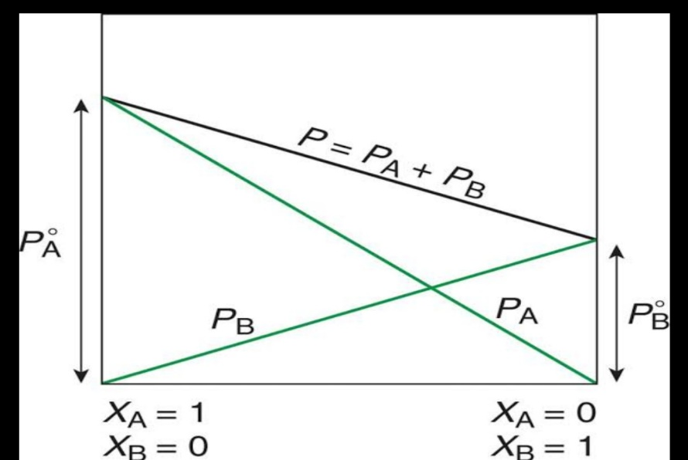
IDEAL SOUTION
solutions which obey Raoults law
ΔV _{mixing} =0
ΔH _{mixing} =0
Here F_{A-A} or F_{B-B} = F_{A-B}
eg: (a) solution of n-hexane and n-heptane
(b) solution of bromoethane and chloroethane
( c ) solution of benzene and toluene

Slide 20
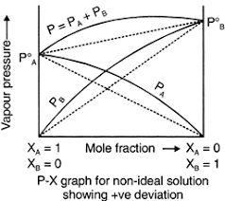
(NON-IDEAL SOLUTION)
SOLUTIONS SHOWING POSITIVE DEVIATION
Do not obey Raouts law
ΔV mixing >0
ΔHmixing > 0
Eg : mixture of cyclohexane and ethanol

Slide 21
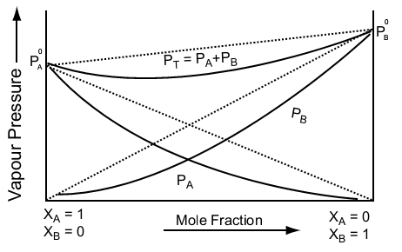
(NON-IDEAL SOLUTIONS)
SOLUTIONS SHOWING NEGATIVE DEVIATIONS
Do not obey Raoults law
ΔV mixing <0
ΔH mixing < 0
Eg : mixture of Acetone and chloroform

Slide 22
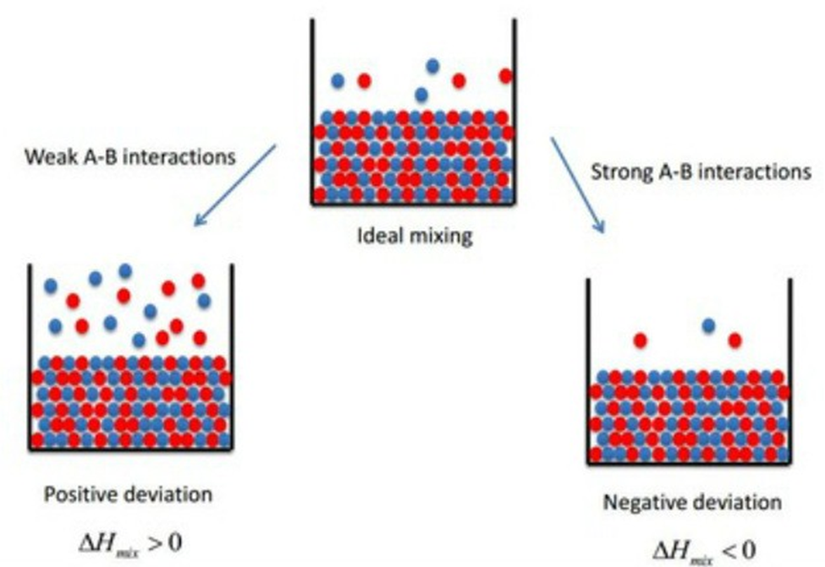

Slide 23
Colligative properties
The properties which depends on the number of solute particles not on the nature.
(1) Relative lowering of vapour pressure of the solvent (ΔP/P₀)
(2 ) Elevation of boiling point of the solvent (ΔT_{b})
(3) Depression of freezing point of the solvent (ΔT_{f})
(4)Osmotic pressure of the solution (π)

Slide 24
RELATIVE LOWERING OF VAPOUR PRESSURE:
when a non-volatile solute is added to a solvent its vapour pressure is decreased.This is called lowering of vapour pressure.
relative lowering of vp, ΔP
( ------) = X_{B}
P⁰_{A}
ΔP = P⁰_{A} x X_{B}
ΔP α X_{B}

Slide 26
Relation between lowering of vapour pressure and molar mass
According to Raoults law relative lowering of vapour pressure = molefraction of the solute
ΔP
------ = X_{B ,} X_{B} is the molefraction of the solute
P⁰_{A}
substituting molality in the above equation
ΔP W_{B} x M_{A}
------ = ------------------
P⁰_{A} M_{B} x W_{A}

Slide 27
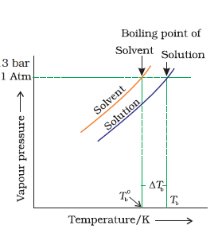
(Colligative Proerty)
2.Elevation of Boiling Point (ΔTb):Then the difference between the boiling points of the pure solvent and that of the solution is called elevation of boiling point (ΔTb).
ΔT_{b}=T_{b} - T_{b}⁰
ΔT_{b} α molality
ΔT_{b} = K_{b} x molality,
where K_{b} molal elevation constant
or Ebullioscopic constant

Slide 28
Relation between Elevation of Boiling point and Molar mass of solute
ΔT_{b} = K_{b} x molality
K_{b} x W_{B}x1000
ΔT_{b} =---------------------- W_{A}- mass of solvent
M_{B} x W_{A} W_{B}- mass of solute
M_{B}- molar mass of solute
1000 K_{b} x W_{B} ΔT_{b}-elevation of boiling point
M_{B}=----------------------
ΔT_{b} x W_{A}

Slide 29
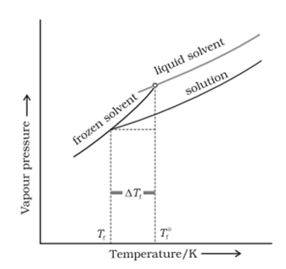
(colligative Property)
Depression of Freezing Point ( ΔT_{f})
.
.
ie ΔT_{f} α molality
ΔT_{f} = K_{f} x molality, or cryoscopic constant
Molal depression constant is the depression in depression in FP when molality is
unity

Slide 30
Relation between Depression of Freezing Point and molar mass of the solute
ΔT_{f} = K_{f} x m ,
W_{B}x 1000
But molality m=-------------
M_{B} X W_{A}
W_{B} x 1000
ΔTf= K_{f} x --------------
M_{B} x W_{A}
1000 K_{f} W_{B}
M_{B} = -----------------
ΔT_{f} W_{A}

Slide 31
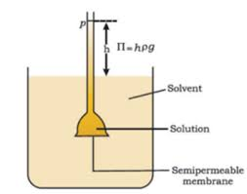
4. Osmotic pressure
Osmosis: If a solvent and solution are separated by a semipermeable membrane ,the solvent molecules will flow through the membrane from pure solvent to solution. This process of flow of solvent is called osmosis.
The excess pressure required to just prevent osmosis is called osmotic pressure.

Slide 32
Molar mass and Osmotic Pressure
π α C α T
n_{B}
π = ---- x RT w_{B}
V But n_{B} = -----
M_{B}
w_{B} x R xT
M_{B} = ---------------
π V

Slide 33
Isotonic Solutions
Two solutions having same osmotic pressure at a given temperature are called isotonic solutions.
π₁ = π₂
w₁ w₂
------ = --------
M₁ M₂
Between two solutions one having higher osmotic pressure is called hypertonic solution and that having lower osmotic pressure is called hypotonic solution.

Slide 34
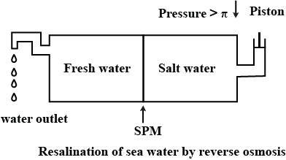
Reverse Osmosis and Water Purification
The direction of osmosis can be reversed if a pressure larger than the osmotic pressure is applied to the solution side . This phenomenon is called reverse osmosis.
Reverse osmosis is used in desalination of sea water.

Slide 35
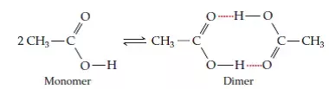
Abnormal Molar Masses
When we determine the molar mass of certain substances by colligative property methods, it will be higher or lower than the actual value.This is called abnormal molar mass.
It is due to (i) association or (ii) dissociation
If association take place the molar mass increases.
eg : Acetic acid undergoes dimerization in benzene.So molar mass will be 120 instead of 60.
(ii) If dissociation take place molar mass decreases
eg: KCl in water
KCl ----→ K⁺ + Cl⁻

Slide 36
Van’t Hoff factor (i)
Normal molar mass
i= ------------------------------
Abnormal molar mass
Observed colligative property
= -----------------------------------------------
Calculated colligative property
If I = 1 neither association nor dissociation.
If I > 1, dissociation
If I < 1 , association

Slide 37
Inclusion of van’t Hoff factor modifies the equations
P_{A}⁰-p_{s} n_{B}
Lowering of VP ---------- = i ----
p_{A}⁰ n_{A}
Elevation of Boiling point , Δ T_{b} = i K_{b} m
Depression of Freezing point Δ T_{f} = iK_{f} m
i n_{B}RT
Osmotic pressure of solution, π = --------
V

