Slide 1
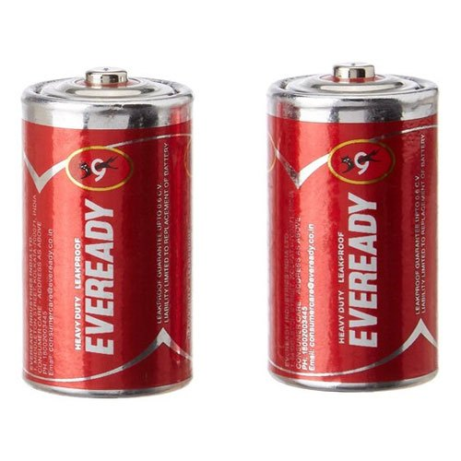
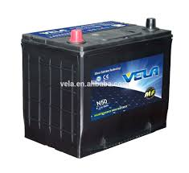

Why Study Electrochemistry?
It is important because
Many of devices that we
use every day that are
battery powered.
A big problem called corrosion
is an electrochemical phenomenon.
Many chemicals and elements
such as Cl₂, NaOH, Al etc.
are produced electrolytically.

Slide 2
DEFINITION
It is the study of the inter-conversion between chemical energy and electrical energy.

Slide 3
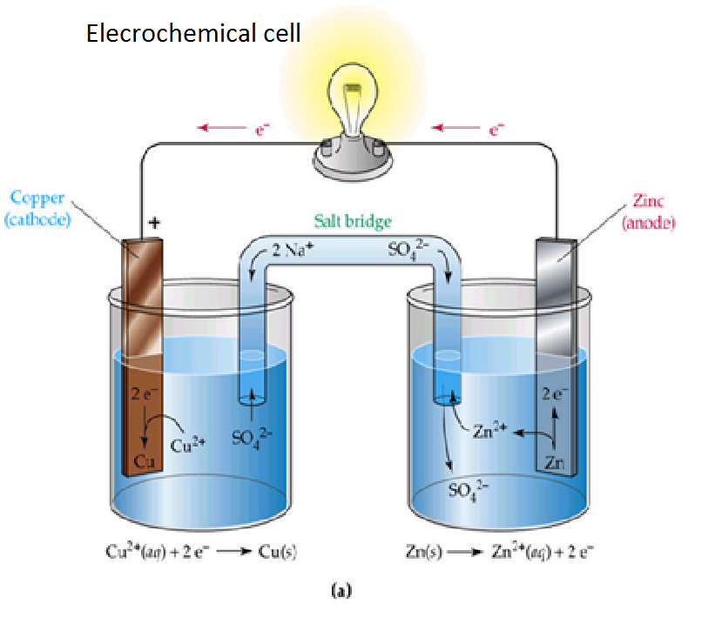
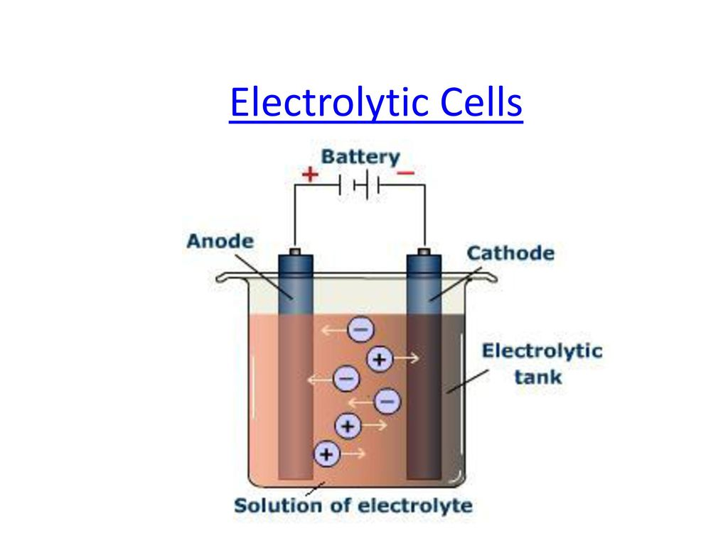
ELECTROCHEMICAL CELLS
GALVANIC CELL
What is an Electrochemical Cell?
An electrochemical cell is a device that can generate electrical energy from the chemical reactions occurring in it, or use the electrical energy supplied to it to facilitate chemical reactions in it. These devices are capable of converting chemical energy into electrical energy, or vice versa.
Such cells capable of generating an electric current from the chemical reactions occurring in them care called Galvanic cells or Voltaic cells. Alternatively, the cells which cause chemical reactions to occur in them when an electric current is passed through them are called electrolytic cells.

Slide 4
ELECTRO CHEMICAL CELLS A COMPARISON
GALVANIC CELL | ELECTROLYTIC CELL
Chemical energy is transformed into electrical energy in these electrochemical cells. | Electrical energy is transformed into chemical energy in these cells.
The redox reactions that take place in these cells are spontaneous in nature. | An input of energy is required for the redox reactions to proceed in these cells, i.e. the reactions are non-spontaneous.
In these electrochemical cells, the anode is negatively charged and the cathode is positively charged. | These cells feature a positively charged anode and a negatively charged cathode.
The electrons originate from the species that undergoes oxidation. | Electrons originate from an external source (such as a battery).

Slide 5
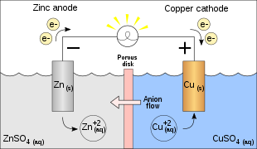
DANIEL CELL
In Daniel’s cell, copper ions are reduced at the cathode while zinc is oxidized at the anode.
Reactions of Daniel cell at cathode and anode are:
At cathode: Cu ²⁺ + 2e– → Cu
At anode: Zn → Zn²⁺ + 2e–

Slide 6
ELECTRODE POTENTIAL
Following two changes occur when a metal rod is dipped in its salt solution,
(a) Oxidation: Metal ions pass from the electrode into solution leaving an excess of electrons and thus a negative charge on the electrode.
The conversion of metal atoms into metal ions by the attractive force of polar water molecules.
M → M^{n} + ne⁻
(b) Reduction: Metal ions in solution gain electrons from the electrode leaving a positive charge on the electrode. Metal ions start depositing on the metal surface leading to a positive charge on the metal.
M^{n+} + ne⁻ → M

Slide 7
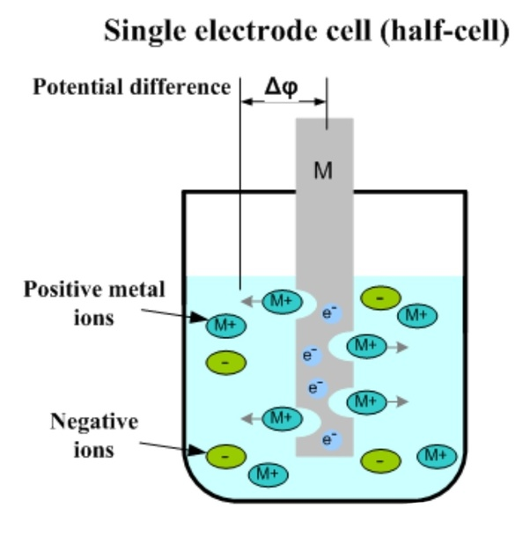
In the beginning, both these changes occur with different speeds but soon an equilibrium is established.
M M^{n+} + ne⁻
In practice, one effect is greater than the other,
If first effect is greater than the second, the metal acquires a negative charge with respect to solution and
If the second is greater than the first, it acquires positive charge with respect to solution, thus in both the cases a potential difference is set up.

Slide 8
REFERENCE ELECTRODE
A reference electrode is an electrode which has a stable and well-known electrode potential.
There are many ways reference electrodes are used. The simplest is when the reference electrode is used as a half-cell to build an electrochemical cell. This allows the potential of the other half cell to be determined. An accurate and practical method to measure an electrode's potential in isolation (absolute electrode potential) has yet to be developed.

Slide 9
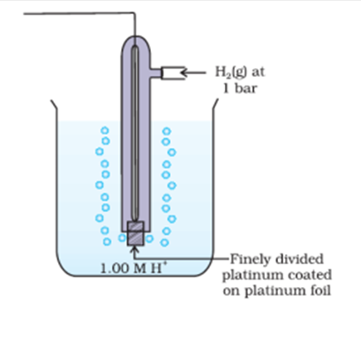
STANDARD HYDROGEN ELECTRODE (SHE)
It is reference electrode consists of a platinum electrode in contact with H₂ gas (1 atm) and aqueous H⁺ ions (1 M).
It is assigned 0.0 V electrode potential.
It may behave as anodic or cathodic half cell.
It is represented as
Pt(s)|H₂(g)(a_{H2}= 1)|H⁺(aq)(a_{H}+ = 1).
When SHE is coupled with an other half cell then cell potential is the value of the electrode potential of half cell.

Slide 10
Determination of Standard Electrode Potential of Zn/Zn²⁺ Electrode
A zinc rod is dipped in 1 M zinc sulphate solution. This half-cell is combined with a standard hydrogen electrode through a salt bridge.
Both the electrodes are con­nected with a voltmeter.
The deflection of the voltmeter indicates that current is flowing from hydrogen electrode to metal electrode or the electrons are moving from zinc rod to hydrogen electrode.
The zinc electrode acts as an anode and the hydrogen electrode as cathode and the cell can be represented as
Cell Representation | Oxidation half reaction | Reduction half reaction
Zn|Zn²⁺ (aq)/Anode(-) || 2H(aq)| H₂ (g)/Cathode (+) | Zn → Zn²⁺ + 2e⁻ | 2H⁺ + 2e⁻ → H₂↑

Slide 11
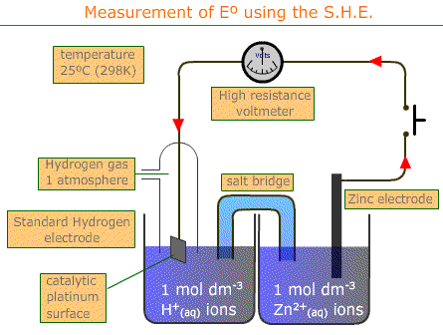
The EMF of the cell is 0.76 volt
E⁰_{CELL =}E⁰_{CATHODE} - E⁰_{ANODE}
0.76 = Eº_{Anode} + 0
Eº_{Anode} = +0.76 V

Slide 12
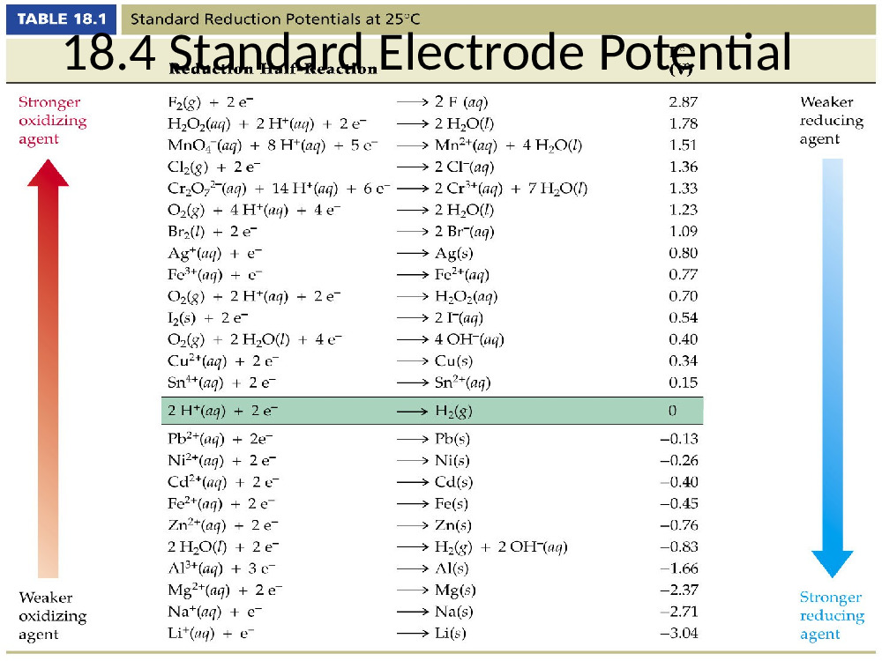

Slide 13
NERNST EQUATION
Reduction Potential under Non-standard Conditions is determined using Nernst Equation when Concentrations not-equal to 1M.
where:
E = actual ½ cell reduction potential
Eº = standard ½ cell reduction potential
n = number of electrons in reaction
T = temperature (K)
R = ideal gas constant (8.314J/(K-mol)
F = Faraday’s constant (96500 C/mol)

Slide 14
Nernst Equation for a cell
Reduction Potential under Non-standard Conditions is determined using Nernst Equation when Concentrations not-equal to 1M. Thus For the cell,
Cu(s)I Cu²⁺(aq)IIZn²⁺ (aq)IZn(s)
With cell reaction. Cu²⁺ (aq) + Zn(s) Zn²⁺ (aq) +Cu(s)

Slide 15
NERNST EQUATION......
At equilibrium E_{cell} =0:
The value of E˚_{cell} is related to Gibbs free energy, ∆G˚ by:
∆G˚ = –nFE˚_{cell}
The value of Equilibrium constant, K is related to ∆G˚ by:
∆G˚ = –2.303RT logK

Slide 16
EQUILIBRIUM CONSTANT AND GIBB’S FREE ENERGY FROM NERNST EQUATION
At equilibrium Ecell = 0
There fore E⁰cell = 0.059/n log Kc
log Kc= E⁰cellX n/0.059
Δ⁰rG = – nFE⁰⁽cell)
Where Δ⁰rG is standard Gibb’s free energy of reaction and E⁰⁽cell) is standard emf of the cell

Slide 17
RESISTENCE & CONDUCTIVITY
Resistance, R, is proportional to the distance, l, between the electrodes and is inversely proportional to the cross-sectional area of the sample, A (noted S on the Figure above). Writing ρ (rho) for the specific resistance (or resistivity),
R =l/Aρ
In practice the conductivity cell is calibrated by using solutions of known specific resistance, ρ*, so the quantities l and A need not be known precisely. If the resistance of the calibration solution is R*, a cell-constant, C, is derived
R*= C X ρ*
The specific conductance (conductivity), κ (kappa) is the reciprocal of the specific resistance.
κ = 1/ρ = C/R
Conductivity is also temperature-dependent. Sometimes the ratio of l and A is called as the cell constant, denoted as G*, and conductance is denoted as G. Then the specific conductance κ (kappa), can be more conveniently written as
κ = G* X G

Slide 18
MOLAR CONDUCTIVITY
The conductivity is defined as the conductivity of an electrolyte solution divided by molar concentration
Molar conductivity = λ_{m} = κ/c
if k is expressed in Sm^{–1} and the concentration, c in mol m^{–3} then the unit of λ_{m} will be Sm²mol^{–1}.
If we use Scm^{–1} as the units for k and mol cm^{–3}, the units of concentration, then the units for λ_{m} are Scm²mol^{–1}. It can be calculated by using the equation:
λ_{m} (Scm²mol^{–1}) = κ(S cm^{–1}) × 1000 (cm³/L)/molarity (mol/L).
OR, 1 Sm²mol^{–1} = 10⁴ Scm²mol^{–1}

Slide 19
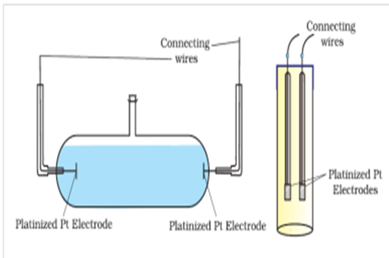
CONDUCTIVITY CELL
While measuring the resistance (DC) changes the composition of the solution. So we use an alternating current (AC) source.
A solution cannot be connected to the bridge like a metallic wire, so we use a specially designed vessel called conductivity cell.

Slide 20
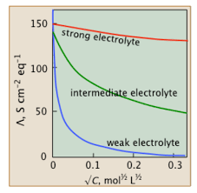
VARIATION OF CONDUCTIVITY & MOLAR CONDUCTIVITY WITH DILUTION
Conductivity decreases with dilution
Molar conductivity increases with dilution
For strong electrolytes
Λm=Λ⁰m-AC^{1/2}

Slide 21
KOHLRAUSCH’S LAW
It states that limiting molar conductivity of an electrolyte is the sum of the individual contributions of the anion and cation of the electrolyte.
Thus, if λ°_{Na}+ and λ°_{Cl -} are limiting molar conductivity of the sodium and chloride ions , then the limiting molar conductivity for sodium chloride is given by the equation:
Ë°_{m(NaCl)} = λ°_{Na+} + λ°_{Cl - .}

Slide 22


APPLICATION OF KOHLRAUSCH’S LAW
This law may be used to determine the limiting molar conductivity, ‘λ°_{m’} degree of dissociation ‘α’ and dissociation constant ‘K_{a}’ of a weak electrolyte.

Slide 23
ELECTROLYTIC CELL AND ELECTROLYSIS
Electrolysis: It is the process in which electrical energy is used to drive a non-spontaneous chemical reaction.
An electrolytic cell is an apparatus for carrying out electrolysis.
Processes in an electrolytic cell are the reverse of those in a galvanic cell.
Electrolysis process is used in Manufacture of Cl₂ and NaOH, Electro-refining and Electroplating, Electrolysis of water etc.

Slide 24
FARADAY’S LAW OF ELECTROLYSIS
(i) First Law: The amount of chemical reaction which occurs at any electrode during electrolysis by a current is proportional to the quantity of electricity passed through the electrolyte (solution or melt).
(ii)Second Law: The amounts of different substances liberated by the same quantity of electricity passing through the electrolytic solution are proportional to their chemical equivalent weights (Atomic Mass of Metal ÷ Number of electrons required to reduce the cation).

Slide 25
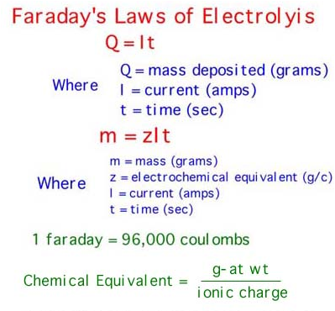

Slide 26
BATTERIES
Batteries are the most important practical application of galvanic cells.
Single-cell batteries consist of one galvanic cell.
Multi-cell batteries consist of several galvanic cells linked in series to obtain the desired voltage.

Slide 27
Types of batteries
PRIMARY BATTERY
In these batteries, the reaction occurs only once and after use over a time period battery becomes dead and cannot be reused again.
Example: Dry Cell
SECONDARY BATTERY
A secondary battery after use can be reused by recharging by passing current through it in the opposite direction
Example: Lead storage cell

Slide 28
DRY CELL
A dry cell is a type of electric battery, commonly used for portable electrical devices. It was developed in 1886 by the German scientist Carl Gassner, after development of wet zinc-carbon batteries by Georges Leclanché in 1866. The modern version was developed by Japanese Yai Sakizo in 1887.
A dry cell uses a paste electrolyte, with only enough moisture to allow current to flow
A common dry cell is the zinc-carbon cell, sometimes called the dry Leclanché cell, with a nominal voltage of 1.5 volts, the same as the alkaline cell.

Slide 29
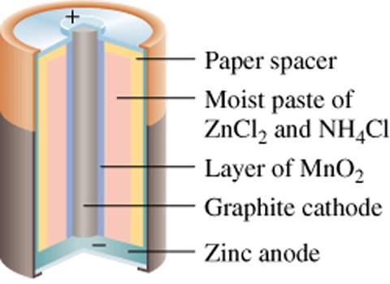
It is also called Leclanche cell
Anode: Zinc metal can
Cathode: MnO₂ and carbon paste
Electrolyte: NH₄Cl and ZnCl₂ paste.
Cell Potential: 1.5 V but decreases to 0.8 V with use.
Anode: Zn(s) → Zn²⁺ (aq) + 2e⁻
Cathode: 2NH⁺₄ (aq) + 2MnO₂ (s) + 2e⁻ → Mn₂O₃ (s) + 2NH₃ (aq) + H₂O (l)
Overall: Zn(s) + 2NH⁺₄(aq) + 2MnO₂(s) → Zn²⁺ (aq) + 2NH₃(aq) + H₂O(l) + Mn₂O₃(s)

Slide 30
MERCURY CELL/ BUTTON CELL
A mercury battery (also called mercuric oxide battery, mercury cell, button cell, or Ruben-Mallory) is a non-rechargeable electrochemical battery, a primary cell.
Mercury batteries use a reaction between mercuric oxide and zinc electrodes in an alkaline electrolyte.
The voltage during discharge remains practically constant at 1.35 volts, and the capacity is much greater than that of a similarly sized zinc carbon battery. Mercury batteries were used in the shape of button cells for watches, hearing aids, cameras and calculators, and in larger forms for other applications

Slide 31
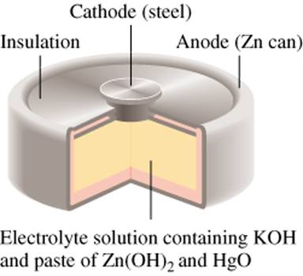
Anode: Zn(Hg) + 2OH⁻ (aq) → ZnO(s) + H₂O (l) + 2e⁻ Cathode: HgO(s) + H₂O (l) + 2e⁻ → Hg(l) + 2OH⁻ (aq) Overall: Zn(Hg) + HgO(s) → ZnO(s) + Hg (l)

Slide 32
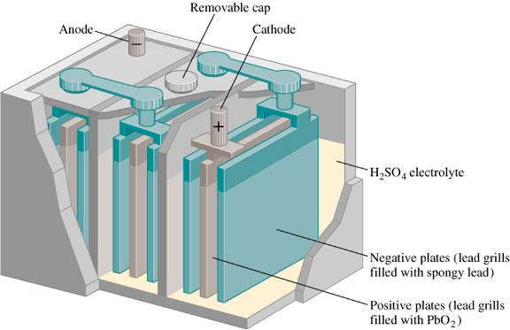
LEAD STORAGE CELL
Anode : Pb(s) + SO²⁻ (aq) PbSO₄(s) + 2e⁻
Cathode:
PbO₂(s) + 4H⁺ (aq) + SO₄²⁻ (aq) + 2e⁻ PbSO₄(s) + 2H₂O(l)
Overall reaction:
Pb(s) + PbO₂(s) + 4H⁺(aq) + 2SO₄²⁻(aq) 2PbSO₄ (s) + 2H₂O (l)

Slide 33
NICKEL CADMIUM BATTERY
The nickel–cadmium battery (Ni-Cd battery or NiCad battery) is a type of rechargeable battery using nickel oxide hydroxide and metallic cadmium as electrodes.
A fully charged Ni-Cd cell contains:
a nickel(III) oxide-hydroxide positive electrode plate
a cadmium negative electrode plate
an alkaline electrolyte (potassium hydroxide).
anode reaction
(i) Cd_{(s)} + 2OH⁻_{(aq)} ==> Cd(OH)_{2(s)} + 2e⁻
cathode reaction
C

Slide 34
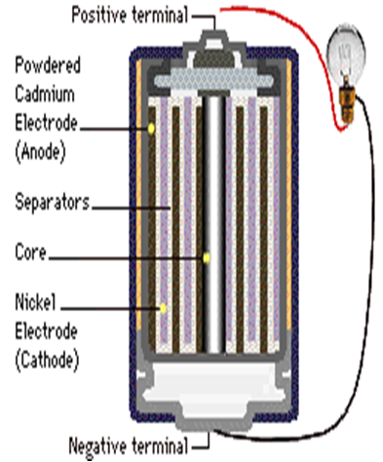
It is rechargeable
Cell Potential :1.30 V
Electrolyte: NiO(OH).
Anode: Cd(s) + 2OH–(aq) → Cd(OH)₂(s) + 2e–
cathode reaction
(ii) NiO_{2(s)} + 2e⁻ + 2H₂O ==> Ni(OH)_{2(s)} + 2OH⁻_{(aq)}
overall cell reaction
(iii) Cd_{(s)} + NiO_{2(s)} + 2H₂O ==> Cd(OH)_{2(s)} + Ni(OH)_{2(s)}

Slide 35
FUEL CELL
It’s a type of galvanic cell that requires a continuous supply of reactants to keep functioning.
Fuel cells are not batteries because they are not self-contained.
It uses externally fed CH₄ , CH₃OH or H₂, which react to form water.
Electrolyte: Hot aqueous KOH solution.
Cell Potential: 1.23 V and have about 40% conversion to electricity; the remainder is lost as heat. Excess heat can be used to drive turbine generators.

Slide 36
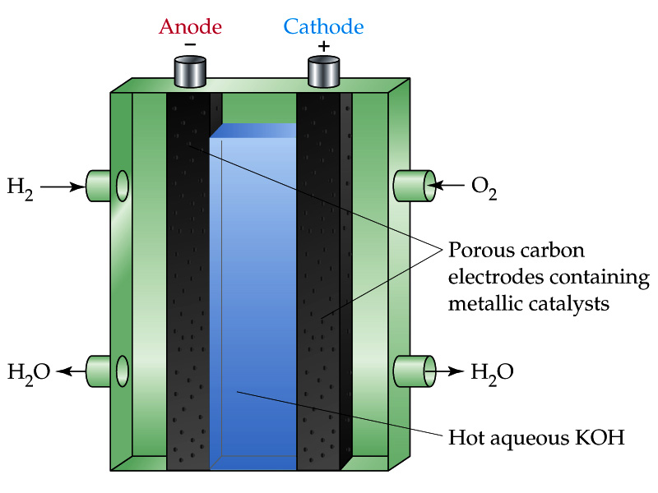
Anode : 2H₂ (g) + 4OH⁻ (aq) 4H₂O (l) + 4e⁻
Cathode: O₂ (g) + 2H₂O (l) + 4e⁻ 4OH⁻ (aq)
Overall: 2H₂ (g) + O₂ (g) 2H₂O (l)

Slide 37
CORROSION
Corrosion is the oxidative deterioration of metal.
25% of steel produced goes to replace steel structures and products destroyed by corrosion.
Rusting of iron requires the presence of both oxygen and water.
Rusting results from tiny galvanic cells formed by water droplets.

Slide 38
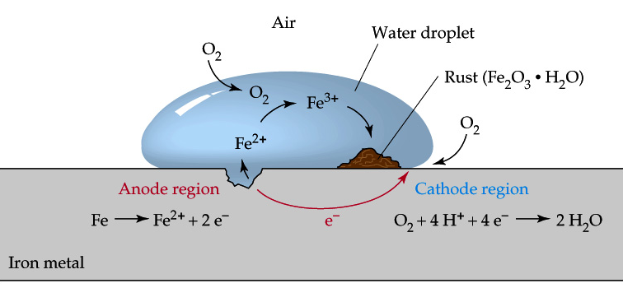
Oxidation: Fe(s) → Fe²⁺(aq) + 2 e–
Reduction: O₂(g) + 4 H⁺(aq) + 4 e– → 2 H₂O(l)
Overall: 2 Fe(s) + O₂(g) + 4 H⁺(aq) → 2 Fe²⁺(aq) + 2 H₂O(l)

Slide 39
Prevention of corrosion
Galvanizing: is the coating of iron with zinc. Zinc is more easily oxidized than iron, which protects and reverses oxidation of the iron.
Cathodic Protection: is the protection of a metal from corrosion by connecting it to a metal (a sacrificial anode e.g. Mg or Zn) that is more easily oxidized.
Electroplating.
By applying paint, grease, rubber to prevent contact of metal surface from air.

