Slide 1
Three aspects of chemical reaction
Thermodynamics
Equilibrium
Kinetics
feasibility
extent
Rate of the reaction

Slide 2
Types of reactions
slow
Rusting of iron,conversion of graphite
to diam to diamond
fast
Precipitation reaction,Neutralisation reaction
moderate
Hydrolysis of cane sugar,decomposition
Of hydrogen peroxide

Slide 3
Content of the chapter
Concentration as a function of time
Rate as a function of time and concentration
Factors affecting rate

Slide 4
Definitions
Chemical Kinetics:-
Study of reaction rates and their mechanisms
Rate of a chemical reaction:
Change in concentration of either reactant or product per unit time.
Unit of rate of reaction Mol L ‾¹S‾¹

Slide 5
Rate of a chemical reaction:
Rate of change in concentration of either reactant or product per unit time.
Unit of rate of reaction Mol L ‾¹S‾¹

Slide 6
Rate of a reaction
A → B
Rate of disappearance of A = -d[A] /dt
Rate of formation of B = +d[B] /dt
d[A] = change in concentration of A over time period dt
Because [A] decreases with time, d[A] is negative.
d[B] = change in concentration of B over time period dt

Slide 7
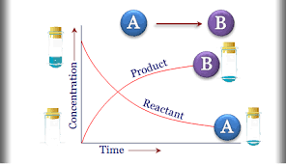
Graphical representation of rate of a reaction

Slide 8
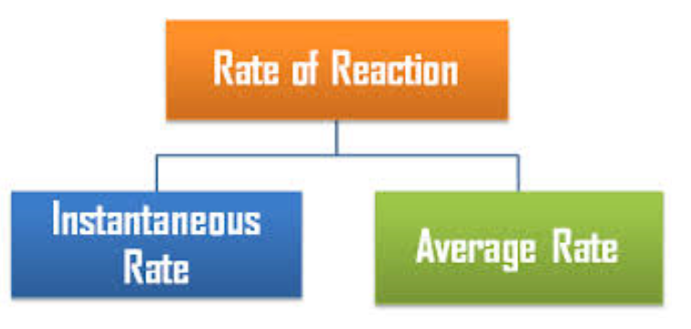

Slide 9
AVERAGE RATE
Instantaneous rate
INSTANTANEOUS RATE
Change in concentration of reactant or product at particular instant of time
Total change in concentration of reactant or product by the elapsed time
Denoted by ΔX/ΔT
Denoted by dx/dt.

Slide 10
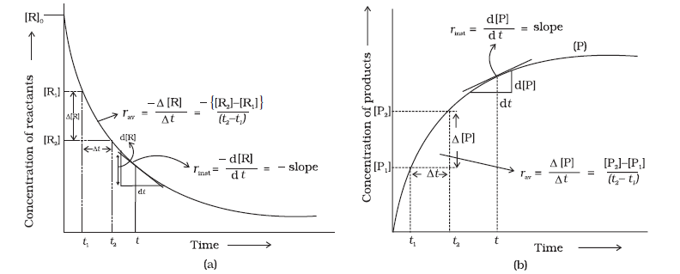
Graphical Representation of average rate and instantaneous rate

Slide 11
?
For the reaction R → P, the concentration of a reactant changes from 0.03 M to 0.02M in 25 minutes. Calculate the average rate of reaction using units of time both in minutes and seconds

Slide 12
A
A
Average rate of a reaction
-Δ[ R]/ Δt
= -( 0.02-0.03)/25 M min‾¹
=4X10‾⁴ M min‾¹
=4X10‾⁴/ 60M sec‾¹
=6.67x10 ‾⁶M sec‾¹

Slide 13
For a reaction
aA+bB→cC+dD
Rate of a reaction=
-1/a d[ A]/dt =-1/b d[ B]/dt
=1/c d[C/dt =1/d d[D]/dt

Slide 14
Examples
2HI(g) → H2(g) + I2(g)
r= -1/2 d [ HI ]/dt=+d [ H₂ ]/dt =d[ I₂ ]/dt
N₂ +3 H₂ → 2NH₃
r=-d[N₂ ]//dt = -1/3 d [ H₂ ]/dt =+1/2 d [ NH₃ ]/ /dt

Slide 15
Factors affecting rate of reaction
Concentration of the reactants
Temperature of the reactants
Catalyst
Pressure
Surface area

Slide 16
Effect of concentration
When concentration of reactant increases rate of reaction increases
Rate Law
Rate of a reaction is directly proportional to concentration of reactants raised to some power
Which may or may not be same as stoichiometric coefficient of reactants in a balanced chemical equation.

Slide 17
Differrential rate equation
For a reaction:
aA + bB → Product
Rate = k[A]^{x}[B]^{y}
^{k is called rate constant}
x and y may or may not be equal to stoichiometric coefficient a and b

Slide 18
Example
2NO+O₂→ 2NO₂
rate=k [NO ]
²
[ O₂ ]

Slide 19
Order of a reaction
Sum of the powers of the concentration of the reactant terms in experimentally determined rate equation.
It can have a value of zero, integral values as well as fractional values
Rate = k [A]^{x} [B]^{y}
x and y represent the order with respect to the reactants A and B respectively
x + y the overall order of a reaction

Slide 20
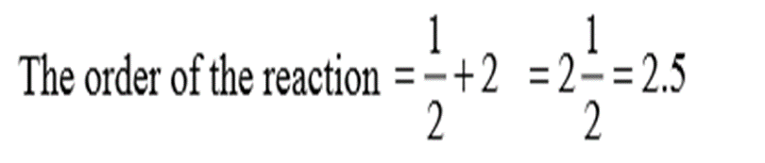
?
A

Slide 21
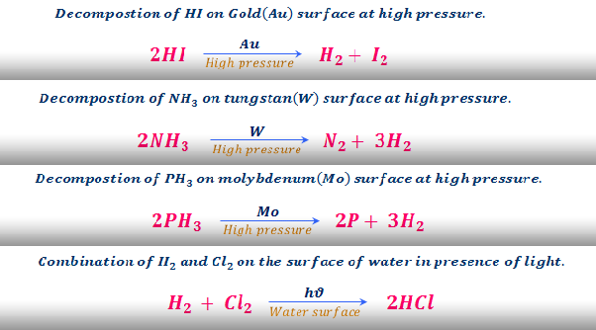
Examples of zero order reaction

Slide 22
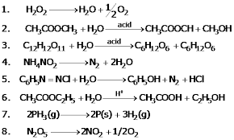
Examples of First Order reaction

Slide 23
Order of reactions…
•A reaction is zero order in a reactant if the change in concentration of that reactant produces no effect.
• A reaction is 1st order if doubling the concentration causes the rate to double.
• A reaction is 2nd order if doubling the concentration causes a quadruple increase in rate.

Slide 24
?
The conversion of molecules X to Y follows second order kinetics. If concentration of X is increased to three times how will it affect the rate
of formation of Y?
X→ Y follows second order kinetics
r =k [X] ²
X is increase 3 times ,rate will become 9 times
r =k [3X] ² i.e., r= 9x k X²
A

Slide 25
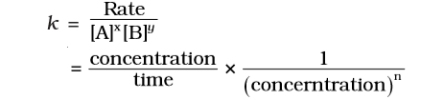
Unit of rate constant
Depending on the order of the reaction unit of rate constant changes
For a general reaction aA+bB → cC+dD
Unit can be expressed as
( mol L^{-1 ) (1- n)} s⁻¹

Slide 26
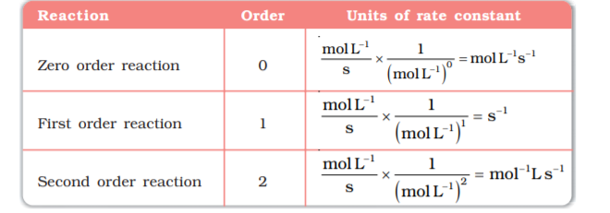
Units of rate constant

Slide 27
?
Identify order of the reaction if the units of its rate constant are i)L‾¹ mol sec‾¹ ii)L mol‾¹ sec‾¹
A
i)Zero order ii)Second order

Slide 28
?
.
The decomposition reaction of NH₃
on platinum surface is given
N₂ +3 H₂ → 2NH₃
What are the rates of production of N₂ and H ₂
if K= 2.5 X10⁻⁴mol l⁻¹ s⁻¹

Slide 29
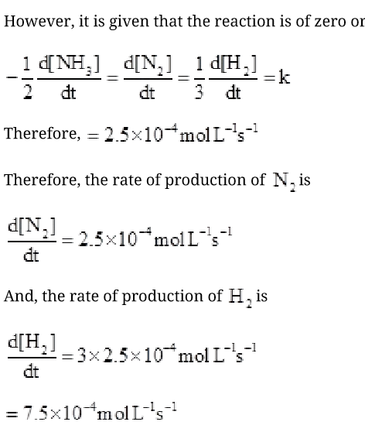
A
der

Slide 30
Elementary Reaction
Elementary reactions are those which complete
in one step
NH₄NO₂ → N₂ + 2H₂O
Decomposition of dinitrogen tetra oxide
N₂O₄(g) → 2NO₂(g)

Slide 31
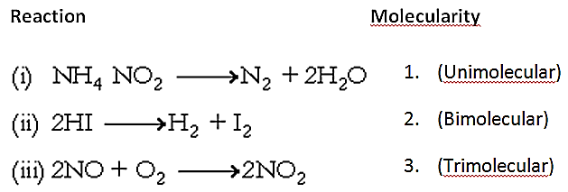
Molecularity
Molecularity of a reaction is simply the number of reacting species (atoms, ions or molecules) involved in an elementary reaction which must collide simultaneously.

Slide 32
Molecularity….
Bimolecular reactions involve simultaneous collision between two species,
e.g. dissociation of hydrogen iodide.
2HI → H₂ + I₂
Trimolecular or termolecular reactions involve simultaneous collision between three reacting species
e.g. 2NO + O2 → 2NO2

Slide 33
Why the reactions having molecularity greater than three rare ?
Since the chances of collision and reaction of more than three molecules at a time are very less, the molecularity greater than three is rare.

Slide 34
Complex reactions
Definition:
Multistep reactions where products are obtained after completion of a sequence of elementary reactions
Molecularity of a complex reaction has no meaning.
The slowest step or slowest reaction determines the rate of the reaction
molecularity of the slowest elementary reaction of a complex reaction similar to the overall order of the complex reaction.

Slide 35
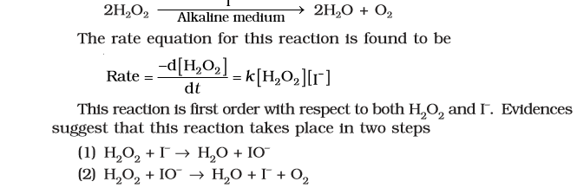
Slow
fast
The first step being slow, is the rate determining
step ,therefore order is two

Slide 36
Difference between order and molecularity
order | molecularity
Experimental quantity | theoretical
can be zero and even a fraction | cannot be zero or a non integer
applicable to elementary as well as complex reactions | applicable only for elementary reactions.
For complex reaction, order is given by the slowest step | individual steps has its own molecularity

Slide 37
Integrated Rate Equations
Equation obtained by integrating the differential rate equation to give a relation between directly measured experimental data, i.e., concentrations at different times and rate constant is called integrated rate equation.

Slide 38
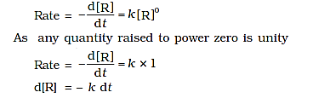
Integrated rate equations
Zero Order Reactions
R → P
Rate ∝ (Conc. Of Reactant)⁰

Slide 39
Integrating both sides
[R] = – k t + I
where, I is the constant of integration.
At t = 0, the concentration of the reactant [R]=[R]o
where [R]o is initial concentration of the reactant.
Substituting in equation )
[R] = –k × 0 + I ]
[R]o=1
Substituting the value of I in the equation )
[R] = -kt + [R]0

Slide 40
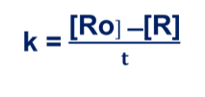
Concentration vs Time plot for zero order reaction
[R₀]
Concentration of R
[R] = -kt + [R]o
Time

Slide 41

First Order Reactions
Consider the reaction,
R → P

Slide 42
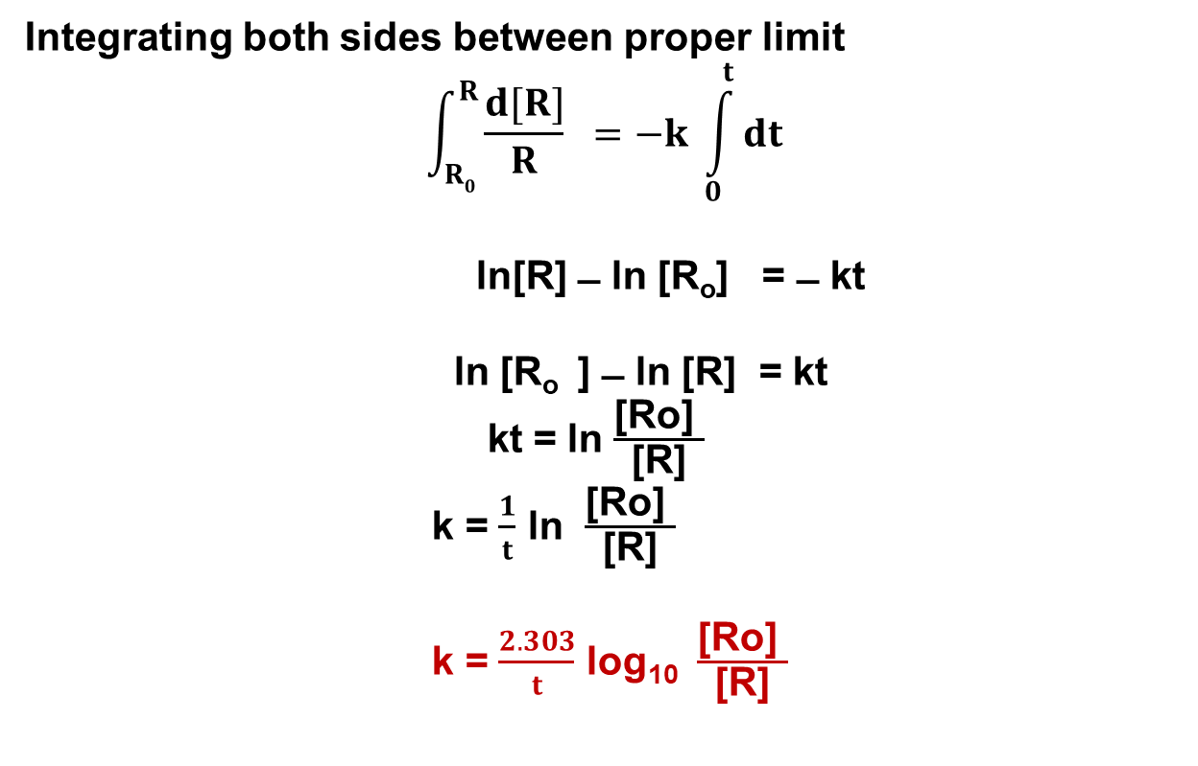

Slide 43
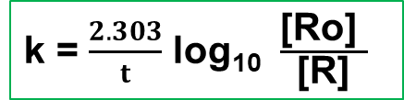

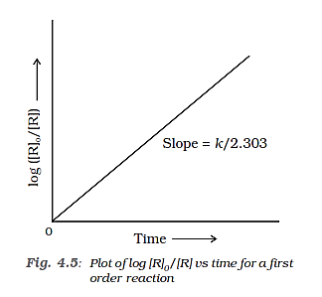
Concentration vs Time plot for first order reaction
y=mx+c

Slide 44
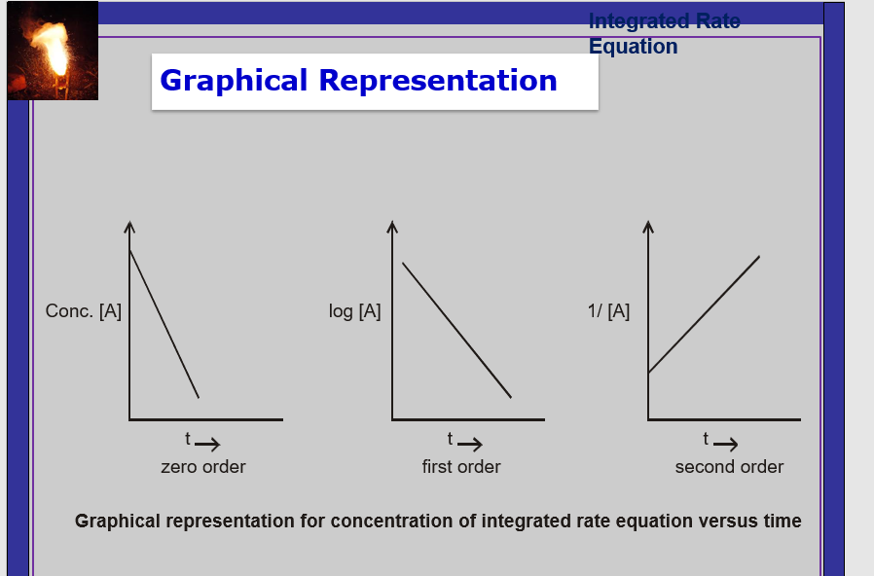

Slide 45
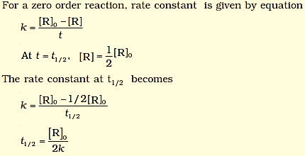

Half Life of a reaction
The half-life of a reaction is the time in which the concentration of a reactant is reduced to one half of its initial concentration. It is represented as t_{1/2}

Slide 46
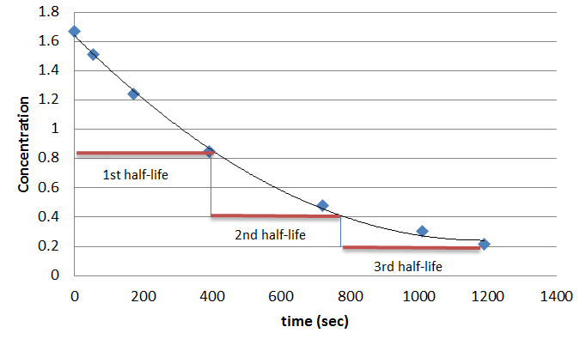

Slide 47
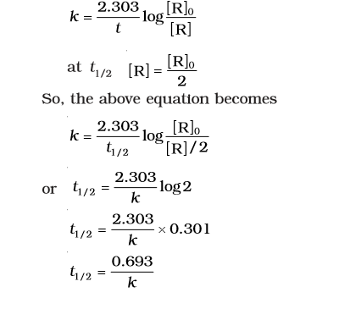
Half life for a first order reaction
Half life of first order reaction is independent of initial concentration

Slide 48
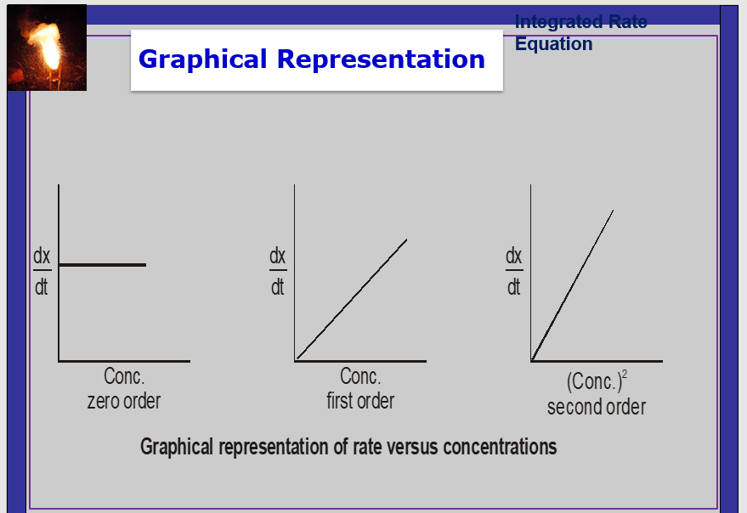

Slide 49
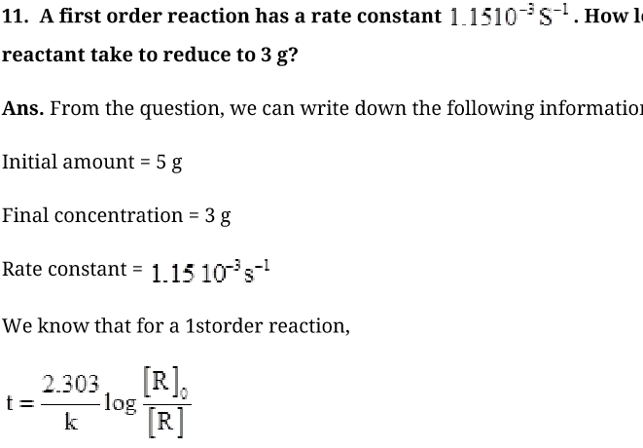

Slide 50
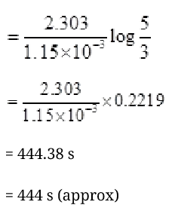

Slide 51
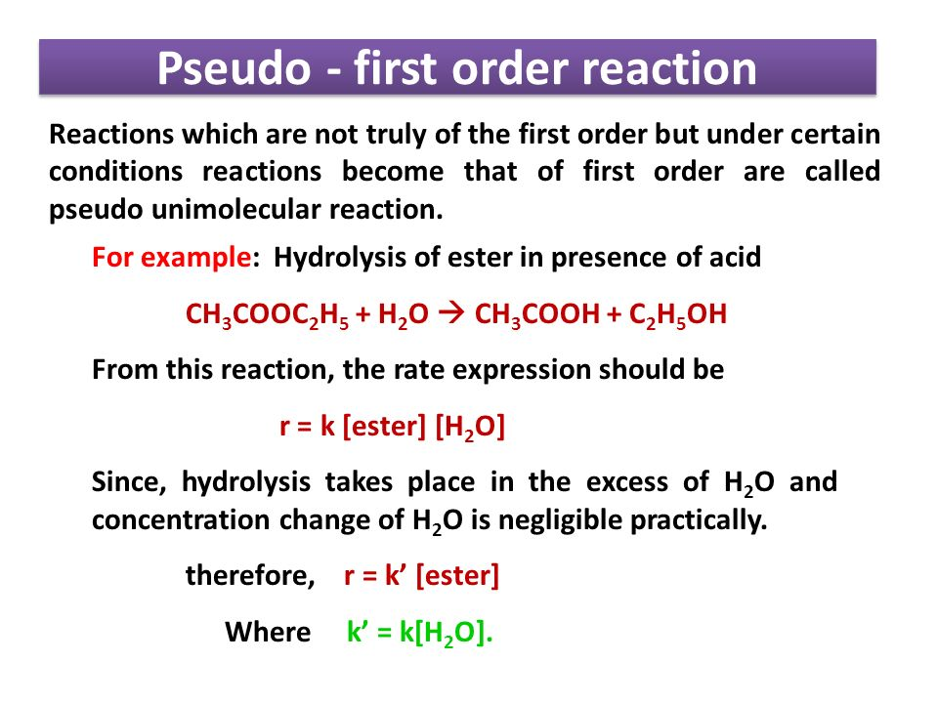

Slide 52
?
Time required to decompose SO₂Cl₂ to half its initial amount is 60 minutes. If the decomposition is a first order reaction, calculate the rate constant of the reaction.

Slide 53
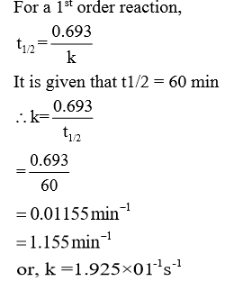
A

Slide 55
Temperature dependence of the rate of reaction:
For a chemical reaction with rise in temperature by 10°
the rate constant is nearly doubled.
The temperature dependence on the rate of a
chemical reaction can be accurately explained by Arrhenius equation
k-rate constant
Ea-activation energy
T –temperature
R-universal gas constant

Slide 56
Temperature dependence of the rate of reaction:
During decomposition of N₂O₅,
The time taken for half of the original amount of material to decompose is 12 min at 50⁰C, 5 h at 25⁰C and 10 days at 0⁰C
Reaction between oxalic acid and potassium permanganate occur at higher temperature

Slide 57
Transition State Theory
According to Arrhenius, reaction takes place through formation of unstable Intermediate called activated complex which exist for short time and then breaks up to form product.

Slide 58


Slide 59
Activation energy (E_{a})
The energy needed to form activated complex is called energy of activation. It is very low for some reactions and very high for others.
E_{a} is always positive.
The larger the value of E_{a}, the slower the rate of a reaction at a given temperature.

Slide 60
Increasing the temperature of the substance increases the fraction of molecules, which collide with energies greater than Ea.

Slide 61
It is clear from the diagram that in the curve at (t + 10), the area showing the fraction of molecules having energy equal to or greater than activation energy gets doubled leading to doubling the rate of a reaction.

Slide 62
For a chemical reaction with rise in temperature by 10°, the rate constant is nearly doubled
The ratio is called the temperature
coefficient and its value is 2 or 3
k_{(T+10)}
k_{T}

Slide 63
Arrhenius Equation
k = A e^{-Ea /RT}
e^{-Ea /RT} = Fraction of molecule having K.E. > E_{a}
Natural logarithm of Arrhenius equation gives
Plot of ln k vs 1/T is straight line shows that increasing the temperature or decreasing the activation energy will
result in an increase in the rate of the reaction and an exponential
increase in the rate constant.

Slide 64
Arrhenius Equation
Plot of ln k vs 1/T is straight line shows that increasing the temperature or decreasing the activation energy will
result in an increase in the rate of the reaction and an exponential increase in the rate constant.

Slide 65
Arrhenius Equation
Equation - 2
Equation - 1

Slide 66
Effect of catalyst on rate of reaction
A catalyst is a substance which alters the rate of a reaction without itself undergoing any permanent chemical change.
For example, MnO₂ catalyse the following reaction so as to increase its rate considerably.

Slide 67
Effect of Catalyst on Rate of reaction

Slide 68
Collision theory
The reactant molecules are assumed to be hard spheres
Reaction occurs when molecules collide with each other.
Rate = Z_{AB}e^{-Ea/RT}
Z AB the number of collisions per second per unit volume of the reaction mixture.
e^{-Ea /RT} the fraction of molecules with energies equal to or greater than Ea.

Slide 69
Collision theory continued…..
The proper orientation of reactant molecules lead to bond formation
Improper orientation makes them simply bounce back
and no products are formed.
Diagram showing molecules having proper and improper orientation

Slide 70
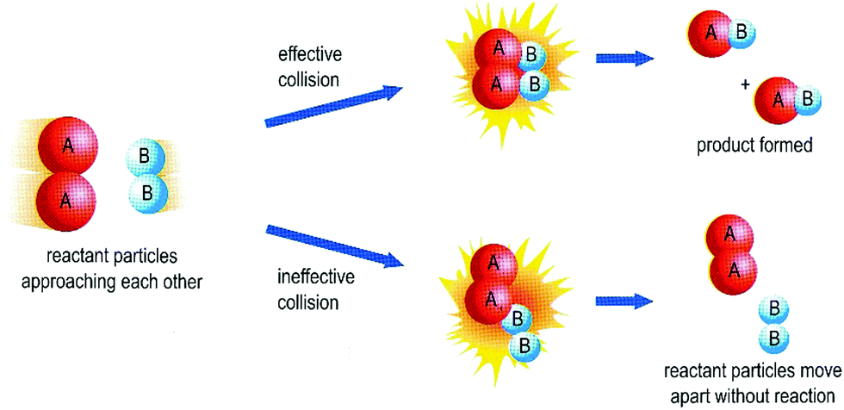

Slide 71
Collision theory…
By considering orientation factor
Rate = PZ_{AB} e^{-Ea/RT}
P=steric factor or probability factor
In collision theory activation energy and proper orientation of the molecules together determine the criteria for an effective collision and hence the rate of a chemical reaction.

