Slide 1
Chemical Reaction
It is a process in which one or more substances are formed as new substances
And it cannot be reversed by physical methods
Chemical reaction involves
Change in state
Change in colour
Change in temperature
Evolution of gas

Slide 2
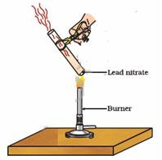

Slide 3
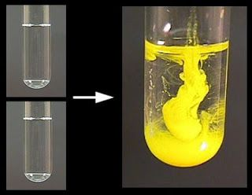

Slide 4
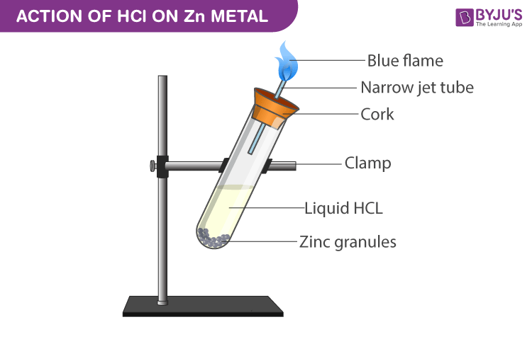

Slide 5
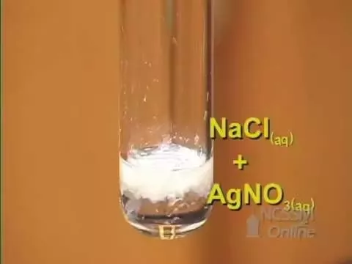

Slide 6
Chemical Reactions happen in our daily life
Digestion of food
Respiration
Rusting of iron
Formation of curd
Burning of wood
Burning of fuel

Slide 7
Reactants : The substances which take part in chemical reaction are called reactants
Products: The substances which are formed during chemical reaction are called products
When Magnesium burns in air gives Magnesium oxide
Magnesium + Oxygen(air) --→ Magnesium oxide
Reactants- Magnesium and Air
Product- Magnesium oxide

Slide 8
Chemical Equation
A chemical reaction can be represented by a chemical equation
It involves use of symbols of substances of reactants and products ith mention of their physical states.
When Magnesium ribbon burns in oxygen ( air ) gives Magnesium oxide
Mg_{(s)} + O_{2(g)} ------------→ MgO_{(s)}
Solid –(s)
Iiquid-(l)
Gas-(g)
Aqueous-(aq)
Aqueous solution: It is solution in which water is solvent

Slide 9
What is the need of balancing a chemical Equation?
Law of Conservation of Mass : It states that matter can neither be created nor be destroyed during a chemical reaction.
So the number of elements ( atoms ) involved in a chemical reaction should be same on reactants side and product side

Slide 10
How to balance a Chemical Reaction?
Fe + H₂O --→ Fe₂O₃ + H₂
2 Fe + 3 H₂O ---→ Fe₂O₃ + 2H₂
Elements | LHS | RHS
Fe | 1 x | 2
H | 2 x | 2 x
O | 1x | 3

Slide 11
Types of Chemical Reactions
Combination Reactions
2. Decomposition Reactions
3. Displacement Reactions
4. Double Displacement Reactions
5. Precipitation Reactions
6. Redox Reactions

Slide 12
Combination Reactions
These are the reactions in which two or more substances combine to form a single product.
A + B ---→ AB
Addition of water to quick lime
CaO + H₂O ---------------→ Ca(OH)₂
Burning of Coal
C_{(s)} + O_{2(g)} ---→ CO_{2(g)}
Formation of Water
H_{2(g)} + O_{2(g)}---→ H₂O_{(l)}

Slide 13
Decomposition Reactions
These are the reactions in which a single substance breaks down into two or more substances.
AB-------→ A + B
Decomposition can be effected by
Heat ( Thermal decomposition)
Electricity ( Electrolysis)
Light (Photolysis)

Slide 14
Decomposition by Heat (Thermal Decomposition)
Decomposition of Ferrous sulphate
Heat
2FeSO_{4(s)} ---------------→ Fe₂O_{3(s)} + SO_{2(g)} + SO_{3(g)}
(green) (red) (Smell of burned Sulphur)
Decomposition of Lead nitrate
Heat
2Pb(NO₃)₂ ---------------------→ 2PbO + 4 NO₂ + O₂
( brown fumes)

Slide 15
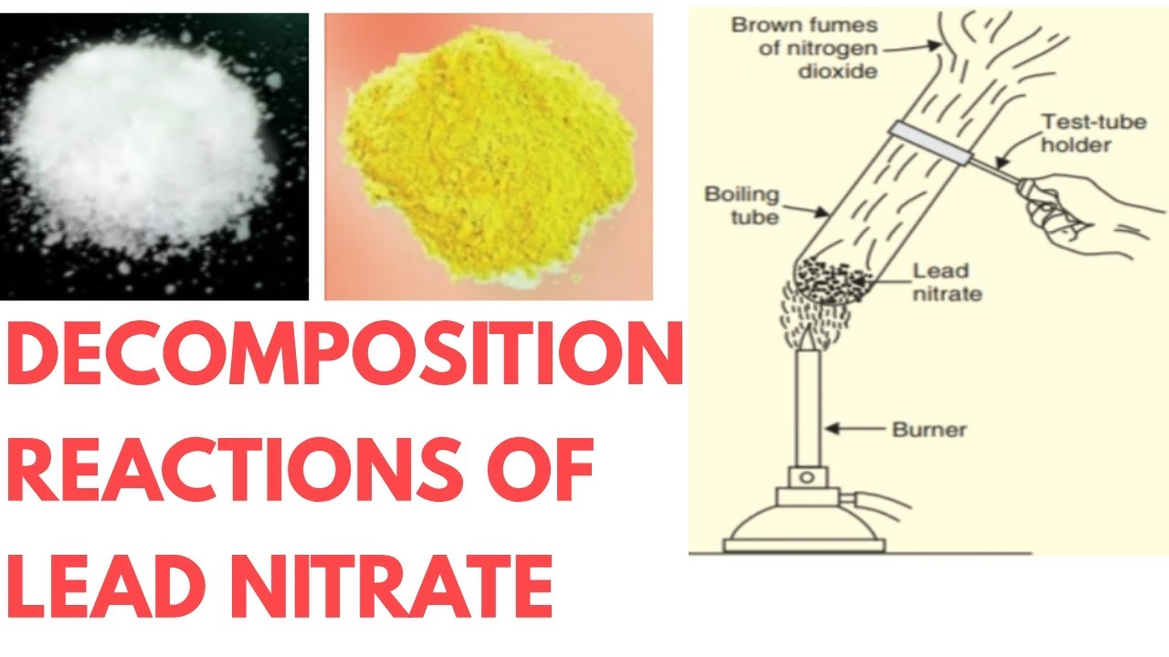

Slide 16
Decomposition by Electricity ( Electrolysis)
Decomposition of Water (Electrolysis of water)
Electricity
H₂O _{(l)} --------------→ H_{2(g)} + O_{2(g)}
H₂ and O₂ formed in the ratio 2:1

Slide 17
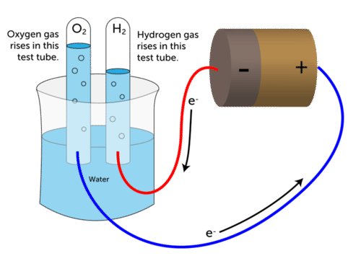

Slide 18
Decomposition by Light ( Photolysis)
Silver chloride exposed to sunlight
sunlight
2AgCl_{(s)} -------------------------→ 2Ag_{(s)} + Cl_{2(g)}
white grey
Photosynthesis
sunlight
6 CO₂ + 6H₂O --→ C₆H₁₂O₆ + 6O₂

Slide 19
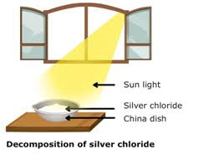
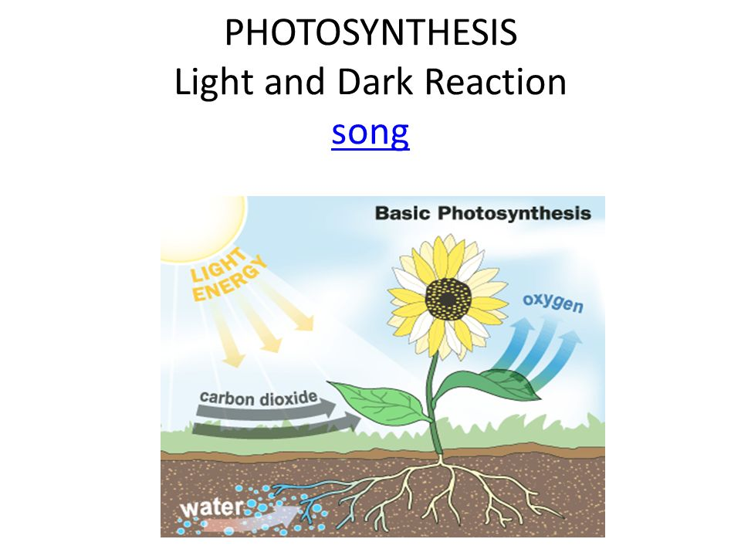

Slide 20
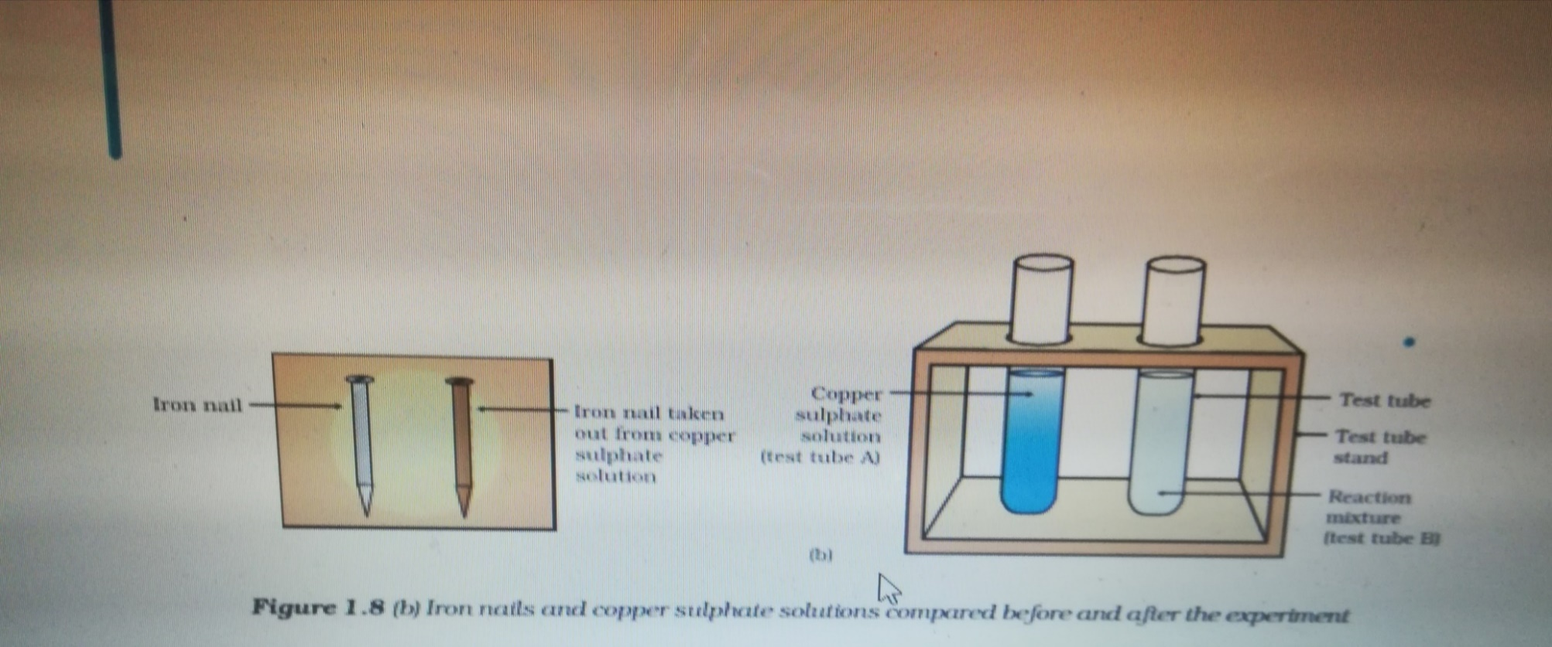
Displacement Reactions
These are the reactions in which a more reactive element displace a less reactive element from its solution.
Fe_{(s)} + CuSO_{4(aq)} ----------→ FeSO_{4(aq)} + Cu_{(s)}

Slide 21
Double Displacement Reactions
These are the reactions in which new compounds are formed by the mutual exchange of ions between two compounds.
Na₂SO_{4(aq)} + BaCl_{2(aq)} ----→ BaSO_{4(aq)} + 2 NaCl_{(aq)}
(sodium Sulphate) (Barium Chloride) (Barium sulphate) (Sodium chloride)
(precipitate-white)
Precipitate-It is an insoluble substance formed.
Pb(NO₃)₂ + 2 KI ----→ PbI₂ + 2 KNO₃
(lead nitrate) (potassium iodide) (lead iodide) (potassium nitrate)
( yellow ppt)

Slide 22
Redox Reactions
Reactions in which oxidation and Reduction together takes place
Oxidation: Addition of oxygen or removal of hydrogen from a substance
2Cu + O₂ ----→ 2CuO
Reduction :Removal of oxygen or addition of hydrogen to a substance
CuO + H₂ ----→ Cu + H₂O
REDuction + Oxidation = REDOX reaction

Slide 23
Oxidation in Daily Life
(i)Corrosion
Destruction of a metal by the action of environmental conditions
Rusting of iron (Hydrated ferric oxide)
Tarnishing of silver ( formation of black coating on silver )
Verdigris on copper ( Green coating on copper)
(ii) Rancidity
The oxidation of fats and oils when exposed to air is known as rancidity . It leads to bad smell and bad taste of food

Slide 24
Exothermic Reactions :These are the reactions which take place with
the liberation of energy
is liberated.
Ex : Burning of Coal
C (s) + O₂(g) ----→ CO₂(g) + heat
Burning of Natural gas
CH_{4(g)} + O_{2(g)} -----------→ CO_{2(g)} + H₂O_{(g)} + heat
Respiration
C₆H₁₂O₆ _{(aq)} + O_{2(g)} -----→ CO_{2(g)} + H₂O_{(l)} + energy
Endothermic Reactions :These are the reactions which takes place
with the absorption of energy.
heat
CaCO_{3(s)} -----------------→ CaO_{(s)} + CO_{2(g)}
light
2AgCl (s) --------------→ 2 Ag(s) + Cl₂(g)

Slide 25
Thank You

