Slide 1
Properties of Metals
Generally solids
Hard
Malleable and ductile(gold is the most ductile metal)
Good conductors of heat and electricity (Silver & copper is the best conductor)
Metallic Lusture
Sonorous
High m.p and b.p
Properties
Exceptions
Mercury is a liquid
Lithium , Sodium are soft
Gallium and cesium have very low m.p –melts in the palm

Slide 2
Properties of Non-metals
Generally solids or gases
Soft
Brittle
Bad conductor of heat and Electricity
No Lusture
Bromine is a liquid
Diamond- an allotrope of carbon is the hardest substance
Graphite is a good conductor
Iodine shows lusture
Properties
Exceptions

Slide 3
Chemical Properties of Metals

Slide 4

Reaction with Air/Oxygen
Almost all metals combine with oxygen to form metal oxides.
Metal + Oxygen → Metal oxide
metal oxides are basic in nature.
But some metal oxides show both acidic as well as basic behaviour-Amphoteric oxides.
Such metal oxides react with both acids as well as bases to produce salts and water.
Eg-Al₂O₃, ZnO

Slide 5

Most metal oxides are insoluble in water
But some of the metal oxides dissolve in water to form alkalis
Eg-Sodium oxide , Potassium oxide

Slide 6
Relative reactivity of Metals towards Oxygen
All metals do not react with oxygen at the same rate.
potassium and sodium react so vigorously that they catch fire if kept in the open.
Hence, to protect them and to prevent accidental fires, they are kept immersed in kerosene oil.
At ordinary temperature, the surfaces magnesium , aluminium, zinc, lead, etc., are covered with a thin layer of oxide.
The protective oxide layer prevents the metal from further oxidation.
Iron does not burn on heating but iron filings burn vigorously when sprinkled in the flame of the burner.
Copper does not burn, but the hot metal is coated with a black coloured layer of copper oxide.
Silver and gold do not react with oxygen even at high temperatures

Slide 7
Reaction with Water
Metals react with water to produce a metal oxide and hydrogen
Metal oxides that are soluble in water dissolve to form metal hydroxide.
Metal + Water → Metal oxide + Hydrogen
Metal oxide + Water → Metal hydroxide

Slide 8
Relative reactivity of Metals towards water
Potassium and Sodium react violently with cold water.
the reaction is so violent and exothermic that the evolved hydrogen immediately catches fire.
The reaction of calcium with water is less violent.
The heat evolved is not sufficient for the hydrogen to catch fire.
Calcium starts floating
the bubbles of hydrogen gas formed stick to the surface of the metal.
Magnesium does not react with cold water. It reacts with hot water
form magnesium hydroxide and hydrogen.
It also starts floating
Aluminium, iron and zinc do not react either with cold or hot water.
they react with steam to form the metal oxide and hydrogen.
lead, copper, silver and gold do not react with water

Slide 9
Reaction with Acids
Metal + Acid → Salt + Hydrogen
Hydrogen gas is not evolved when a metal reacts with nitric acid.
It is because HNO₃ is a strong oxidising agent.
It oxidises the H₂ produced to water and itself gets reduced to any of the nitrogen oxides (N₂O, NO,NO₂).
But magnesium (Mg) and manganese (Mn) react with very dilute HNO₃ to evolve H₂ gas.

Slide 10
Reaction with Other Metal salt solution
A more reactive metal displaces less reactive metal from its solution
Metal A + Salt solution of B → Salt solution of A + Metal B
Displacement reaction can be used to determine the relative reactivity of Metals

Slide 11
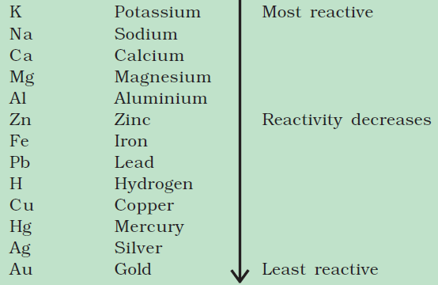
Reactivity Series
Metals arranged in the decreasing order of their reactivities

Slide 12
Why Inert Gases are Inert?
The outer most shell of noble/inert gases contain 8 electrons (except He)
No other elements have 8 electrons in their valence shell
The configuration of 8 electrons is very stable which makes the noble gases inert
The configuration of 8 electron is known as octet
Atoms of other elements attains stability if they get 8 electrons in their outermost shell

Slide 13
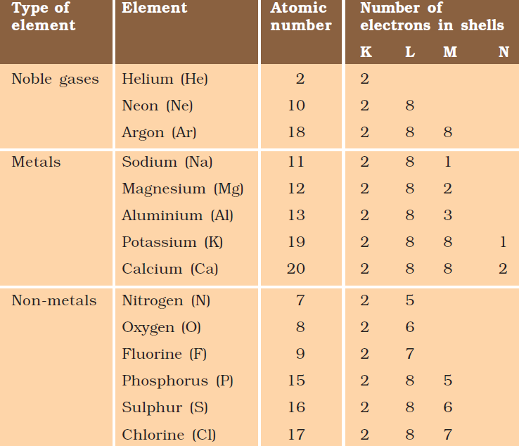

Slide 14

How ‘Na’ attains stability
‘Na’ will loose one electron from its outer most shell

Slide 15

How ‘Cl’ attains stability
‘Cl’ will gain one electron to its outermost shell

Slide 16

When ‘Na’ and ‘Cl’ react……
Sodium and chloride ions, are oppositely charged,
They attract each other
They are held by strong electrostatic forces of attraction to exist as sodium chloride (NaCl).
sodium chloride does not exist as molecules but aggregates of oppositely charged ions

Slide 17
Properties of ionic compounds

Slide 18
Physical nature
Solids, Hard, Brittle in nature
Melting and Boiling Point
High melting and Boiling point
Solubility
Soluble in polar solvents and insoluble in nonpolar solvents
Conduction of electricity
Conducts electricity through solution.Non conductor in solid state

