Slide 1
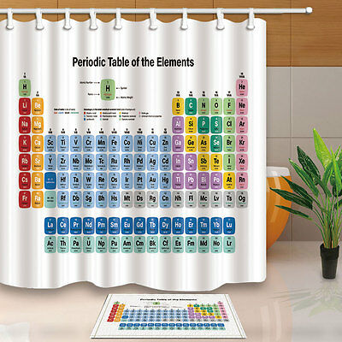

PERIODIC CLASSIFICATION OF ELEMENTS

Slide 2
1) Classification of elements :-
The arranging of elements into different groups on the
basis of the similarities in their properties is called
classification of elements.
The classification of similar elements into groups makes
the study of elements easier.
There are about 114 different elements known so far.
2) Early attempts at classification of elements :-
a) The earliest attempt to classify elements was grouping
the then known elements (about 30 elements) into two
groups called metals and non metals.
The defect in this classification was that it had no place
for metalloids (elements which have properties of both
metals and non metals) which were discovered later.

Slide 3
b) Dobereiner’s Triads :-
Dobereiner classified elements in the increasing order of their atomic masses into groups of three elements called triads. In each triad the atomic mass of the middle element was approximately equal to the average atomic mass of the other two elements.
The defect in this classification was that all the then known elements could not be correctly arranged into triads.
Triad | Atomic mass | Average atomic mass of Ist and 3rd element
Lithium Li Sodium Na Potassium K | 6.9 23.0 39.0 | 22.95
Calcium Ca Strontium Sr Barium Ba | 40.1 87.6 137.3 | 88.7
Chlorine CI Bromine Br Iodine I | 35.5 79.9 126.9 | 81.2

Slide 4
c) Newland’s octaves :-
Newland classified the elements in the increasing order of their atomic masses into groups of eight elements called octaves like the notes of music. He found that when the elements were arranged in the increasing order of their atomic masses into octaves then there was similarity of properties in every eighth element.
The defect in this classification was:-
i) All the known elements and elements discovered later could not be correctly arranged into octaves.
ii) Some elements having different properties were placed in the same rows like cobalt and nickel having different properties are placed along with Fluorine, Chlorine and Bromine. Iron having properties similar to Cobalt and Nickel are placed in different rows.
sa | re | ga | ma | pa | da | ni
H | LI | Be | B | C | N | O
F | Na | Mg | Al | Si | P | S
Cl | K | Ca | Cr | Tl | Mn | Fe
Co and Ni | Cu | Zn | Y | In | As | Se
Br | Rb | Sr | Ce and La | Zr | - | -

Slide 5
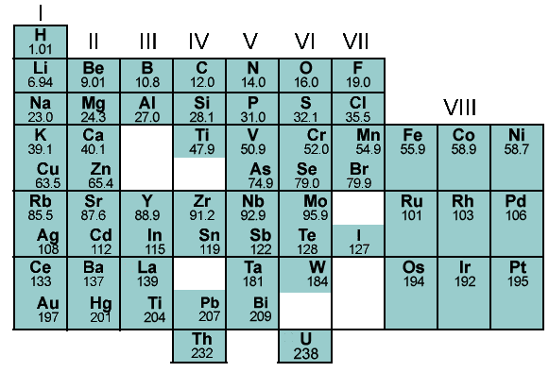
3a) Mendeleev’s periodic law :-
Mendeleev’s periodic law states that, ‘ The properties of elements are periodic functions of their atomic masses’.
A B
A B
A B
A B
A B
A B
A B
Transition series

Slide 6
b) Mendeleev’s periodic table :-
Mendeleev classified elements in the increasing order of their atomic masses and similarities in their properties.
The formulae of the oxides and hydrides formed by the elements was also the basis for the classification of the elements.
Mendeleev’s periodic table has 6 horizontal rows called periods and 8 vertical rows called groups. The groups 1 to 7 had two sub groups called A sub group and B sub group. Group 8 had 3 rows of elements. Elements having similar properties were placed in the same groups. There are some spaces left vacant in the table to accommodate the elements to be discovered in future.
Merits of Mendeleev’s periodic table :-
i) Elements were classified on a more fundamental basis of their atomic masses and properties.
ii) Spaces were left vacant to accommodate the elements to be discovered in future.
iii) It could predict the properties of the elements which helped in the discovery of new elements.
iv) The inert gas elements discovered later could be placed in a separate group without disturbing the table.
Defects of Mendeleev’s periodic table :-
i) Some elements are not arranged in the increasing order of their atomic masses. Co is placed before Ni, Te is placed before I etc.
ii) Position of hydrogen is not clear because it shows properties similar to metals as well as non metals.
iii) The position of isotopes of elements is not clear.

Slide 7
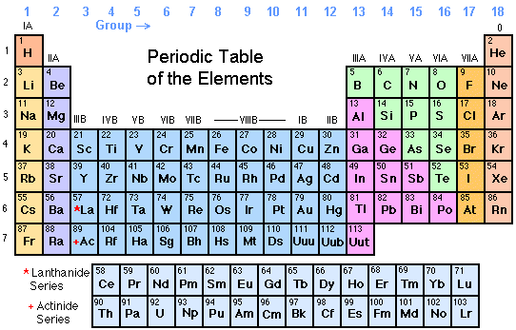
4a) Modern periodic law :-
Modern periodic law states that, ‘ The properties of elements are periodic functions of their atomic numbers’.

Slide 8
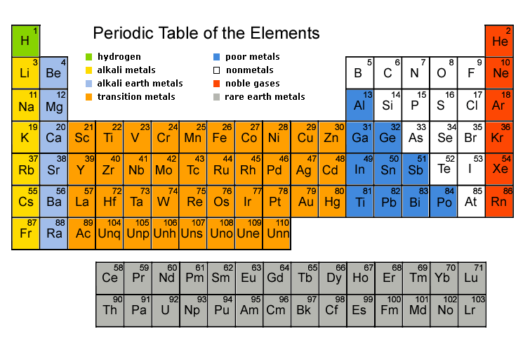

Slide 9
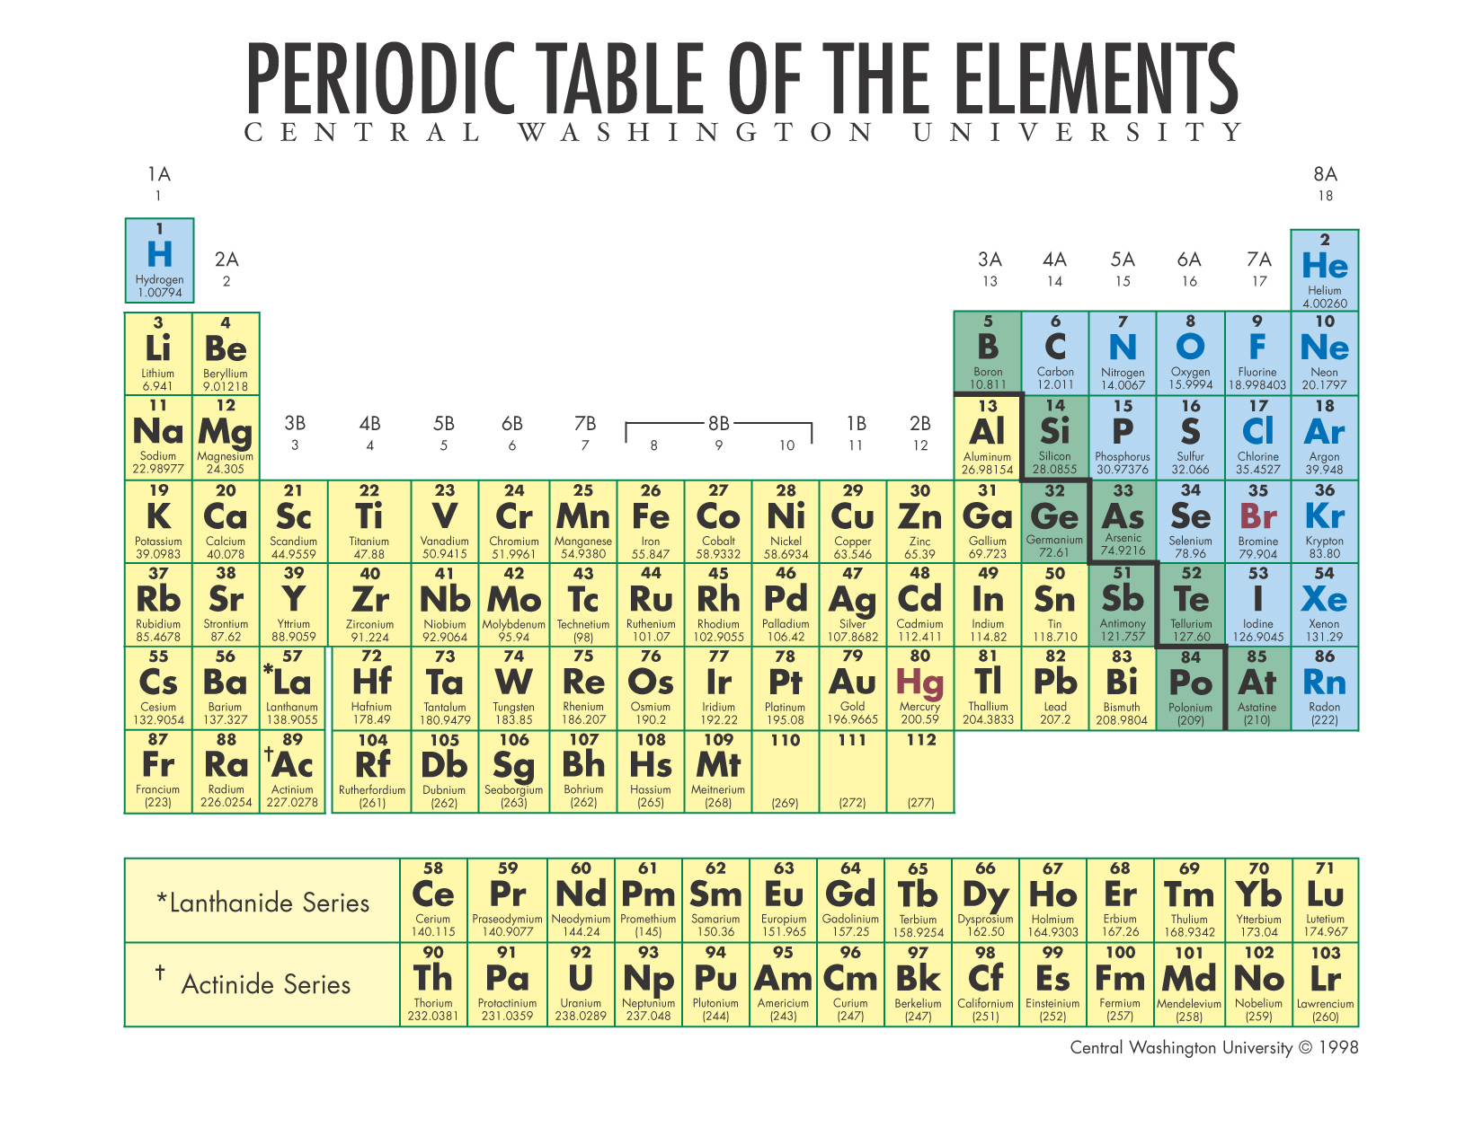

Slide 10
b) Modern periodic table :-
In the modern periodic table elements are arranged in the increasing
order of their atomic numbers in the form of a table having 7 horizontal
rows of elements called periods and 18 vertical rows of elements called
groups.
i) Periods :-
There are 7 periods of elements as follows :-
First period has 2 elements H and He called very short period.
Second period has 8 elements Li to Ne called short period.
Third period has 8 elements Na to Ar called short period.
Fourth period has 18 elements K to Kr called long period.
Fifth period has 18 elements Rb to Xe called long period.
Sixth period has 32 elements Cs to Rn called very long period.
Seventh period has 28 elements from Fr to atomic number 114
called incomplete period.
14 elements each of he sixth and seventh periods are placed
separately at the bottom of the table.
The 14 elements of the sixth period from La to Lu are called
Lanthanides. and the 14 elements of the seventh period from Ac to Lr
are called Actinides.

Slide 11
ii) Groups :-
There are 18 groups of elements divided into 9 main groups. They are
I, II, III, IV, V, VI, VII, VIII and 0 groups. The groups I to VII has two sub
groups each called A – sub group and B – sub group. Group VIII has 3
rows of elements and 0 group has one row of elements.
The A sub group elements are called normal elements.
The B sub group elements are called transition elements.
Lanthanides and Actinides are called inner transition elements.
Group 1 (I A ) elements are called alkali metals
Group 2 (II A) elements are called alkaline earth metals.
Group 17 (VII A) elements are called halogens.
Group 18 (0 group) are called noble gases.
In a group all the elements have the same number of valence
electrons. Group I elements have 1 valence electron, Group II elements
have 2 valence electron, Group III elements have 3 valence electrons
etc.
In a period all the elements contain the same number of shells.

Slide 12
5. Properties of elements in periods and groups :-
i) Valence electrons :-
In a period the number of valence electrons increases from 1 to 8 from the left to the right and the number of shells is the same.
Eg :- 2nd Period
Elements - Li, Be, B, C, N, O, F, Ne
AN - 3 4 5 6 7 8 9 10
EC - 2,1 2,2 2,3 2,4 2,5 2,6 2,7 2,8
Valence electrons - 1 2 3 4 5 6 7 8
Shells - 2 2 2 2 2 2 2 2
In a group the number of valence electrons is the same for all the elements but the number of shells increases from top to bottom.
Eg :- Group – I A
Elements AN EC VE Shells
H 1 1 1 1
Li 3 2,1 1 2
Na 11 2,8,1 1 3
K 19 2,8,8,1 1 4

Slide 13
ii) Valency :-
In a period the valency of the elements increases from 1 to 4 and then decreases from 4 to 0 from the left to the right.
Eg :- 2nd Period
Elements - Li, Be, B, C, N, O, F, Ne
AN - 3 4 5 6 7 8 9 10
EC - 2,1 2,2 2,3 2,4 2,5 2,6 2,7 2,8
Valence electrons - 1 2 3 4 5 6 7 8
Valency - 1 2 3 4 3 2 1 0
In a group the valency is the same for all elements of the group.
Eg :- Group – I A
Elements AN EC VE Valency
H 1 1 1 1
Li 3 2,1 1 1
Na 11 2,8,1 1 1
K 19 2,8,8,1 1 1

Slide 14
iii) Atomic size ( Radius of the atom) :-
In a period the atomic size of the elements decreases from the left to the right because the nuclear charge (number of protons) increases and so the electrons are pulled closer to the nucleus.
Eg :- 2nd Period
Elements - Li, Be, B, C, N, O, F, Ne
AN - 3 4 5 6 7 8 9 10
EC - 2,1 2,2 2,3 2,4 2,5 2,6 2,7 2,8
No. of protons - 3 4 5 6 7 8 9 10
Atomic size decreases
In a group the atomic size of the elements increases from top to bottom because the number of shells increases and the distance between the nucleus and shells also increases.
Eg :- Group – I A
Elements AN EC VE Shells
H 1 1 1 1 Atomic
Li 3 2,1 1 2 size
Na 11 2,8,1 1 3 increases
K 19 2,8,8,1 1 4

Slide 15
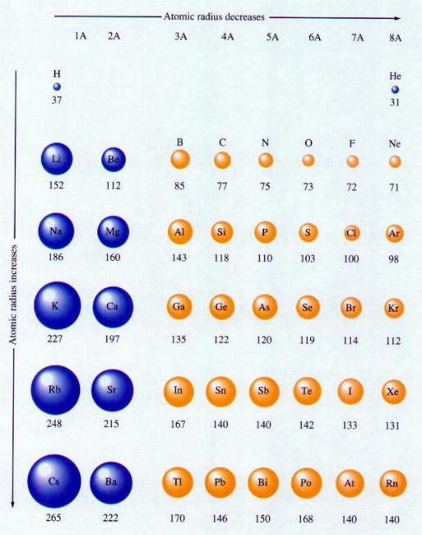

Slide 16
iv) Metallic property (Electropositive nature) :-
In a period the metallic property of the elements decreases from the left to the right.
Eg :- 3rd Period
Elements - Na, Mg, Al, Si, P, S, Cl, Ar
Metals Metalloid Non metals
Metallic property decreases
In a group the metallic property of the elements increases from the top to the bottom.
Eg :- Group VI A
Elements
Carbon C - Non metal Metallic
Silicon Si - Metalloid property
Germanium Ge - Metalloid increases
Tin Sn - Metal
Lead Pb - Metal

Slide 17
v) Non metallic property (Electronegative nature) :-
In a period the non metallic property of the elements increases from
the left to the right.
Eg :- 3rd Period
Elements - Na, Mg, Al, Si, P, S, Cl, Ar
Metals Metalloid Non metals
Non metallic property increases
In a group the non metallic property of the elements decreases from
the top to the bottom.
Eg :- Group VI A
Elements
Carbon C - Non metal Non metallic
Silicon Si - Metalloid property
Germanium Ge - Metalloid decreases
Tin Sn - Metal
Lead Pb - Metal

