Slide 1
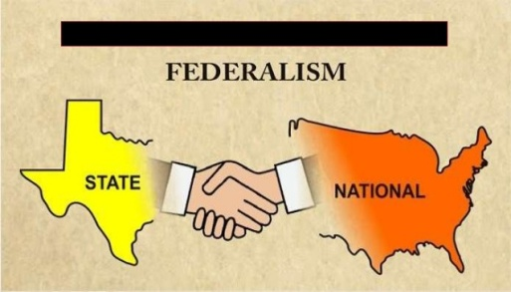
Federalism
Federalism is a way of organizing a nation so that two or more levels
of government have formal authority over the land and people.
What is federalism?
Origin:
Federalism word is derived from latin word “Foedus” which means a compact or an agreement.
Meaning:
Federalism is a method of government that allows two or more
entities to share control over the some geographic region.
Federalism is a system of government in which the power is divided
between a central authority and various constituent units of the
country.

Slide 2
Federalism
Usually, a federation has two levels of government.
One is the government for the entire country that is
usually responsible for a few subjects of common
national interest.
The others are governments at the level of provinces or
states that look after much of the day-to-day
administering of their state.
Both these levels of governments enjoy their power
independent of the other

Slide 3
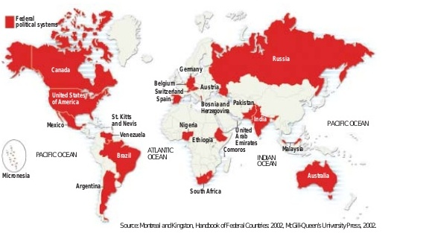
FEDERAL COUNTRIES IN THE WORLD
Though only 25 of the world’s 192 countries have federal political systems, their citizens make up 40 per cent of the world’s population. Most of the large countries of the world are federations.

Slide 4
What is unitary system?
In this form of administration, there is only one level of government over the whole country. If there are more sub-units, they are subordinates to central.
Here, central government passes on the orders to other levels of government(provincial or the local government).
Other levels of government are subordinate to central government
Example: United kingdom

Slide 5
What is Federal system?
In this form of administration, there are two levels of government(Central/National and State).
The central government cannot order the state government to do something.(two different types of law-Central and states laws).
State government has powers of its own for which it is not answerable to the central government.
Both these governments are separately answerable to the people.
Example: USA.

Slide 6
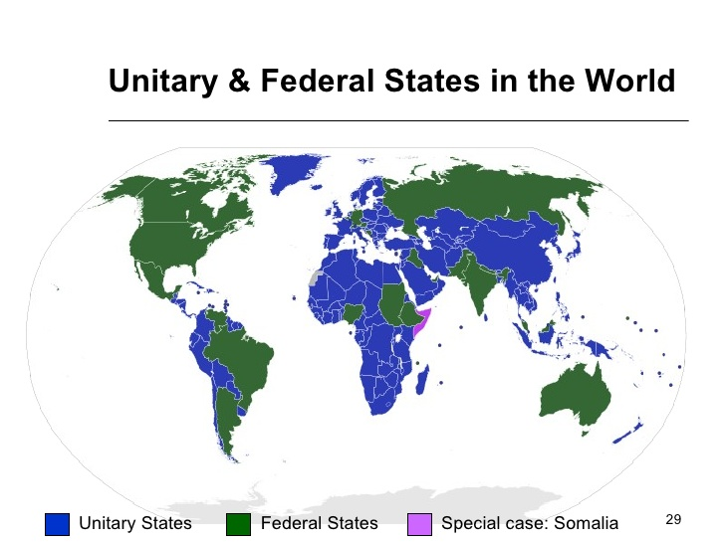
Unitary and Federal System Countries in the World

Slide 7
The Key Features of federation
There are two or more levels (or tiers) of government.
Different tiers of government govern the same citizens, but each tier has its own JURISDICTION in specific matters of legislation, taxation and administration.
The jurisdictions of the respective levels or tiers of government are specified in the constitution. So the existence and authority of each tier of government is constitutionally guaranteed.
The fundamental provisions of the constitution cannot be unilaterally changed by one level of government. Such changes require the consent of both the levels of government.
Courts have the power to interpret the constitution and the powers of different levels of government. The highest court acts as an umpire if disputes arise between different levels of government in the exercise of their respective powers.

Slide 8
The Key Features of federation
Sources of revenue for each level of government are clearly specified to ensure its financial autonomy.
The federal system thus has dual objectives:
- To safeguard and promote unity of the country.
- To accommodate regional diversity.
Therefore, two aspects are crucial for the institutions and
practice of federalism:
- Governments at different levels should agree to some rules of power-sharing.
- They should also trust that each would abide by its part of the agreement.
An ideal federal system has both aspects mutual trust and agreement to live together.

Slide 9
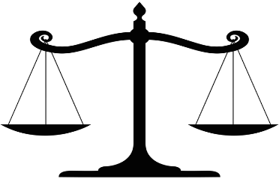
Balance of power
The exact balance of power between the central and the state government varies from one federation to another.
This balance depends mainly on the historical context in which the federation was formed.

Slide 10
TYPES OF FEDERALISM
There are two kinds of routes through which federations have been formed:
‘Coming together’ federation’:-
- it involves independent states coming together on their own to
form a bigger unit.
- It helps to maintain sovereignty and security.
- Each state is equally strong.
Example: USA, Switzerland and Australia.

Slide 11
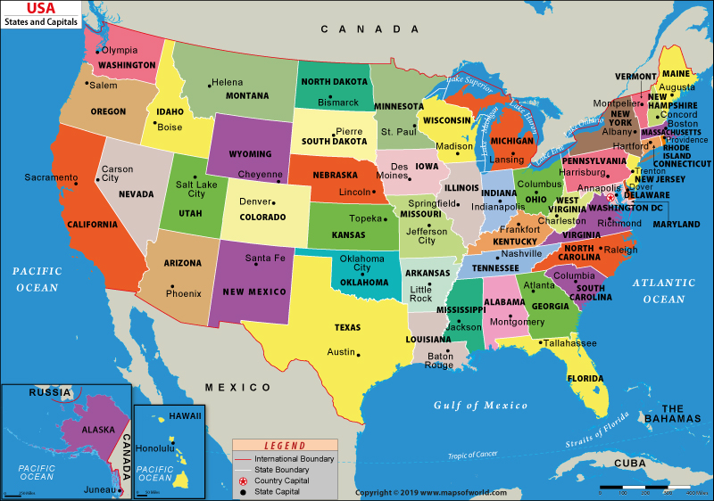
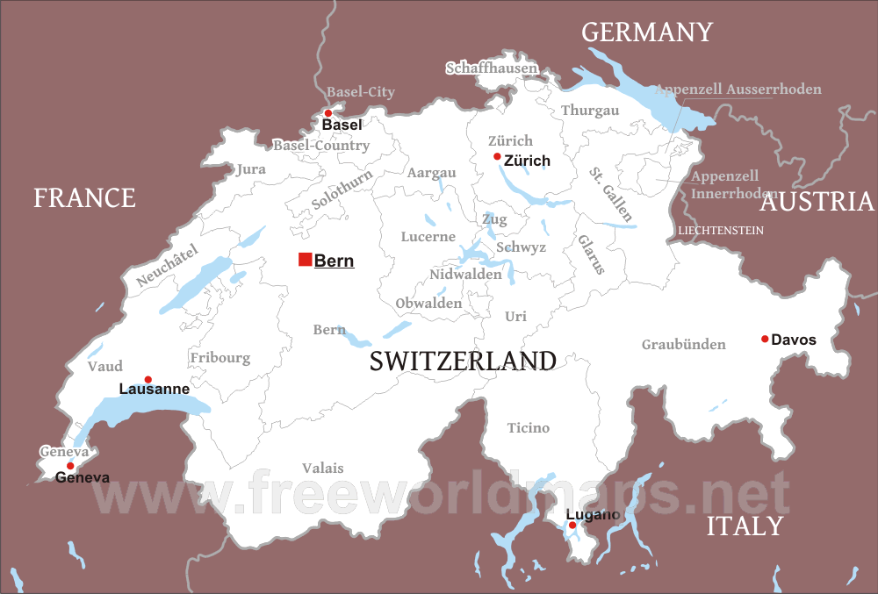
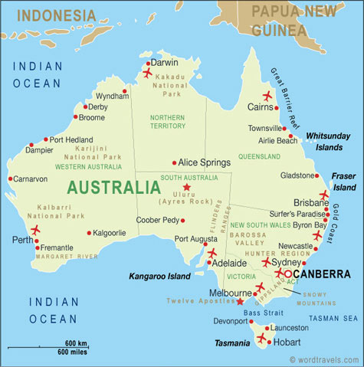
Example of ‘Coming together’ federation countries

Slide 12
TYPES OF FEDERALISM
‘Holding together’ federation:
- It is where a large country decides to divide its power between the constituent States and the national government (Country is divided into states for better Administration).
- It helps for accommodation of diversity.
- Some states might be given more power. The
ultimate power lies in the hand of central.
Example: India, Spain and Belgium.

Slide 13
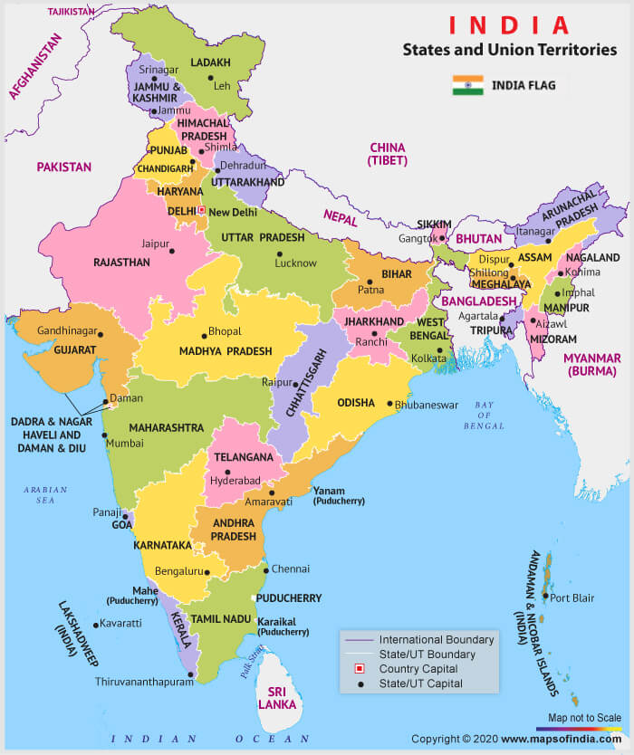
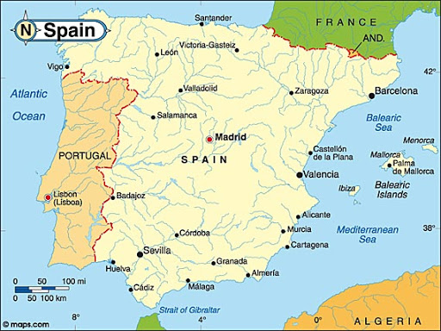
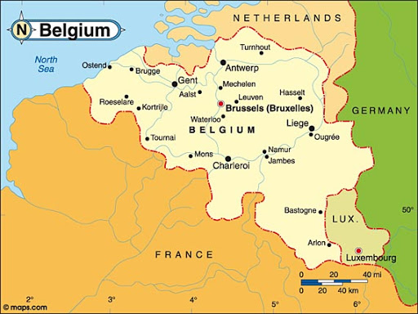
Example of ‘Holding together’ federation countries

Slide 14
What makes India a federal Country?
Division of powers
Some states are given more
powers
Written constitution
Union territories
Jurisdiction
Levels of Government

Slide 15
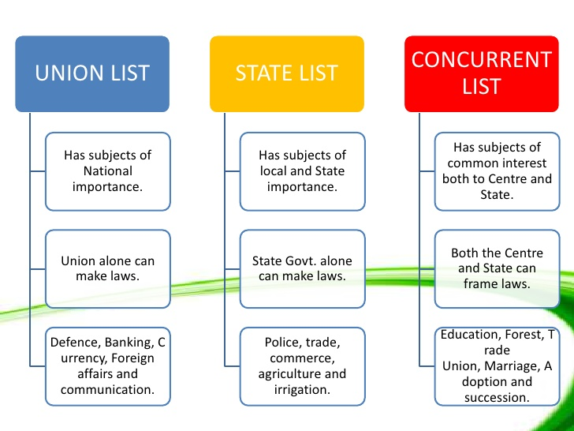
Division of power

Slide 16

Division of power

Slide 17
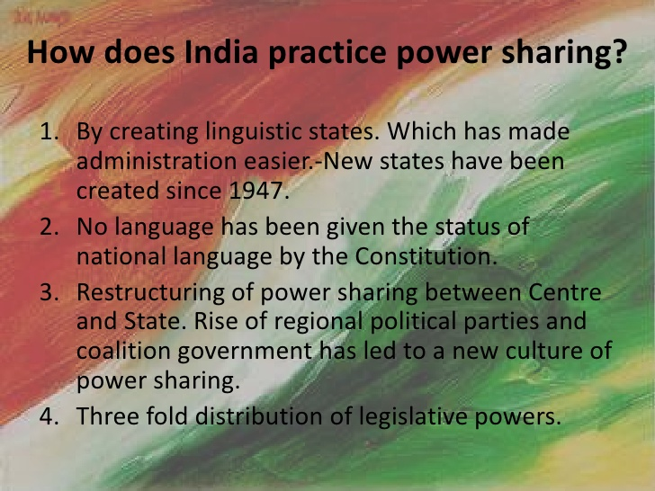
How is Federalism Practiced in India

Slide 18
How is Federalism Practiced in India
Linguistic States:
The first challenge faced after independence was linguistic states.
In 1947, the areas, boundaries and names of several old states of India were changed in order to create new states.
New states were formed on the basis of language and culture.
(who spoke the same language lived in the same state.)
Ex: Gujarat, West-Bengal and Bihar.
Some states were formed on the basis of ethnicity and geography such as Nagaland, Uttarakhand and Jharkhand
Some concerned that it might lead to disintegration of the nation, but worked well and effectively.

Slide 19
How is Federalism Practiced in India
Language Policy :
A second test for Indian federation is the language policy. Our constitution did not give the status of national language to any one language. Hindi was identified as the official language. But it is the mother tongue of only about 40% of Indians.
There are 21 other Scheduled languages. State can enjoy its own language for official purpose.
We have adopted three languages structure and any two languages can be used for administrative purpose.

Slide 20
How is Federalism Practiced in India
Language Policy :
According to constitution, the use of English for official Purposes was to stop in 1965. but non-Hindi speaking States demanded that the use of English, therefore the central government said to continue the use of English along with Hindi for official purposes.
A candidate in an examination conducted for the central government positions may opt to take the examination in any of these languages. States too have their own official languages.

Slide 21
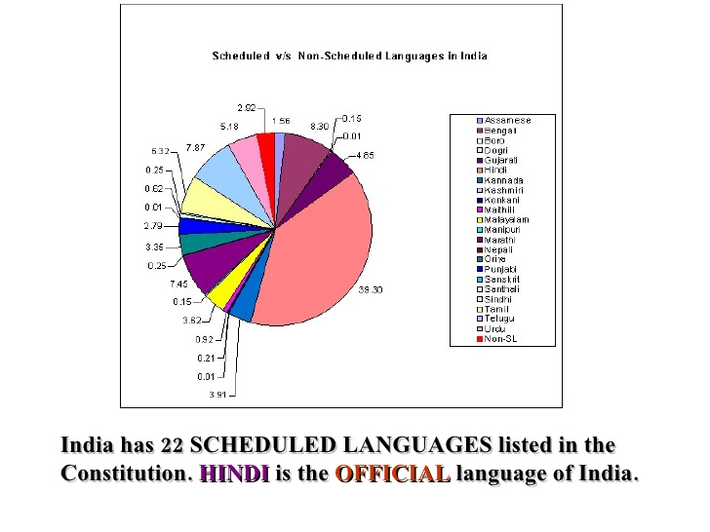
Scheduled Language of India

Slide 22
How is Federalism Practiced in India
Central and State Relation :
It helped a lot to avoid clashes between central and states.
When same political party ruling in central and state. State couldn't enjoy more power as central government could influence the decisions of states.
But after 1990, many regional parties came up and acquired the power in states. This was also the beginning of the era of Coalition Governments at the centre.
Since no single party got a clear majority in the Lok Sabha, the major national parties had to enter into an alliance with many parties including several regional parties to form a government at the centre.
This led to a new culture of power sharing and respect for the autonomy of the state governments. Thus more independent decisions were taken by states and federal system was practiced.
Today, these regional political parties are even affecting the decision making in central also.
So we can say that today’s power sharing is more effective than it was practiced in the early days when constitution was written.

Slide 23

LINGUISTIC DIVERSITY OF INDIA
As per the census report, 2001 of India held in 2001 there are 1500 distinct languages.
These languages were grouped together under some major languages like Bhojpuri, Magadhi, Bundelkhandi, Chattisgarhi, Rajasthani, Bhili and many others were grouped together under ‘Hindi’.
Even after this grouping, the census found 114 major languages of these 22 languages are now included in Eighth scheduled of the Indian constitution and are therefore called scheduled languages others are called non- scheduled languages.
In terms of languages, India is perhaps the most diverse country in the world.

Slide 24
DECENTRALIZATION IN INDIA
When power is taken away from central and given to other levels of government(state government and given to local government) is called ‘Decentralization’.
It plays very important role in democracy as
It helps to reduce the burden of central government
It helps to increase the participation of people in decision making and also democratic process.
It helps to solve local problems effectively.
Local self government is called schools of democracy.

Slide 25
DECENTRALIZATION IN INDIA
We have after independence two tiers of government in our country. But now we have three tier of government in our country. Why?
India is a vast country therefore India cannot be run only through these two tiers government.
States in India are as large as independent countries of Europe.(in terms of population, Uttar Pradesh is bigger than Russia, Maharashtra is about as big as Germany).
Many of these states are internally very diverse so there is thus a need for power sharing within these states.

Slide 26
DECENTRALIZATION IN INDIA
A major step towards decentralization was taken in 1992. The Constitution was amended to make the third-tier of democracy more powerful and effective. Here are the key features of 3-tier democracy:
- It is constitutionally mandatory to hold regular elections to local government bodies.
- Seats are reserved in the elected bodies and the executive heads of these institutions for the Scheduled Castes, Scheduled Tribes and Other Backward Classes.
- At least one-third of all positions are reserved for women.
- State Election Commission has been created in each State to conduct panchayat and municipal elections.
-The State governments are required to share some powers and revenue with local government bodies. The nature of sharing varies from State to State.

Slide 27
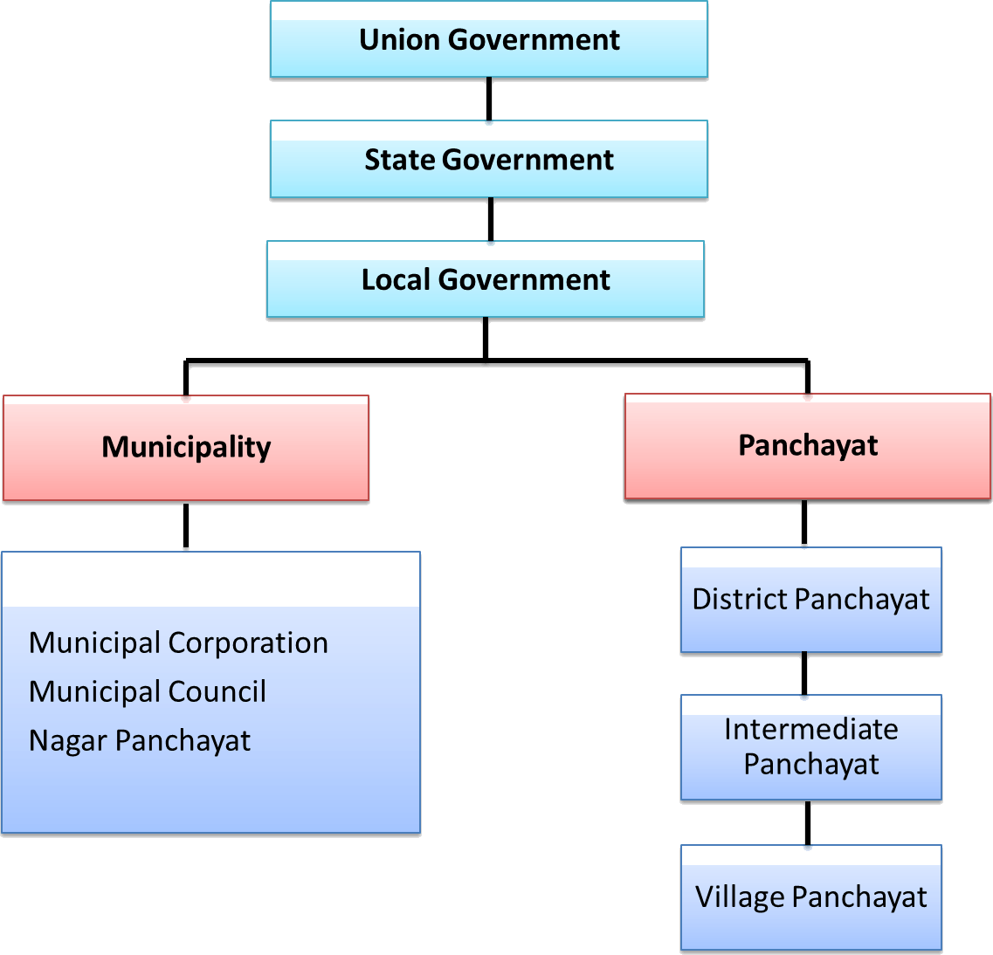
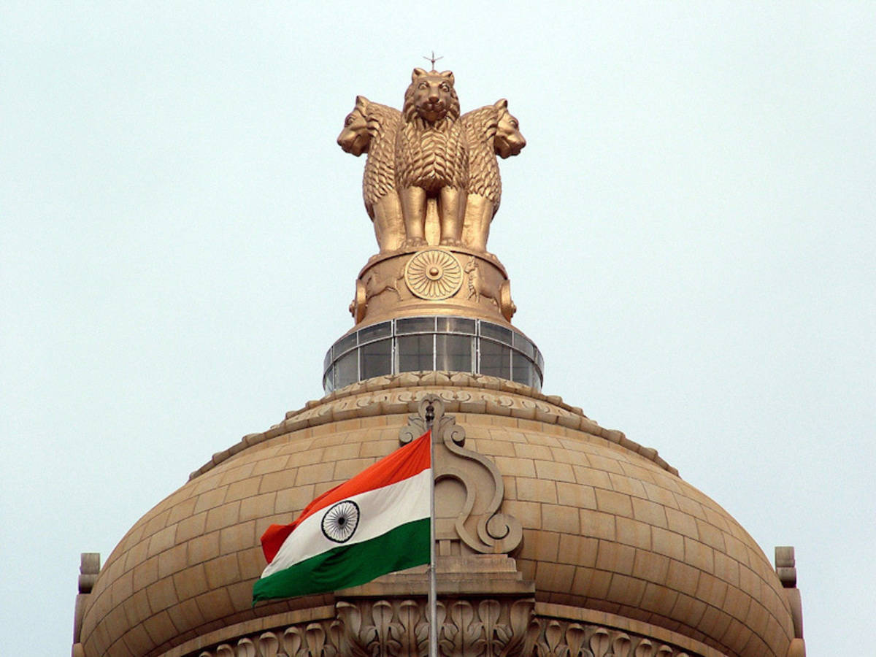
DECENTRALIZATION IN INDIA Federal structure in India

Slide 28
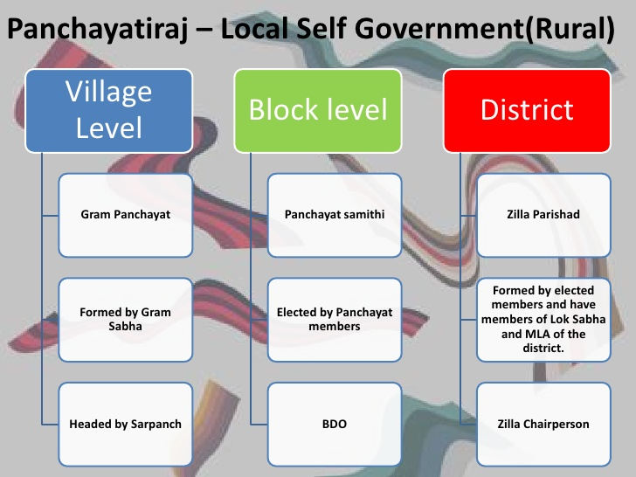
STRUCTURE OF SELF LOCAL GOVERNMENT ( Rural)

Slide 29
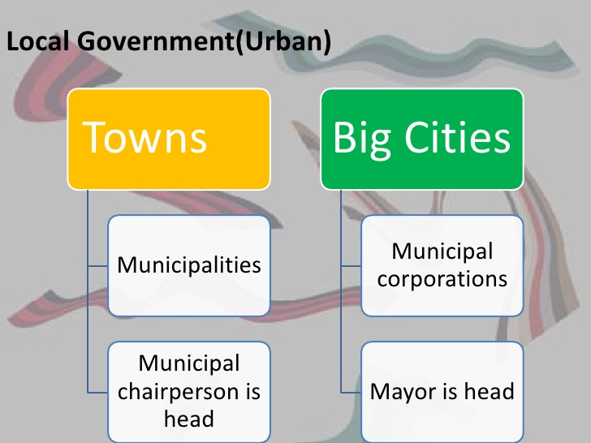
STRUCTURE OF SELF LOCAL GOVERNMENT(Urban)

Slide 30
Deficiencies of Local Self Government
Elections to Gram Sabhas are not held regularly.
Most of the state governments are not transferring powers and resources (Ex. Financial Needs).
Women inactive participation.

Slide 31
JAI HIND

