Slide 1
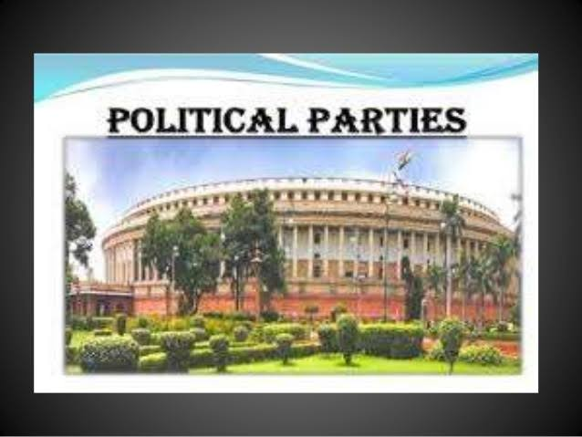

Slide 2
WHY DO WE NEED POLITICAL PARTY
MONARCHY (KING) CENTRE OF POWER
CONSTITUTIONAL MONARCHY DISTRIBUTION OF POWER
REPRESENTATIVE DEMOCRACY BEGINNING OF DEMOCRACY
POLITICAL PARTY MODERN DEMORRACY

Slide 3
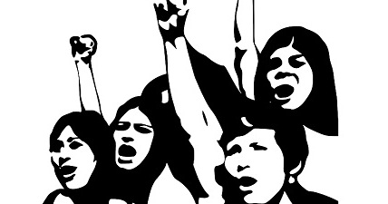
MEANING OF POLITICAL PARTY
A political party is a group
of people who come to-
gether to contest
election and hold
power in the govt.
They agree on some policies and programmes for the society with a view to promote the collective good.

Slide 4
COMPONENTS OF POLITICAL PARTY
The leaders, like- MLA, MP.
The active members, who organises, participates & makes arrangement of party activities (local leaders).
The followers, means – common people.

Slide 5
FUNCTIONS OF A POLITICAL PARTY
1. Parties contest elections,
2. They put forward different policies
and programmes for their citizen.
3. They play a decisive role in making
laws for the citizen.
4. Parties form & run the govt.

Slide 6
Continuation …..
5. Loosing parties play the role of oppositions to the party in power.
6. Parties shape public opinion, means- fulfill the genuine demands.
7. Parties provide opportunities to access the govt machinery and welfare schemes.
8. They shape representative democratic system.

Slide 7
NECCESSITY OF POLITICAL PARTY
(Imagine a situation, if)
NO, POLITICAL PARTY | POLITICAL PARTY, PRESENT
No uniform decision | Decision as a whole
Independent candidates | Representative democracy
No major accountability | An accountable Govt may be set up
Limited to constituency only | May work beyond the Constituency
No one to take care the country | Certain party may take care the country
More conflict | Less conflict

Slide 8
HOW MANY PARTIES SHOUD WE HAVE….??
In a democracy, any group of citizens is free to form a political party. It evolves-
-over a long period of time,
-depending on its socio-cultural views,
-regional and geographical divisions,
-history of politics etc.
Thus, we can say: “No system is ideal for all countries and all situations”.

Slide 9
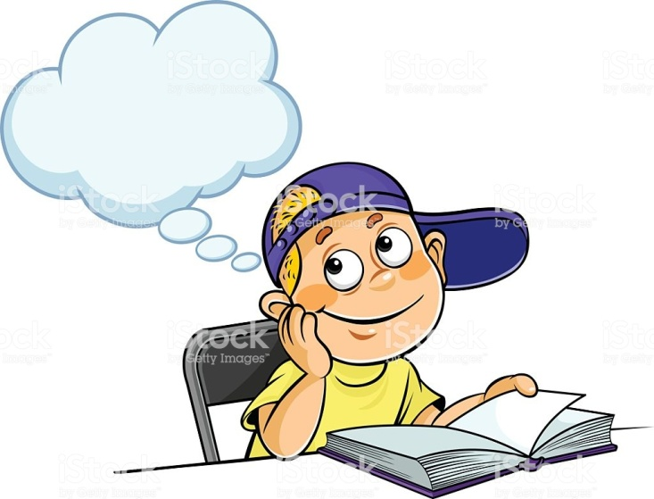
One Party Two Party
System Systems
Party
System
Multi-Party
System

Slide 10
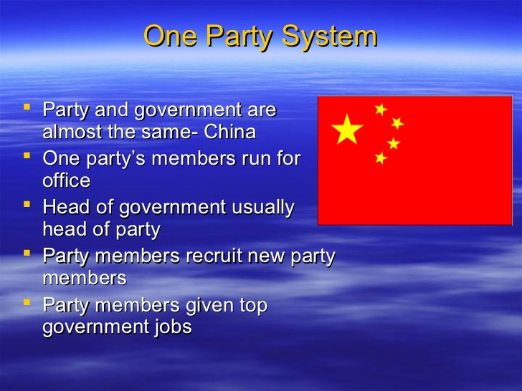

Slide 11
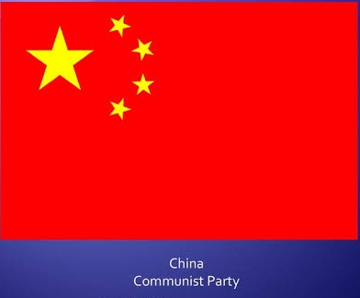
Continue….
Thus, One-party system is a type of system of a state in which one political party has the right to form the govt. All other parties are either outlawed or allowed to take only a limited participation in elections.
Example: China…..

Slide 12
Two-Party System
Two-party system where two major political parties dominate the political landscape. At any point of time, one of the two parties typically holds a majority in the legislature and is usually referred to as the majority or governing party while the other is called as the Minority or Opposition Party.‎
Example: United States, Zimbabwe, United Kingdom, Jamaica, Malta etc.

Slide 13
Multi-Party System
A multi-party system is a political system in which multiple political parties across the political spectrum run for national election and all have the capacity to gain control of government offices, separately or in coalition.
Example: Argentina, Armenia, Brazil, France, Germany, India, Iran, Indonesia and Ukraine etc.

Slide 14
NATIONAL POLITICAL PARTIES
QUALIFICATIONS:
-A party that secures at least 6% of the
total votes in –
Lok Sabha Election, or
Assembly Election in four states.
Wins at least four seats in Lok Sabha.
-They contribute in national unity.

Slide 15
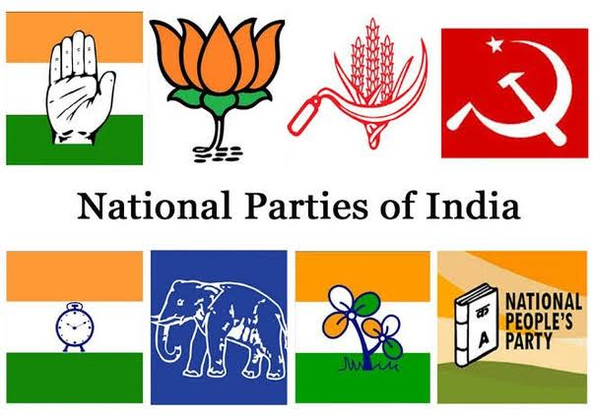
Can you identify the symbols of the National Political parties …??

Slide 16
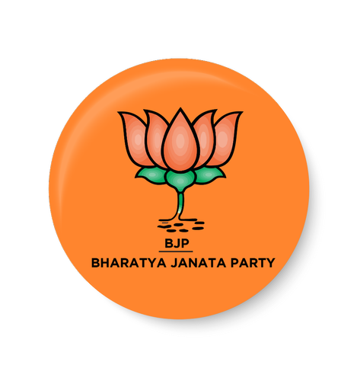
BHARATIYA JANATA PARTY
Founded in 1980 by reviving former Bharatiya Jana Sangh.
Presently largesst single political party of the country.
Taking inspiration by India’s Ancient Culture and Values.
The major conceptual element is its Cultural Nationalism [Hindutva].

Slide 17
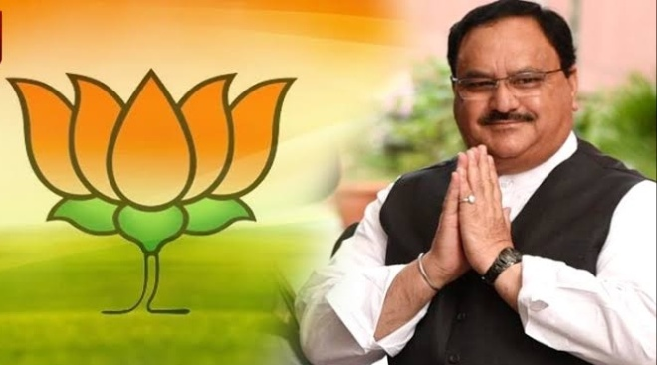
Continuation…. Identify the picture …??
Major Agenda Of BJP:
Wants to build a strong and modern India.
A Uniform Civil Code for all citizen.
Territorial and political integration of Jammu & Kashmir.
Ban on religious conversion.
Currently in power and leading the NDA
[National Democratic Alliance] at Centre.

Slide 18
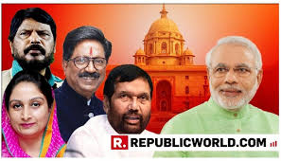
NATIONAL DEMOCRATIC ALLIANCE

Slide 19
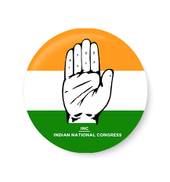
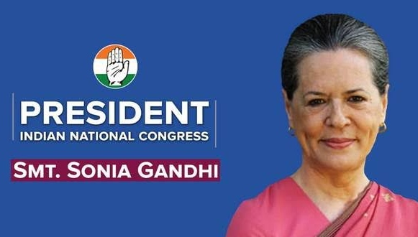
INDIAN NATIONAL CONGRESS
Oldest party of India, Founded in 1885.
Popularly known as the Congress Party.
Present President of the
party is: Smt Sonia Gandhi
Adopted the theory of
secularism, welfare of weaker section
& minorities.

Slide 20
Continuation…
Introduced - New Economic Reforms.
It was a dominant political party and ruled over 60 years either as major party or as alliance.
It gave most Prime Minister to the nation.
Currently lost support, but, leading the alliance as - UPA [ United Progressive Alliance] at Centre.

Slide 21
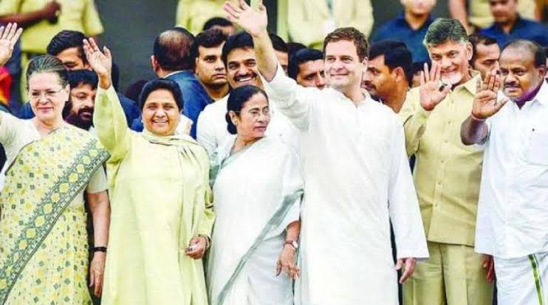
UNITED PROGRESSIVE ALLIANCE

Slide 22
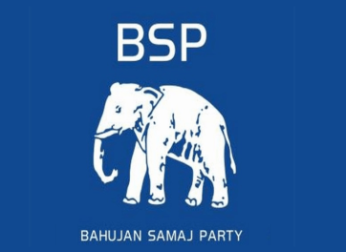
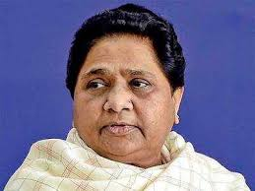
BAHUJAN SAMAJWADI PARTY
Formed in 1984 under the leadership of Kanshi Ram.
Present President of the
party is – Mayawati.
Draws inspiration from
Sahu Maharaja, Mahatma Phule, Periyar Ramaswami Naicker, B R Ambedkar etc.
Fighting for : the Social Transformation and Economic Emancipation of the Bahujans.

Slide 23
continuation…
The Party represents- SCs, STs, OBCs and Religious Minorities.
Supports the reservation policy of the Govt for their upliftment.
Having strong base in Uttar Pradesh and substantial base in Madhya Pradesh, Delhi, Chhattisgarh, Uttarakhand, Punjab etc.

Slide 24
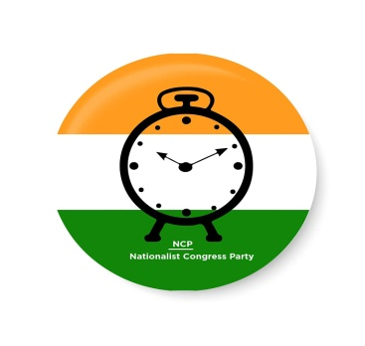
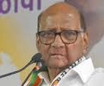
NATIONALIST CONGRESS PARTY
Formed in 1999, due to split
in the Congress Party.
Present President of the
party is: Sharad Pawar.
Ideology: Gandhian secularism, Equality, Democracy, Federalism and Social Justice.
Only Indian born citizen to take over the high offices of the govt.
Coalition govt in many states with UPA .

Slide 25

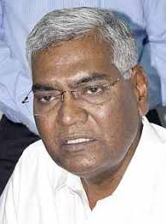
COMMUNIST PARTY OF INDIA
Founded in 1925 by M N Roy.
Believes in Marxism-Leninism, Socialism, Secularism and Democracy.
Opposes- the forces of Secessionism and Communalism.
Having supports among poor, farmer,
factory worker, agricultural labourers and
the intelligentsia.
At present, enjoys strong support in Kerala, West Bengal and Tripura.

Slide 26
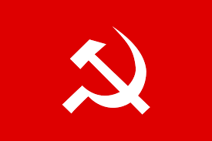
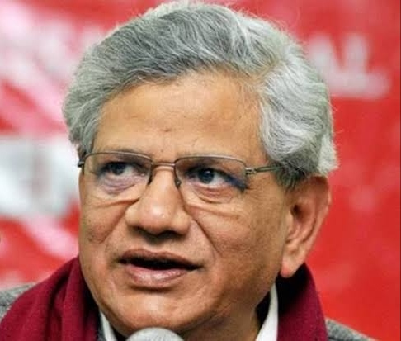
COMMUNIST PARTY OF INDIA-MARXIST
Founded in 1964.
Believes in Marxism-Leninism,
Socialism, Secularism and Democracy.
Opposes- Imperialism and Communalism.
Against of free flow of capitals and goods.
At present, enjoys strong support in Kerala and lost support from West Bengal and Tripura.
Currently supports UPA from outside.

Slide 27
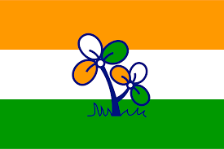
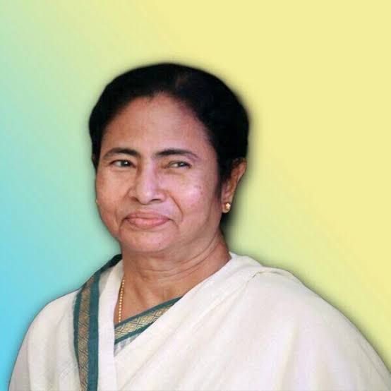
ALL INDIA TRINAMOOL CONGRESS
Founded in 1998, developed
due to split in the INC Party.
Founder & Chairperson-
Mamata Banerjee.
Ideology: Anti-Communism & Bengali Nationalism [ Maa-Mati-Manush].
Currently ruling in West Bengal and have substantial base in Manipur, Tripura and Kerala.
Currently supports UPA at centre.

Slide 28
STATE POLITICAL PARTIES
QUALIFICATIONS:
-A party that secures at least 6% of the total votes in –
An election to the Legislative Assembly election of a state
Wins at least two seats.
-Commonly referred as Regional Party.
-Contributed to the strengthening of federalism and democracy.

Slide 29
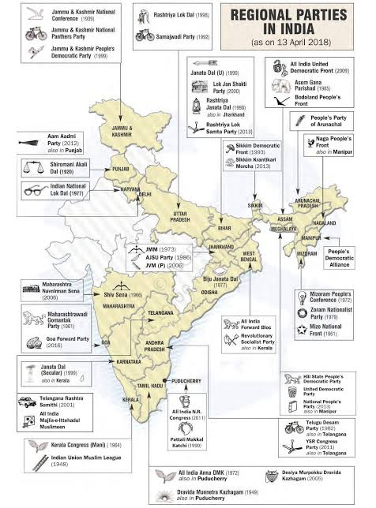

Slide 30

CHALLENGES TO POLITICAL PARTY
Lack of internal democracy within parties.
Challenges of dynastic
succession.
Growing role of money
and muscle power.
Don’t seem to offer a
meaningful choice to the voters.

Slide 31
HOW CAN PARTY BE REFORMED..?
Through, Anti-Defection Law, 1985.
By reducing the influence of money and muscle power.
Filing income tax returns.
By holding organisational
elections.
Declaration of property every
year.
Educational and political awareness of
the party members.

