Slide 1
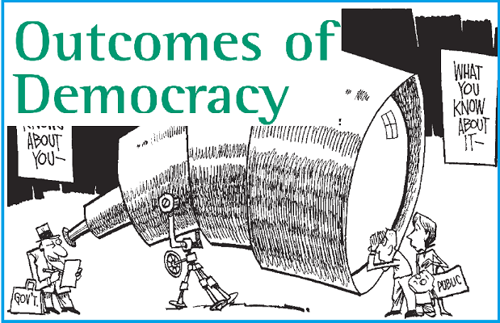

Slide 2
DEMOCRACY IS BETTER THAN DICTATORSHIP OR OTHER FORMS OF GOVERNMENTS.

Slide 3
WHY IS DEMOCRACY A BETTER FORM OF GOVERNMENT ?
PROMOTES EQUALITY AMONG CITIZENS;
ENHANCES THE DIGNITY OF THE INDIVIDUAL;
IMPROVES THE QUALITY OF DECISION MAKING;
PROVIDES A METHOD TO RESOLVE CONFLICTS; AND
ALLOW ROOM TO CORRECT MISTAKES.

Slide 4
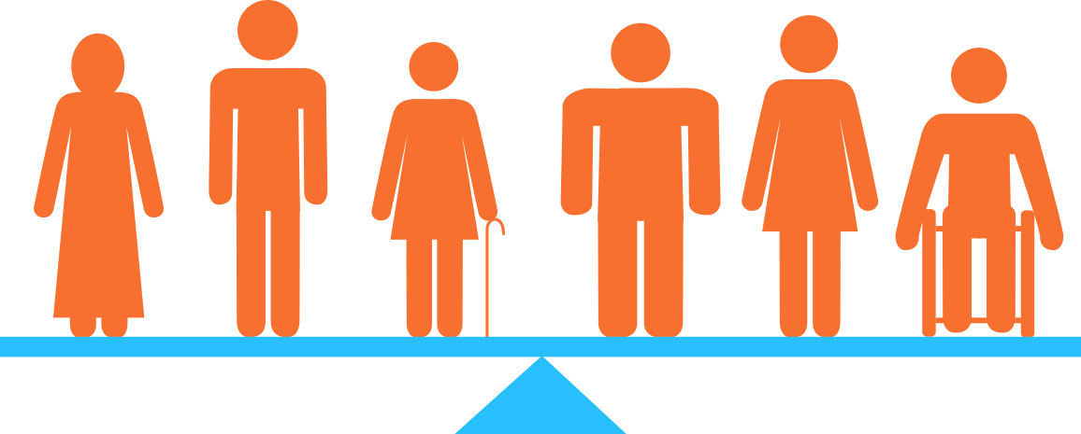
PROMOTES EQUALITY AMONG CITIZENS

Slide 5
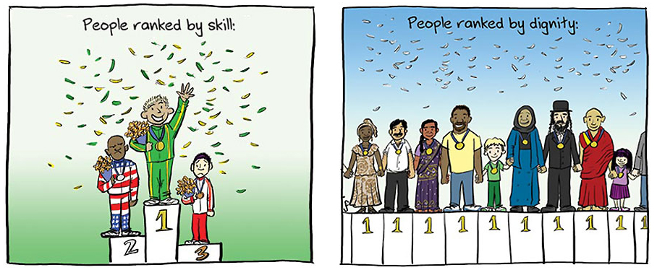
ENHANCES THE DIGNITY OF THE INDIVIDUAL

Slide 6

IMPROVES THE QUALITY OF DECISION MAKING

Slide 7
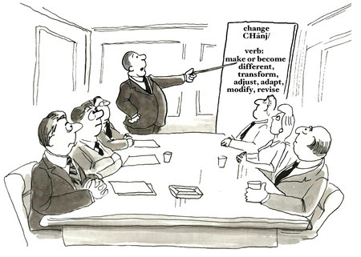
PROVIDES A METHOD TO RESOLVE CONFLICTS

Slide 8
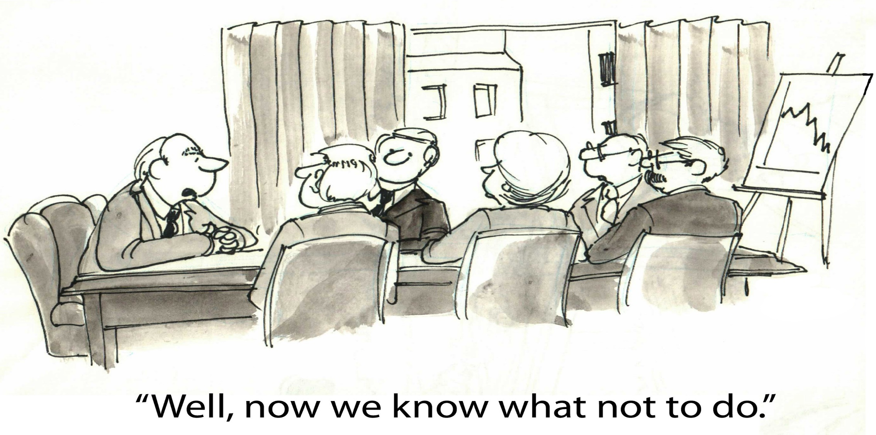
ALLOW ROOM TO CORRECT MISTAKES

Slide 9
What is accountable, responsive and legitimate government?
Accountable
In a democratic government, the working of the government machinery is transparent. It means a citizen can enquire if any decision was taken based on prescribed norms and procedures. Thus, a democratic government follows procedures and is accountable to the people.

Slide 10
People have the right to choose their representatives and control them
Citizens have the rights and the means to examine the process of decision making that is the mechanism of transparency
Practices and institutions like regular, free and fair elections and open public debate
Citizens right to information about the government and its functioning

Slide 11
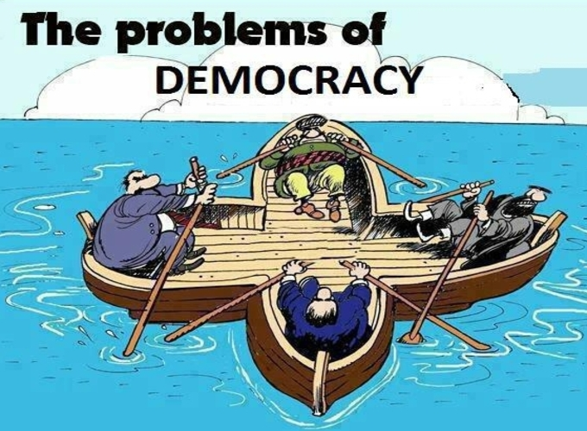
Negative Part of Accountable Democracy
Democracy produces less effective government
In democracy decisions are delayed

Slide 12
JUSTIFICATION
Some people think that democracy produces less effective government. other forms of governments do not have to think about majority opinions and deliberations, but democracy keeps in mind both hence it cannot be called a less effective government
Democracy is based on the idea of deliberation and negotiation so some delay is bound to take place and decision maybe both more acceptable and more effective the cost of time that democracy pays is perhaps worth it.

Slide 13
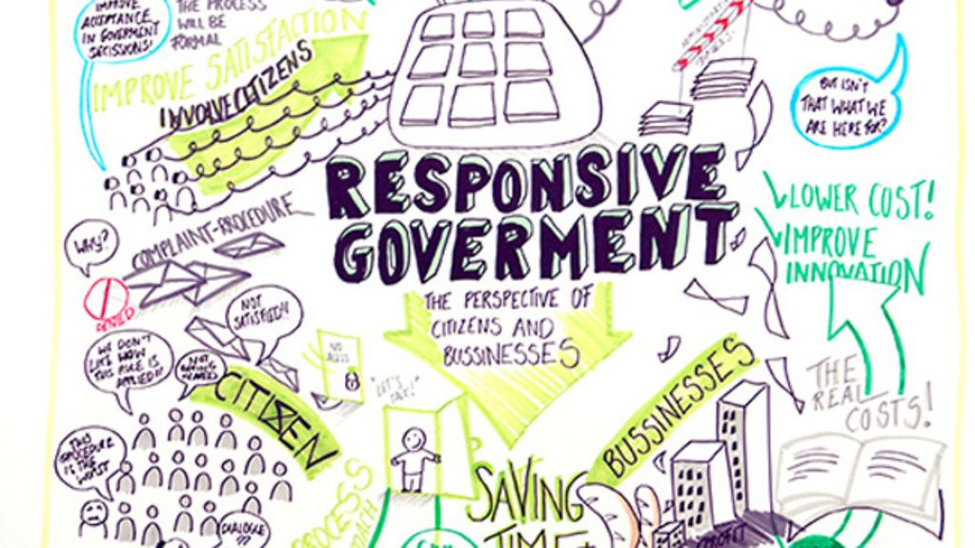

Slide 14
Responsive government
A government is said to be responsive government when it responds to the demands of the public and considers it very much part of the government.

Slide 15
Responsible and responsive to the needs and expectations of the people
It promotes the formation of public opinion and cares about the public opinion.
Democracy is attentive to the needs and demands of the people
it is expected that a democratic government is
-Largely free from corruption
- often sensitive to the people

Slide 16
Negative part of responsive government
Most democracies fell short of elections that provide a fair chance to everyone and in every decision to public debate
Democratic governments do not have a very good record regarding sharing of information.

Slide 17
Justification
All one can say is that democracies have had greater success in setting up regular and free elections. Thus, it is much better than any non-democratic regime in this respects.

Slide 18
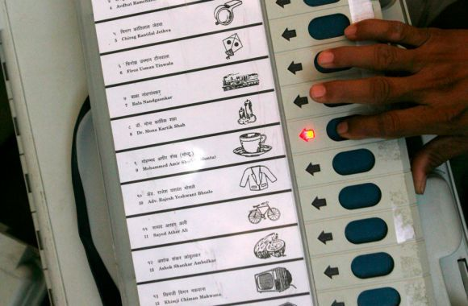
legitimate
The government is legitimate if it is elected by the citizens of the country in free and fair elections.

Slide 19
Democracy is a government of the people
The majority party or group of political parties forms the government
Whenever possible and necessary citizens should be able to participate in decision making that affects them all
It generates its own support to itself

Slide 20
Negative part of legitimate government
Democracies often frustrate the needs of the people and often ignore the demands of a majority of its population.
There are routine tales of corruption which convince us that democracy is not a clean and responsive government

Slide 21
Justification
Democracy may be slow, less efficient,not always responsive and clean but it is people's own government.For example The evidence of South Asian democratic regimes shows that democracy is a suitable government.

Slide 22

ECONOMIC GROWTH AND DEVELOPMENT

Slide 23

ECONOMIC GROWTH
The rate of economic growth in democracies is slow and gradual in the interest of people of the country
Democracy always seeks welfare and social economic equality

Slide 24
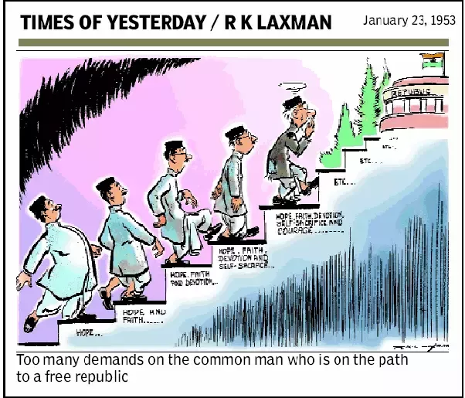
Negative part of economic growth
If we consider all democracies and all dictatorship between 1950 and 2000, we will see that dictatorship have slightly higher rate of economic growth. The inability of democracy to achieve growth worries us.

Slide 25
Justification
This alone cannot be the reason to reject democracy as when we find such significant difference in growth rate, it is better to prefer democracy as it has several other positive outcomes

Slide 26
Economic development
In democracies, economic development depends upon the factors like population size ,global situation ,co operation and economic priorities.
The difference in the rates of economic development in democracies and dictatorship is negligible

Slide 27
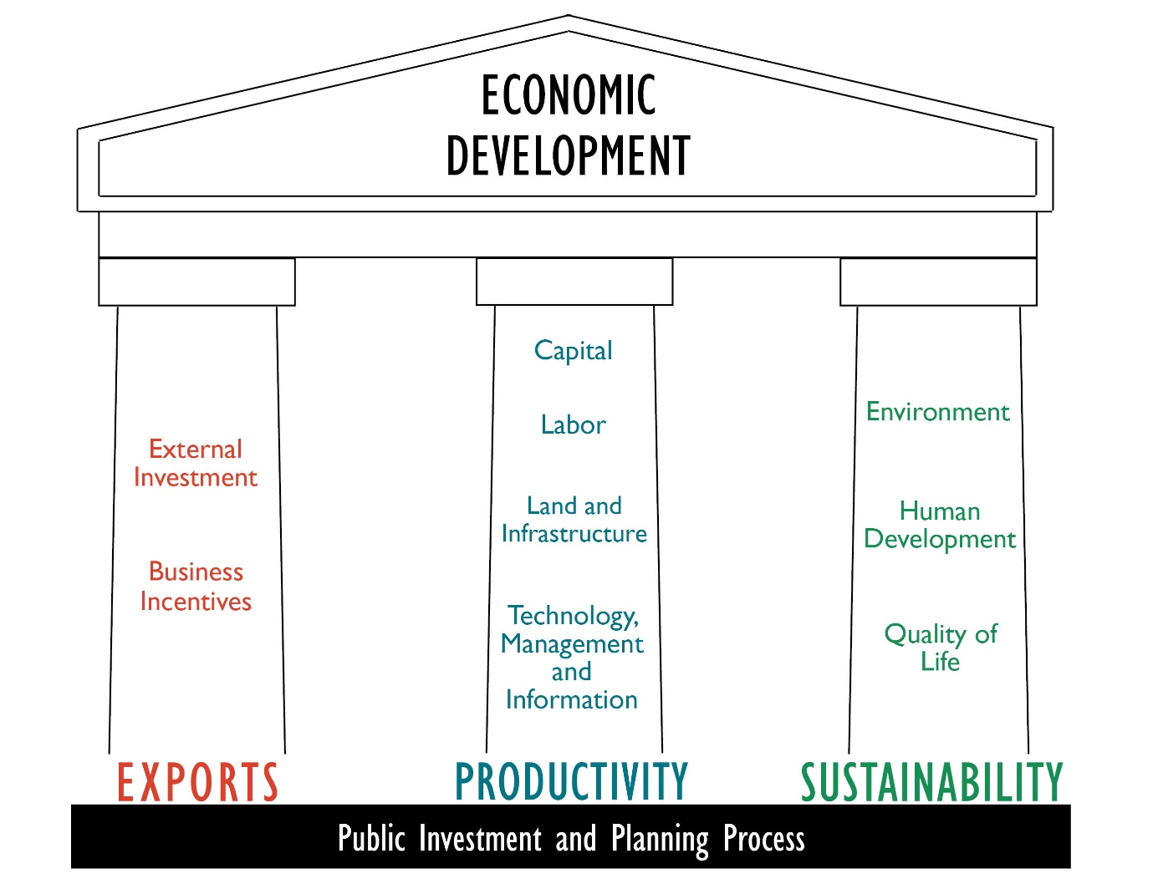

Slide 28
Negative part of economic development
Evidence shows that in practice democracy cannot guarantee high economic development

Slide 29
Justification
We do accept the fact of low economic development in democracy but we can expect democracy not to lag behind dictatorship in this respect.
It is better to prefer democracy as it has several other positive outcomes.

Slide 30
Reduction in inequality of poverty
It is expected from democracy to reduce economic disparities.
Democracies ensure just distribution of goods, incomes and opportunities

Slide 31
Negative part of reduction in inequality of poverty
We find growing economics inequalities in democracy.
In actual life, democracies do not appear to be very successful in eliminating poverty.
A small number of ultra rich enjoy a highly disproportionate share of wealth and income, the have- nots have very little to depend upon.
In Bangladesh, more than half of the population leaves in poverty.
Several poor countries are dependent on the rich countries for their basic needs.

Slide 32
Justification
Democracies lead to a just distribution of goods and opportunities. If democracy cannot completely eliminate poverty, at least it tries to reduce poverty ratio with welfare policies and programs.

Slide 33
Accommodation of social diversity.
Democracies ensure peaceful and harmonious life to citizens.
Democracy usually develops procedure to conduct a competition which reduces the possibility of social tension becoming explosive or violent.
Democratic regime have the ability to handle social difference, divisions and conflicts through the provision of accommodation, reservation and special privileges.
Democracy evolves new mechanism to negotiate.

Slide 34
Dignity and freedom of the citizens.
Democracy stands much superior to any form of government in promoting dignity and freedom of the individuals.
The passion for respect and freedom are the basis of democracy.
Democracy ensures dignity of women. Equal treatment and equal respect are the ingredients of a democratic society.

Slide 35
The principle of individual freedom and dignity have legal and moral force in democracy.
Democracy in India has strengthened the claims of the disadvantaged and discriminated caste for equal status and equal opportunities.

Slide 36
The most distinctive feature about democracy is that it's examination never gets over.
As people get some benefits they ask for more.
People always come up with more expectations and many complaints.

Slide 37
The fact the people are complaining is itself a testimony to the success of democracy.
It transforms people from the status of subjects into that of citizens

