Slide 1
C H A L L E N G E S T O
D E M O C R A C Y

Slide 2
M A I N C H A L L E N G E S T O D E M O C R A C Y :
CORRUPTION AND INEFFICIENCY
ROLE OF ANTI- SOCIAL ELEMENTS
•
GROWING ECONOMIC AND SOCIAL INEQUALITIES AMONG PEOPLE
CASTEISM AND COMMUNALISM

Slide 3
WHAT IS A CHALLENGE?
A CHALLENGE IS A DIFFICULTY THAT CARRIES WITHIN IT AN OPPORTUNITY FOR PROGRESS.
Once people overcome it , they go up to a higher level than before. Every country and every individual face different type of challenges.

Slide 4
FOUNDATIONAL CHALLENGE
Foundational challenge involves making the transition to democracy and then instituting a democratic government.This involves bringing down the existing non-democratic regime, keeping military away from controlling government and establishing a sovereign and functional state.
For eg:
Pakistan still faces the challenge of foundation because every Pakistani ruler bows down to the military even if elected by people, to avoid being overthrown.
Nepal is a very good example of overcoming its foundational challenge where monarchy was replaced by democratic government.

Slide 5
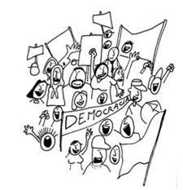
CHALLENGE OF EXPANSION
It involves applying the basic principle of democratic government across all the regions, different social groups and various institutions.
Issues like ensuring greater power to local governments, extension of federal principle to all the units of the federation, inclusion of women and minority groups, etc. are seen.
It also means no decision should be exclusive of control of democracy.

Slide 6
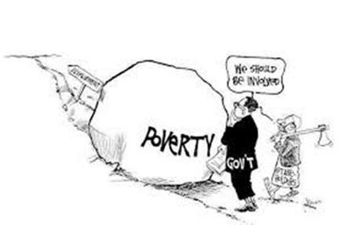
DEEPENING OF DEMOCRACY
It involves strengthening of the institutions and practices of democracy.This should happen in such a way that people can realise their expectations of democracy.
But ordinary people have different expectations from democracy in different societies. Therefore, this challenge takes different meanings and paths in different parts of the world. All in all it means strengthening those institutions that help people’s participation and control.
This requires an attempt to bring down the control and influence of the rich
and powerful people in making governmental decision.
For eg:
Rule of Salvador Allende in Chile was opposed but if seen, it was helping in
overcoming challenge of deepening of democracy.

Slide 7
POLITICAL REFORMS
Law has an important role to play in political reforms. Carefully developed changes in law help
discourage wrongdoings and encourage good political practices.
Democratic reforms should be taken out by political ventures, parties, campaigns and politically attentive subjects.
A bill should be made to control the internal activities of administrative parties. Political bodies should maintain a record of its members, to hold accessible polls, to support its own Constitution, etc.
The quality of self-government depends on the level of public sharing. It is challenging to reform governments if common citizens do not directly engage in politics and just criticize it from extreme.Thus, the support of citizens in politics is unavoidable for a republic.
Any proposal for political reforms should not only think about the what is a good solution but
also about its implementation.
RTI ACT IS ONE OF THE BEST LAW REFORM WHICH EMPOWERS PEOPLE TO CARRY OUT DEMOCRATIC REFORMS.

Slide 8
R E D E F I N I N G D E M O C R A C Y
T H E D E F I N I T I O N O F D E M O C R A C Y W I L L B E
R E D E F I N E D I F T H E F O L L OW I N G A R E A D D E D TO I T :
T H E R U L E R S E L E C T E D B Y T H E P E O P L E M U S T TA K E A L L T H E M A J O R D E C I S I O N S ;
E L E C T I O N S M U S T O F F E R A C H O I C E A N D F A I R
O P P O RT U N I T Y TO T H E P E O P L E TO C H A N G E T H E
C U R R E N T R U L E R S ;
T H I S C H O I C E A N D O P P O RT U N I T Y S H O U L D B E AVA I L A B L E TO A L L T H E P E O P L E O N A N E Q U A L B A S I S ;
T H E E X E R C I S E O F T H I S C H O I C E M U S T L E A D TO
A G OV E R N M E N T L I M I T E D B Y B A S I C R U L E S O F
T H E C O N S T I T U T I O N A N D C I T I Z E N S ’ R I G H T S .

