Slide 1
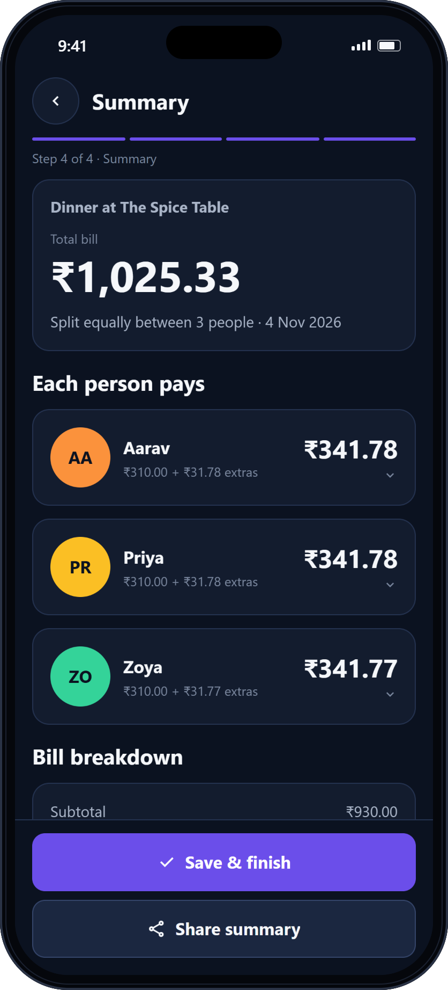
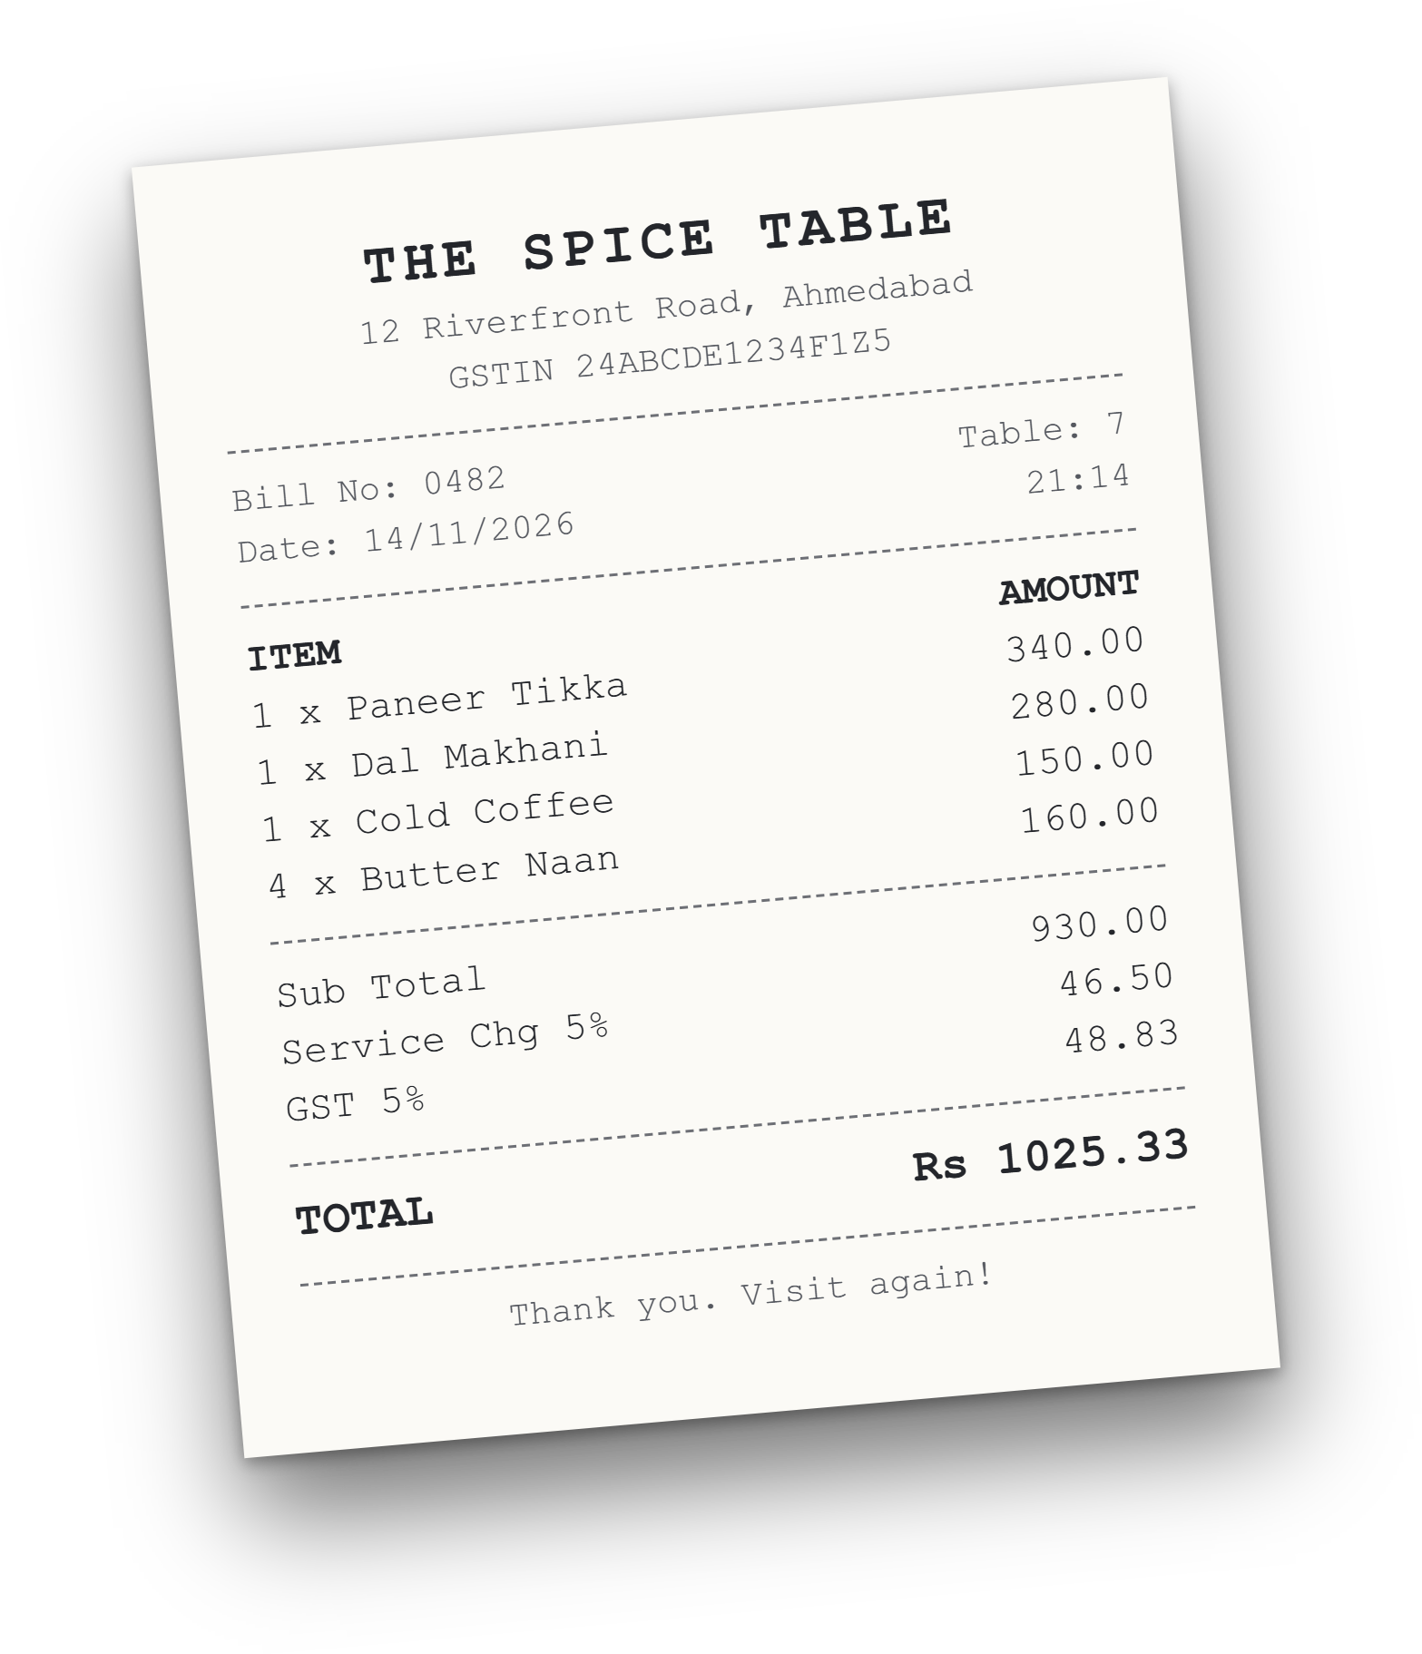
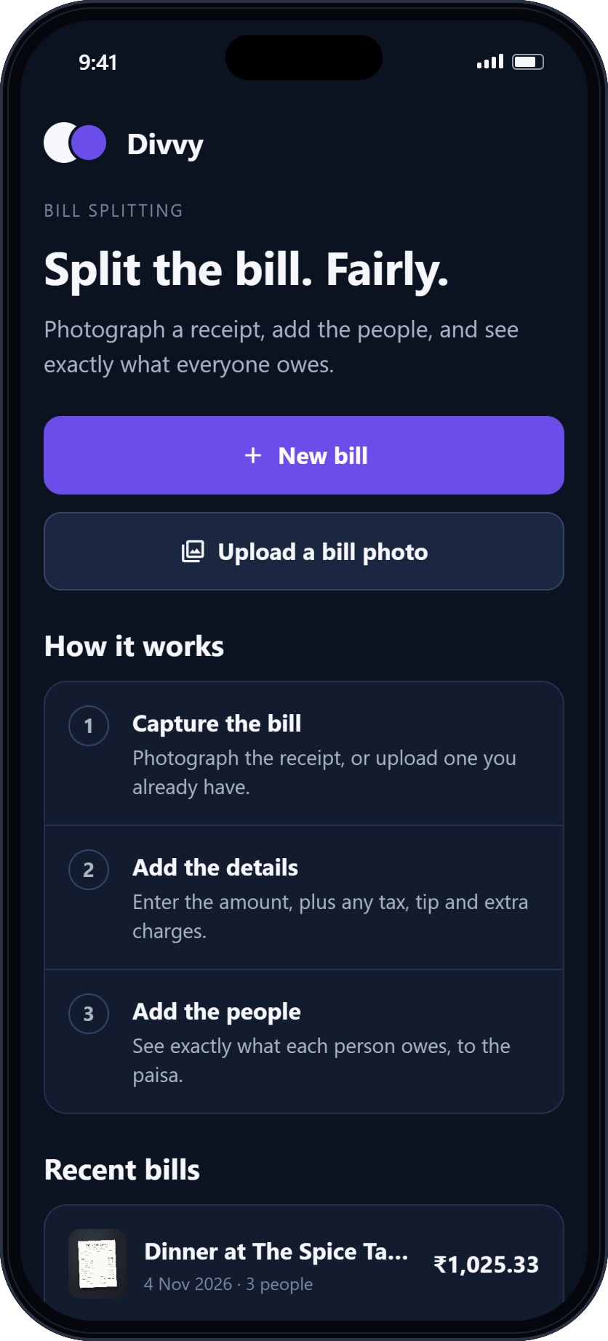
Divvy
MOBILE APPLICATION DEVELOPMENT · PROJECT
Split the bill.
Fairly.
Divvy — intelligent, receipt-based bill splitting
Photograph a receipt, add the people, and see exactly what everyone owes — to the paisa.
Krish Dwivedi
BSc Computer Science · UIT, Karnavati University
Mobile Application Development · 2026
Notes:
Divvy is a mobile app that splits a restaurant bill fairly and exactly. The phones show real screenshots of the running app; the receipt is a sample bill used throughout this presentation.

Slide 2
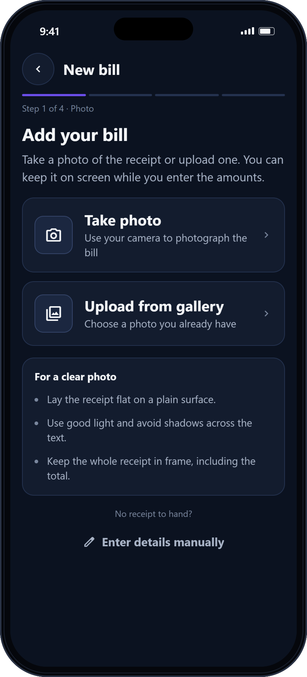




02 · INTRODUCTION
Meet Divvy
Divvy turns a photographed restaurant bill into a fair, exact split for everyone at the table.
What it is
A receipt-first mobile app for iPhone and Android, built with React Native and Expo.
The problem it solves
Shared bills are split by hand: slow, error-prone and hard to verify.
Who it is for
Friends, flatmates, students and colleagues who eat out and share costs.
Why it is useful
Every share is exact, explained line by line, and computed on the device.
APP SCREENSHOT · ADD YOUR BILL
Divvy Mobile Application Development · UIT, Karnavati University
02 / 15
Notes:
What Divvy is, the problem, the audience and why it is useful. The screen on the right is the real capture screen.

Slide 3





03 · PROBLEM STATEMENT
Splitting a bill by hand is slow, unclear and often wrong
Manual calculations
Totals worked out on a calculator, at the table.
BY HAND
WITH DIVVY
₹1,025.33 ÷ 3
Item by item
Allocating items
= 341.7766… → ₹341.78 each
Plus fair service charge and GST
Equal splits ignore who actually ordered what.
AA
Aarav
₹341.78
AA
Aarav
₹349.15
Taxes and charges
Is GST charged on the service charge? Usually guessed.
PR
Priya
₹341.78
PR
Priya
₹349.12
ZO
Zoya
₹341.78
ZO
Zoya
₹327.06
Inaccurate shares
Rounding each share separately creates or loses paise.
Collected ₹1,025.34
Collected ₹1,025.33
No record
₹0.01 over the bill, and Zoya pays ₹14.71 for paneer she never ate.
Exactly the bill. Each person pays for what they ordered.
Once the chat moves on, nobody remembers who paid what.
Same sample bill: 4 items, service charge 5%, GST 5% — 3 people.
Divvy Mobile Application Development · UIT, Karnavati University
03 / 15
Notes:
Left: the five recurring problems. Right: the same sample bill split by hand and by Divvy. Rounding 341.7766 up for everyone collects one paisa too many; an equal split also charges Zoya for food she did not order. Divvy's figures are produced by the project's calculation engine.

Slide 4










04 · PROPOSED SOLUTION
Implemented
Final release
A receipt-first workflow, from photo to fair share
Divvy starts from the receipt itself. Each step hands clean, structured data to the next — and every value stays editable.
01
02
03
04
05
06
07
Capture
Scan
Review
People
Allocate
Calculate
History
Photograph the bill or pick it from the gallery
On-device OCR reads items, prices and charges
Check and correct every extracted value
Add everyone sharing the bill
Assign each item to whoever ordered it
Exact shares, including tax, tip and charges
Save, revisit and share past bills
Receipt-first
Exact to the paisa
Private by design
The photo is the starting point of the bill, not an attachment.
Shares always add up to the bill total — by construction.
Runs on the device. No account, nothing uploaded.
Divvy Mobile Application Development · UIT, Karnavati University
04 / 15
Notes:
The seven-step workflow. Filled circles are implemented in the app today; outlined circles (scanning, reviewing extracted values and item-by-item allocation) complete the final release. The calculation engine already supports item allocation.

Slide 5
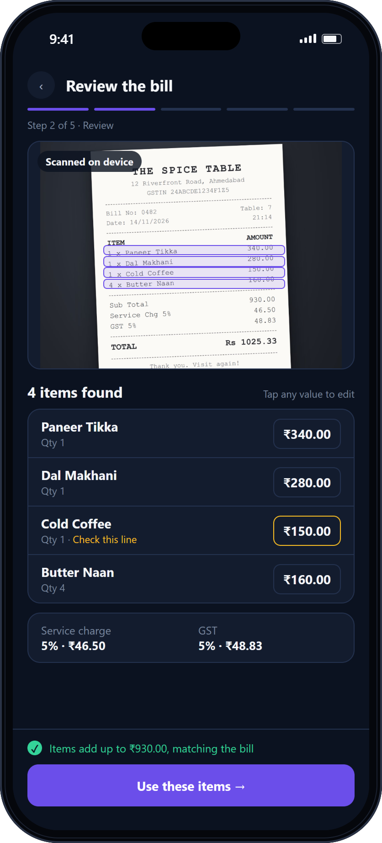
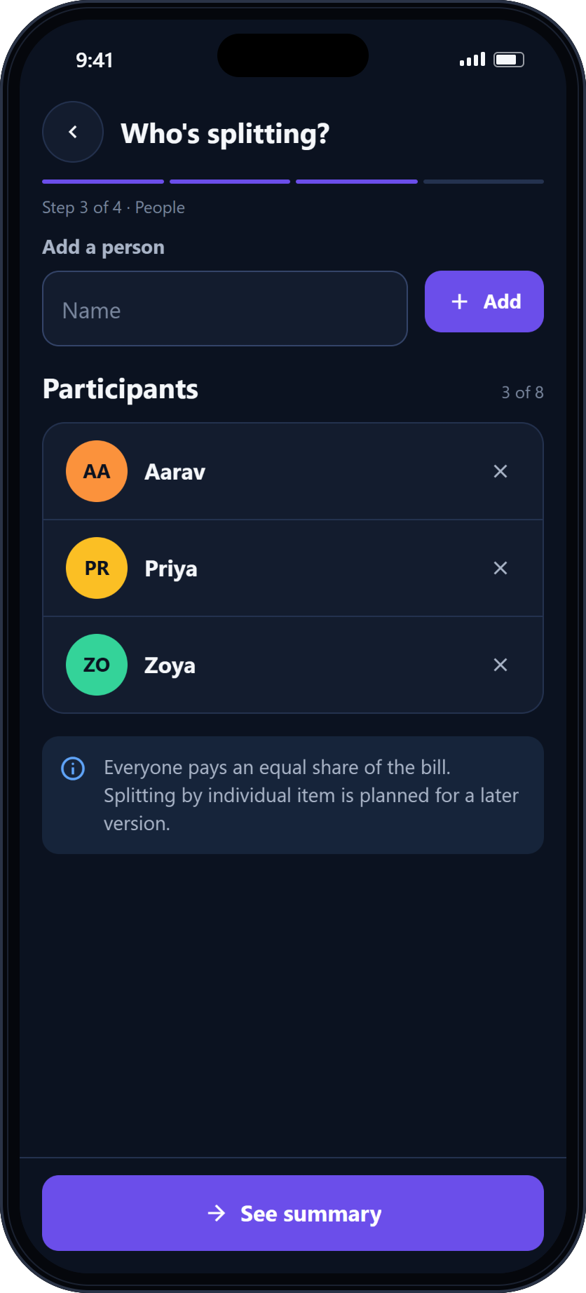
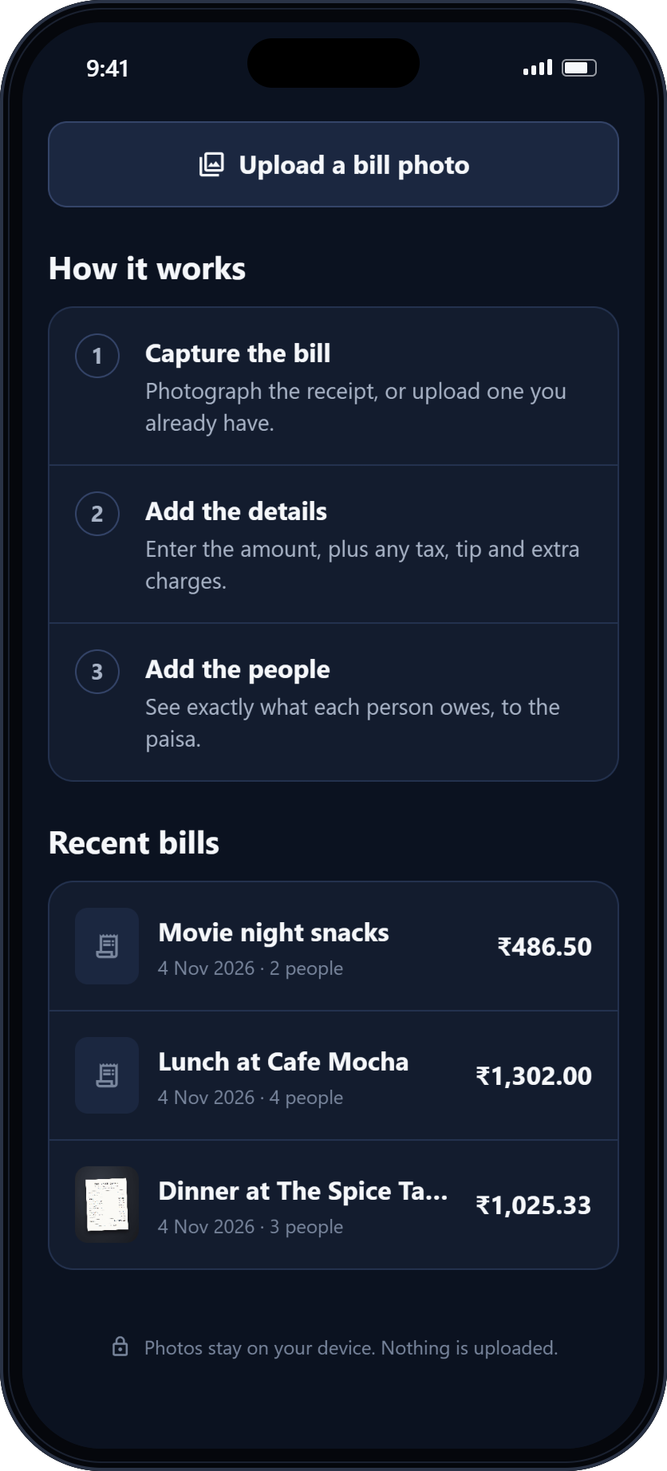
05 · APPLICATION OVERVIEW
The Divvy app
Home dashboard
Receipt scanning
Bill summary
Participants
Bill history
APP SCREENSHOT
CONCEPT DESIGN
APP SCREENSHOT
APP SCREENSHOT
APP SCREENSHOT
Divvy Mobile Application Development · UIT, Karnavati University
05 / 15
Notes:
Four of these five screens are real screenshots of the running app (web build at iPhone size). Receipt scanning is a concept design for the final release, built from the app's own design tokens.

Slide 6









06 · CORE FEATURES
Implemented
Final release
Everything needed to split a bill properly
Camera capture
Gallery upload
Automatic extraction
Editable bill details
Photograph a bill with the system camera
Use a receipt photo you already have
On-device OCR reads items, prices and totals
Amount, tax, tip and extra charges
Participants
Item-wise allocation
Automatic splitting
Tax, tip and charges
Up to 8 people, each with a colour avatar
Assign every item to whoever ordered it
Exact shares, recalculated instantly
Percent or fixed amount, applied in order
Individual breakdowns
Bill history
Share summary
Private by design
See exactly how each share is made up
Recent bills on the home screen
Send the split to the group as text
On device, no sign-up, nothing uploaded
Divvy Mobile Application Development · UIT, Karnavati University
06 / 15
Notes:
Twelve capabilities. Ten are implemented today; automatic extraction (OCR) and the item-allocation interface complete the final release. Bill history currently lists recent bills on the home screen; saving them permanently on the device is part of the final release.

Slide 7
07 · SYSTEM ARCHITECTURE
Implemented
Final release
How the system fits together
A layered, fully on-device design. The calculation core is pure TypeScript with no framework imports.
ON THE DEVICE · iOS AND ANDROID · NO BACKEND
Presentation layer
Home
Capture
Preview
Details
People
Summary
Expo Router screens · design system
form input & edits
rendered on Summary
photo → recognised lines → parsed items
Camera & gallery
Text recognition
Receipt parser
Bill state
Calculation engine
Settlement
expo-image-picker
Google ML Kit
pure TypeScript
reducer + context
buildBill → computeSettlement
per-person totals
src/platform
src/ocr
src/ocr
src/store
src/core
derived, never stored
Inputs are stored; money is always recomputed from them, so totals can never go stale.
Bill history
Share
SQLite, on device
system share sheet
Divvy Mobile Application Development · UIT, Karnavati University
07 / 15
Notes:
Solid boxes exist in the code today; dashed boxes (ML Kit text recognition, the receipt parser and SQLite history) complete the final release. The engine in src/core imports nothing from React, React Native or Expo — it takes a plain Bill and returns a plain Settlement.

Slide 8
08 · DATA FLOW DIAGRAM
DFD Level 0 — context diagram
Device camera
and photo library
Captured or chosen image
User
person splitting the bill
Receipt photo
Bill details and corrections
Camera / picker request
0
Divvy
bill-splitting system
Participants and item allocations
Extracted bill for review
Individual shares and breakdown
Bill history
Split summary (text)
Messaging apps
via the system share sheet
External entity
Process
Data flow
Yourdon–DeMarco notation. Data stores appear at Level 1.
Divvy Mobile Application Development · UIT, Karnavati University
08 / 15
Notes:
Context diagram: the whole system is one process. The user supplies the receipt, bill details, participants and allocations, and receives the extracted bill to review, each person's share and the bill history. The device camera and photo library supply images; the split summary leaves through the system share sheet.

Slide 9
09 · DATA FLOW DIAGRAM
DFD Level 1 — major processes
User external entity
receipt photo
corrections
participant names
1.0
Capture or upload receipt
2.0
Extract receipt information
items &
charges
3.0
Review and correct details
4.0
Manage participants
image
image
bill details
people
D1
Receipt images
D2
Bill draft (items, charges, people)
items, people
save
7.0
Save and retrieve bills
6.0
Calculate individual shares
5.0
Allocate expenses
D3
Bill history
settled bill
allocated bill
past bills
bill history
individual shares
item assignments
User * same entity, drawn twice for clarity
Divvy Mobile Application Development · UIT, Karnavati University
09 / 15
Notes:
Level 1 expands the single process into seven. D1 holds the receipt image, D2 the bill being built (items, charges and participants), and D3 saved bills. Settlements are derived from D2 every time rather than stored, so a saved total can never disagree with its inputs.

Slide 10
10 · TECHNOLOGY STACK
Implemented
Final release
Built on a modern, native-first stack
FRAMEWORK
APP LAYER
DEVICE & DATA
QUALITY
RN
React Native 0.88
ER
Expo Router
IP
expo-image-picker
JS
Jest + ts-jest
Native UI for iOS and Android from one codebase
File-based, typed navigation between screens
Camera capture and gallery upload
274 automated tests, incl. a 1,000-bill property test
EX
Expo SDK 58
R19
React 19
ML
Google ML Kit
ES
ESLint + Prettier
Tooling, device APIs and Expo Go on the iPhone
UI, with state in a pure reducer + Context
On-device text recognition for receipts
Linting and formatting, zero warnings allowed
TS
TypeScript
SF
expo-image · expo-symbols
SQ
SQLite
HB
Hermes
Strict types; money is a branded Paise type
Fast images and native SF Symbols icons
On-device storage of past bills
JavaScript engine for the mobile bundle
Divvy Mobile Application Development · UIT, Karnavati University
10 / 15
Notes:
Only technologies the project actually uses are listed as implemented. Google ML Kit was selected and prototyped in a spike, but runs only in a development build, so it is part of the final release, as is SQLite history.

Slide 11
11 · CORE LOGIC
How Divvy calculates each share
1
Money is an integer
WORKED EXAMPLE · THE SPICE TABLE
Every amount is stored in paise: ₹123.45 is 12345. No floating point ever touches money.
AA
PR
ZO
Total
2
Split each item
Paneer Tikka
170.00
170.00
—
340.00
An item is divided among the people who ordered it. Spare paise go to them in a fixed order.
shared by Aarav, Priya
Dal Makhani
93.34
93.33
93.33
280.00
shared by all three
Cold Coffee
—
—
150.00
150.00
3
Apply charges in order
Zoya
Service charge on the items, then GST on items + service, then tip. Percentages round once, half away from zero.
Butter Naan ×4
53.34
53.33
53.33
160.00
shared by all three
Items subtotal
316.68
316.66
296.66
930.00
4
Largest remainder
Service charge 5%
15.84
15.83
14.83
46.50
Each charge is shared in proportion to what each person ordered; leftover paise go to the largest remainders.
of ₹930.00
GST 5%
16.63
16.63
15.57
48.83
of ₹976.50 = 48.825 → 48.83
5
Reconcile
Each person pays
349.15
349.12
327.06
1,025.33
Σ shares = bill total is checked on every bill and proven on 1,000 generated bills.
Σ = 102,533 paise = 93,000 + 4,650 + 4,883 — exactly the bill, as computed by Divvy's engine.
Divvy Mobile Application Development · UIT, Karnavati University
11 / 15
Notes:
The worked example is taken from docs/money-model.md and reproduced by running the real engine (computeSettlement). Dal ₹280 ÷ 3 leaves one paisa, which goes to Aarav (first by id). Service: floors sum to 46.49, the leftover paisa goes to the largest remainder (Aarav). GST 48.825 rounds half away from zero to 48.83; floors sum to 48.81 and the two leftover paise go to Aarav and Priya. Tip is apportioned the same way.

Slide 12






12 · FEATURES AND USP
What makes Divvy different
THE GUARANTEE
Σ shares = total
Receipt-first
Less typing
The bill photo is where every split begins, not an afterthought.
Scanning pre-fills items and charges; you confirm instead of typing.
Exactly — not approximately — on every bill. No paisa is created or lost by rounding.
Transparent
Exact money
Every share is broken down into items, charges and tax.
Integer paise and largest-remainder rounding, end to end.
274
automated tests
1,000
generated bills reconciled
Built for Indian bills
Private and offline
8
people per bill
GST on service charge, ₹ with lakh-style grouping.
Runs on the device. No account, no upload, no network.
Divvy Mobile Application Development · UIT, Karnavati University
12 / 15
Notes:
The figures are real: 274 tests pass in the repository (10 suites), the property test generates 1,000 random bills and checks the invariant on each, and the app caps a bill at 8 participants to match its 8-colour avatar palette.

Slide 13
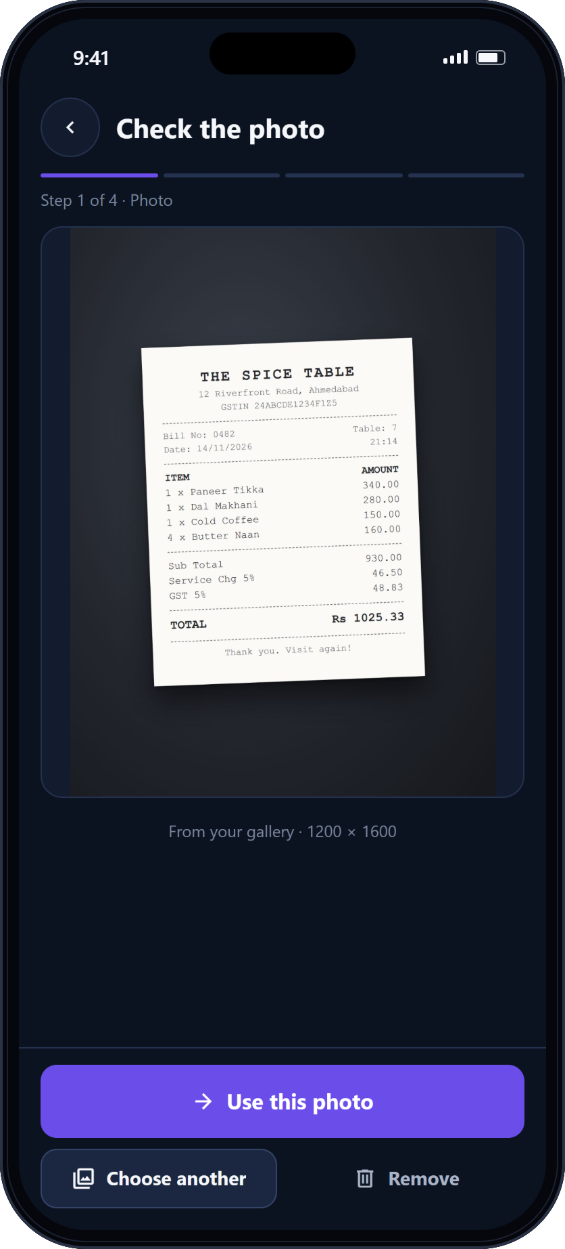
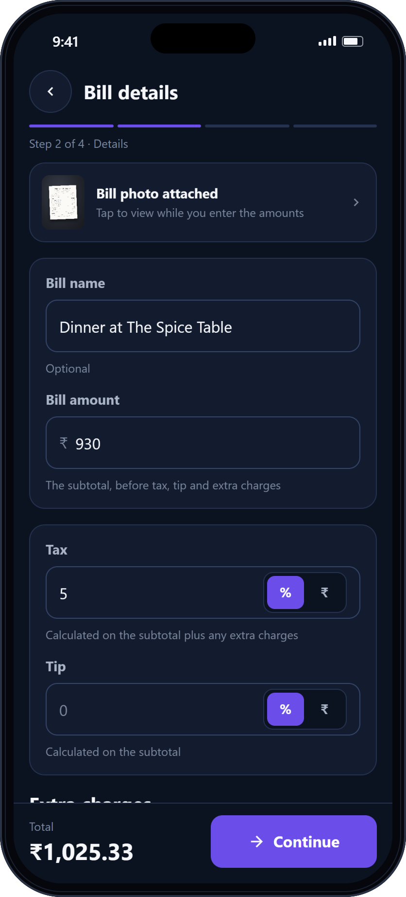
13 · USER EXPERIENCE
The user journey
1
2
3
4
5
6
Start
Add the bill
Check the photo
Bill details
Who's splitting
Each person pays
Begin a new bill
Camera or gallery
Retake or replace
Amount, tax, charges
Add the people
Exact shares
App screenshots of the working flow. Final release adds Scan & review after step 3 and Assign items after step 5.
Divvy Mobile Application Development · UIT, Karnavati University
13 / 15
Notes:
The six screens are real screenshots, captured by driving the app with the sample receipt. In the final release, receipt scanning slots in after the photo is confirmed, and item assignment after the people are added.

Slide 14





14 · FUTURE SCOPE
Where Divvy goes next
Beyond the final release — directions that build on the same exact, on-device core.
Smarter OCR
Advanced allocation
Group expenses
Settlement tracking
Tune the parser on a corpus of real Indian receipts; flag low-confidence lines.
Drag-to-assign, fractional shares (½, ⅓) and splitting by unit.
Saved groups of friends and flatmates for one-tap setup.
Mark who has paid, with a UPI payment link for each person.
WHAT STAYS THE SAME
Exact money, transparent shares, private by default.
History and analytics
Optional cloud sync
Personalisation
Search, filters and monthly spending summaries.
Opt-in backup across devices; on-device stays the default.
Light theme, default tax and tip, saved preferences.
Divvy Mobile Application Development · UIT, Karnavati University
14 / 15
Notes:
Future scope only — none of these are claimed as built. Each extends the existing engine: it already supports per-item assignment, discounts and ordered adjustments, so the work is mostly interface.

Slide 15
15 · CONCLUSION
Conclusion
01
Problem
Divvy
Splitting a shared bill by hand is slow, error-prone and hard to verify.
02
Solution
Divvy turns a receipt photo into an exact, item-by-item split in a few taps.
Thank you
03
Technical contribution
A pure-TypeScript money engine in integer paise — ordered charges, largest-remainder rounding — proven by 274 tests.
Questions are welcome.
04
Product value
Krish Dwivedi
BSc Computer Science · UIT, Karnavati University
Mobile Application Development · 2026
Fair, transparent shares that everyone at the table can trust and check.
Notes:
Summary of the problem, the solution, the technical contribution and the product value. Thank the panel and invite questions.

