Slide 1
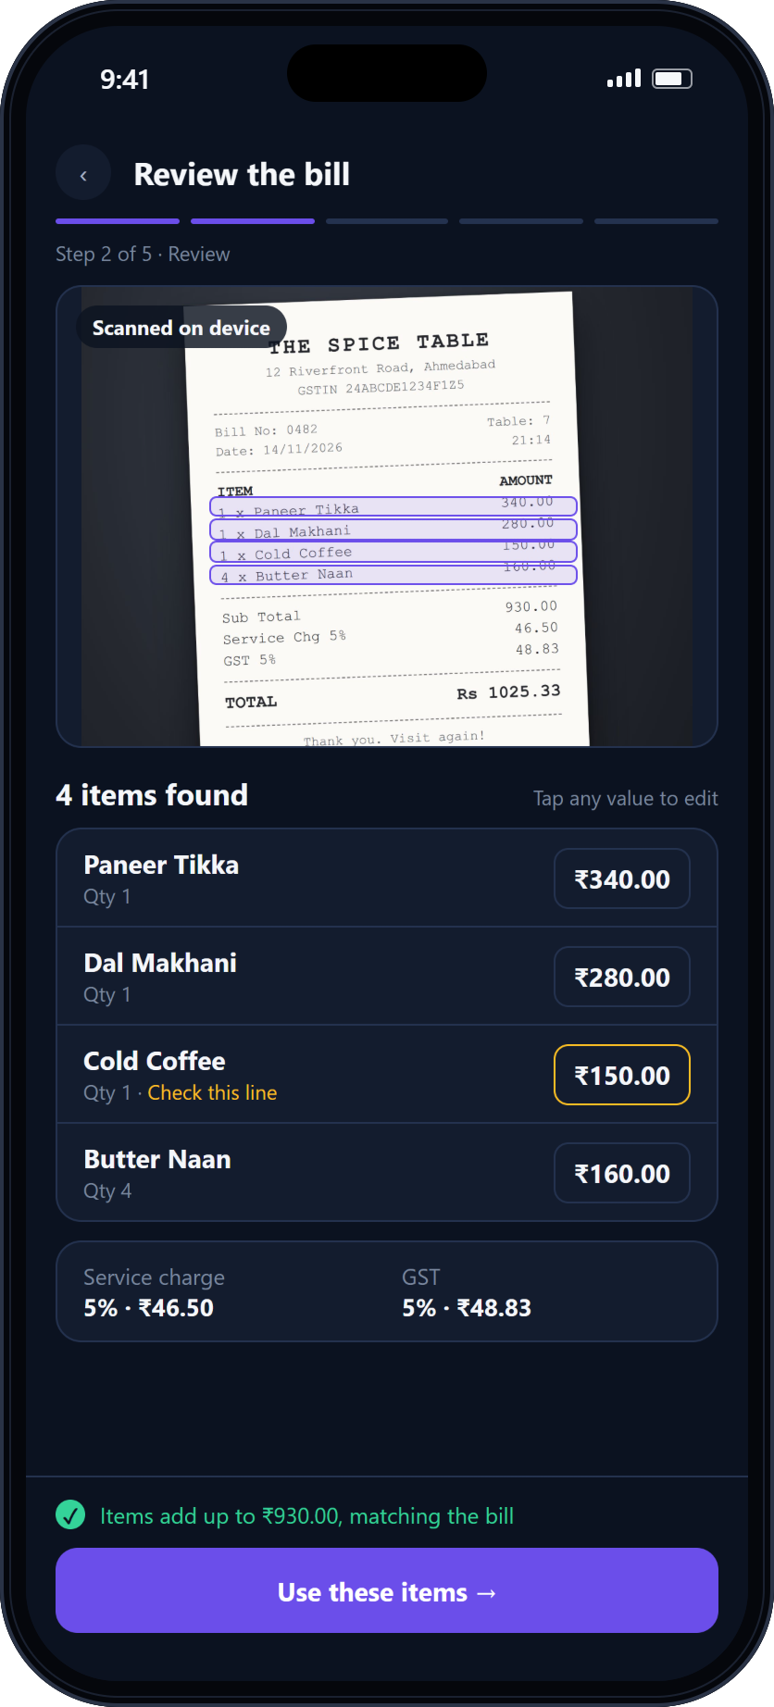
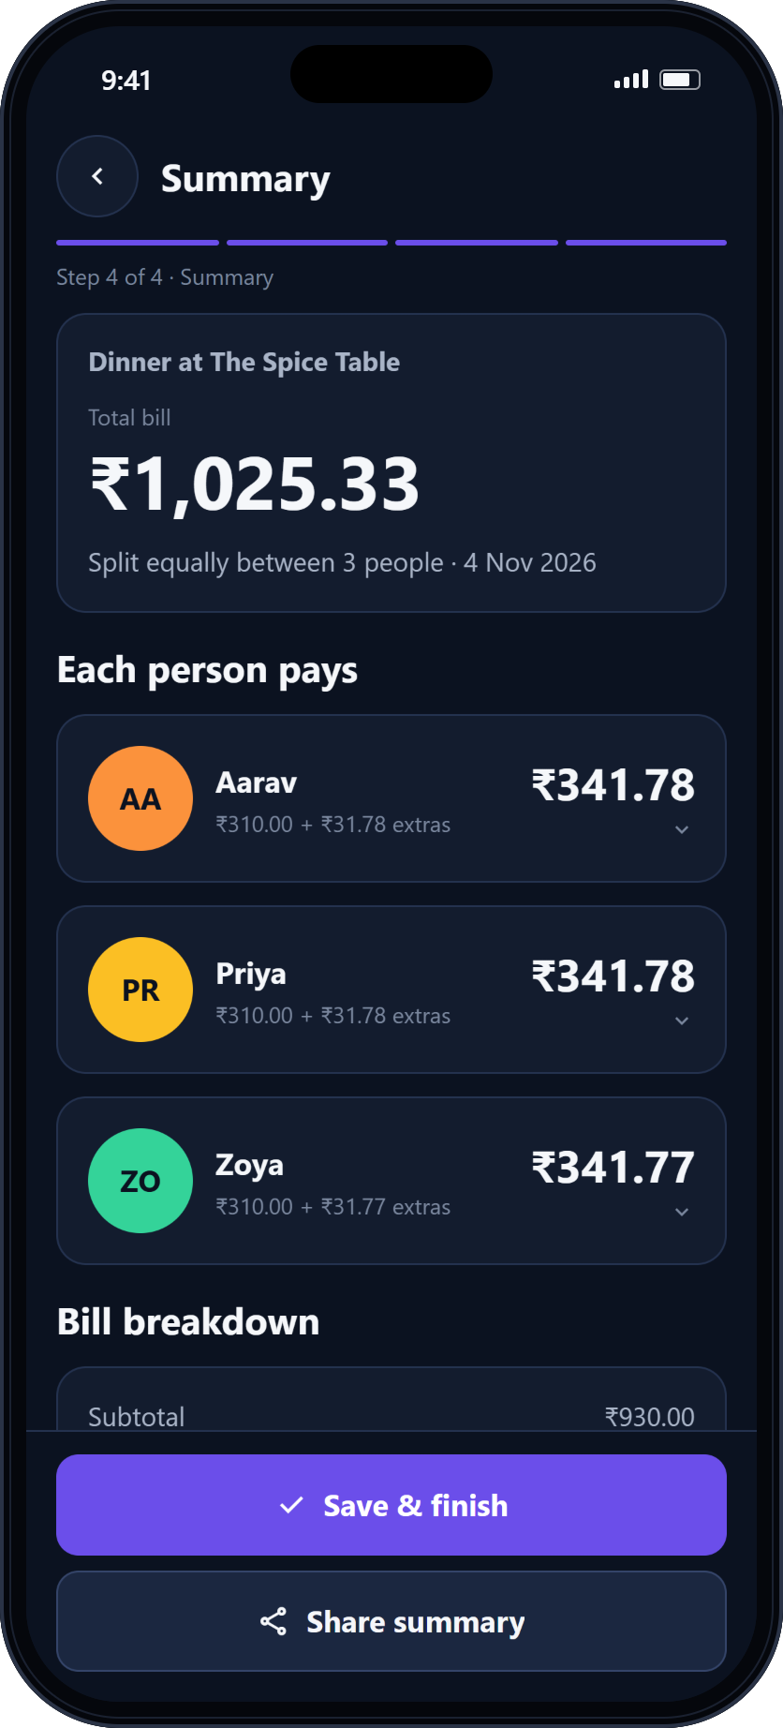
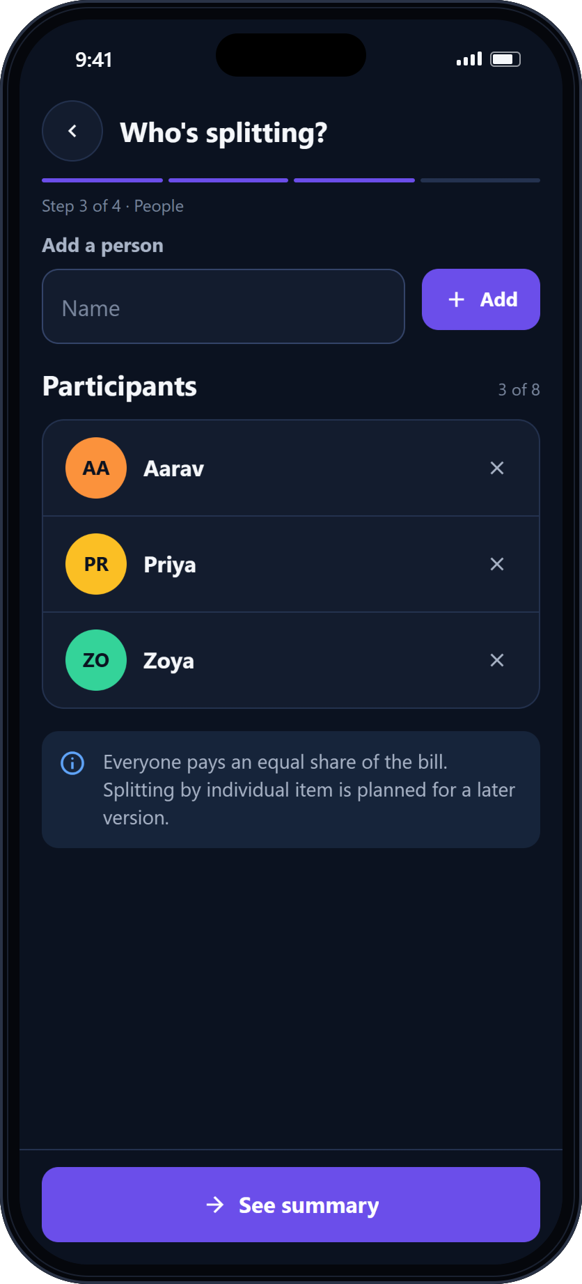
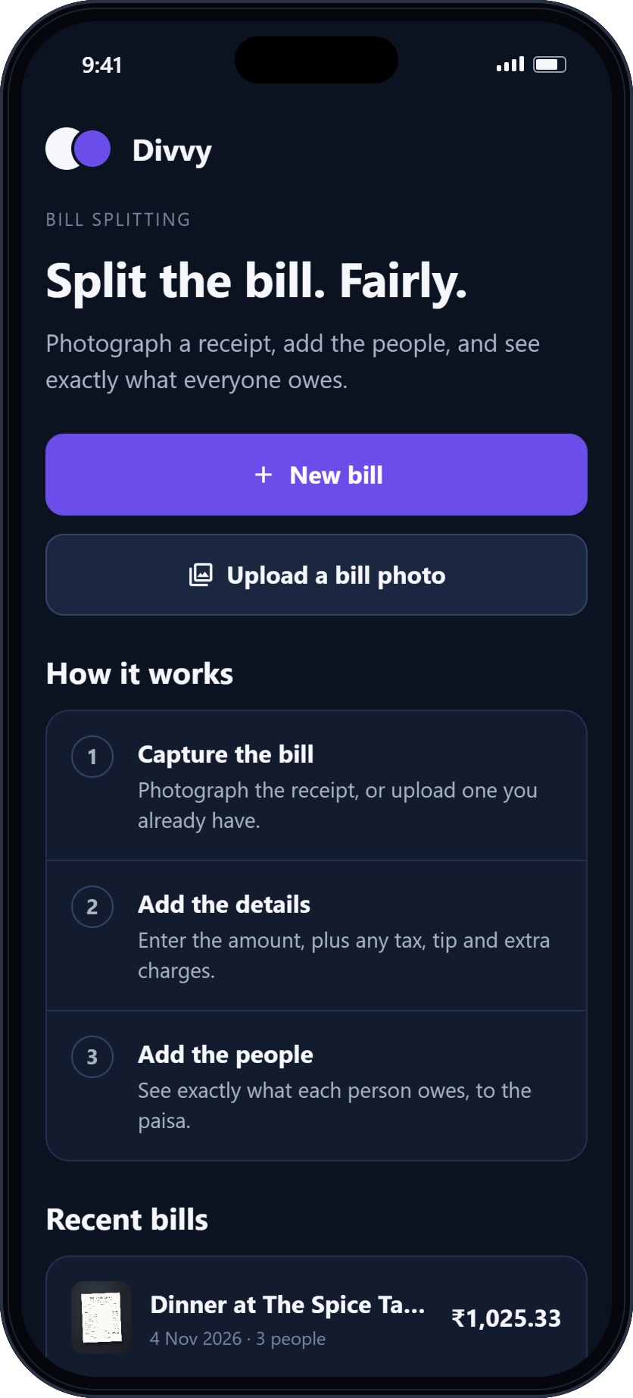
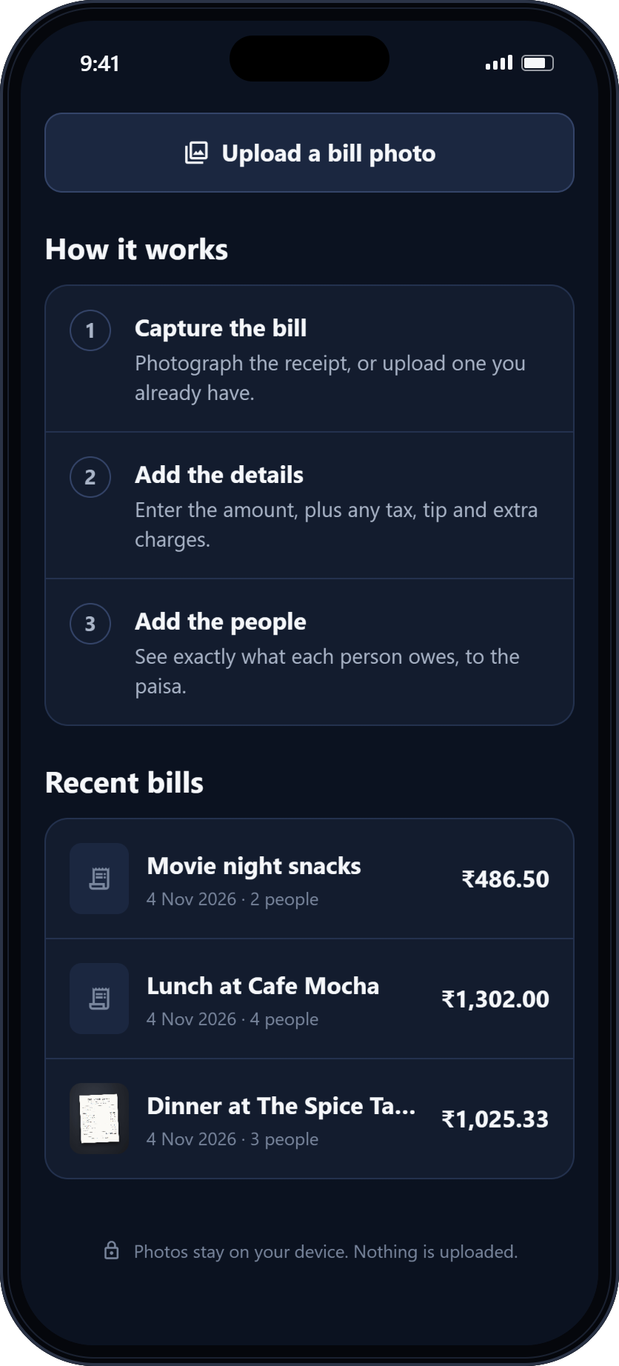
















Divvy
UIT, Karnavati University
BSc Computer Science · Mobile Application Development
MOBILE APPLICATION DEVELOPMENT · PROJECT
Split the bill. Fairly.
Divvy — intelligent, receipt-based bill splitting for iPhone and Android
Photograph a receipt, add the people, and see exactly what everyone owes — to the paisa.
Dashboard
Receipt scanning
Bill summary
Participants
Bill history
APP SCREENSHOT
CONCEPT DESIGN
APP SCREENSHOT
APP SCREENSHOT
APP SCREENSHOT
01 The problem
02 Receipt-first solution
Totals worked out by hand, at the table
Photograph the bill. Divvy reads it, you confirm it and assign items; service and GST are shared in proportion.
Equal splits ignore who ordered what
AA
Aarav
₹349.15
GST on the service charge is guessed
PR
Priya
₹349.12
Rounding each share creates or loses paise
ZO
Zoya
₹327.06
By hand ₹1,025.33 ÷ 3 → 3 × ₹341.78 = ₹1,025.34
Σ ₹1,025.33 exactly the bill
03 Application workflow
Implemented
Final release
Capture / Upload
OCR
Review
Add people
Split
Summary
04 System architecture
05 Technology stack
Expo Router screens · design system · on device, no backend
React Native 0.88
Expo SDK 58
TypeScript
Expo Router
Camera & gallery
OCR
Bill state
Engine
expo-image-picker
React 19
expo-image-picker
ML Kit + parser
reducer + context
pure TypeScript
Jest · 274 tests
ESLint · Prettier
Solid implemented
Dashed final release
Bill history
Summary · Share
ML Kit OCR
SQLite
SQLite
share sheet
06 Features and USP
Receipt-first
Less typing
Transparent
Exact money
Indian bills
Private
Photo starts the bill
OCR pre-fills items
Every share explained
Σ shares = total
GST on service charge
On device, no account
Conclusion Divvy makes splitting a bill fast, fair and verifiable: a receipt-first workflow on a money engine that is exact by construction.
Krish Dwivedi
BSc Computer Science · UIT, Karnavati University
Notes:
A3 portrait poster, 297 × 420 mm. Phones are real app screenshots except the one marked Concept design. All money figures come from the project's calculation engine.

