Slide 1

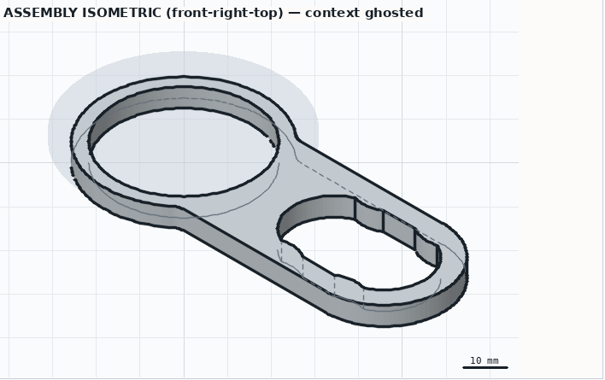
KINTSUGI
Photograph what broke. Print what fits.
An agent that turns phone photos of a broken part into a verified, printable replacement — and checks its own work like an engineer.
photos → spec → STL
assembly view · context ghosted · dimensions from the mesh
HACK47: OFFGRID · September–October 2026
Built on the OpenAI Responses API · GPT-6
Krish Gupta
Notes:
Open with the object in hand if you can: the snapped handle and the printed one. Kintsugi is an agent that designs 3D-printed replacement parts from phone photos — the difference from 'ask an LLM for the CAD' is that it measures, verifies and asks for what it still needs.

Slide 2


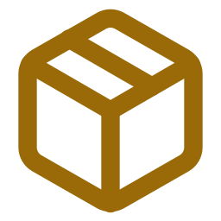

It breaks at the one part that mattered.
The object still works. The part that fits it no longer exists.
A handle, a clip, a knob, a cap — small, specific, and the reason the whole thing is in the bin.
Replacement means shipping a whole new thing. Or nothing, off-grid.
The supply chain is the wrong size for a 6-gram part.
[photo: the snapped handle on the bottle — replace]
"Just ask an LLM for the OpenSCAD" gives you plausible code that is 1.5 mm out.
The model never sees what it built. Nobody measured anything.
1 of 1 parts
the one that broke
Kintsugi — the repair is visible, and it is the point.
Notes:
The personal version: the carry handle on my water bottle snapped at the ring. A 6 mm ring and a loop. Five minutes for someone who can measure a neck and write OpenSCAD; impossible for everyone else. And the naive LLM version fails in a specific way: it is plausible and it doesn't fit.

Slide 3





Photograph what broke. Print what fits.
1
Intake
2
Capture rounds
3
Design loop
Photos + one sentence → the part, the features it mates with, a draft spec. Standard sizes it recognises become first estimates.
The evidence graph knows what is still a guess; the capture agent asks for the exact photo or ruler reading, measures uploads on a calibration sheet, stops when it knows enough.
GPT-6 writes OpenSCAD; every spec dimension is measured on the exported mesh; blueprints carry those numbers as dimension lines it must look at.
4
Code-blind critic
5
Fit coupon
6
Export
A second model reviews drawings and checks — never the code — and sends the design back when the numbers pass but the part is wrong.
The mating feature alone at three clearances, printed first. The one that slides on locks the clearance.
Oriented STL/3MF, a customizer-ready .scad (every dimension a slider), blueprint PDF, a print card that says why.
web app · phone-friendly capture · runs locally with your OpenAI key · demo mode needs no key
Notes:
Six steps, and the user only does three of them: photos, a couple of readings, and looking at the result. Everything in between is the agent measuring, designing, checking and asking.

Slide 4
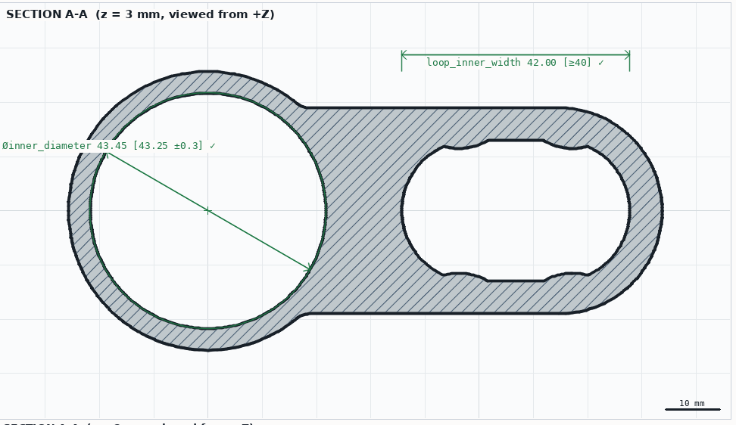
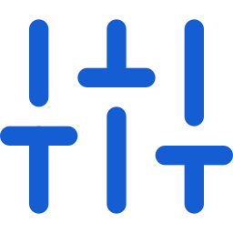

The model never grades its own homework.
Measured, never trusted
A Part Spec dimension carries a measure recipe (circle fit at z = 3, hole extent along x, gap, notch mouth…). The checker runs it on the exported STL.
Drawn from the measurement
Views, sections and assembly sheets with dimension lines computed from the mesh, in pass/fail colour. The model must look before it changes anything.
Reviewed without the code
A fresh-context critic gets the spec, the check table and the drawings. It catches a hole through the load path or missing finger scallops — things no number can.
SECTION A-A of iteration 1 — the bore is measured on the mesh at 43.45 mm against 43.25 ± 0.3 (43 + 0.25 clearance); the label is green because it passed, and the model sees exactly this picture.
43.45 [43.25 ±0.3] ✓
what the model sees, not what it wrote
Notes:
This is the idea the whole system is built around. Verification is executable, not interpretive: every dimension knows how to measure itself on the finished mesh. And the drawings the model looks at are generated from those measurements, so it cannot fake them.

Slide 5
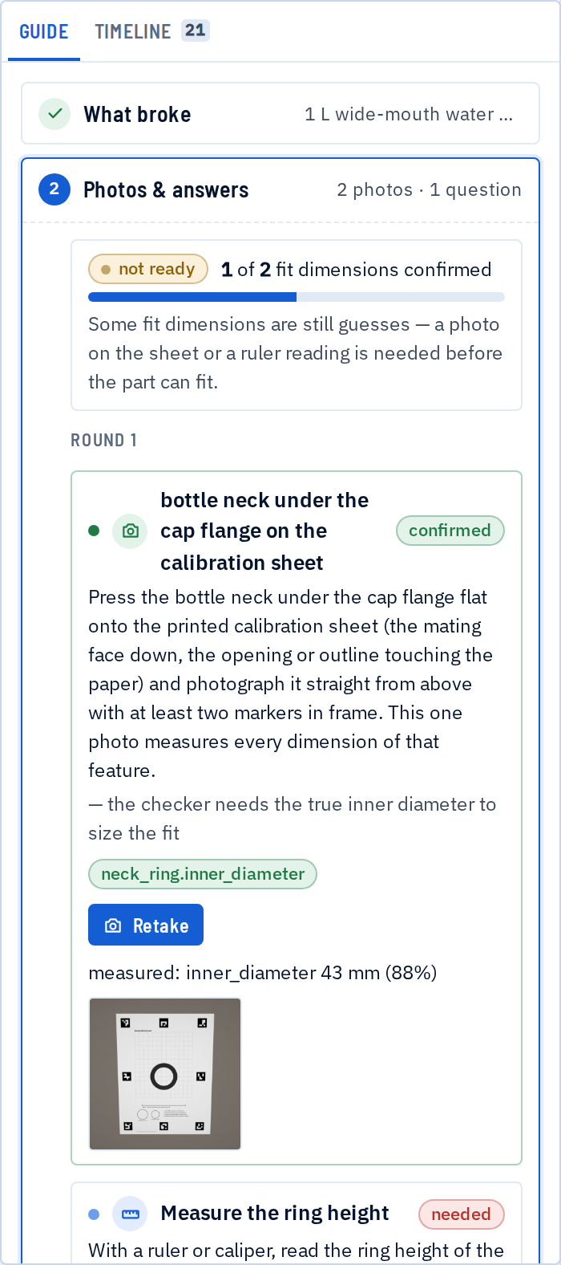
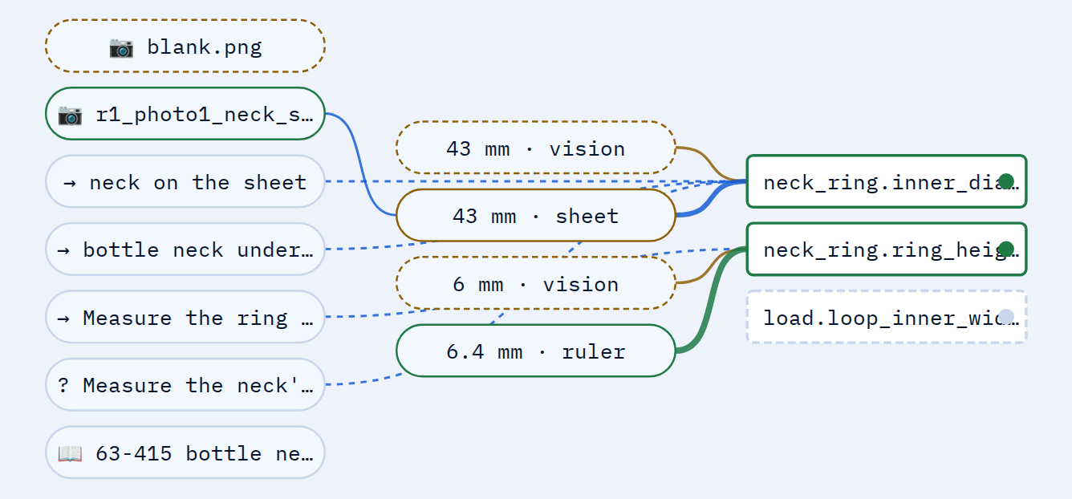
It asks for the photo it needs — not a number.
≤ 0.5 mm
diameter error on synthetic ground truth, up to 35° of camera tilt
the evidence graph: photos, readings and standards → estimates → dimensions → checks
≤ 0.3 mm
One photo per mating feature, pressed flat on a printed ArUco calibration sheet; each upload is graded and measured automatically.
Heights get a ruler reading; a standard size (63-415 finish, 3/4" PVC, M5) gets one confirming photo.
A capture agent rewrites the round for the object in the pictures: what to remove, which side down, what to avoid.
The designer can ask the same way mid-run; the measured value comes back in its resume message.
circle-centre error
one round
the plan for the bottle handle: one sheet photo, one ruler reading (scripted demo)
kintsugi/spec/evidence.py · kintsugi/agent/capture.py · kintsugi/measure/
Notes:
The follow-up loop is driven by a graph, not a prompt. missing() ranks what still needs evidence; plan_round() batches it into the fewest user actions; readiness() decides when designing is safe. The model's job is to write the instructions for this object — the arithmetic is ours.

Slide 6
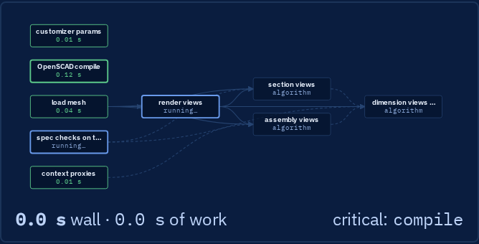
Every stage is a typed dataflow graph.
Nodes declare inputs and outputs; edges follow. A node starts the moment its inputs exist — no wave barriers.
Algorithms run in threads, model calls as coroutines; guards skip, optional nodes may fail, after= orders without data.
People are nodes: a human node suspends the run with a request and resumes when the answer lands in the state.
Every run leaves a trace — per-node timing, the critical path, serial vs wall — drawn live in the Graph tab.
the iteration pipeline, live: params ∥ compile → mesh → checks ∥ views ∥ context → sections ∥ assembly → compose; blue = critical path
checks ∥ sheets
4 graphs
~300 lines
rendered in parallel, every run traced
iteration · intake/capture · export · session flow
the runtime, no framework
Notes:
Graph engineering, in the sense of state-based graphs with defined inputs and outputs where agents or algorithms operate in the nodes. Declaring what depends on what gave us parallelism, traces, resumable human steps and the critical path for free — and the session flow itself is a guarded state graph.

Slide 7
Two models, two jobs — on the Responses API.
Designer · gpt-6-astra
Checker + renderer
Critic · gpt-6-astra, fresh context
reasoning effort high · sandboxed file tools · iterate / ask_user / finish
part.scad
OpenSCAD compile → mesh checks → blueprint sheets (images) — a dataflow graph, no model
sheets
sees the spec, the check table and the drawings — never the code; JSON verdict: pass / revise / ask the user
check table + sheets return as the tool's output — text and images the model looks at
revise → the designer gets the verdict in a fresh tool loop
function tools with image outputs
previous_response_id — each sheet uploaded once
reasoning.effort per role
text.format json_object for critic & intake
vision: intake + capture agent
gpt-6-sol for the cheap passes
stateless fallback with encrypted reasoning
kintsugi/agent/llm.py — one provider facade; a scripted provider runs the same loop for tests and demos
Notes:
Native to the Responses API: function tools whose outputs are images so the model looks at its own blueprints; previous_response_id so the growing pile of sheets is uploaded once; reasoning effort tuned per role; JSON mode for the structured passes; vision in intake and the capture agent. Two models, two jobs: the designer grades itself generously, so a fresh-context critic that never sees the code is worth the tokens.

Slide 8
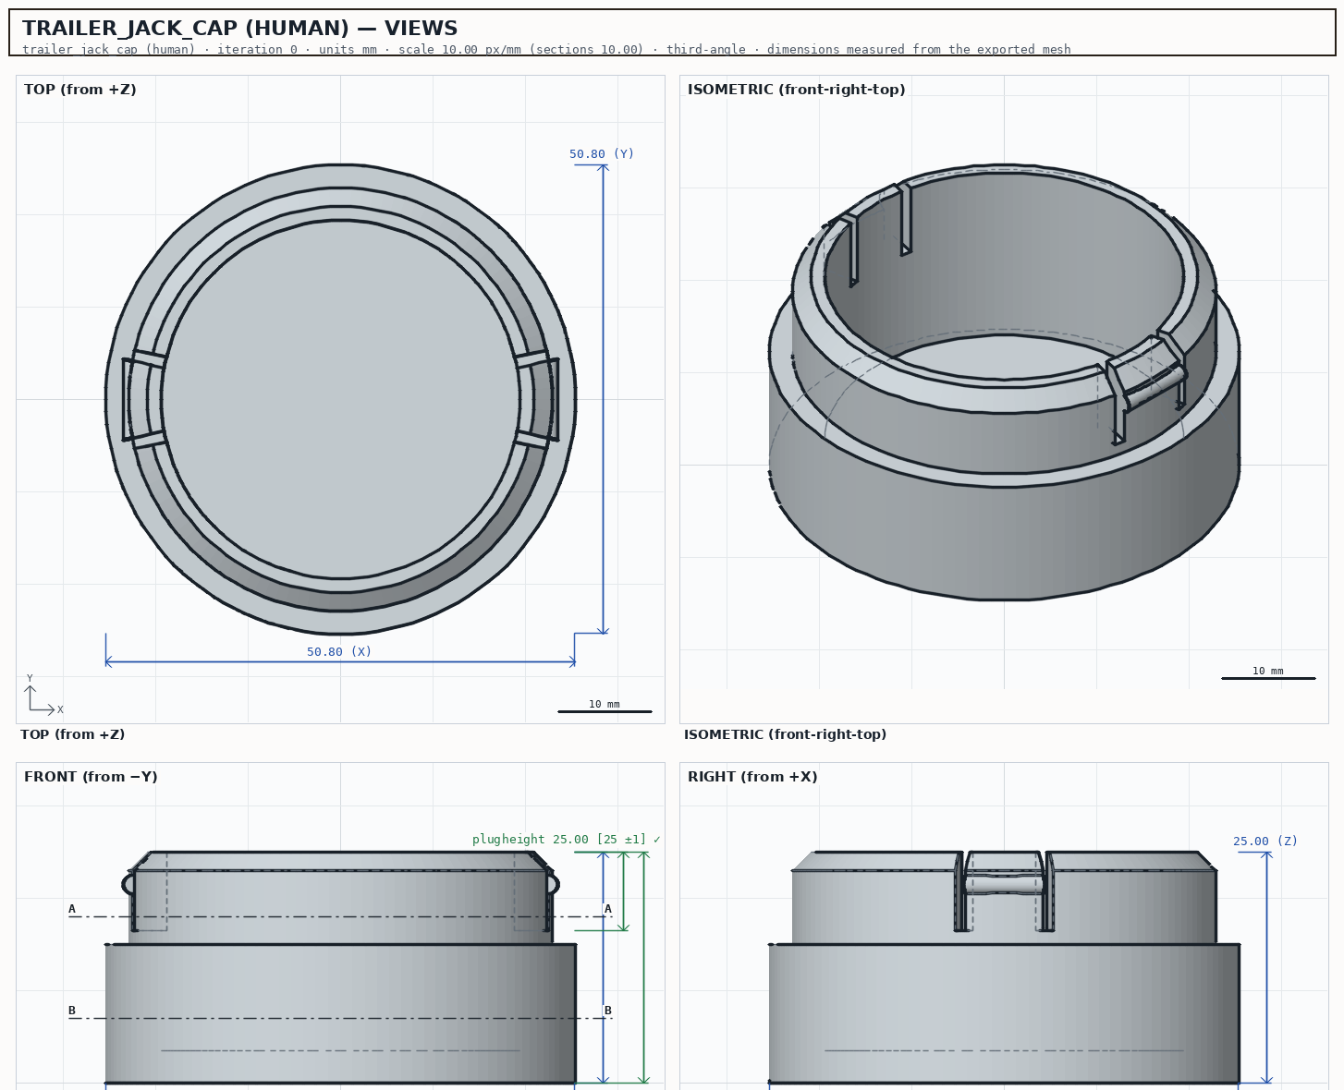
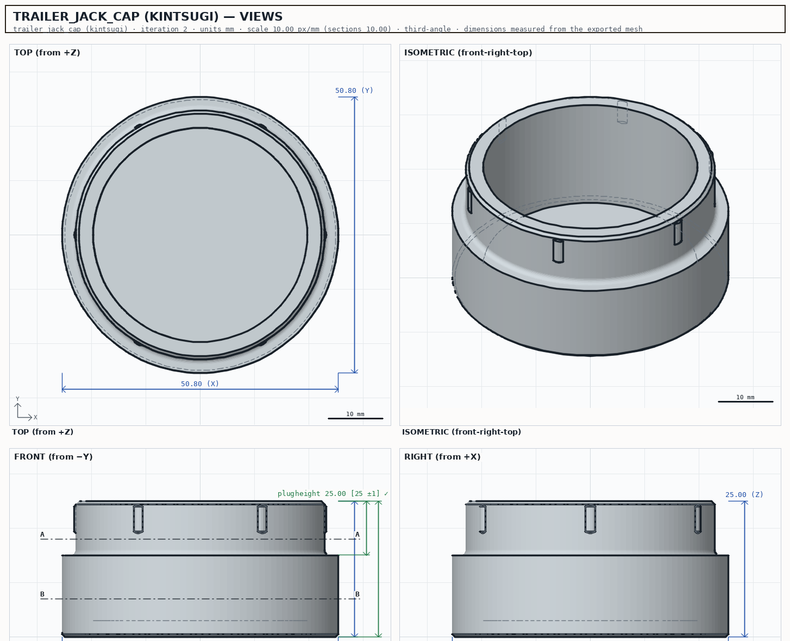
Measured, not claimed.
part (human reference) | Kintsugi | human | iter. | blind judge
rack spacer | pass | pass | 2 | human 9 · kin 7
cabinet plug | pass | fail: walls | 1 | kintsugi 9 · human 6
IKEA DOMBÅS handle | pass | pass | 1 | kintsugi 9 · human 5
trailer jack cap | pass | pass | 2 | kintsugi 9 · human 7
dishwasher rack hinge | pass | fail: topology, walls | 4 | kintsugi 8 · human 6
5/5 pass hard checks · 4/5 preferred†
A/B vs human-designed repair parts
2 / 3 caught †
critic probe: defects the numeric checks cannot see; control passes
A/B: a spec written from each human part's own mating dimensions; Kintsugi designs from the spec alone, never sees the reference; both measured by the same checker, judged blind from the sheets. † runs on the previous model provider — being re-run on GPT-6.
≤ 0.05 mm
the toolchain on known geometry: circle fits, interference ≤3 %, measurement ≤0.5 mm — before any model
1·1·1·7
human — trailer jack cap
kintsugi — same spec, 2 iterations
iterations to converge, four bottle-handle runs †
Notes:
Every number here has a file behind it in eval/reports and tests/. The dagger marks numbers produced on the previous model provider; they are re-run on GPT-6 before submission and replaced.

Slide 9
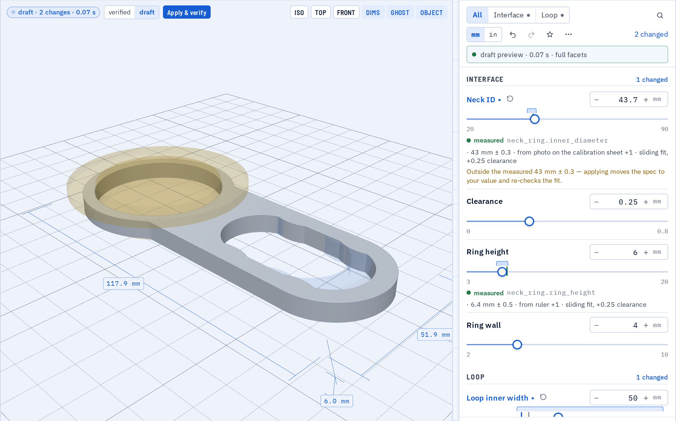


A guide, not a console. A part you can change.
Sliders that know their evidence
A live 3D draft on each change; the measured value, its sources and its tolerance band on the rail; computed lengths turn red against the spec before you apply.
Six steps left, the engineer's view right
Photos and readings from a phone on the same Wi-Fi; checks, code, spec and graphs on the desktop.
Coupon before the part
Three clearances in one small print; the one that slides on locks the fit.
Demo mode for judges
A scripted designer runs the whole flow in a minute without a key; the real thing needs only an OpenAI key in Settings.
the Customize tab: a draft of the handle after two slider moves, the verified mesh ghosted behind it, the bottle neck in place, Apply & verify one click away
Notes:
Product thinking: the person does three things and looks at pictures. The guide never shows a blank screen — every stage has its one next action. And the finished part is not a file: it is a parametric designer like MakerWorld's, except every fit dimension shows where its number came from and warns before a check would fail.

Slide 10




After OFFGRID
Order the print when you have no printer
Publish the parametric part with its spec
Slant 3D Portals + Stripe from the export step — scoped, not built.
MakerWorld / Printables: the next person with the same bottle gets it in one click, with the checks attached.
Grow the standards base into an interface library
Repair-café and makerspace fleet mode
Threads, snap profiles, appliance clips; intake matches against it with vision, one confirming photo instead of three.
One server, many phones, a queue of prints; multi-photo reconstruction and a printed measuring jig for what a flat sheet cannot reach.
$10k of credits → 50 real broken objects × 5 runs each
a published benchmark of convergence, cost and fit per model and reasoning effort — the harness already exists
Notes:
Potential: the same loop is a general verified-CAD agent; the product path is ordering, publishing and a fleet. And the credits have an obvious use: the benchmark harness is built, it just needs objects and runs.

Slide 11
Built in the open, in the OFFGRID window.
1
2
3
4
5
6
toolchain
design loop
measurement
web workspace
OpenAI port
graph engineering
compile · checks · renderer · spec
critic · policy · A/B eval
sheet · rectify · circle fit
SSE · 3D · sheets · sliders
Responses API · fake provider
runtime · evidence · capture loop
1 real GPT-6 run
15 / 15
5 A/B parts
3 docs
2 iterations · $1.01
checks pass on its mesh
judged blind against humans
design rev B · hand-off · eval reports
The UI was driven end to end in a headless browser at desktop and phone widths after each change; one real GPT-6 run is in eval/reports/gpt6-first-run. No real photo or print yet; rough edges are listed in docs/HANDOFF.md.
Solo build; AI coding assistants used throughout, as the rules allow. OpenSCAD, BOSL2, OpenCV, trimesh and the OpenAI SDK are the third-party pillars — all disclosed.
Thanks to HACK47 and the sponsors — OpenAI, whose Responses API runs every model call here, and Red Bull, who keep the house shipping.
github.com/KrishGup/kintsugi · docs/design.html · docs/HANDOFF.md · eval/reports/
Notes:
The build order matters: the verification toolchain came first and was tested on known geometry before any model was involved. The model was the last thing added, not the first.

Slide 12
Photograph what broke.
Print what fits.
Off-grid, the repair is the supply chain.
github.com/KrishGup/kintsugi · demo: kintsugi.orangecliff-df186167.eastus2.azurecontainerapps.io · video: docs/submission/kintsugi-demo.mp4
KINTSUGI · HACK47: OFFGRID · Krish Gupta
Notes:
Close on the object: the printed handle on the bottle. Kintsugi — photograph what broke, print what fits.

