Slide 1
ESC201: Lecture 14

Slide 2
Implementation of a Function using Mux
A 2 variable function can be implemented with a 4:1 mux with 2 select lines: one-to-one correspondence
0
0
0
0
1
0
1
1
1
1
0
1
0
1
1
0
x₁
x₂
Can we do better?

Slide 3
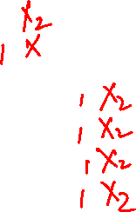
Implementation of a Function using Mux
A 2 variable function can be implemented with a 2:1 mux with 1 select line
x₂
x₂
0
0
0
y = x₂ when x₁ = 0
0
1
1
1
0
1
1
1
0
y = x₂ when x₁ = 1

Slide 4

Implementation of a Function using Mux
A 3 variable function can be implemented with a 4:1 mux with 2 select lines
x | y | z | F
0 | 0 | 0 | 0
0 | 0 | 1 | 1
0 | 1 | 0 | 1
0 | 1 | 1 | 0
F = z when xy = 00
z
z
F = $\overline{z}$when xy =01
0
1 | 0 | 0 | 0
1 | 0 | 1 | 0
1 | 1 | 0 | 1
1 | 1 | 1 | 1
F = 0 when xy = 10
1
x
y
F = 1 when xy = 11

Slide 5
Implementation of a Function using Mux
A 3 variable function can be implemented with a 4:1 mux with 2 select lines: not an unique implementation
0
0 0
0 0
0
F = 0 when yz = 00
1
0
0
0
0 1
0 1
1
F = x when yz =01
x
1
0
1
0
1 0
1 0
1
F = 1 when yz = 10
1
1
x
y
z
0
1 1
1 1
0
F = x when yz = 11
1
1

Slide 6
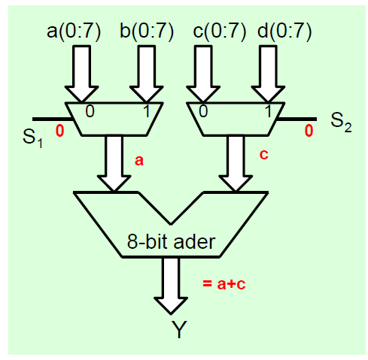
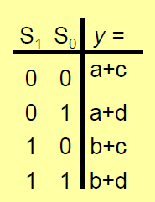
Mux Applications
Resource Sharing

Slide 7

Decoders
Decodes an encoded information
maps a smaller number of inputs to a larger set of outputs
$$Y_{0}\text{=}\overline{B}.\overline{A};$$
$$Y_{1}\text{=}\overline{B}.A;$$
$$Y_{2}\text{=}\text{B}.\overline{A};$$
$$Y_{3}\text{=}B\text{.} \text{A}$$

Slide 8
Decoders with ‘Enable’ input

Slide 9
Decoders in Vending Machine

Slide 10
Term Generator for SOP Expression of a Function
term

Slide 11
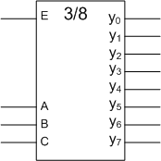

Implementation of a Function using Decoders
Decoder allows a quick implementation
No minimization, but lots of gates…

Slide 12
Bigger Decoders
3 by 8 decoder using a 2 by 4 decoder
e c b a
0
1
1
0
e
c
0
E
A
B
1
1
0
0
0
0
0
0
0
0

Slide 13
De-Multiplexer
S₁ | S₀ | y₀ | y₁ | y₂ | y₃
0 | 0 | D | 0 | 0 | 0
0 | 1 | 0 | D | 0 | 0
1 | 0 | 0 | 0 | D | 0
1 | 1 | 0 | 0 | 0 | D
Data

Slide 14
De-Mux vs Decoder
Only difference is in name and application
S₁ | S₀ | Y₀ | Y₁ | Y₂ | Y₃
0 | 0 | D | 0 | 0 | 0
0 | 1 | 0 | D | 0 | 0
1 | 0 | 0 | 0 | D | 0
1 | 1 | 0 | 0 | 0 | D

Slide 15
Exercise: Multiplier
B₁ B₀
Multiplicand
A₁ A₀
Multiplier
A₀B₁ A₀B₀
A₁B₁ A₁B₀
Partial products
C3 C2 C₁ C₀

Slide 16
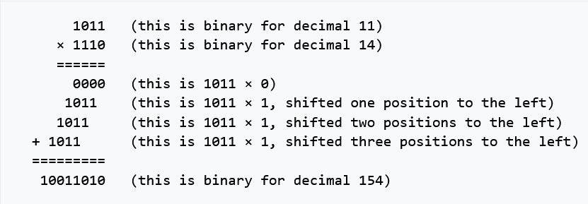
Binary Multiplication of n-bit Numbers
Circuit for multiplying 4 bit numbers
Complications:
How to add four bits and carry
Circuit for left or right shifting?

Slide 17
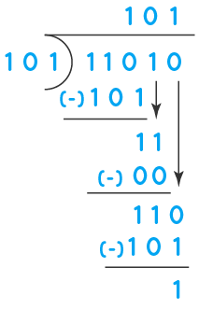
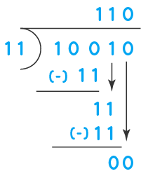
Binary Division
Circuit for division
Complications:
How to compare two numbers?
Circuit for left and right shifting?

Slide 18
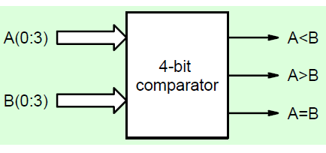
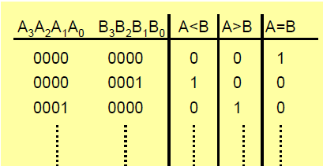
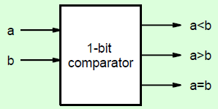
Comparator

Slide 19
Bit-wise Comparison
where x_{i} = 1 only if the pair of bits in position i are equal (i.e., if both are 1 or both are 0).

Slide 20






Bit-wise Comparison
$a>b$ only if $a=1$ and $b=0$
$$y_{i}=A_{i}.\overline{B_{i}}$$
$a<b$only if $a=0$ and $b=1$
$$z_{i}=\overline{A_{i}}.B_{i}$$
$a=b$ only if $a>b$ and $a<b$ both are false
$$x_{i}=\overline{(A_{i}.\overline{B_{i}}+\overline{A_{i}}.B_{i})}=A_{i}.B_{i}+\overline{A_{i}}.\overline{B_{i}}$$

Slide 21



Comparator via Modular Approach
$$y_{i}=A_{i}.\overline{B_{i}}$$
$$x_{i}=A_{i}.B_{i}+\overline{A_{i}}.\overline{B_{i}}$$
$$z_{i}=\overline{A_{i}}.B_{i}$$
$$\left(A>B\right)=y_{3}+x_{3}y_{2}+x_{3}x_{2}y_{1}+x_{3}x_{2}x_{1}y_{0}$$
$$\left(A<B\right)=z_{3}+x_{3}z_{2}+x_{3}x_{2}z_{1}+x_{3}x_{2}x_{1}z_{0}$$

Slide 22

$$\left(A>B\right)=y_{3}+x_{3}y_{2}+x_{3}x_{2}y_{1}+x_{3}x_{2}x_{1}y_{0}$$
A>B
A< B
A = B
$$\left(A=B\right)=x_{3}x_{2}x_{1}x_{0}$$

