Slide 1
Anti-ARP system to detect, prevent and recover from Man-in-the-Middle attacks. Review - 2

Slide 2
Team Members Details
Madhav Chaturvedi – 18BEC1036
Krish Jani – 18BEC1010
Nithesh Chowdary – 17MIS1098
Deva Dattan - 17MIS1105

Slide 3
Software Required
VMware workstation 15
ISO file of kali, ubuntu and windows 7
Ettercap, arpspoof, setoolkit and browser (included with kali)
Python 3.7

Slide 4
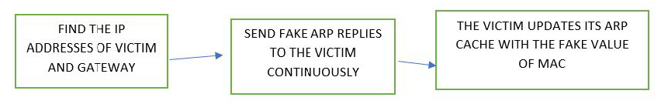
ARP Poisoning/Spoofing-
ARP stands for Address Resolution Protocol is a networking protocol that enables communications in a particular network by linking the network and data link layer. So, ARP spoofing is a type of attack wherein the attacker sends forged APR replies to the victim and as a result, the victim updates its ARP cache with the fake value sent by the attacker, hence the attacker places itself into the communication between the server and the client without any notice of either if the endpoint devices. Hence to demonstrate this ARP attack, we performed an attack to fetch the Username and password which the victim enters on a particular website. The tool used to perform this is ettercap. Ettercap is an open source network security tool for man-in-the-middle attack on LAN.
Block Diagram

Slide 5
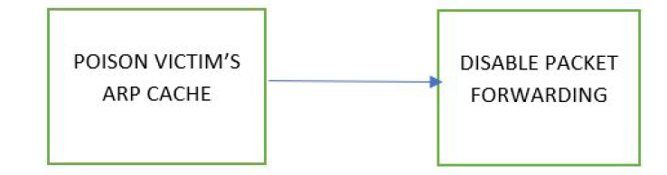
DoS Attack-
DoS stands for Denial of Service. A DoS attack is an attack that is meant to shut down a particular machine or network hence making it inaccessible to others on the network. This attack is accomplished by flooding the target with traffic or sending some sort of information that triggers a crash. We have tried a non conventional DoS attack by attacking the user’s system instead of a server. By depriving the victim to send packets, in essence we would have performed a DoS attack on the server side. As a result of this attack the whole of the internet and intranet would not be accessible by the victim. For demonstrating this we performed a simple attack by poisoning the arp cache of the victim with the attacker’s MAC address. Hence we can alter the packet forwarding for the victim to 0, it denies the access of the whole of internet to the victim as all the packets sent by the victim is being blocked by the attacker. If we set the packet forwarding to 1, and then the victim can access the internet as usual.

Slide 6
DNS Spoof-
DNS stands for Domain Name Server. So, DNS spoofing is an attack wherein the attacker can redirect the victim to another website which is not intended to be visited by the victim by injecting a fake DNS record in the DNS cache. As a result of these fake DNS entries, the victim can be redirected to any IP of the attacker’s choosing. This attack can be easily performed in the Kali Linux environment using various inbuilt tools. One such tool that we used is Ettercap. Using ettercap, we first poison the victim’s ARP cache with our MAC address. Then we search for available hosts in the network and add the gateway as TARGET2 and the victim as TARGET1 and start unified sniffing. Finally we add the dns_spoof plugin that is available in ettercap and wait for some time for it to start. Once we get the message that the target website’s DNS has been spoofed, we can check the victim machine and try opening the website in it. We observe that the victim is redirected to some other website even though the address bar says that it is the original website.

Slide 7
Detection :- The detection mechanism is called anti-ARP, a simple python program that browses different IP addresses in the ARP cache and checks if any two IP addresses have the same MAC addresses or not. If they have the same MAC address, that means the ARP cache is poisoned. Once the poisoning is confirmed, the user isprompted with a message saying that the ARP cache has been poisoned. Along with this message, the attacker’s MAC address is also displayed.
2. Prevention :- For prevention, we designed an algorithm and coded it in python. This algorithm does the task of making all the entries in the ARP cache as static because of the fact that they cannot be altered by the attacker once made static. As a result, no matter how many fake ARP replies are sent to the victim, its ARP cache won't be changed.
3. Recovery :- Once we have detected that ARP cache is poisoned, we can execute the recovery algorithm which is also coded in python. The main idea of the recovery process is copying a clean set of entries into the cache or altering a specific entry in the cache. The clean ARP cache entries are stored when the application is started, provided that the cache is cleaned while starting it. If the user knows the MAC address of the gateway, or any other node in the network, they can enter the ARP entry using one of the features of the recovery system.

Slide 8
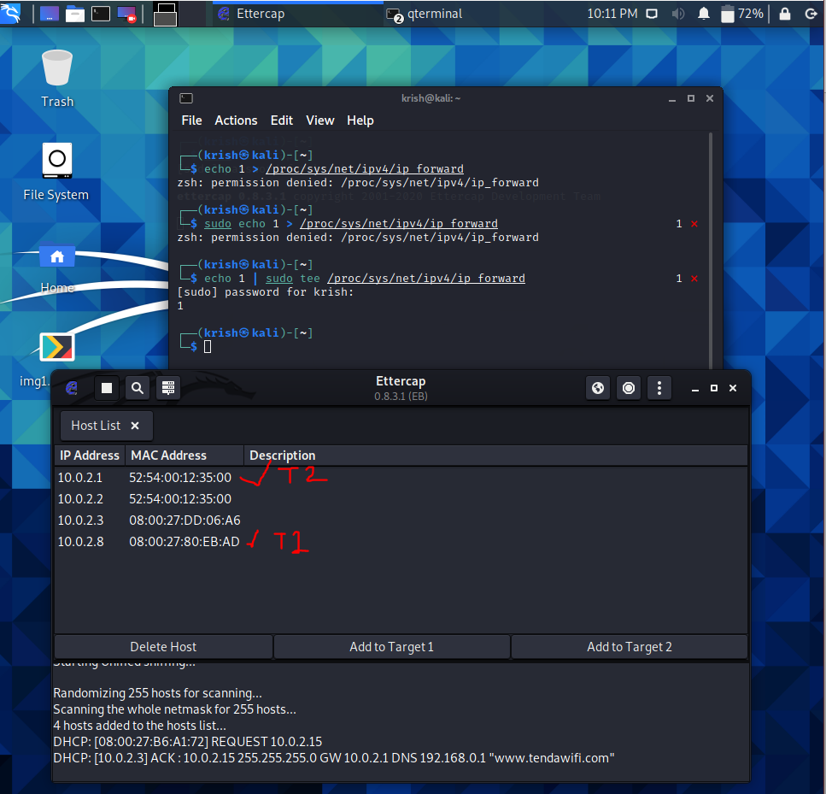
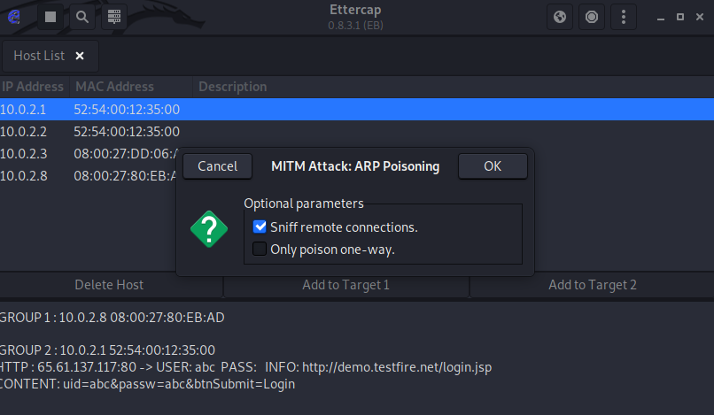
Output Screenshots (Password attack)

Slide 9
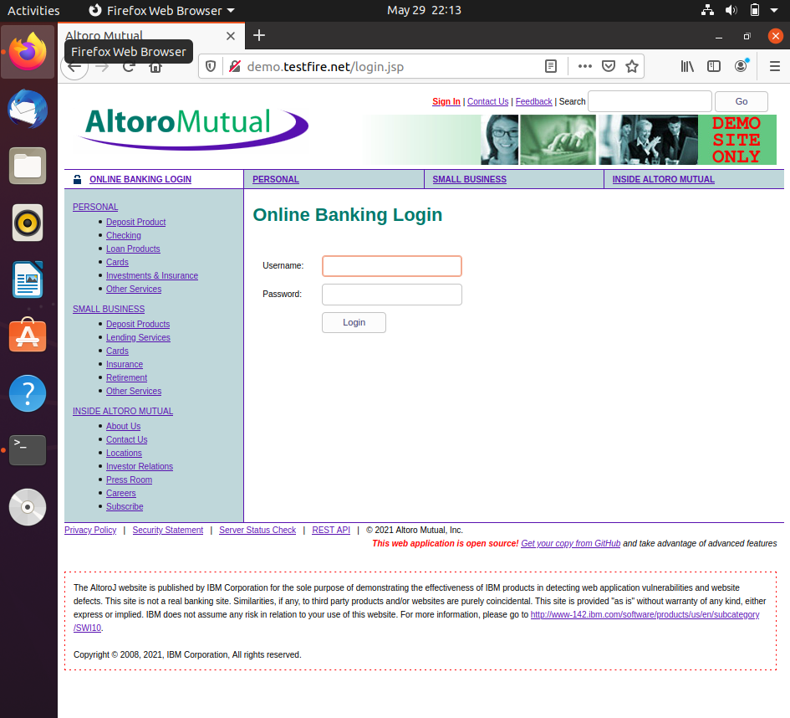
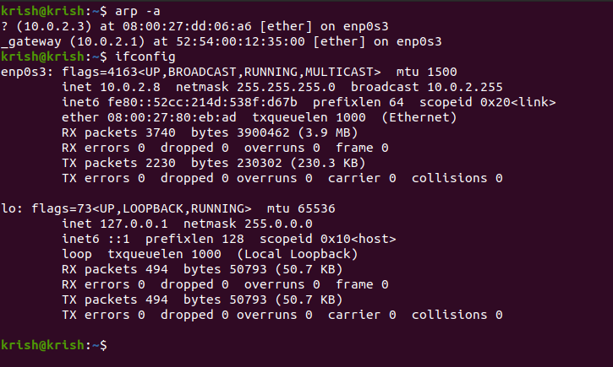
Output Screenshots

Slide 10
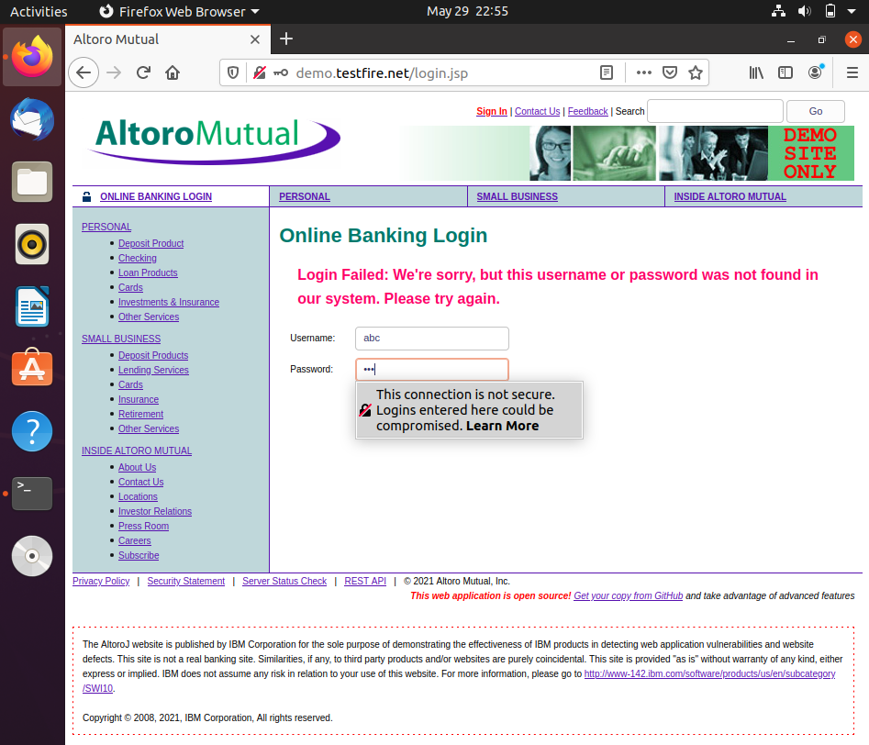
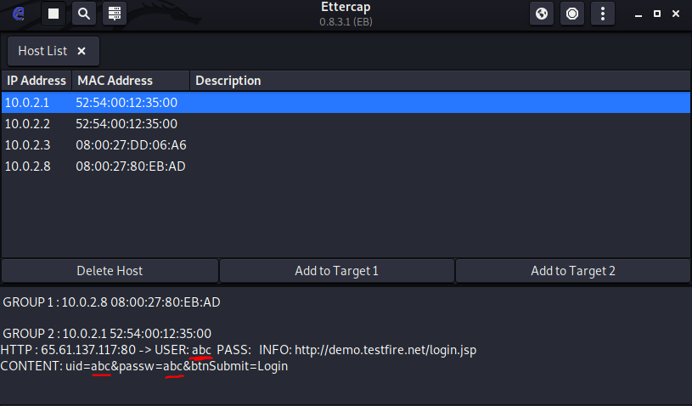
Output Screenshots

Slide 11
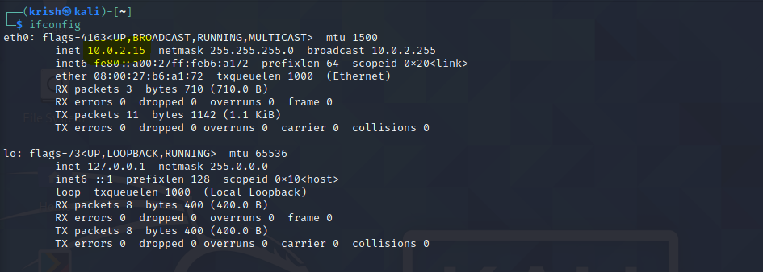
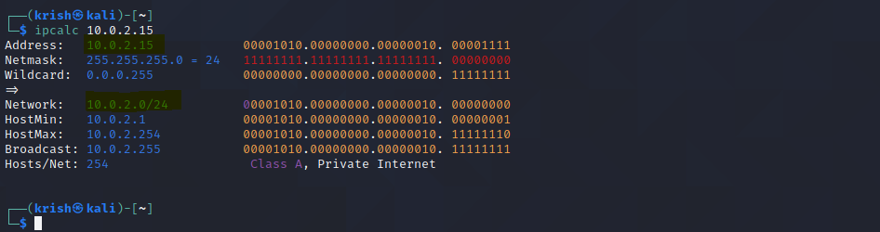
Output Screenshots (DNS Attack)

Slide 12
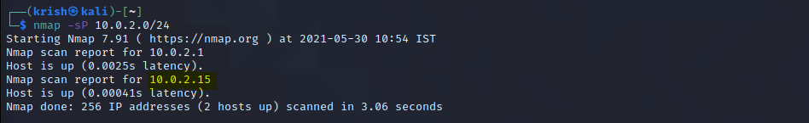
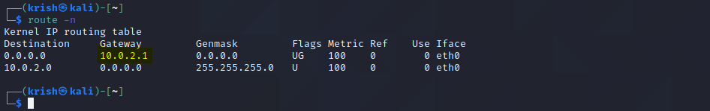
Output Screenshots

Slide 13
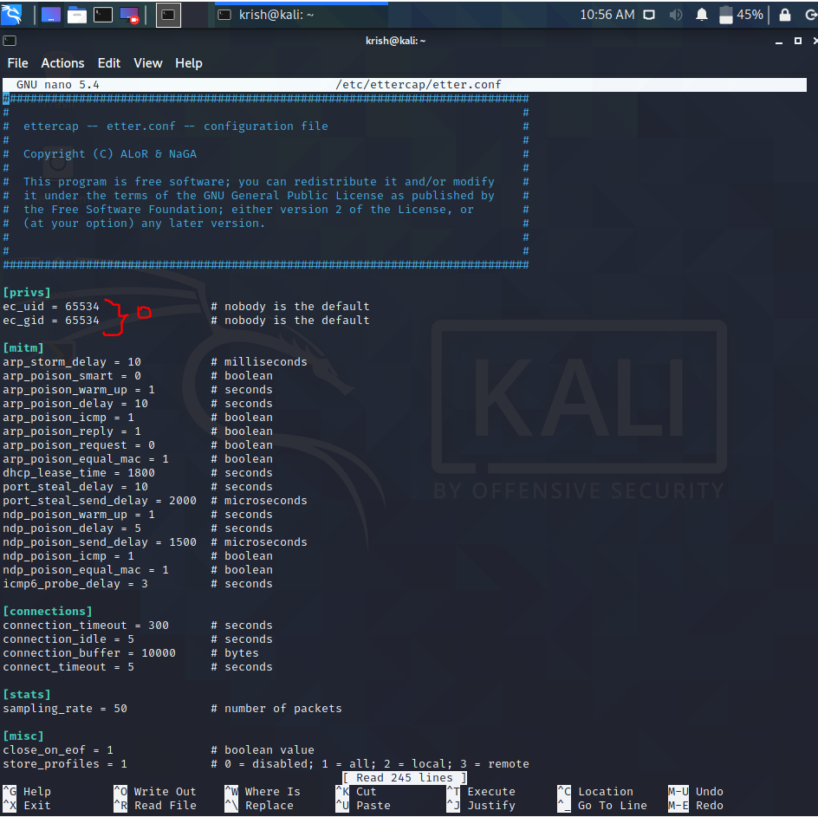
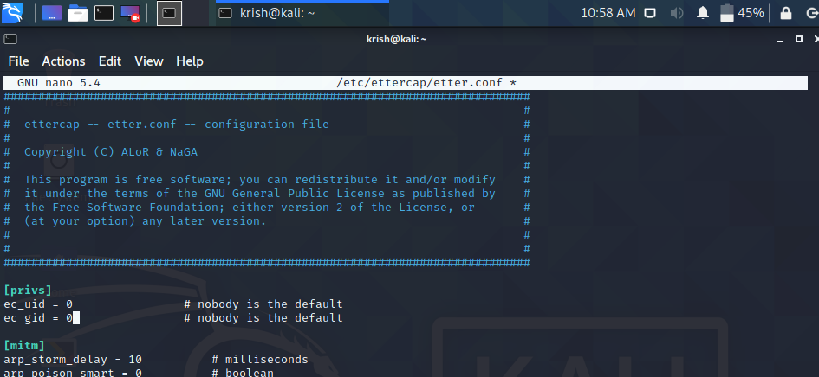
Output Screenshots

Slide 14
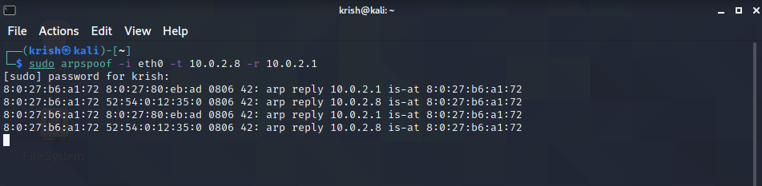
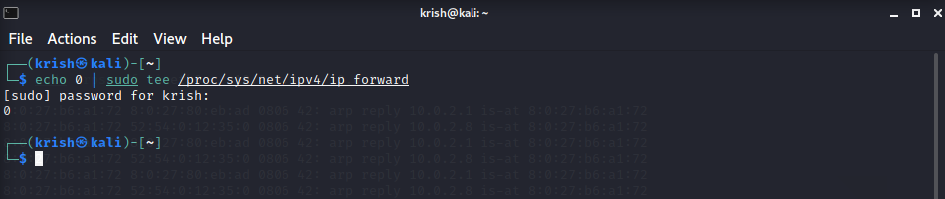
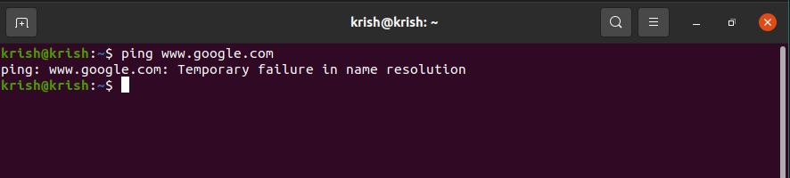
Output Screenshots (DoS Attack)

Slide 15
References from Base Journals
Y. Kim, S. Ahn, N. C. Thang, D. Choi and M. Park, "ARP Poisoning Attack Detection Based on ARP Update State in Software-Defined Networks," 2019 International Conference on Information Networking (ICOIN), Kuala Lumpur, Malaysia, 2019, pp. 366-371, doi: 10.1109/ICOIN.2019.8718158. (Base Research Paper)
D. R. Rupal, D. Satasiya, H. Kumar and A. Agrawal, "Detection and prevention of ARP poisoning in dynamic IP configuration," 2016 IEEE International Conference on Recent Trends in Electronics, Information & Communication Technology (RTEICT), Bangalore, 2016, pp. 1240-1244, doi: 10.1109/RTEICT.2016.7808030.
A. A. Maksutov, I. A. Cherepanov and M. S. Alekseev, "Detection and prevention of DNS spoofing attacks," 2017 Siberian Symposium on Data Science and Engineering (SSDSE), Novosibirsk, 2017, pp. 84-87, doi: 10.1109/SSDSE.2017.8071970.
D. S. N. Mary and A. T. Begum, "An Algorithm for Moderating DoS Attack in Web Based Application," 2017 International Conference on Technical Advancements in Computers and Communications (ICTACC), Melmaurvathur, 2017, pp. 26-31, doi: 10.1109/ICTACC.2017.17.

Slide 16
Thank you

