Slide 1


Manipal University Jaipur
School of Computer Science and Engineering
Department of Data Science and Engineering
DSE3170 Project Based Learning-3 Presentation
On
Deep Reinforcement Learning for Multi-Node Smart-Grid Power Balancing
Presented by : Garv Singodia (2430010240) Krish Jariwala (2430010238) Samarth Mujumdar (2430010236) Vatsal Bharati (2430010237) |  | Under the Guidance of : Dr Aprna Tripathi

Slide 2
Outline
Introduction of
Literature Survey
Research Gap
Problem Statement
References
Motivation
Objective
Proposed Methodology
Abstract
Result and Discussion on Outcome (Conference Paper/ Patent/ Copyrights)

Slide 3
Abstract
+21.2 %
LSTM forecast skill
vs persistence
23.52 %
imbalance cut by the
centralized DQN
−14.93 %
decentralized PPO
(worse than no control)
▪ Three-node grid (city / suburb / industrial) simulated hourly with weather regimes and rare events
▪ Two control paradigms compared on one simulator and one evaluation harness
▪ Every result reported against trivial baselines and an attainable upper bound
▪ Negative decentralized result diagnosed and reported as measured
Centralized control recovers 96 % of the achievable control; decentralized control does not.
DSE3170 Project Based Learning-3
3

Slide 4
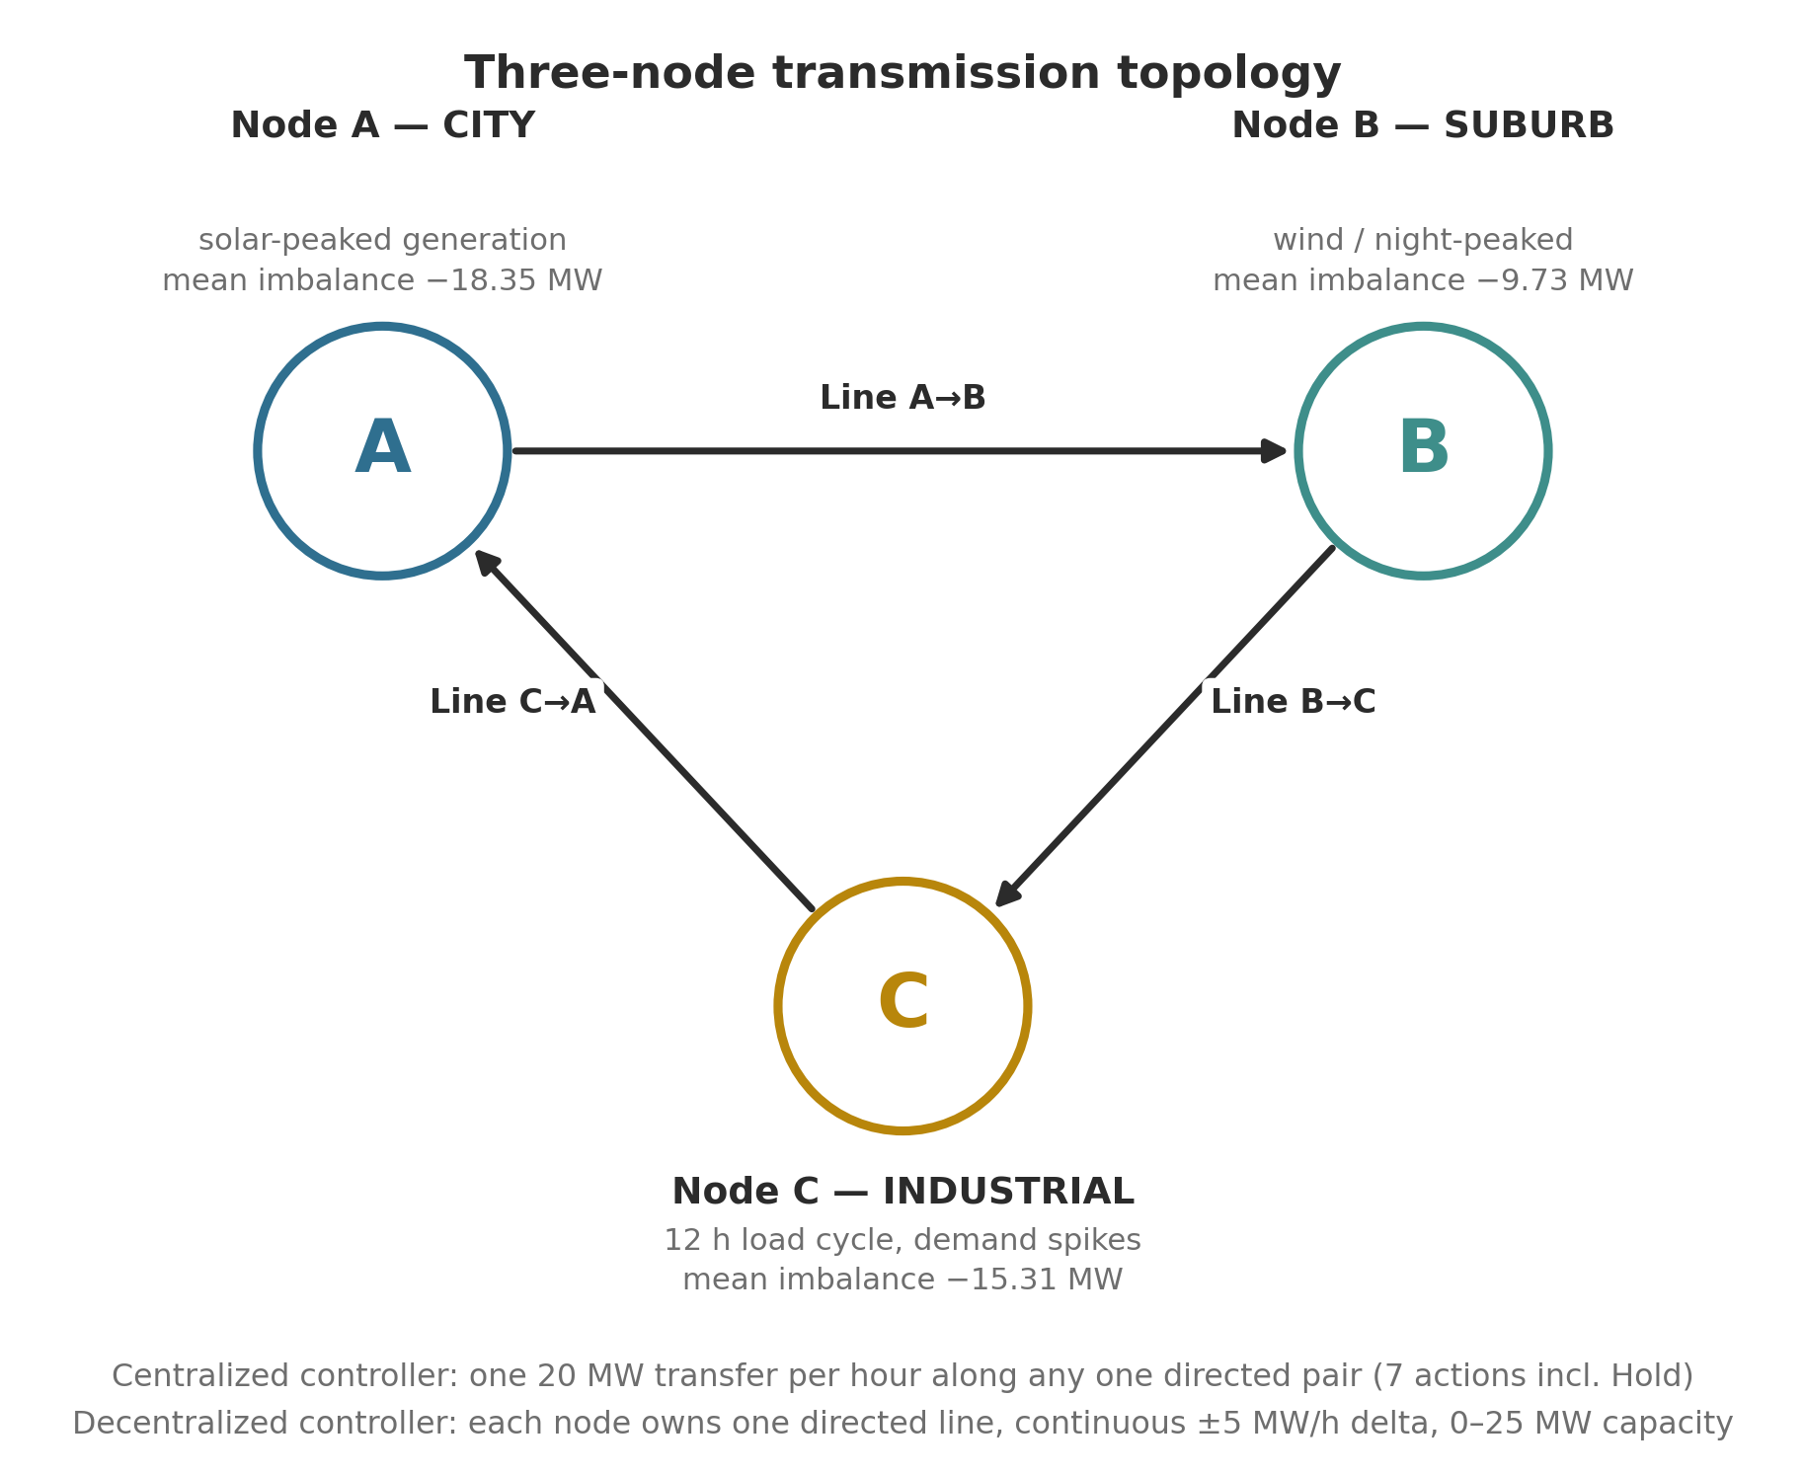
Introduction
▪ Solar and wind make every substation a source as well as a sink
▪ Net imbalance swings from surplus to deficit several times a day
▪ Unresolved imbalance → curtailment, shedding or reserve generation
▪ Routing is the cheapest remedy — but it is a sequential decision
DSE3170 Project Based Learning-3
4

Slide 5
Literature Survey
Strand | What it contributes | Used here as
Short-term load / net-load forecasting | LSTM is the standard neural baseline for autocorrelated, daily-periodic signals | Supervised pre-training stage
RL for economic dispatch & voltage control | Grid as an MDP; DQN for discrete actions, PPO for continuous | Both control paradigms
Multi-agent RL for distributed energy | Each substation as an independent agent; PettingZoo API | Decentralized environment
Self-attention for sequences | Weights hours by relevance, not recency | Transformer-DQN encoder
Transfer learning via frozen encoders | Injects supervised knowledge into an RL agent | TransferAgent variant
No novel algorithm is claimed — the contribution is a controlled, baselined comparison.
DSE3170 Project Based Learning-3
5

Slide 6
Research Gap
▪ Percentage improvements reported without an attainable upper bound — uninterpretable
▪ Trivial baselines omitted, although “do nothing” is a legal action that dominates the labels
▪ Centralized and decentralized controllers evaluated in separate studies on different simulators
▪ Negative results in multi-agent grid control are under-reported
DSE3170 Project Based Learning-3
6

Slide 7
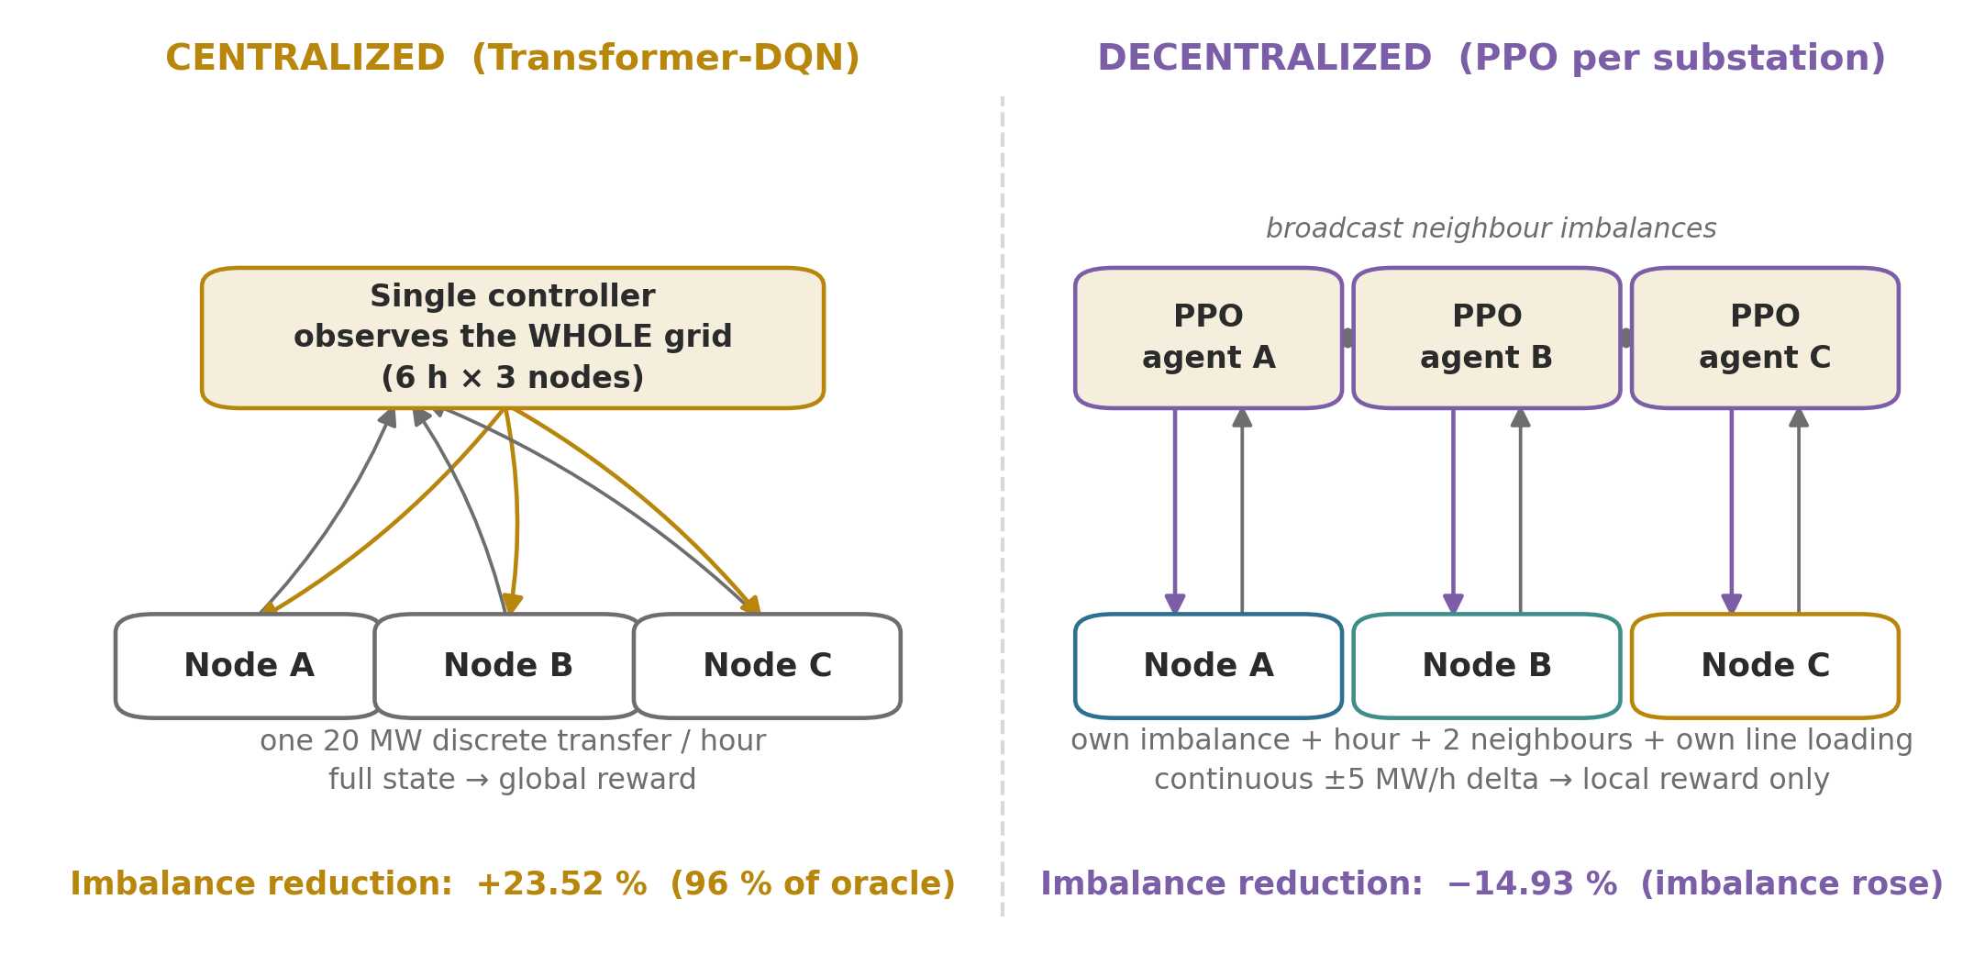
This project reports every controller against both a trivial baseline and a ceiling.
DSE3170 Project Based Learning-3
7

Slide 8
Problem Statement
▪ Given: hourly load and generation at three grid nodes
▪ Decide: how much power to route on each line, every hour
▪ Minimise: total absolute net imbalance | A | + | B | + | C |
▪ Subject to: line capacity and the cost of the transfers
▪ Under two information structures: full vs. local observability
The same task, solved twice — once by a controller that sees everything,
once by three that do not.
DSE3170 Project Based Learning-3
8

Slide 9
Motivation
Practical
Academic
▪ Every MWh of unresolved imbalance costs curtailment, shedding or reserve generation
▪ Routing is the cheapest of the three remedies
▪ Decisions scale badly as controllable nodes multiply
▪ Decentralized control is advocated for scalability and fault tolerance
▪ The information each agent gives up is rarely quantified
▪ One simulator + one harness + the same unseen hours makes that cost measurable
DSE3170 Project Based Learning-3
9

Slide 10
Objectives
▪ Build a seeded, physically motivated three-node grid simulator and validate it statistically
▪ Enforce a data audit, imputation and physical-clipping stage on every dataset
▪ Pre-train an LSTM imbalance forecaster and measure its skill against persistence
▪ Train a Transformer-DQN on a discrete routing action space (centralized)
▪ Test transfer learning by freezing the forecaster's feature layer as the state encoder
▪ Train three PPO substation agents with continuous delta-control (decentralized)
▪ Evaluate every controller on identical unseen hours against explicit baselines
▪ Report the paradigm comparison honestly, including unfavourable results
DSE3170 Project Based Learning-3
10

Slide 11
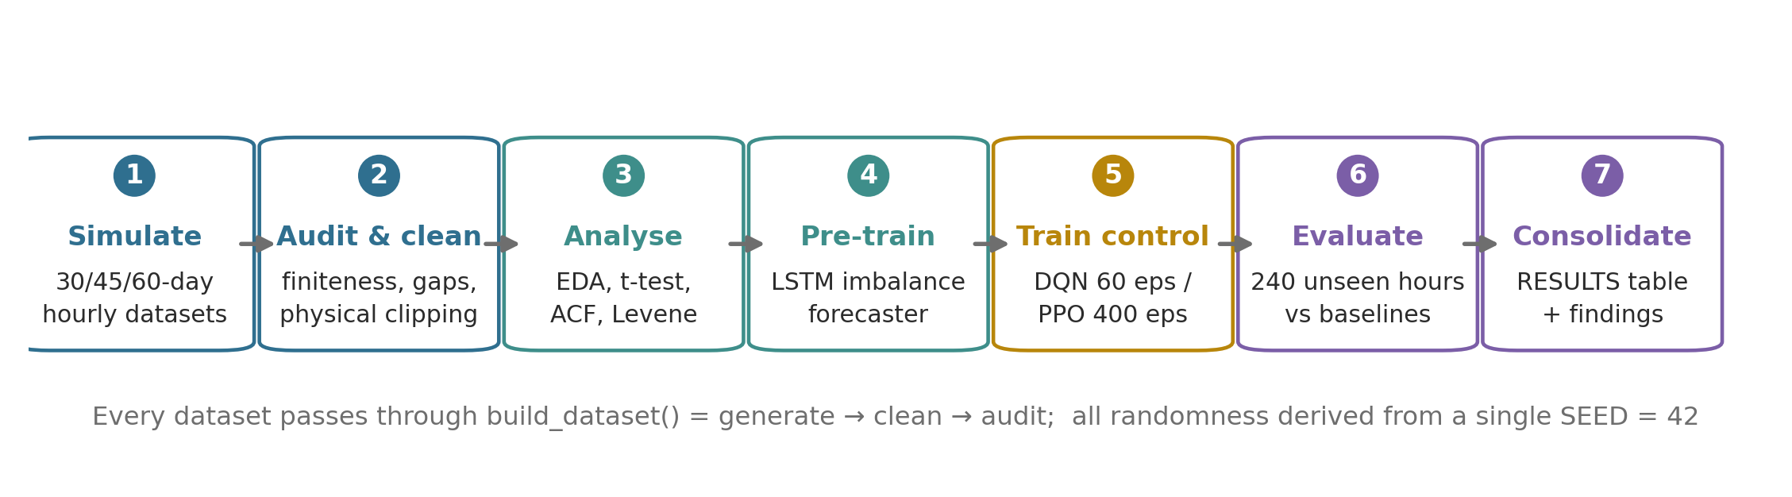
Proposed Methodology
Seven stages, executed top-to-bottom from a single seed
▪ Every dataset passes through build_dataset() = generate → clean → audit
▪ Separate seeds for EDA (30 d), pre-training (60 d), training (45 d) and test (11–12 d)
▪ All randomness derives from SEED = 42, so results are reproducible in any execution order
DSE3170 Project Based Learning-3
11

Slide 12
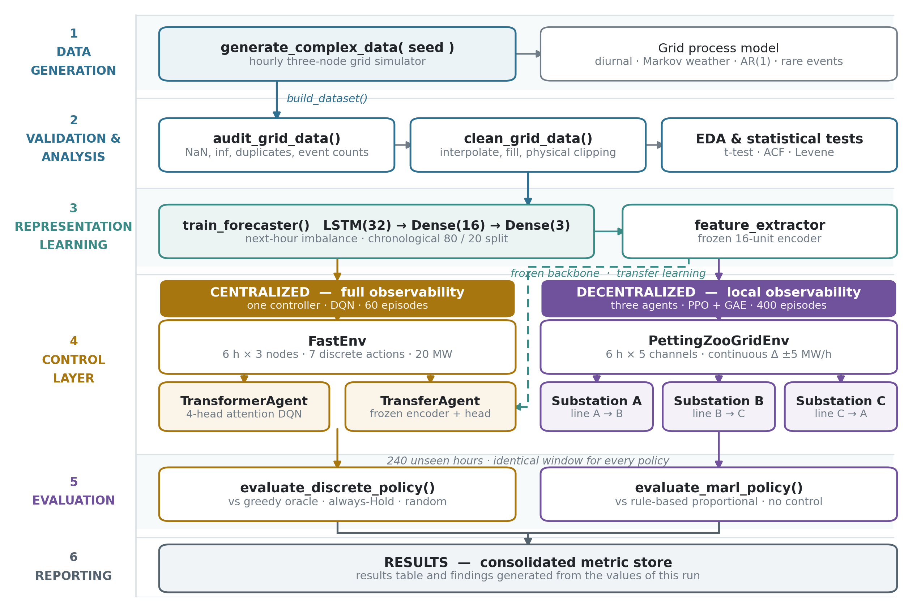
System Architecture
DSE3170 Project Based Learning-3
12

Slide 13
Grid Simulator and Dataset
No external dataset — data is generated, audited and cleaned
What the simulator models
What the audit confirmed
▪ Diurnal cycles with node-specific phase
▪ 3-state Markov weather chain (normal / heatwave / storm)
▪ AR(1) momentum noise (0.85), not white noise
▪ Rare events: solar outage, demand spike, brown-out
▪ 0 missing, 0 infinite, 0 duplicate rows in every dataset
▪ 0 negative generation or load after clipping
▪ Rare events verified to fire (e.g. 36 solar-outage hours in 30 days)
▪ Mean total | imbalance | = 75.61 MW — the quantity to minimise
DSE3170 Project Based Learning-3
13

Slide 14
Characterising the Signal
Statistical tests that justify the model design
Test | Result | Design consequence
One-sample t-test | A −18.35, B −9.73, C −15.31 MW; all p ≪ 0.001 | Structural deficit — not noise about zero
Pearson correlation | A–B r = −0.294; B–C r = +0.452 | A and B complementary → routing has headroom
Autocorrelation | lag-1 = +0.949, lag-24 = +0.872 (node A) | 6-hour window + explicit hour-of-day feature
Levene test | Variance differs by weather regime, p ≪ 0.001 | Genuinely heteroscedastic — regimes matter
Statistics come first: the 6-hour lookback is a measured choice, not an assumption.
DSE3170 Project Based Learning-3
14

Slide 15
Centralized Controller
FastEnv + Transformer-DQN / TransferAgent
Environment — FastEnv
Agents
▪ State: 6 h × 3 nodes of normalised net imbalance
▪ Actions: 7 discrete — Hold + six 20 MW directed transfers
▪ Reward: differential — MW of grid stress the action removed
▪ Ranks actions exactly as a greedy oracle does
▪ Transformer-DQN: Dense(32) → learned positional embedding → 4-head attention → 7 Q-values
▪ Replay 2000, batch 64, γ 0.95, ε 1.0 → 0.01 per episode
▪ TransferAgent: same DQN over the frozen forecaster encoder
▪ 60 episodes × 100 steps for both
DSE3170 Project Based Learning-3
15

Slide 16
Decentralized Controller
PettingZooGridEnv + three PPO substation agents
Environment
PPO training
▪ Each node owns one directed line (A→B, B→C, C→A), 25 MW capacity
▪ Action: continuous delta of ±5 MW/h on its own shunt
▪ Observation: own imbalance, hour, two broadcast neighbours, own line loading
▪ Reward: strictly local — own imbalance + own line penalty
▪ Actor-critic with 2-head attention over the local window
▪ γ 0.94, λ 0.95, clip 0.2, 4 epochs per rollout
▪ Adam 5×10⁻⁵, gradient-norm clip 0.5, entropy bonus 0.01
▪ 400 episodes; transmission penalty annealed 0 → 0.05 over episodes 50–250
DSE3170 Project Based Learning-3
16

Slide 17
Evaluation Design
240 unseen hours — identical window for every policy in a paradigm
Centralized references
Decentralized references
▪ Greedy oracle — the attainable ceiling
▪ Always-Hold — 0.00 % by construction
▪ Uniform random
▪ Metrics: accuracy, macro F1, Cohen's κ, imbalance reduction
▪ Rule-based proportional controller
▪ No control — must return exactly 0.00 %
▪ Metrics: imbalance reduction, transmission cost, worst-node peak
▪ Evaluation is always greedy — no exploration leaks in
The no-control sanity check proves the “managed” figure measures the actions and nothing else.
DSE3170 Project Based Learning-3
17

Slide 18
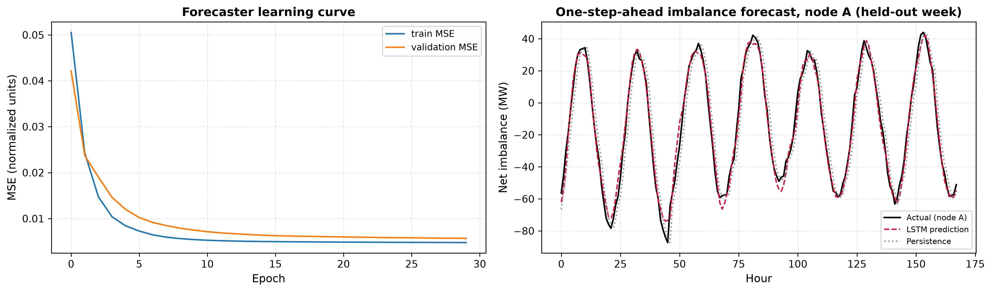
Result 1 — Supervised Forecaster
Model | MAE (MW) | RMSE (MW) | R²
LSTM forecaster | 4.995 | 7.54 | 0.911
Persistence baseline | 6.850 | 9.57 | 0.856
+21.2 % RMSE reduction over persistence — the frozen backbone encodes real structure.
DSE3170 Project Based Learning-3
18

Slide 19
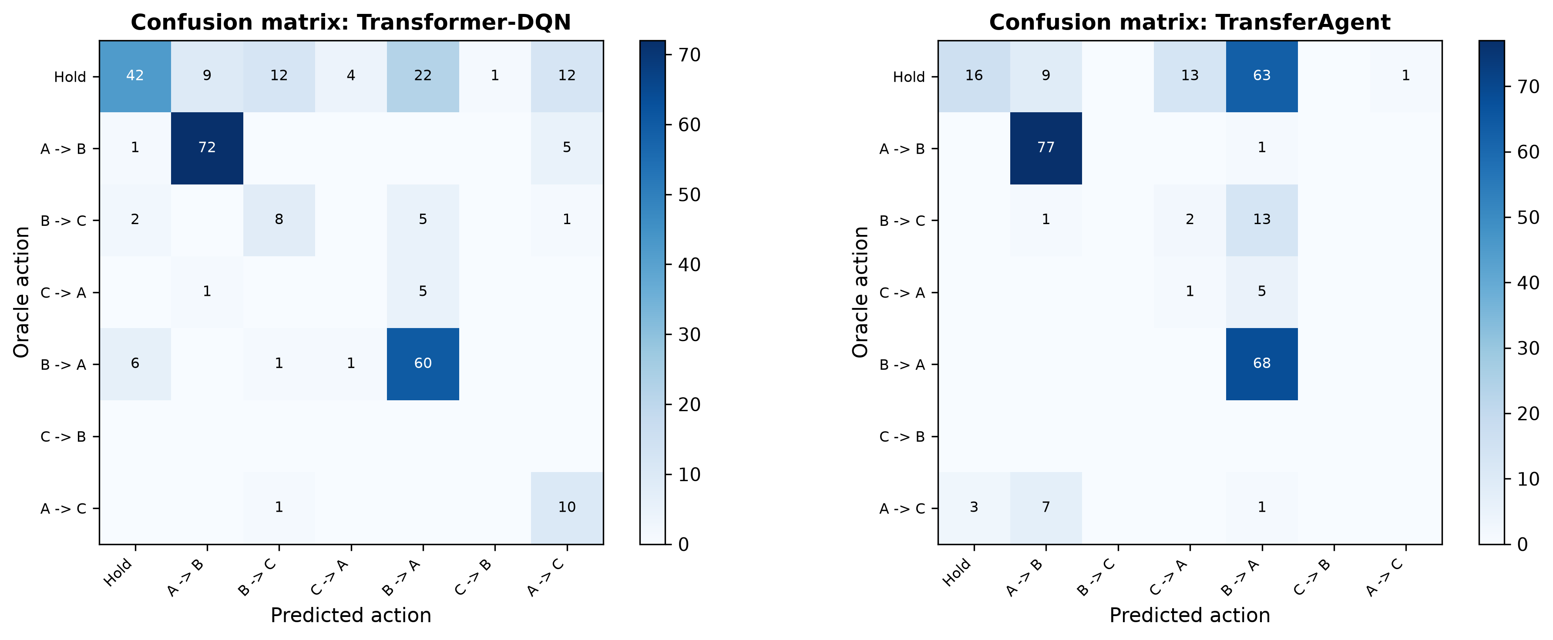
Result 2 — Decision Quality vs the Oracle
281 unseen states; always-Hold alone would score 36.3 % accuracy
Model | Accuracy | F1 (macro) | Cohen's κ
Transformer-DQN | 0.683 | 0.448 | 0.586
TransferAgent | 0.577 | 0.312 | 0.436
Baseline: always Hold | 0.363 | 0.089 | 0.000
Baseline: random | 0.114 | 0.090 | −0.026
Always-Hold reaches 0.363 accuracy but κ = 0.000 — chance correction is what separates a policy from a label-frequency artefact.
DSE3170 Project Based Learning-3
19

Slide 20
Result 3 — Physical Grid Performance
Centralized paradigm — 240 unseen hours, unmanaged total 16 303.73 MW
Policy | Reduction (%) | Transmission cost (MW) | Active hours (%)
Greedy oracle (ceiling) | 24.39 | 150 | 62.5
Transformer-DQN | 23.52 | 201 | 83.8
TransferAgent | 22.04 | 223 | 92.9
Baseline: always Hold | 0.00 | 0 | 0.0
Baseline: random | −14.91 | 202 | 84.2
96 %
of the achievable control
recovered by the DQN
−14.91 %
random policy — acting badly
is worse than not acting
The oracle ceiling is what makes 23.52 % readable as “nearly optimal” rather than “just a number”.
DSE3170 Project Based Learning-3
20

Slide 21
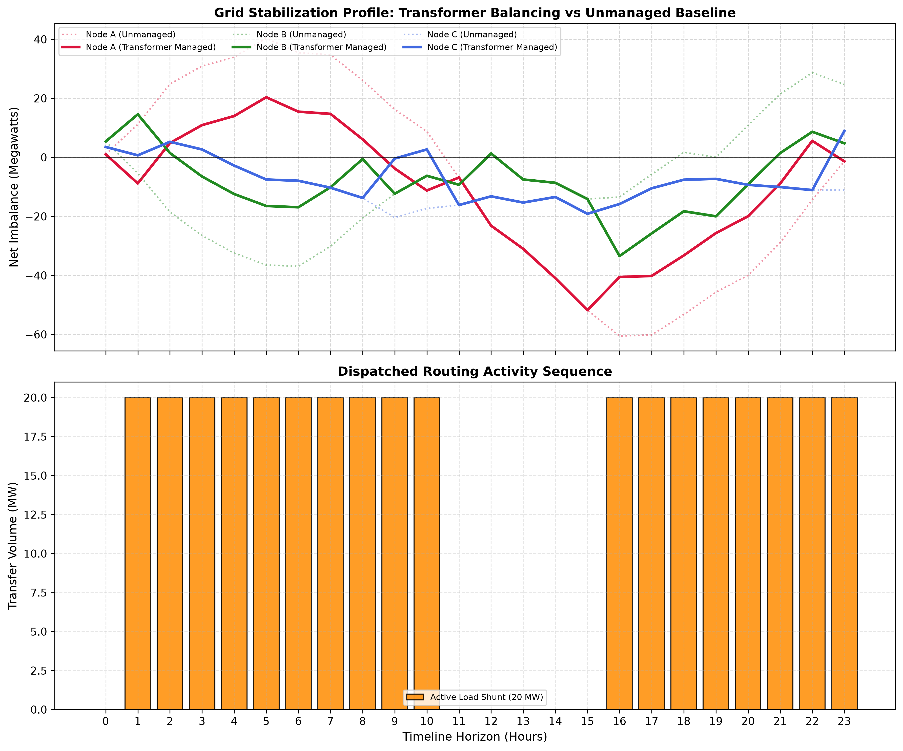
Result 4 — Learned Routing Behaviour
24-hour telemetry: 1 352.0 MW unmanaged → 920.9 MW managed (+31.9 %)
Morning: A surplus → routes A→B. Midday: all nodes in deficit → correctly Holds. Evening: B recovers → switches to B→A.
DSE3170 Project Based Learning-3
2`

Slide 22
Result 5 — The Decentralized Negative Result
Reported as measured, not tuned away
Policy | Reduction (%) | Transmission cost (MW) | Mean | imbalance | / h (MW)
Rule-based proportional | 21.71 | 160.03 | 48.74
No control (sanity check) | 0.00 | 0.00 | 62.26
Decentralized PPO | −14.93 | 297.49 | 71.55
▪ The learned controller is worse than doing nothing — and worse than a one-line heuristic
▪ Telemetry: line A→B saturates at 25 MW within five hours and stays there; B→C and C→A stay at 0
▪ Cause 1: reward is local, but each node's imbalance depends on its neighbour's line
▪ Cause 2: ±5 MW/h delta cannot follow swings several times larger
▪ Cause 3: all three nodes are usually in deficit at once, so saturating a line is locally rational
▪ Rebalancing the critic loss and raising the learning rate were measured — neither fixed it
DSE3170 Project Based Learning-3
22

Slide 23
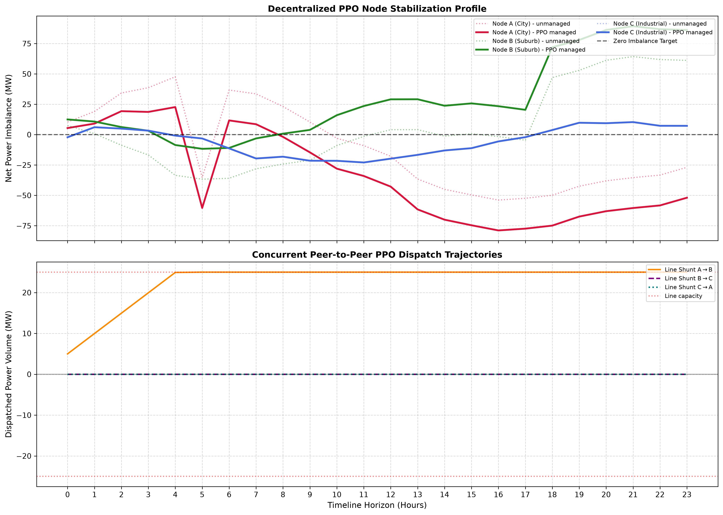
Result 5 (cont.) — Why It Fails
Shunt levels stop tracking the imbalance
At hour 05 node A sits at −35.4 MW and is still exporting 25 MW — a constant transfer applied to a signal that reverses sign.
DSE3170 Project Based Learning-3
23

Slide 24
Paradigm Comparison
▪ Centralized: 23.52 % against a 24.39 % ceiling — 96 % of the achievable control
▪ Decentralized: −14.93 % against 21.71 % for the classical proportional rule
▪ The information gap plus local-only credit assignment costs more than the scalability it buys — on this task
DSE3170 Project Based Learning-3
24

Slide 25
Limitations
▪ The grid is synthetic — no real weather, demand or price data
▪ Idealised transmission: no losses, impedance, voltage or frequency dynamics
▪ Centralized action space allows one 20 MW transfer per hour — this bounds the ceiling at 24.39 %
▪ Single seeded run per result — run-to-run variance is not quantified
▪ The two paradigms use different test windows, so each is read against its own references
▪ Modest budgets (60 DQN / 400 PPO episodes) — neither controller is claimed to be converged
DSE3170 Project Based Learning-3
25

Slide 26
Conclusion
R² 0.911
LSTM forecaster
on a chronological split
κ 0.586
DQN vs oracle
(always-Hold: 0.000)
21.71 %
rule-based beats
the learned PPO agents
▪ The centralized DQN recovers nearly all the control its actions permit
▪ A frozen forecasting encoder is not automatically a good control encoder
▪ Decentralized PPO did not learn a usable policy — the cause is diagnosed
▪ A percentage means nothing without a baseline and a ceiling beside it
23.52 % is excellent because the ceiling is 24.39 %. −14.93 % is a failure because doing nothing scores 0.00 %.
DSE3170 Project Based Learning-3
26

Slide 27
Future Scope
Fix what failed
Extend the study
▪ Shared or mixed reward instead of purely local credit
▪ Widen the per-hour delta bound so the shunt can track the signal
▪ Evaluate MAPPO / QMIX against the same rule-based reference
▪ Fine-tune rather than freeze the forecasting backbone
▪ Replace the simulator with real substation and weather data
▪ Add line losses, impedance and storage as a controllable element
▪ Scale beyond three nodes — where decentralization should pay off
▪ Repeat over multiple seeds and report confidence intervals
DSE3170 Project Based Learning-3
27

Slide 28
References
▪ V. Mnih et al., “Human-level control through deep reinforcement learning,” Nature, vol. 518, pp. 529–533, 2015.
▪ J. Schulman et al., “Proximal policy optimization algorithms,” arXiv:1707.06347, 2017.
▪ J. Schulman et al., “High-dimensional continuous control using generalized advantage estimation,” ICLR, 2016.
▪ A. Vaswani et al., “Attention is all you need,” NeurIPS, pp. 5998–6008, 2017.
▪ S. Hochreiter and J. Schmidhuber, “Long short-term memory,” Neural Computation, vol. 9, no. 8, pp. 1735–1780, 1997.
▪ J. Terry et al., “PettingZoo: Gym for multi-agent reinforcement learning,” NeurIPS, vol. 34, pp. 15032–15043, 2021.
▪ J. Cohen, “A coefficient of agreement for nominal scales,” Educ. Psychol. Meas., vol. 20, no. 1, pp. 37–46, 1960.
▪ R. S. Sutton and A. G. Barto, Reinforcement Learning: An Introduction, 2nd ed. MIT Press, 2018.
The full IEEE reference list is given in the project report.
DSE3170 Project Based Learning-3
28

Slide 29
Thank You
DSE3170 Project Based Learning-3
29

