Slide 1


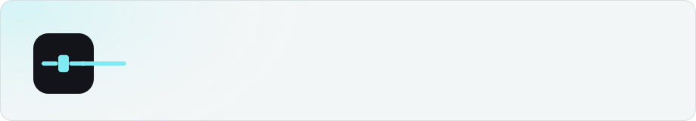

Presented by :
Krish Kamra, Jash Kankariya, Tejas Kini
NetTransfer
Computer Networks Presentation

Slide 2

NetTransfer: A File, Two Sockets, One Sandbox
A custom TCP file protocol demonstrating Computer Networks fundamentals through a localhost laboratory environment.
TCP Control
HTTP / WS API
Web Console
Port 2121
Port 8000
Port 3000
NetTransfer is a complete, self-contained file-transfer system built on a hand-designed TCP session protocol running on loopback. Every component, from the React web console at port 3000, through the FastAPI middleware at port 8000, down to the raw TCP server at port 2121, was authored from scratch as a Computer Networks laboratory exercise. The system is intentionally unencrypted so that every byte of the protocol exchange is visible in Wireshark, making it an ideal vehicle for demonstrating TCP session mechanics, HTTP control planes, and WebSocket progress channels simultaneously.
Lab Scope
  Custom TCP session protocol with FTP-style reply codes
  FastAPI middleware bridging HTTP ↔ TCP
  React console with live WebSocket progress
  Per-user filesystem sandbox with bcrypt auth
  Full packet visibility, no TLS by design
Notes:
1

Slide 3



System Architecture: Two Hops
Storage
Browser :3000
Filesystem users/account/ with SQLite metadata
Sends HTTP /api and WS /ws/transfers
Two-hop Data Path
TCP Server :2121
FastAPI :8000
Handles protocol commands and auth
Opens short-lived TCP session
Control Plane
Storage Layer
Same-Origin Proxy
Two-Hop Data Path
FastAPI opens a short-lived TCP session on port 2121 for each upload or download. The session is AUTH'd, the command issued, bytes transferred, and the connection closed — one file per TCP lifetime.
SQLite holds file metadata and transfer history. Raw file bytes live on the filesystem under users/<account>/. Both the TCP server and FastAPI share the same directory tree.
Vite dev server proxies /api and /ws routes to port 8000, so the browser treats both the static UI and the API as a single origin — no CORS complexity.
File bytes travel Browser → FastAPI → TCP Server → Storage on upload, and the reverse on download. The HTTP hop and the TCP hop are both visible in Wireshark on their respective ports.
Notes:
2

Slide 4
Custom TCP Protocol: Port 2121
Complete Session Transcript
Reply Code Reference
← 220 Welcome to NetTransfer TCP Service
→ AUTH demo-user s3cr3t
← 230 User demo-user logged in successfully.
→ STOR demo-note.txt 17
← 150 Ready to receive 17 bytes.
→ <17 raw bytes, no header>
← 226 Transfer complete. Saved 17 bytes.
→ QUIT
← 221 Service closing control connection.
Code | Meaning
220 | Service ready: sent on connect
230 | AUTH accepted: user logged in
150 | Transfer starting : ready for bytes
226 | Transfer complete: bytes saved
221 | QUIT acknowledged: connection closing
553 | Path rejected: sandbox violation
STOR Framing
RETR Framing
Chunk Size & Sandbox
File size carried in the command line: STOR filename.txt 17. Raw bytes follow immediately, no binary header. Server reads exactly the declared byte count.
Server prepends an 8-byte unsigned big-endian length header (>Q struct format) before the payload, then sends the file bytes, then replies 226. Example: 00 00 00 00 00 00 00 11 = 17 bytes.
Both sides read/write in 64 KiB chunks. Any path containing / or .. is rejected with error 553 before the resolved path is checked against users/<account>/.
Notes:
3

Slide 5


Authentication & Security Model
Credential Lifecycle
Per-User Sandbox
No TLS — By Design
1
bcrypt Hash at Rest
Every account is isolated inside users/<account>/. The TCP server resolves every path and verifies the canonical result stays within the account directory. Escape attempts return 553.
The lab intentionally omits TLS so that AUTH traffic, file contents, and token frames are fully visible on the loopback interface. This is the mechanism that makes Wireshark demonstration meaningful.
Passwords are stored as bcrypt hashes in SQLite — the plaintext password is never persisted to disk. Verification occurs at login time only.
2
JWT in the Browser
After successful login the browser receives a JWT token and retains it for the session. The plaintext password is discarded by the client immediately.
3
TCP AUTH Relay
Lab limitation: AUTH frames on port 2121 carry credentials in plaintext. Do not linger on these frames during the live demonstration.
The FastAPI control plane temporarily holds the password to perform AUTH <user> <password> over TCP. The credential is dropped from memory on sign-out.
4
WebSocket JWT Handshake
/ws/transfers receives the JWT token in the first text frame; the server validates it and responds with ready before streaming progress events.
Notes:
4

Slide 6
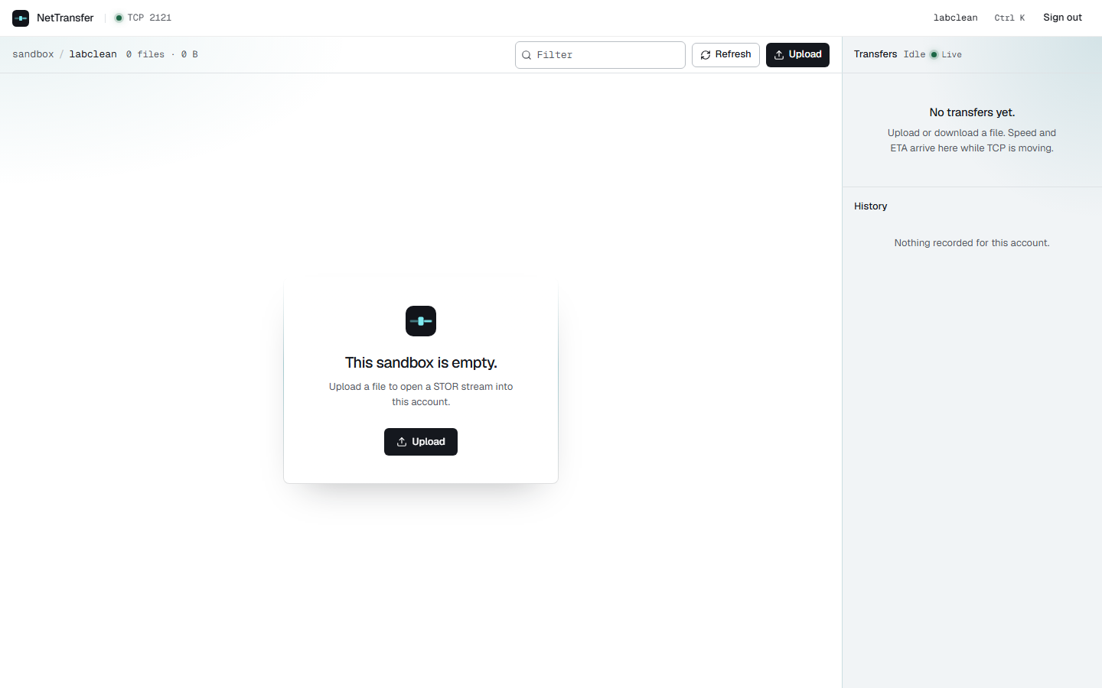
Sign-In & Empty Sandbox
Entry Point: The HTTP login form at port 3000 submits credentials to FastAPI, which validates against the bcrypt hash and returns the JWT token used throughout the remainder of the session.
Left Panel — Sign-In Form
Notes:
5

Slide 7
Sign-In & Empty Sandbox
Right Panel — Empty Sandbox + Live Indicator
Notes:
5

Slide 8
Upload & Download: Transfer Tracking
Two-Hop Measurement: The browser measures the HTTP portion (Browser → FastAPI on port 8000); FastAPI captures TCP transfer metrics (FastAPI → TCP Server on port 2121) and streams them back via WebSocket.
Transfer Card (Live)
History Table (Persistent)
Displays bytes transferred, speed (B/s), ETA, and state sourced from TCP session progress. WebSocket text frames carry transferred_bytes JSON as the TCP server streams each 64 KiB chunk.
SQLite records each completed transfer — filename, size, direction, timestamp, speed. Rows persist after the TCP session closes, providing an audit trail independent of the live WebSocket connection.
Notes:
6

Slide 9
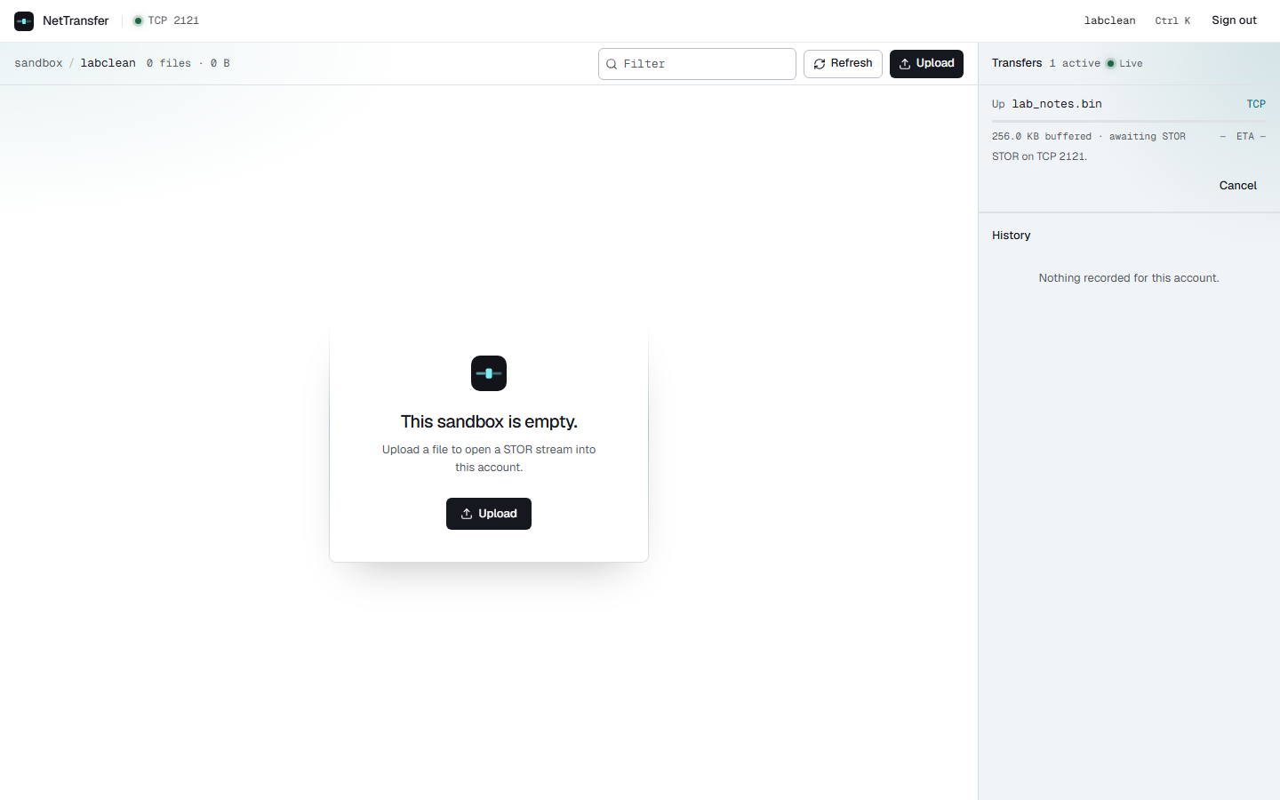
Notes:
6

Slide 10
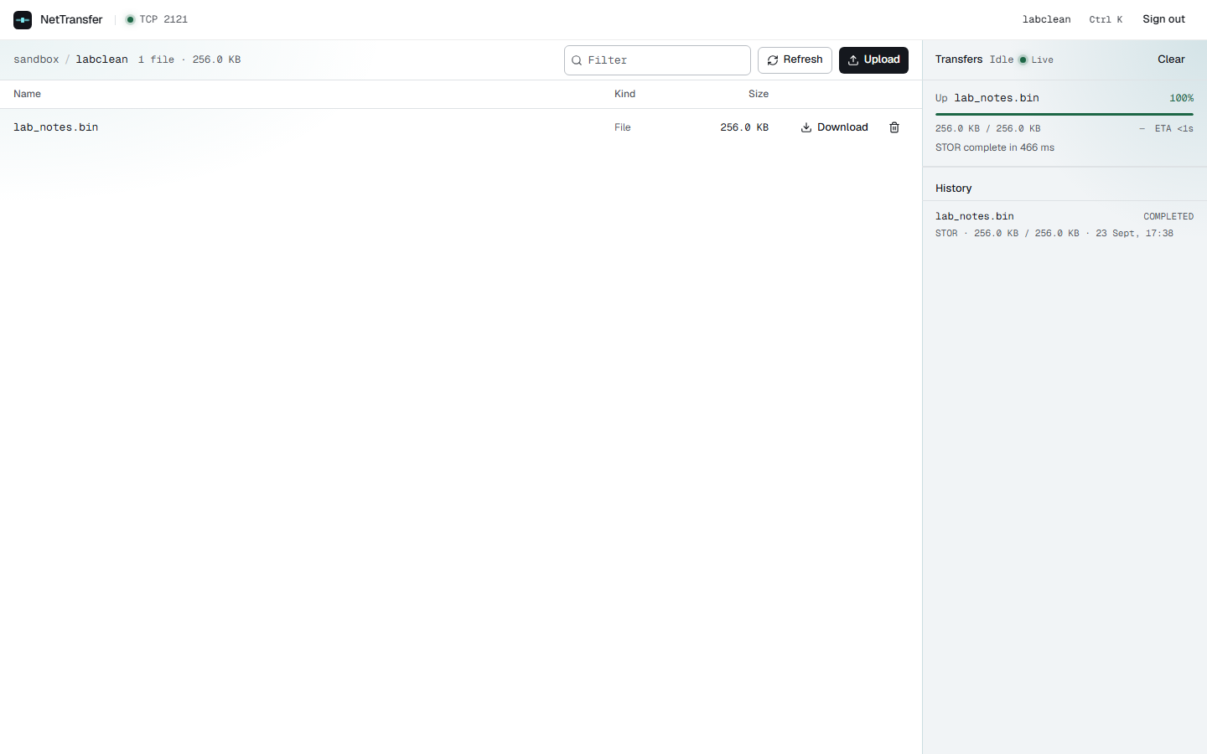
Notes:
6

Slide 11
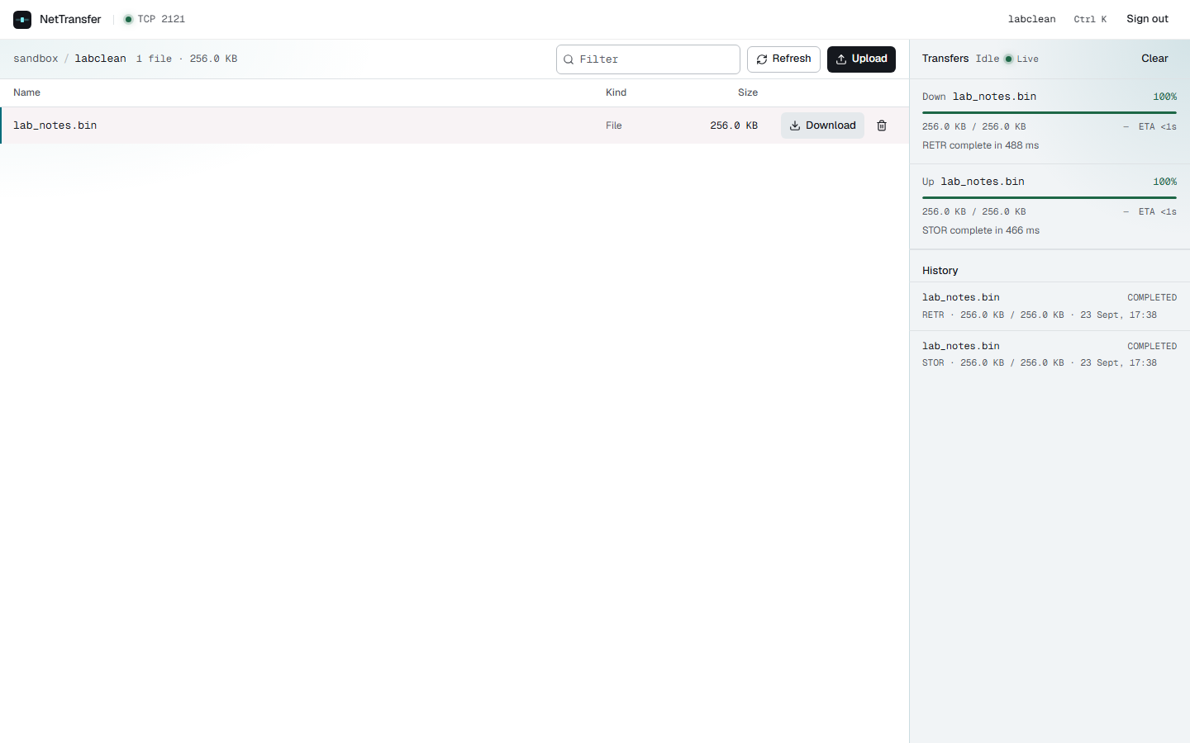
Notes:
6

Slide 12
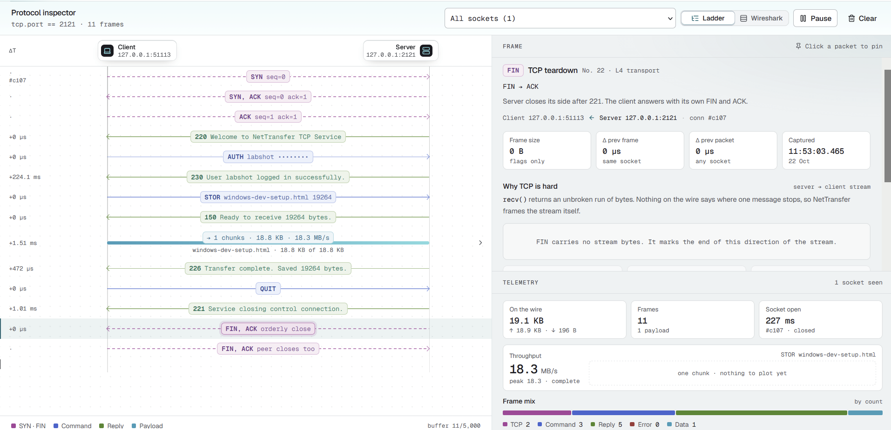
Live Demonstration:
Notes:
8

Slide 13
What the Demonstration Proved
TCP Protocol — Port 2121
HTTP + WebSocket — Port 8000
Shared Storage
Port 2121 carried the complete designed session: three-way handshake, FTP-style reply codes (220 / 230 / 150 / 226 / 221), size-declared STOR with raw bytes, length-prefixed RETR with 8-byte >Q header, and clean QUIT termination. Wireshark verified every frame.
Both the TCP server and FastAPI read/write the same users/<account>/ directory. The file appeared in the browser's file table immediately after STOR completed — account state changed visibly across both processes.
Port 8000 carried the same file through a standard HTTP POST (/api/transfers/upload), and streamed real-time progress through WebSocket text frames containing transferred_bytes JSON. The 101 Switching Protocols upgrade is visible in the capture.
The custom application is the agreement on the wire. The console is a client of that agreement. The packet capture is the evidence.
Notes:
9

Slide 14
Milestones & Conclusion
Milestone | Demonstrated Through
TCP STOR / RETR commands | Two TCP streams in Wireshark on port 2121
8-byte RETR length header (>Q) | Wireshark hex dump — 00 00 00 00 00 00 00 11
Per-user filesystem sandbox | Account directory isolation; error 553 on path escape
Accounts & bcrypt password storage | Sign-in form + SQLite hash; no plaintext at rest
SQLite transfer history | History table rows persisting after TCP session ends
Bytes / speed / ETA metrics | Transfer Card display sourced from TCP session progress
HTTP control plane | Upload flow visible on port 8000 in Wireshark
React web console | Screenshots + live demonstration at port 3000
WebSocket progress channel | Live badge + transferred_bytes JSON frames on port 8000
Full Wireshark capture | Packet-level analysis of all three ports simultaneously
NetTransfer is a localhost lab for reading and understanding a protocol you wrote. It demonstrates how React Web Console → HTTP/WebSocket Control Plane → Custom TCP File Protocol → Per-user Sandbox connects a modern web interface with fundamental Computer Networks concepts. Every layer — framing, authentication, sandboxing, progress reporting — was designed and implemented as a cohesive system, then verified at the packet level.
Questions Welcome
  TCP framing design (STOR vs RETR asymmetry)
  Sandbox path resolution & error 553
  Two-hop architecture trade-offs
  Wireshark capture methodology
  Lab limitations & TLS extension path
Notes:
10

