Slide 1
measured, not promised
FINAL PROJECT PRESENTATION | CSI1006 | SEVENTH SEMESTER
Attention-Driven Graph Neural Networks
for Influence and Anomaly Detection
in Complex Networks
A shared graph-attention encoder, tested as a hypothesis on CPU-sized benchmarks
Krish Kapoor
Registration No. 23MIC0023
A.M. Karthikeshwaran
Registration No. 23MID0215
School of Computer Science and Engineering (SCOPE), VIT Vellore
Notes:
Opening (30 s). Introduce the team and the question: can the attention weights of a graph attention network serve both to rank influential nodes and to flag anomalous ones? Stress at the start that we treat this as a hypothesis, that every number on later slides is measured from saved runs, and that influence labels are simulated while Cora anomalies are injected.
Sources: project proposal (Review 1); report Sections 1 and 5.

Slide 2
Context: hubs and outliers are hard to explain
Why influence and anomaly questions are usually answered separately
The challenge
The limitation
The opportunity
Social, communication and interaction networks hold many linked entities. Finding the ones that spread activity and the ones that behave oddly strains conventional pipelines.
Degree, PageRank and betweenness treat neighbours alike. Deep detectors return a score but rarely say which neighbours drove it.
A graph attention network learns a weight per neighbour. Those weights might double as an influence signal and an anomaly signal.
Problem. Given an attributed network, can one learnable model both rank nodes by influence and flag anomalous nodes, stay interpretable, and train on a laptop CPU?
We test this against classical baselines and non-attentive controls rather than assume it.
Attention-driven GNN for influence and anomaly detection | Krish Kapoor (23MIC0023), A.M. Karthikeshwaran (23MID0215)
2
Notes:
Context (1 min). The three cards come from the proposal: challenge, limitation, opportunity. The problem statement is the proposal's, rephrased as a testable question.
Sources: proposal slides 2-3; Velickovic et al. 2018 (GAT); Akoglu et al. 2015 (survey).

Slide 3
Objectives and research questions
The proposal's six objectives, turned into measurable checks
1 Represent networks as attributed graphs; document data, labels and splits
2 Train a multi-head attention encoder under a CPU budget
3 Test attention as a shared signal for influence ranking and anomaly scoring
4 Benchmark against degree, PageRank, betweenness, Isolation Forest and a DOMINANT-style GCN
5 Evaluate with precision, recall, F1, ROC-AUC, AP, rank correlation, NDCG and held-out cascade spread
6 Validate the attention-based interpretation by perturbation, and record compute
RQ1
Does attention-only scoring detect anomalies as well as reconstruction?
RQ2
Does received attention rank held-out spread better than degree and PageRank?
RQ3
Does joint training help either task versus task-only training?
RQ4
Do high-attention edges matter more to the output than random ones?
Attention-driven GNN for influence and anomaly detection | Krish Kapoor (23MIC0023), A.M. Karthikeshwaran (23MID0215)
3
Notes:
Objectives (1 min). Left: the six objectives from the proposal. Right: four research questions we can answer with the saved runs. Each is answered on slides 10-13 with the measured numbers, including negative outcomes.

Slide 4
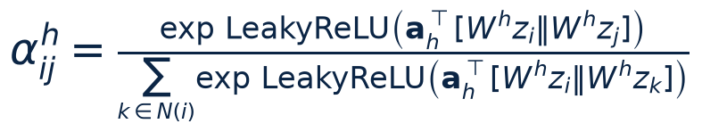
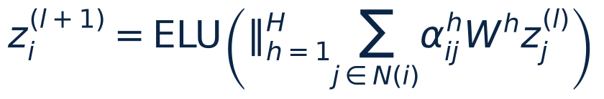
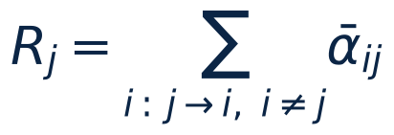
Theory: message passing and attention
Who attends to whom, and what can be summed
GAT coefficient for the arc j → i (softmax over arcs arriving at i)
GCN uses fixed degree-normalised weights: not uniform, but not learned per edge
GAT learns the weights; GATv2 makes the neighbour ranking depend on the query node
Softmax makes the coefficients arriving at any node sum to 1, so summing there cannot rank nodes (unit-tested)
Attention leaving a source, summed over its targets, can differ between nodes: that is what we rank by
Attention is an association with the output, not automatically an explanation (Jain & Wallace 2019)
Layer update (heads concatenated)
Received attention of a source j (our influence signal)
Attention-driven GNN for influence and anomaly detection | Krish Kapoor (23MIC0023), A.M. Karthikeshwaran (23MID0215)
4
Notes:
Theory (1.5 min). Kipf & Welling 2017 for GCN, Velickovic et al. 2018 for GAT, Brody et al. 2022 for GATv2. Key point: because each target's coefficients sum to one, the useful quantity is attention a source RECEIVES from its targets. Isolated nodes get zero. Attention as explanation: Jain & Wallace 2019, Wiegreffe & Pinter 2019.

Slide 5
Literature survey and the defensible gap
Ingredients exist; our contribution is the controlled integration
Work | What it establishes | Implication for us
GCN, GAT, GATv2 (2017-2022) | Fixed vs learned vs dynamic neighbour weights | Matched encoder comparison
DOMINANT, AnomalyDAE, ResGCN | Reconstruction (and attention) for anomalies | DOMINANT-style GCN baseline
BOND / PyGOD (2022) | Organic vs injected anomalies, consistent protocols | Weibo (organic) + Cora (injected)
DeepLinker / GANR (2019-21) | Received attention as a node centrality | Not new: add degree control, held-out cascades
Kempe et al. (2003) | Independent-cascade spread model | Simulated influence target
GNNExplainer, Jain & Wallace | Attention may not explain predictions | Perturbation test of attention
Gap we can defend: one shared encoder evaluated on both tasks under one protocol, with non-attentive controls and a perturbation test. Not claimed: a first unified model or a new architecture.
The proposal's 'Zhang et al. (2022)' citation could not be verified and is not used.
Attention-driven GNN for influence and anomaly detection | Krish Kapoor (23MIC0023), A.M. Karthikeshwaran (23MID0215)
5
Notes:
Literature (1 min). All entries were opened at primary sources; the matrix and claim ledger are in docs/literature. Zhang et al. 2022 as written in the proposal could not be found in arXiv, Crossref or OpenAlex; we excluded it and list real near-matches in docs/literature/zhang2022_verification.md. DeepLinker/GANR (Gu et al.) already rank by received attention.

Slide 6
System architecture and functional flow
What is actually implemented (editable shapes)
ARCHITECTURE
Data
Weibo (pinned, verified)
Cora + injection
CSV import
Preparation
symmetrise, split
normalise (train)
cascade targets
Shared model
2-layer GAT / GATv2 / GCN
attribute, structure,
influence heads
Scoring
anomaly scores
received attention
validation threshold
Evidence + UI
run records, tables
Streamlit dashboard
report, slides
FUNCTIONAL FLOW
Train
unsupervised
losses + train
cascade targets
Select
validation labels:
alpha, threshold
(then frozen)
Extract
attention per
layer, head, arc
Score
rec | attention-only
| combined; R_j raw
and adjusted
Evaluate
same test nodes for
all methods
Perturb
remove high / random
/ low attention
edges
Labels enter only at 'Select' (validation) and 'Evaluate' (test). The encoder never sees anomaly labels; validation or test nodes' influence targets are never used for training.
Attention-driven GNN for influence and anomaly detection | Krish Kapoor (23MIC0023), A.M. Karthikeshwaran (23MID0215)
6
Notes:
Architecture (1 min). Top row mirrors report Figure 'System architecture'; bottom row mirrors 'Functional block diagram'. Emphasise the leakage boundary: unsupervised training, validation labels choose only alpha and the threshold, test labels are used once for evaluation. Transductive disclosure: the encoder sees all nodes' features and all edges, but no labels.

Slide 7
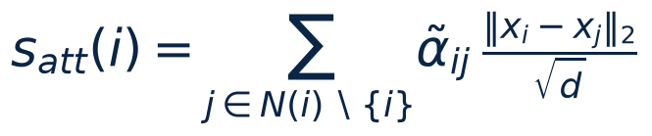
Methodology: scoring equations and objectives
Definitions fixed before the benchmark runs
Training objective (shared encoder, three losses)
Encoder: 2 layers, width 64; GAT 4 heads × 16; GATv2 and GCN as controls
Structure loss on sampled edges and non-edges (1:1): no dense N×N matrix
Influence head trained on train-node cascade targets only
Each loss sends gradient into the shared encoder (unit-tested)
Joint model = our extension; attention-only scores test the proposal's stronger claim
Controls: uniform-neighbour deviation, untrained-GAT attention
alpha and the F1 threshold are chosen on validation and frozen: model selection is label-informed
Attention-only anomaly score (no decoder output)
Reconstruction and combined scores
Attention-driven GNN for influence and anomaly detection | Krish Kapoor (23MIC0023), A.M. Karthikeshwaran (23MID0215)
7
Notes:
Method (1.5 min). Equations are in report Section 3.2. a_sel in {0,.25,.5,.75,1} is chosen by validation ROC-AUC. The combined score uses fixed 0.5/0.5 weights on train-robust-z-scored components, not tuned. Adam, lr 0.005, weight decay 5e-4. On Weibo, 30% of arcs are kept per training epoch (DropEdge-style, Rong et al. 2020) for CPU feasibility; inference uses the full graph.

Slide 8
Datasets, label provenance and evaluation protocol
Organic and injected anomalies are kept apart
 | Weibo (organic) | Cora + injection (synthetic)
Nodes / undirected edges | 8,405 / 377,271 | 2,708 / 5,593
Features | 400 (user attributes) | 1,433 (bag of words)
Anomalies | 868 (10.3%), organic labels (original 2022 file) | 140 (5.2%): 70 structural + 70 contextual
Source | PyGOD / BOND file | Planetoid Cora; seeded DOMINANT-style injection
Caveat | 2024 upstream file blanks val/test labels: pinned + SHA-256 checked | Never observed fraud
30/20/50 split, stratified, seeded; transductive
Normalise with train statistics; thresholds frozen on validation
Influence: independent-cascade spread, separate random streams for train, validation and test nodes
All rankings scored on the same held-out test nodes
≥3 seeds (Cora 5, Weibo 3)
Metrics
Anomaly: precision, recall, F1 at the validation threshold, ROC-AUC, average precision, precision@k, confusion matrix.
Influence: Spearman, Kendall τ, NDCG@k, top-k overlap, spread of the selected 10/20-node seed set (held-out cascades).
Attention-driven GNN for influence and anomaly detection | Krish Kapoor (23MIC0023), A.M. Karthikeshwaran (23MID0215)
8
Notes:
Data and protocol (1.5 min). Cora topic classes are NOT anomaly labels. Weibo labels are organic (suspicious posting behaviour, BOND Appendix A.1.1). Our dataset validation found that the current upstream Weibo file blanks the validation and test labels (347 of 868 anomalies remain); we pin the original 2022 commit, verify its SHA-256 and re-ran every Weibo experiment. The comparison with the corrupted run is in report Sec. 5.1. Influence is a simulation proxy, never observed influence. Sources: Liu et al. 2022 (BOND); Ding et al. 2019 (injection); Kempe et al. 2003 (IC); Sen et al. 2008 and Yang et al. 2016 (Cora).

Slide 9
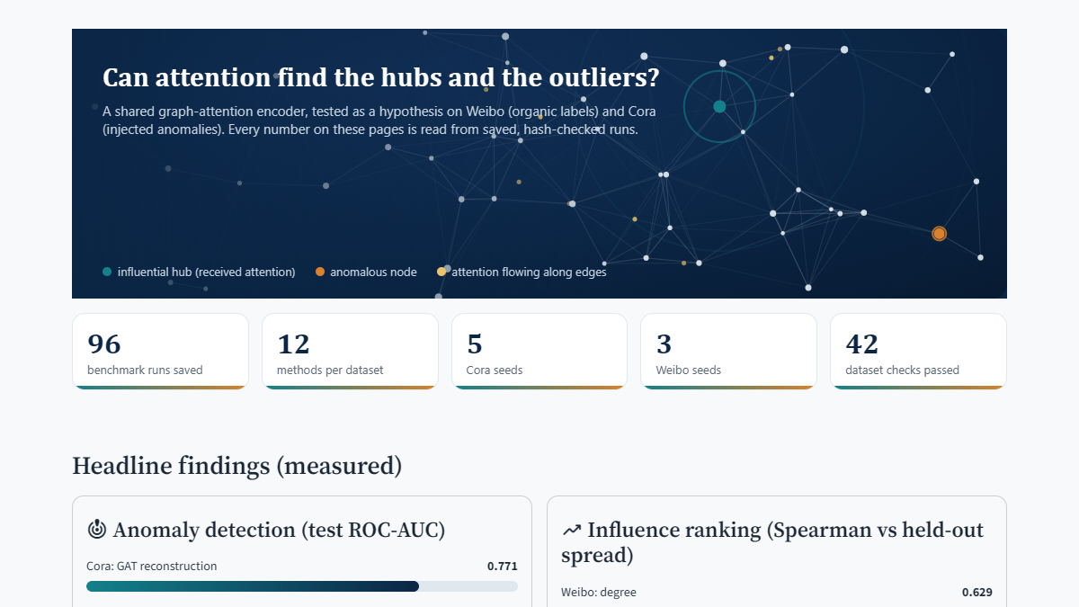
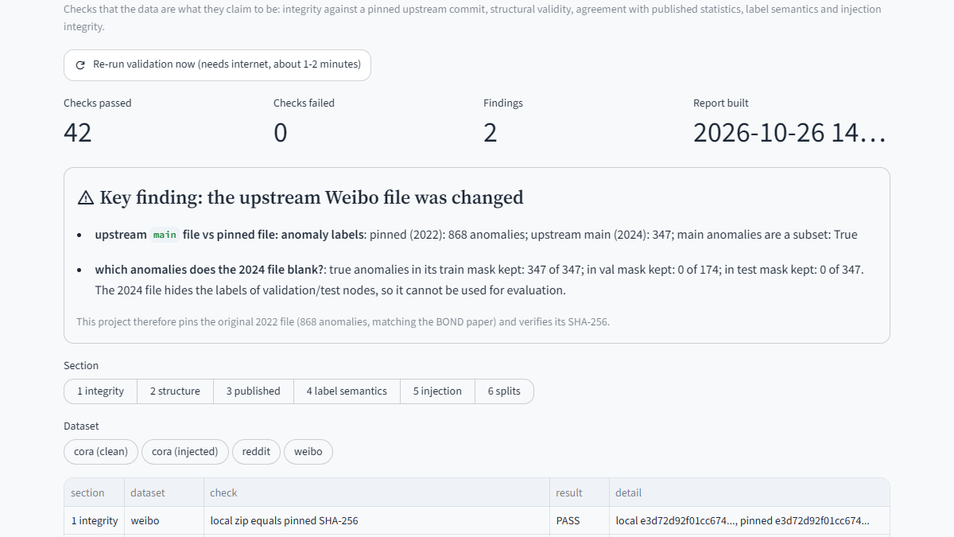
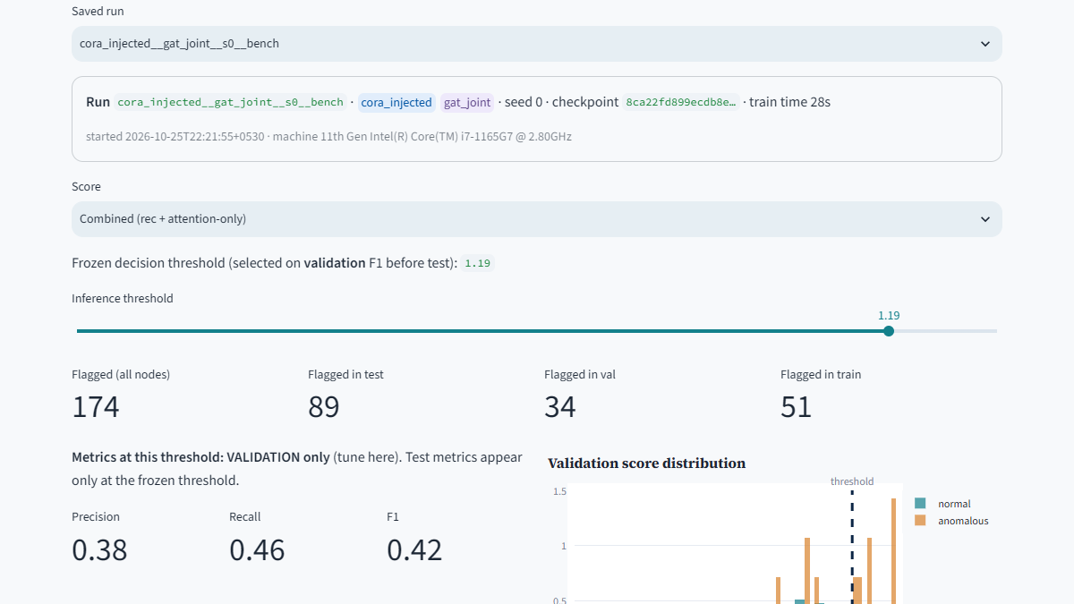
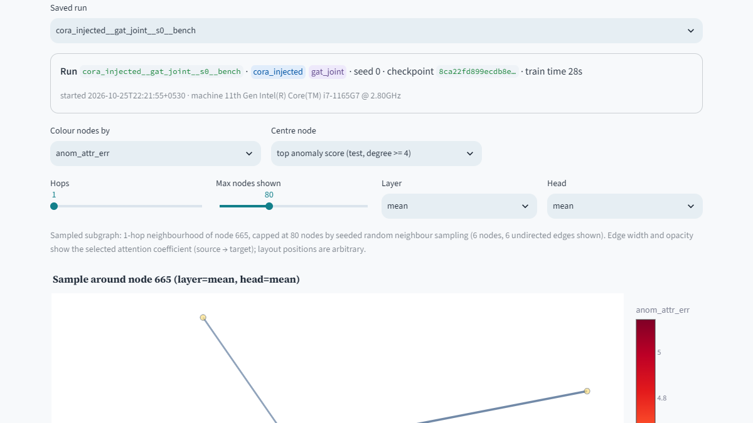
Implemented features and real dashboard screenshots
Streamlit app running locally; every view reads saved runs
CSV graph import with validation
Train / smoke jobs, status, checkpoint reload
Influence table with degree, PageRank, simulated spread
Adjustable anomaly threshold (tuned on validation)
Layer / head attention view
Saved-run comparisons, exports
Overview: animated hero and count-up tiles
Dataset authenticity page
Anomaly scores + live distribution
Sampled graph + node inspector
Attention-driven GNN for influence and anomaly detection | Krish Kapoor (23MIC0023), A.M. Karthikeshwaran (23MID0215)
9
Notes:
Features and demo sequence (2 min). All screenshots are from the running dashboard.
Demo sequence (see reports/demo_script.md): 1) Data & graph summary: pick Cora, show injection parameters. 2) Train / evaluate: start a smoke job, watch the log, then reload a checkpoint and verify that saved predictions are reproduced. 3) Anomaly scores: move the threshold, note that metrics at the slider are shown on validation only. 4) Influence ranking: pick p, sort by received attention and by degree. 5) Graph explorer: centre on the top test anomaly, switch layer and head. 6) Demos: known injected anomaly, high-spread node, explanation-vs-perturbation, model reload.

Slide 10
Anomaly results and baseline comparison
Test ROC-AUC, mean over seeds (axis starts at chance); controls included
Cora: attention-only 0.796 vs uniform-neighbour control 0.790 vs untrained attention 0.791: learned attention adds at most +0.006 AUC (paired, 5 of 5 seeds)
Weibo: GCN reconstruction 0.791, GATv2 0.773, GAT 0.771; attention-only 0.609 is below its control 0.630; Isolation Forest 0.458 (below chance)
Attention-driven GNN for influence and anomaly detection | Krish Kapoor (23MIC0023), A.M. Karthikeshwaran (23MID0215)
10
Notes:
Anomaly results (1.5 min). Bars are means over seeds (standard deviations in report Table 5.2 and in artifacts/results/tables). Colours: grey baselines, navy reconstruction, teal attention-based scores, sand control. Message for RQ1: the attention-only score matches reconstruction on injected Cora but also matches an untrained-attention and a uniform-weight control, so the signal comes from the neighbour feature discrepancy, not from learned attention. Weibo: BOND reports that classical methods already do very well there, so a strong baseline is expected.
Sources: results index artifacts/results/results_index.json; Liu et al. 2022.

Slide 11
Influence results and baseline comparison
Spearman vs held-out simulated spread (middle cascade probability), mean over seeds
Weibo: degree 0.629, GCN head 0.889, GAT received attention -0.198 (non-learned uniform control 0.109)
Cora: received attention 0.335 = uniform control 0.335; degree adjustment turns it negative (-0.507)
Top-10 seed set (Cora): degree 104 vs random 25 activated nodes
Attention-driven GNN for influence and anomaly detection | Krish Kapoor (23MIC0023), A.M. Karthikeshwaran (23MID0215)
11
Notes:
Influence results (1.5 min). Ground truth = held-out independent-cascade spread on the same test nodes for every method. RQ2: received attention tracks the non-learned uniform-attention control closely because learned attention is nearly uniform (entropy ratio about 0.98-1.0 on Cora). Individual spread differs from seed-set spread: the oracle top-10 by individual spread is not the best seed set because chosen nodes overlap. Not observed influence: simulation only.
Sources: Kempe et al. 2003; Gu et al. 2019/2021 for received attention; report Tables in Section 5.

Slide 12
Ablation, explanation validation and measured compute
RQ3 and RQ4, with measured cost
Cora, ROC-AUC / influence ρ | Anomaly | Influence head
GCN joint | 0.776 | 0.732
GAT joint | 0.776 | 0.648
GATv2 joint | 0.769 | 0.667
GAT 1-head joint | 0.770 | 0.637
GAT anomaly-only | 0.771 | n/a
GAT influence-only | n/a (head untrained) | 0.680
Isolated run | Cora s | Weibo s | Weibo MB
GCN joint | 10 | 36 | 1063
GAT joint | 12 | 52 | 1222
GATv2 joint | 16 | 82 | 1525
Training seconds and memory, single runs, CPU only (i7-1165G7). On Weibo the benchmark averages agree with these; Cora benchmark averages were about 2x higher (CPU shared).
Weibo high vs random: anomaly p = 0.003, influence p = 0.0001; Cora anomaly p = 0.0095
Joint vs task-only: no reliable benefit (anomaly AUC +0.005 on Cora, +0.007 on Weibo; the influence-only head is as good or better)
Edge removal: high-attention edges matter more than random ones for anomaly scores (Cora +0.019, Weibo +0.067) and for influence on Weibo (+0.298), not on Cora where attention is uniform
Attention describes what the trained model uses; it is not a causal explanation and not a better predictor than the controls
Attention-driven GNN for influence and anomaly detection | Krish Kapoor (23MIC0023), A.M. Karthikeshwaran (23MID0215)
12
Notes:
Ablations, explanation test and compute (1.5 min). Ablation numbers are means over seeds from artifacts/results/tables/ablation_*.csv. Perturbation test: remove m<=3 edges of a target chosen by highest attention, lowest attention or at random; recompute the frozen model's output identically; paired bootstrap CI over targets pooled across seeds. Parameter budgets: GAT and GCN have about 96k encoder parameters, GATv2 about 192k (two weight matrices); 1-head and 4-head GAT have identical parameter counts. Compute: wall-clock measured per run; memory in the report is a cumulative process peak (upper bound).

Slide 13
Outcomes, failure cases, limitations and conclusion
What the measurements support, and what they do not
What we found
Failure cases and limits
Conclusion
Reconstruction and neighbour-discrepancy scores detect injected Cora anomalies (AUC about 0.77 to 0.80); Isolation Forest 0.68
Attention-only scoring is matched by controls on Cora and weaker on Weibo
Received attention equals the uniform control on Cora and is worse on Weibo; degree adjustment destroys it
A plain GCN head is the best learned influence ranker (Weibo Spearman 0.89)
Edge removal: attention marks edges that matter to the model where it is sharp (Weibo), not where it is uniform (Cora)
Data trap: the upstream Weibo file blanks val/test labels; our first run used it. Found by validation, fixed, re-run
GAT influence head overfits noisy targets
Influence is simulated; Cora anomalies are injected
Weibo structure error and Isolation Forest below chance; transductive; arc subsampling; 3 to 5 seeds
As tested, attention-derived signals do not beat simple controls on either task
The negative result is itself informative; the pipeline, controls and perturbation test are reusable
Joint training: no reliable benefit at this scale
Claims are limited to these datasets, budgets and proxies
Attention-driven GNN for influence and anomaly detection | Krish Kapoor (23MIC0023), A.M. Karthikeshwaran (23MID0215)
13
Notes:
Outcomes (1.5 min). Be explicit that these are valid negative outcomes: they are results, not failures of the project. State the limits: simulation proxy for influence, injected labels on Cora, label-count discrepancy on Weibo, transductive evaluation, CPU compute budget, and few seeds. What is not run is listed in the report and PROGRESS.md.

Slide 14
Future work and selected references
Test attention on graphs with dynamic or sharper attention (GATv2 with entropy regularisation)
Use measured cascades instead of simulated spread
Run the full BOND suite and Reddit (near-chance for most detectors) under the same protocol
Multi-scale neighbourhoods (Gutiérrez-Gómez et al. 2020)
Stronger faithfulness tests and explainers (GNNExplainer-style)
Inductive evaluation on unseen graphs
Selected references (full list in report Section 8)
Kipf & Welling. Semi-supervised classification with GCNs. ICLR 2017.
Veličković et al. Graph attention networks. ICLR 2018.
Brody, Alon, Yahav. How attentive are GATs? ICLR 2022.
Ding et al. Deep anomaly detection on attributed networks. SDM 2019.
Liu et al. BOND: benchmarking unsupervised outlier node detection. NeurIPS D&B 2022.
Kempe, Kleinberg, Tardos. Maximizing the spread of influence. KDD 2003.
Ying et al. GNNExplainer. NeurIPS 2019.
Gu et al. DeepLinker / GANR (attention rank). arXiv 2019; Sci. Rep. 2021.
Akoglu, Tong, Koutra. Graph-based anomaly detection and description. DMKD 2015.
Attention-driven GNN for influence and anomaly detection | Krish Kapoor (23MIC0023), A.M. Karthikeshwaran (23MID0215)
14
Notes:
Close (1 min). Future work follows directly from the limits. Full numbered bibliography: report Section 8 and docs/literature/references.bib; every entry was opened at a primary source. Questions.

