Slide 1



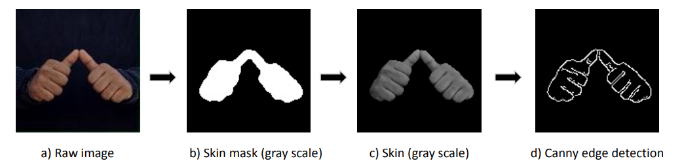

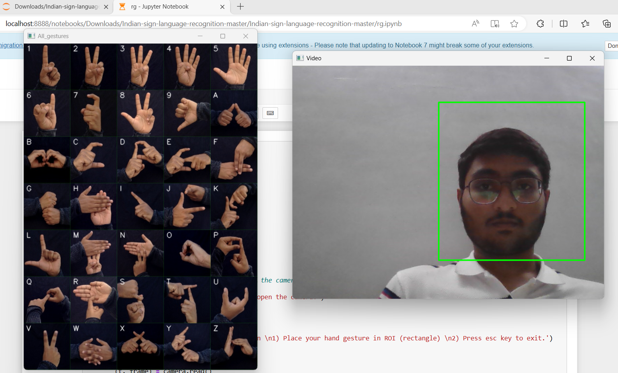




CHAROTAR UNIVERSITY OF SCIENCE & TECHNOLOGY FACULTY OF TECHNOLOGY AND ENGINEERING C S PATEL INSTITUTE OF TECHNOLOGY
DEPARTMENT OF COMPUTER SCIENCE AND ENGINEERING
Subject: Project-II (CSE210) | Title of Project: Indian Sign Language Recognition
Project Team ID: 10 |  |  | Guide Name: Prof. Srushti Gajjar
22CS039 – Krish Mavani |  | 22CS040 – Ruchit Meshiya
Description of Project :
Flow of proposed solution :
Functionalities :
Create a bridge for deaf and mute communication using sign language, a visual code. This project enhances understanding, fostering communication by addressing challenges through education and experience.
Implement a system to display predicted outputs (0-9 and A-Z) for recognized hand gestures.
Models and Algorithms :
View:
Technology Stack :
1. Cluster Model :
K-means clustering
2. Classification:
SVM
3. Feature Extraction:
ORB
SIFT
Python
Sci-kit Learn

