Slide 1

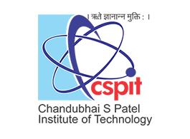

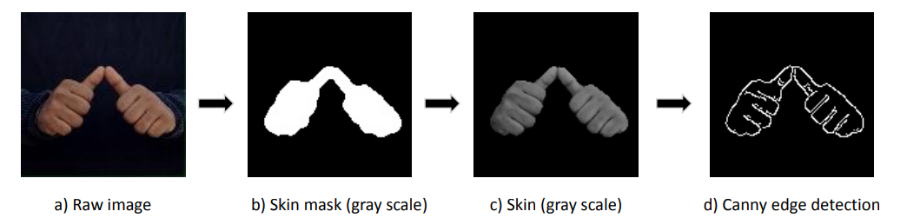
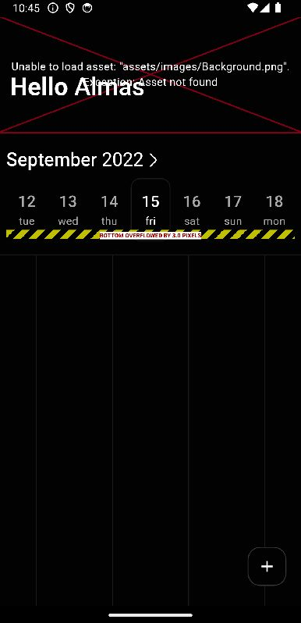
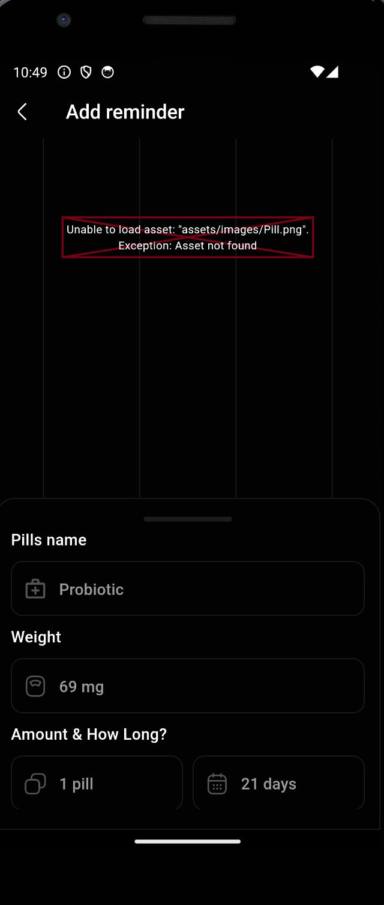
CHAROTAR UNIVERSITY OF SCIENCE & TECHNOLOGY FACULTY OF TECHNOLOGY AND ENGINEERING C S PATEL INSTITUTE OF TECHNOLOGY
DEPARTMENT OF COMPUTER SCIENCE AND ENGINEERING
Subject: Project-II (CSE210) | Title of Project: Indian Sign Language Recognition
Project Team ID: |  |  | Guide Name: Prof. Srushti Gajjar
22CS039 – Krish Mavani |  | 22CS040 – Ruchit Meshiya
Description of Project :
Flow of proposed solution :
Functionalities :
Communication is vital, but deaf and mute individuals face challenges with natural language.
Sign language, using visual gestures, is structured code with specific meanings.
Many struggle to understand sign language due to lack of education and experience. So this project will become a medium for communication between them.
Collect a diverse dataset of hand gesture images representing Indian Sign Language (ISL) for training and testing. Ensure proper labeling of the dataset for supervised learning. Utilize ORB (Oriented FAST and Rotated BRIEF) descriptors for feature extraction.
Apply SIFT (Scale-Invariant Feature Transform) descriptors for canny edge images. Integrate a mechanism to display the predicted output (0-9 and A-Z) for recognized hand gestures.
Models and Algorithms :
View:
Technology Stack :
SVM for Classification:
Trained on visual word histograms, it predicts gestures effectively.
Efficient Clustering with Mini Batch K-Means:
Enhances visual word extraction for efficient classification.
Feature Extraction using ORB and SIFT:
ORB and SIFT contribute to the creation of visual words, providing essential information for the SVM model to recognize sign language gestures.
Language: Python
Libraries and Frameworks: OpenCV, scikit-learn
Machine Learning Model: Support Vector Machine (SVM)
(handling high-dimensional feature vectors extracted from sign language images, providing robust classification with the ability to handle nonlinear relationships and prevent overfitting)
Clustering Algorithm: Mini Batch K-Means
Feature Extraction Techniques: ORB, SIFT
Data Preprocessing Tools: Canny Edge Detection, Skin Tone Analysis

