Slide 1

Inward and Outward Registry
PID: 428
Presented by: Krish Prajapati
Enrollment Number: CS35

Slide 2
Introduction
Every commercial organization must have a tangible internal and external register. These registers are required in order to run a successful business. These registers will be stored with security personnel, who will record the data anytime an inbound or outbound transaction occurs on business property.
The various authorities should properly verify these registries every day. They should be kept not just for goods, but also for couriers and papers going in and out.

Slide 3
PROJECT DESCRIPTION
The Inward Outward Register System is intended for use of various branch offices that send and receive daily courier/post physical mail.This application can handle inbound and outbound traffic as well as reporting.
With the help of this system ,we can be able to record the data of any product. It will help the organization to search the product easily.

Slide 4
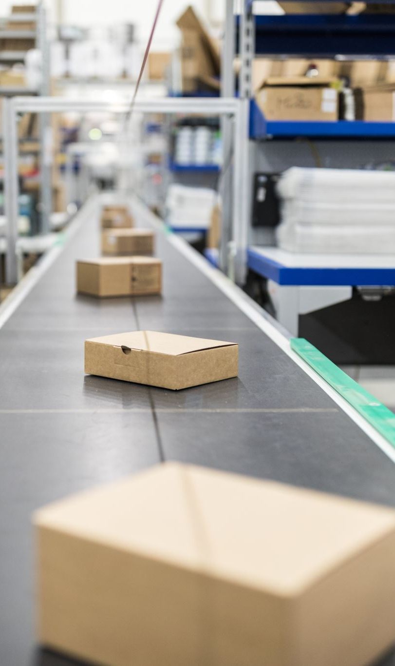
What is Material Inward Register?
When a new material enters in the company's premises, the data associated with that material is logged in the material inflow register.

Slide 5

WHAT IS MATERIAL outWARD REGISTER?
When a company's material/stock/products depart the company's permises, the data is entered in the material outbound register.

Slide 6
Information required to create the inward register
Inward No.
Date
Intime
Bill or Challen No.
Supplier Name
Material Particulars
Quantity
Vehicle Number
Driver's Name
Security Signature
Remarks

Slide 7
Information to be recorded in material OUTWARD REGISTER
Outward No.
Date
Out Time
Bill or Challan No.
Name & Address of the Party
Material Particulars
Quantity
Vehicle Number
Driver's Name
Driver's Signaure
Remarks

Slide 8
Tips to maintain Material inward and outward registers
Train the security guards on how to fill these registers.
Keep sufficient printouts of the sheets (or) registers.
Check the data every day.
Don’t change
Don’t change security guards regularly.
Make it mandatory to record each entry of inward and outward materials, don’t tolerate any negligence.
Signature of the security guard is must on inward and outward register, whereas driver’s signature is must on outward register.
Hire the security guards, who have the enough qualification to maintain these registers.

Slide 9
Conclusion :
The new online web based Inward Outward Register is well designed application which will make the data entry in system quick and easy and follows all the security guideliance to save the data from being hacked or misused.

Slide 10
THANK YOU!

