Slide 1

PCB Routing Algorithms
Prepared By​
Anamika Patel​
​
Supervised By ​
Prof Smruti R Sarangi ​

Slide 2
PCB
Standard dielectric material used for circuit boards is a flame-resistant composite of woven fiberglass cloth and epoxy resin, known as FR-4
Metal traces and planes for the circuitry are usually composed of copper

Slide 3
PCB Board Classes
Distinguishing characteristic of PCBs is their class–either 1, 2, or 3
Class 1 boards: Consumer electronic.
Class 2 boards: Devices where high reliability is important and which try to minimize failure.
Class 3 boards: The most exacting manufacturing standards of a PCB. If it fails, lives are immediately at stake. For eg. the boards on an airplane.

Slide 4
Types of Printed Circuit Boards
Rigid Boards: Board layout contained within a rigid substrate
Flexible Boards: Composed of less rigid material that allows for far greater deflection
Board thickness far less than standard rigid board
A metal-core PCB: Offshoot of rigid board designs
Increased ability to dissipate heat throughout the board to protect sensitive circuitry

Slide 5
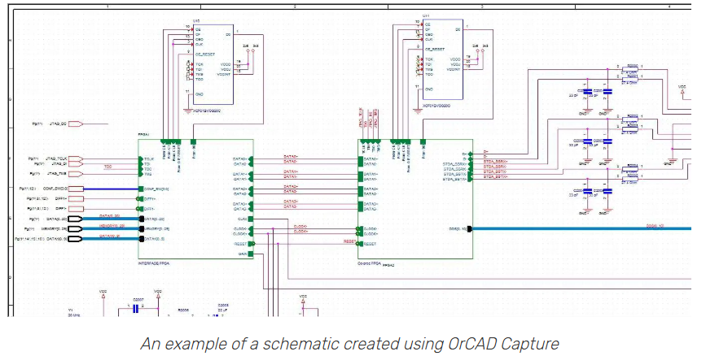
PCB Design and Manufacturing Process
Develop the library CAD parts
Library includes schematic symbols, simulation models, footprints for PCB layout and step models for 3D PCB display
Layout
Component are optimally organized
Connect the nets to the pins by drawing the traces and planes between the pins
Design rules prevent the traces of one net from touching another net
Manufacturing drawings and the output files are created for being used to build the board
Creation of logical representation of the circuitry on a schematic
Symbols placed on a schematic sheet, connected to form a circuitry, circuit simulation to verify electrical functioning,
Connectivity data sent by schematic tools to the layout tools
Step-by-step process of Design and Manufacturing of a circuit board:
Schematic Creation and Simulation
Setting up PCB design grids and DRCs
Component placement
PCB Routing
Power planes
Assembling the BOM and building the board

Slide 6
PCB Design and Manufacturing Process
Create the Schematic
Creating logic symbols for the parts that will be implemented: resistors, capacitors, inductors, connectors, and integrated circuits (ICs)
Simulate the Circuitry
With parts and nets organized on the schematic, the circuit is to be verified if it will work the intended way
CAD Tool Setup
Set up design rules and constraints that will keep distinct nets from overlapping while maintaining the correct amount of distance to different objects
Organize them on schematic sheets within the CAD tools
Wires can be drawn that represents the connectivity between the pins of the schematic symbols
These lines are nets and they can represent single nets or group of nets
Circuit simulations are employed in a simulation program with the Integrated Circuit Emphasis tool (SPICE tool)
The designed circuits are tested using SPICE tools before building the actual hardware
Design grids help place components and route traces in a neat and orderly manner
Place Components
Place the component footprints within the board outline in the CAD system
Placing these parts for their best performance while being mindful of connectivity, areas of excessive heat and electrical noise and other physical obstructions such as connectors, cables, and mounting hardware
Designers to place the components so that they can be best assembled by the manufacturer
Route the PCB
Connect the nets
Convert rubber-band net connections into drawn traces and planes
Automated routing features
Making sure that nets are the correct length for the signals they are conducting
Ensure they do not cross areas of excessive noise
Prevent cross-talk or other signal integrity problems that may degrade the performance of the built board

Slide 7
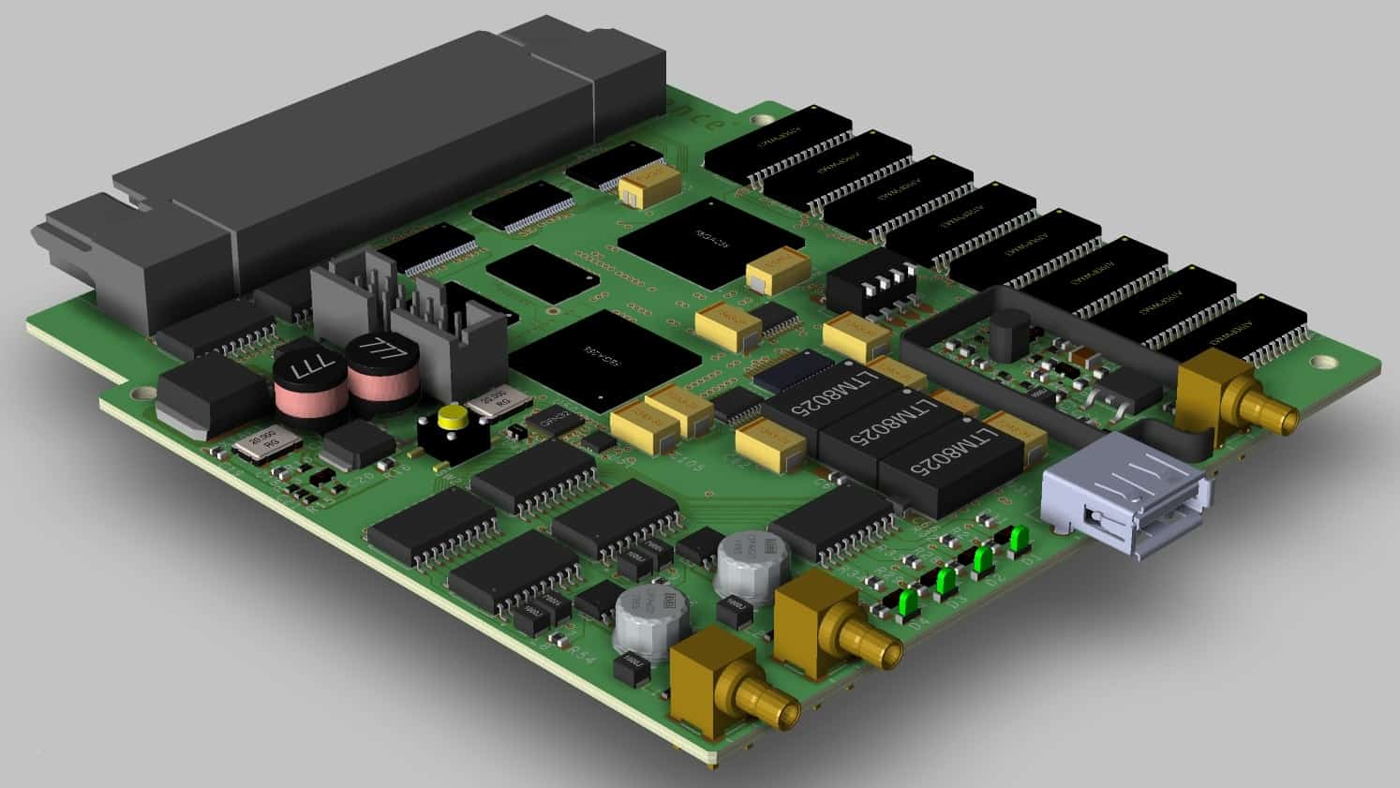
Final Rules Check
Ensure a clear PCB return current path
  Each active component on the board need to be connected to power and ground nets
  Accomplished by flooding areas or layers with solid power and ground planes that these components can tap into
  These planes return the signals that are routed with traces
  Planes with too many holes, cut-outs or splits can cause return paths to create a lot of noise and degrade the performance of the PCB
PCB design is complete with:
    The component placement
    Trace routing
    Power and Ground planes finished
Run a final rules check on it
Set up the different text and markings
Drawings obtained as output to be used during manufacturing to both fabricate and assemble the final board
Designers use tools to estimate costs for building the board
  Printed Circuit Board created with OrCAD PCB Designer

Slide 8
Need of automation in PCB routing
Increasing clock frequency imposes special physical constraints on high performance PCBs such as
  Length-matching routing
  Pairwise routing
  Planar routing
Automated PCB routers
  which are tuned to handle such constraints are in great demand
  Required for modern high-performance PCB layout
  Need for PCB-specific algorithms to follow planar routing guidelines, minimizing via usage mid-route
    Handles signal integrity issues like ringing, reflection, impedance matching, crosstalk, etc.
Two major research problems in PCB routing on net level are
  Escape Routing problem
  Length-matching routing problem
  Escape routing and length matching routing have different tasks
Notes:
To prevent signal integrity issues such as ringing and reflection, PCB routing should follow planar routing guidelines, minimizing via usage mid-route. This critical difference from IC routing highlights the need for PCB-specific algorithms to handle challenges like impedance matching, crosstalk, and signal quality.

Slide 9
1. Escape Routing
Most intensively studied problem among all the PCB routing problems
It is to route from specified pins in a pin array to the boundary of the array
Classified into
  Unordered escape
  Ordered escape
  Simultaneous escape
Both unordered and ordered escape routing problems involve only a single pin array in following researches
  PCB routing researches
  Package routing researches- problem of routing from inside a pin array to some linearly arranged bonding pads
Simultaneous escape routing is only for PCB routing

Slide 10
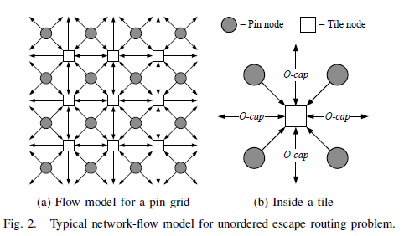
Unordered Escape
Network flow approaches are used to solve the unordered escape routing problem
Each routing path as a unit flow from the pin to the boundary
Estimate the maximum number of escapable pins
Since no ordering is specified, a flow solution always corresponds to some non-crossing routing
Typical network model using network-flow to solve the unordered problem: Fang et al’s [1-3] works on flip-chip design (shown in the figure)
  Works well if we only consider orthogonal wiring capacity (maximum no of wires allowed between two horizontally or vertically adjacent pins
  Doesn’t capture the diagonal capacity
  No of wires passing between two diagonally adjacent pins cannot be correctly captured by this model

Slide 11
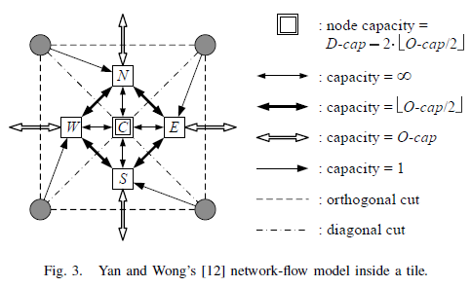
Unordered Escape Network method
Yan and Wong [4] network model (fig 3):
  Correctly captures the diagonal as well as orthogonal capacity
  Able to control the flow in finer detail inside each tile by adding nodes and edges- thereby capture the diagonal capacity
Yu et al’s [5] network model:
  Based on triangulation of the pins
  Do not assume a regular rectangular grid structure of the pins

Slide 12
Ordered Escape Solution
Network flow doesn’t work
Because flow doesn’t carry the ordering information
Application of heuristics that may lose optimality or exponential time approaches:
  Integer Linear Programming (ILP)
  Boolean Satisfiability (SAT) solver
Integer Linear Programming
Fang et al [6]: Formulation of ordered escape routing problem as an ILP problem
ILP solution with reduction technique
Pruning of no of variables by 99.9%
Run time for a fairly large design (over 1000 pins) down to about an hour
ILP formulation doesn’t guarantee optimality

Slide 13
Ordered Escape routing methods
Boolean Satisfiability Problem Solver
Luo and Wong [7] transformed ordered routing problem into Boolean Satisfiability (SAT) problem
No assumption: guaranteed solution if there exists one
First work that can optimally solve the ordered escape routing problem
Optimality comes at a price: Router takes 10 mins to route a 10x10 grid
Time complexity grows very fast when the grid size increases
Runtime cutdown by Partition Technique: Decomposes a large problem into smaller problems
Extended in [8] (17) to handle cyclic ordering and pin clustering
Powerful router in solving small but difficult problems
It rips-up and reroutes a small region where other heuristics based routers fail
Lee et al. [9] routing algorithm
No monotonic constraint on the routing
Routing algorithm is based on computing the weighted longest common subsequence and maximum planar subset of chords
Shows a 122x speedup compared with ILP based router

Slide 14
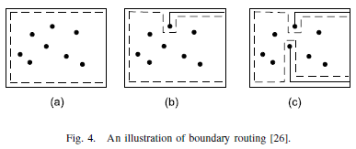
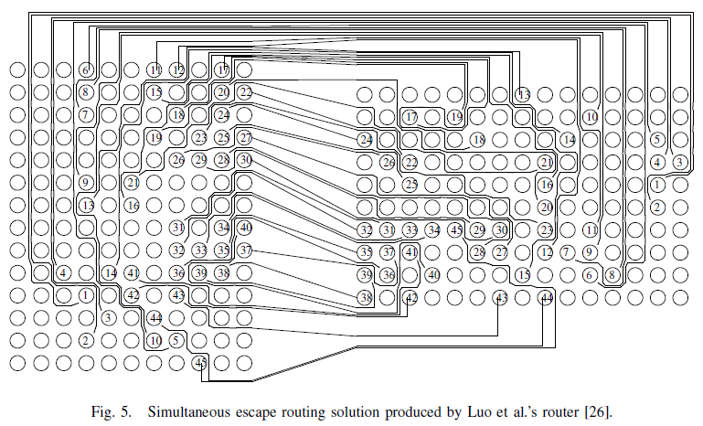
Simultaneous Escape Routing
Simultaneous escape routing problem is unique to PCB routing
Luo et al’s [10] novel boundary routing approach
Build a routing boundary for all the pins inside a pin grid
When routing a net, let the routing path follow the boundary as much as possible
The routing boundary is shrunk to exclude the routed net, after a net is routed
Solved a set of all industrial escape problems in comparison to Cadence Allegro PCB router which solved only half of the problems
Fig 4 shows novel boundary routing approach
Fig 5 shows routing result for one problem

Slide 15
Simultaneous Escape Routing
Kajitani’s Potential Router
Idea based on the analogy between planar routing and equipotential lines in an electric field
Viewing planar routing as the equipotential lines in certain electric field
Enumerating possible configurations of the electric field leads to enumerating possible planar topologies for the routing
As focus of work on planar topology- therefore applicable to all three types of escape routing problems

Slide 16
Length-Matching Routing
To connect the escaped routes between the boundaries of pin arrays while satisfying certain length constraints
The nets are subjected to very stringent length constrains due to the high clock frequencies
Two types of length-matching constraints:
  Min-max length bounds
    Each net is given minimum and maximum length bounds
    Length of the routing must be within the bounds
  Bounded length difference
    A group of nets are expected to have similar length
    Difference between the lengths of a group of nets must be limited by some given bound
To carefully distribute the limited routing resources to satisfy the length requirements of all the nets

Slide 17
Length-Matching Routing
Ozdal and Wong’s [11], [12] Lagrangian Relaxation based routing scheme
Controls the length of each net
Lagrangian multipliers are iteratively updated to reflect the current resource need of each net
A special router routes the nets according to the resource need
Two potential issues:
  Long runtime when the problem is large and difficult as it needs many iterations
  Routing of each net must be monotonic in one direction, thus, limiting the possible topology of the solution

Slide 18
Length-Matching Routing
2. Ozdal and Wong’s [13], [14] Algorithm for Length matching routing inside a channel
Use of river routing derives the routing boundary of each net
Detouring of each net inside its bounded area
Approximates optimal solution by a constant factor
Achieves quite significant speedup as it avoids calling a router iteratively
Limited applications as only channel routing problem is considered

Slide 19
Length matching routing
Kubo et al’s Symmetric Slant Grid Interconnect Scheme
Reduces length matching problem into a general grid routing problem
Handles multi-sink nets
Assumes XY routing style for IC routing
Not practical for PCB routing

Slide 20
Length matching algorithm
Yan and Wong’s Length-matching algorithm [15]
Proposed single-detour routing style
No restriction on the routing topology, No requirement for the pins to be aligned along a channel, Routing not limited to be monotonic
Viewing the problem as an area assignment problem
Use of placement structure, Bounded – Sliceline Grid (BSG)
Extremely useful for huge routing grids as it’s gridless router- performance doesn’t depend on the routing grid size
Thus, 1000x speed-up over the Lagrangian relaxation based router
Figure in the next slide shows one of the routing result
Router efficiently utilizes the routing space for wire extension
Algorithm extended to handle multi-layer routing and multiple separation rules
Proposed a single detour routing style to untangle the twisted nets
Drawback
Generating a good topology for a design filled with many obstacles is non-trivial

Slide 21
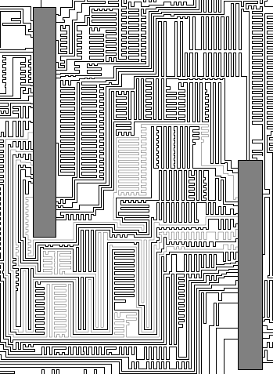

Slide 22
Ant colony algorithm for length matching or isometric wiring in PCB design
Leverages feedback mechanism and optimization techniques
Balances constraints:
  Length matching
  Space usage
  Dynamic path selection

Slide 23
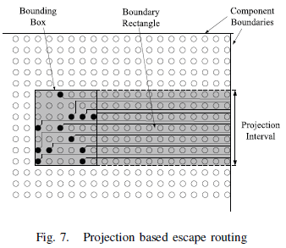
PCB routing problems on bus level
Hui et al’s [16] Projection based escape routing:
Escape routing of each bus is bounded by a rectangle formed by projecting the pin cluster of the bus toward the boundary of the pin grid (Figure shown)

Slide 24
Their Projection based multi-layer solution results in shorter wire length and occupies smaller routing space in comparison to projection based pin assignment and escape routing solution with single-layer escape routing solution
Figure 8 illustrates this argument
Multilayer routing solution produced by their projection based scheme has shorter and straighter wires
Escaping all the pins in one layer results in very imbalanced wire length:
  Some pins have very long detours in their escape routing while some other pins escape without any detour
  Later making length matching routing a much more challenging problem
Projection based multi-layer solution has very straight wires:
  Length difference is much smaller, making length-matching routing an easier problem

Slide 25
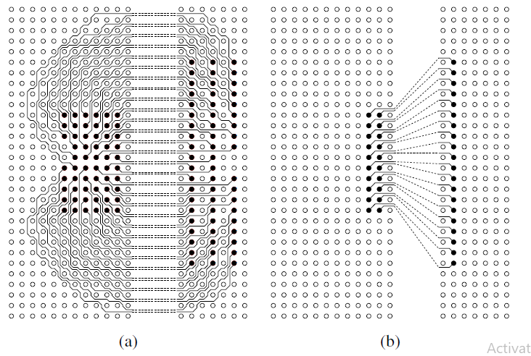

Slide 26
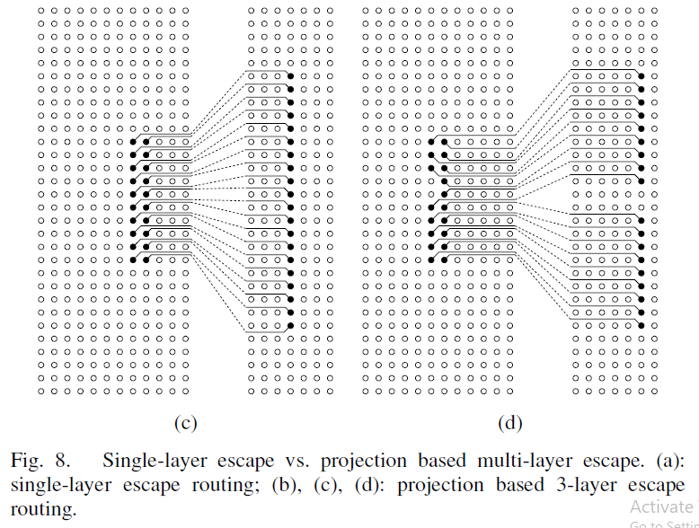

Slide 27
Hui et al’s optimal algorithm [17] to select a maximum subset of buses
  Projection rectangles do not have any conflict
Yan et al’s algorithm [18] solves the multi-layer bus assignment problem
  Can optimally assign all the buses to multiple layers while keeping the total no of layers at minimum
Kong et al’s [19] optimal algorithm finds maximum non-conflicting subset of the buses
  Studied the problem where buses are projected toward all four sides of a pin grid

Slide 28
Kong et al’s [20] first automatic bus planner for PCB routing
  Performs global routing of buses on each layer
  Does layer assignment
  Planner tested on a state of the art industrial board (7000+ nets and 12 layers)
  Achieved very good routability
  Length constrained also considered
Meister et al’s pin assignment problem for PCB [44]
  Proposed four heuristics for pin assignement
  Both wire length and routability considered
  Approach may run faster than the simultaneous pin assignment and escape routing scheme in [21]

Slide 29
References
J.-W. Fang, I.-J. Lin, Y.-W. Chang, and J.-H. Wang, “A network-flowbased RDL routing algorithm for flip-chip design,” IEEE TCAD, vol. 26, no. 8, Aug. 2007.
J.-W. Fang, I.-J. Lin, P.-H. Yuh, Y.-W. Chang, and J.-H.Wang, “A routing algorithm for flip-chip design,” in ICCAD, 2005, pp. 753–758.
J.-W. Fang and Y.-W. Chang, “Area-I/O flip-chip routing for chippackage co-design,” in ICCAD, 2008, pp. 518–522
T. Yan and M. D. F. Wong, “A correct network flow model for escape routing,” in DAC, 2009, pp. 332–335.
M.-F. Yu, J. Darnauer, and W. W.-M. Dai, “Interchangeable pin routing with application to package layout,” in ICCAD, 1996, pp. 668–673.
J.-W. Fang, C.-H. Hsu, and Y.-W. Chang, “An integer linear programming based routing algorithm for flip-chip design,” in DAC, 2007, pp. 606–611.
L. Luo and M. D. F. Wong, “Ordered escape routing based on Boolean satisfiability,” in ASPDAC, 2008, pp. 244–249.
——, “On using SAT to ordered escape problems,” in ASPDAC, 2009, pp. 594–599.
P.-W. Lee, C.-W. Lin, Y.-W. Chang, C.-F. Shen, and W.-C. Tseng, “An efficient pre-assignment routing algorithm for flip-chip designs,” in ICCAD, 2009, pp. 239 –244.
L. Luo, T. Yan, Q. Ma, M. D. F. Wong, and T. Shibuya, “B-Escape: A simultaneous escape routing algorithm based on boundary routing,” in ISPD, 2010, pp. 19–25.
M. M. Ozdal and M. D. F. Wong, “Length-matching routing for highspeed printed circuit boards,” in ICCAD, 2003, pp. 394–400.
——, “A length-matching routing algorithm for high-performance printed circuit boards,” IEEE TCAD, vol. 25, no. 12, pp. 2784–2794, Dec. 2006.
——, “A provably good algorithm for high performance bus routing,” in ICCAD, 2004, pp. 830–837.
——, “Algorithmic study of single-layer bus routing for high-speed boards,” IEEE TCAD, vol. 25, no. 3, pp. 490–503, Mar. 2006.

Slide 30
References
T. Yan and M. D. F. Wong, “BSG-route: A length-matching router for general topology,” in ICCAD, 2008, pp. 499–505.
——, “Optimal simultaneous pin assignment and escape routing for dense PCBs,” in ASPDAC, 2010, pp. 275–280.
H. Kong, T. Yan, M. D. F. Wong, and M. M. Ozdal, “Optimal bus sequencing for escape routing in dense PCBs,” in ICCAD, 2007, pp. 390–395.
T. Yan, H. Kong, and M. D. F. Wong, “Optimal layer assignment for escape routing of buses,” in ICCAD, 2009, pp. 245–248.
H. Kong, Q. Ma, T. Yan, and M. D. F. Wong, “An optimal algorithm for finding disjoint rectangles and its application to PCB routing,” in DAC, 2010, pp. 212–217.
H. Kong, T. Yan, and M. D. F. Wong, “Automatic bus planner for dense PCBs,” in DAC, 2009, pp. 326–331.
——, “Optimal simultaneous pin assignment and escape routing for dense PCBs,” in ASPDAC, 2010, pp. 275–280.
https://resources.pcb.cadence.com/blog/2023-an-introduction-to-printed-circuit-boards
https://resources.altium.com/p/pcb-layout-guidelines
Tan Yan and Martin D. F. Wong, “Recent Research Development in PCB Layout”, ©2010 IEEE

