Slide 1
BCSE308P · Computer Networks Lab · Innovative Evaluation Practices
a path, seen hop by hop
C
HOPTRACE
1
2
3
Network Path Fault Localization through Application-to-Hop Correlation
4
5
Krish Chirag Shah sole author
Reg. no. 24BCE0624
Assignment 9 · Project Presentation (VTOP)
Slot F2 · Team 24
appears to begin at or after Hop 3
Illustration of the idea; not measured data.
Research prototype. The current detector has not been independently validated; the independent Phase 4 run missed its false-attribution target (3/12 = 25% vs at most 10%).
Notes:
Introduce the project and the central claim: HOPTRACE estimates where along an observed network path an application's degradation appears to begin. Mention up front that it is a research prototype and that the current detector has not been independently validated.

Slide 2
Slow, but where on the path?
ping and traceroute
Application monitoring
HOPTRACE
measure the path
measures the symptom
joins the two on one clock
• Per-hop reachability and RTT
• Nothing about what the application felt
• Sees that responses got slower
• Nothing about where on the path
• Probes every hop and samples the app's own RTT
• Compares when each series starts to misbehave
The question: where along the observed path does the application's degradation first appear?
Not the question: which router caused it. Timing correlation does not establish causation.
HOPTRACE · BCSE308P Computer Networks Lab · Krish Chirag Shah · 24BCE0624
2
Notes:
The problem: when an application slows down, ping and traceroute describe the path but not what the application experienced, and application monitoring sees the symptom but not the path. HOPTRACE puts both on one clock. Stress the boundary of the claim: when changes appear, not why.

Slide 3
Objectives and scope
1
Build a reproducible testbed with a known path and injectable faults
In scope (implemented)
• 6-namespace linear testbed, 5 hops
• Raw-socket probing + WebSocket telemetry
• Latency, jitter, loss, bandwidth faults
• Median/MAD onsets, alignment, typed evidence
• Stored-result dashboard, guided explanation
2
Measure path hops and application RTT on one shared clock
3
Detect onsets, align them in time, report evidence-bounded results
Out of scope (not claimed)
4
Keep ground truth out of the engine's reach; score afterwards
• Real or multi-path networks
• Reliable loss / bandwidth localization
• Calibrated confidence; causal claims
• Sealed, full-scale evaluation (spec Phase 5)
5
Evaluate on separate tuning and held-out sets, and disclose misses
HOPTRACE · BCSE308P Computer Networks Lab · Krish Chirag Shah · 24BCE0624
3
Notes:
Five objectives on the left. On the right, what is in scope and, just as importantly, what is explicitly out of scope and not claimed: real networks, calibrated confidence, and reliable localization of loss and bandwidth faults.

Slide 4
Key idea: measure, detect, align, report
1
Measure
2
Detect
3
Align
4
Report
Probe every hop; sample the app's own RTT
Find when each series starts to misbehave
Does a hop's onset line up with the app's?
Name the earliest corroborated hop
one CLOCK_MONOTONIC
median + 5·MAD, 3 in a row
|Δt| ≤ 1.5 s + persistence
at or after Hop N
The only sentence it will say
“Degradation appears to begin at or after Hop N.”
Never: “Router N caused it.” Forbidden phrases are asserted out in code.
HOPTRACE · BCSE308P Computer Networks Lab · Krish Chirag Shah · 24BCE0624
4
Notes:
The four-step loop. Measure on one monotonic clock; detect an onset per series using median plus five MAD, requiring three buckets in a row; align the application onset with hop onsets inside a 1.5 second window, requiring downstream persistence; report using a locked, evidence-bounded sentence.

Slide 5
System architecture
OBSERVATION AND ANALYSIS (reads no ground truth)
Path prober
→ hop.jsonl
Controlled testbed
6 namespaces
Correlation engine
→ EvidenceRecord
Interpretation
→ path_bundle.json
Dashboard
reads stored bundles
App telemetry
→ app.jsonl
EvidenceRecord to score
✕ isolation boundary: engine and dashboard never read ground truth
injects faults
EXPERIMENT CONTROL AND EVALUATION
Fault controller
tc netem / tbf
writes labels
Ground-truth DB
OS-permission isolated
read
Evaluation
scores vs labels
Frontend: React + TypeScript; no backend
HOPTRACE · BCSE308P Computer Networks Lab · Krish Chirag Shah · 24BCE0624
5
Notes:
Two halves kept apart on purpose. Top: observation and analysis, which reads no ground truth. Bottom: experiment control and evaluation. The fault controller injects real impairments into the testbed and records labels in a permission-isolated store; the evaluation joins results to labels only afterwards. The dashboard shows stored bundles only.

Slide 6
Network topology and testbed
path start
Hop 1
Hop 2
Hop 3
Hop 4
Hop 5
ns-client
client
s1
ns-r1
router
s2
ns-r2
router
s3
ns-r3
router
s4
ns-r4
router
s5
ns-server
server
10.10.1.1
10.10.1.2
10.10.2.1
10.10.2.2
10.10.3.1
10.10.3.2
10.10.4.1
10.10.4.2
10.10.5.1
10.10.5.2
Path prober + app client
co-located: one CLOCK_MONOTONIC
Fault controller
tc netem/tbf on ns-r2 egress (example)
Application server
WebSocket echo in ns-server
“Hop N onward” rule: a fault on the link leaving Hop N is first visible at Hop N+1, because Hop N's own reply is generated before that link. Verified here: 200/200 packets, hops 10.10.1.2 → 10.10.5.2 in order.
HOPTRACE · BCSE308P Computer Networks Lab · Krish Chirag Shah · 24BCE0624
6
Notes:
Six Linux network namespaces in a line: client, four routers, server, joined by veth pairs on /30 subnets. The prober and the application client both run in the client namespace so they read the same monotonic clock. Faults are injected on a router's egress link, so the first hop that can show the fault is the next one.

Slide 7
Data collection: two streams, one clock
Path prober
Application client
One shared clock
• 5 hops (TTL 1-5)
• 2 probes per hop per round
• A round every 0.5 s
• 0.3 s timeout; TCP-SYN (default) or UDP
• No answer = unknown, never interpolated
• Hand-written RFC 6455 WebSocket
• Ping at 20 Hz (feeds the detector)
• Interactions: Poisson, mean 2/s, 150 ms budget
• Missing reply after 2 s: RTT stays null
• RTT computed client-side only
• Both in ns-client
• One CLOCK_MONOTONIC call
• Onsets directly comparable
• No cross-host synchronisation
• Bucket width 0.5 s = probe round
hop.jsonl (one line per probe)
app.jsonl (one line per application sample)
{"round_id":0,"ttl":1,"hop_ip":"10.10.1.2",
"rtt_ms":0.050222,"responded":true,"probe_index":0,
"t_send_mono_ns":16726703720,
"t_recv_mono_ns":16726784215}
{"seq":0,"kind":"ping",
"t_send_mono_ns":16793313189,
"t_recv_mono_ns":16793623395,
"rtt_ms":0.310206,"responded":true,"missed_budget":false}
HOPTRACE · BCSE308P Computer Networks Lab · Krish Chirag Shah · 24BCE0624
7
Notes:
Parameters of both measurement streams. Both processes run in the client namespace and call the same monotonic clock function, so their timestamps can be compared directly with no clock synchronisation. Unanswered probes are recorded as not responded and never interpolated.

Slide 8
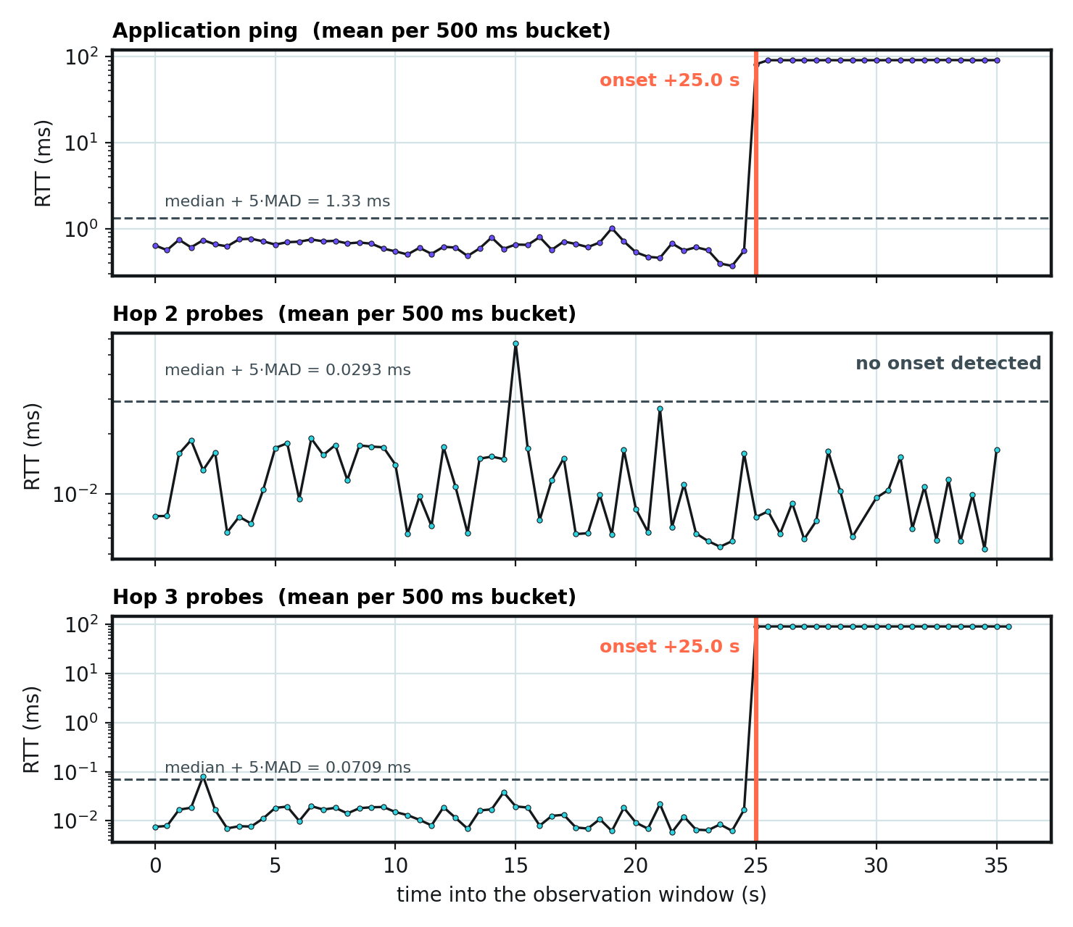
Correlation methodology
Bucket
1
Mean RTT per 500 ms bucket for the app and for each hop. No answer = unknown.
Onset
2
T = median + 5 × MAD over the series. Onset = first of 3 consecutive buckets above T.
Align
3
|t_hop − t_app| ≤ 1.5 s, and every deeper hop must also show a concurrent onset.
Caveat: global baseline: a fault covering most of the window can yield “no onset”.
Measured: demo-run-01. App and Hop 3 onset at +25.0 s; Hop 2's single noisy bucket is ignored.
HOPTRACE · BCSE308P Computer Networks Lab · Krish Chirag Shah · 24BCE0624
8
Notes:
Left: the three operations. Bucket both streams into 500 millisecond buckets; threshold is median plus five MAD of the whole series and an onset needs three consecutive buckets above it; then align the application onset with hop onsets inside 1.5 seconds and require every deeper hop to agree. Right: the recorded demo run, recomputed with the project's own code. Hop 2 has one noisy bucket that the three-in-a-row rule ignores. Limitations: the baseline is global, so a fault that covers most of the window can hide itself.

Slide 9
Evidence model and confidence
fact
inference
correlation
confidence
unknown
measured
consistent with
timing only
heuristic
not observed
Confidence: a fixed heuristic
Read it correctly
score = corroborating fraction × (1 − unknown hops / 5)
• Not a probability; not calibrated
• Ignores signal strength
• Unknown ≠ healthy
• “No onset” ≠ “no fault”
• Only high confidence prints “…at or after Hop N”
unknown hops | score | level
0 | 1.0 | high
1 | 0.8 | high
2 | 0.6 | medium
3 | 0.4 | low
HOPTRACE · BCSE308P Computer Networks Lab · Krish Chirag Shah · 24BCE0624
9
Notes:
Every claim carries exactly one of five tags. Confidence is a fixed heuristic: corroborating fraction times one minus unknown hops over five. Because persistence already requires all downstream hops to agree, the fraction is one whenever a range is reported, so the level depends only on how many hops were unknown. It is not a probability and it is not calibrated. Unknown is not healthy.

Slide 10
Implementation and technology stack
0
third-party
Python packages
6
network
namespaces
5
hops
measured
2
OS identities
isolate labels
Measure and control
Analyse and present
Dashboard
• Python 3.12.3, stdlib only
• Raw sockets (TCP-SYN / UDP)
• RFC 6455 WebSocket, hand-written
• iproute2 6.1: ip netns, tc netem/tbf
• SQLite ground-truth store
• synchronize → onset → align → evidence
• Locked result sentences
• path_bundle.json export
• Metrics: Wilson CI, Brier score
• unittest: 117 tests
• React 19 · TypeScript (strict)
• Vite 8 · Tailwind 4 · Motion
• Zod schema validation
• Vitest: 310 tests; axe, ESLint a11y
• Node ≥ 22.12; no CDN at runtime
Environment: WSL2 Ubuntu 24.04 (kernel 6.18.33.2) for the testbed; Windows 11 + Node 24.14.1 for the dashboard checks. Windows-native Python is unsupported.
HOPTRACE · BCSE308P Computer Networks Lab · Krish Chirag Shah · 24BCE0624
10
Notes:
What is actually used. Python code is standard library only, with no third-party packages. The testbed runs on WSL2 Ubuntu 24.04. The dashboard is React, TypeScript, Vite, Tailwind, Zod and Motion. Required versus optional tools are separated in the report.

Slide 11
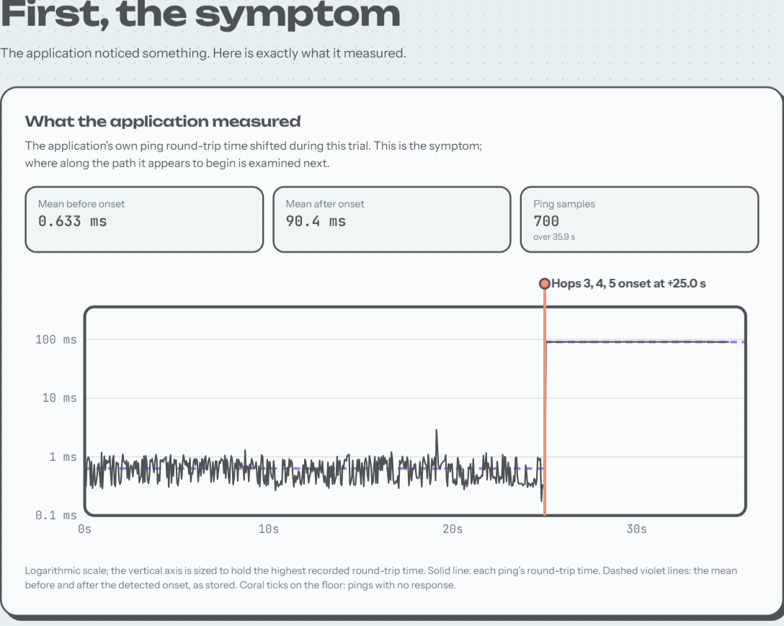
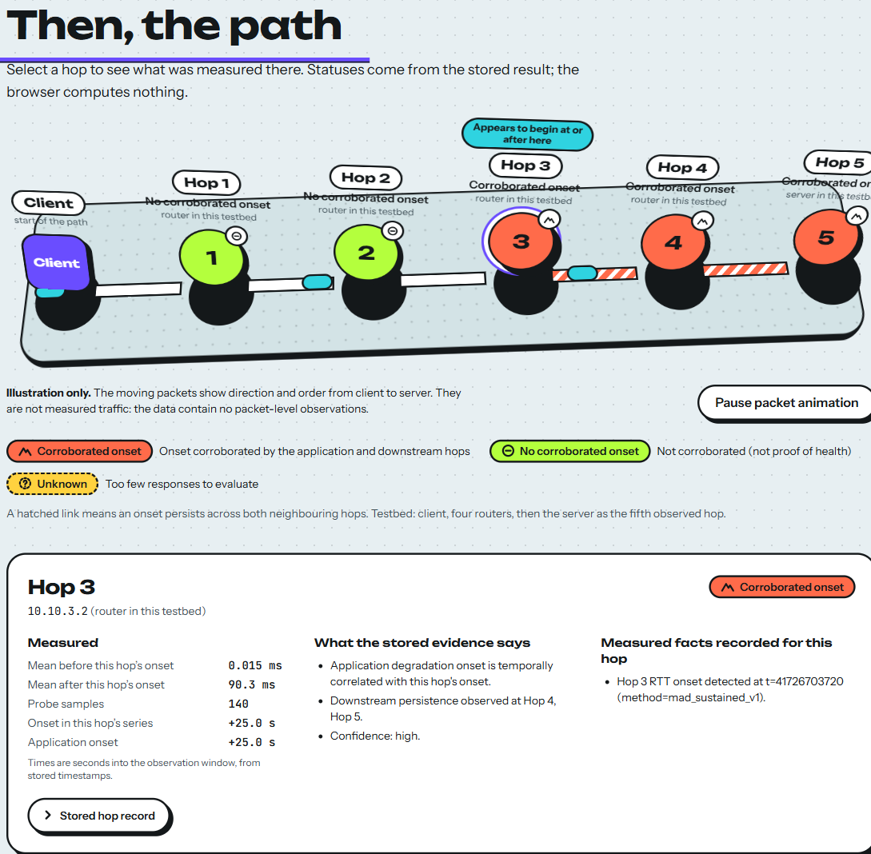
Dashboard: from symptom to hop
1
The symptom. App RTT 0.633 ms → 90.4 ms; onset at +25.0 s (700 pings).
2
The path. Hops 3-5 corroborated; Hop 3 inspected: 0.015 → 90.3 ms. Moving packets are illustrative only.
HOPTRACE · BCSE308P Computer Networks Lab · Krish Chirag Shah · 24BCE0624
11
Notes:
Genuine screenshots of the production build, demo-run-01. Left: the application's own RTT, the symptom, with the stored before and after means and the detected onset. Right: the path with a stored status per hop, and the hop inspector for Hop 3. The moving packets are illustrative only; the data contain no packet-level observations. The dashboard displays stored results and never recomputes them.

Slide 12
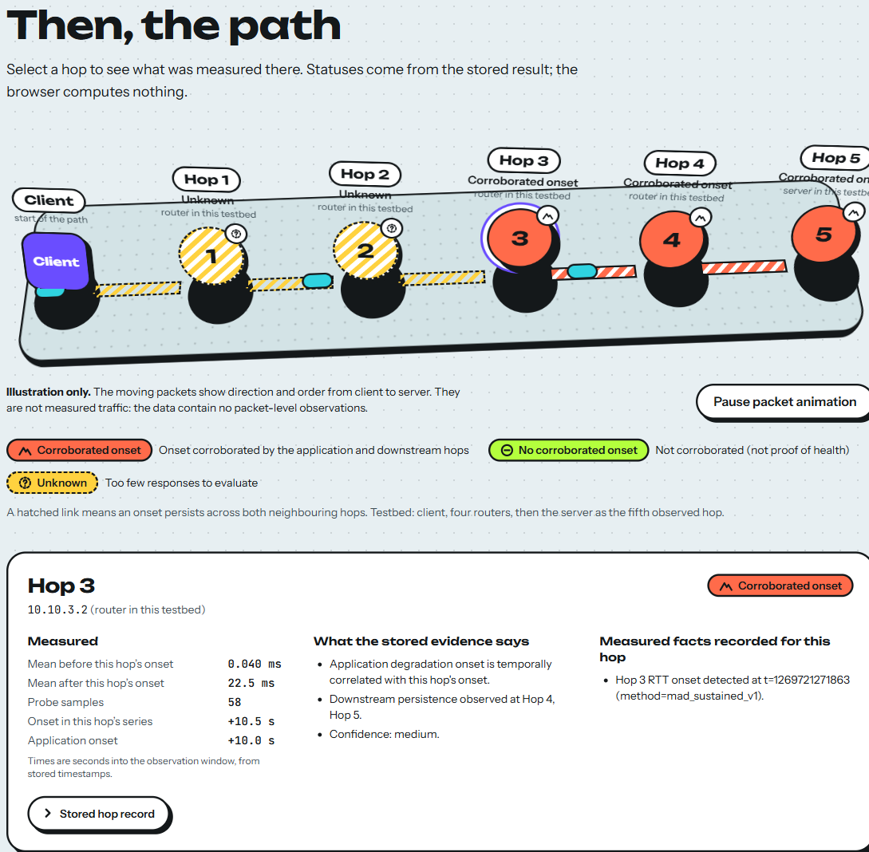
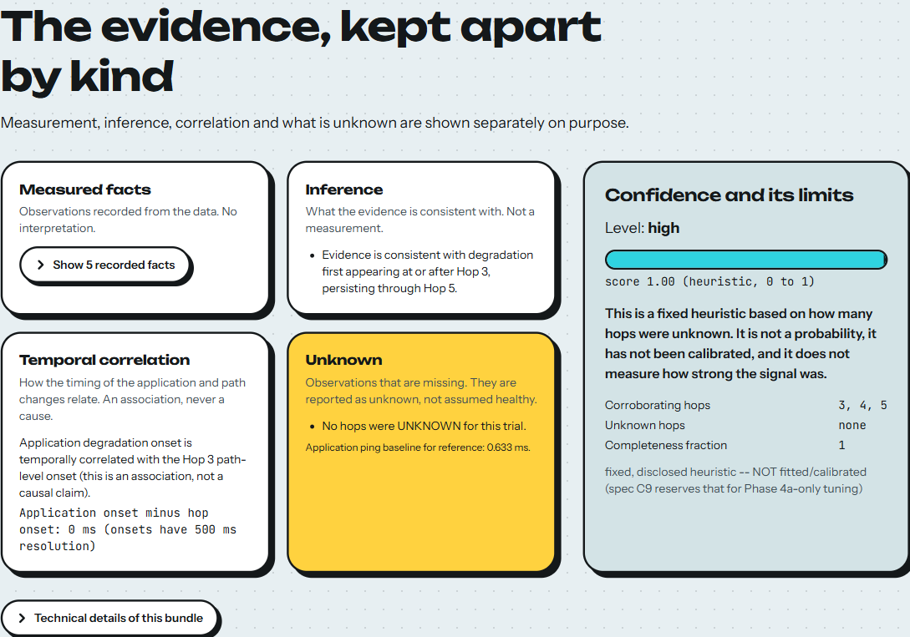
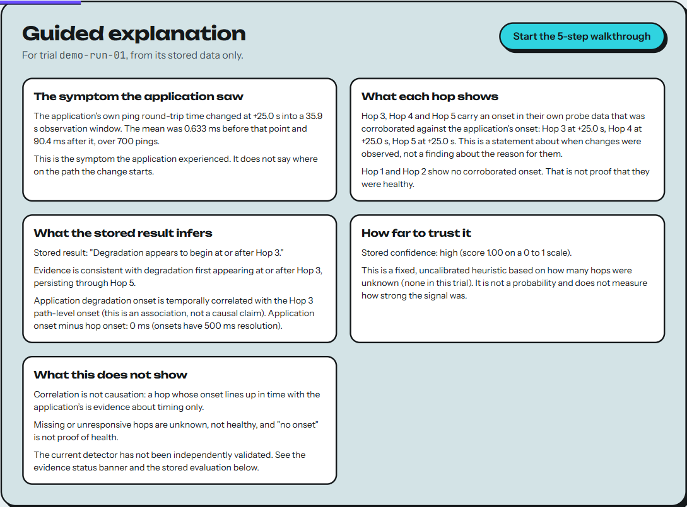
Dashboard: unknowns, evidence, guided mode
Unknown ≠ healthy
p4-held-12: Hops 1-2 unknown (hatched yellow); partially localized, medium confidence.
Evidence, kept apart
Facts, inference, correlation, unknown; confidence panel: “not a probability”.
Guided explanation
Off by default; five-step walkthrough from stored data only.
Screens captured from the current build. The page only formats stored values; statuses, onsets and confidence come from the bundle.
HOPTRACE · BCSE308P Computer Networks Lab · Krish Chirag Shah · 24BCE0624
12
Notes:
Left: a held-out trial where Hops 1 and 2 returned too few responses; they are shown as unknown, not healthy. Middle: evidence kept apart by kind, with the confidence panel stating it is a heuristic and not a probability. Right: the optional guided explanation, off by default, built only from the selected bundle.

Slide 13
Testing and verification (run 27 Oct 2026)
117
310
40
200/200
Python unit tests
all OK (WSL2)
frontend tests
14 files, all pass
layout checks
10 widths × 4 trials
packets, 0% loss
5 hops in order
Also verified
Not run (disclosed)
✓ TypeScript strict typecheck; ESLint, 0 warnings
✓ Production build + distribution-safety check
✓ 4 trials switched in a real browser; packet pause; guided walkthrough
✓ Repository hygiene check; live testbed build + teardown
✓ Report and deck numbers asserted against result files
• Full live demo (overwrites a recorded trial)
• Historical evaluation scripts (overwrite results)
• Offline and cross-browser tests
• Clean-clone test
HOPTRACE · BCSE308P Computer Networks Lab · Krish Chirag Shah · 24BCE0624
13
Notes:
These checks were actually run for this submission. Unit tests are separate from integration or browser checks and from the experimental evaluation. The right-hand card lists what was deliberately not run: the live demo overwrites a recorded trial, the evaluation scripts overwrite result files, and offline, cross-browser and clean-clone tests have not been done.

Slide 14
Results: Phase 4 failed its target
Phase 4 · mad · INDEPENDENT held-out run
Phase 4b · mad_sustained · EXPOSED set
3/12
= 25%
false attribution
1/12
= 8.3%
false attribution
✕ TARGET MISSED: at most 10%
⚠ same trials, inspected during design
Metric (12 trials) | Phase 4 · independent | Phase 4b · exposed
Within ±1 hop (localized trials) | 3/3 | 4/4 (95% CI 51–100%)
Exact first hop (localized trials) | 2/3 | 3/4
Clean-control false positives | 2/4 | 0/4
Recall of injected faults | 3/8 = 37.5% | 4/8 = 50%
Brier score (confidence check) | 0.432 (n = 5) | 0.040 (n = 4)
Meeting a numeric threshold on an exposed set does not validate the current detector.
HOPTRACE · BCSE308P Computer Networks Lab · Krish Chirag Shah · 24BCE0624
14
Notes:
State this plainly. Phase 4 was the only independent held-out run and it missed the false-attribution target: 3 of 12, 25 percent, against at most 10 percent. Phase 4b scored 1 of 12 on the same held-out set after its traces had been inspected during design, so it is a historical record, not independent validation. The table compares both. All samples are tiny: 12 trials, 8 faults and 4 clean controls.

Slide 15
What the held-out trials show
Held-out trial | Phase 4 | Phase 4b
01 clean | FA | –
02 clean | – | –
03 clean | FA | –
04 latency · hop 2 | ✓ | ✓
05 jitter · hop 3 | ✓ | ✓
06 loss · hop 4 | miss | miss
07 bandwidth · hop 1 | miss | miss
08 jitter · hop 2, transient | miss | ✓
09 bandwidth · hop 3, transient | miss | miss
10 loss · hop 1 | miss | miss
11 clean · Hop 1 silent | – | –
12 jitter · Hops 1-2 silent | FA | FA
Latency and jitter localized
when a claim was made (one jitter claim was a false attribution)
1
Loss and bandwidth: 0 of 4
held-out; also 0 of 4 on the Phase 4b tuning set
2
Small samples
one trial moves a rate by 8.3 points; 4/4 has a 95% interval of 51–100%
3
✓ correct claim FA false attribution miss no claim – no claim, correctly
HOPTRACE · BCSE308P Computer Networks Lab · Krish Chirag Shah · 24BCE0624
15
Notes:
Per-trial outcomes on the held-out set. Latency and jitter were localized when a claim was made. Loss and bandwidth: no claim in any of the four trials, under either detector, and none on the Phase 4b tuning set. The remaining false attribution, trial 12, occurred where the first affected hop was itself unknown. Four clean controls cannot separate zero from nearly fifty percent false positives.

Slide 16
Limitations and threats to validity
≠
No independent validation
0/4
Loss and bandwidth
≈
Confidence is a heuristic
Phase 4 missed its target; Phase 4b ran on an exposed set; the sealed evaluation (spec Phase 5) has not been run
Not localized (held-out and tuning). Bandwidth observability with current probe load is unproven
Fixed formula, uncalibrated, not a probability; it falls only when hops are unknown
?
Unknown ≠ healthy
→
Correlation ≠ causation
12
Small, controlled setting
No onset can mean healthy, a long fault, or too little data; there is no “insufficient data” state
Timing evidence only. The 1.5 s window and 500 ms resolution are fixed and unvalidated
12 + 12 + 10 trials vs a 120-trial spec; one linear path; ICMP rate limit switched off
HOPTRACE · BCSE308P Computer Networks Lab · Krish Chirag Shah · 24BCE0624
16
Notes:
Six limitations, each supported by a file in the repository. The most important: no independent validation of the current detector. Also loss and bandwidth are not localized, confidence is an uncalibrated heuristic, unknown hops cannot be assumed healthy, timing correlation is not causation, and the samples and parameters are small and fixed.

Slide 17
Conclusion and future work
What HOPTRACE shows
Future work (recorded, not yet authorized)
• App RTT and per-hop RTT can be compared on one shared clock to estimate where degradation appears to begin
• It runs end to end: testbed, prober, WebSocket app, isolated fault controller, engine, dashboard
• It is honest about failure: the independent run missed its target and the interface says so
• It claims timing evidence, never a cause
1 Sealed evaluation set + calibration check (spec Phase 5)
2 Is bandwidth observable with controlled background traffic?
3 An explicit “insufficient data” result state
4 Validate the 1.5 s window and global-baseline assumption
5 Offline, cross-browser and clean-clone tests
HOPTRACE · BCSE308P Computer Networks Lab · Krish Chirag Shah · 24BCE0624
17
Notes:
The engineering works end to end and every check run for this submission passes. The science is less settled and the project says so: the independent evaluation missed its target, loss and bandwidth are not localized, confidence is a heuristic. Future work is recorded but not yet authorized.

Slide 18
References and questions
References (full list in the report)
Deliverables
• RFC 6455: The WebSocket Protocol (Fette, Melnikov), 2011
• RFC 792: Internet Control Message Protocol (Postel), 1981
• RFC 9293: Transmission Control Protocol; RFC 1071: Internet checksum
• Linux tc-netem(8), tc-tbf(8), ip-netns(8), veth(4), clock_gettime(2)
• Hampel 1974 (MAD); Page 1954 (CUSUM); Adams & MacKay 2007 (BOCPD); Killick et al. 2012 (PELT)
• Wilson 1927 (score interval); Brier 1950 (Brier score)
• Project: hoptrace-phase-0-5-spec.html, docs/EVIDENCE_LEDGER.md
Report: PDF, Assignment 8
Deck: this file, Assignment 9
Code: GitHub repo F2_Team24, Assignment 10
https://github.com/KrishUsesGit/F2_Team24
Questions?
Krish Chirag Shah · 24BCE0624
HOPTRACE · BCSE308P Computer Networks Lab · Krish Chirag Shah · 24BCE0624
18
Notes:
Close with the sources the implementation relies on and the deliverables: the report PDF, this deck, and the GitHub repository once publication is approved.

