Slide 1
A. D. PATEL INSTITUTE OF TECHNOLOGY (ADIT)
Department of Information Technology | Constituent College of CVM University
HOSTEL MANAGER
Automated Resident & Administrative Mobile Application
Course: Mobile Application Development (102000701) | Class: IT1
PROJECT TEAM (4 MEMBERS)
Jay Chaudhary (12302080601041)
Team Leader — Architecture, Build & Deployment
Jay Bhoi (12302080601042)
Application Developer — Core Activities & Navigation
Kishan Prajapati (12302080601056)
UI/UX & Testing — Material 3 XML & Test Matrix
Krish Varde (12302080601057)
Database Developer — SQLite Schema & Transactions

Slide 2
PROBLEM CONTEXT
Key Problems in Manual Hostel Management
02 / 14
1. Lost Complaint Slips
Grievances recorded on paper registers frequently get misplaced with zero status updates.
2. Room Double-Booking
Manual bed allotment leads to record mismatches and accidental duplicate allocations.
3. Scattered Fee Ledgers
Hostel and mess fees are tracked on physical registers, causing long verification queues.

Slide 3
PROJECT GOALS
Objectives & Proposed Mobile Solution
03 / 14
Core Objectives
• Replace paper registers with an Android app.
• Provide dual roles: Student & Warden.
• Prevent double-booking with atomic transactions.
• 100% offline-first with zero server costs.
What the App Delivers
• Live room view with roommate contacts.
• Instant mock UPI fee payment simulation.
• Maintenance complaint filing & tracking.
• Live Warden KPI dashboard & room inventory.

Slide 4
TECHNOLOGY STACK
Core Technologies & Development Stack
04 / 14
Java (OpenJDK 17)
CORE LOGIC
• Native Android code
• OOP architecture
• Clean exception handling
Android SDK & M3
UI FRAMEWORK
• API 26 to API 34
• Material Design 3
• Responsive XML layouts
SQLite Database
DATA STORAGE
• Embedded local engine
• ACID transactions
• Zero server overhead
Tools & Testing
TOOLCHAIN
• Android Studio & Gradle
• Physical OnePlus Phone
• ADB live log testing

Slide 5
ARCHITECTURE & DESIGN
3-Tier Architecture & Database Schema
05 / 14
3-Tier Architecture
1. Presentation Layer
Material 3 XML layouts, Activities & Custom Adapters.
2. Business Logic Layer
Session management, input validation & allocation rules.
3. Data Layer
SQLiteOpenHelper with atomic transaction locks.
Database Tables (SQLite)
• users
Login credentials, roles (Student / Admin), roll numbers
• rooms
Room number, block, floor, capacity, rent
• complaints
Category, title, urgency, status, remarks
• fee_records
Total fees, amount paid, balance, status

Slide 6
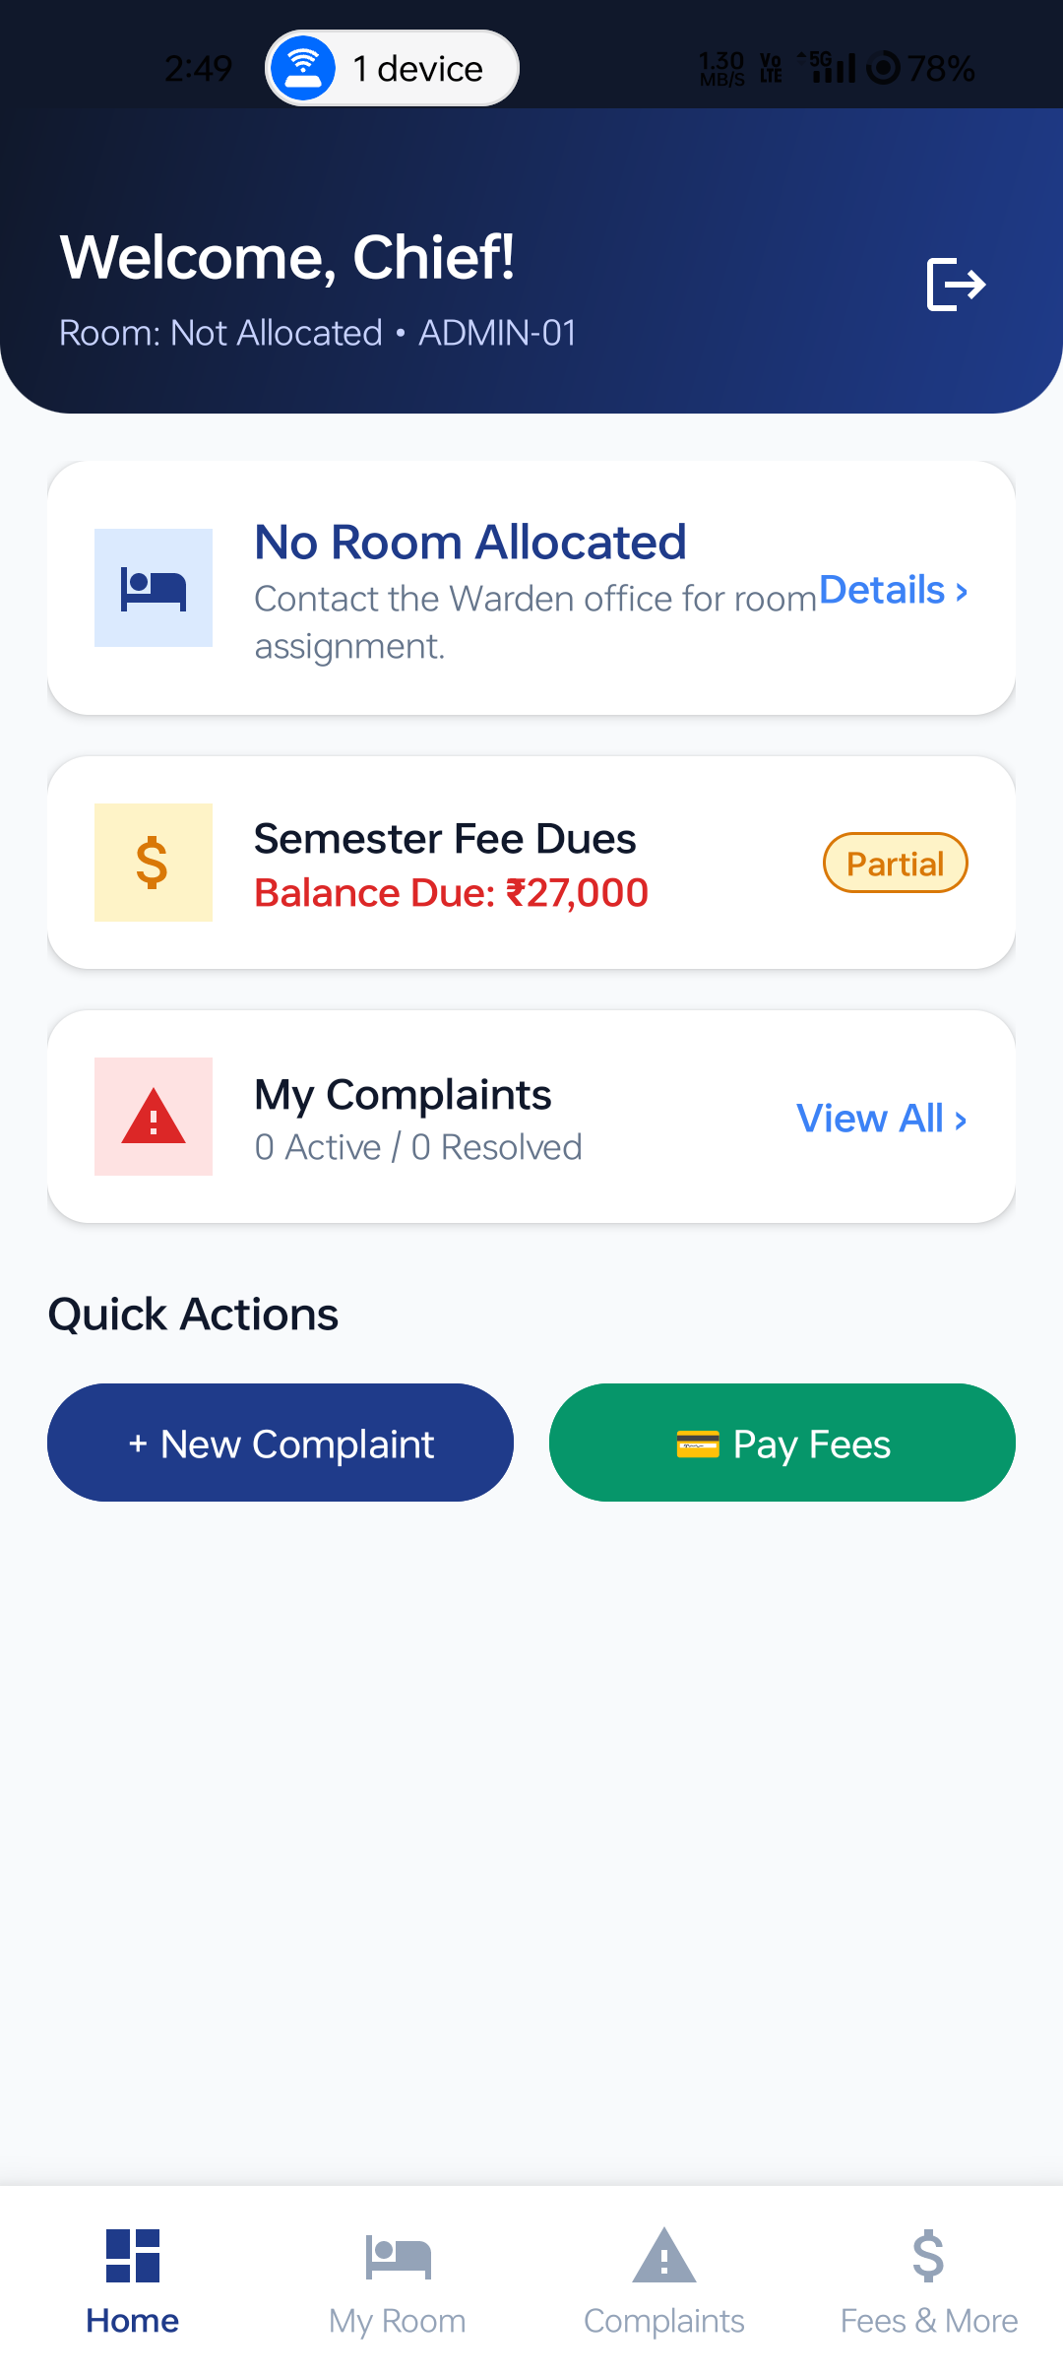
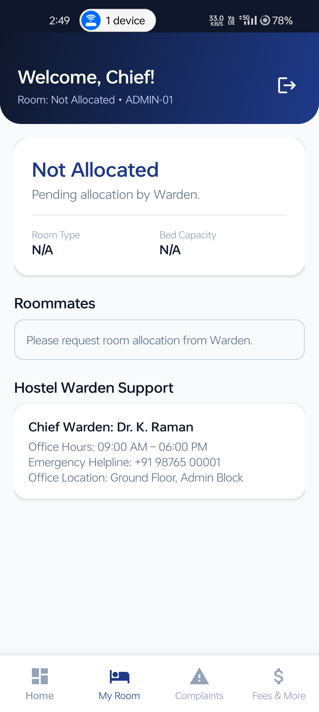
STUDENT MODULE
Resident Portal: Features & App Screens
06 / 14
Resident Student Features
• Dashboard Summary
Instant view of room, fees, and open complaints.
• My Room & Roommates
Displays room specs and roommate contact details.
• Digital Fee Ledger
Itemized fees with one-tap simulated UPI payment.
• Complaint Ticketing
Raise issues by category with real-time status.
Dashboard Screen | My Room & Roommates

Slide 7
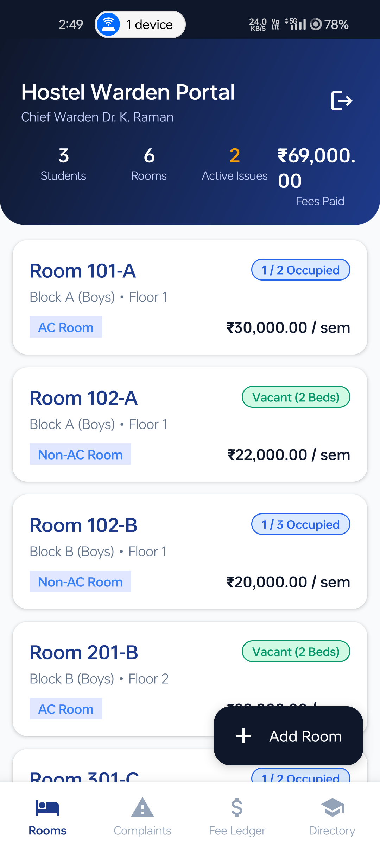
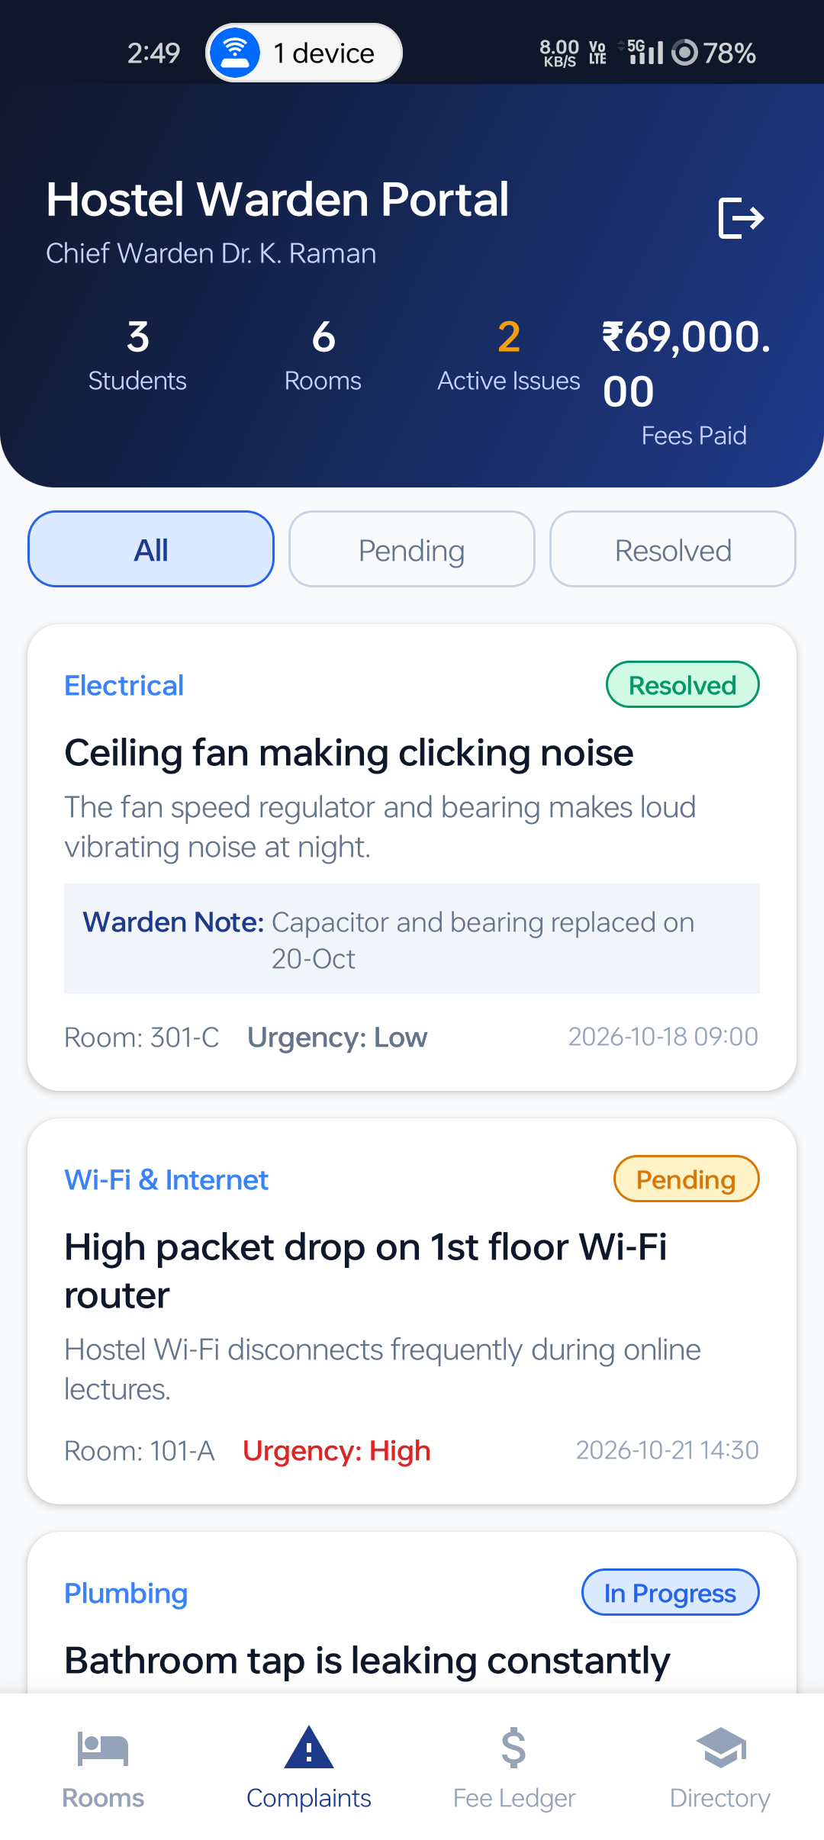
WARDEN MODULE
Administrative Portal: Features & App Screens
07 / 14
Warden Administration Controls
• Executive KPI Dashboard
Live counters for students, vacant beds & complaints.
• Room Inventory Control
Add new rooms with AC/Non-AC, capacity & rent.
• Resolve Complaints
Review issues by priority and resolve with remarks.
• Student & Fee Directory
Audit resident profiles and fee payment status.
Room Inventory Screen | Resolve Complaint Modal

Slide 8
TECHNICAL HIGHLIGHTS
Key Engineering Features in Hostel Manager
08 / 14
1. Atomic Room Allocation (Zero Overbooking)
SQLite transactions ensure a room is never allocated past its capacity, preventing double-booking.
2. Session Management & Auto-Login
Encrypted SharedPreferences remembers user role and ID, keeping the user logged in until explicit logout.
3. Smart Back Navigation & Exit Safety
AndroidX back dispatcher routes to the Home tab first, followed by an exit confirmation dialog.

Slide 9
LIVE DEMONSTRATION
What We Will Demonstrate Live in the App
09 / 14
Step 1: 1-Tap Login
Select Student or Warden role with quick demo fill.
Step 2: Room & Roommates
View allocated bed and real-time roommate directory.
Step 3: Pay Fees via UPI
Simulate UPI fee payment and see balance clear to Rs 0.
Step 4: File & Resolve Ticket
Student raises complaint; Warden updates status live.

Slide 10
TESTING & QA
Black-Box Testing Execution & Verification
10 / 14
18 / 18 Test Cases Passed (100% Success Rate) on Android 14 Phone
Test Feature | Verified System Behavior | Result
User Registration | Validates input; rejects duplicate roll numbers | PASSED
Role-Based Login | Directs correctly to Student or Warden portal | PASSED
Room Allocation | Blocks allocation when room capacity is full | PASSED
UPI Fee Payment | Clears balance to Rs 0 and updates status to PAID | PASSED
Complaint Resolution | Warden remarks reflect live on student device | PASSED

Slide 11
TEAM CONTRIBUTIONS
Individual Responsibilities (Team of 4)
11 / 14
Jay Chaudhary
Team Leader | 12302080601041
Project planning, overall architecture design, Gradle build setup, and physical ADB device deployment.
Jay Bhoi
Application Developer | 12302080601042
Core application logic, Activity workflows (Splash, Login, Register, Main), and back navigation routing.
Kishan Prajapati
UI/UX & Tester | 12302080601056
Authoring 14 Material Design 3 XML layouts, custom drawables, and executing the black-box test suite.
Krish Varde
Database Developer | 12302080601057
3NF normalized SQLite database schema, atomic room allocation transactions, and live XAMPP DB viewer.

Slide 12
CHALLENGES & SOLUTIONS
Technical Challenges Faced & How We Solved Them
12 / 14
1. Room Overbooking on Fast Clicks
Challenge: Rapid clicks could assign more students than a room's bed capacity.
Solution: Locked allocations inside SQLite transactions with precondition checks.
2. Accidental App Closure
Challenge: Pressing the hardware back button while on inner tabs exited the app.
Solution: Handled back presses with AndroidX dispatcher to return Home before exit dialog.
3. Viewing SQLite on Physical Phone
Challenge: Android 14 prevents direct PC access to internal phone databases.
Solution: Built a lightweight batch script + PHP bridge to inspect database in browser.

Slide 13
FUTURE SCOPE & CONCLUSION
Project Scalability & Concluding Summary
13 / 14
Future Scope
• Cloud Sync: Centralize data via Firebase / MySQL.
• Push Notifications: Instant alerts on complaint updates.
• Payment Gateway: Live UPI integration via Razorpay.
• QR Attendance: QR code scanning for night curfew.
Project Conclusion
• Fully working native Android mobile application.
• Eliminates paper registers and record errors.
• 100% offline-first with zero server costs.
• Verified on Android 14 physical hardware.

Slide 14
THANK YOU!
Hostel Manager — Mobile Application Development Mini Project
Questions & Live Demonstration Discussion
Native Android (Java) • SQLite Engine • Material Design 3 • 100% Tested
Team Members:
Jay Chaudhary (12302080601041) | Jay Bhoi (12302080601042)
Kishan Prajapati (12302080601056) | Krish Varde (12302080601057)
Department of Information Technology, A. D. Patel Institute of Technology (ADIT)

