Slide 1

Cairns Bhutanese Community (CBC) Mobile Application
-By Krisha Chaitanyabhai Chodvadiya (12311204)

Slide 2


Introduction
The Cairns Bhutanese Community (CBC) supports Bhutanese people in Cairns by creating and helping community connections, preserving Bhutanese/Nepali culture. The current website provides access to community information, membership as well as have a separate CBC form for requesting assets/items from the CBC community.

Slide 3
Table of Contents
01
02
03
Persona
Details
System
Design
Privacy &
Ethics
04
05
Usability
Evaluation
Usability
Improvements

Slide 4

Persona
Details
01

Slide 5
Persona of a Frequent Community Event Organiser
Basic Profile
Name: Sarah Mitchell
Age: 24
Role: Community Event Organiser
Frequency: 2-4 times per month
Digital Confidence: Comfortable using mobile application and online services
About Sarah
Personas provide designers with different representation of a target user group and can help communicate user needs throughout the design process (Miaskiewicz & Kozar, 2011). In this project, Sarah represents community event organiser who organises workshops, community meetings and small events at CBC. As part of her role, she frequently needs to request equipments. As she organises events in regular intervals, she often needs to provide same contact information and request similar assets multiple times.
Goals
Organise community events smoothly with minimal admin efforts.
Quickly find which assets are available on selected date and time.
Request the required assets without filling out repetitive forms.
Track the progress of submitted requests to handle delays properly before the events.
Keep a record of past requests.
Spend more time organising the event rather than managing administrative tasks.

Slide 6
Persona of a Frequent Community Event Organiser
Motivation
Sarah wants the asset request process to be quick, predictable and transparent so that she can focus on organising successful community events.
Frustrations/ Pain Points
Lack of asset visibility
Sarah does not know which assets are currently available before submitting a request.
Repetitive form filling
Sarah frequently requests assets but has to enter the same contact information each time.
Uncertainty after submitting a request
She can not easily see what is happening with her request post submission.
Dependency on the admin office and Time pressure
She has to contact the admin office to get updates about her request and if a delay is there for an equipment then that can affect her event planning.

Slide 7
Persona of a Frequent Community Event Organiser
Relevant behaviours
Uses her smartphone frequently for planning and communication
Usually plans the events several days or weeks in advance.
Requests multiple assets for a single event.
Frequently requests the similar type of equipment.
Prefers a quick call confirming the equipment availability.
Checks the status of important requests as the event date approaches.
Accessibility & Diversity Considerations
The application should have below features for providing accessibility for keeping the application accessible to each and every person.
Clear and simple language throughout the application
Readable text and proper contrast between background and text.
Support to enable high contrast mode.
Use of clear labels rather than just the icons.
The whole screen should be scalable.
Navigation in the application should be simple and easy to understand.
Allow users to modify prefill data in the screens.
Talkback and similar service should provide proper output for the written text.

Slide 8
System
Design
02

Slide 9
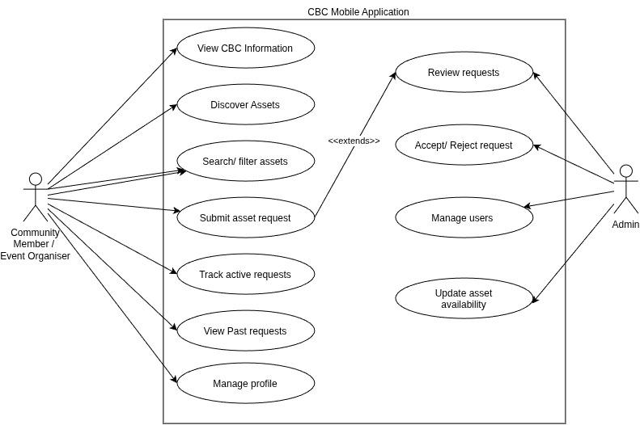
Use case diagram for CBC Mobile application

Slide 10
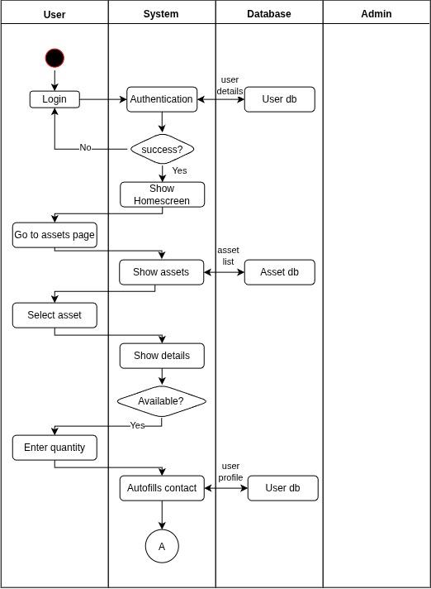
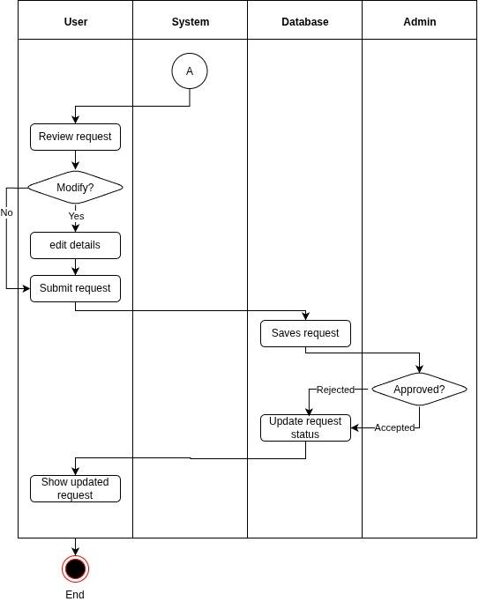
View Assets and Submit Asset Request Activity Diagram

Slide 11
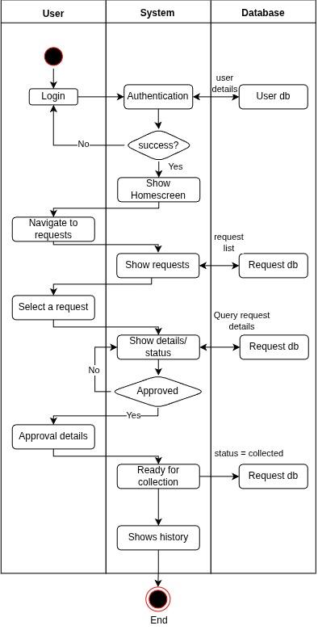
Manage and Track Requests Activity Diagram

Slide 12
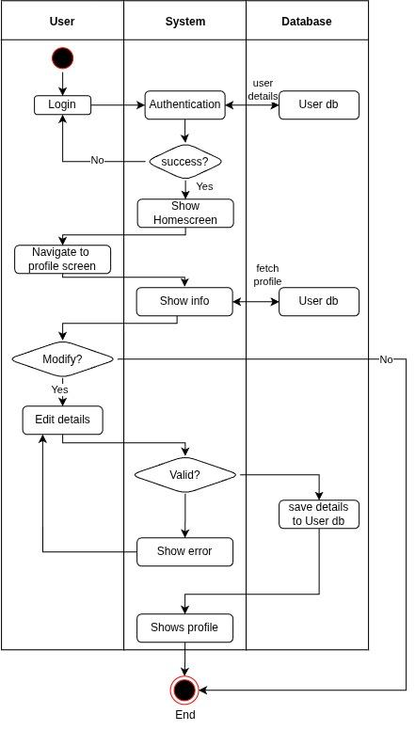
View and modify profile details Activity Diagram

Slide 13
Privacy
& Ethics
03

Slide 14
APP Principles reflected in application
Sl No | Name | Description
APP 3 | Collection | Request page only collects what’s required to create a request - name, email, phone, location and purpose. No extra fields or data are required.
APP 5 | Notification | on-screen text explicitly mentions profile details were auto filled and are editable before Sarah submits.
APP 12 | Access | Requests page only shows Sarah, her past requests and not some other users’ requests. They are access restricted data.
APP 13 | Correction | Profile page allows Sarah to modify her personal details whenever required.
APP 6 | Disclosure | Profile information is required for account creation and as contact details in request management and asset request details are required for asset management.
APP 11 | Security | Access controls, authentication, encryption and securely storing all the data.

Slide 15
Ethical Design decision
Persona trait | Design decision | Privacy / ethical consideration
Frequent requests assets | Profile based autofill | Collect only necessary contact/ profile details and allow users to edit them.
Needs quick access to CBC information and assets | Asset availability shown before requesting | No personal data is required just to browse assets
Need status updates | Live request status and confirmation | Only expose a user’s own request information.
May request similar assets repeatedly | Past request history and request again button | User controls over the request history and stored information.
Community user with diverse needs | Responsive, pageframe, font and size scaling | Avoid excluding users based on ability, language or digital literacy.

Slide 16
Usability
Evaluation
04

Slide 17
Usability Testing Methodology
Purpose:
The usability evaluation was conducted to assess whether the application meets the defined usability goals through practical user testing.
Testing approach I followed:
3 participants were recruited.
Each participant performed the same 3 usability tasks.
Each session lasted approximately for 20 minutes.
Participants were asked to complete the tasks independently while their interaction with the application was recorded.
Task performance and usability issues were recorded for later analysis.
Usability goals tested:
Efficient Asset Discovery
Low effort Request submission
Form validation and error prevention

Slide 18
Usability Test tasks and expected outcomes
Usability goal | Description | Expected Outcome
Efficient Asset Discovery | Go to the asset list and view the asset list and try to find the required asset in the list. | The participant should be able to navigate to the “assets” screen and view available assets and find their required asset.
Low effort request submission | Try to submit the request for an asset from the available assets list. | The participant should be able to submit the request form for required asset.
Form validation and error prevention | Attempt to submit a request using incomplete or empty fields. | The application should prevent user to continue and show error saying that the information needs to be corrected.

Slide 19
Participant consent and recordings
Here is the recording link for each of the participant reviewing my application:
Participant Sl No | Link to recording
Purab | Link
Part2
Part3

Slide 20
Testing Measurements & Results - Participant 1
Usability Goal | Task completed | Problems faced | Assistance Required | Observation
Efficient Asset Discovery | Yes | Participant was not sure why unavailable items are in the asset list | No | Unavailable asset filter is required and should be shown only when user requests for it.
Low effort request submission | Yes | Participant was not able to open an asset request form from the homescreen shortcut | Yes | Application only provides request form creation from an asset detail page and no option directly from the requests screen
Form validation and error prevention | No | Participant was able to submit the empty or invalid field form | No | User can not proceed if no asset is selected for the request but contact details should not be empty.

Slide 21
Testing Measurements & Results - Participant 2
Usability Goal | Task completed | Problems faced | Assistance Required | Observation
Efficient Asset Discovery | Yes | Participant noticed that some assets were limited or unavailable, they needed to differentiate them when selecting an asset. | No | Browse assets shortcut made asset discovery straightforward and user was satisfied with the flow.
Low effort request submission | Yes | Participant was not able to find a create request form, and thus gets confused. | No | Create form was missing from the requests page and invalid shortcut.
Form validation and error prevention | No | Participant was able to continue with invalid and empty information. | No | The form does not validate required fields.

Slide 22
Testing Measurements & Results - Participant 3
Usability Goal | Task completed | Problems faced | Assistance Required | Observation
Efficient Asset Discovery | Yes | Participant’s concern was why unavailable assets were displayed when they were not requested. | No | Asset discovery was straightforward but an option to hide/ filter assets for availability is required.
Low effort request submission | Yes | Participant had difficulty in distinguishing selected assets from other assets displayed in the form. | No | Selected asset should be separate from other non-selected assets.
Form validation and error prevention | No | Participant could proceed to the review form with invalid information and no proper validation error was provided | No | Form validation should check required fields and invalid values before allowing the user to continue.

Slide 23
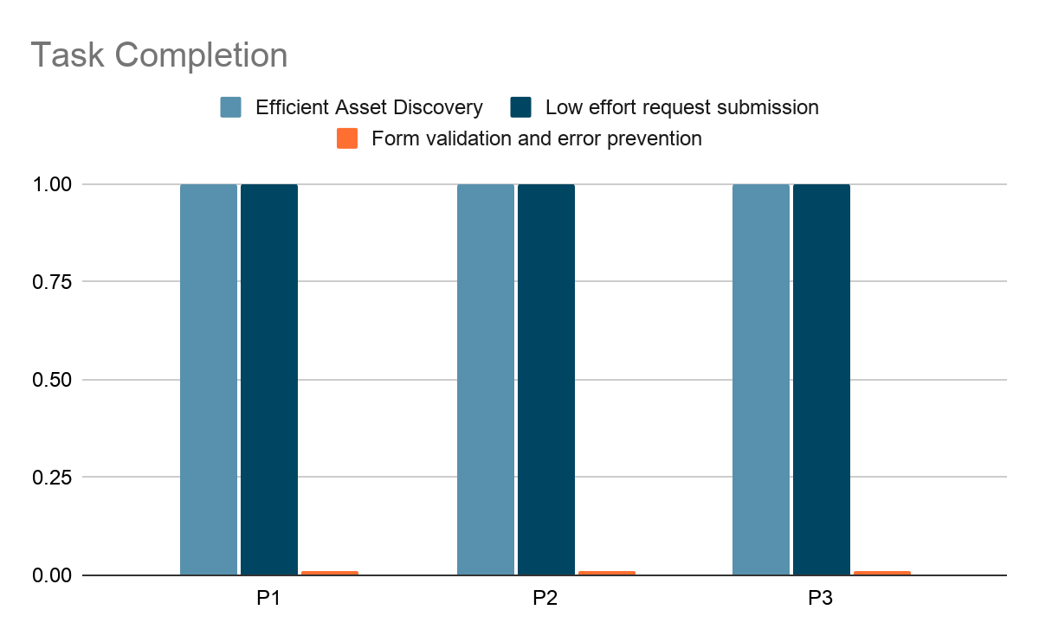
Graph: Task completion by usability goal
Conclusion:
All the 3 participants were able to complete the first 2 usability goal which are: Efficient Asset Discovery and Low effort request submission
but they were not able to complete the last usability goal i.e. Form validation and error prevention.

Slide 24
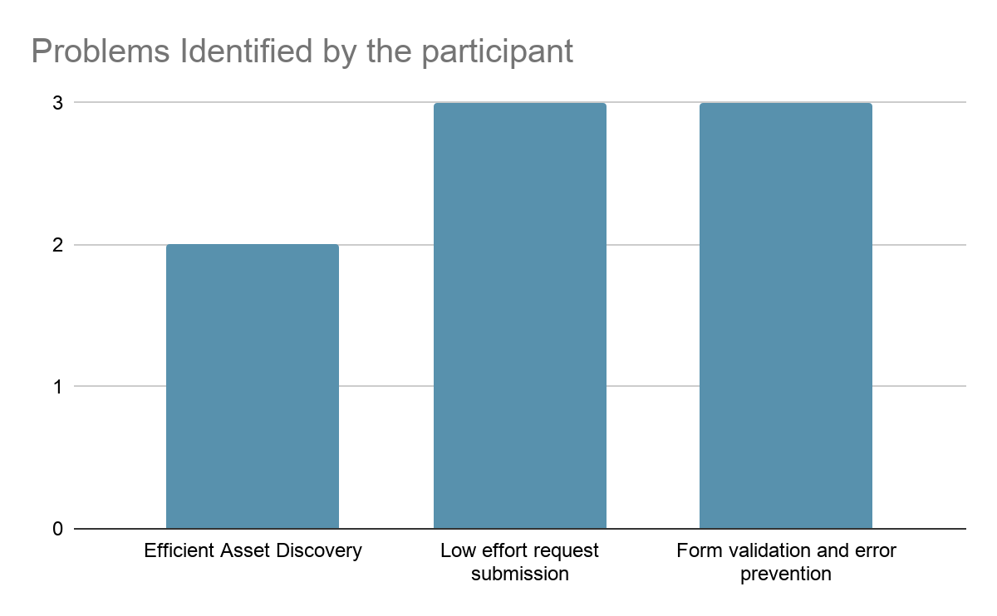
Graph: Problems identified by the participant
Efficient Asset Discovery
- Participant 1 was satisfied by the application and did not identify a problem in the flow.
Low effort request submission
- All three participant found that the create request form shortcut redirection is not working as expected.
Form validation and error prevention
- Participant feels a feedback message stating at least 1 asset should be selected. Contact details should be mandatory.

Slide 25
Usability
Improvements
05

Slide 26
Efficient Asset Discovery - Improvement
Area | Details
Finding | Participants were able to find suitable assets successfully but they questioned why unavailable assets were displayed together with requestable assets.
Usability Issue | Users have to manually distinguish between available, limited and unavailable assets.
Recommendation | Introduce a filter option which let user filter the asset based on asset availability.
Implementation | By default, user will see only the assets which are requestable but user can choose to see the unavailable assets from the filter.
Usability Principle | Efficient information presentation - shows users only the information which is relevant to their current task.

Slide 27
Low-Effort Request Submission - Improvement
Area | Details
Finding | The homescreen shortcut did not navigate to a “request form” instead took to “My requests” page. My requests page was lacking a button for form creation. Request form was showing selected and not selected assets all at once place, creating confusion.
Usability Issue | Navigation for creating a form is not correct. Selected and non-selected assets in the same leads to confusion.
Recommendation | Homescreen shortcut should open a new empty request form. Selected and non selected assets should be shown separately.
Implementation | Add asset button should display other available assets.
Usability Principle | Clear navigation and information design.

Slide 28
Form Validation & Error Prevention - Improvement
Area | Details
Finding | Participants were able to move forward with invalid or incomplete details.
Usability Issue | The application is not preventing user from submitting the invalid form leading to communication issues during asset allocation process.
Recommendation | Mandatory fields should be validated and empty fields should not be allowed. A warning message or an error message should be shown on screen to the user to understand the issue and make required changes to submit the asset request form.
Implementation | Validate mandatory fields and use regex for validating formats for email field. An inline error message will be shown for invalid or incomplete details.
Usability Principle | Error prevention and visibility of status with user feedback.

Slide 29
Important
Links
06

Slide 30
Important Project links
Name | Link
Github repository | https://github.com/Krisha-12/cbc_pwa
PWA Deployed link | https://krisha-12.github.io/cbc_pwa/
Recorded video link | https://drive.google.com/file/d/1meZbw2j7Sh6x6f7SBWvnJHsyFJv9IudM/view?usp=drive_link

Slide 31

Thanks

