Slide 1
Compliance Framework Implementation MediCore AI Solutions
Emmanuel Frimpong
Krisha Lakhani
Nisarg Sheth
Siqi Yang

Slide 2
Company Profile & Compliance Overview
Company Overview
MediCore AI Solutions
Healthcare tech startup
25 employees
AI diagnostics & cloud EHR
Compliance Requirements
HIPAA, SOC 2, ISO 27001
SOX for future growth
NIST CSF foundational
Common Controls Framework (CCF)

Slide 3
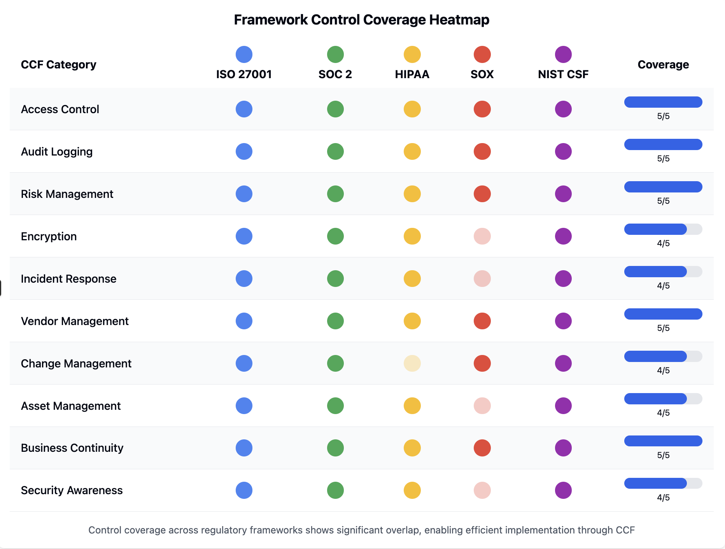
Framework Overlap

Slide 4
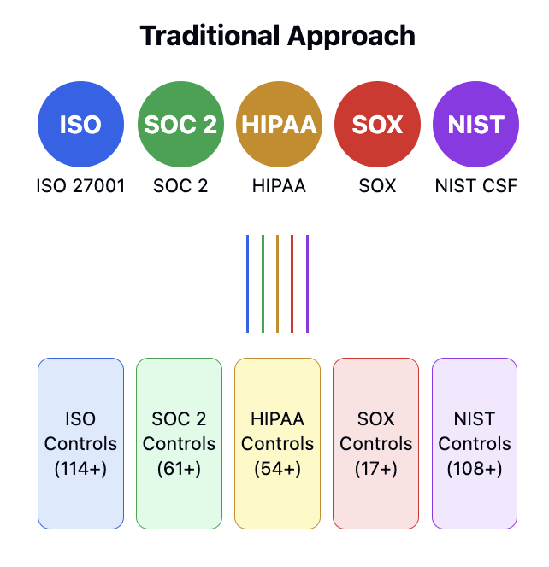
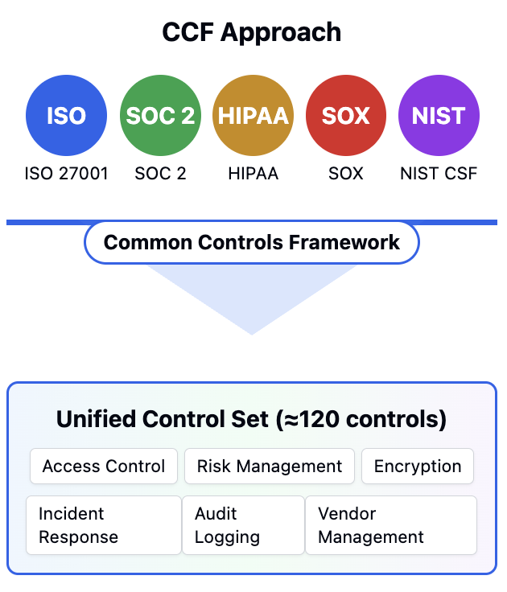

Slide 5
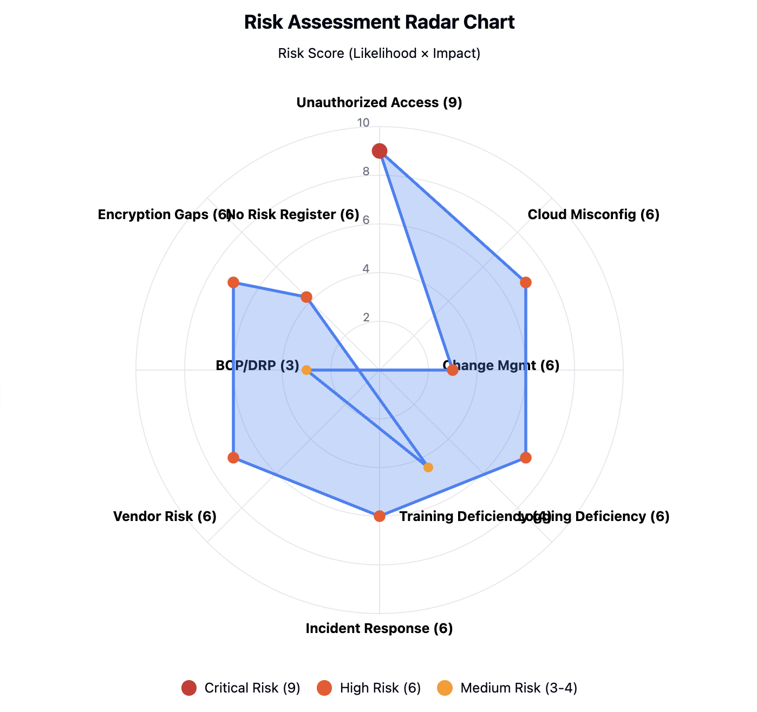

Slide 6
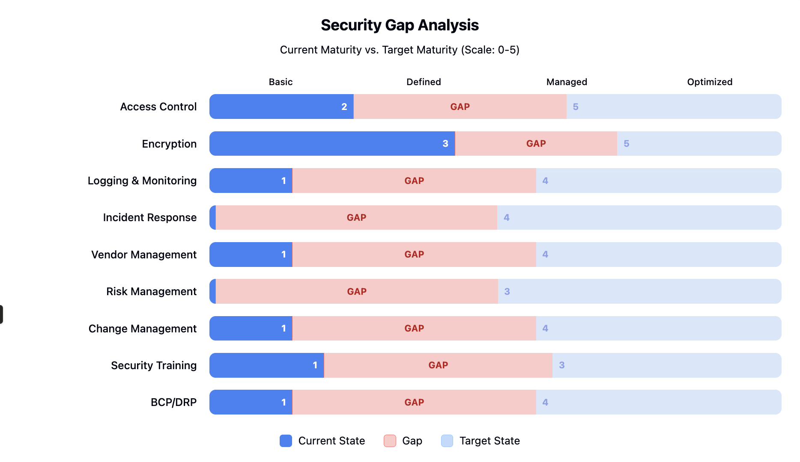
Security gap Analysis

Slide 7
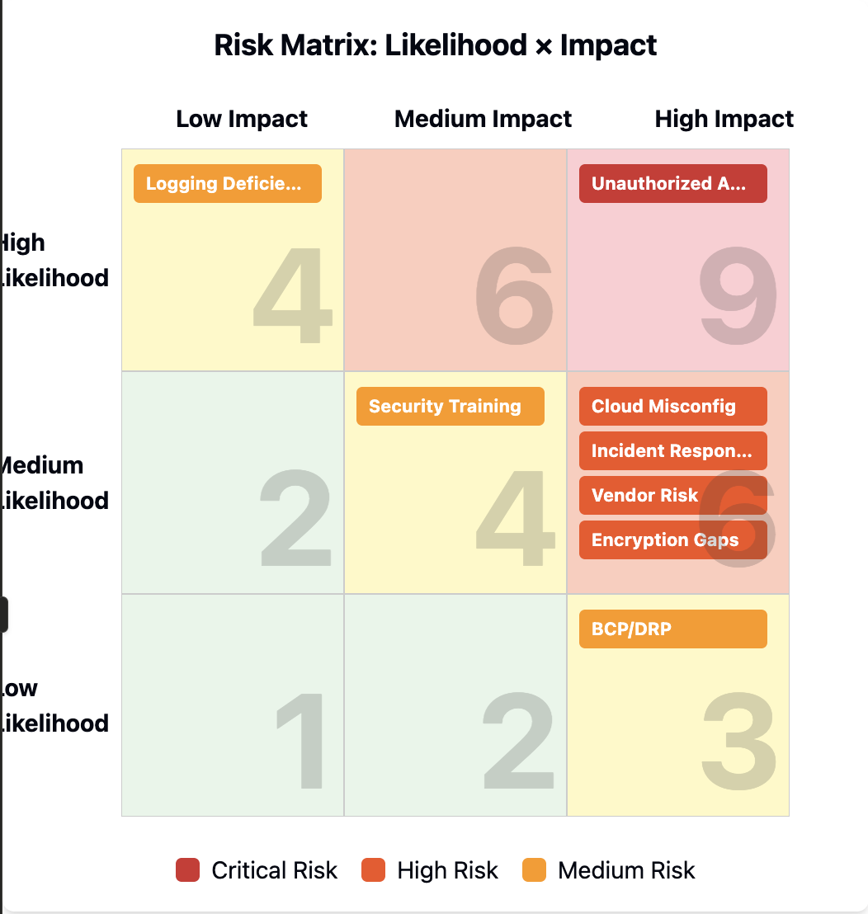
Key Risks Identified
High Likelihood
Medium Likelihood
Low Likelihood

Slide 8
Developed Compliance Controls (CCF-Based)
Developed 9 integrated controls addressing top risks and compliance gaps.
Unified under Common Controls Framework (CCF) for efficiency across HIPAA, ISO 27001, SOC 2, NIST CSF, SOX.
Control Area | Key Focus | Compliance Goals
Access Control | RBAC, PAM, access | HIPAA, ISO, SOC 2
Encryption | AES/TLS, DLP | HIPAA, ISO, NIST
Logging & Monitoring | SIEM, alerts | HIPAA, ISO, SOC 2
Incident Response | Plan, team, testing | HIPAA, NIST, ISO
Vendor Management | Assesment, monitoring | HIPPA, SOC 2
Risk Management | Register, treatment plans | ISO, HIPPA
Change Management | Workflow, testing | SOX, SOC2
Training | Awareness, phishing | HIPAA, ISO
BCP/DRP | Recovery testing | HIPAA, ISO, SOC 2

Slide 9
Detailed Control: Access Control System
Role-Based Access Control (RBAC) across all PHI-related systems
Quarterly access reviews
Privileged Access Management (PAM)
Session timeout and re-authentication
Users
Access Rules
Roles
Review Cycle

Slide 10
Roadmap to Full Compliance (12 Months)
Phase 1 (M1–2):
Phase 2 (M3–4):
Phase 3 (M5–6):
Phase 4 (M7–8):
Phase 5 (M9–10):
Phase 6 (M11–12):
Risk assessment, security policies, team formation
Access control, encryption, incident response
Monitoring, change mgmt, vulnerability scans
Security training, BCP/DRP planning, vendor reviews
Testing: IR exercises, recovery, pen testing
Audit prep, final documentation, compliance validation

Slide 11
Mapping Controls to Multiple Frameworks
Each control mapped to 2–4 frameworks
CCF approach reduces duplication

Slide 12
Conclusion & Key Takeaways
MediCore AI Solutions, a healthcare tech startup, implemented a unified compliance framework (CCF) addressing requirements across HIPAA, ISO 27001, SOC 2, NIST CSF, and SOX. The project identified key risks, designed targeted controls, and developed a structured 12-month roadmap for compliance implementation.
Key Takeaways:
Unified framework significantly reduces redundancy and effort.
Prioritizing critical risks enhances security posture.
Clear, phased implementation ensures regulatory readiness and supports scalable growth.

