Slide 1
Blinkit Sales Analysis

Slide 2
Overall Performance using Cards
Total Sales : Total sales has been increasing steadily over the years.
Average Sales: Per item are relatively high.
No of item: The large no of item suggests a diverse product range.
Average Rating: The average rating satisfactory, but theirs is the room of improvement.

Slide 3
Charts and Insight
Total Sales by Outlet Establishment
Chart type-Line Chart
Insight-Chart showing outlet establishment over time (2011-2022). Steady growth in outlet establishment with a significant increase in 2018.
Sales by Outlet Size
Chart type-Donut Chart
Insight-Majority of outlets are of medium size.

Slide 4
Charts and Insight
Sales by outlet location
Chart type- Clustered column chart
Insight- Tier 3 location have the highest sales, followed by Tier 2 and 1
All metrics by outlet type
Chart type- Matrix card
Insight- Supermarket type1 has the highest sales and average sales.
5.Total Sales by Item type
Chart type- Bar chart
Insight- Fruits and snacks are the top-selling items compared to others item.

Slide 5
Charts and Insight
Total Sales by Fat Content
Chart type- Donut chart
Insight- Low fat item have a higher share of sales compared to regular items.
Fat content by Outlet for Total Sales
Chart type- Clustered Bar Chart
Insight- Tier3 low fat content have a higher sales.

Slide 6
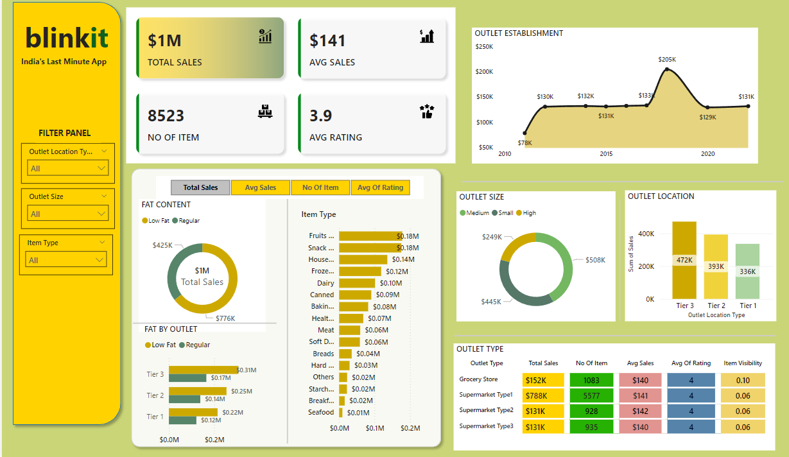
Dashboard

