Slide 1
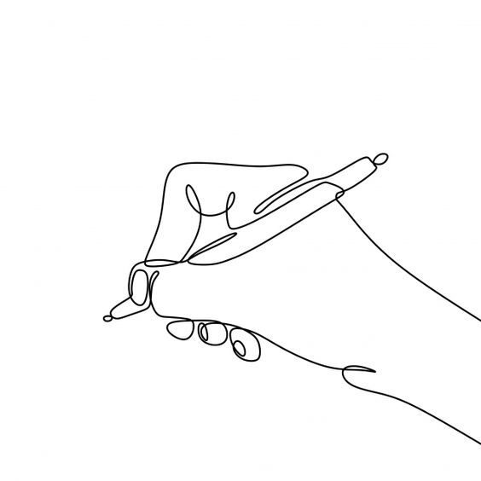

Gesture-to-Text: Neural Network for Space Writing
Presenter Name
Krisha Ketankumar Patel
Siri ravali dunaka
Guided By
Dr. Shivanjali Khare
CSCI 6660: Introduction to Artificial Intelligence

Slide 2
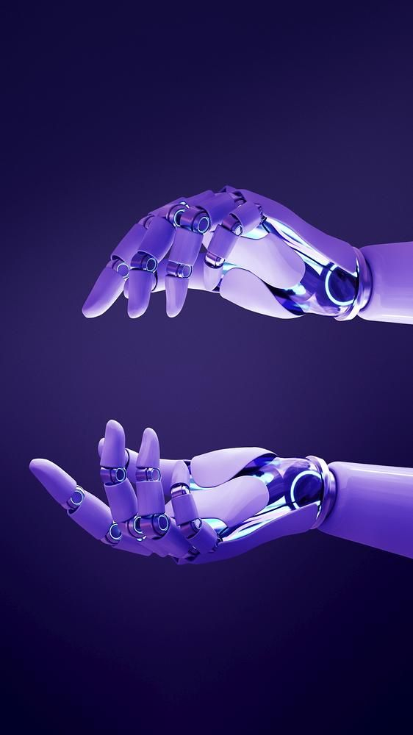
Project Topic
Space writing involves the act of writing characters or digits in free space using hand movements, hand palms, fingers, or other writing tools like a pen. This is achieved with the assistance of a circular device that functions as a marker, which is then tracked by a camera.

Slide 3
Statement of Project Objectives:
Gesture-Based Character Recognition: This project aims to develop a system for recognizing space writing, a form of gesture recognition where hand motions are utilized to represent characters and digits written in free space.
Interpolation Techniques and Space Language Identification: We will examine various interpolation methods using accessible space writing datasets and create a method for identifying different space writing languages based on recognition accuracy.
Comprehensive Performance Evaluation: Our approach's performance will be rigorously assessed across various datasets, comparing it to leading methods with a significant margin. This evaluation will encompass both user-specific and user-independent principles.

Slide 4
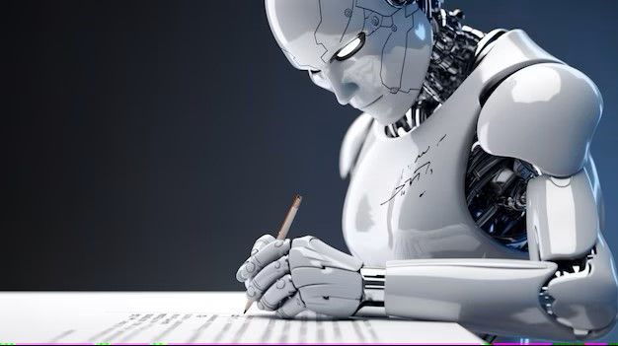
Approach
Object Segmentation in Writing: The process of identifying and isolating the object involved in writing.
Identification of the Writing-Object Center: Determining the central position of the writing object.
Trajectory Tracking and Projection in a Two-Dimensional Plane: The technique of monitoring and projecting the path of the writing object in a two-dimensional space.
Recognizing the Persona: Identifying and recognizing the unique characteristics or persona of the writing, likely referring to recognizing the individual style or patterns in space writing.
Architectures of Networks: Utilizing specific neural network architectures tailored for the task of space writing recognition

Slide 5

Deliverables
Utilizing Standard Web Cameras: The project's solution will be designed to avoid the need for additional sensors by utilizing the built-in generic web cameras found in common monitor devices or laptops.
Addressing Depth Information Challenges: Recognizing that specific sensors may lack depth information, which can complicate text data processing, the project will employ image analysis techniques to address this challenge.
Dividing and Tracking Writing Device: The solution will involve using image analysis to segment and track the movement of the writing device, whether it's a fingertip or a marking tip. This tracking will be used to project three-dimensional computer stroke data onto a two-dimensional plane

Slide 6
Evaluation Methodology
Leveraging Neural Networks for Space Writing: We will explore the feasibility of using Neural Networks to facilitate space writing.
Utilizing Python and Essential Libraries: The implementation will be done in the Python programming language, harnessing various libraries such as Keras Model, Collections, NumPy, OpenCV, among others.
Experimental Setup and Error Analysis: To achieve our project objectives, we will establish a structured experiment, conduct a comprehensive error analysis, and incorporate recognition rates as part of the evaluation process.
Real-Time Space Writing Recognition: As a key objective, we will develop a method for real-time recognition of space writing gestures.

