Slide 1

Building an AI Pipeline for Image Segmentation and Object Analysis
Your Name: Krishan Kumar

Slide 2

Project Overview
Goal:
Develop a comprehensive AI pipeline that processes images to segment, identify, and analyse objects.
Outcome:
Output a summary table with mapped data for each object in the image.
Overview of Steps:
Image Segmentation: Detect and segment objects within the image.
Object Extraction and Storage: Isolate and store each segmented object with unique identifiers.
Object Identification: Classify and describe each object using pre-trained models.
Text/Data Extraction: Extract relevant text or data from the objects.
Summarize Object Attributes: Provide a summary of attributes for each object.
Data Mapping: Map all extracted data and attributes to each object and the master image.
Output Generation: Produce a final annotated image and a summary table.

Slide 3

Pipeline Steps and Deliverables
Step 1: Image Segmentation
1
Model Options:
Mask R-CNN: Provides high accuracy for segmentation tasks.
DETR (Detection Transformer): Uses transformers for object detection and segmentation.
Deliverables:
Code for segmentation
Visual output with segmented regions highlighted
Step 2: Object Extraction and Storage
2
Tools:
OpenCV: For image processing and object extraction.
PIL (Python Imaging Library): For image manipulation and saving.
Deliverables:
Extracted objects saved as individual images
Metadata file/database with unique IDs and master ID
Step 3: Object Identification
3
Model Options:
YOLO (You Only Look Once): Fast and efficient object detection.
Faster R-CNN: Accurate and robust for various object detection tasks.
CLIP: Versatile for identifying and describing objects in images.
Deliverables:
Object identification results
Descriptions of objects

Slide 4
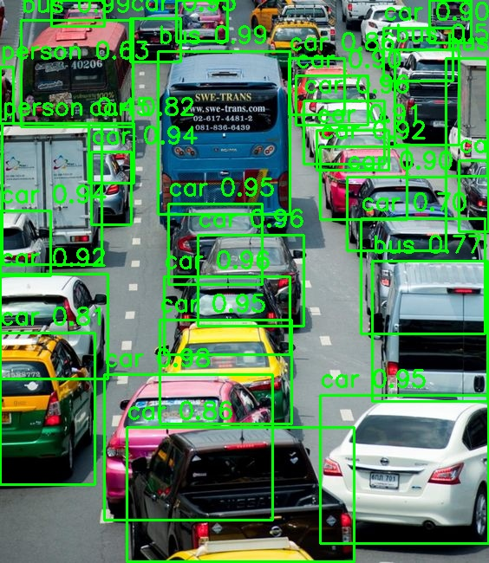
Integration with Streamlit and Image Example
Streamlit Integration Purpose:
Interactive Web Application: Build an easy-to-use interface to demonstrate the AI pipeline in action.
Features:
Image Upload: Allow users to upload their own images for segmentation and analysis.
Visualization: Display segmented objects, bounding boxes, and masks directly on the uploaded image.
Data Presentation: Show extracted data, object IDs, descriptions, and summaries in an interactive format.

Slide 5

Results and Conclusion
Results
Segmentation: Effective segmentation with clear object boundaries.
Object Extraction: Objects successfully extracted and saved with unique IDs.
Identification: Accurate object identification and descriptions.
Text Extraction: Reliable text/data extraction from objects.
Visualization: Final image and summary table illustrate pipeline outputs.
Conclusions
Successes: The pipeline effectively segments, identifies, and analyzes objects.
Challenges: Minor issues with complex or overlapping objects.
Future Work: Improve model accuracy and explore additional features.
Summary: Achieved key objectives with room for refinement and enhancement.

