Slide 1


TECH4BHARAT 2026 | NATIONAL HACKATHON
Problem Statement PS 2.2 | Jeweltech
KARIGAR360
Every Gram Accounted For.
Every Job Traceable.
Every Settlement Transparent.
Bringing accountability, transparency and intelligence to India's jewellery job-work ecosystem.
ISSUED 100.0 g
RECONCILED 100.0 g

Slide 2

THE PROBLEM
A High-Value Industry.
A Workflow Built on Trust.
Jewellers work with independent karigars to manufacture, polish, repair and finish jewellery. Materials move between parties.
Issuance and receipt may have no shared acknowledgement.
Job progress and partial returns are hard to track.
Reconciliation becomes time-consuming.
Weight or allowance differences lead to disputes.
ONE JOB. FIVE RECORDS.
Settlement records scatter across channels.
Material moved between parties. The record of it did not.
The problem is not simply tracking gold. It is establishing a reliable shared record of responsibility throughout the job lifecycle.
Paper register
WhatsApp chat
Verbal note
Weighing slip
Memory only
No shared acknowledgement. No single source of truth.
KARIGAR360
THE PROBLEM
02

Slide 3
THE TWO-SIDED ECOSYSTEM
Two Stakeholders. One Shared Source of Truth.
KARIGAR360 is designed for both sides — it is not merely a jeweller's internal tracking dashboard.
ONE SHARED JOB RECORD
one job | one ledger | two counterparties
PROPOSED UI | SAMPLE DATA
JEWELLER PLATFORM
WEB APP
KARIGAR PLATFORM
MOBILE
JOB LEDGER
View assigned jobs
JOB-2481
Acknowledge material received
ACTIVE JOBS
PENDING ACKS
RETURNS DUE
DISCREPANCIES
Gold necklace
Update job progress
12
3
4
1
22K | 100.0 g
Record partial and final material returns
JOB-2481 Gold necklace 22K
IN PROGRESS
MATERIAL RECEIVED
Upload supporting evidence
ACKNOWLEDGED
Review and approve or dispute reconciliation proposals
JOB-2476 Ring setting 22K
RETURN RECEIVED
PRODUCTION
60%
Create and assign job orders
RECONCILIATION
Record gold issued and agreed job terms
100.0 g = 100.0 g
SHARED LEDGER ROW | JOB-2481
Track acknowledgement and production progress
ACCOUNTED = ISSUED
issued 100.0 g returned 98.5 g
Monitor returns and pending jobs
APPROVE
DISPUTE
allowance 0.8 g recoverable 0.7 g
Review discrepancies and settlement statements
MATCHED — SHARED BY BOTH PARTIES
KARIGAR360
THE TWO-SIDED ECOSYSTEM
03

Slide 4

THE SOLUTION
PROPOSED PRODUCT CONCEPT
Introducing KARIGAR360.
01
Digital Job Ledger
Every job gets a unique, traceable record.
A shared digital workflow that follows every job from material issuance to final settlement.
Material Acknowledgement
02
Both parties record and confirm material transfers.
03
Live Job Tracking
One connected workflow. Fewer fragmented records. Greater accountability.
Track production stages, deadlines and partial returns.
04
Intelligent Reconciliation
Compare recorded material, returns and agreed allowances.
ONE SHARED JOB RECORD
05
CORE
CAPABILITIES
05
Transparent Settlement
Generate a settlement statement both parties review and approve.
KARIGAR360
THE SOLUTION
04

Slide 5
HOW IT WORKS
PROPOSED WORKFLOW
From Gold Issuance to Verified Settlement.
One job lifecycle, six recorded steps. Every step produces a record the other party can see.
01
02
03
04
05
06
Create Job
Issue & Acknowledge
Track Production
Record Returns
Reconcile
Approve & Close
JEWELLER
BOTH
KARIGAR
KARIGAR
BOTH
BOTH
The jeweller creates a job with material details, agreed terms, expected completion date and karigar information.
The jeweller records the material issued. The karigar confirms receipt.
The karigar updates progress and records relevant production events.
Partial or final returns are recorded with relevant weight and evidence.
The system compares recorded material flow against the agreed rules and flags differences for review.
Both parties review the reconciliation and approve the settlement before the job is closed.
One job. One ledger. Both sides informed at every step.
JEWELLER
KARIGAR
BOTH
KARIGAR360
HOW IT WORKS
05

Slide 6

THE INTELLIGENCE
PROPOSED ARCHITECTURE
AI That Assists.
Rules That Ensure Accuracy.
KARIGAR360 combines AI-assisted information capture with deterministic reconciliation and human-approved decisions.
AI ASSISTANCE
HUMAN APPROVAL
capture and summarise
DETERMINISTIC RECONCILIATION ENGINE
no closure without sign-off
Voice-to-record
Python Decimal arithmetic | no LLM-generated estimates
Jeweller reviews and approves
Gross and net weight
Purity
Document intelligence
Karigar approves or disputes
Stones and non-gold components
Agreed process allowances
Job intelligence
Recoverable scrap and residual material
Partial returns
Closure and settlement require explicit human approval
Follow-up intelligence
Measurement precision and agreed units
Settlement assistance
Every correction is preserved in an append-only audit history.
Differences are flagged for review. Both parties can dispute.
Assistive capture only. It never decides loss or liability.
TRUST SAFEGUARDS
AI does not independently decide gold losses or financial liabilities.
Calculations use deterministic arithmetic, not LLM estimates.
Discrepancies are flagged for review, not treated as accusations.
Both parties can dispute a reconciliation.
Corrections are preserved in an append-only audit history.
Job closure and settlement require explicit human approval.
KARIGAR360
THE INTELLIGENCE
06

Slide 7

A DIFFERENT APPROACH
Beyond Tracking. Towards Shared Accountability.
A shared, evidence-backed job lifecycle — not one-sided record keeping.
OUR PROPOSED DIFFERENTIATION
Two-sided acknowledgement, not one-sided data entry
Shared job-level history, not scattered communication
Evidence-linked reconciliation, not unexplained differences
MATERIAL ISSUED BY THE JEWELLER
100 g
Mutual review and approval, not unilateral job closure
Append-only corrections, not silent record changes
POSITIONING
Bar is proportional to the 100 g issued.
98.5 g
Finished material
Our proposed distinction is shared evidence, dual acknowledgement and mutual reconciliation. It is a design hypothesis to validate with jewellers and karigars in the field — not a claim that other jewellery software lacks job-work or gold-ledger features.
0.8 g
Agreed process allowance
0.7 g
Recoverable material
= 100 g total accounted material
Illustrative example only — not a claim about industry-standard allowances or actual customer transactions.
KARIGAR360
A DIFFERENT APPROACH
07

Slide 8
MARKET & BUSINESS MODEL
Built for a connected jewellery job-work ecosystem.
A proposed SaaS model. Market sizing, pricing levels and adoption figures are not yet established.
TARGET USERS
CONNECTED ECOSYSTEM
Independent jewellers
Jewellery manufacturers
KARIGAR360
JEWELLERS
KARIGARS
Workshops coordinating outsourced job-work
Independent karigars and artisan networks
WORKSHOPS
POTENTIAL VALUE
Reduced administrative effort
PROPOSED SUBSCRIPTION MODEL
Better visibility into outstanding jobs
More organised reconciliation
Starter
Professional
Business
Better documentation of material movement
Small jewellers and workshops
Advanced tracking and reconciliation
Multi-user larger operations
Improved transparency between counterparties
Optional premium features: advanced analytics, integrations with existing jewellery business software, and document intelligence.
KARIGAR360
MARKET & BUSINESS MODEL
08

Slide 9
EXECUTION & ROADMAP
From a real-world problem to a scalable platform.
Four phases, from field discovery to a scalable platform. Phases 2 to 4 are planned development — no product is deployed today.
01
02
03
04
Discover & Validate
Build the MVP
Pilot & Improve
Scale
Conduct interviews with 2–3 jewellers
Role-based jeweller and karigar interfaces
Test with consenting jewellers and karigars
Multilingual voice interaction
Advanced analytics and alerts
Map existing job-work workflows
Digital job ledger
Validate workflows with both parties
Integrations with existing jewellery business software
Validate the most painful reconciliation problems
Material issue and acknowledgement
Measure task completion and reconciliation effort
Expand to additional workshops and jewellery clusters
Identify karigar-side adoption barriers
Return recording, discrepancy and evidence workflow
Refine usability and business rules
Dual approval and audit history
PROPOSED TECHNOLOGY FOUNDATION
PLANNED — NOT YET IMPLEMENTED
FRONTEND
BACKEND
DATABASE
AI ORCHESTRATION
RECONCILIATION
EVIDENCE
Next.js / React PWA
Python FastAPI
PostgreSQL
Mastra
Python Decimal
Secure file storage
KARIGAR360
EXECUTION & ROADMAP
09

Slide 10
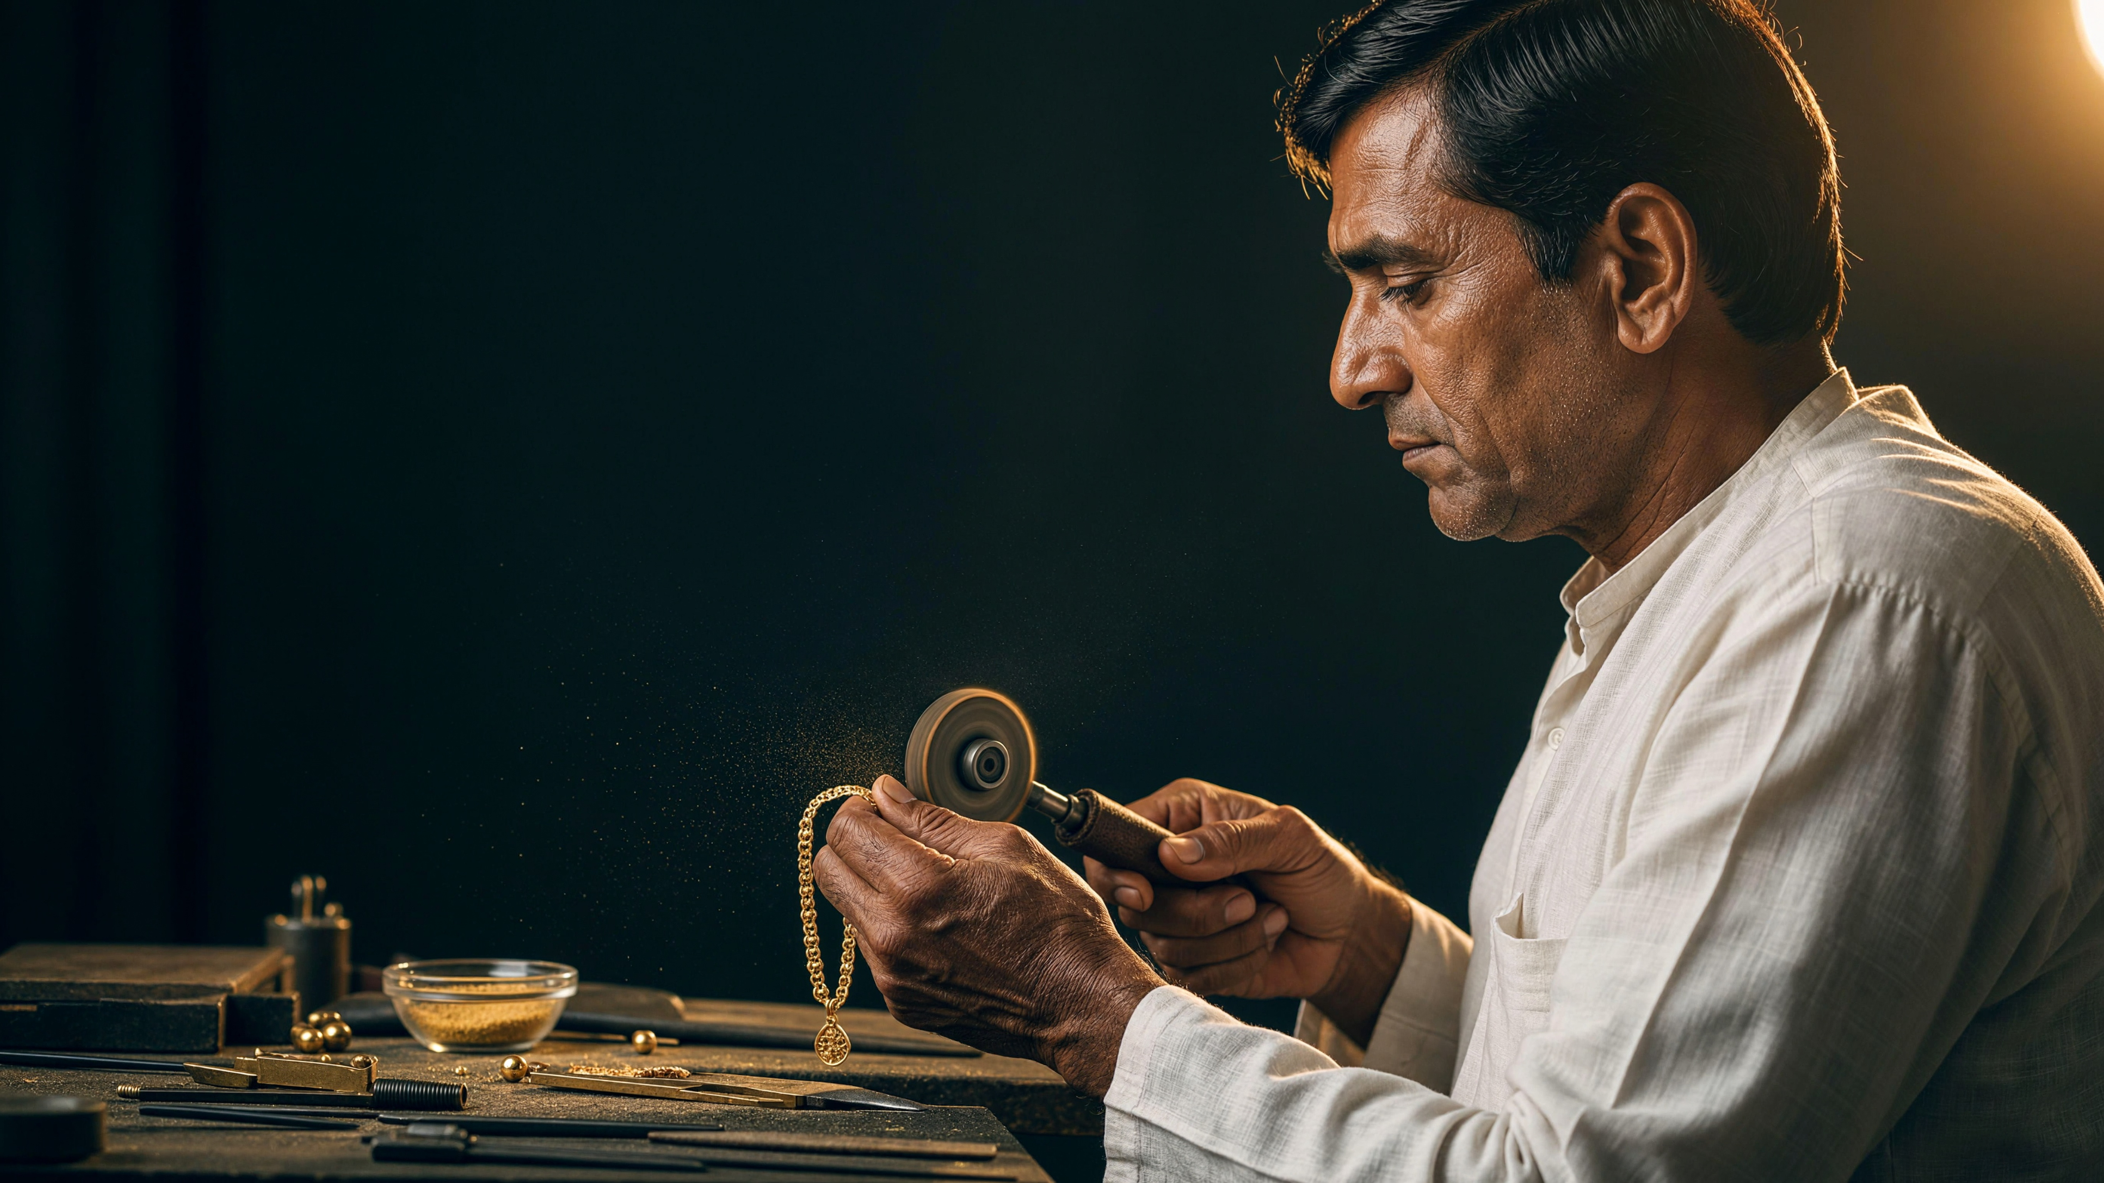

THE PROMISE
Trust Should Not Depend on Memory.
Every gram deserves accountability. Every karigar deserves transparency. Every jeweller deserves confidence.
KARIGAR360
Every Gram Accounted For. Every Job Traceable. Every Settlement Transparent.
Let's bring a shared digital foundation to jewellery job-work.
10

