Slide 1


SAVEETHA SCHOOL OF ENGINEERING
SAVEETHA INSTITUTE OF MEDICAL AND TECHNICAL SCIENCES
COURSE CODE:
CSA1590 -CLOUD COMPUTING FOR BIG DATA ANLYTICS FOR VIRTUAL CLUSTERS
TOPIC:
PROJECT ON SCALABLE WEB APPLICATION DEPLOYMENT
SUPERVISED BY:
Dr. Gnana Soundari
By,
NAME : G. Ram Charan
REG.NO: 192210439
vk

Slide 2

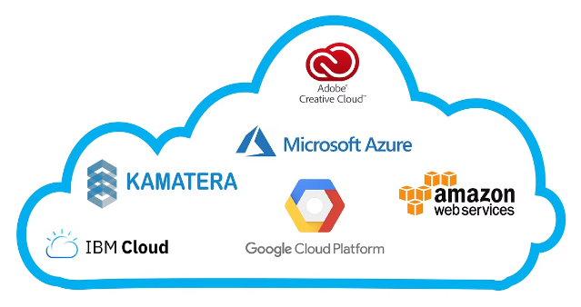
Scalable Web Application Deployment
This presentation outlines the key steps for deploying a scalable web application in the cloud. We will cover the entire lifecycle from problem analysis to testing, ensuring a robust and reliable solution.

Slide 3

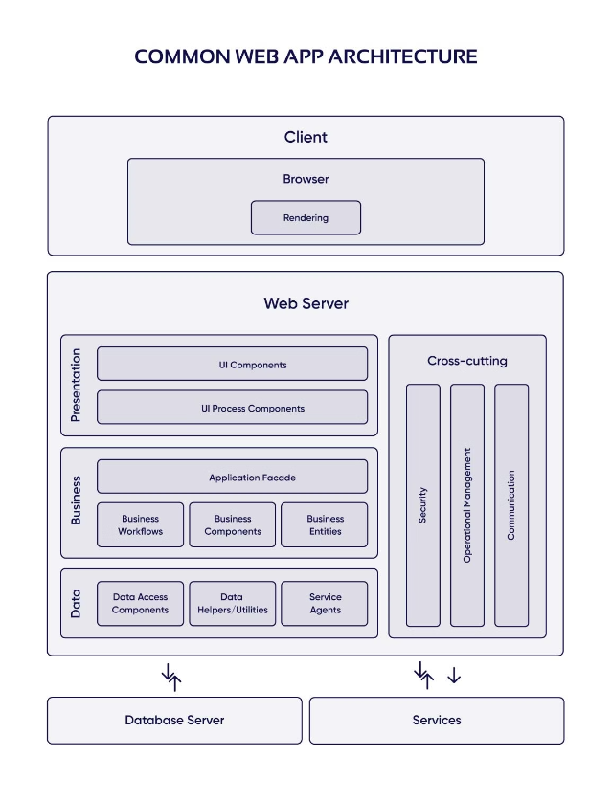
Problem Statement
1
Scalability
The application must be able to handle increasing user traffic and data demands without performance degradation.
2
Availability
The system needs to maintain high uptime and minimal downtime for critical business operations.
3
Cost-Efficiency
Cloud deployment should optimize costs by automatically scaling resources based on demand.

Slide 4
Requirement Analysis
Functional
Non-Functional
Deployment
Identify core user features, APIs, and data processing needs.
Define the different types of users and their interactions with the application.
Determine the number of concurrent users the application should support
Define performance, scalability, security, and reliability requirements.
Define how the system should scale (horizontally, vertically, or both) to accommodate growth.
outline security protocols, including data encryption, user authentication, and authorization.
Outline cloud infrastructure, CI/CD, and monitoring requirements.
Decide on cloud providers and services (e.g., AWS, Azure, GCP) that will be used for hosting, storage, and other functionalities.

Slide 5

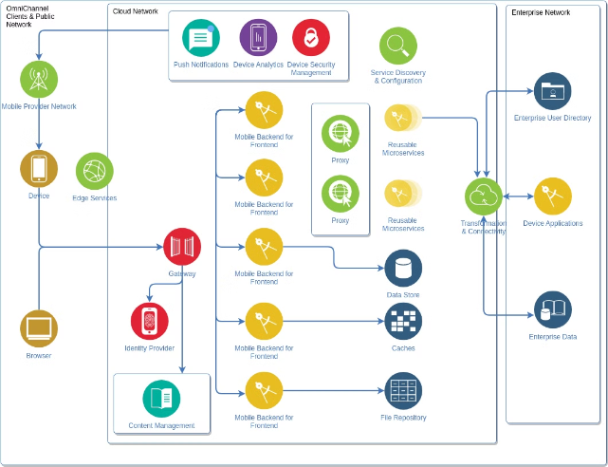
Architecture Design
1
Microservices
Break the application into loosely coupled, independently scalable services.
2
Load Balancing
Distribute traffic across multiple instances for high availability.
3
Caching
Implement in-memory caching to improve response times.

Slide 6
Data Ingestion and Processing
Ingestion
Processing
Storage
Use managed services like Pub/Sub or Kinesis to ingest high-volume data streams.
Data ingestion refers to the process of collecting, importing, and processing data from various sources. For scalable applications, this process needs to be efficient and capable of handling large data volumes in real-time or batch modes.
Leverage serverless functions or stream processing engines to transform and enrich data.
Data Transformation: This involves cleaning, filtering, aggregating, and converting data into the desired format.
Store processed data in scalable, cost-effective cloud storage solutions.
Data Storage: After processing, data needs to be stored in databases, data lakes, or other storage solutions depending on the use case.

Slide 7
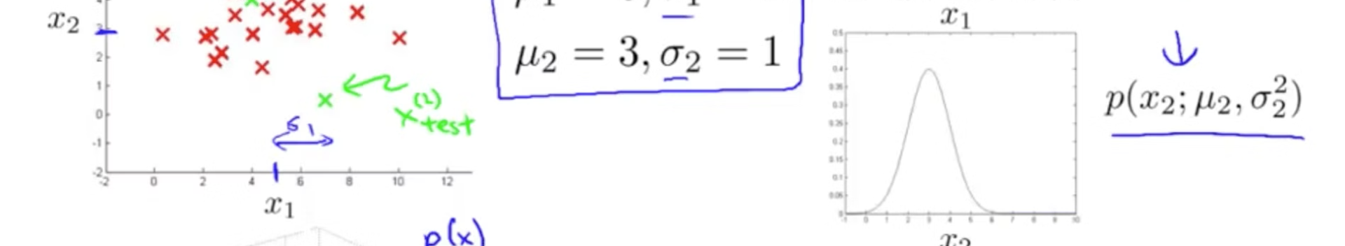
Anomaly Detection
Real-time Monitoring
ML-based Modeling
Monitor key metrics and events to detect anomalies in real-time.
Use machine learning models to identify patterns and outliers in data.
Root Cause Analysis
Automated Remediation
Investigate anomalies to understand the underlying causes and issues.
Trigger automated actions to mitigate the impact of detected anomalies.

Slide 8


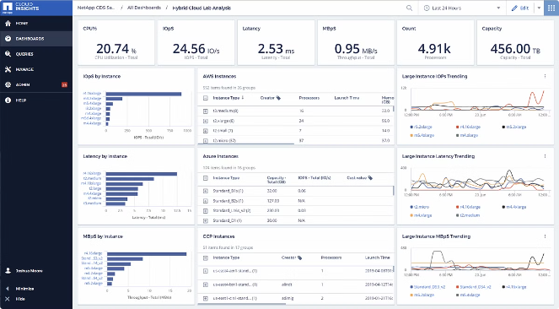



Real-time Monitoring and Alerting
CPU Utilization
Monitor CPU usage across instances to ensure optimal performance.
Memory Usage
Track memory consumption to identify and resolve potential bottlenecks.
Network Throughput
Analyze network traffic and connectivity to maintain high availability.
Error Reporting
Capture and analyze application errors to proactively address issues.

Slide 9


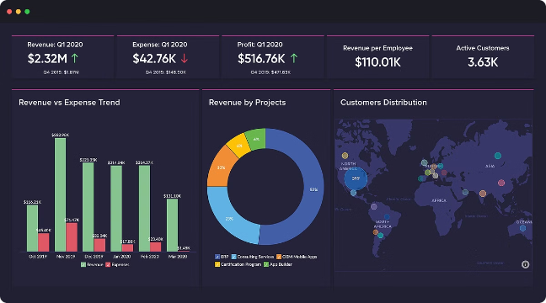


Visualization and Reporting
Metrics Dashboard
Create a centralized dashboard to visualize key performance indicators.
Ad-hoc Reporting
Provide self-service tools for users to generate custom reports.
Anomaly Alerting
Set up automated alerts to notify stakeholders of critical issues.

Slide 10

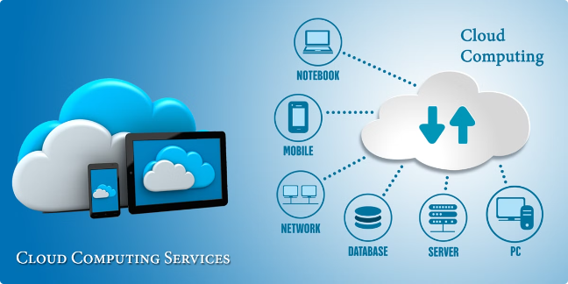
Cloud Integration and Deployment
1
Infrastructure Provisioning
Use Infrastructure as Code (IaC) to automate the creation of cloud resources.
2
Continuous Integration
Implement a CI/CD pipeline to build, test, and deploy application updates.
3
Monitoring and Logging
Integrate with cloud-native monitoring and logging services for observability.

Slide 11

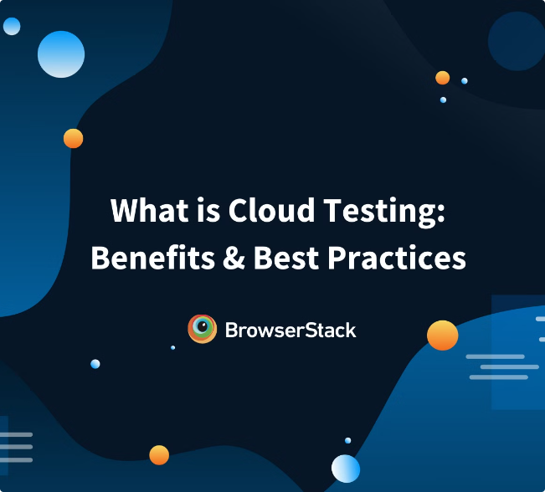
Testing
Unit Tests
Validate individual components and functions.
Integration Tests
Ensure seamless interaction between services.
End-to-End Tests
Verify the entire application workflow from a user's perspective.
Load Tests
Assess the system's performance under high traffic and data loads.
Security Tests
Identify and address potential vulnerabilities in the application.

Slide 12


