Slide 1
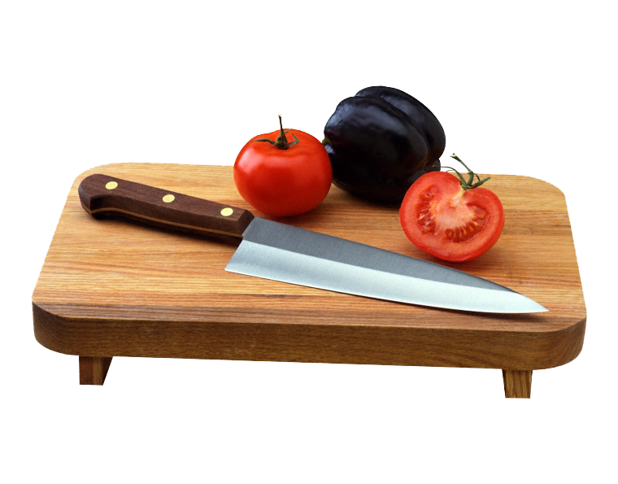
Galanto Inovations
Krishanshu_Wrist
By-
Krishanshu Srivatava

Slide 2
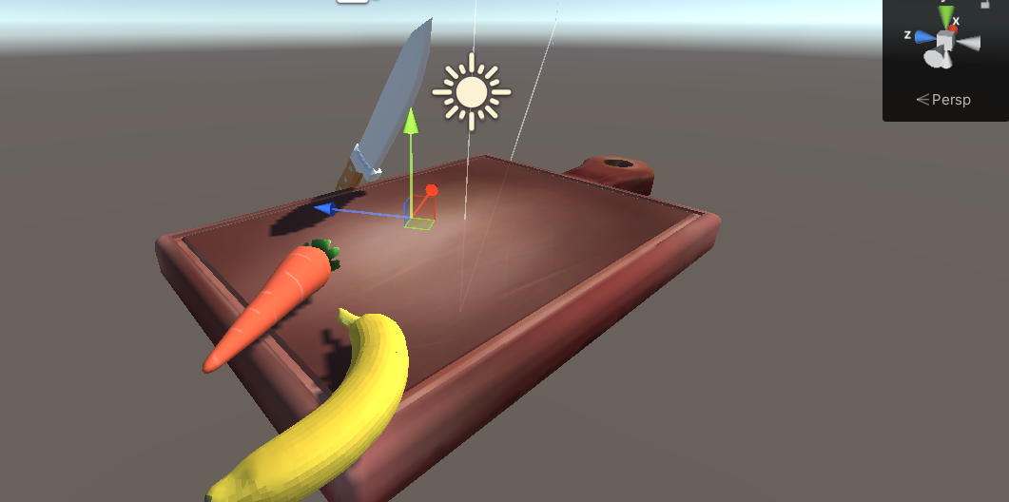
Game Environment
Game is setup with a chopping board, knife, and fruits and vegetables.

Slide 3
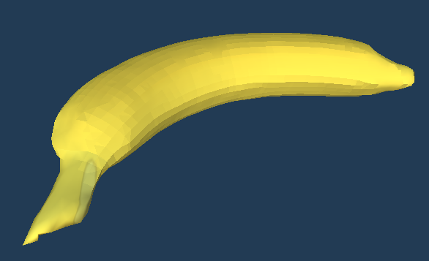
3D Model
3D model of various fruits and vegetables like banana, tomato, potato etc.
Given figure of banana

Slide 4
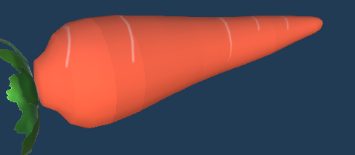
3D Model
3D model of various fruits and vegetables like banana, tomato, potato etc.
Given figure of Carrot

Slide 5
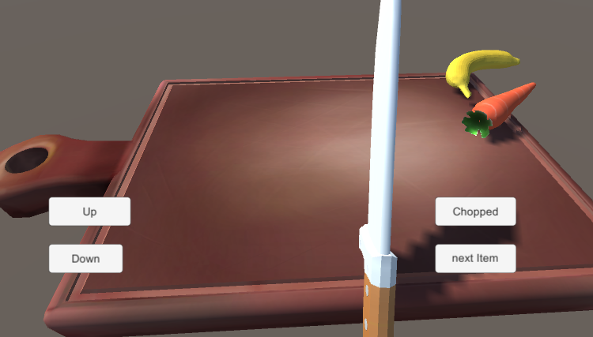
GamePlay
Use Up and Down button to control the knife movement and chop the given fruits and vegetables. Use Next Item to draw the fruit to chopping and after chopping. Click on the chopped button to finish and put it to the chopped place.

Slide 6
Challenges faced while implementing the assignment
There are various challenges that occur while implementing the assignment.
Getting the models.
Deciding the working mechanics.
Shaping and Texturing the models.
Building for Android Purposes

