Slide 1
Submitted By:
Krishant Chauhan
Course:-BCA Sem:-6
Section:-A
University Roll no:-1921085
Submitted To:-
Dr. Chandrakala Arya

Slide 2
What is BlockChain
A Technology that:-
A series of linked blocks.
Cryptographically chains blocks in chronological order.
Sequentially updated but not erased.
Cryptographic hashes assure integrity of data.

Slide 3
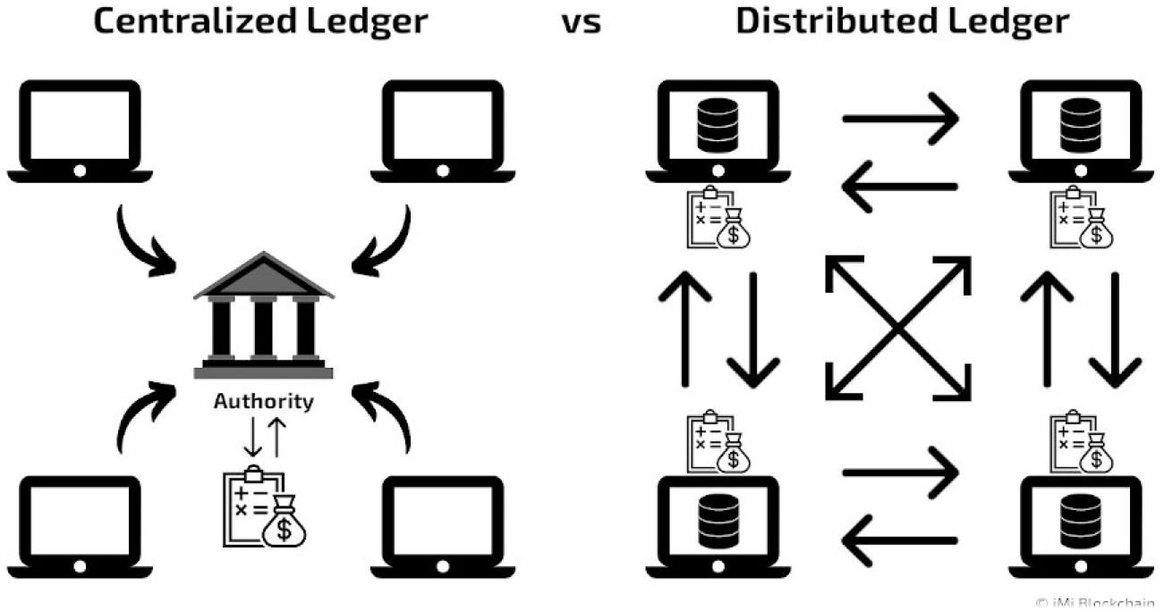
Types of LEDGER?

Slide 4
Types of Blockchain
Public
Private
Hybrid

Slide 5
Public Blockchain
No Central Authority.
Permissionless.
Take long time to Approve Transaction.
Bitcoin take 10 min or more.

Slide 6
Private
Controlled by Single Authority.
Need Permission.
Identified and Trusted.

Slide 7
Uses of Blockchain
In Supply Chain Management.
In Cyber Security.
Blockchain in Voting System.

Slide 8
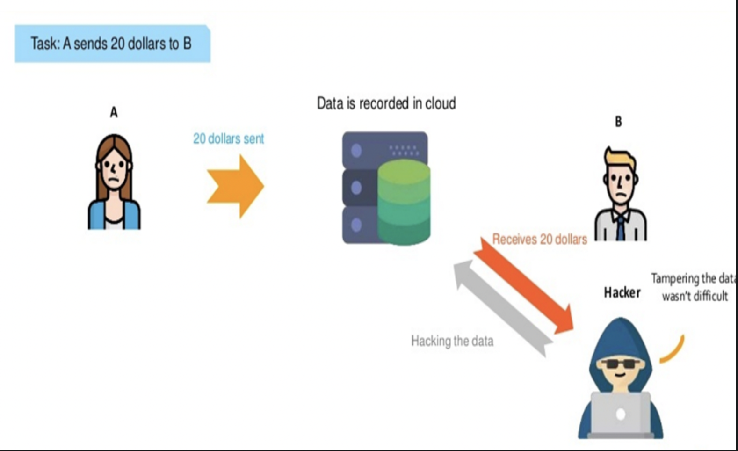
Example:-Without Blockchain
Tempering the data
wasn’t difficult

Slide 9
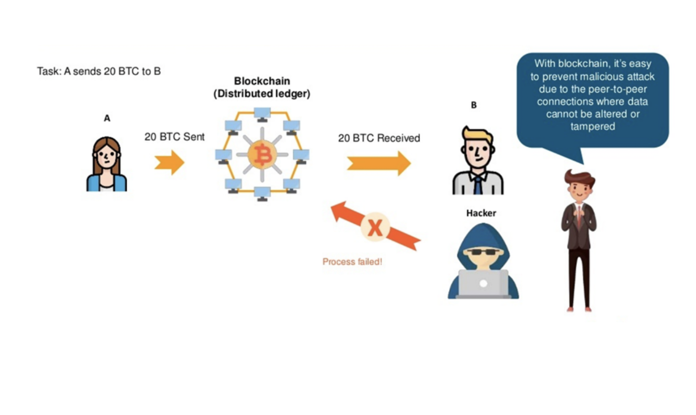
Example:- With Blockchain
Prevent malicious Attack
due to the
Peer-to-Peer
Connections.

Slide 10
BLOCKCHAIN USE IN CRYPTOGRAPHY
Initiation and Broadcasting of Transaction
Digital Signatures
Chaining Blocks
• Hash Function

Slide 11
Advantages of Blockchain
Improved accuracy by removing human involvement in verification.
Cost reductions by eliminating third-party verification
Efficiency and speed
Transactions are secure, private, and efficient
Transparent technology

