Slide 1

MOOCS Seminar
NAME: SAHIL RAWAT
COURSE: BCA (A)
ROLLNO:1921152(51)

Slide 2
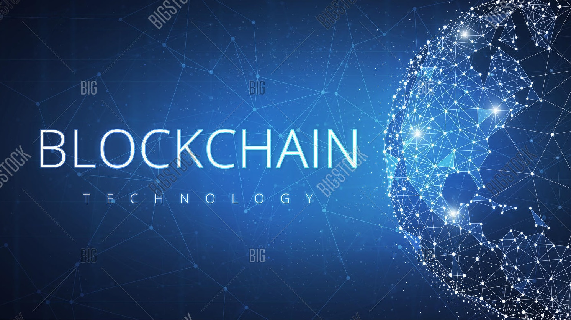

Slide 3
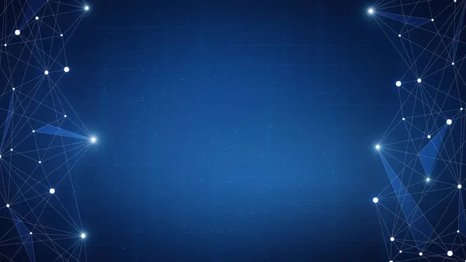
What is A Blockchain?
A blockchain is a constantly growing ledger which keeps a permanent record of all the transactions that have taken place in a secure, chronological, and immutable way.
Let's breakdown the definition,
Ledger: It is a file that is constantly growing.
Permanent: It means once the transaction goes inside a blockchain, you can put up it permanently in the ledger.
Secure: Blockchain placed information in a secure way. It uses very advanced cryptography to make sure that the information is locked inside the blockchain.
Chronological: Chronological means every transaction happens after the previous one.
Immutable: It means as you build all the transaction onto the blockchain, this ledger can never be changed.

Slide 4


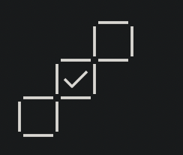
How Does a Blockchain Work?
As each transaction occurs, it is recorded as a “block” of data.
Each block is connected to the ones before and after it.
Transactions are blocked together in an irreversible chain: a blockchain.

Slide 5
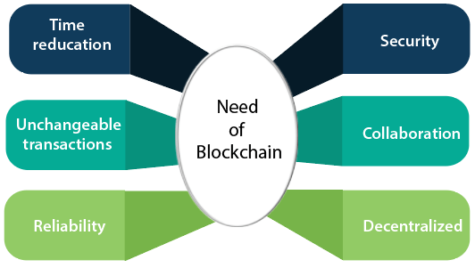
Need Of Blockchain

Slide 6

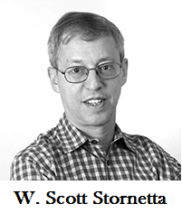
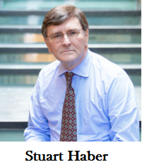
History of Blockchain
The blockchain technology was described in 1991 by the research scientist Stuart Haber and W. Scott Stornetta. They wanted to introduce a computationally practical solution for time-stamping digital documents so that they could not be backdated or tampered. They develop a system using the concept of cryptographically secured chain of blocks to store the time-stamped documents

Slide 7
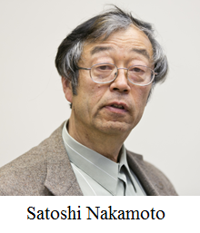
Introduction Of Bitcoin
Satoshi Nakamoto introduced the bitcoin in the year 2008.
In 2008, Satoshi Nakamoto conceptualized the theory of distributed blockchains. He improves the design in a unique way to add blocks to the initial chain without requiring them to be signed by trusted parties. The modified trees would contain a secure history of data exchanges. It utilizes a peer-to-peer network for timestamping and verifying each exchange. It could be managed autonomously without requiring a central authority. These improvements were so beneficial that makes blockchains as the backbone of cryptocurrencies. Today, the design serves as the public ledger for all transactions in the cryptocurrency space.

Slide 8
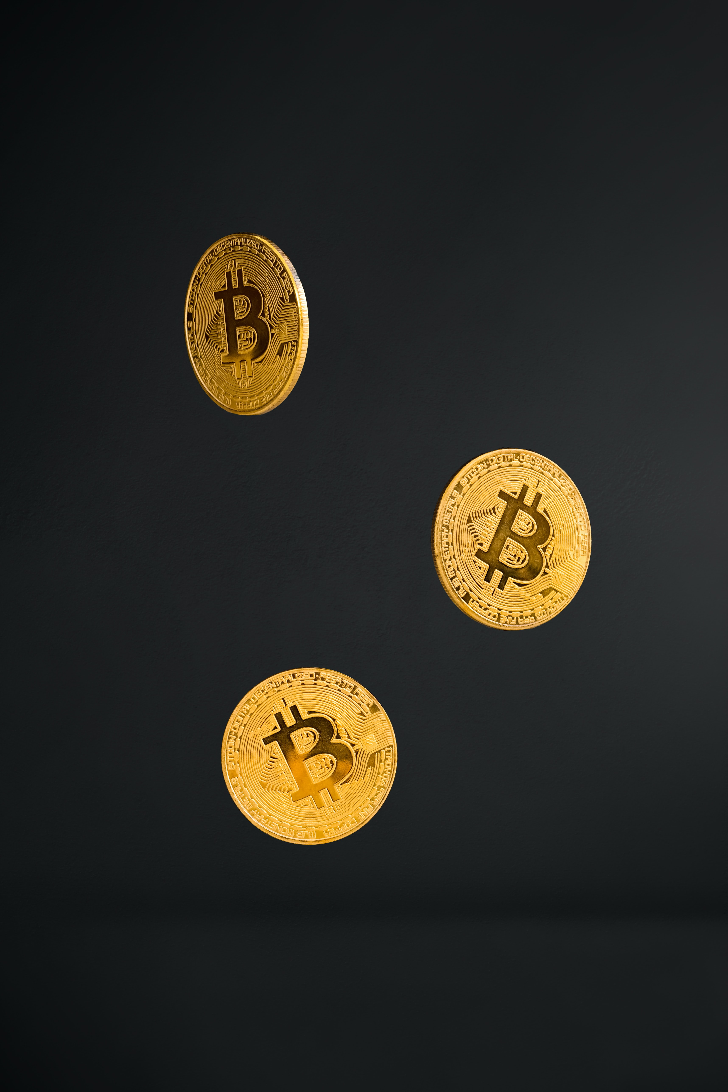
What is Bitcoin?
Bitcoin is a cryptocurrency(virtual currency), or a digital currency that uses rules of cryptography for regulation and generation of units of currency. A Bitcoin fell under the scope of cryptocurrency and became the first and most valuable among them. It is commonly called decentralized digital currency.
A bitcoin is a type of digital assets which can be bought, sold, and transfer between the two parties securely over the internet. Bitcoin can be used to store values much like fine gold, silver, and some other type of investments. We can also use bitcoin to buy products and services as well as make payments and exchange values electronically.
When you send bitcoin to someone or used bitcoin to buy anything, you don?t need to use a bank, a credit card, or any other third-party. Instead, you can simply send bitcoin directly to another party over the internet with securely and almost instantly.

Slide 9
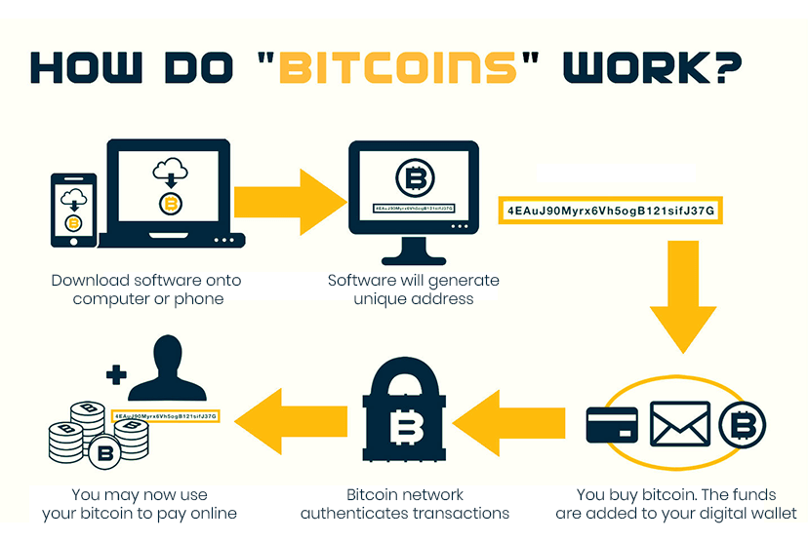

Slide 10
Application Of Blockchain
Banking & Finance
Voting
Healthcare
Media
Big Data
Financial Management and Accounting
Secure Internet of Things networks

Slide 11
Thank You

