Slide 1
Introduction to Java
Programming
SUBMITTED BY :
Name: Sahil Rawat
Course: MCA ‘A’
Sem: 1
ROLLNO:28
SUBMITTED TO:
Ms. Anupriya

Slide 2
Features Of JAVA
Platform Independent
Object-Oriented Programming Language
Simple
Robust
Write Once Run Anywhere
Secure

Slide 3
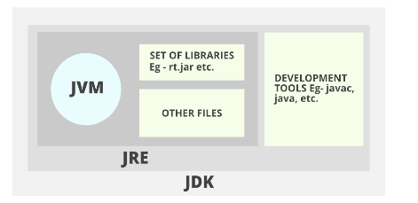
JVM,JRE,JDK

Slide 4
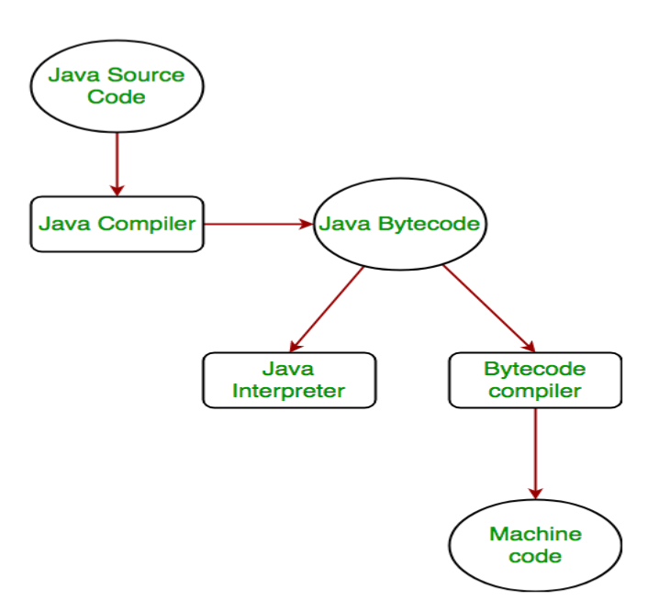
How is Java platform independent?

Slide 5
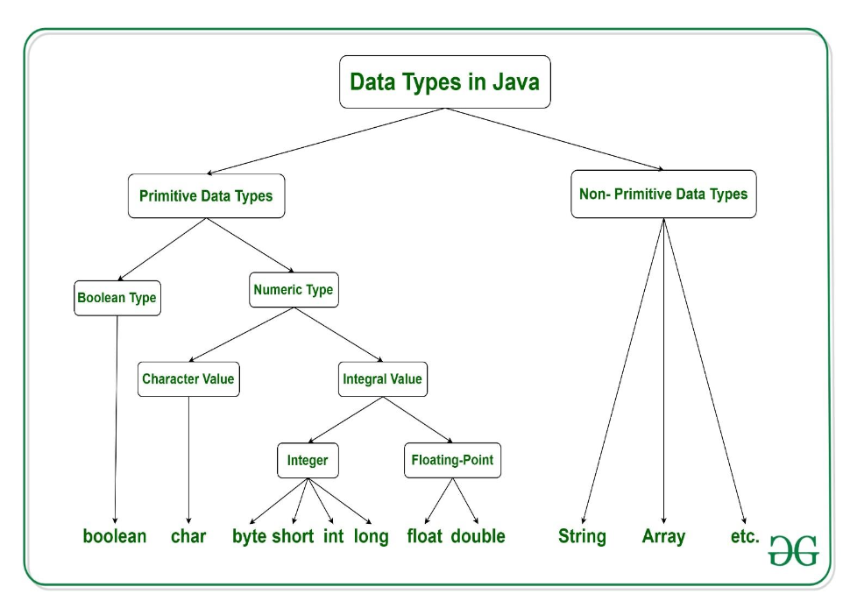
Data Types

Slide 6
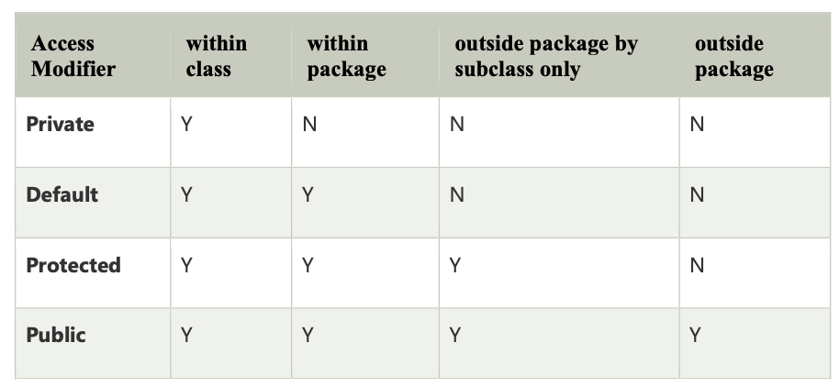
Access modifiers

Slide 7
JAVA OBJECT ORIENTED
Abstraction
Encapsulation
Inheritance
Polymorphism

Slide 8
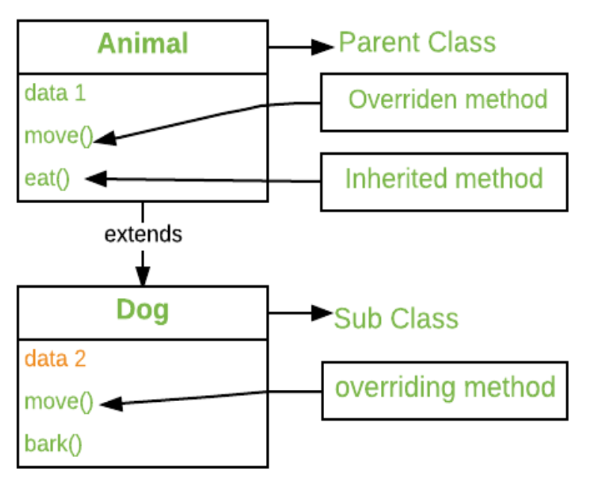
Method Overriding

Slide 9
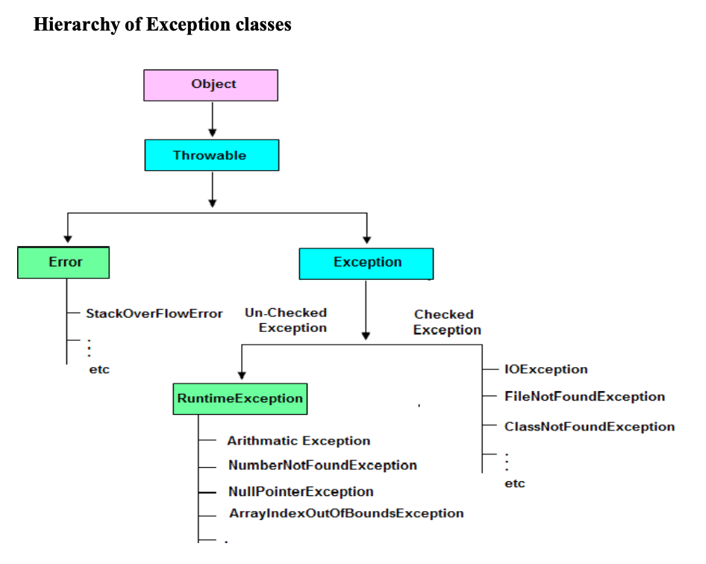
Exception Handling

