Slide 1
UNIT-2
Correlation and Regression

Slide 2
Correlation
Methods of correlation summarize the relationship between two variables in a single number called the correlation coefficient. The correlation coefficient is usually represented using the symbol r, and it ranges from -1 to +1.
A correlation coefficient quite close to 0, but either positive or negative, implies little or no relationship between the two variables. A correlation coefficient close to plus 1 means a positive relationship between the two variables, with increases in one of the variables being associated with increases in the other variable.
A correlation coefficient close to -1 indicates a negative relationship between two variables, with an increase in one of the variables being associated with a decrease in the other variable. A correlation coefficient can be produced for ordinal, interval or ratio level variables, but has little meaning for variables which are measured on a scale which is no more than nominal.

Slide 3
Types of Correlation
The scatter plot explains the correlation between the two attributes or variables. It represents how closely the two variables are connected. There can be three such situations to see the relation between the two variables
Positive Correlation – when the values of the two variables move in the same direction so that an increase/decrease in the value of one variable is followed by an increase/decrease in the value of the other variable.
Negative Correlation – when the values of the two variables move in the opposite direction so that an increase/decrease in the value of one variable is followed by decrease/increase in the value of the other variable.
No Correlation – when there is no linear dependence or no relation between the two variables.

Slide 4
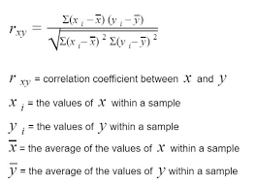
Karl Pearson’s coefficient of correlation

Slide 5
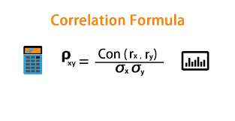

Slide 6
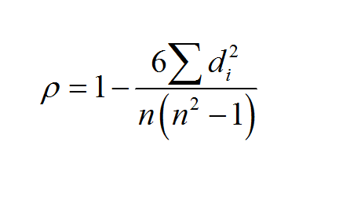
Rank Correlation

Slide 7
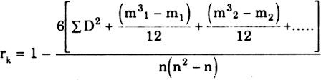
If rank is repeated where m1, m2 are no of ranks which is repeating.

Slide 8
Example:
Compute the rank correlation coefficient for the following data of the marks obtained by 8 students in the Commerce and Mathematics.

Slide 9
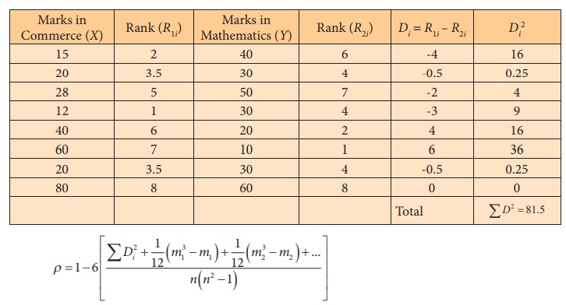

Slide 10
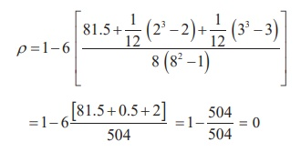
20 is repeated two times corresponding to ranks 3 and 4. Therefore, 3.5 is assigned for rank 2 and 3 with m1=2.
In Mathematics (Y), 30 is repeated three times corresponding to ranks 3, 4 and 5. Therefore, 4 is assigned for ranks 3,4 and 5 with m2=3.
Therefore,

Slide 11
Regression Analysis
A regression line is an estimate of the line that describes the true, but unknown, linear relationship between the two variables. The equation of the regression line is used to predict (or estimate) the value of the response variable from a given value of the explanatory variable.
OR
A regression line is a line which is used to describe the behavior of a set of data. In other words, it gives the best trend of the given data.

Slide 12
Where linear regression is used?
Regression lines are used in the financial sector and in business. Various financial analyst employs linear regressions to forecast stock prices, commodity prices and to perform valuations for many different securities. Various companies employ linear regressions for the purpose of forecasting sales, inventories, and many other variables.

Slide 13

Calculate the regression coefficient and obtain the lines of regression for the following data

Slide 14
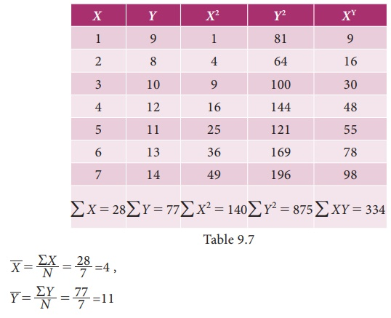

Slide 15
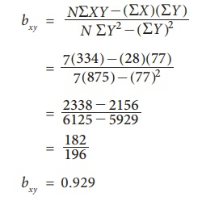
Regression coefficient of X on Y

Slide 16
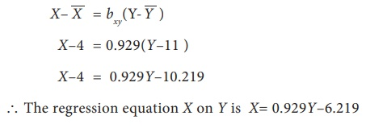
(i) Regression equation of X on Y

Slide 17
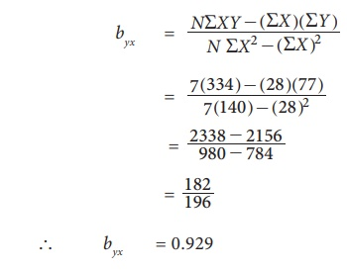
(ii) Regression coefficient of Y on X

Slide 18
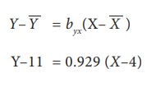
iii) Regression equation of Y on X
Y = 0.929X–3.716+11
= 0.929X+7.284
The regression equation of Y on X is Y= 0.929X + 7.284

Slide 19

relation formula between correlation and regression coefficient
r= +-$\sqrt{bxy∗byx}$
We can calculate correlation from regression coefficient.

Slide 20
