Slide 1
What is Java Script?
Java script is a client-side scripting language.
A scripting language is a light weight programming language.
Java script is programming code that can be inserted into HTML pages.
Java script inserted into HTML pages, can be executed by all modern web browsers.
Java script can enhance the dynamics and interactive features of your page by allowing you to perform calculations, check forms, write interactive games, add special effects, create security passwords and many more.

Slide 2
Inserting Java Script
There are three common ways of inserting javascript code in a web page:
Inside an HTML tag script
In an external file
As a value of some HTML attribute

Slide 3
JavaScript in a tag Script
Inside an HTML tag script:
<script type=“text/javascript”>
alert(“Java Script is working in your browser”);
</script>

Slide 4
JavaScript in an external file
Inside an external .js file, linked to the HTML page:
<script type=“text/javascript” src=“path/to/file.js”> </script>
The external .js file will include just the javascript code, not HTML.

Slide 5
JavaScript as a value of some HTML attribute
<a href=“javascript:alert(‘java script is working in your browser’);”>link</a>

Slide 6
Writing text using JavaScript
<html>
<body>
<script type="text/javascript">
document.write("Hello World!");
</script>
</body>
</html>

Slide 7
Hello World!

Slide 8
Formatting text…
<html>
<body>
<script type="text/javascript">
document.write("<b>Hello World!</b>")
</script>
</body>
</html>

Slide 9
Output…
Hello World!

Slide 10
Case Sensitivity
Java Script is a case sensitive language, which mean that the name of keywords and other language identifiers must always be typed with the correct capitalization.

Slide 11
Comments
Java Script has two ways of inserting comments:
// single line comment
/* Multiple line comments
Multiple line comments
*/

Slide 12
Displaying some text on web page
You can write on page by using the following statement of Java Script:
document.write(“message”)
document.writeln(“message”)

Slide 13
Java Script Display Possibilities
Java Script does NOT have any built-in print or display function.
Java Script can display data in different ways:
Writing into an alert box, using window.alert().
Writing into the HTML output
Using document.write()
Writing into an HTML element
Using innerHTML
Writing into browser console
using console.log()

Slide 14
VARIABLES
A variable is a “named storage” for data. The value stored can be change in the program.
Variable Declaration can be done as follows:
use the let keyword
use var keyword
use const keyword
use nothing

Slide 15
VARIABLES
The var keyword is used in all JavaScript code from 1995 to 2015.
The let and const keywords were added to JavaScript in 2015.

Slide 16
Initialize variables
let radius=5;
or
var radius=5;
or
radius =5;
or
const radius =5;

Slide 17
Identifiers
Identifier – Set of characters that comprise the variable’s name.
Rules :
Begin with a letter
Comprise of sequence of letters, numbers, _, special characters depending on the language
Case sensitive
Eg. NAME, name, a, A, cs_170

Slide 18
Operators in JS
Arithmetic Operators
Assignment Operators
Comparison Operators
Logical Operators
Conditional Operators
Type Operators

Slide 19
Arithmetic Operators are used to perform arithmetic on numbers.
Example
let a = 4; let x = (500 + 50) * a;
Assignment operators assign values to JavaScript variables.
Example
let x = 5; x += 10;

Slide 20
The + operator can also be used to add/concatenate strings.
let text1 = "John"; let text2 = “Joe"; let text3 = text1 + " " + text2;
Adding Strings and Numbers
Adding two numbers, will return the sum, but adding a number and a string will return a string.
Example:
let x = 5 + 5; let y = "5" + 5; let z = "Hello" + 5;

Slide 21
Logical Operators
&& - logical AND
|| - logical OR
! – logical NOT
Type Operators
typeof - return the type of a variable
Eg:
typeof "John" // Returns "string"

Slide 22
Data Types in JS
Numbers
Strings
Boolean
Objects
Undefined
null

Slide 23
Numbers
Numbers can be written with, or without decimals.
Eg:
let x1 = 34.00; let x2 = 34;
let y = 185e5; // 18500000
Booleans
-true or false.
Eg:
let x = 15; let y = 15; let z = 6; (x == y) // Returns true (x == z) // Returns false

Slide 24
Undefined: A variable that has not been assigned a value is of type undefined.
Eg:
let name;
console.log(name)
String:
String is used to store text.
Single quotes: 'Hello'
Double quotes: "Hello"
Backticks: `Hello`

Slide 25
String Example:
const name1=“RAM”
const name2=“SHYAM”
const result= `The names are ${name1} and ${name2}`;
Single quotes and double quotes are practically the same and you can use either of them.
Backticks are generally used when you need to include variables or expressions into a string.

Slide 26
null:
Const abc = null;
The code above suggests that the abc variable is empty.

Slide 27
Object Data Type
An object is a complex data type that allows us to store collections of data.
Example:
const student = { firstName: ‘Joe', lastName: null, class: 10 };

Slide 28
JavaScript Output
innerHTML : Write into an HTML element.
To access an HTML element, JavaScript can use document.getElementById(id) method.
The id attribute defines the HTML element. The innerHTML property defines the HTML content.

Slide 29
<html>
<body>
<h2>Hi, this is my first JavaScript program</h2>
<p>First Paragraph</p>
<p id="demo"></p>
<script>
document.getElementById("demo").innerHTML = 8 + 6;
</script>
</body>
</html>

Slide 30
2. document.write()
The document.write() function is commonly used when testing simple web applications.
Example:
<!DOCTYPE html>
<html>
<body>
<h2>Hi, my javascript program </h2>
<p>My first program</p>
<script>
document.write(5 + 6);
</script>
</body>
</html>

Slide 31
3. window.alert()
use an alert box to display data
window keyword is optional
<!DOCTYPE html>
<html>
<body>
<h2>Hi, my javascript program </h2>
<p>My first program</p>
<script>
window.alert(10+10);
</script>
</body>
</html>

Slide 32
4. console.log()
For debugging purposes, you can call the console.log() method in the browser to display data.
<!DOCTYPE html>
<html>
<body>
<h2>Hi, my javascript program </h2>
<p>My first program</p>
<script>
console.log(5 + 6);
</script>
</body>
</html>

Slide 33
Functions in Java Script
A JavaScript function is defined with the function keyword, followed by a name, followed by parentheses ().
Function names can contain letters, digits, underscores, and dollar signs.
Syntax:
function name(parameter1, parameter2, parameter3) { // code to be executed }

Slide 34
Example:
let x = add(4, 3);
function add(a, b) {
return a + b;
}

Slide 35
Array
JavaScript array is an object that represents a collection of similar type of elements.
Three ways to construct array in JavaScript
By array literal
By creating instance of Array directly (using new keyword)
By using an Array constructor (using new keyword)

Slide 36
By array literal
var arrayname=[value1,value2.....valueN];
JavaScript Array directly (new keyword)
var arrayname=new Array();
JavaScript array constructor
Here, you need to create instance of array by passing arguments in constructor so that we don't have to provide value explicitly.

Slide 37
Array with Methods
Array to String Conversion:
<!DOCTYPE html>
<html>
<body>
<h2>JavaScript Array Methods</h2>
<h2>toString()</h2>
<p>The toString() method returns an array as a comma separated string:</p>
<p id="demo"></p>
<script>
const fruits = ["Banana", "Orange", "Apple", "Mango"];
document.getElementById("demo").innerHTML = fruits.toString();
</script>
</body>
</html>

Slide 38
join() method
- joins all array elements into a string.
const fruits = ["Banana", "Orange", "Apple", "Mango"]; document.getElementById("demo").innerHTML = fruits.join(" / ");
Output:
Banana / Orange / Apple / Mango

Slide 39
Array pop()
The pop() method returns the value that was "popped out“
Array push()
The push() method adds a new element to an array (at the end)
Array shift()
The shift() method removes the first array element and "shifts" all other elements to a lower index.
Array unshift()
The unshift() method adds a new element to an array (at the beginning), and "unshifts" older elements

Slide 40
Merging (Concatenating) Arrays
-The concat() method creates a new array by merging (concatenating) existing arrays.
-The concat() method does not change the existing arrays. It always returns a new array.
Array splice()
The splice() method can be used to add new items to an array.
const fruits = ["Banana", "Orange", "Apple", "Mango"]; fruits.splice(2, 0, "Lemon", "Kiwi");
The first parameter (2) defines the position where new elements should be added (spliced in).
The second parameter (0) defines how many elements should be removed.

Slide 41
Array slice()
The slice() method slices out a piece of an array into a new array.

Slide 42
DOM
The Document Object Model (DOM) is an application programming interface (API) for manipulating HTML documents.
The DOM represents an HTML document as a tree of nodes. The DOM provides functions that allow you to add, remove, and modify parts of the document effectively.

Slide 43
The DOM represents an HTML document as a hierarchy of nodes.
Consider the following HTML document:
<html>
<head>
<title>JavaScript DOM</title>
</head>
<body>
<p>Hello DOM!</p>
</body>
</html>

Slide 44
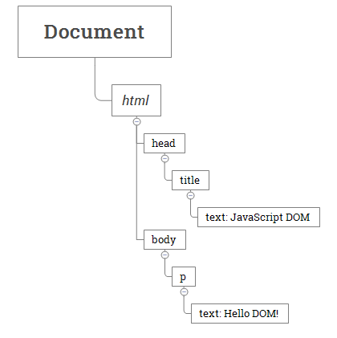

Slide 45
In this DOM tree, the document is the root node. The root node has one child node which is the <html> element. The <html> element is called the document element.

Slide 46
The HTML DOM is a standard for how to get, change, add, or delete HTML elements.
DOM Defines:
The HTML elements as objects
The properties of all HTML elements
The methods to access all HTML elements
The events for all HTML elements

Slide 47
In the DOM, all HTML elements are defined as objects.
A property is a value that you can get or set (like changing the content of an HTML element).
A method is an action you can do (like add or deleting an HTML element).

Slide 48
<html> <body> <p id="demo"></p> <script> document.getElementById("demo").innerHTML = "Hello World!"; </script> </body> </html>
Here, getElementById is a method, while innerHTML is a property.

Slide 49
The innerHTML property can be used to get or change any HTML element, including <html> and <body>.

Slide 50
Selecting elements
getElementById() – select an element by id.
getElementsByName() – select elements by name.
getElementsByTagName() – select elements by a tag name.
getElementsByClassName() – select elements by one or more class names.
querySelector() – select elements by CSS selectors.

Slide 51
<html>
<head>
<title>JavaScript getElementById() Method</title>
</head>
<body>
<p id="message">A paragraph</p>
const p = document.getElementById('message'); console.log(p);
</body>
</html>

Slide 52
Output:
<p id="message">A paragraph</p>

Slide 53
Manipulating elements
createElement() – create a new element.
appendChild() – append a node to a list of child nodes of a specified parent node.
textContent – get and set the text content of a node.
innerHTML – get and set the HTML content of an element.
DocumentFragment – learn how to compose DOM nodes and insert them into the active DOM tree.
after() – insert a node after an element.
append() – insert a node after the last child node of a parent node.
prepend() – insert a node before the first child node of a parent node.
insertAdjacentHTML() – parse a text as HTML and insert the resulting nodes into the document at a specified position.
replaceChild() – replace a child element by a new element.
cloneNode() – clone an element and all of its descendants.
removeChild() – remove child elements of a node.
insertBefore() – insert a new node before an existing node as a child node of a specified parent node.
insertAfter() helper function – insert a new node after an existing node as a child node of a specified parent node.

Slide 54
Working with Attributes
HTML Attributes & DOM Object’s Properties – understand the relationship between HTML attributes & DOM object’s properties.
setAttribute() – set the value of a specified attribute on a element.
getAttribute() – get the value of an attribute on an element.
removeAttribute() – remove an attribute from a specified element.
hasAttribute() – check if an element has a specified attribute or not.

Slide 55
Event Handling
HTML events are "things" that happen to HTML elements.
When JavaScript is used in HTML pages, JavaScript can "react" on these events.
Event handlers typically have names that begin with on, for example, the event handler for the click event is onclick
Example:
<input type="button" value="Save" onclick="alert('Clicked!')">

Slide 56
<!DOCTYPE html>
<html>
<body>
<button onclick="document.getElementById('demo').innerHTML=Date()">The time is?</button>
<p id="demo"></p>
</body>
</html>

Slide 57
Some common HTML events
onchange
onclick
onmouseover
Onmouseout
onkeydown
onload

Slide 58
Validation on Forms
Form validation is a “technical process where a web-form checks if the information provided by a user is correct.”

Slide 59
Form validation types:
After submit validation
Inline validation

Slide 60
DOM Traversal
The Document Object Model, or DOM for short, is a tree-like representation of an HTML document. It provides an API that allows you, as the web developer, to interact with a website using JavaScript.
DOM traversal (also called walking or navigating the DOM) is the act of selecting nodes in the DOM tree from other nodes.

Slide 61
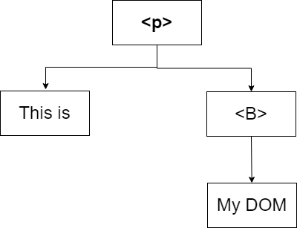
<p> This is <B> My DOM </B> </p>

Slide 62
DOM tree can be accessed in the following manner:
Downwards: searching for an element starting with a top-most node (like the document node) and moving downwards.
Upwards: move from an inner element up the tree, searching for an outer element.
Sideways: search for an element from another element at the same level (meaning the two elements are siblings) in the document tree.

Slide 63
Traversing downwards
There are two methods to traverse downwards:
querySelector or querySelectorAll
children

Slide 64
children
<ul class="list">
<li><a href="#">Link 1</a></li>
<li><a href="#">Link 2</a></li>
<li><a href="#">Link 3</a></li>
<li><a href="#">Link 4</a></li>
<li><a href="#">Link 5</a></li>
</ul>
const list = document.querySelector('.list')
const listItems = list.children
console.log(listItems)

Slide 65
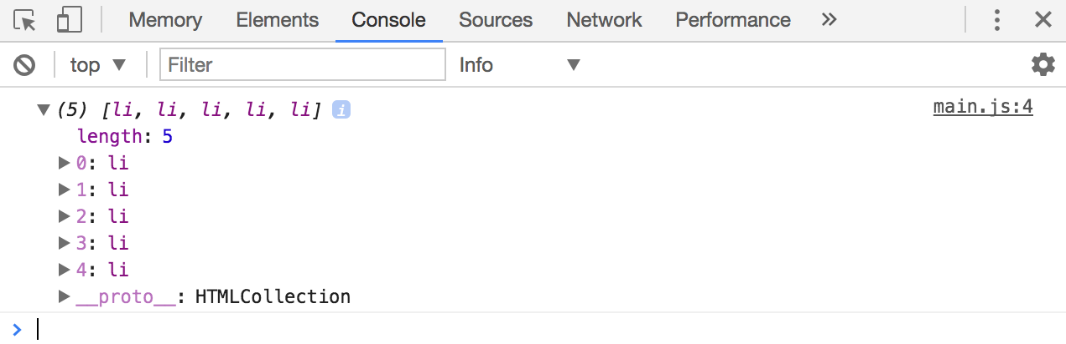

Slide 66
Selecting a specific child
<ul class="list">
<li><a href="#">Link 1</a></li>
<li><a href="#">Link 2</a></li>
<li><a href="#">Link 3</a></li>
<li><a href="#">Link 4</a></li>
<li><a href="#">Link 5</a></li>
</ul>
const listItems = document.querySelectorAll('li')
const firstItem = listItems[0]
const secondItem = listItems[1]
const thirdItem = listItems[2]
const fourthItem = listItems[3]
const fifthItem = listItems[4]
console.log(firstItem)
console.log(secondItem)
console.log(thirdItem)
console.log(fourthItem)
console.log(fifthItem)

Slide 67
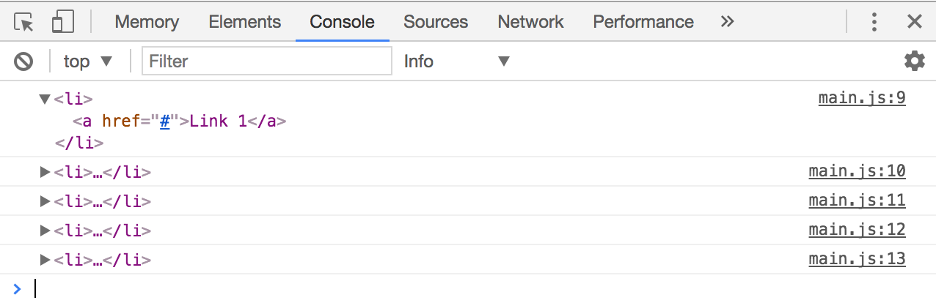

Slide 68
Traversing upwards
There are two methods to traverse upwards:
parentElement
closest

Slide 69
<ul class="list">
<li><a href="#">Link 1</a></li>
<li><a href="#">Link 2</a></li>
<li><a href="#">Link 3</a></li>
<li><a href="#">Link 4</a></li>
<li><a href="#">Link 5</a></li>
</ul>
const firstListItem = document.querySelector('li')
const list = firstListItem.parentElement
console.log(list)
// <ul class="list">...</ul>

Slide 70
Traversing sideways
There are three methods to traverse sideways:
nextElementSibling
previousElementSibling
Combining parentElement, children, and index

Slide 71
You can select next element with nextElementSibling
<ul class="list">
<li><a href="#">Link 1</a></li>
<li><a href="#">Link 2</a></li>
<li><a href="#">Link 3</a></li>
<li><a href="#">Link 4</a></li>
<li><a href="#">Link 5</a></li>
</ul>
const firstListItem = document.querySelector('li')
const secondListItem = firstListItem.nextElementSibling
console.log(secondListItem)
// <li><a href="#">Link 2</a></li>

Slide 72
You can select next element with previousElementSibling
<ul class="list">
<li><a href="#">Link 1</a></li>
<li><a href="#">Link 2</a></li>
<li><a href="#">Link 3</a></li>
<li><a href="#">Link 4</a></li>
<li><a href="#">Link 5</a></li>
</ul>
const secondListItem = document.querySelectorAll('li')[1]
const firstListItem = secondListItem.previousElementSibling
console.log(firstListItem)
// <li><a href="#">Link 1</a></li>

Slide 73
DOM 2 Event Model
One of the drawbacks of Basic Event Model is, you can register only one handler. If you want to register multiple event handlers, it doesn't work to do the following:
window.onload = function() { // handler1 }; window.onload = function() { // handler2 };
In the above example, window.onload will refer to the second function and the first one will be discarded.

Slide 74
DOM Level 2 Event Model allows us to register two or more event handlers.
DOM Level 2 Event Model uses the addEventListener function to add multiple event handlers.

Slide 75
<html>
<head>
<meta content="text/html; charset=UTF-8" http-equiv="content-type">
<script type="text/javascript">
window.addEventListener('load', function() {
function handler() {
document.getElementById('console').innerHTML
= 'Who\'s clicked: ' + this.id;
}
document.getElementById('btn1')
.addEventListener('click', handler);
document.getElementById('btn2')
.addEventListener('click', handler);
}, false);
</script>
</head>
<body>
<button id="btn1">Button 1</button><br>
<button id="btn2">Button 2</button><br>
<div id="console"></div>
</body>
</html>

Slide 76
Errors
There are three types of errors in programming:
Syntax Errors
Runtime Errors
Logical Errors.

Slide 77
Exception Handling in JavaScript
An exception is the anomalous code that breaks the normal flow of the code.
For example, the Division of a non-zero value with zero will result into infinity always, and it is an exception. Thus, with the help of exception handling, it can be executed and handled.

Slide 78
Exception Handling Statements
There are following statements that handle if any exception occurs:
throw statements
try…catch statements
try…catch…finally statements.

Slide 79
<html>
<head> Exception Handling</br></head>
<body>
<script>
try{
var a= ["34","32","5","31","24","44","67"];
document.write(a);
document.write(b);
}
catch(e)
{
alert("There is error which shows "+e.message);
}
finally
{
document.write("The size of array is 7");
}
</script>
</body>
</html>

Slide 80
Throw Statement
A throw statement is used to raise an exception. It means when an abnormal condition occurs, an exception is thrown using throw.
The thrown exception is handled by wrapping the code into the try…catch block. If an error is present, the catch block will execute, else only the try block statements will get executed.

Slide 81
Throw Statement
Throw statements are used for throwing user-defined errors.
User can define and throw their own custom errors. When throw statement is executed, the statements present after it will not execute. The control will directly pass to the catch block.

Slide 82
try{
throw exception; // user can define their own exception
}
catch(error){
expression; } // code for handling exception

Slide 83
_{<!DOCTYPE html>}
_{<html>}
_{<body>}
_{<h1>JavaScript Statements</h1>}
_{<h2>The throw Statement</h2>}
<p>Please input a number between 5 and 10:</p>
_{<input id="demo" type="text">}
<button type="button" onclick="myFunction()">Test Input</button>
_{<p id="message"></p>}
_{<script>}
_{function myFunction() {}
const message = document.getElementById("message");
_{message.innerHTML = "";}
let x = document.getElementById("demo").value;
_{try {}
_{if(x == "") throw "is Empty";}
if(isNaN(x)) throw "not a number";
_{if(x > 10) throw "too high";}
_{if(x < 5) throw "too low";}
}
_{catch(err) {}
message.innerHTML = "Input " + err;
}
}
_{</script>}
_{</body>}
_{</html>}

