Slide 1



Getting started with Microservices
Safely delivering to production with speed
Notes:
Resting slide on screen before you begin presenting.

Slide 2
Agenda
The Monolith
Domain Driven Design
Cloud Native

Slide 3
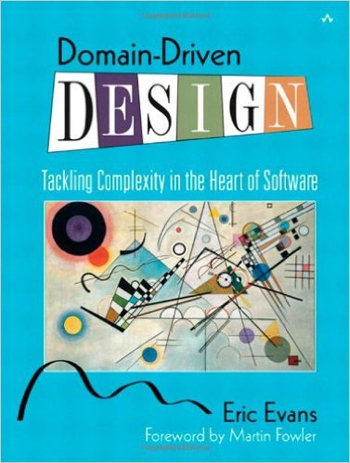
Domain Driven Design
An approach for designing software system that model the complexity of the real world
Kicked off in 2004 by Eric Evans
A practical microservice design methodology
Notes:
well, in a time when SOA was all the rage...

Slide 4
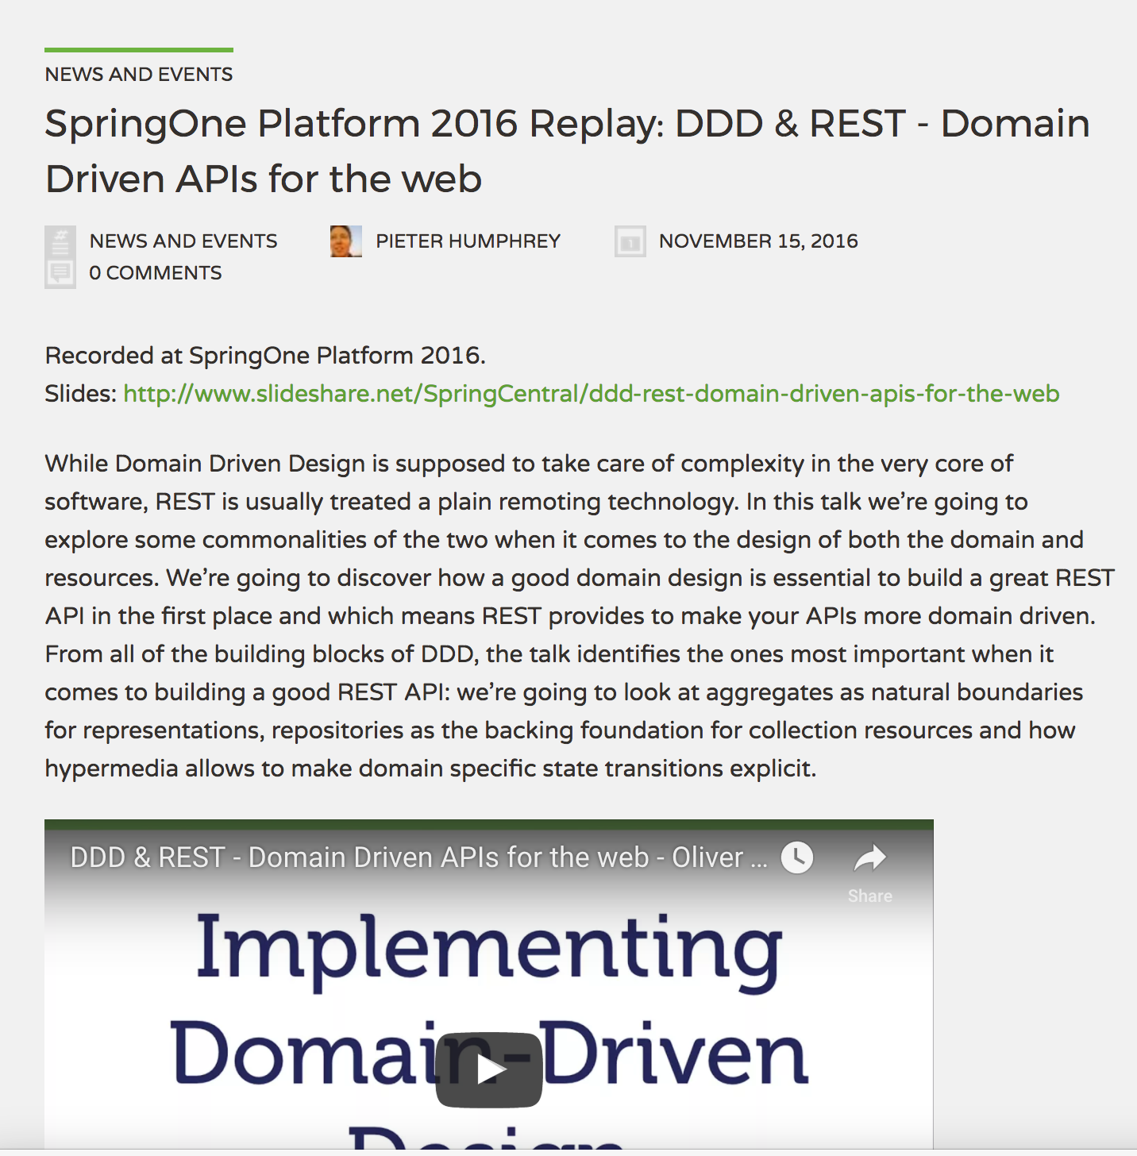
Spring & DD API’s
https://spring.io/blog/2016/11/15/springone-platform-2016-replay-ddd-rest-domain-driven-apis-for-the-web

Slide 5

The Monolith
Forces
Solution
Resulting Context
Notes:
Forces
Team of developers working on a project
New team members must be productive
Application must be easy to understand and modify
Scale up - scalability, availability and resiliency
Solution
Multi-module packaged in single WAR or even EAR
Single directory hierarchy
N-Tier Architecture
Layered Architecture
Resulting context
Complexity becomes the enemy
Overloaded web container
Continuous delivery becomes burdensome
Scale out
Technical debt
Domain specificity

Slide 6
“Anyone who has never made a mistake has never tried anything new.”
- Albert Einstein
Notes:
The object here is if you fail then fail fast
What is the methodology for designing a microservice?
How to break up a monolith?
What are the design patterns?

Slide 7

Domain Driven Design
Cloud Native Design
Notes:
Rise of the Jedi is the focus here, design patterns and architecture to move us away from the dark side

Slide 8
Cloud Native Design
Evaluate components for 12-factor compliance
Evaluate components and architecture for Cloud Native Design

Slide 9
Cloud Native Design
Evaluate components for 12-factor compliance
Evaluate components and architecture for Cloud Native Design
Standalone services
Common services

Slide 10
Evaluate for 12-Factor Compliance
no file based access to resources
run code on demand
coordinate cross service configurations
route public requests
read and write persistent data
add and remove resources
record internal and external events
isolate resources and failures
measure performance and health
detect and determine failure (plan & provoke failure)
recover failures
work tomorrow

Slide 11
Evaluate for the Cloud
Cloud Native
Micro-service architecture and principles
API first design
Design for failure
Apps are unaffected by dependent service failure
Proactive testing for failure
Metrics and monitoring baked in
Cloud agnostic runtime implementation
Cloud Resilient
Cloud Friendly
Twelve factor applications
Horizontally scalable
Leverage platform for HA
Cloud Ready
No file-system requirements or uses S3 API
Self-contained application
Platform managed ports and addressing
Consume off platform services using platform semantics

Slide 12
Let’s talk about SpringTrader

Slide 13
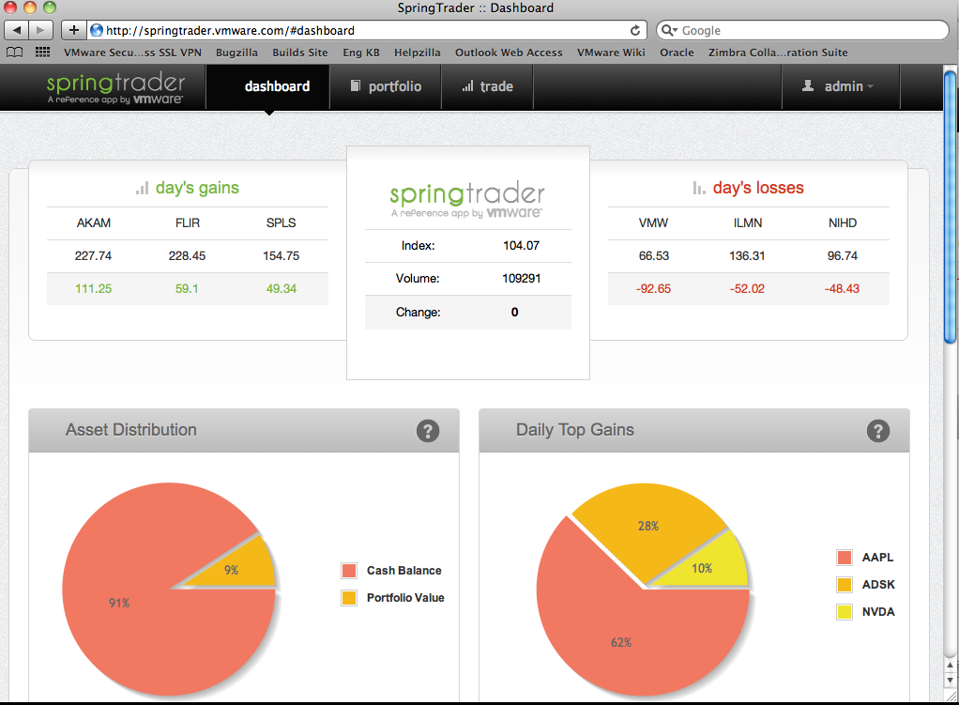

Slide 14
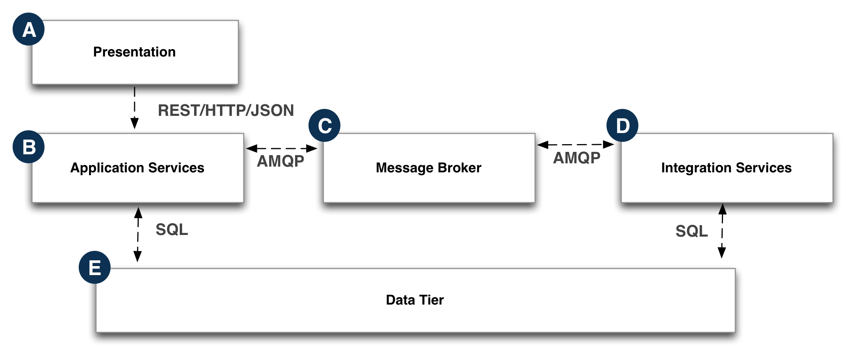

Slide 15
Use Case
if securities are subjected to randomized changes, as if by market forces – wouldn’t it be better to make use of real-time data?

Slide 16
Goals
Replace the existing simulated Quote data with real-time data
Minimize changes to existing code base
Make sure we have a working system when refactoring occurs

Slide 17
Introduce Microservice
Locate the code
Identify a service interface
Use the proxy pattern
Create an implementation of the interface
Point the monolith to the new service
Notes:
Locate the code that represents the functionality that will be refactored
Identify a service interface that will be the “go-to” for the rest of the monolith
Use the proxy pattern and modify existing code so that it exclusively funnels through this service interface
Create an implementation for the monolith to talk to our new microservice, and provide code to bridge any “impedance mismatch”
Point the monolith to the new service via the new implementation

Slide 18
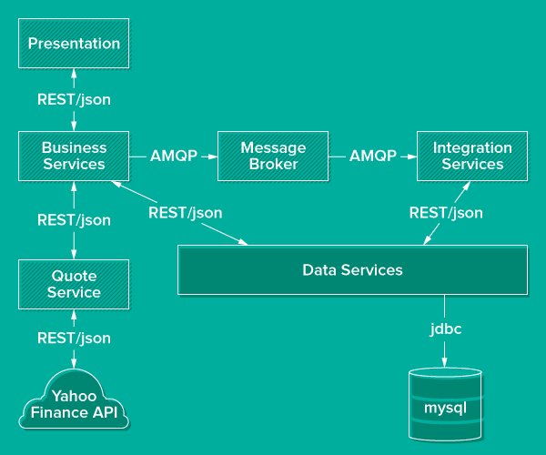

Slide 19
Service Availability
Provide a way to handle failures in remote services
Provide a way to locate and manage loosely coupled services
Make changes while minimizing changes to existing codebase
Make sure there is a working system, are there test to validate

Slide 20
Introduce
Config Server
Service Discovery
Circuit Breaker
Notes:
Service Discovery - we need a simple approach to enable locating microservices by name and at a known catalog endpoint. And use this dynamically at runtime
Circuit Breaker - if a service becomes unavailable, a “fallback method (to an alternative service with similar functionality) can be invoked instead. Normal operations is automatically restored once the failing service is available

Slide 21
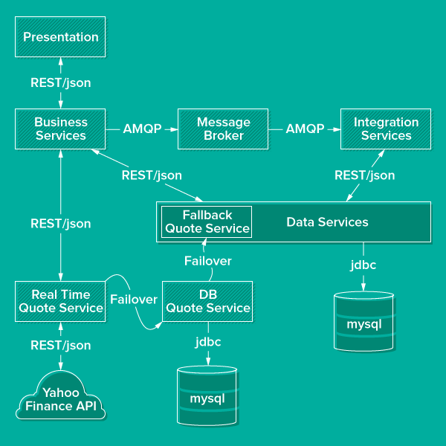

Slide 22
Decompose Further (remember domains)
Use the same technique used on QuoteService to “evaporate” the data modules
Notes:
Service Discovery - we need a simple approach to enable locating microservices by name and at a known catalog endpoint. And use this dynamically at runtime
Circuit Breaker - if a service becomes unavailable, a “fallback method (to an alternative service with similar functionality) can be invoked instead. Normal operations is automatically restored once the failing service is available

Slide 23
Approach
We have interwoven domain models
Domains can be difficult to untangle, but bounded context techniques can help
Quotes: external market events that happened outside the system
Accounts: users of the system, and their profiles
Orders: transactional events acted on by users
Notes:
Service Discovery - we need a simple approach to enable locating microservices by name and at a known catalog endpoint. And use this dynamically at runtime
Circuit Breaker - if a service becomes unavailable, a “fallback method (to an alternative service with similar functionality) can be invoked instead. Normal operations is automatically restored once the failing service is available

Slide 24
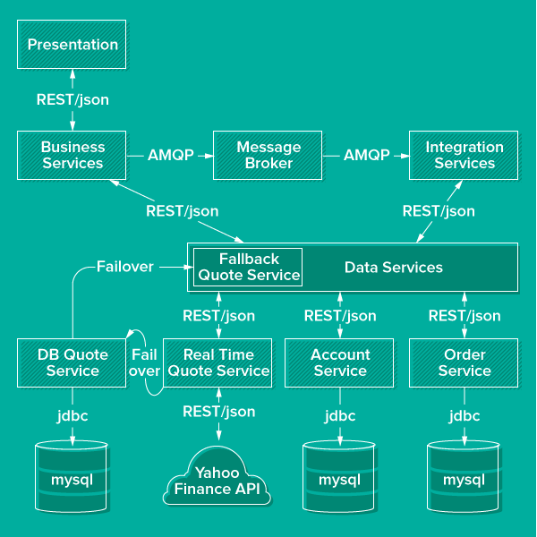

Slide 25
How to start?
Defining your domain, entities that comprise the domain and the necessary domain logic.
Service layer and only add services where the logic doesn't belong in any domain entity or value object.
Use Ubiquitous Language, Design by Contract (DbC), Automated Tests, Continuous Integration / Continuous Delivery and Refactoring
Notes:
Domain driven design effort begins where domain modeling ends. Ramnivas Laddad recommends the following steps on how to go about implementing a domain object model. He emphasizes on putting more focus on domain objects than services in the domain model.
Start with domain entities and domain logic.
Start without a service layer initially and only add services where the logic doesn't belong in any domain entity or value object.
Use Ubiquitous Language, Design by Contract (DbC), Automated Tests, CI and Refactoring to make the implementation as closely aligned as possible with the domain model.

Slide 26
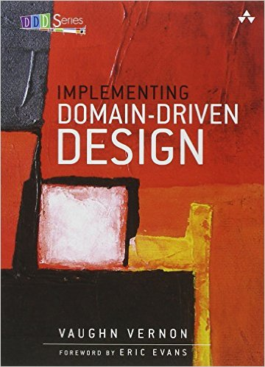
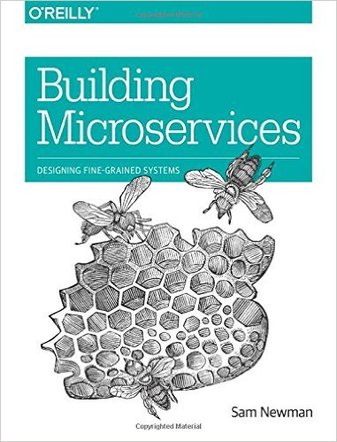
Recommended Reading

Slide 27
Questions
How are you defining your Dev team boundaries?
How many developers per team?
Does the team structure define app architecture or the other way around?
Notes:
Domain driven design effort begins where domain modeling ends. Ramnivas Laddad recommends the following steps on how to go about implementing a domain object model. He emphasizes on putting more focus on domain objects than services in the domain model.
Start with domain entities and domain logic.
Start without a service layer initially and only add services where the logic doesn't belong in any domain entity or value object.
Use Ubiquitous Language, Design by Contract (DbC), Automated Tests, CI and Refactoring to make the implementation as closely aligned as possible with the domain model.

