Slide 1



Cloud Native Applications
Polyglot Persistence with Spring Data REST
Notes:
Resting slide on screen before you begin presenting.

Slide 2



Key Themes
Speed
Scale
Security
Stability
Notes:
all really apply to using Spring Boot

Slide 3

Spring Data
Provides a familiar and consistent, Spring-based programming model for data access while still retaining the special traits of the underlying data store.
It makes it easy to use data access technologies, relational and non-relational databases, map-reduce frameworks, and cloud-based data services.

Slide 4
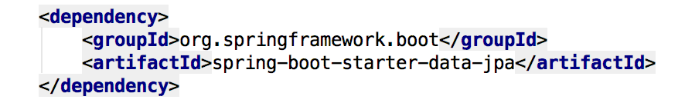
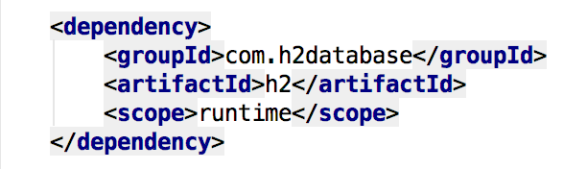

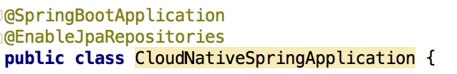
Spring Data JPA
Add the Spring Data JPA starter to our pom.xml file
Sprinkle a database connector into our pom.xml
Sprinkle a little @EnableJpaRepositories annotation into our Spring Boot application

Slide 5
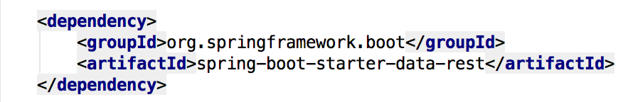
Spring Data REST
Goal is to provide a solid foundation on which to expose CRUD repositories to our repository managing entities using plain HTTP REST semantics
Add a dash of Spring Data REST starter into our pom.xml
Notes:
Provide radically faster and widely accessible “getting started” experience for all Spring development
Opinionated out of the box, but get out of the way as quickly as possible
Provide a range of non-functional features (embedded servers, metrics, health checks, externalized config)

Slide 6
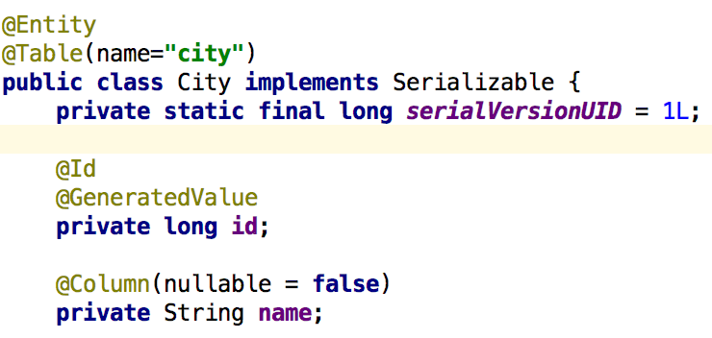
Spring Data JPA, @Entity & Repository
Let’s create an @Entity to manage
Let’s create a JPA Repository to manage our @Entity

Slide 7
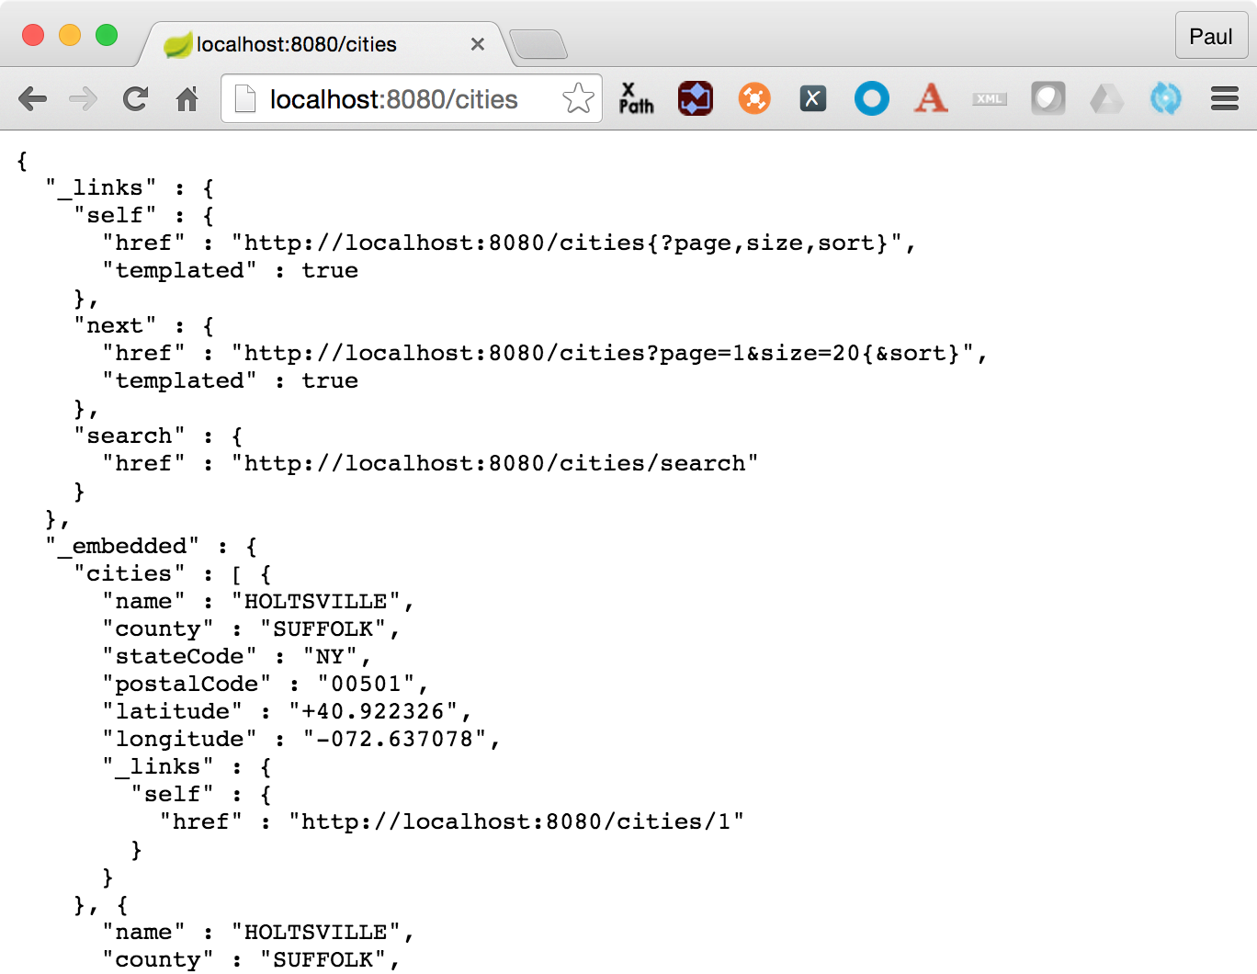
Spring Data REST, what happens
For this repository, Spring Data REST exposes a resource collection at “/cities”
Context path is derived from the un-capitalized, pluralized, simple class name of the domain class being managed
Exposes an item resource for each of these items managed by the repository under the URI template /cities/{id}

Slide 8
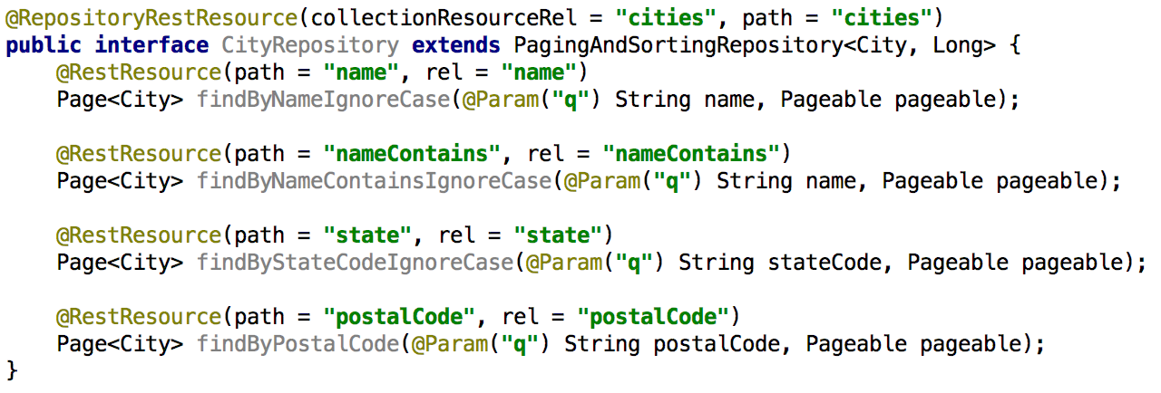
Support Search, or findBy*
Add some search methods using @RestResource to our CityRepository class

Slide 9
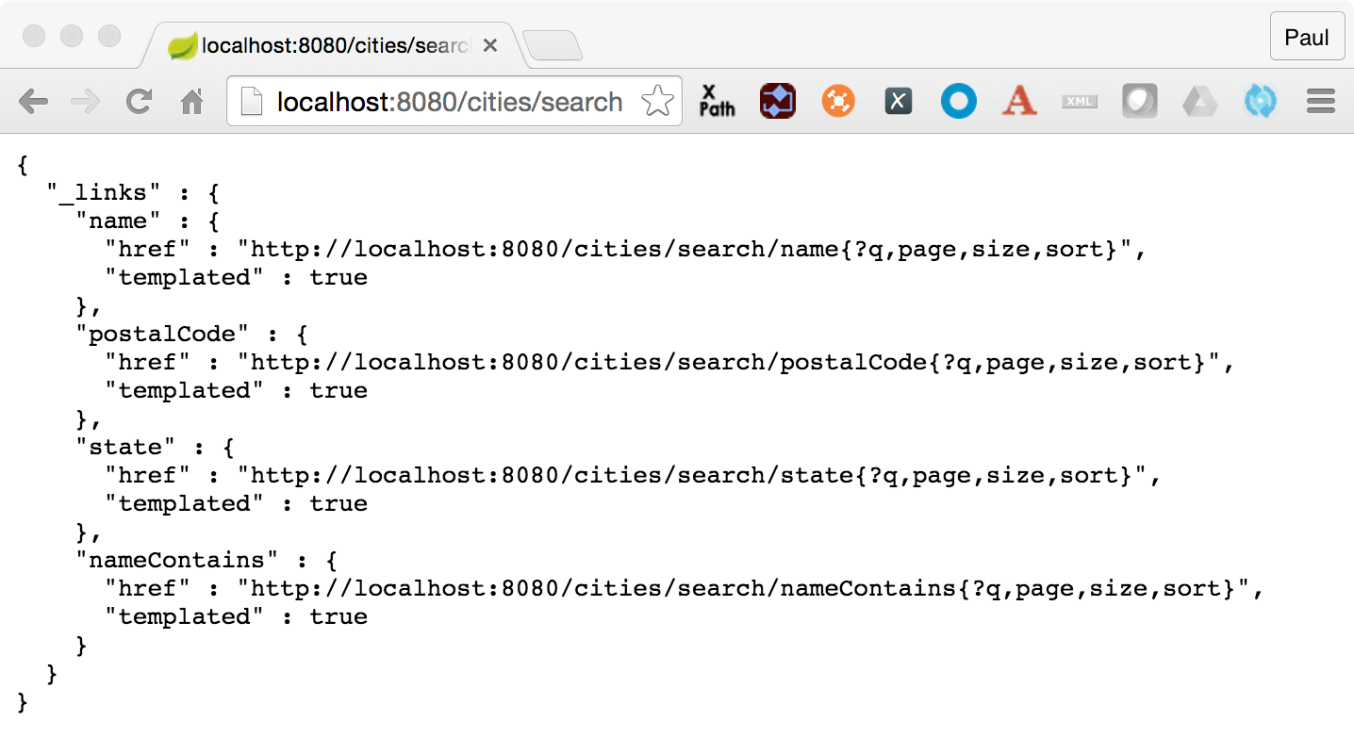
Spring Data REST, what happens?
For this repository, we now see search methods when we hit the /{repository}/search endpoint

Slide 10
Spring Data REST, Custom Queries
Add a method “findByStateCode” to our CityRepository that defines an custom query using @Query notation and takes an @Param argument for the stateCode

Slide 11
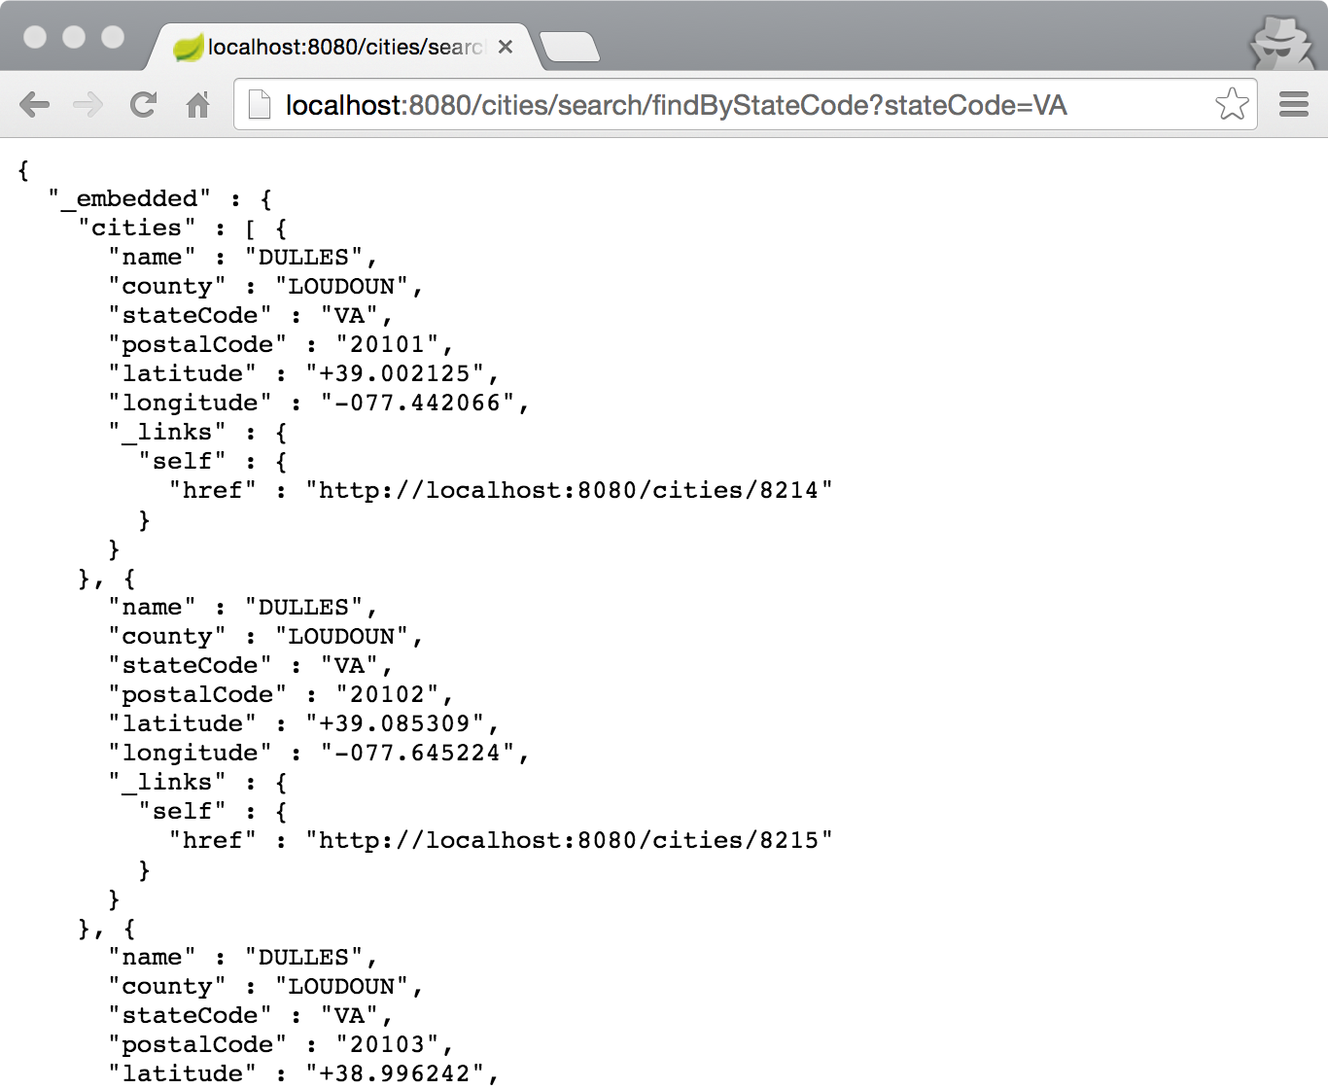
Spring Data REST, what happens?

Slide 12
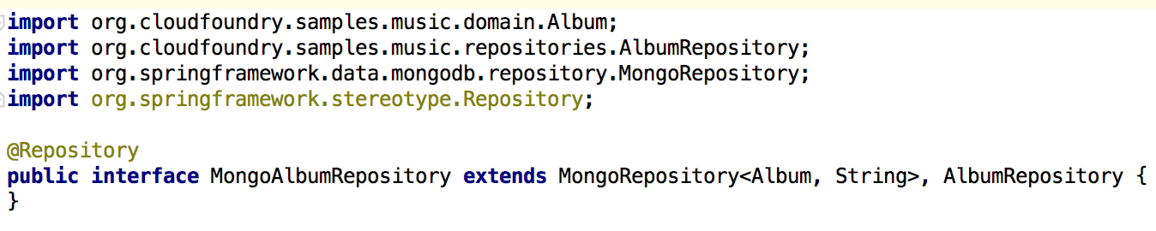
MongoRepository

Slide 13
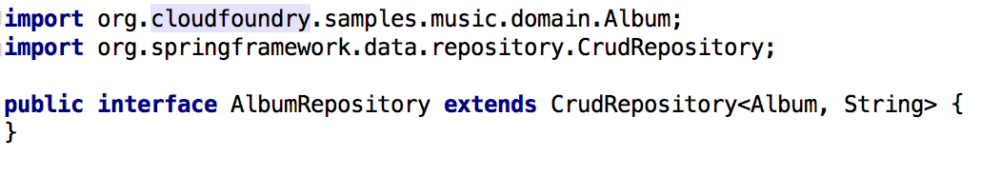
RedisRepository

Slide 14
Supported Repositories
Spring
JPA
MongoDB
Redis
Solr
GemFire
KeyValue
Community
Aerospike
Cassandra
Couchbase
DynamoDB
ElasticSearch
Neo4J

Slide 15
Questions
What is your most common data persistence target?
How do you abstract your app from underlying data tier?
How do you handle version changes of database in your app?

Slide 16

LAB

