Slide 1



Cloud Native Applications
Spring Cloud Config
Notes:
Resting slide on screen before you begin presenting.

Slide 2
Config in a Spring Context
Configuration in a Spring context can usually be described as values that wire up Spring beans.
Spring has provided several approaches to setting config, including externalizing (via Command Line arguments, Env Variables, etc.)
Still, gaps exist:
Changes to config require restarts
No audit trail
Config is de-centralized
No support for sensitive information (no encryption capabilities)

Slide 3
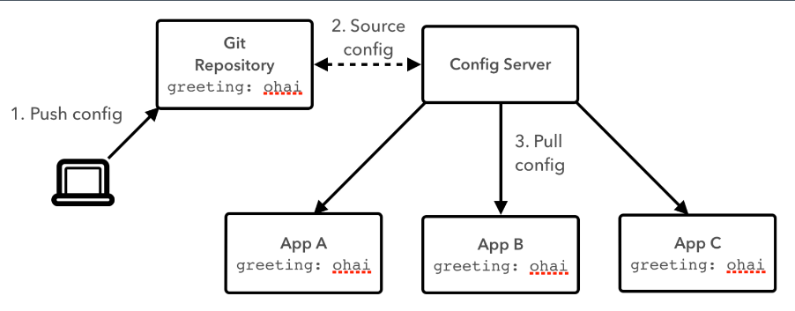
Spring Cloud Config

Slide 4
Spring Cloud Config Server
The Server provides an HTTP, resource-based API for external configuration (name-value pairs, or equivalent YAML content).
Bind to the Config Server and initialize Spring Environment with remote property sources
Embeddable easily in a Spring Boot application using @EnableConfigServer
Encrypt and decrypt property values (symmetric or asymmetric)

Slide 5
Spring Cloud Config Server
@SpringBootApplication
@EnableConfigServer ← MAGIC!!
public class ConfigServer {
public static void main(String[] args) {
SpringApplication.run(ConfigServer.class, args);
}
}
http://github.com/adamz/config-repo/blob/master/demo.yml
application.yml
spring:
cloud:
config:
server:
git:
uri: http://github.com/adamz/config-repo.git
Greeting: Bonjour
Notes:
The server is easily embeddable in a Spring Boot application using the@EnableConfigServer annotation.
Application configuration data is stored in a backend
Git, Subversion and File System backends are supported
Git is the default backend. It's great for auditing changes and managing upgrades
Setting the git backend is done via the spring.cloud.config.server.git.uriconfiguration property

Slide 6
Consuming Application
@Configuration
@EnableAutoConfiguration ← MAGIC!!
@RestController
public class GreetingService {
@AutoWired Greeter greeter;
@RequestMapping("/")
public String home() {
return String.format("%s World", greeter.greeting);
}
@Component
@RefreshScope
public class Greeter {
@Value("${greeting}")
String name = "World";
}
}
bootstrap.yml
spring:
application
name: demo
cloud:
config:
uri: http://my-config-server.com
Notes:
Config server exposes config on the following endpoints:
/{application}/{profile}/[{label}] /{application}-{profile}.yml /{label}/{application}-{profile}.yml /{application}-{profile}.properties /{label}/{application}-{profile}.properties
{application} maps to "spring.application.name" on the client side;
{profile} maps to "spring.active.profiles" on the client (comma separated list); and
{label} which is a server side feature labelling a "versioned" set of config files.

Slide 7
Refreshing Configuration Context
@Component
@RefreshScope ← MAGIC!!
public class Greeter {
@Value("${greeting}")
String name = "World";
}
Update Git Repository
Send a POST refresh request to the application(s) to refresh
Curl –X POST http://my-awesome-app.com/refresh
Notes:
Requires the Actuator dependency on the classpath (pom.xml).

Slide 8

Refreshing Configuration Context
When running many applications, refreshing each one can be cumbersome.
Instead, leverage Spring Cloud Bus pub/sub notification with RabbitMQ.
Send a POST request to the refresh endpoint to fetch updated config values:
http://my-awesome-app.com/bus/refresh
<dependency>
<groupId>org.springframework.cloud</groupId>
<artifactId>spring-cloud-starter-bus-amqp</artifactId>
</dependency>
Notes:
Requires the Cloud Bus AMQP dependency on the classpath (pom.xml).
<dependency>
<groupId>org.springframework.cloud</groupId>
<artifactId>spring-cloud-starter-bus-amqp</artifactId>
</dependency>

Slide 9
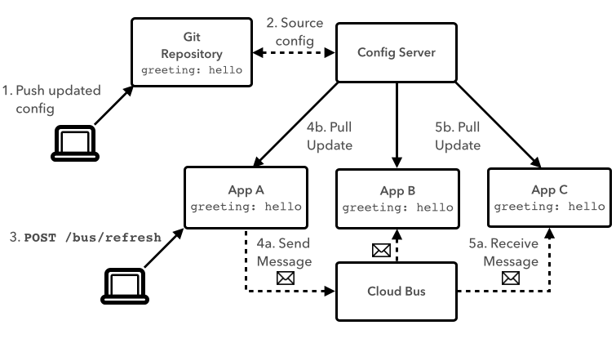
Refreshing Configuration Context
Notes:
Requires the Cloud Bus AMQP dependency on the classpath (pom.xml).
<dependency>
<groupId>org.springframework.cloud</groupId>
<artifactId>spring-cloud-starter-bus-amqp</artifactId>
</dependency>

Slide 10
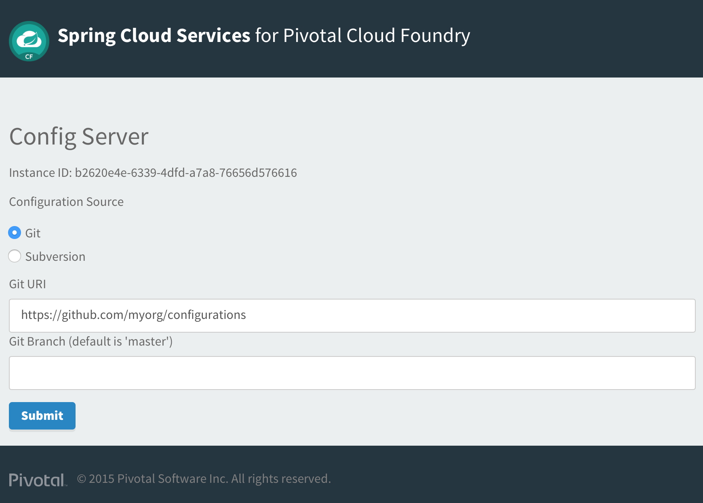
Spring Cloud Services: Config Server
Automated deployment of server component
Simply specify Git URL
Bind into CF application
Optionally Bind in RabbitMQ service for the Cloud Bus
Notes:
Requires the Cloud Bus AMQP dependency on the classpath (pom.xml).
<dependency>
<groupId>org.springframework.cloud</groupId>
<artifactId>spring-cloud-starter-bus-amqp</artifactId>
</dependency>

Slide 11

Demo

