Slide 1



Cloud Native Applications
Spring Cloud Netflix – Circuit Breakers and Fault Tolerance
Notes:
Resting slide on screen before you begin presenting.

Slide 2



Key Themes
Speed
Scale
Security
Stability

Slide 3
Fault Tolerance
One failure must not cause a cascading failure across the entire system.
For example, for an application that depends on 30 services where each service has 99.99% uptime, here is what you can expect: 99.99^30 = 99.7% uptime 0.3% of 1 billion requests = 3,000,000 failures 2+ hours downtime/month if all dependencies have 99.99%
Reality is generally worse.
Source: https://github.com/Netflix/Hystrix/wiki
Notes:
Service Discovery is one of the key tenets of a microservice based architecture.
In distributed systems, application dependencies cease to be a method call away.
Trying to hand configure each client or use some form of convention can be very difficult to do and can be very brittle.

Slide 4
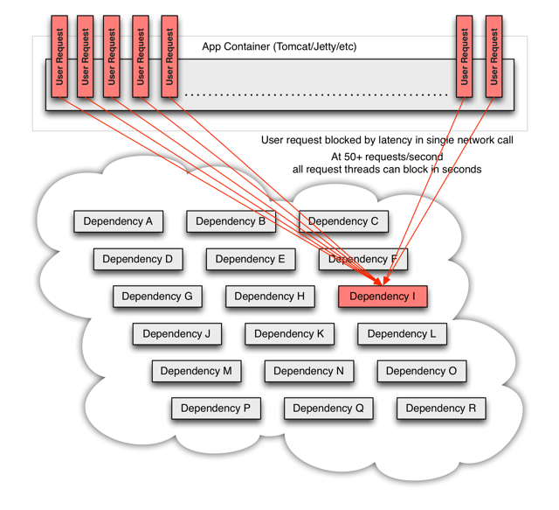
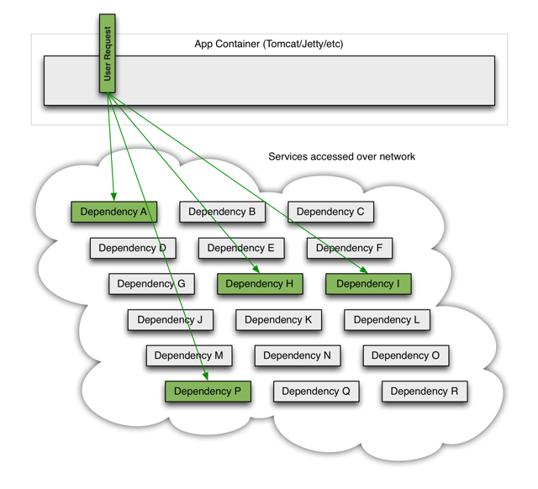
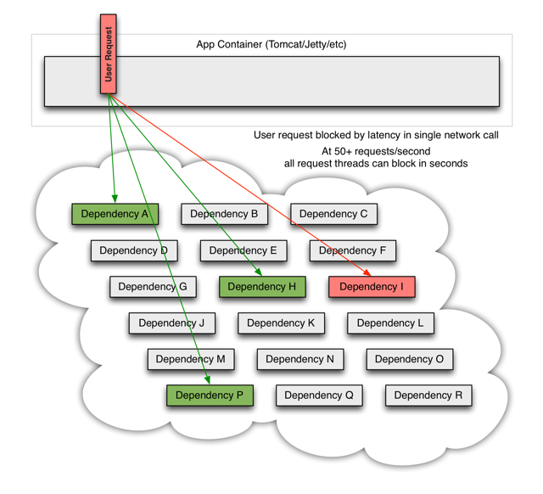
Distributed Systems Failures
Notes:
Service Discovery is one of the key tenets of a microservice based architecture.
In distributed systems, application dependencies cease to be a method call away.
Trying to hand configure each client or use some form of convention can be very difficult to do and can be very brittle.

Slide 5
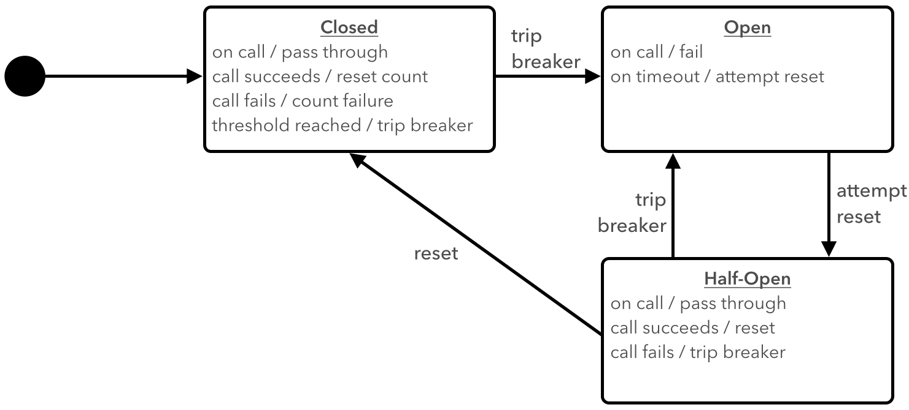
Circuit Breaker Pattern

Slide 6
Implementing Circuit Breakers
@SpringBootApplication
@EnableDiscoveryClient
@EnableCircuitBreaker
public class MyClientApp{
public static void main(String[] args) {
SpringApplication.run(MyClientApp.class, args);
}
}
MAGIC!!
<dependency>
<groupId>io.pivotal.spring.cloud</groupId>
<artifactId>spring-cloud-starter-hystrix</artifactId>
</dependency>

Slide 7
@HystrixCommand
@Service
public class FortuneService {
@HystrixCommand(fallbackMethod = "defaultFortune",
commandProperties = {
@HystrixProperty(name="execution.isolation.thread.timeoutInMilliseconds”, value="500")
})
public String getFortune() {
return restTemplate.getForObject("http://fortune-service", String.class);
}
public String defaultFortune() {
logger.debug("Default fortune used.");
return "This fortune is no good. Try another.";
}
}

Slide 8
@HystrixCommand Metrics
Hystrix publishers real-time metrics for each @HystrixCommand
Informational and Status (isCircuitOpen)
Cumulative and Rolling Event Counts (countExceptionsThrown & rollingCountExceptionsThrown)
Latency Percentiles (latencyExecute_percentile_995)
Latency Percentiles: End-to-End Execution ( latencyTotal_percentile_5)
Property Values (propertyValue_circuitBreakerRequestVolumeThreshold)
Published to /hystrix.stream endpoint & boot actuator metrics
Individual /hystrix.streams aggregated via Turbine and published via /turbine.stream or AMQP.

Slide 9
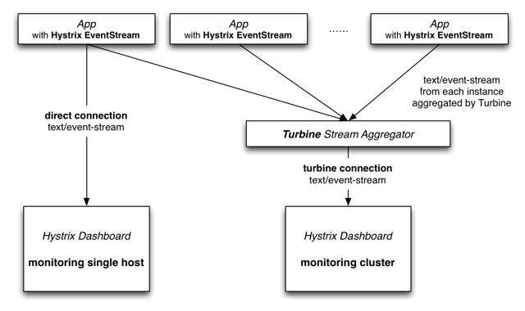
Hystrix Metrics With Turbine

Slide 10
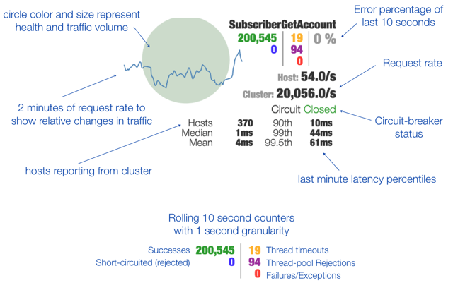
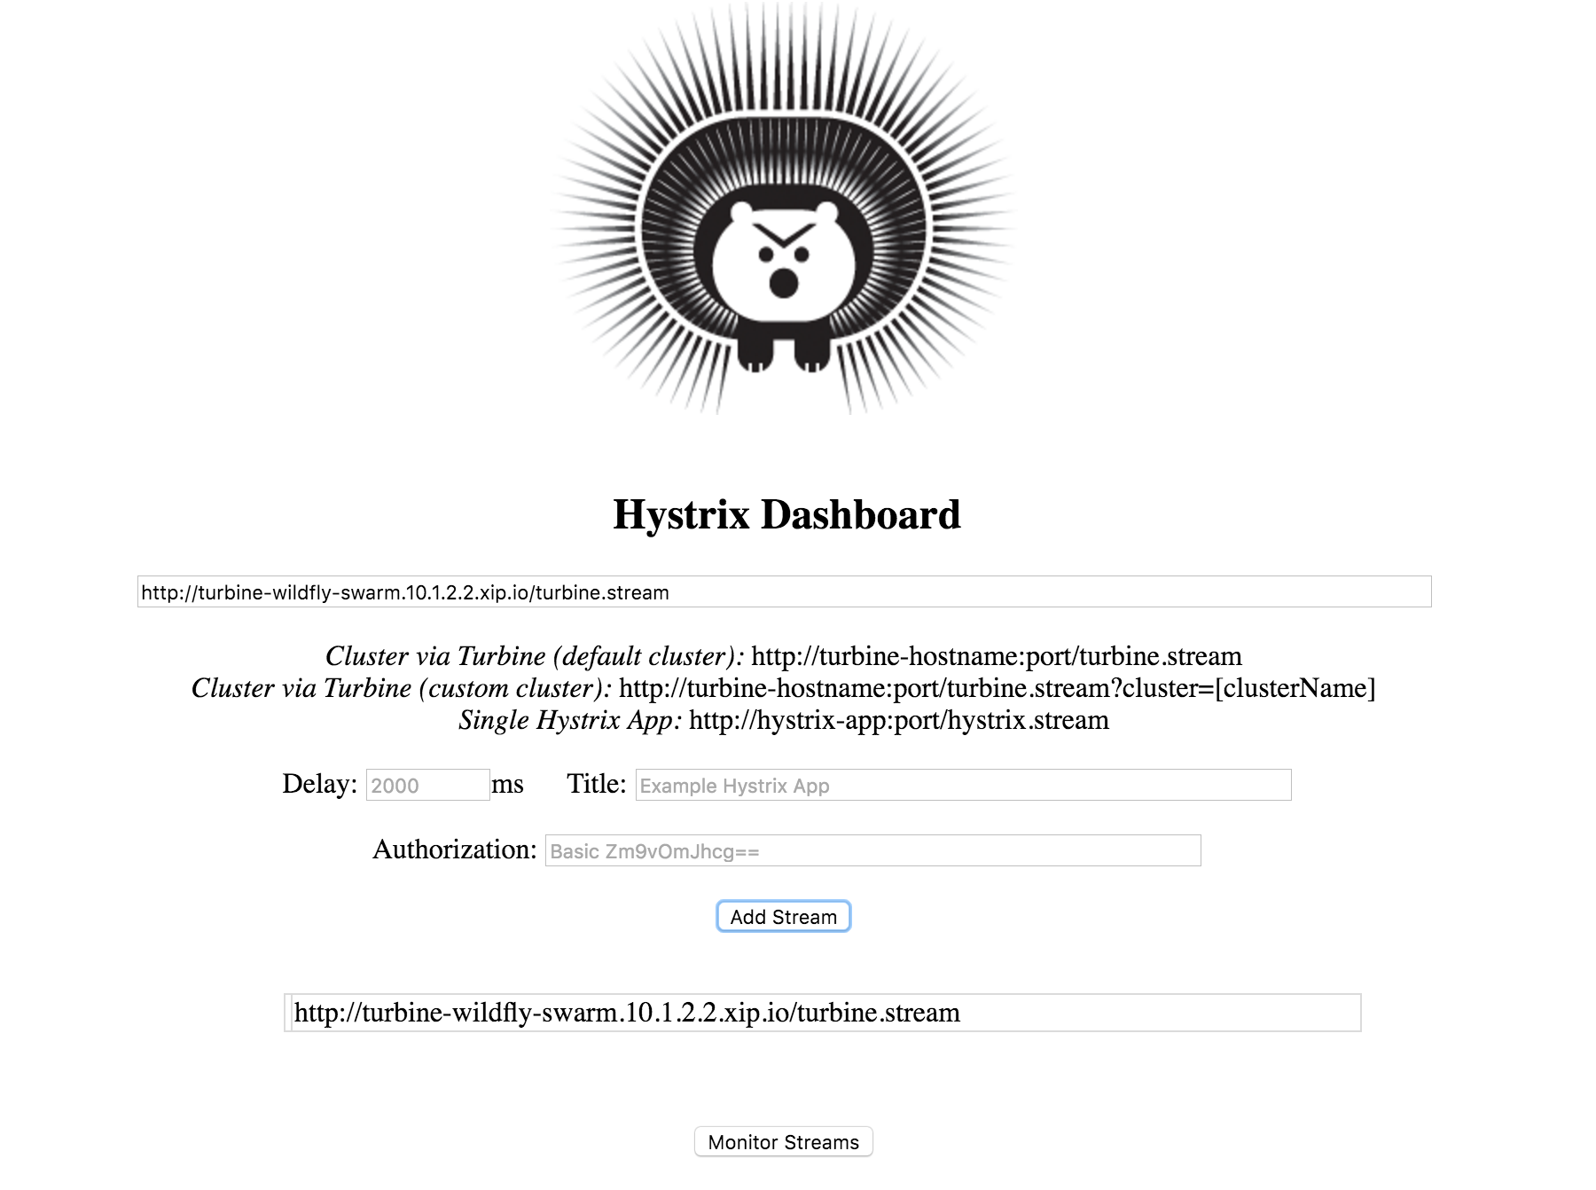
Hystrix Dashboard

Slide 11
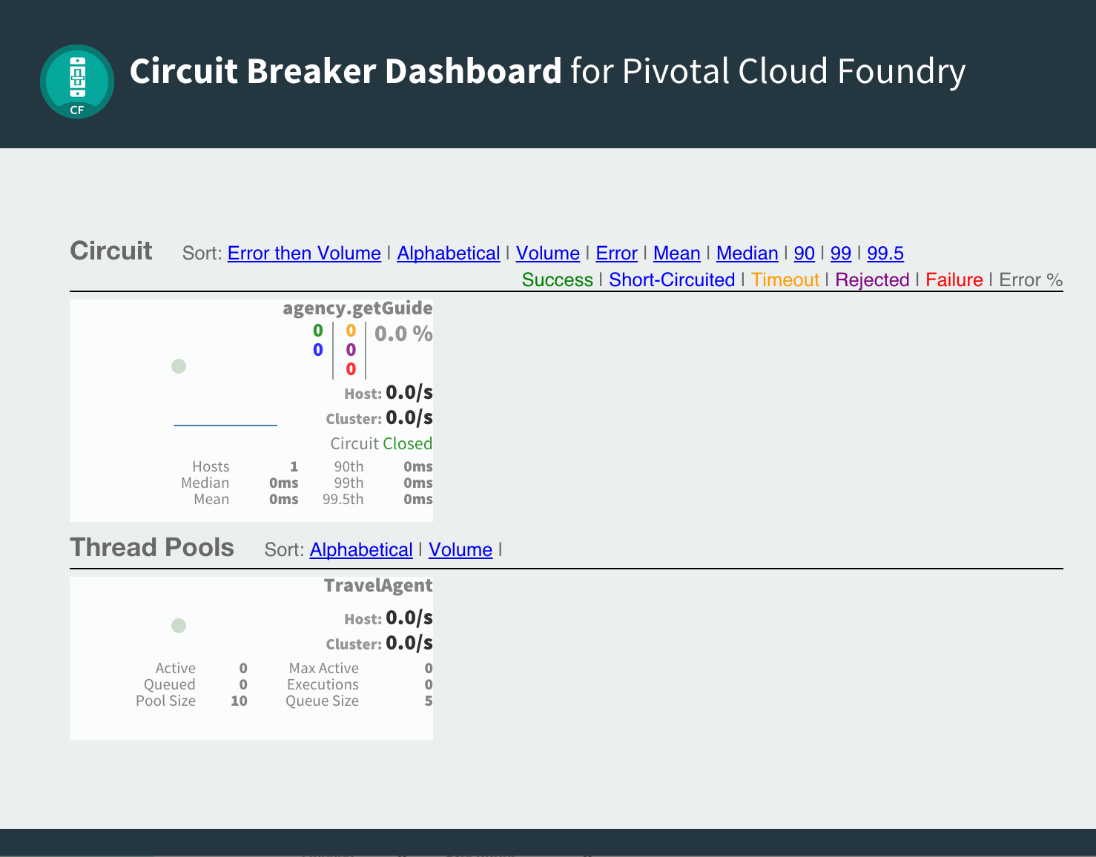
Hystrix Dashboard
Automated deployment dashboard + Turbine + RabbitMQ
Bind service into app
Include starter dependency in app
<dependency>
<groupId>io.pivotal.spring.cloud</groupId>
<artifactId>spring-cloud-services-starter-circuit-
breaker</artifactId>
</dependency>

Slide 12
Questions
What is your bulkhead strategy?
What are your typical bottlenecks?
How do you detect and resolve your bottlenecks?

Slide 13

Demo

