Slide 1
IBM DATA SCIENCE CAPSTONE PROJECT
( The Battle of Neighborhoods )
An approach to recommend the best Cuisines & Restaurants in Kolkata
Submitted by :
Krishanu Podder (https://www.linkedin.com/in/krishanu-podder-905a9a89/)

Slide 2
An approach to recommend the best cuisines and restaurants in Kolkata
Krishanu Podder
27-May-2020
Introduction
Background
A travel agency is a private retailer or public service that provides travel and tourism-related services to the general public on behalf of accommodation or travel suppliers. Travel agencies can provide outdoor recreation activities, airlines, car rentals, hotels, railways, travel insurance, package tours etc. For a traveler who is travelling to a new place with the help of a travel agency, the place would be new and his food habits might not match with the place. In this case a travel agency can guide or recommend the customers with information like where can the customer get his favorite dish or which places are famous for a particular type of dish.
For this project, I have taken Kolkata (India) as my target city.
Kolkata is the capital of the Indian state of West Bengal. According to the 2011 Indian census, it is the seventh most populous city in India; the city had a population of 4.5 million, while the suburb population brought the total to 14.1 million, making it the third-most populous metropolitan area in India. Located on the east bank of the Hooghly River approximately 80 kilometers west of the border with Bangladesh, it is the principal commercial, cultural, and educational centre of East India, while the Port of Kolkata is India's oldest operating port. The city nicknamed the "City of Joy" is widely regarded as the "cultural capital" of India and as of 2019, six Nobel Laureates have been associated with the city. Recent estimates of Kolkata Metropolitan Area's economy have ranged from 60 to 150 billion dollar (GDP adjusted for purchasing power parity) making it the third most-productive metropolitan area in India, after Mumbai and Delhi.
A city filled with history and romance, Kolkata has long been viewed as the home of some of the best food in India. Much of this is to do with its past. Bengal was once ruled by the Mughals, who gave Bengali food the sweet spices, nuts and dried fruit that are characteristic of Persian rice and meat dishes. Later, Calcutta was the seat of British colonial power in India for almost 200 years. Over time, Calcutta became Kolkata and a melting pot of cultures and cuisines from around the world—Chinese, Portuguese, Armenian. They came and settled here and made the most of local ingredients to build a library of dishes, across street foods, family diners, bakeries, mishti shops and ethnic eateries.

Slide 3
Over last few decades Kolkata is continuously growing because of the city’s important role in government and commercial business. With its diverse culture , comes diverse food items. There are many restaurants in Kolkata City, each belonging to different categories like Chinese, Italian, French etc.
As part of this project, I will try to list and visualize all major parts of Kolkata City.
I will try to dig in to the data related to various cuisines, restaurants and find the answers to few questions :-
Which is the best location in Kolkata for Chinese Cuisine ?
Which areas have large number of Chinese Restaurant Market ?
Which areas have less number of restaurants ?
Which is the best place to stay if I prefer Chinese Cuisine ?
What places have best restaurant in Kolkata?
Problem
For a traveler who is travelling to a new place with the help of a travel agency, the place would be new and his food habits might not match with the place. In this case a travel agency can guide or recommend the customers with information like where can the customer get his favorite dish or which places are famous for a particular type of dish. That would not only be helpful for the customers but also add to the reputation of the travel agency. Besides the travel agency can have collaboration with the good restaurants, that would be advantageous for their business.
Interest
Obviously, travel agency which wants to give the best service to the passengers would be interested to implement a cuisine or restaurant recommending system to the new passengers who are not well acquinted with a new place. Besides any service provider or travel guide may also be interested to provide the best service to the customers.
Data acquisition and cleaning
Data sources
Kolkata Restaurants data that contains list Locality, Restaurant name, Rating along with their latitude and longitude.
Data source : Zomato kaggel dataset
( https://www.kaggle.com/shrutimehta/zomato-restaurants-data )
Description : This data set contains the required information. And I will use this data set to explore various locality of Kolkata city.

Slide 4
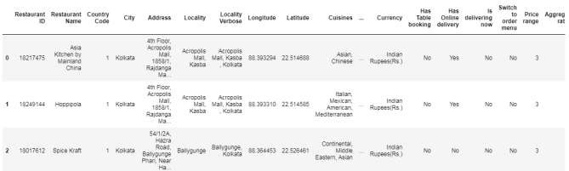
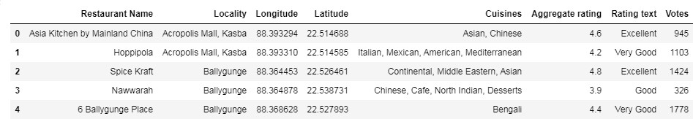
Nearby places in each locality of Kolkata city.
Data source : Fousquare API
( https://developer.foursquare.com/ )
Description : By using this API, I will get all the venues in each neighborhood.
2.2 Data cleaning
The data downloaded from the data source is in csv format and contains many unwanted columns, which can be excluded from analysis part.
Fig: Uncleaned Dataset
This dataset is cleaned by excluding certain columns.
Fig: Clean DataSet
2.3 Feature selection
The important features of the data set was obtained that would help to create the clusters that contains our required data
After data cleaning, there were 8 features in the data.

Slide 5
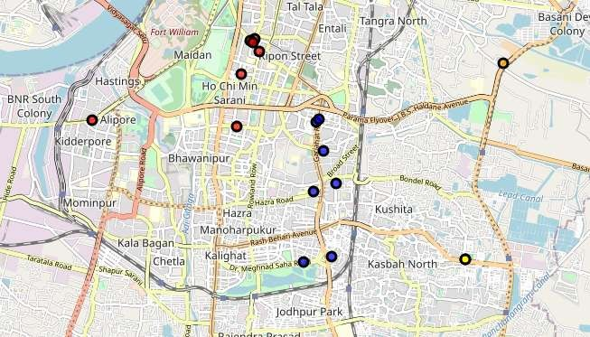
Methodology (approach to solve the problem):
The Kolkata city data from Zomato kaggel dataset will be collected.
All venues for each neighborhood will be found using FourSquare API .
All venues that are nearby by locality will be filtered out.
Aggregative rating will be used for each restaurant to find the best places.
Visualizing the Ranking of neighborhoods using folium library(python)
[Machine Learning Technique used : K-means Clustering]
3.1 Creating map to show the restaurant clusters
A Map was created to show the 5 clusters of restaurants that are present in Kolkata area.
Each sample (restaurant) was classified in different clusters.

Slide 6
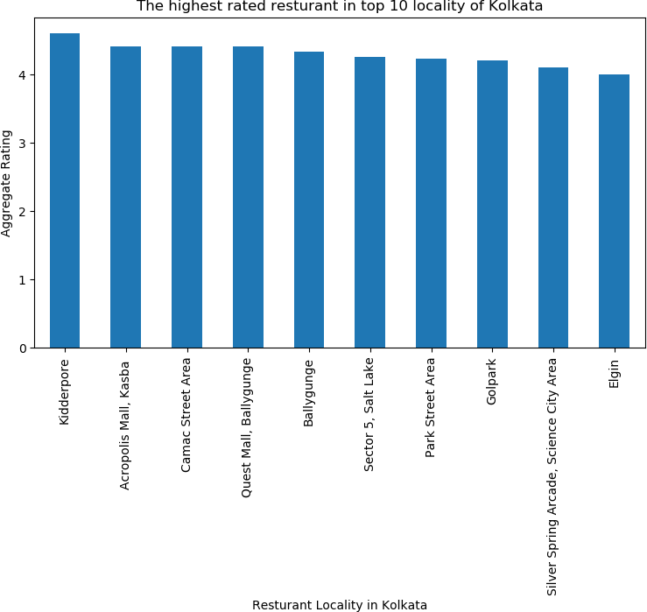
Exploratory Data Analysis
Q : Which places have the best restaurant in Kolkata?
Ans : The best restaurants are available in Kidderpore

Slide 7
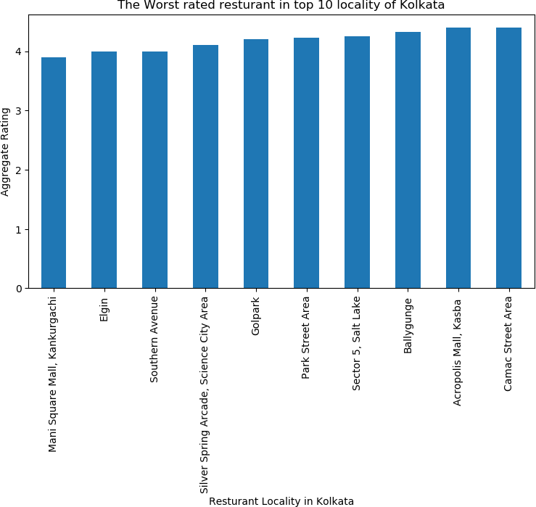
3.2.2 Q: Which places have the worst restaurants in Kolkata?
Ans: The worst restaurants are available in Mani Square Mall, KanKurgachi

Slide 8
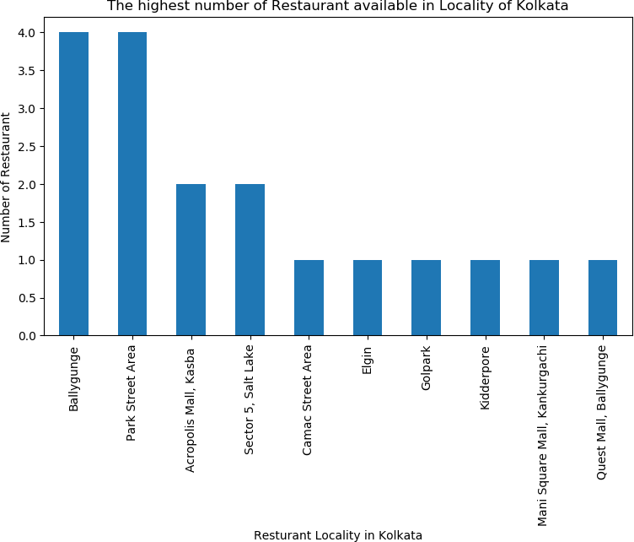
3.2.3 Q: Which places are suitable for a foodie in kolkata?
Ans: Ballygunge is the best place for a foodie to stay

Slide 9
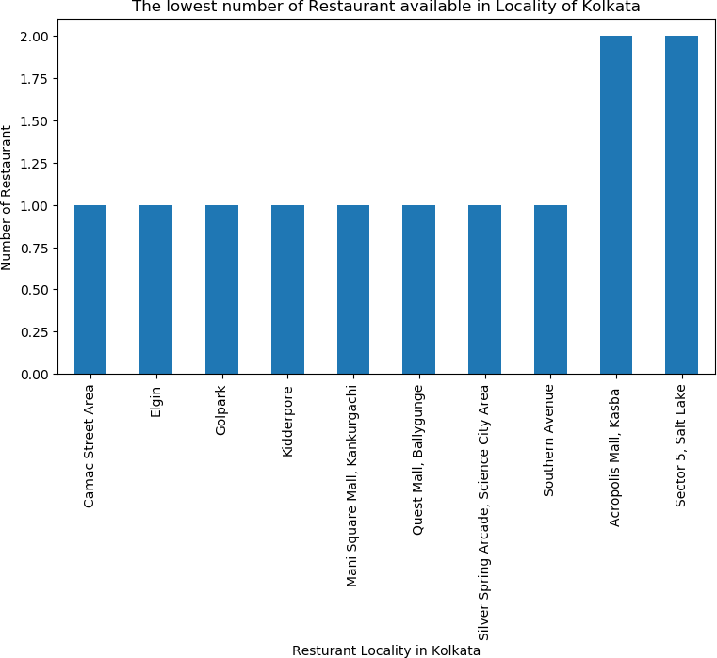
3.2.4 Q: Which place is not suitable for a foodie in Kolkata?
Ans: Camac Street Area is not suitable for a foodie in Kolkata

Slide 10
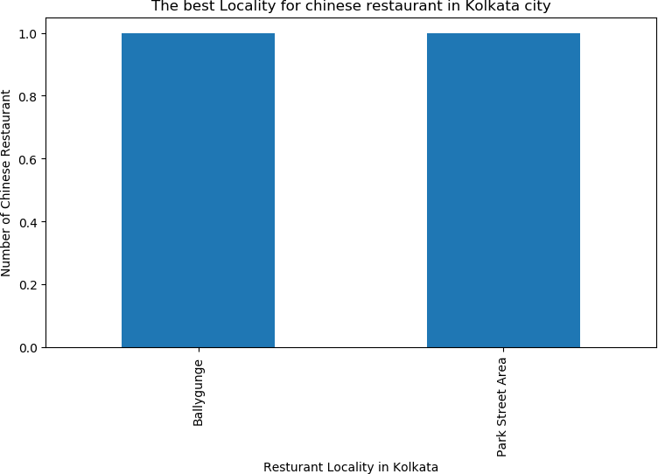
3.2.5 Q: What are the best places for chinese restaurant in Kolkata?
Ans : Ballygunge and Park Street Area are equally the best place for Chinese restaurant.

Slide 11
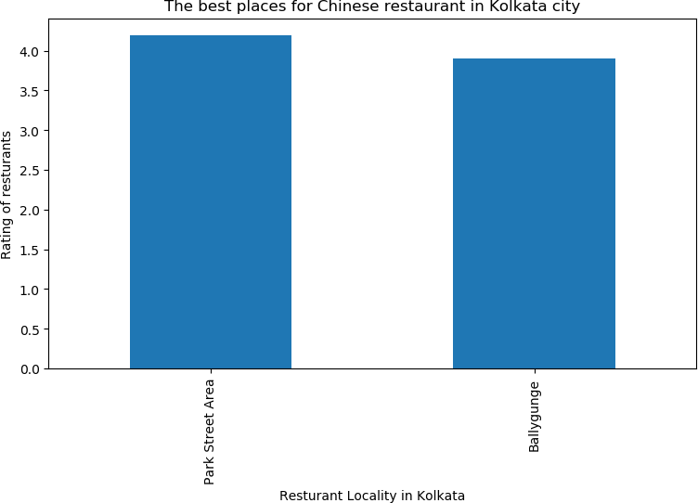
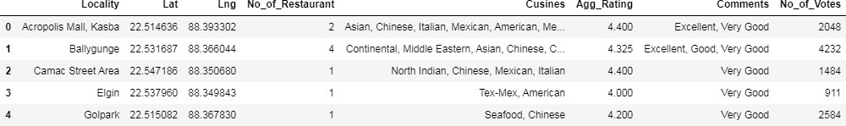
3.2.6 Q: Which places have the best chinese restaurants in Kolkata?
Ans : Parkstreet Area has the best Chinese restaurants.
Data transformation
Grouping the data based on Locality
The data was then grouped into several groups based on the locality

Slide 12
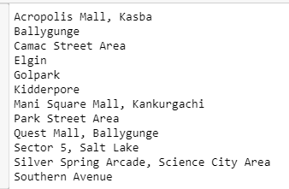
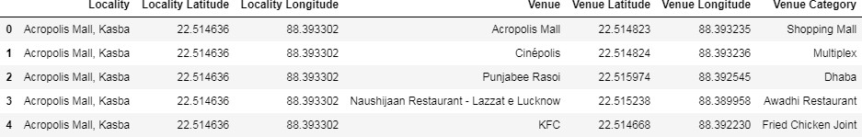
Creating a list of all the localities and venues in the locality
Defining Foursquare Credentials and Version
## Defining Foursquare Credentials and Version
CLIENT_ID = 'xxxxxxxxxxxxxxxxxxxxxxxxxxxxxxxxxxxxx' # Foursquare ID CLIENT_SECRET = 'xxxxxxxxxxxxxxxxxxxxxxxxxxxxxxxxx' # Foursquare Secret
VERSION = '20180605' # Foursquare API version
Finding the venues in all Kolkata Locality

Slide 13
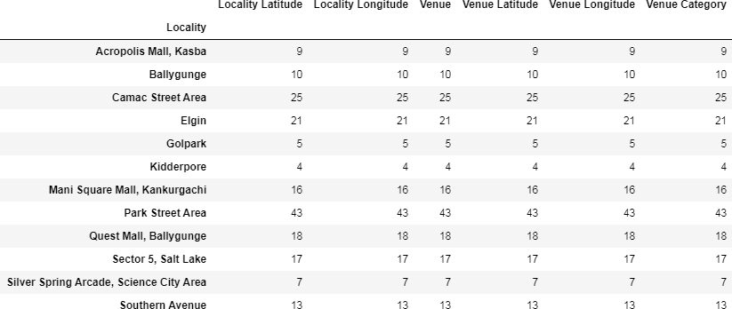
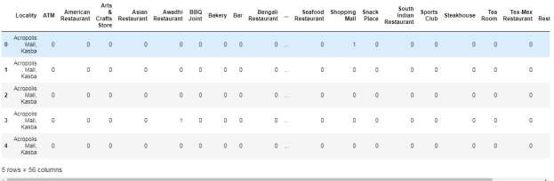
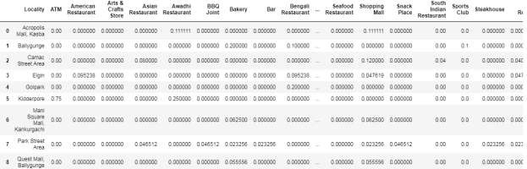
4.2.3 Analyzing each locality
Each locality was analysed as per the availability of the various services

Slide 14
4.2.4 Printing each Locality along with the top 5 most common venues
----Acropolis Mall, Kasba ---- venue freq
0
1
Hotel 0.11
Restaurant 0.11
Awadhi Restaurant 0.11
Indian Sweet Shop 0.11
Multiplex 0.11
----Ballygunge----
venue freq
0 1 Vegetarian | Bakery 0.2 / Vegan Restaurant | 0.1
2 | Pizza Place 0.1
3 | Hookah Bar 0.1
4 | Dhaba 0.1
----Camac Street Area----
venue freq
Shopping Mall 0.12
Indian Restaurant 0.08
Asian Restaurant 0.08
Mexican Restaurant 0.08
Italian Restaurant 0.08
Elgin
venue freq
Café 0.14
Fast Food Restaurant 0.10
American Restaurant 0.10
Nightclub 0.10
Bengali Restaurant 0.10
----Golpark----
venue freq
Mughlai Restaurant 0.2
Bengali Restaurant 0.2
Café 0.2
Chinese Restaurant 0.2
Plaza 0.2

Slide 15
----Kidderpore----
venue freq
0
1
2
3
ATM 0.75
Awadhi Restaurant 0.25
Plaza 0.00
Lounge 0.00
4 Mediterranean Restaurant 0.00
----Mani Square Mall, Kankurgachi----
venue freq
0
1
Fast Food Restaurant 0.12
Café 0.12
2 Vegetarian / Vegan Restaurant 0.06
3
4
Shopping Mall 0.06
Multiplex 0.06
----Park Street Area----
venue freq
Café 0.12
Indian Restaurant 0.07
2
3
4
Hotel 0.07
Restaurant 0.07
Nightclub 0.07
----Quest Mall, Ballygunge---- venue freq
Indian Restaurant 0.11
Irish Pub 0.06
Chinese Restaurant 0.06
Multiplex 0.06
Italian Restaurant 0.06
----Sector 5, Salt Lake----
venue freq
0
1
Café 0.24
Multiplex 0.12
2 Indian Restaurant 0.06
3
4
IT Services 0.06
Dhaba 0.06
----Silver Spring Arcade, Science City Area----

Slide 16
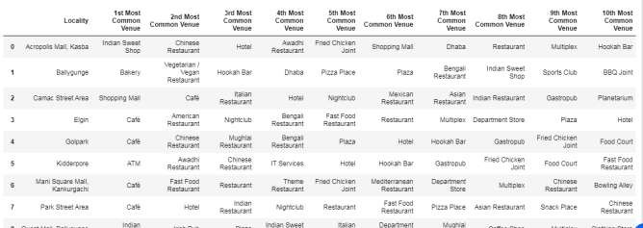
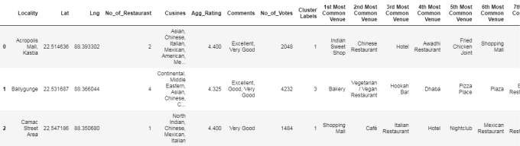
0
1
2
venue freq Bengali Restaurant 0.14
Lounge 0.14
Asian Restaurant 0.14
Multicuisine Indian Restaurant 0.14
Indian Restaurant 0.14
----Southern Avenue----
venue freq
Café 0.31
Boutique 0.15
Vegetarian / Vegan Restaurant 0.08
3
4
Park 0.08
Plaza 0.08
4.2.5 Displaying the top 10 venues for each Locality.
4.3 Clustering the Locality into 5 clusters

Slide 17
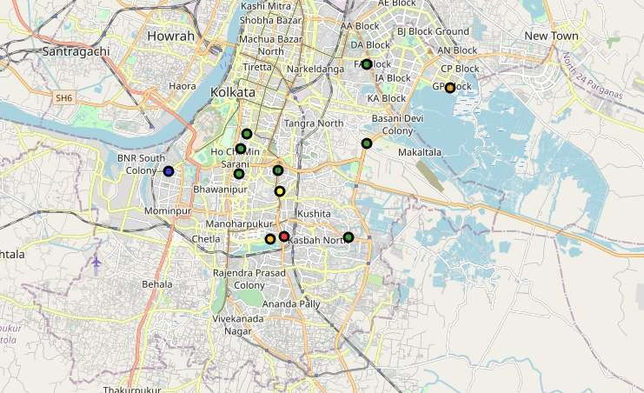
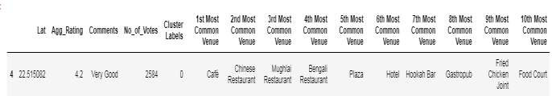
4.4 Creating the final map
Examining the clusters
Cluster 1

Slide 18
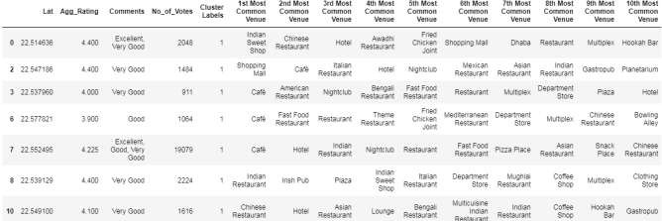


4.5.2 Cluster 2
4.5.3 Cluster 3
4.5.4 Cluster 4
4.5.5 Cluster 5
Results
Ballygunge, Park Street Area are some of the best neighborhoods for Chinese cuisine.
Park Street, Ballygunge have the best Chinese Restaurant.
Ballygunge, Park street Area, Acropolis Mall Kasba are the best places for a foodie.
Kidderpore, Acropolis Mall Kasba have best restaurants in Kolkata.
Cluster 1, Cluster 2, Cluster 5: It is most recommended for cafe.
Cluster 3 : It is most recommended for Awadhi restaurant, Chinese Restaurant.
Cluster 4: It is most recommended for Bakery & Veg restaurant.

Slide 19
4.2. Discussion
After looking at the result, we can see that Ballygunge, Park Street Area are some of the best neighborhoods for Chinese cuisine, Park Street, Ballygunge have the best Chinese Restaurant. Ballygunge, Park street Area, Acropolis Mall Kasba are the best places for a foodie. Kidderpore, Acropolis Mall Kasba have best restaurants in Kolkata. Moreover if a travel agency has to recommend a traveler about the area that the passenger should choose for staying, then the
cluster analysis can be utilized. Here the data analysis and clustering of Kolkata shows that
Cluster 1, Cluster 2, Cluster 5: It is most recommended for cafe, Cluster 3 : It is most recommended for Awadhi restaurant, Chinese Restaurant, Cluster 4: It is most recommended for Bakery & Veg restaurant.
4.7 Conclusion
The technique can be implemented in various apps which can recommend the travellers about the best cuisines and restaurants in a place. It can be made more accurate using more data. I have used the data set from Zomato. Like wise data set other food delivery services can be used to create a better experience for the customers. The travel agency would be able to make a better relation with the customers and passengers that would be helpful for the business.
***

