Slide 1
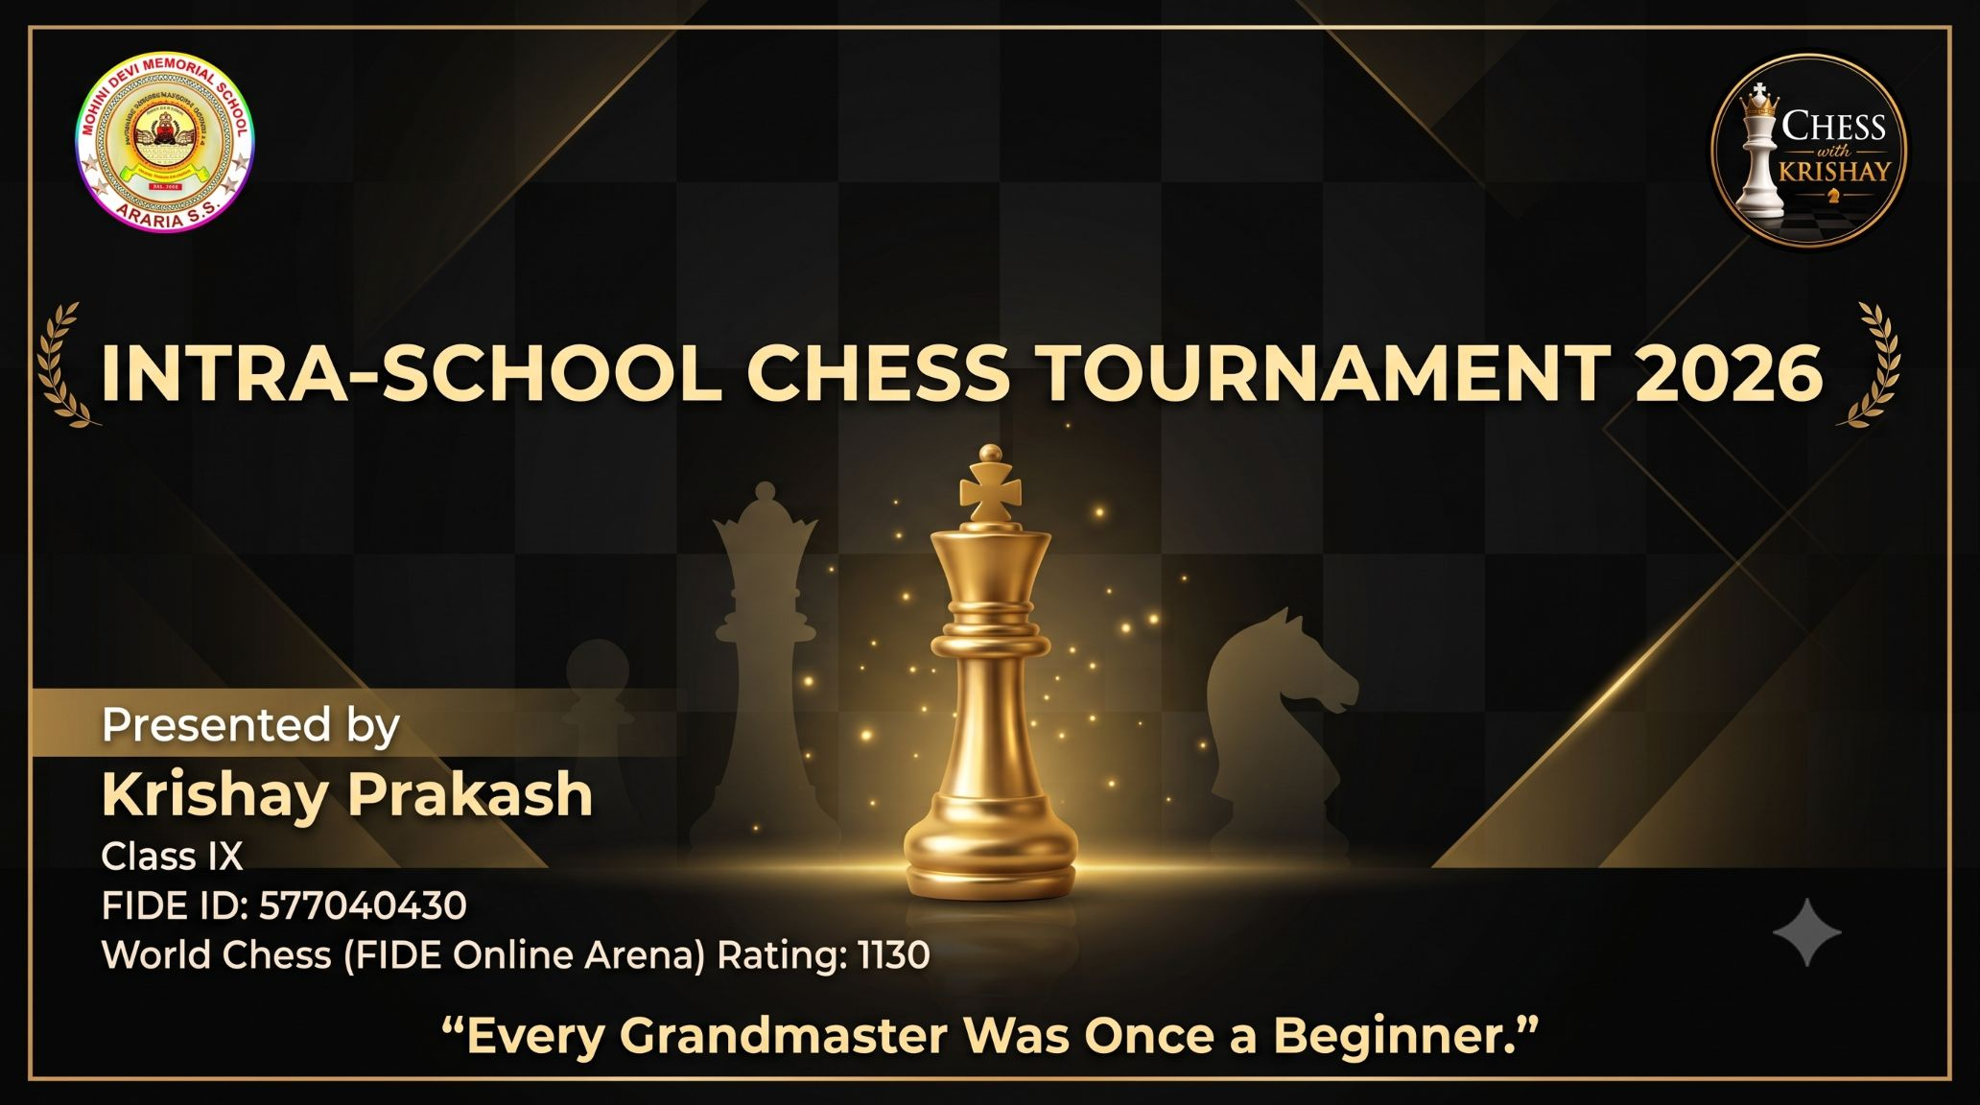

Slide 2
Stay Motivated
Touch on Hard Work, Mindset, and the Realities of Competition.
Victories are cool, but the experiences you rack up along the way? That's the good stuff
Lowering your resistance to change, removing bias and being willing to adapt will help you tackle whatever comes your way
Preparedness for a game that usually lasts four-five hours requires good physical condition and also steady nerves
-Vishwanathan Anand
FIDE Vice President
First Grandmaster from India
Five time world champion
FIDE OFFICIAL TOURNAMENT REGULATIONS • SLIDE 1 OF 9

Slide 3
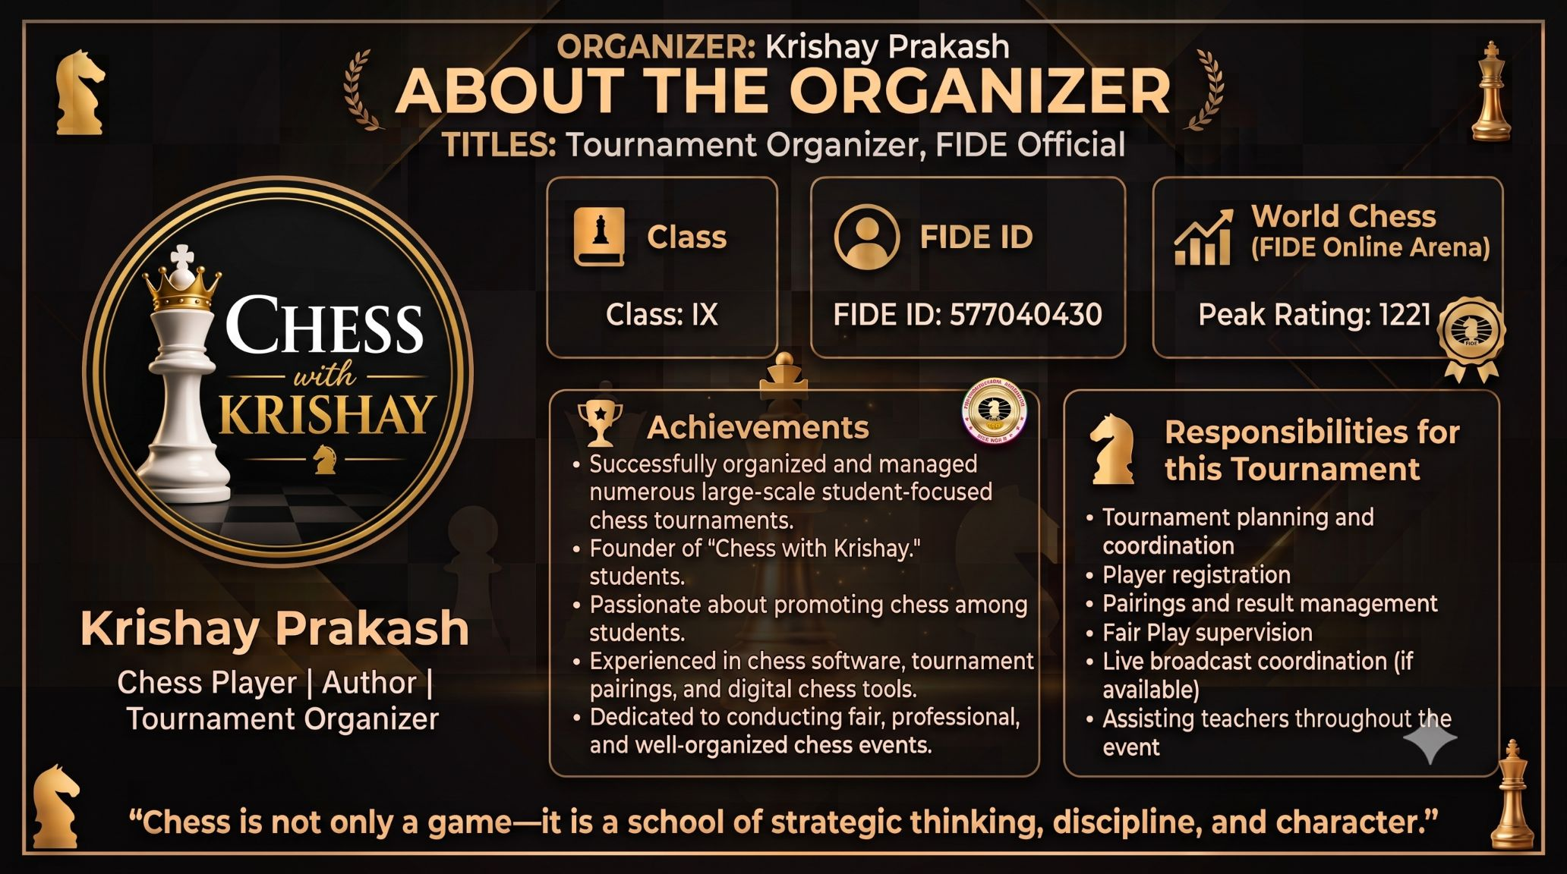

Slide 4
Tournament Rules
OFFICIAL REGULATIONS & GOVERNING PRINCIPLES
FIDE Laws of Chess will be followed wherever applicable.
Touch-move rule applies strictly during all rounds.
Illegal moves will be handled immediately by the official arbiter.
Players must maintain absolute silence during active games.
Spectators are strictly prohibited from interfering or offering advice.
FIDE OFFICIAL TOURNAMENT REGULATIONS • SLIDE 1 OF 9

Slide 5
Time Control
CLOCKS, ALLOTTED DURATIONS & TIME LIMITS
Time control parameters will be officially announced before tournament commencement.
If digital/analog clocks are available, players must press the clock after each completed move.
If clocks are unavailable, the arbiter may impose a time limit if a game exceeds the allotted duration.
FIDE OFFICIAL TOURNAMENT REGULATIONS • SLIDE 2 OF 9

Slide 6
Fair Play Policy
INTEGRITY, ETHICS & ANTI-CHEATING DIRECTIVES
No electronic devices allowed in the playing hall during games.
No engine or human assistance permitted from spectators, coaches, or other players.
Unsporting behavior or disruption may result in formal warnings or immediate disqualification.
All decisions of the Chief Arbiter are final and binding.
FIDE OFFICIAL TOURNAMENT REGULATIONS • SLIDE 3 OF 9

Slide 7
Tournament Format
PAIRINGS, SYSTEMS & STANDINGS PROGRESSION
Tournament structure will utilize the Swiss System or Round Robin (depending on total entries).
Official pairings will be announced prior to the start of each round.
Tournament winners are determined strictly by cumulative points scored.
Official tiebreak systems will be calculated and applied if necessary.
FIDE OFFICIAL TOURNAMENT REGULATIONS • SLIDE 4 OF 9

Slide 8
Scoring System
POINT ALLOCATION MATRIX PER GAME RESULT
MATCH RESULT | POINTS AWARDED
Win | 1 point
Draw | 0.5 points
Loss | 0 points
Bye (if applicable) | 1 point
FIDE OFFICIAL TOURNAMENT REGULATIONS • SLIDE 5 OF 9

Slide 9
Tie-break Criteria
ORDER OF TIEBREAK SYSTEMS FOR EQUAL SCORES
If two or more players finish with the exact same score:
1. Buchholz Score (Swiss System)
2. Sonneborn-Berger Score (Round Robin)
3. Direct Encounter (Head-to-head result)
4. Total Number of Wins
5. Blitz Play-off Match (if required by Arbiter)
FIDE OFFICIAL TOURNAMENT REGULATIONS • SLIDE 6 OF 9

Slide 10
Arbiter's Duties
RESPONSIBILITIES OF TECHNICAL OFFICIALS
Prepare and publish accurate pairings before each round.
Officially start and signal the end of each round.
Resolve all active game disputes, claim verifications, and illegal move penalties.
Record, verify, and maintain official game score sheets and results.
Ensure fair play standards and uphold playing hall discipline.
FIDE OFFICIAL TOURNAMENT REGULATIONS • SLIDE 7 OF 9

Slide 11
Code of Conduct
SPORTSMANSHIP & PLAYER ETIQUETTE
Respect opponents, arbiters, organizers, and venue personnel at all times.
Shake hands respectfully before the start and after the conclusion of every game.
Do not distract, annoy, or provoke other players during active play.
Accept all official arbiter decisions with grace and sportsmanship.
Play with absolute honesty and true sportsmanship.
FIDE OFFICIAL TOURNAMENT REGULATIONS • SLIDE 8 OF 9

Slide 12
Equipment & Material
STANDARD SET SPECIFICATIONS & CLOCK SETUP
Use certified standard tournament chess clocks.
Ensure all boards, pieces, and complete sets comply with competition standards.
FIDE OFFICIAL TOURNAMENT REGULATIONS • SLIDE 9 OF 9

Slide 13
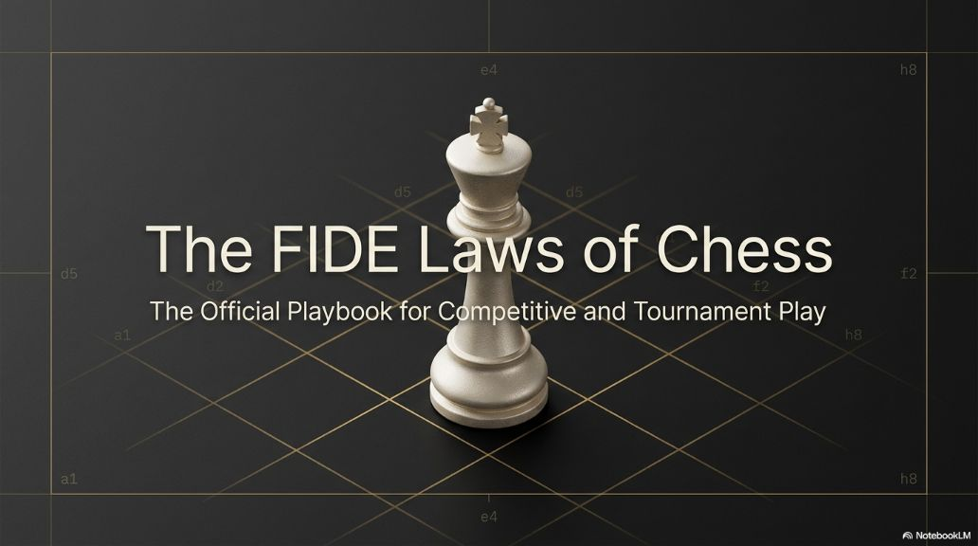

Slide 14
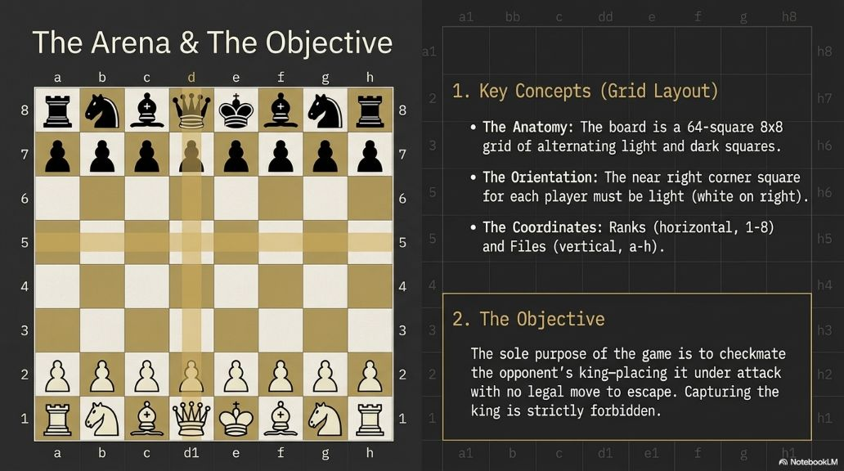

Slide 15
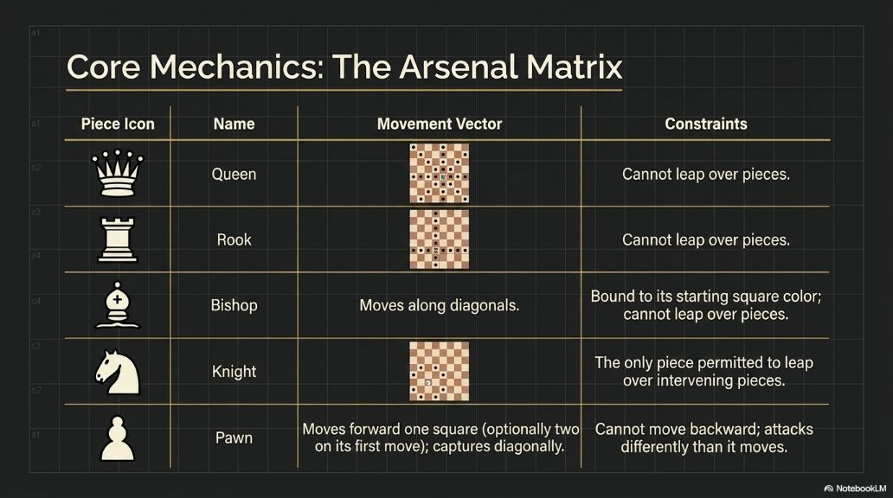

Slide 16
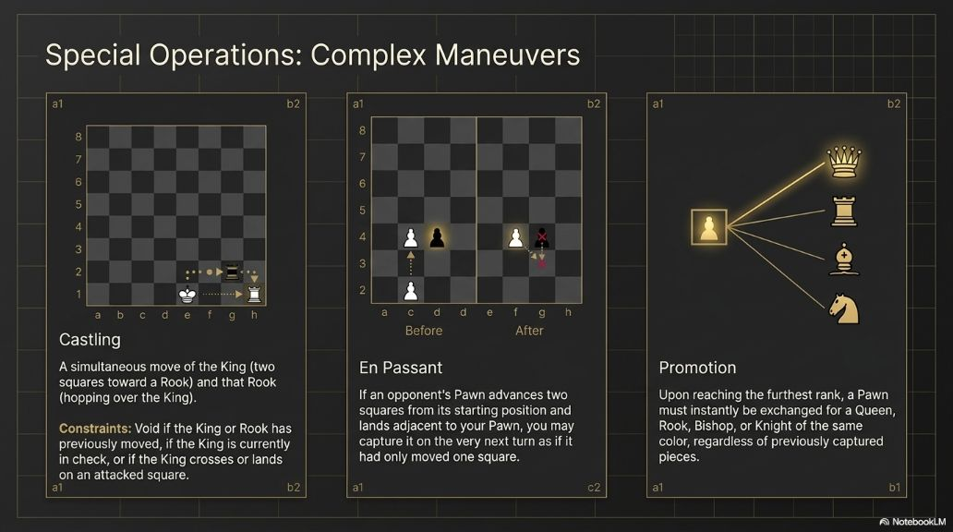

Slide 17
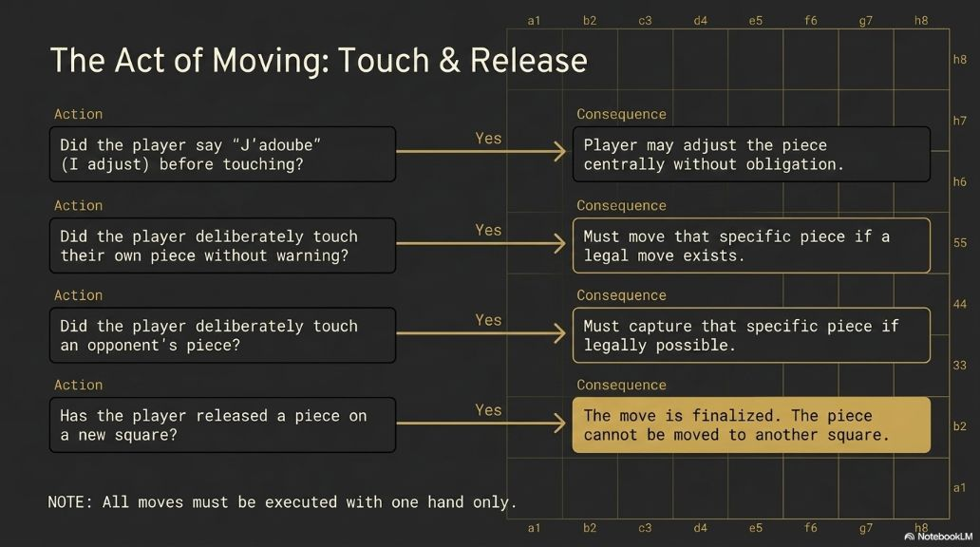

Slide 18
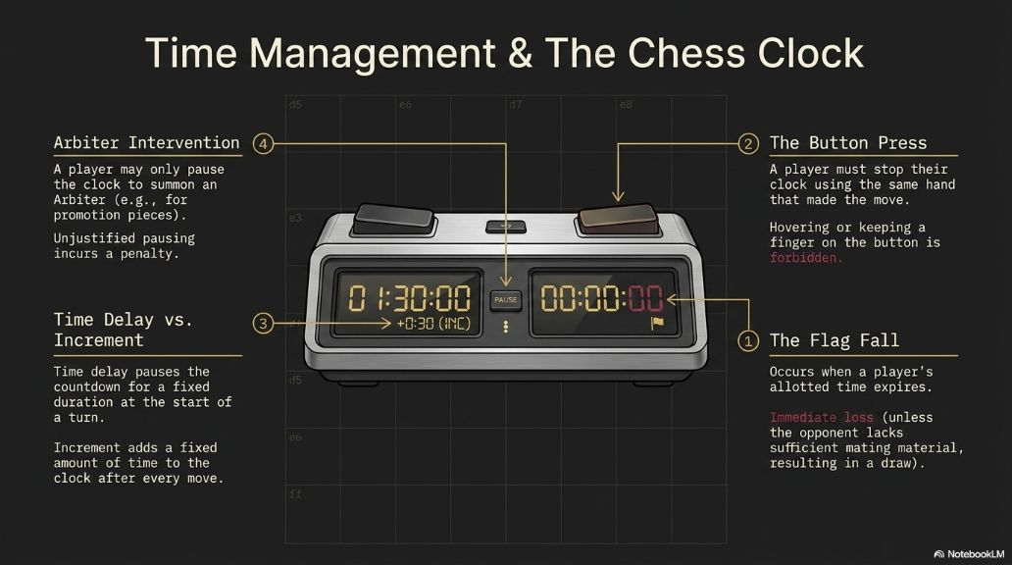

Slide 19
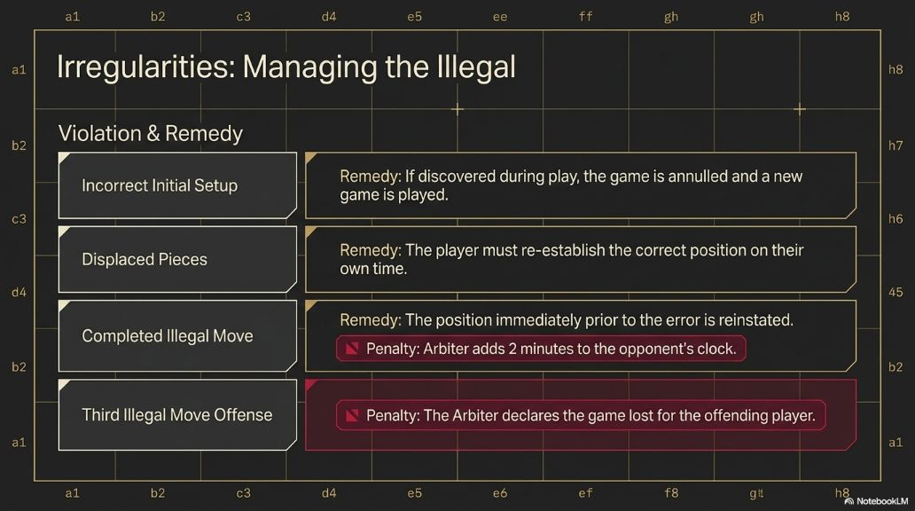

Slide 20
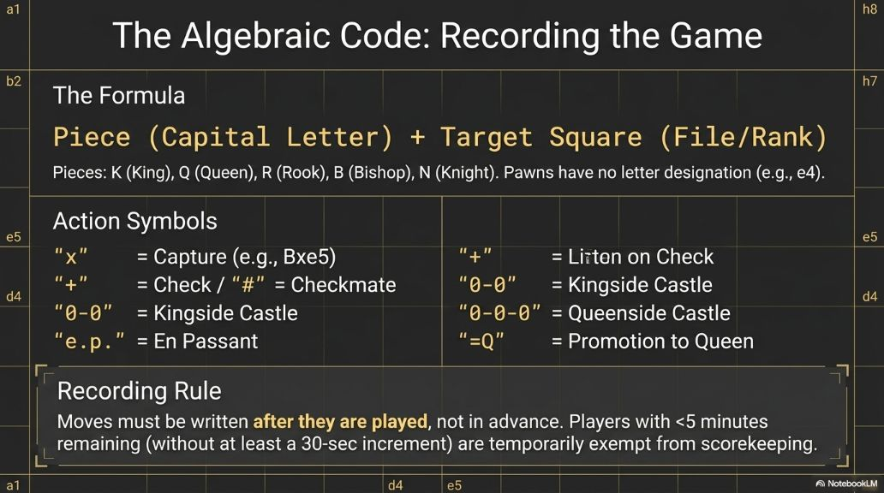

Slide 21
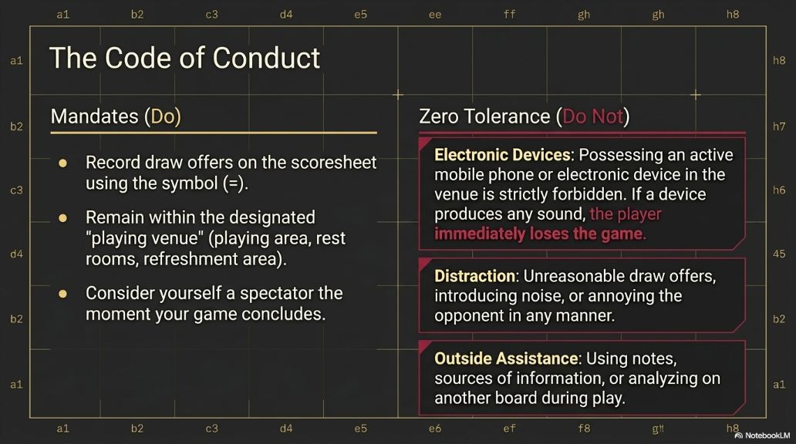

Slide 22
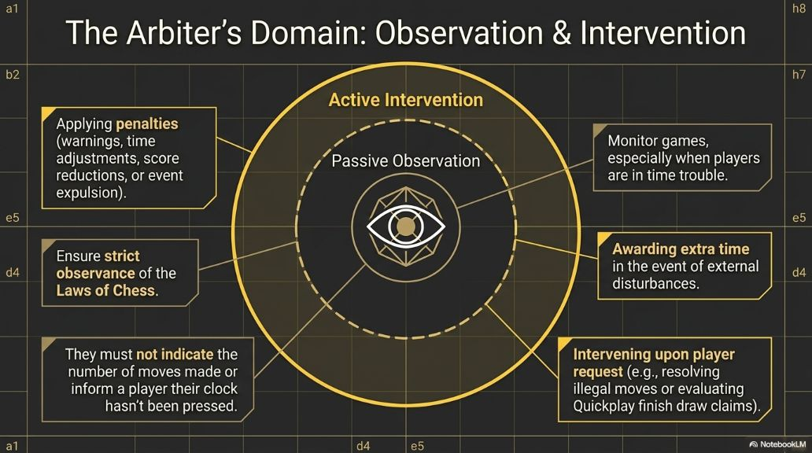

Slide 23
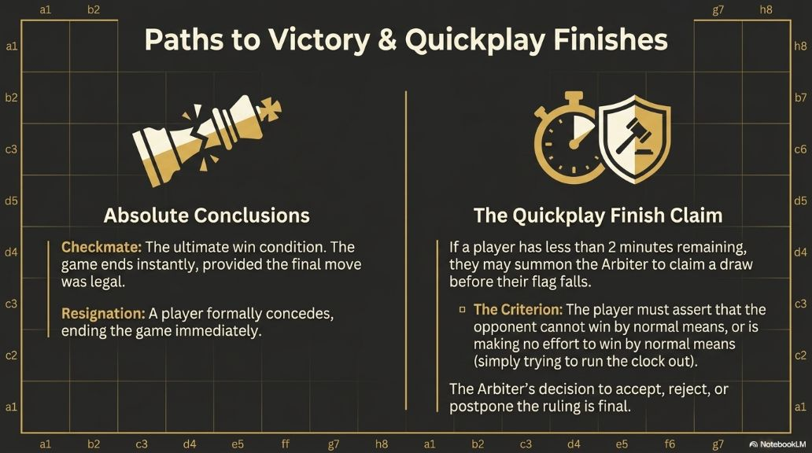

Slide 24
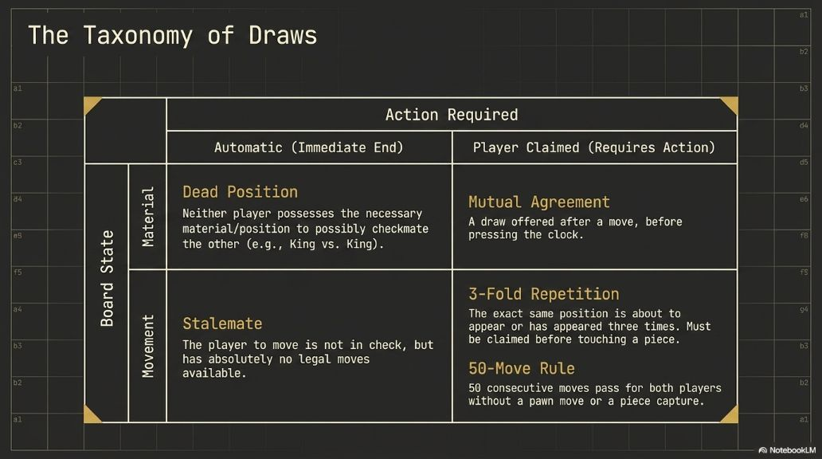

Slide 25
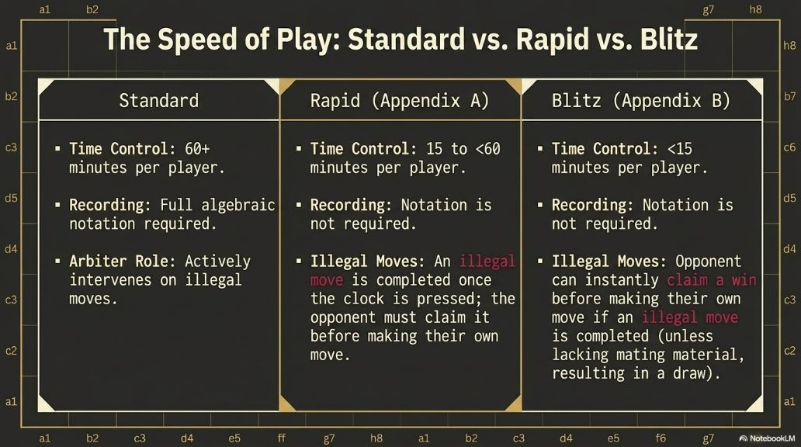

Slide 26
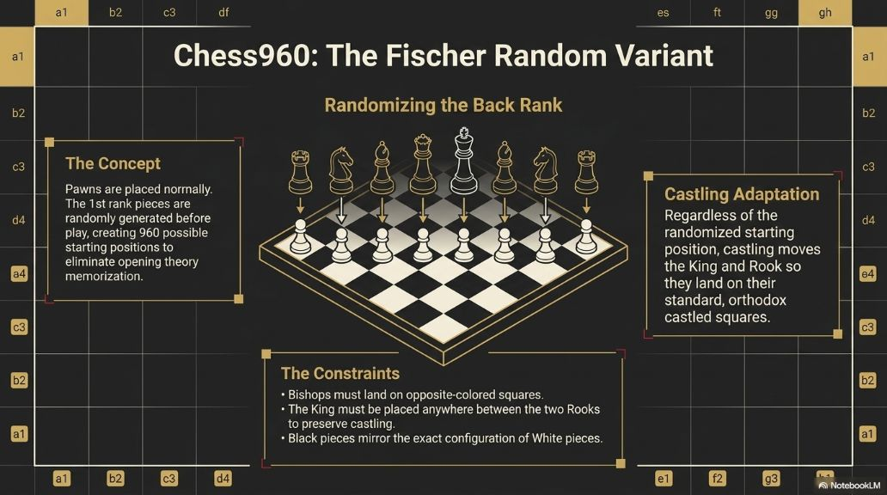

Slide 27
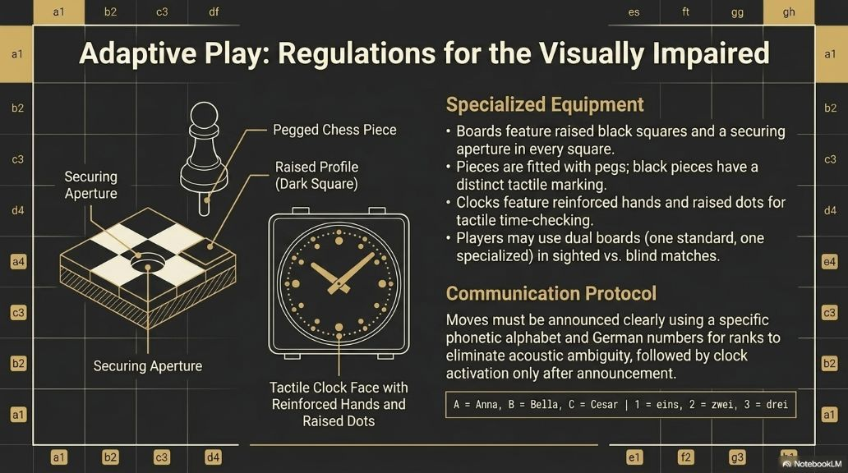

Slide 28
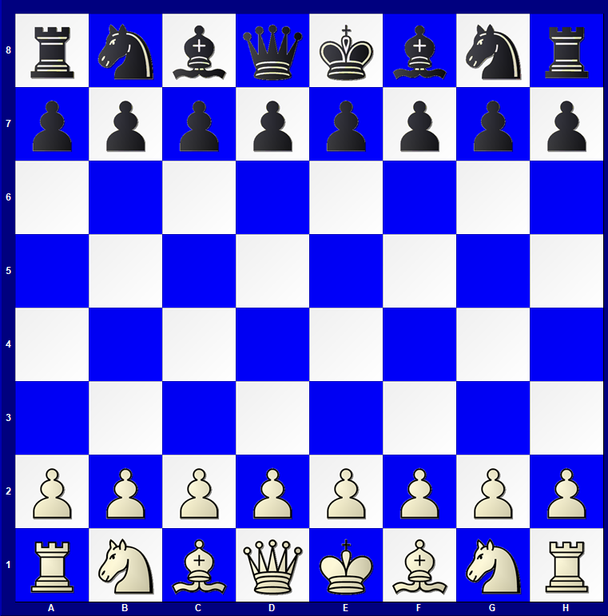

Slide 29
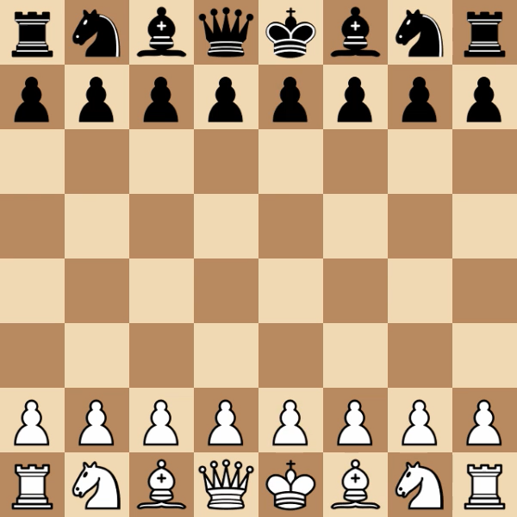

STOCKFISH 18 v/s STOCKFISH 18

Slide 30
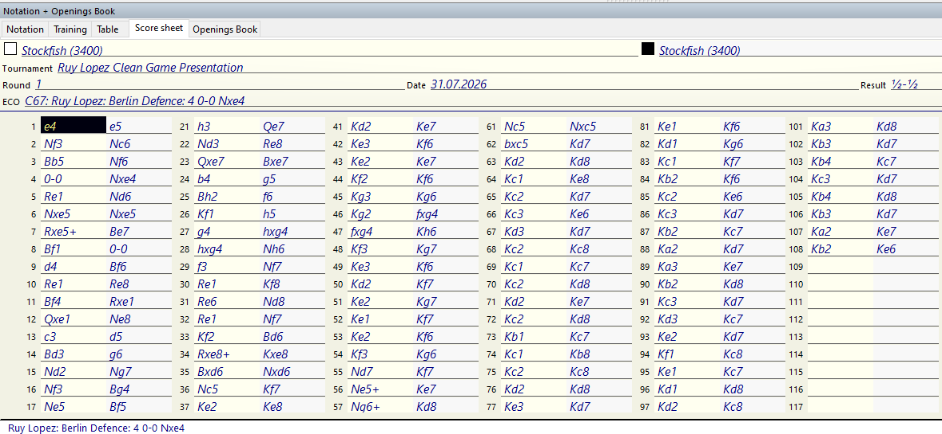

Slide 31
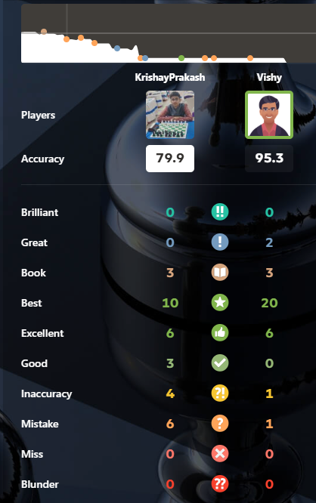
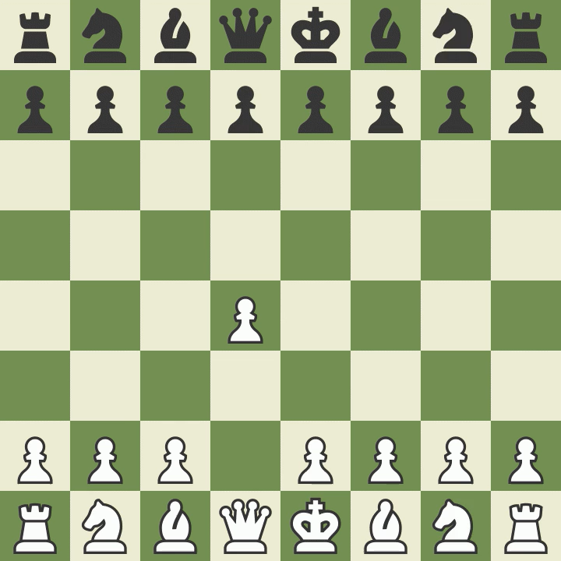
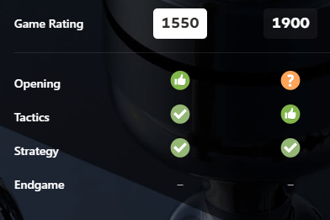
Krishay Prakash v/s Vishy Bot

Slide 32
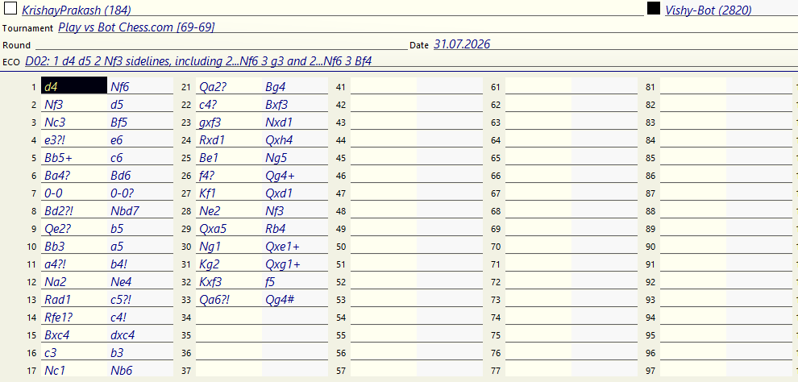

Slide 37


