Slide 1
Course Project title “Detect propaganda in news articles”
Team number : 16
Vaibhav B.V. 01FB16ECS430
Krishna Khurana 01FB16ECS482
Vikram G 01FB16ECS484
UE16CS333 project submission

Slide 2
About the project
Project idea:
Given a set of news articles, classify each article in one of two possible classes: “propagandistic article” or “non-propagandistic article.”
The annotation was done indirectly using a technique known as distant supervision, i.e., an article is considered propagandistic if it comes from a news outlet that has been labeled as propagandistic by human annotators.

Slide 3
Uniqueness and analysis
Why you think your project is somewhat uncommon ?
The current political landscape is shaped by extreme polarization of opinions and by the proliferation of fake news.
It has been found that rumors and fake news tend to spread six times faster than truthful information. This situation both damages the reputation of respectable news outlets and it also undermines the very foundations of democracy, which needs free and reliable press to thrive.
While obvious propaganda might only fool a limited number of people, subtle propaganda can potentially go unnoticed even by the most careful readers. This raises the natural question: How can we expect computers to recognize propaganda if even humans often fail to do so? So let’s shed some light on this.

Slide 4
Dataset source and preprocessing done
Dataset source : https://s3.us-east-2.amazonaws.com/propaganda-datathon/dataset/datasets-v5.zip
Our dataset consists of news text and tag to be predicted.
2. Any pre-processing steps performed (give brief description)
Serial No | Briefly mention the pre processing done
1. | PorterStemmer – For removing common morphological and inflectional endings.
2. | Removing all punctuations and non-alphabetical characters
3. | Removing stop words from text
4. | Word_tokenize – To tokenize sentences into words.
5. | LabelEncoder – Used to encode the labels of the target feature with value 0 and num_of_classes -1

Slide 5
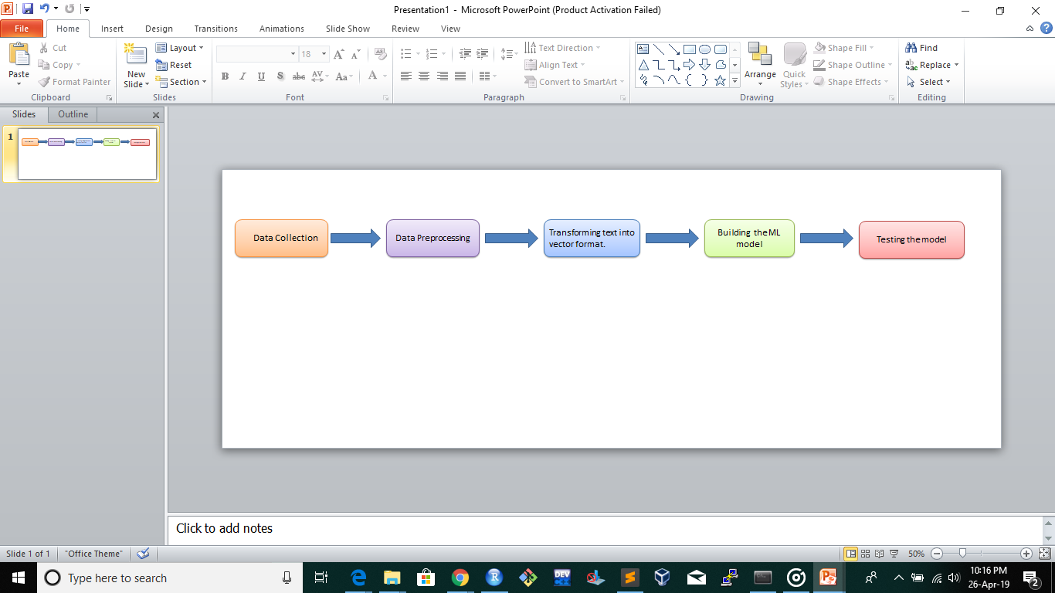
Quantity of work - High level block diagram of our implementation

Slide 6
Quantity of work – the main code modules ( what they do)
Serial no | Code module description | Status (% complete) | What it does ?
1. | TfidfVectorizer | 100 | Vectorizes the text and forms a matrix on the basis of term-frequency and inverse document frequency
2. | CountVectorizer | 100 | It takes into account the count of a particular term in a document.
3. | Truncated SVD | 100 | Makes a dense vector representation from the Tfidf sparse vector representation.
4. | N-gram level tf-idf | 100 | Taking into account n-grams, representing tf-idf scores
5. | Character level tf-idf | 100 | Working with tf-idf scores on character level.
6. | LSTM | 90 | Using the activation function, it tries to remember the context.

Slide 7
Quality of work – CODE MODULES that are working well
Serial no | Code Module from previous slide | Status (% complete) | Comments if there are minor issues
1. | SVC (Support Vector Classifier- SVM) | 100 | Minor issue if testing for a smaller test set, since it trained with small vocabulary using tfidf
2. | LSTM | 90 | 89.06 % accuracy using wiki.word2vec with pretrained word vectors.
3. | Propaganda detection at sentence level | 80 | Using sentence similarity using lch (Leacock-Chodorow)similarity. Only one propaganda techniques is used where a sentence is considered propagandistic if it is deviating from the original theme.
4. | Lch_similarity | 100 | Used for detecting propaganda in sentences with similarity score > 0.75
5. | lexicon_methods.emotional_valence() | 100

Slide 8
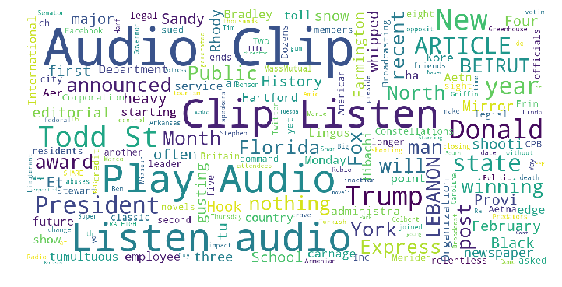
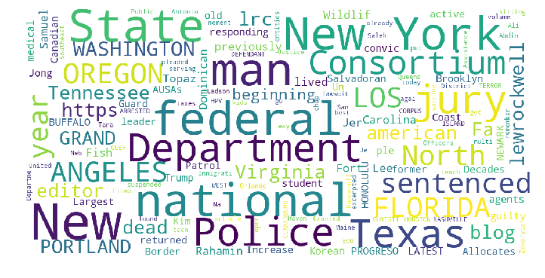
Visualization
Non-propaganda
Propaganda

Slide 9
Accuracy of our models
Serial no | Code Module from previous slide | Accuracy
1. | SVC (Support Vector Classifier- SVM) | 95.68 % accuracy with TfidfVectorizer
2. | Logistic Regression | 95.56 % accuracy with CountVectorizer
4. | Xgboost | 94.19 % accuracy with word level tfidf
6. | Naïve Bayes Classifier | Using TfidfVectorizer 92.77% accuracy.
7. | LSTM | 89.06 % accuracy using wiki.word2vec with pretrained word vectors
8. | Propaganda detection at sentence level | Using sentence similarity using lch (Leacock-Chodorow)similarity. Accuracy is calculated using Conditional Probability, >0.75 sentence similarity

Slide 10
Propaganda detection at sentence level
Red_Herring using sentence similarity | Loaded_Language using sentiment score
Principle Used: If the news article or speaker tries to deviate the public from the main topic, by introducing irreverent data. | Principle Used: It has been found that articles which are propagandistic, use extreme language like extreme +ve or extreme –ve.
We took a sample of the whole dataset, and only for the sentences with similarity score > 0.75 (from the article topic). | Here we worked on whole dataset, converted the sentence into sentiment features, like ANGRY, SAD,HAPPY,INSPIRED,AMUSED
Accuracy : 82.65 % | Accuracy : 71.75 %

Slide 11
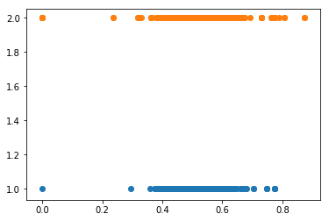
Results of RED_herring using similarity b/w sentences and topic
Non-propaganda :
We can see that there are more non-propagandistic articles with similarity values greater than 0.75 than propagandistic articles
Propagandistic articles

Slide 12
Our top three learning in this project
Serial No | Top Learning in this project
1 | We learnt that a simple linear model can outperform complex models like ANN and LSTM if the dataset is well balanced.
2 | Here the sparse vector strategy seems to work better than dense vector strategy, since sparse vector represents more information.
3 | For propaganda detection at sentence level, we found that if any sentence deviates from the main theme it is leading to propaganda; Also if sentences uses extreme language there is a higher possibility that the sentence will contain propaganda.

Slide 13
Top Challenges unresolved so far
Serial No | Brief description of challenge | Type of challenge (scope/data/design/implementation / others)
1 | For detecting propaganda at sentence level, we are only working one Red_Herring which is caused when the speaker introduces irrelevant material to the issue being discussed, so that everyone's attention is diverted away from the points made. | We haven’t worked with other propaganda techniques, like Whataboutism, Name Calling,etc
2 | Also after detecting if a sentence has propaganda, our future challenge would be to predict what kind of Propaganda it is? | Our future work involves doing propaganda tagging.

Slide 14
Our Going forward plan (if any)
Serial No | What you plan to do ? | When you plan to do ? Indicate month/year
1 | Combine the models for different Propaganda techniques, so as to improve the accuracy resulting in a global Propaganda identifier. | After 3rd year summer.
2 | Using Bidirectional RNNs to get context from history and future sentences. | Same as above.

